Slide 1

Group 441G meche Mircea-ionuț moreanu vlad-ștefan opriș teodora-alexandra
Project 3

Slide 2
cONTENTS
INTRODUCTION
HARDWARE RESOURCES
SOFTWARE RESOURCES
HARDWARE IMPLEMENTATION
SOFTWARE IMPLEMENTATION
CONCLUSIONS
GANNT CHART & CONTRIBUTIONS TABLE

Slide 3
1. introduction
The purpose of this project is to transmit a message from a smartphone to an Arduino UNO board via Bluetooth and displaying the message on an LCD.
Android app – MIT App Inventor – will connect to the Arduino through Bluetooth.
Message received as string and displayed on the LCD. If said string contains a keyword (e.g. “ETTI”), an LED will be lit for a few seconds.

Slide 4
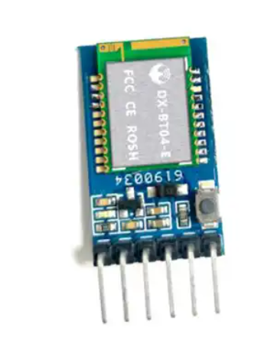
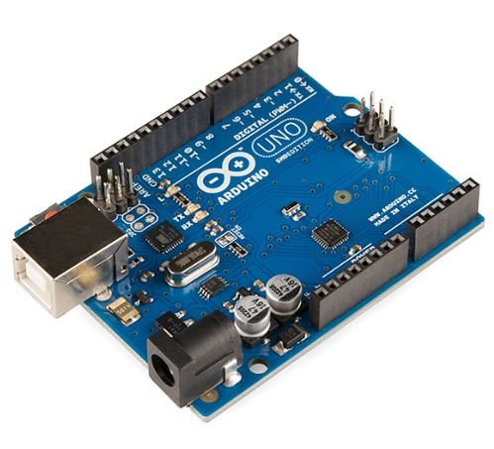
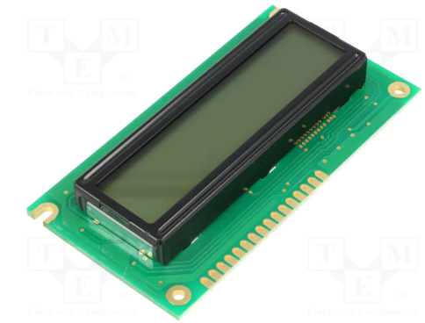
2. Hardware Resources
Arduino UNO board
Bluetooth module BT04-E
LCD RC1602A
10kΩ potentiometer
220Ω resistor

Slide 5


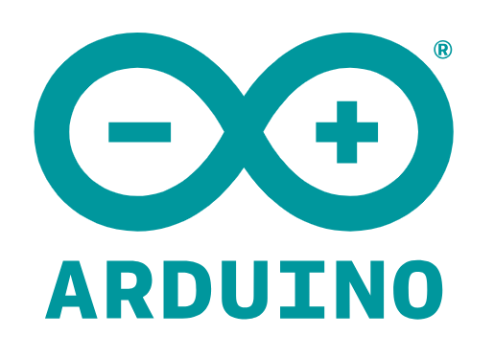
3. Software resources
Arduino IDE
MIT App Inventor
“LiquidCrystal” library
“SoftwareSerial” library

Slide 6
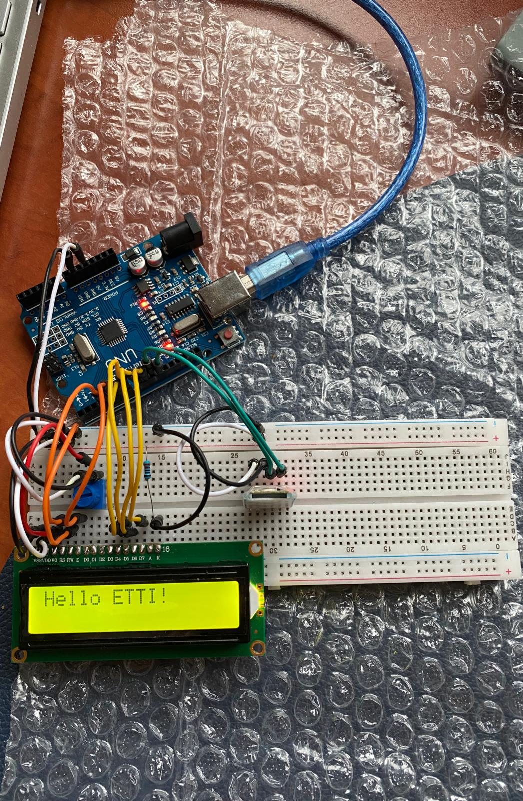
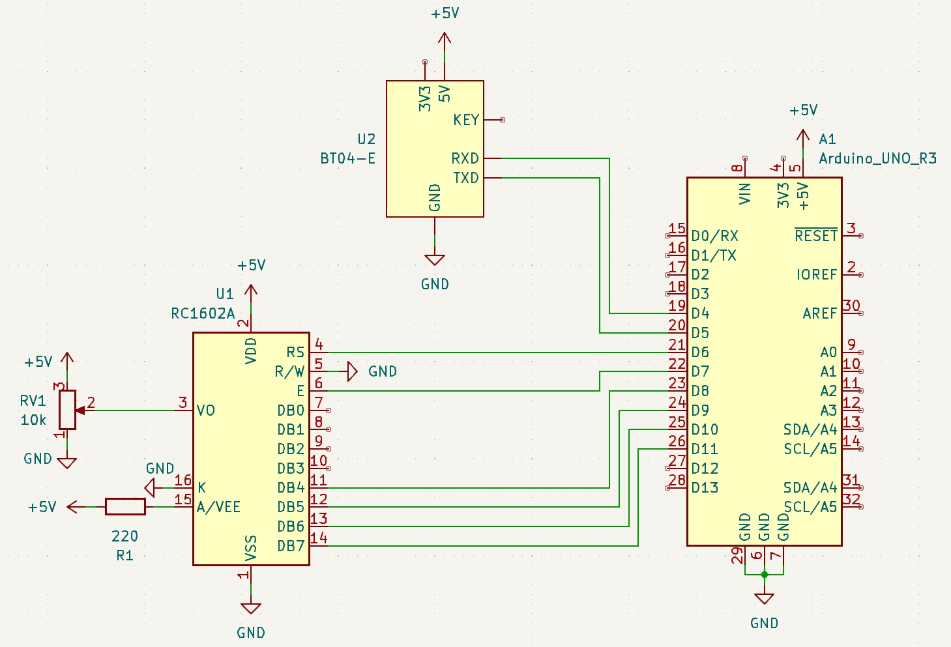
4. HARDWARE IMPLEMENTATION

Slide 7
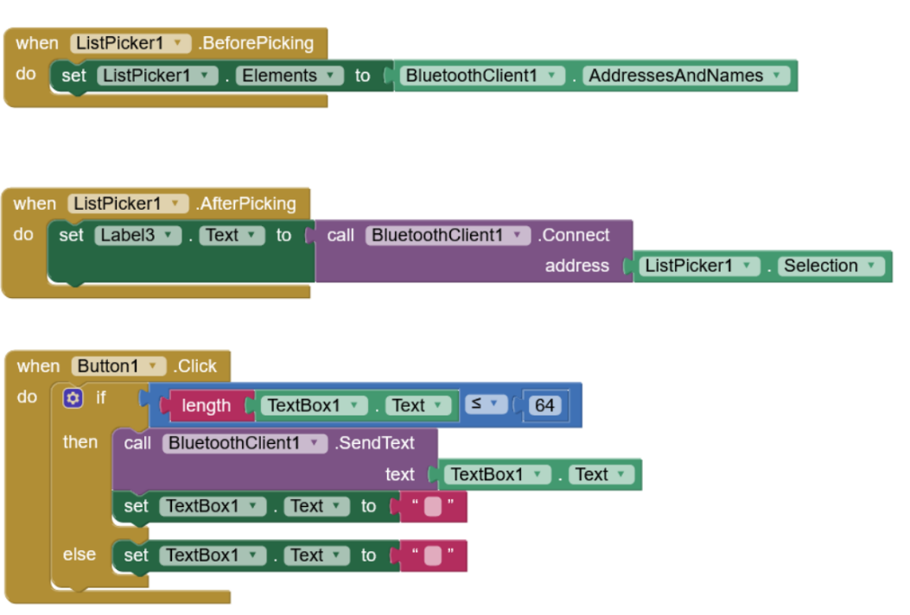
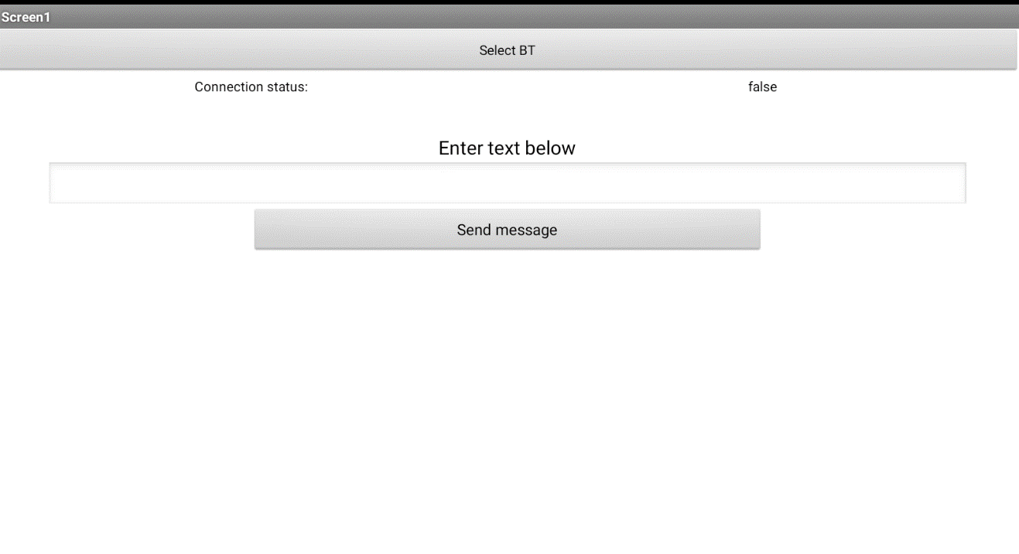
5. SOFTWARE IMPLEMENTATION

Slide 8
6. CONCLUSIONS
Good opportunity to learn new things about the Arduino UNO board, but also to touch up on pre-existing knowledge.
A problem we encountered was the memory management of the text strings done by the standard Arduino library code.
Fun introduction to Android development (AppInventor)
Interesting integration of 2 technologies
Potential for growth

Slide 9
7. GANNT CHART & CONTRIBUTIONS TABLE
 | 10.2023 | 11.2023 | 12.2023 | 01.2024
Research
Arduino Code
Further Research
Android App
Debugging
Documentation
Submission

Slide 10
Contributions table
Deadline | Task Mircea | Task Vlad | Task Teodora
31/10/2023 | Research
31/11/2023 |  | Prototype Arduino Code
31/12/2023 | Prototype Android App | Arduino Code improvements
06/01/2024 | Final Debugging
 | Documentation

Slide 11
Thank you for your attention!

Slide 12
Questions

