Slide 1
Sky-camera based Cloud Movement Prediction and Sunlight Forecast
Yuchen Han (1824423)

Slide 2
Outline
Project speciﬁcation
Data preprocessing
Design of algorithms
Evaluation

Slide 3
1.Project Speciﬁcation
Aim: Find the relationship between sky images and the future photovoltaic power output.
Challenge: Estimating PV based on the relative position of sun and cloud, however, is quite challenging because of the changing weather patterns.

Slide 4
1. Project Speciﬁcation
This project uses 3 neural networks to do comparation.
MLP, CNN-MLP, LSTM-CNN-MLP
The input of neural networks is the sky pictures and corresponding photovoltaic power values.
Tools:
The implementation of this project is mainly in python.
Python is used to do data pre-processing, images processing and result evaluation.
Keras will be used to implement MLP, CNN, LSTM. Several libraries such as matplotlib, sklearn and numpy will also be used to transform vectors and do visualization.

Slide 5
2.Data
2.1 Data source
2.2 Data preprocessing

Slide 6
2.1 Data source
A photovoltaic panel was installed on the roof of EE building in Xi’an Jiaotong University. The sky camera was installed near the solar panel. 5 images can be captured every 5 seconds at diﬀerent exposures(34,100,500,1000,2800) ms, which can obtain more detail information than single one.
In the meantime, solar panel also records the corresponding photovoltaic values into a text ﬁle.

Slide 7
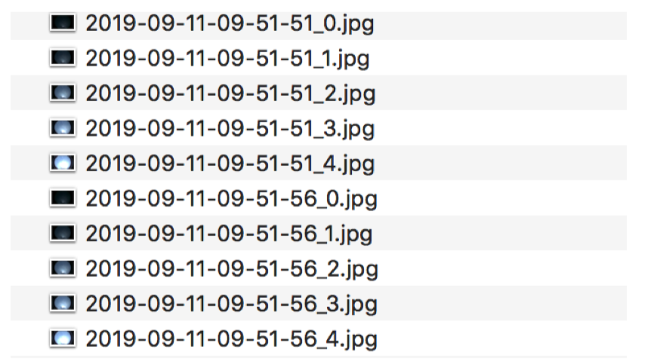
2.1 Data source
Sky images in computer

Slide 8
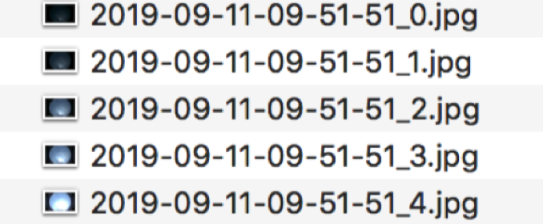
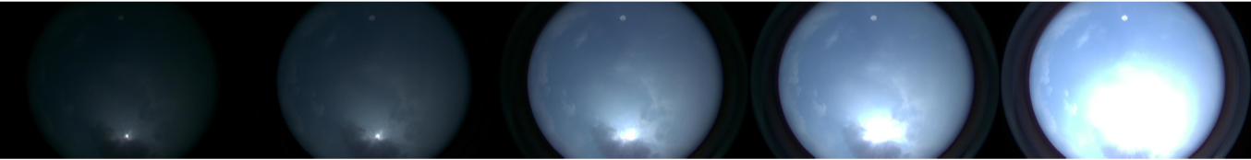
2.1 Data source
Sky images
Image resolution : 1928 × 1208

Slide 9
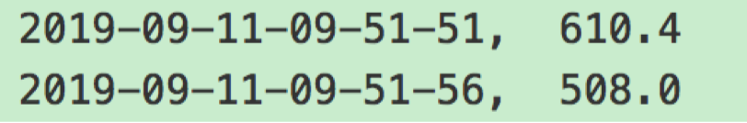
2.1 Data source
photovoltaic data

Slide 10
2.2 Data preprocessing
The project computes the mean of all values gathered in the [t −60s, t ] interval, where t is sampled every minute.
The data where the image is invalid (too dark), or photovoltaic power output is 0 (below sensitivity threshold) is removed

Slide 11
3 DESIGN OF ALGORITHM
3.1 MLP
3.2 CNN-MLP
3.3 LSTM-CNN-MLP

Slide 12
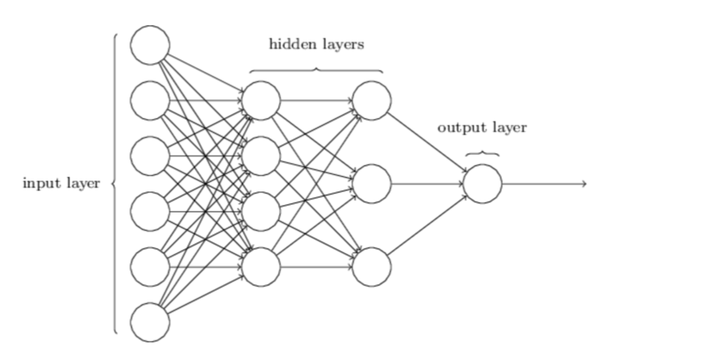
3.1 MLP with past photovoltaic values

Slide 13
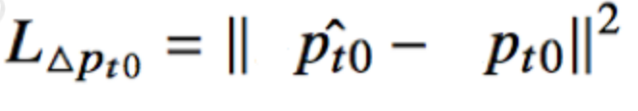
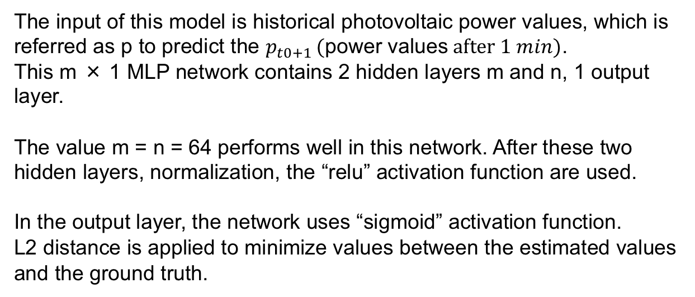
3.1 MLP
The input of this model is historical photovoltaic power values, which is referred as p to predict the $p_{t0+1 }(\text{power} \text{values} after 1 min)$.
This m × 1 MLP network contains 2 hidden layers m and n, 1 output layer.
The value m = n = 64 performs well in this network. After these two hidden layers, normalization, the “relu” activation function are used.
In the output layer, the network uses “sigmoid” activation function.
L2 distance is applied to minimize values between the estimated values and the ground truth.

Slide 14
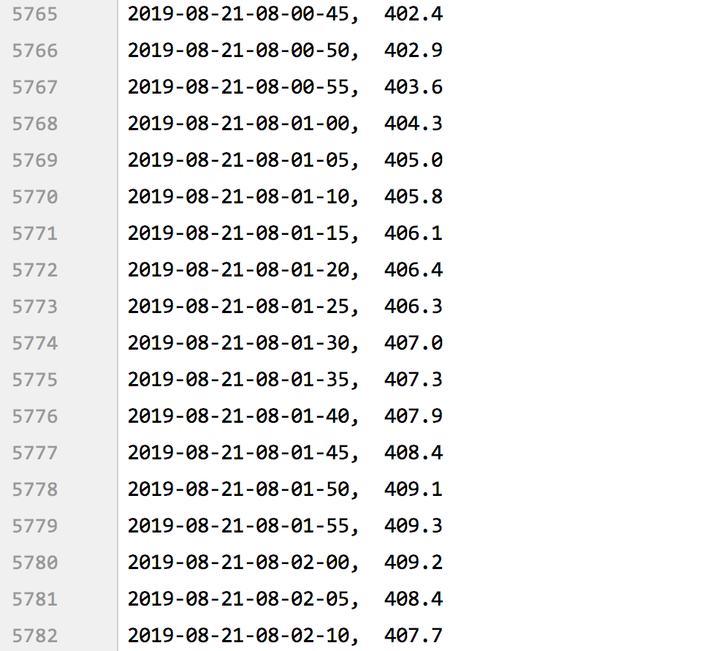
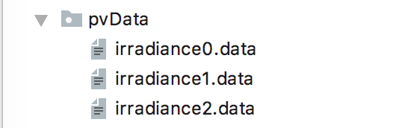
3.1 MLP
Data files:(raw data)

Slide 15
3.1 MLP
Since sampling a single photovoltaic value every minute can be quite noisy, we compute the mean of all values gathered in the [t-60s,t] interval, where t is sampled every minute.

Slide 16
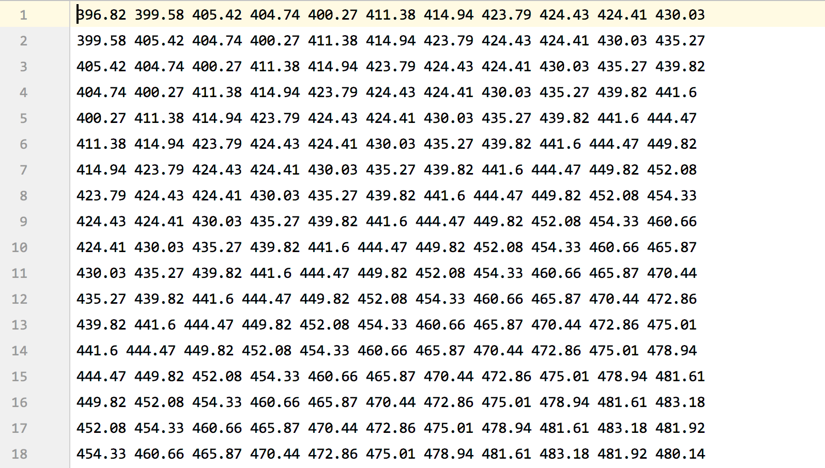
3.1 MLP
After processing: (use 10 min to predict 11 min)

Slide 17
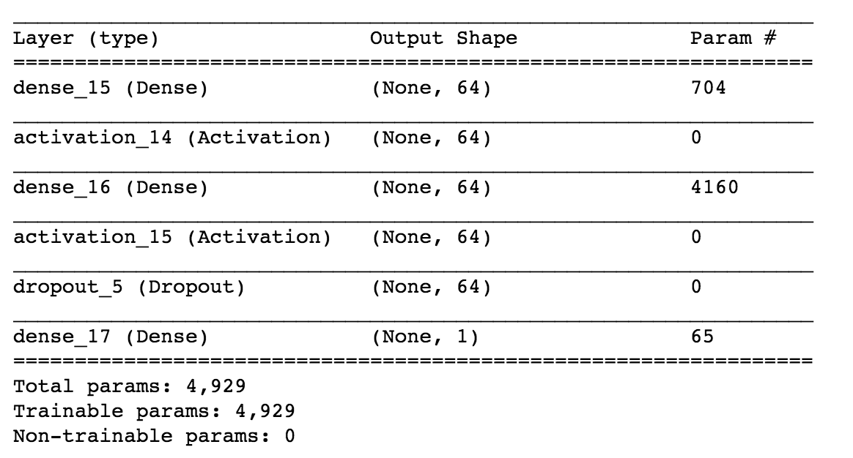
3.1 MLP

Slide 18
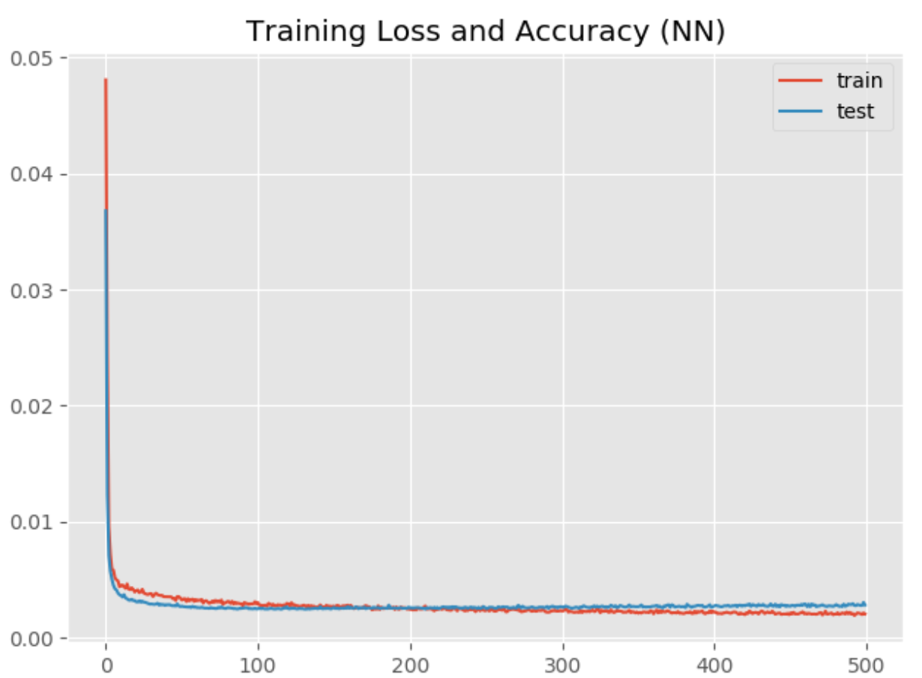
3.1 MLP

Slide 19
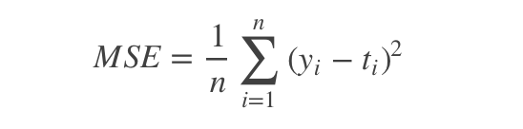
3.1 MLP
Loss function:
Regression problems are predictions of specific values. These problems need not to be a predefined category, but an arbitrary real number. The neural network that solves the regression problem generally has only one output node, and the output value of this node is the predicted value.
mean_squared_error

Slide 20
3.2 CNN
Although MLP network can use historical power value p as input to do prediction, it has no relevance with images. The procedure will lose many feathers. Therefore, convolutional neural network(cnn) will be applied in order to solve this problems.
CNN is an appropriate model to extract pictures’ information. Then this project uses a combination of CNN with MLP to learn information through the images and photovoltaic values.

Slide 21
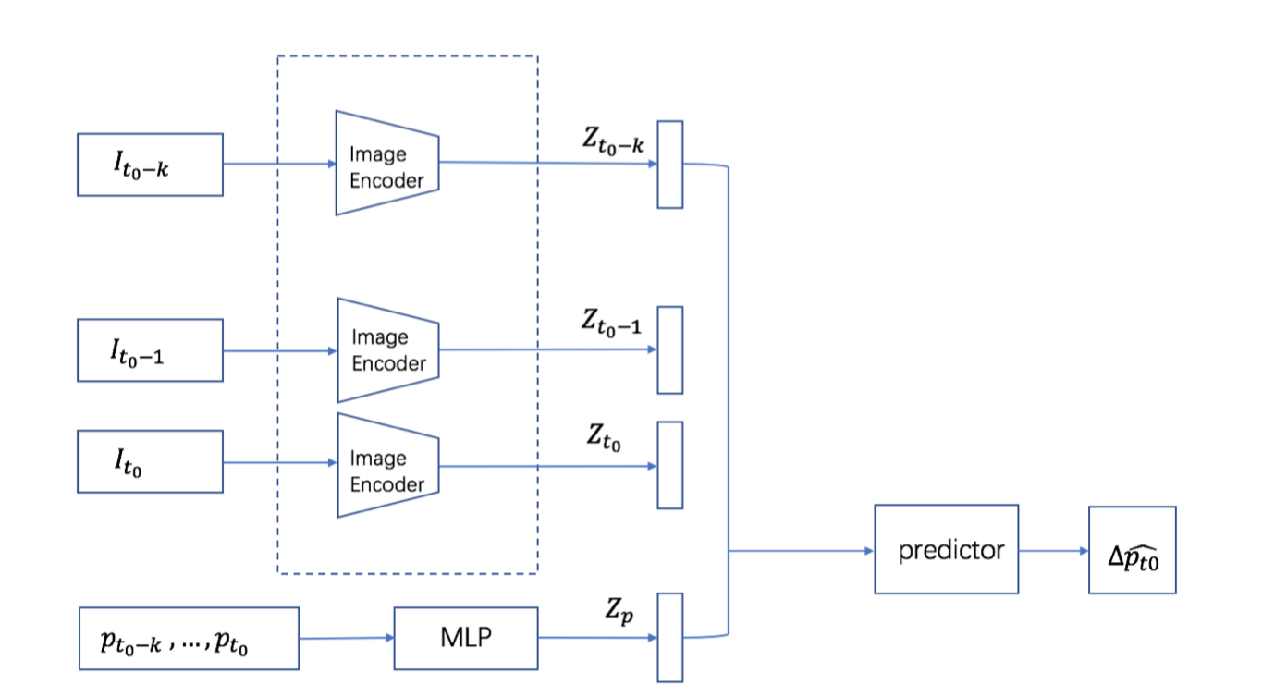
3.2 CNN

Slide 22
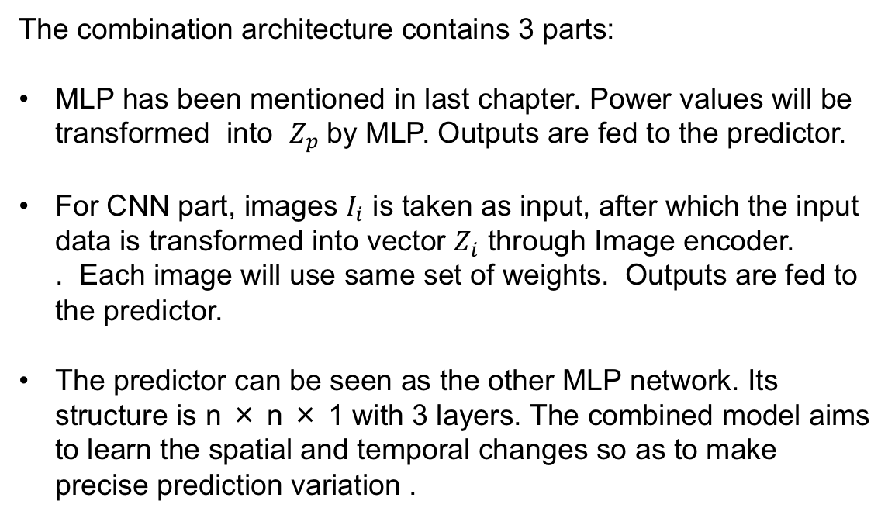
3.2 CNN
The combination architecture contains 3 parts:
MLP has been mentioned in last chapter. Power values will be transformed into $Z_{p}$by MLP. Outputs are fed to the predictor.
For CNN part, images $I_{i}$ is taken as input, after which the input data is transformed into vector $Z_{i}$ through Image encoder. . Each image will use same set of weights. Outputs are fed to the predictor.
The predictor can be seen as the other MLP network. Its structure is n × n × 1 with 3 layers. The combined model aims to learn the spatial and temporal changes so as to make precise prediction variation .

Slide 23
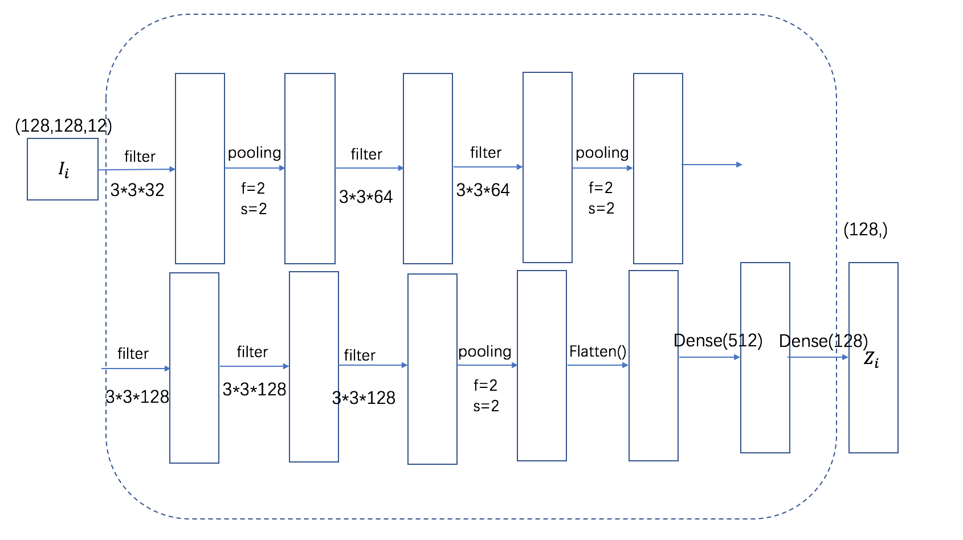
3.2 CNN
Image encoder structure
Max pooling same padding

Slide 24
3.2 CNN
Aim:
using pv data and corresponding images in 5 min to predict pv for next min.

Slide 25
3.2 CNN
Procedure:
1.get the first image names
2.build the relationship between image and pv.
get the pv, compute the mean of values and store the values into list.(6 values)
3.according to the index of pv, images can be obtained. 3 images are used in 15s.(12 images in 1 min)
4. images are transformed to grey while channels are added as 12 images are processed together. (128,128,12) 5 new images are stored into a list.

Slide 26
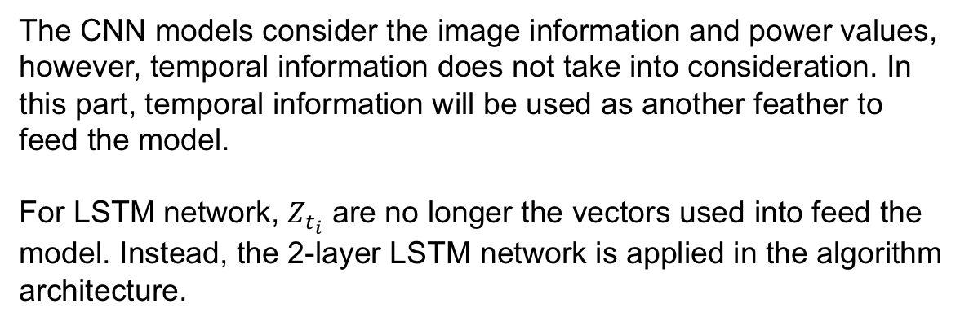
3.3 LSTM
The CNN models consider the image information and power values, however, temporal information does not take into consideration. In this part, temporal information will be used as another feather to feed the model.
For LSTM network, $Z_{t_{i}}$ are no longer the vectors used into feed the model. Instead, the 2-layer LSTM network is applied in the algorithm architecture.

Slide 27
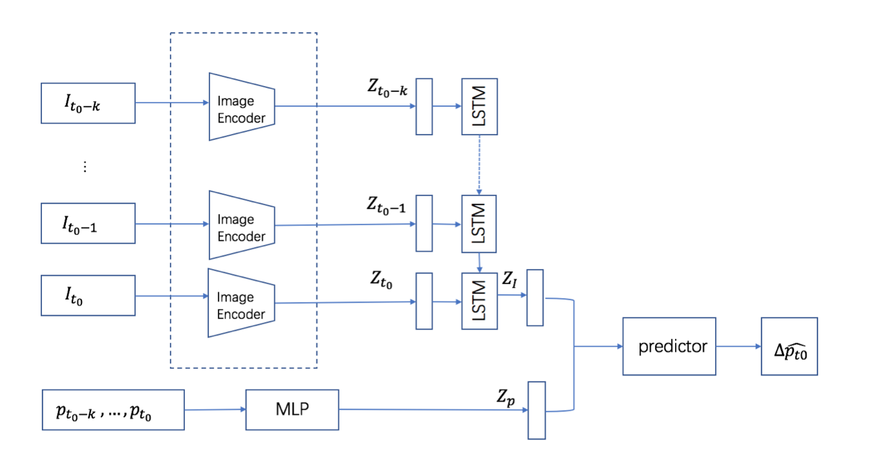
3.3 LSTM

Slide 28


3.3 LSTM
LSTM is good at getting the e structure of sequences. After the data being processed, z t I has all the past latent temporal information. Then z t I and z t p are concatenated to train the ﬁnal network through a predictor to predict . . The loss function remains the same as

Slide 29
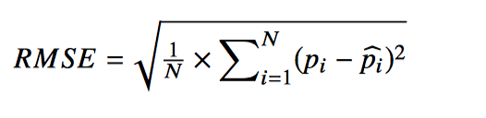
4 Evaluation
RMSE
It is used to measure the deviation between the observed value and the truth value.

Slide 30
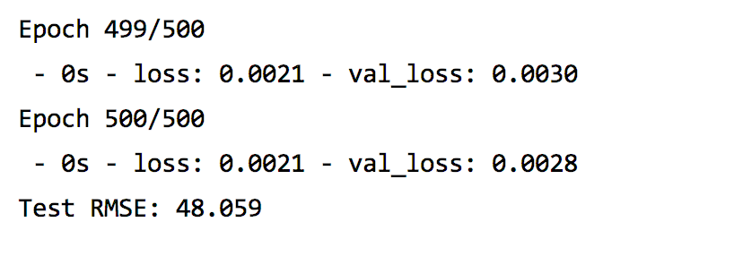
4 Evaluation
RMSE for MLP:

Slide 31
Thank you for Listening!

