Slide 1
Sky-camera based Cloud Movement Prediction and Sunlight Forecast
Yuchen Han (1824423)

Slide 2
1.Project Speciﬁcation
Aim: Find the relationship between sky images and the future photovoltaic power output.
Challenge: Estimating PV based on the relative position of sun and cloud, however, is quite challenging because of the changing weather patterns.

Slide 3
1. Project Speciﬁcation
The input of neural networks is the sky pictures and corresponding photovoltaic power values. The project uses the input data and trained neural networks to predict photovoltaic power in a very short term future.
Python will be used to do data pre-processing, images processing and result evaluation. The implementation of this project will be mainly in python. Keras will be used to implement MLP, CNN, LSTM. Several libraries such as matplotlib, sklearn and numpy will also be used to transform vectors and do visualization. For experiment, the data will run in the environment with 1080Ti GPU.

Slide 4
2.Data
2.1 Data source
2.2 Data preprocessing

Slide 5
2.1 Data source
A photovoltaic panel was installed on the roof of EE building in Xi’an Jiaotong University. The sky camera was installed near the solar panel. 5 images can be captured every 5 seconds at diﬀerent exposures(34,100,500,1000,2800) ms, which can obtain more detail information than single one.
In the meantime, solar panel also records the corresponding photovoltaic values into a text ﬁle.

Slide 6
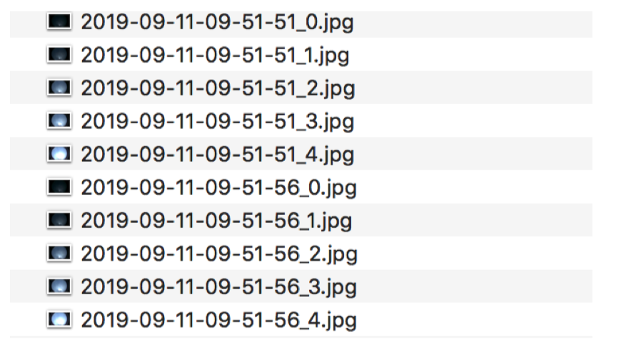
2.1 Data source
Sky images on computer

Slide 7
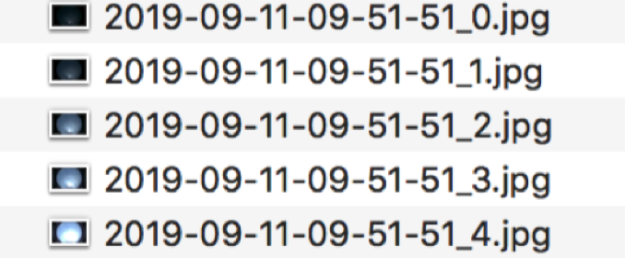
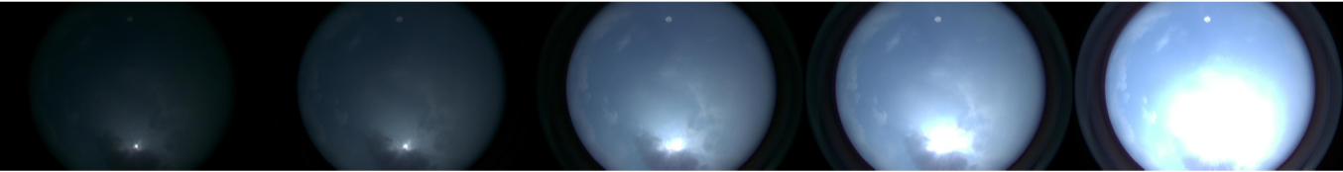
2.1 Data source
Sky images
Image resolution :1928 × 1208

Slide 8
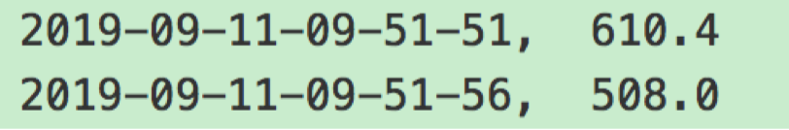
2.1 Data source
photovoltaic data

Slide 9
2.2 Data preprocessing
The project computes the mean of all values gathered in the [t −60s, t ] interval, where t is sampled every minute. The data where the image is invalid (too dark), or photovoltaic power output is 0 (below sensitivity threshold) is removed

Slide 10
3 DESIGN OF ALGORITHM
3.1 MLP with past photovoltaic values
3.2 CNN
3.3 LSTM

Slide 11
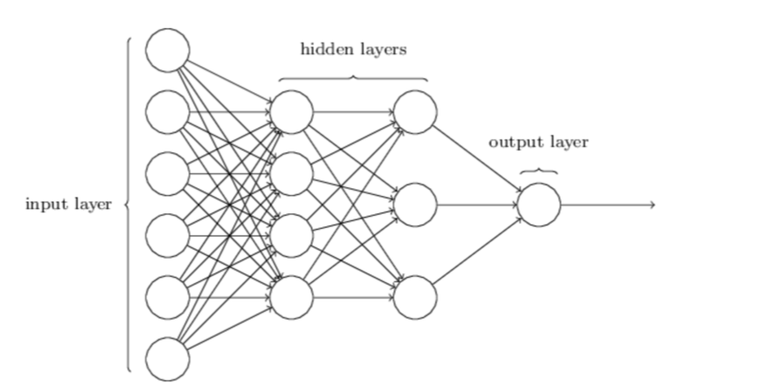
3.1 MLP with past photovoltaic values

Slide 12

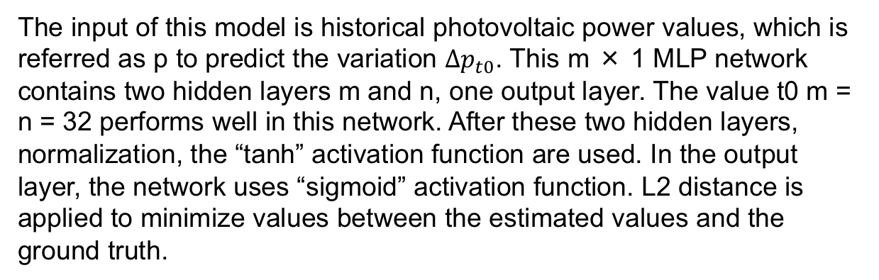
3.1 MLP with past photovoltaic values
The input of this model is historical photovoltaic power values, which is referred as p to predict the variation $∆p_{t0}$. This m × 1 MLP network contains two hidden layers m and n, one output layer. The value t0 m = n = 32 performs well in this network. After these two hidden layers, normalization, the “tanh” activation function are used. In the output layer, the network uses “sigmoid” activation function. L2 distance is applied to minimize values between the estimated values and the ground truth.

Slide 13
3.2 CNN
Although MLP network can use historical power value p as input to do prediction, it has no relevance with images. The procedure will lose many feathers. Therefore, convolutional neural network(cnn) will be applied in order to solve this problems.
CNN is an appropriate model to extract pictures’ information. Then this project uses a combination of CNN with MLP to learn information through the images and photovoltaic values.

Slide 14
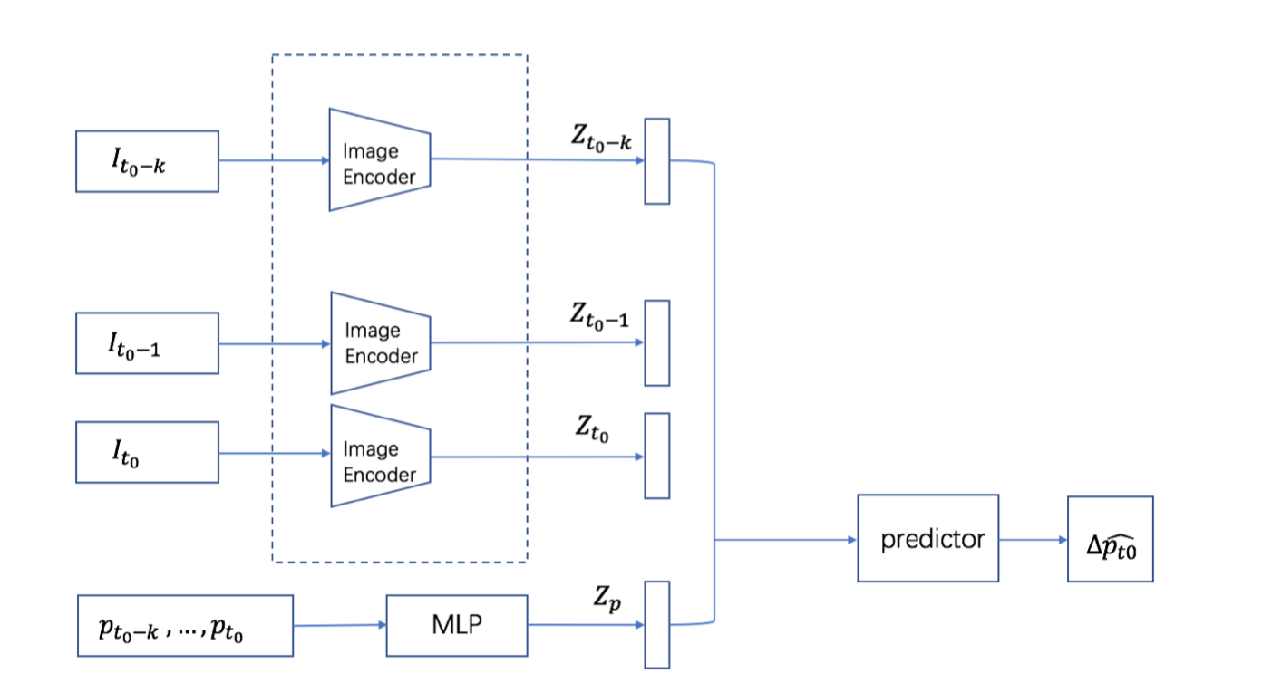
3.2 CNN

Slide 15



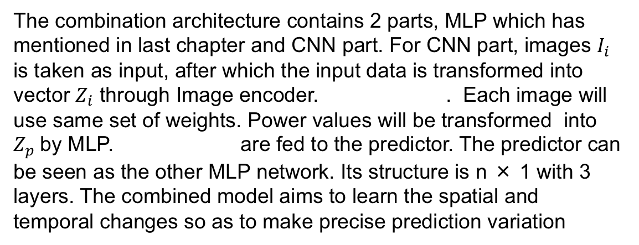
3.2 CNN
The combination architecture contains 2 parts, MLP which has mentioned in last chapter and CNN part. For CNN part, images $I_{i}$ is taken as input, after which the input data is transformed into vector $Z_{i}$ through Image encoder. . Each image will use same set of weights. Power values will be transformed into $Z_{p}$by MLP. are fed to the predictor. The predictor can be seen as the other MLP network. Its structure is n × 1 with 3 layers. The combined model aims to learn the spatial and temporal changes so as to make precise prediction variation

Slide 16
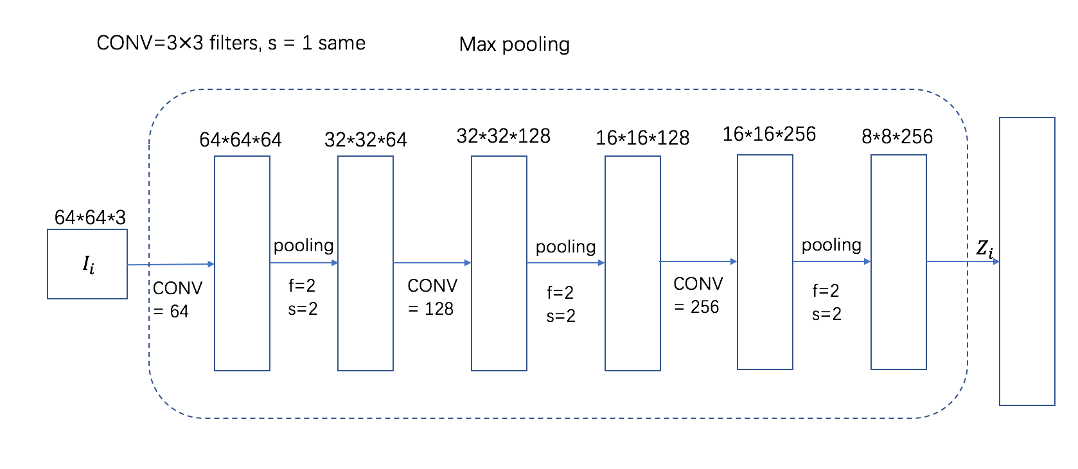
3.2 CNN
Image encoder structure

Slide 17
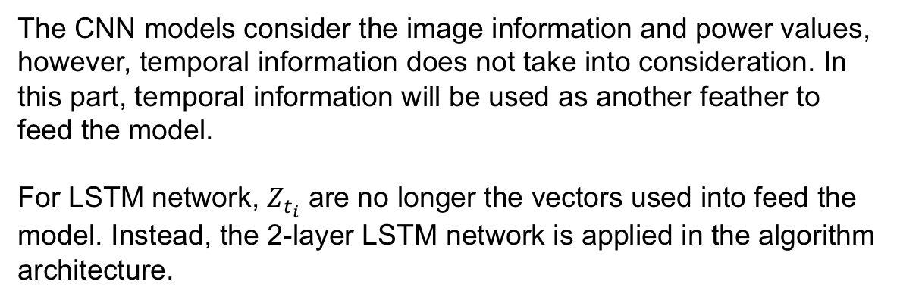
3.3 LSTM
The CNN models consider the image information and power values, however, temporal information does not take into consideration. In this part, temporal information will be used as another feather to feed the model.
For LSTM network, $Z_{t_{i}}$ are no longer the vectors used into feed the model. Instead, the 2-layer LSTM network is applied in the algorithm architecture.

Slide 18
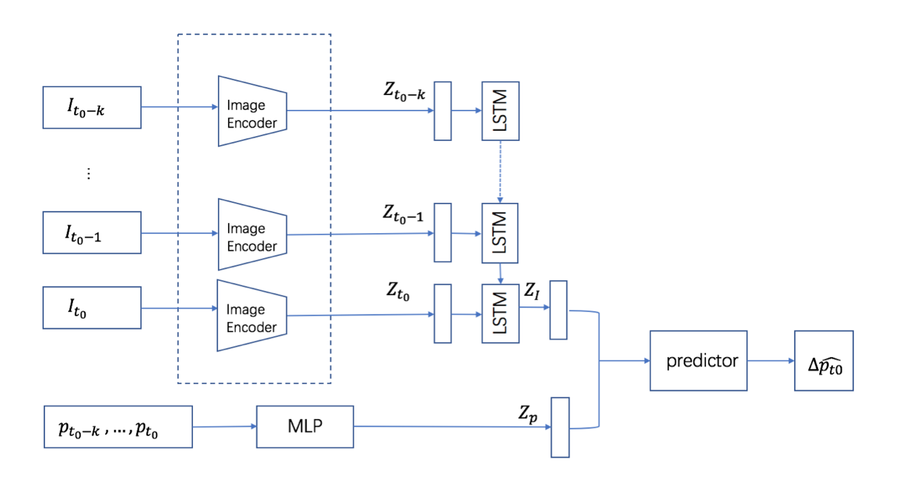
3.3 LSTM

Slide 19


3.3 LSTM
LSTM is good at getting the e structure of sequences. After the data being processed, z t I has all the past latent temporal information. Then z t I and z t p are concatenated to train the ﬁnal network through a predictor to predict . . The loss function remains the same as

Slide 20
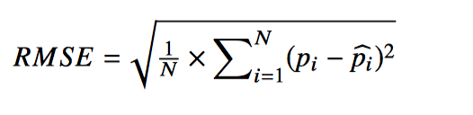
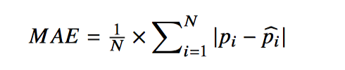
4 Evaluation
1. RMSE
It is used to measure the deviation between the observed value and the truth value.
2. MAE
The “mean absolute error” (MAE) is the average of absolute errors, which can reﬂect the actual situation of the prediction value error well.

Slide 21
5 Review
So far, datasets have already been obtained from solar panels. What’s more, relevant literatures have been reviewed in order to determine the research topic and algorithms for this project. Considering one of the major tasks in this project is using combination of neural networks to train data, some important algorithms (CNN, LSTM) have been reviewed and used into small samples, which makes contribute to build a well-performed algorithm architecture.

Slide 22
Thank you for Listening!

