Slide 1









Image
Encoder
$$Z_{t_{0}−k}$$
$$I_{t_{0}−k}$$
$$Z_{t_{0}−1}$$
$$I_{t_{0}−1}$$
Image
Encoder
Image
Encoder
$$Z_{t_{0}}$$
$$I_{t_{0}}$$
predictor
$$∆\hat{p_{t0}}$$
$$Z_{p}$$
$$p_{t_{0}−k} , …, p_{t_{0}}$$
MLP

Slide 2


(128,128,12)
filter
pooling
filter
filter
pooling
$$I_{i}$$
3*3*32
f=2
s=2
3*3*64
3*3*64
f=2
s=2
(128,)
Dense(512)
Dense(128)
filter
filter
filter
pooling
Flatten()
$$Z_{i}$$
3*3*128
3*3*128
3*3*128
f=2
s=2

Slide 3



Image
Encoder
$$Z_{t_{0}−k}$$
LSTM
$$I_{t_{0}−k}$$
…
$$Z_{t_{0}−1}$$
LSTM
$$I_{t_{0}−1}$$
Image
Encoder
Image
Encoder
$$Z_{t_{0}}$$
LSTM
$$Z_{I}$$
$$I_{t_{0}}$$
predictor
$$Z_{p}$$
$$p_{t_{0}−k} , …, p_{t_{0}}$$
MLP

Slide 4



CONV=3$×$3 filters, s = 1 same
Max pooling
64*64*64
32*32*64
32*32*128
16*16*128
16*16*256
8*8*256
128*128*12
pooling
pooling
pooling
$$Z_{i}$$
$$I_{i}$$
CONV
= 64
f=2
s=2
CONV
= 128
f=2
s=2
CONV
= 256
f=2
s=2

Slide 5




$$p_{t_{0}−k}$$
…
$$p_{t_{0}−1}$$
$$p_{t_{0}+t}$$
…
…
n
m
$$p_{t_{0}}$$

Slide 6
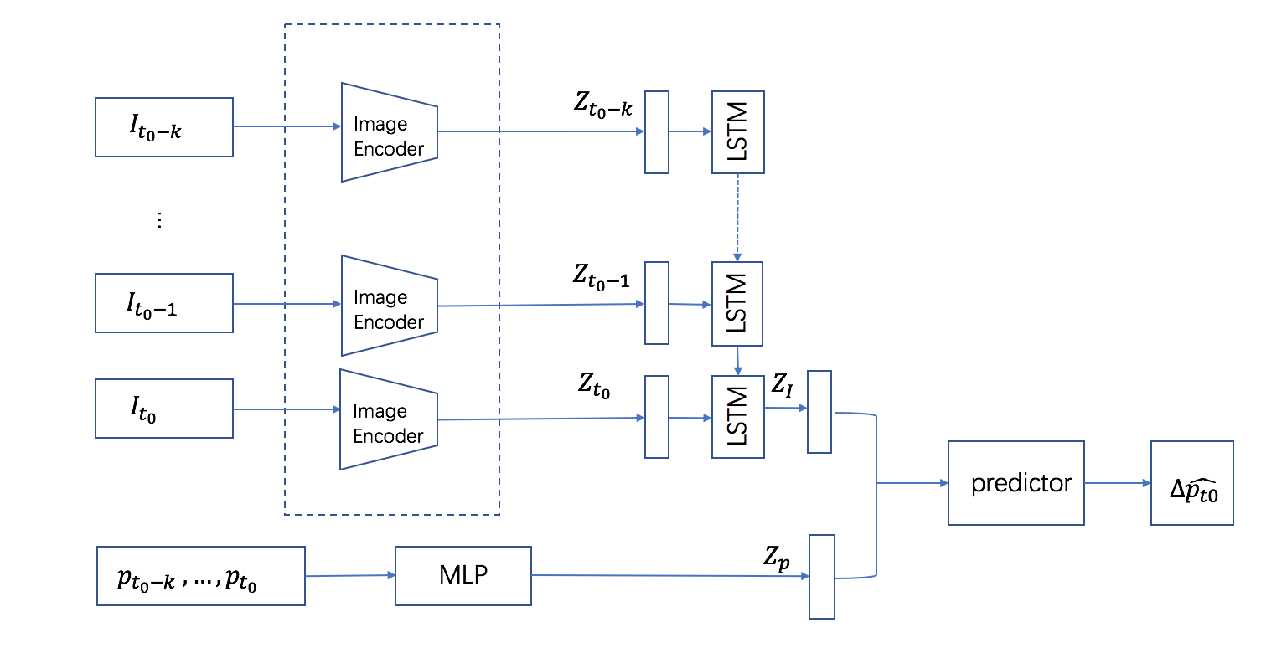

Slide 7
