Slide 1
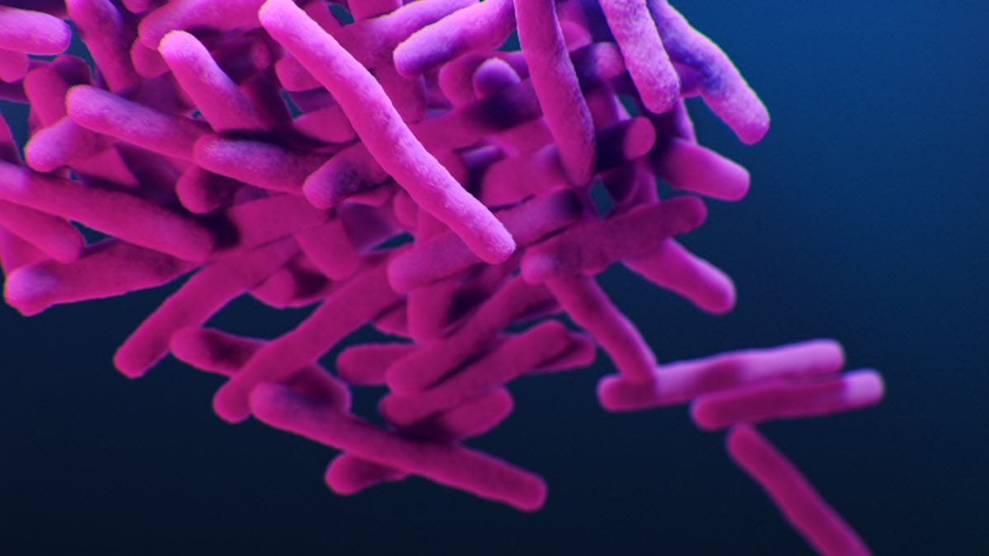
Tuberculosis (TB)
Supervised by :
Dr. Anna Tskitishvili

Slide 2

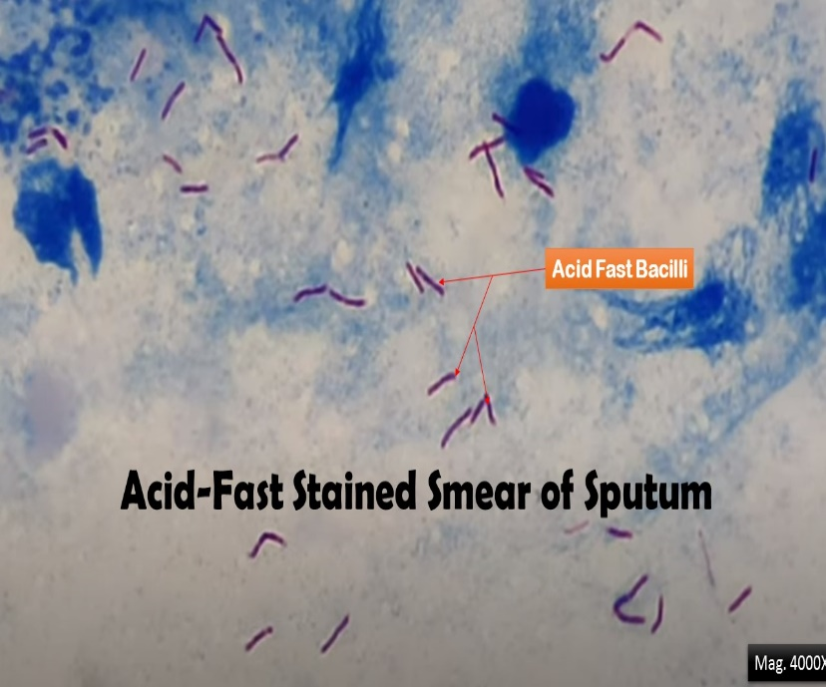
OVERVIEW
TB is caused by M tuberculosis (Mtb), a slow-growing obligate aerobe and a facultative intracellular parasite
Mtb are non-spore-forming and nonmotile curved intracellular rods, Their cell walls contain mycolic acid-rich, long-chain glycolipids and phosphoglycolipids (mycocides) that protect mycobacteria from cell lysosomal attack ^{[72]} . The mycolic acid component also helps retain red basic fuchsin dye after acid rinsing (acid-fast stain), the basis of the acid-fast stains used for pathologic identification.

Slide 3
Transmission
Humans are the only known reservoir for Mtb. The organism is spread primarily via airborne aerosol from an individual in the infectious stage of TB (although transdermal and GI transmission have been reported). TB also is reported to be transmitted through organ transplant, and screening protocols are in place with close surveillance of high-risk donors
Infection with M tuberculosis (Mtb) results most commonly through exposure of the lungs or mucous membranes to infected aerosols. Droplets in these aerosols are 1-5 μm in diameter; in a person with active pulmonary TB, a single cough can generate 3000 infective droplets, with as few as 10 bacilli needed to initiate infection. Exposure to a similar infectious dose can occur within 5 minutes of a conversation with an infected individual. The highest number of bacilli per mL are reported of sputum with laryngeal tuberculosis, making it a highly contagious variant.
Risk factors
for developing active disease after Mtb infection include recent acquisition (within 18 months), exposure to higher infectious inoculum, malnutrition, tobacco smoking, pulmonary fibrotic lesions, alcoholism, intravenous drug use, and comorbidities, including HIV, diabetes, silicosis, immunosuppression (particularly TNF-alpha inhibitors), cancer of head and neck, hematological malignancies, end-stage renal disease, chronic malabsorption, and gastrectomy

Slide 4
Pathophysiology
Due to inhalation of aerosolized Mycobacterium tuberculosis
B. Primary TB arises with initial exposure.
1. Results in focal, caseating necrosis in the lower lobe of the lung and hilar lymph nodes
that undergoes fibrosis and calcification, forming a Ghon complex
2. Primary TB is generally asymptomatic, but leads to a positive PPD.
C. Secondary TB arises with reactivation of Mycobacterium tuberculosis.
1. Reactivation is commonly due to AIDS; may also be seen with aging
2. Occurs at apex of lung (relatively poor lymphatic drainage and high oxygen tension)
3. Forms cavitary foci of caseous necrosis; may also lead to miliary pulmonary TB or
tuberculous bronchopneumonia
4. Clinical features include fevers and night sweats, cough with hemoptysis, and weight
loss.
5. Biopsy reveals caseating granulomas; AFB stain reveals acid-fast bacilli
6. Systemic spread often occurs and can involve any tissue; common sites include
meninges (meningitis), cervical lymph nodes, kidneys (sterile pyuria), and lumbar
vertebrae (Pott disease)

Slide 5

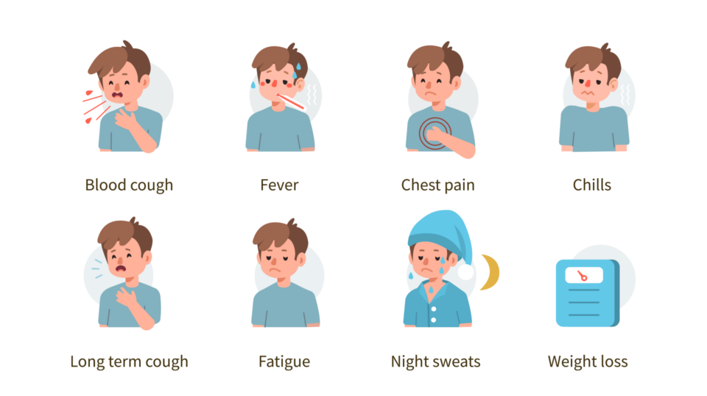
Clinical presentation
Pt. will present with:
Cough
Weight loss/anorexia
Fever
Night sweats
Hemoptysis
Chest pain due to pleural involvement
Fatigue
Chills
Elderly individuals with TB may not display typical signs and symptoms of TB infection because they may not have a good immune response.

Slide 6

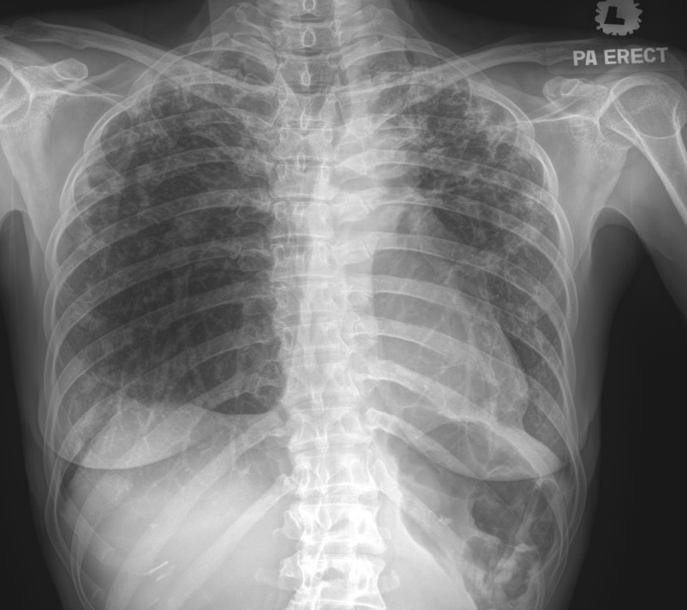
Investigation
Cxr
A patchy or nodular infiltrate frequently is seen in apical or subapical posterior areas of the upper lobe or superior segments of the lower lobe.
Cavity formation
Fibrotic scars
Mantoux test
Sputum culture
Ziehl-Neelsen staining of sputum

