Slide 1
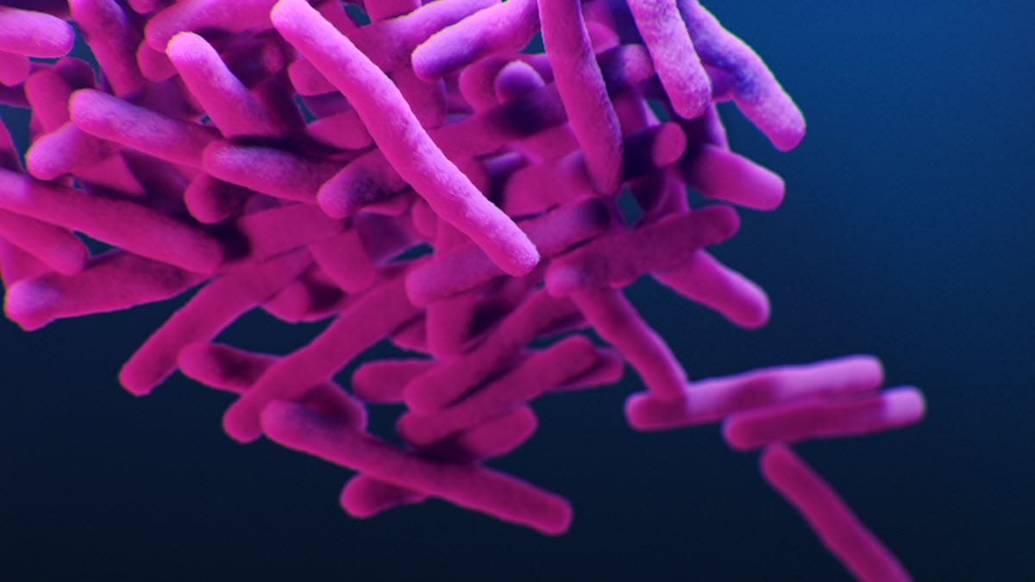
Tuberculosis (TB)
Supervised by :
Dr. Anna Tskitishvili

Slide 2

Case study
Pt. profile : 62 yr old pt. denies smoking , reported that his wife died a yr ago , traveled from India to Usa
Chief complaint : 3 months of unintentional weight loss
Associated symptoms : no vomiting or diarrhea
depressive symptoms
3 month productive cough green sputum
not feeling feverish
Vitals: 38°C , RR 16bpm
PE : abdominal exam: benign, no masses no hematochezia
chest exam : on auscultation fine wheezes and scattered crackles where heard , normal heart rhythm
neck exam : normal thyroid gland and no cervical or supraclavicular lymphadenopathy
Past medical hx : no medication
Past surgical hx : none
Allergies : none

Slide 3
Arguments
TB:
Chronic productive cough
Unintentional weight loss
Moved from India (endemic)
Crackles
Low grade fever
Pneumonia:
Productive cough with green sputum
Suggests bacterial infection
Fever
Crackles and wheezes
Old age
Lung cancer:
Unintentional weight loss
Persistent cough
Crackles and wheeze
Old age
COPD:
History of productive cough
Crackles and wheezes
Green sputum (chronic infection)
Pts. Can lie (smoking)

Slide 4
counterarguments
Covid-19:
No mention of classic covid symptoms
Anosmia
Sore throat
Significant fever spikes
Respiratory distress
Plus it took over 3 months
Pneumonia:
Lack of acute respiratory distress
16bpm
No history of chills and rigors
No cxr findings
COPD:
Denies smoking
No significant respiratory distress
No past history of chronic airway disease
Lung cancer:
No smoking history
No evidence of lymphadenopathy or masses
Negative stool occult

Slide 5

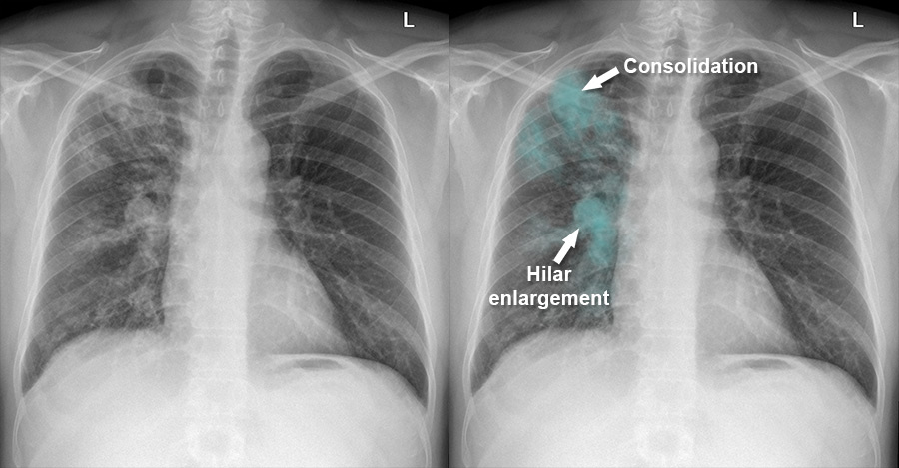
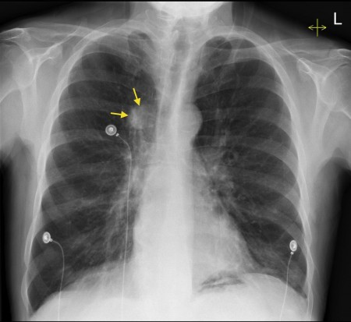
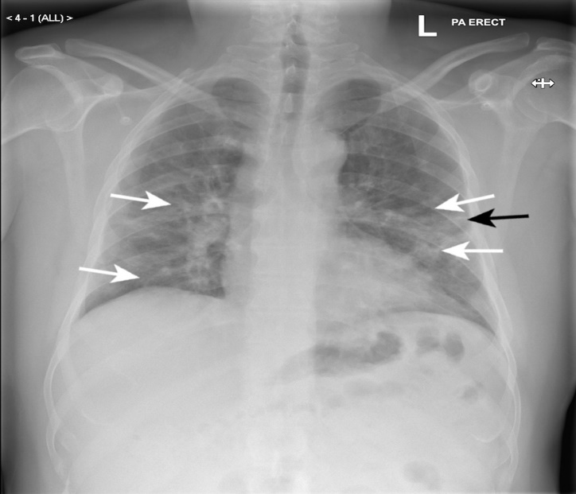
Investigation
Cxr (gold standard)
Sputum culture
Gram & blood (general)
Specific (acid fast stain )
PCR

Slide 6
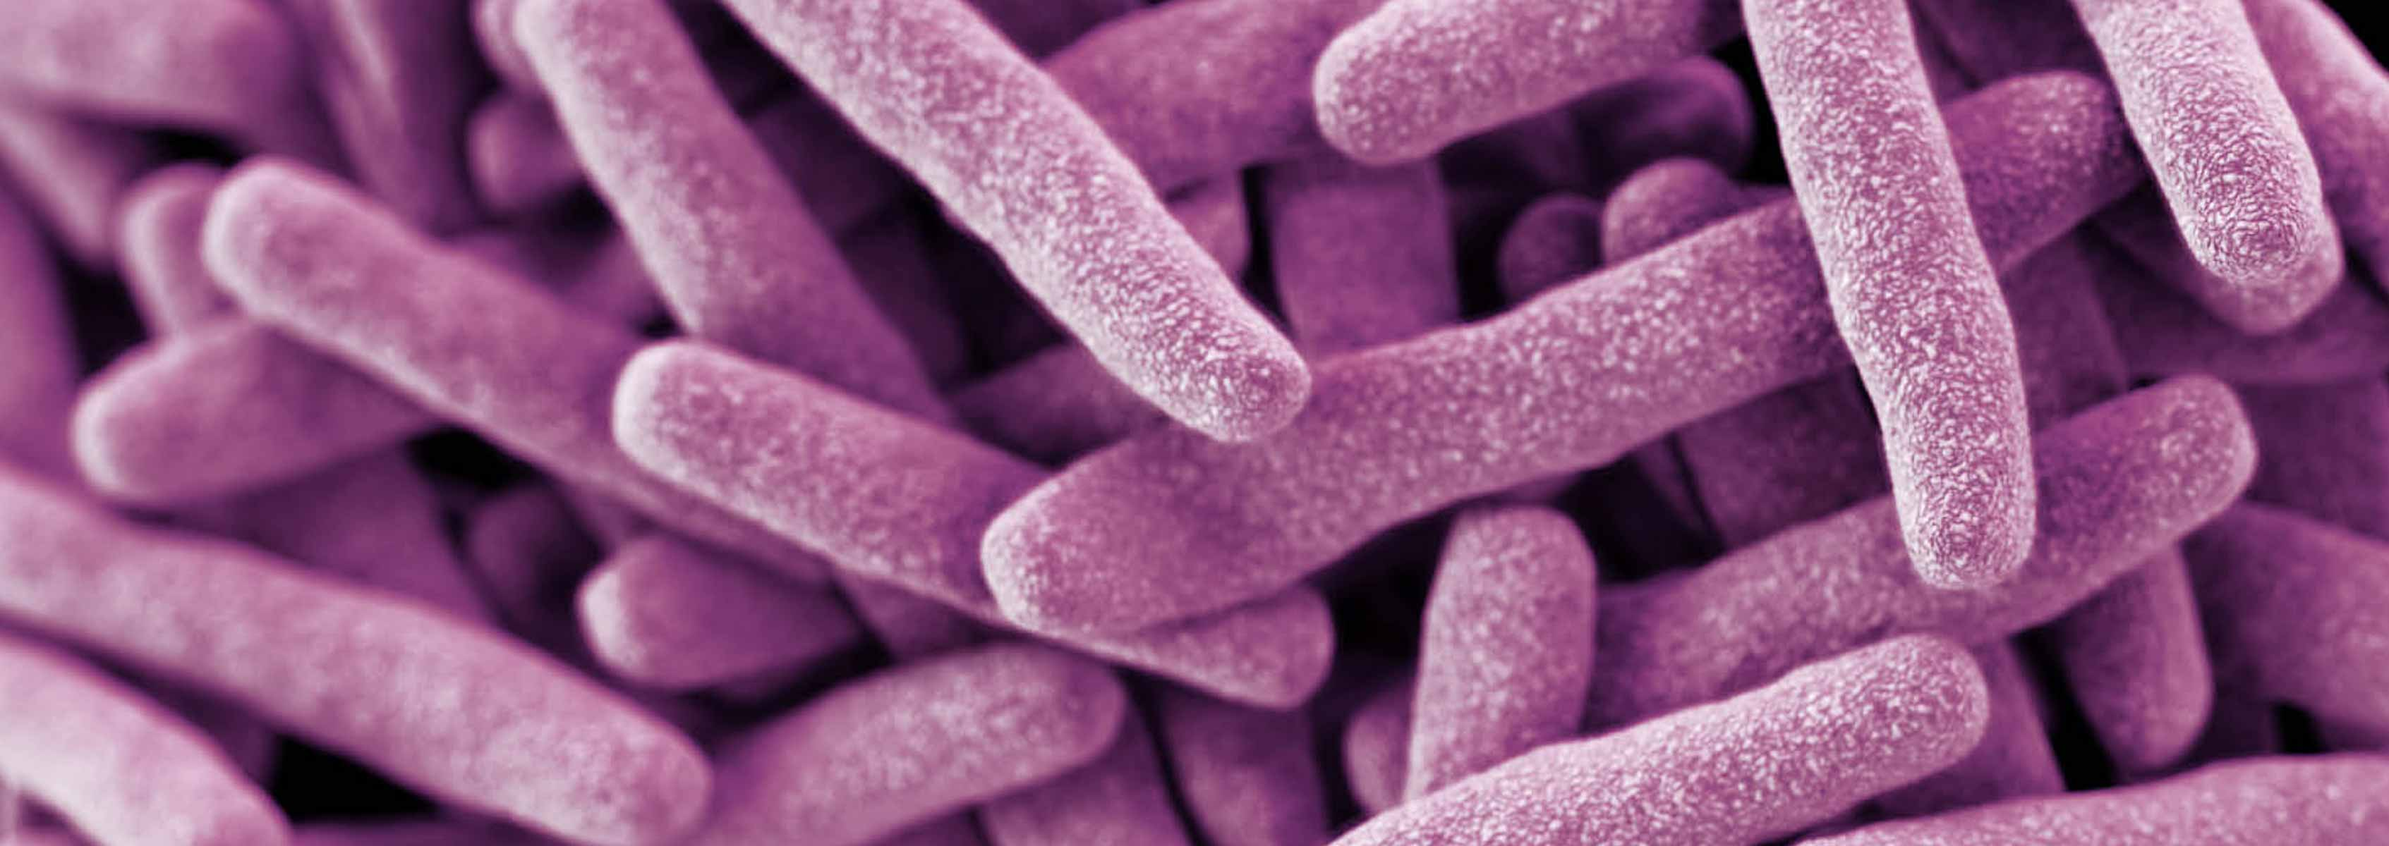
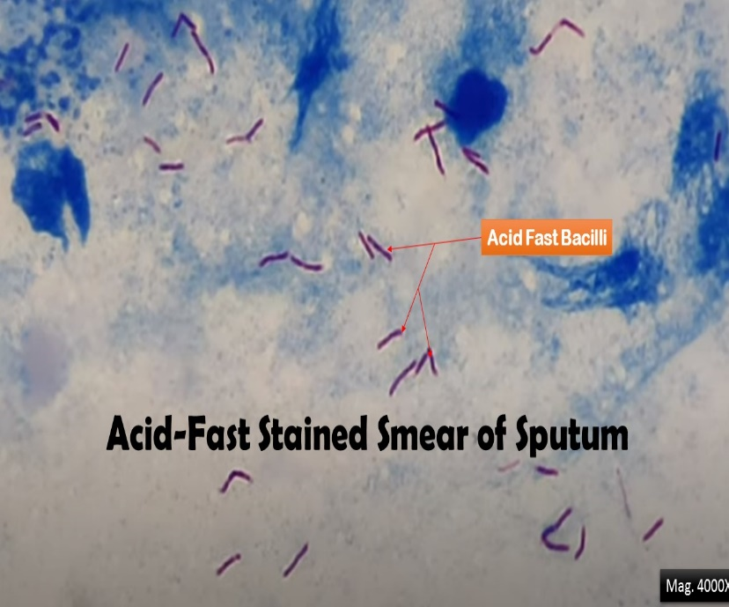
TB OVERVIEW
TB is caused by M tuberculosis (Mtb), a slow-growing obligate aerobe and a facultative intracellular parasite
Mtb are non-spore-forming and nonmotile curved intracellular rods, Their cell walls contain mycolic acid-rich, long-chain glycolipids and phosphoglycolipids (mycocides) that protect mycobacteria from cell lysosomal attack. The mycolic acid component also helps retain red basic fuchsin dye after acid rinsing (acid-fast stain), the basis of the acid-fast stains used for pathologic identification.

Slide 7
Transmission
Humans are the only known reservoir for Mtb. The organism is spread primarily via airborne aerosol from an individual in the infectious stage of TB (although transdermal and GI transmission have been reported). TB also is reported to be transmitted through organ transplant, and screening protocols are in place with close surveillance of high-risk donors
Infection with M tuberculosis (Mtb) results most commonly through exposure of the lungs or mucous membranes to infected aerosols. Droplets in these aerosols are 1-5 μm in diameter; in a person with active pulmonary TB, a single cough can generate 3000 infective droplets, with as few as 10 bacilli needed to initiate infection. Exposure to a similar infectious dose can occur within 5 minutes of a conversation with an infected individual. The highest number of bacilli per mL are reported of sputum with laryngeal tuberculosis, making it a highly contagious variant.
Risk factors
for developing active disease after Mtb infection include recent acquisition (within 18 months), exposure to higher infectious inoculum, malnutrition, tobacco smoking, pulmonary fibrotic lesions, alcoholism, intravenous drug use, and comorbidities, including HIV, diabetes, silicosis, immunosuppression (particularly TNF-alpha inhibitors), cancer of head and neck, hematological malignancies, end-stage renal disease, chronic malabsorption, and gastrectomy

Slide 8
Pathophysiology
Due to inhalation of aerosolized Mycobacterium tuberculosis
B. Primary TB arises with initial exposure.
1. Results in focal, caseating necrosis in the lower lobe of the lung and hilar lymph nodes
that undergoes fibrosis and calcification, forming a Ghon complex
2. Primary TB is generally asymptomatic, but leads to a positive PPD.
C. Secondary TB arises with reactivation of Mycobacterium tuberculosis.
1. Reactivation is commonly due to AIDS; may also be seen with aging
2. Occurs at apex of lung (relatively poor lymphatic drainage and high oxygen tension)
3. Forms cavitary foci of caseous necrosis; may also lead to miliary pulmonary TB or
tuberculous bronchopneumonia
4. Clinical features include fevers and night sweats, cough with hemoptysis, and weight
loss.
5. Biopsy reveals caseating granulomas; AFB stain reveals acid-fast bacilli
6. Systemic spread often occurs and can involve any tissue; common sites include
meninges (meningitis), cervical lymph nodes, kidneys (sterile pyuria), and lumbar
vertebrae (Pott disease)

Slide 9
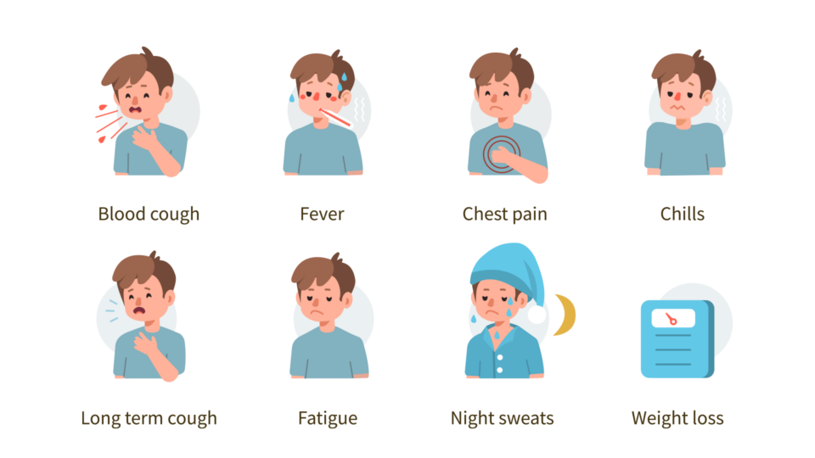
Clinical presentation
TB:
Cough
Weight loss/anorexia
Fever
Night sweats
Hemoptysis
Chest pain due to pleural involvement
Fatigue
Chills

Slide 10

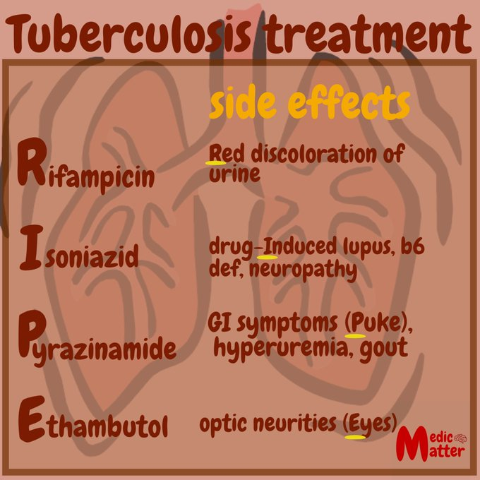
Treatment & management
Isolate the pt. in a private room with –ve pressure
Drug therapy
For initial empiric treatment start a 4 drug regimen
Rifampin
Isoniazid
Pyrazinamide
Ethambutol
Discontinue ethambutol once fully susceptible
After 2 months pyrazinamide can be stopped
Rifampin should continue for 4 months
If isolated isoniazid resistance is documented then discontinue it
Monitoring for sputum cbc liver enzymes serum creatinine weekly

Slide 11
