Slide 1
NDK: JNI crashes, errors and common mistakes

Slide 2
Plan
Introduction
JNI table reference counting
Working with NDK native threads
Exception Handling
Different linking issues
Reduce the size of native libs
NDK crash handling and NDK tools

Slide 3

What is NDK?
The Android NDK is a toolset that lets you implement parts of your app in native code, using languages such as C and C++. For certain types of apps, this can help you reuse code libraries written in those languages.
The Java Native Interface (JNI) is a programming framework that enables Java code running in a Java Virtual Machine (JVM) to call and be called by native applications and libraries written in other languages such as C, C++ and assembly.

Slide 4
Why we use NDK/JNI?
Legacy support
Security, performance solutions
Low-level platform specific API
C++ cross-platform solutions
Android Java Layer
JNI Layer
Win desktop C++
C/C++ Core
Win mobile C++
iOS Objective-C
MacOS Objective-C

Slide 5
Common mistakes

Slide 6
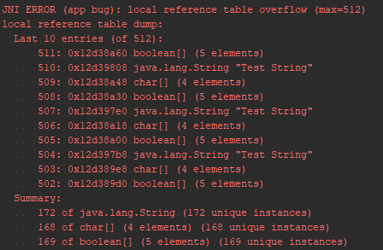
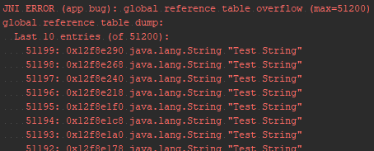
Local and Global References
JNI reference types: LocalRef, GlobalRef
JNI local table reference overflow
JNI global table reference overflow
Android 8.0 improvements
for(int i = 0; i< 100000; i++) { jstring testString = env->NewStringUTF("Test String"); jobject globalObject = env->NewGlobalRef(testString);
globalArray.push_back(globalObject); env->DeleteLocalRef(testString); }
for(int i = 0; i< 600; i++) { jstring testString = env->NewStringUTF("Test String"); jbooleanArray arrayB = env->NewBooleanArray(42); jcharArray arrayC = env->NewCharArray(42); // do something }
Notes:
In Android versions prior to Android 8.0, the number of local references is capped at a version-specific limit. Beginning in Android 8.0, Android supports unlimited local references
Також собі

Slide 7
Native threads
What is Invocation API?
Thread local references.
Do not forget to attach native thread to the JVM
Library and Version Management
JNI_OnLoad
JNI_OnUnload
Invocation API Functions
AttachCurrentThread
DetachCurrentThread
GetEnv

Slide 8

Linker problems
Runtime errors and exceptions:
JNI DETECTED ERROR IN APPLICATION
java.lang.UnsatisfiedLinkerError: No implementation found
java.lang.NoSuchMethodError: no method
C linkage
Release mode and Java obfuscation
ProGuard, DexGuard
Library set
armeabi-v7a, arm64-v8a, x86, x86_64
extern "C“ {} }
Notes:
Можливі проблеми лінковки Java – JNI
Проблеми завантаження бібліотек: extern C, сігнатура функцій, рефакторінг
Обфускація proguard

Slide 9
Other typical mistakes
UTF-8 and UTF-16 strings
Caching method IDs, field IDs and classes
Not checking for exceptions

Slide 10
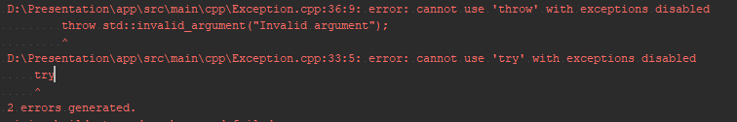
Exception handling
C++ exception support
-fexceptions
-fno-exceptions
android { compileSdkVersion 26 defaultConfig { applicationId "com.softserveinc.ndkexampledemo" minSdkVersion 21 targetSdkVersion 26 versionCode 1 versionName "1.0" externalNativeBuild { cmake { cppFlags "-std=c++11 -fexceptions" } } }

Slide 11
JNI exception handling
jmethodID nativeCallbackWithException = env->GetStaticMethodID(clazz,
"nativeCallbackWithException", "()V"); env->CallStaticVoidMethod(clazz, nativeCallbackWithException); if(env->ExceptionCheck()) { DEMO_LOG("Exception is pending. Ignore it\n"); env->ExceptionClear(); }
Java pending exception:
env->ExceptionCheck();
env->ExceptionClear();
Throw exception to Java:
env->ThrowNew(jclass clazz, const char* message);
env->Throw(jthrowable obj);
try { // Do something and throw C++ exception throw std::invalid_argument("Invalid argument"); } catch (const std::exception & exception) { DEMO_LOG("Exception is caught: %s\n", exception.what()); jclass exClass = env->FindClass("java/lang/IllegalArgumentException"); env->ThrowNew(exClass, exception.what()); }

Slide 12
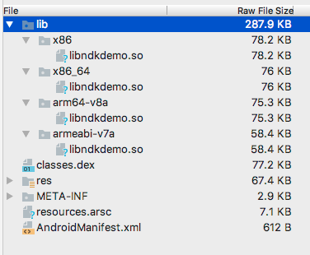
Reduce APK size by reducing C/C++ artefacts
Supported ABIs
Disable C++ exception support
-fexceptions
Disable RTTI
-frtti
Strip debug symbols
-ffunction-sections
-fdata-sections
-fvisibility=hidden

Slide 13
Crash handling

Slide 14
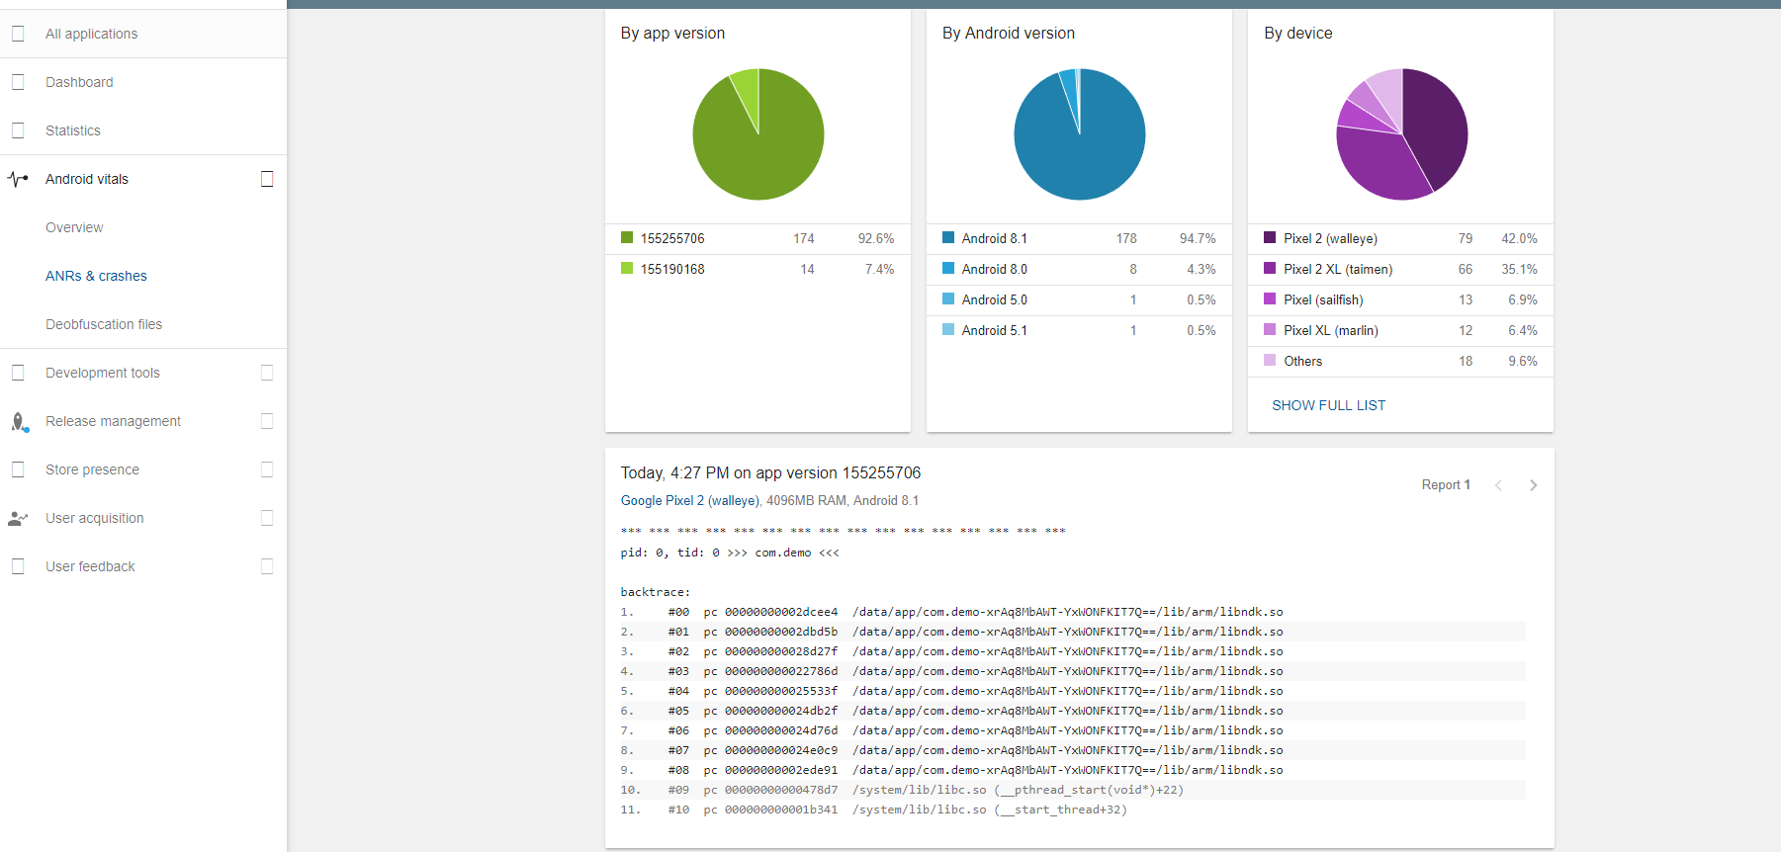

Slide 15
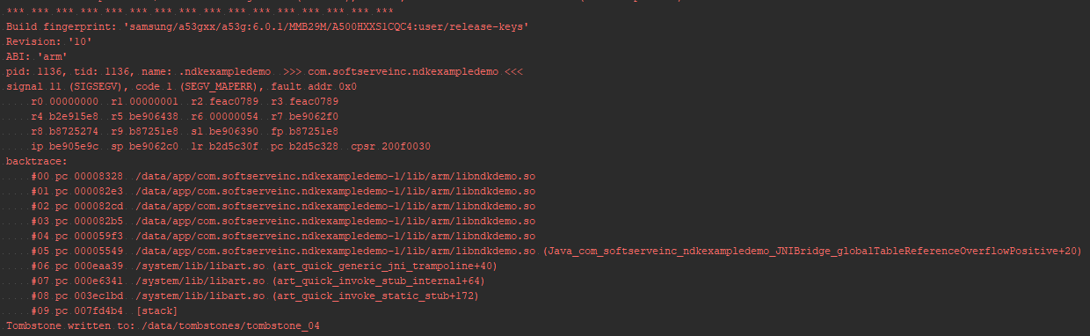
Crash handling

Slide 16
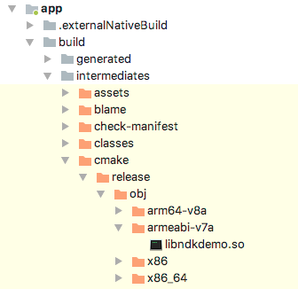
NDK tools
ndk-stack
backtrace
symbolic shared library
ndk-stack
Result stack

Slide 17
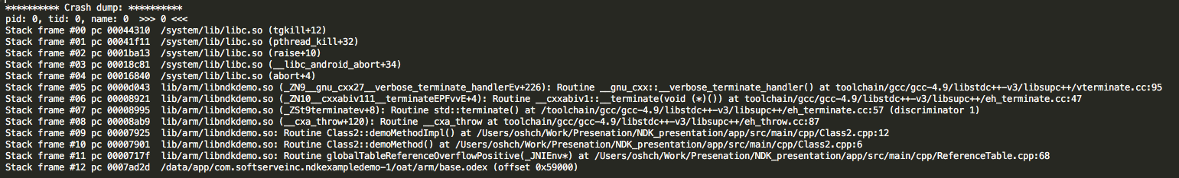
NDK tools

Slide 18
Own signal handler
static void on_signal (int sig, siginfo_t *siginfo, void *context) { printf ("Sending PID: %ld, UID: %ld\n", (long)siginfo->si_pid, (long)siginfo->si_uid); } void registerSignalHandler() { struct sigaction act; memset (&act, '\0', sizeof(act)); act.sa_sigaction = &on_signal; act.sa_flags = SA_SIGINFO; sigaction(SIGSEGV, &act, NULL); }

Slide 19
Constrains
Async-safety
all functions calls must be reentrant
Static storage duration
can’t pass state into the signal handler

Slide 20
Questions?
Thank you

