Slide 1
NDK: JNI crashes, errors and common mistakes

Slide 2
Plan
Introduction
JNI table reference counting
Working with NDK native threads
Exception Handling
Different linking issues
Reduce the size of native libs
NDK crash handling and NDK tools
- Welcome to Native world -- Introduction -- Project specific: Android, Java, C++. Why we need NDK? | - Common JNI/NDK problems -- JNIEnv, JavaVM variable issues -- Local table reference overflow -- Global table reference overflow -- JNI Thread issues. Attaching/Detaching ndk threads. -- Examples | - Exception Handling -- Handle exception from Java side -- Handle exception from JNI -- Handle C++ exception. How to enable it -- Examples | - NDK crash handling -- cmake/mk file configuration -- strip debug symbols -- ndk tools -- how desymbolicate crash log -- C++/NDK crash handling -- restrictions -- Examples

Slide 3
Why we use NDK/JNI?
Legacy support
Security, performance solutions
Low-level platform specific API
C++ cross-platform solutions
Android Java Layer
JNI Layer
C/C++ Core
Win desktop C++
iOS Objective-C
MacOS Objective-C

Slide 4
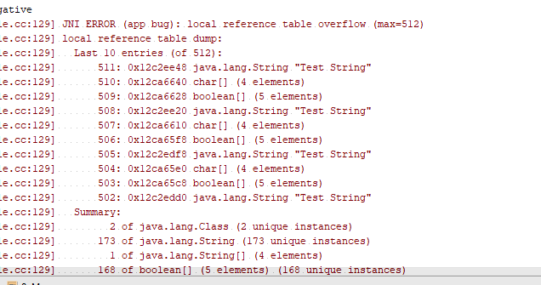

Local and Global References
JNI reference types: LocalRef, GlobalRef
JNI local table reference overflow
JNI global table reference overflow

Slide 5
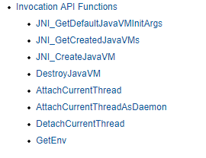
Native threads
What is Invocation API?
Do not forget to attach native thread to the JVM

Slide 6


Linker problems
Java obfuscation
Java
C++

Slide 7
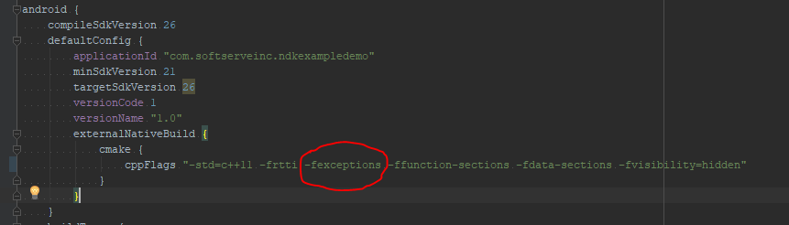
Exception handling
C++ exception support
Pending exception from Java side
Throw exception from C++

Slide 8
Reduce APK size by reducing C/C++ artefacts
Disable C++ exception support
Disable RTTI
Strip debug symbols

Slide 9
Crash handling
Google Developer Console example

Slide 10
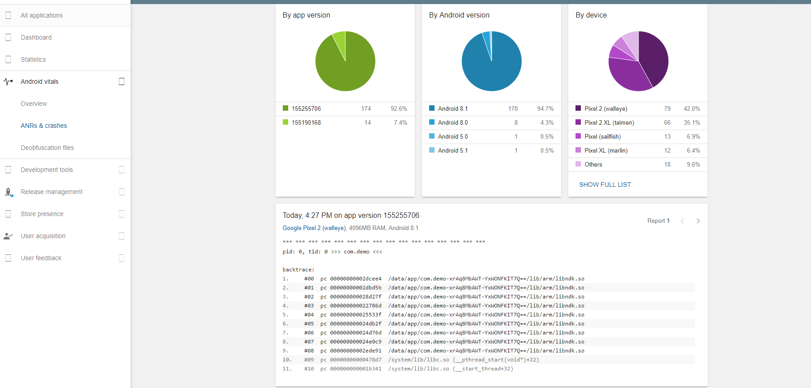

Slide 11
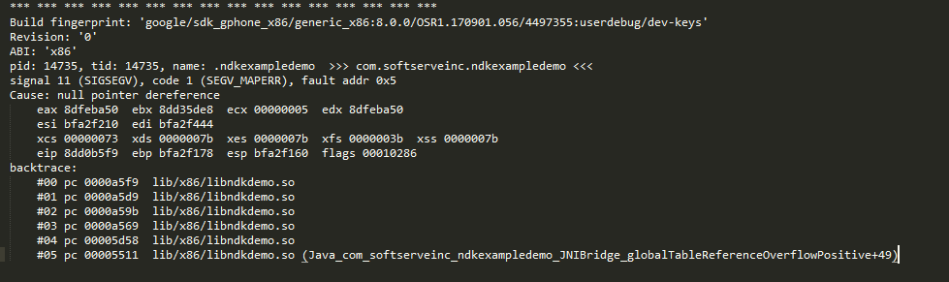
Crash handling
NDK tools: ndk-stak

Slide 12
Questions ?

Slide 13
Thank you

