Slide 1
NDK: JNI crashes, errors and common mistakes

Slide 2
Plan
Introduction
JNI table reference counting
Working with NDK native threads
Exception Handling
Different linking issues
Reduce the size of native libs
NDK crash handling and NDK tools

Slide 3

What is NDK?
The Android NDK is a toolset that lets you implement parts of your app in native code, using languages such as C and C++. For certain types of apps, this can help you reuse code libraries written in those languages.

Slide 4
Why we use NDK/JNI?
Legacy support
Security, performance solutions
Low-level platform specific API
C++ cross-platform solutions
Android Java Layer
JNI Layer
Win desktop C++
C/C++ Core
Win mobile C++
iOS Objective-C
MacOS Objective-C

Slide 5
Common mistakes

Slide 6
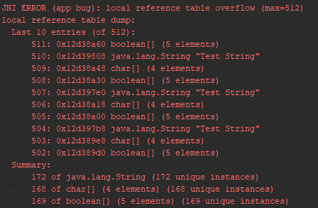
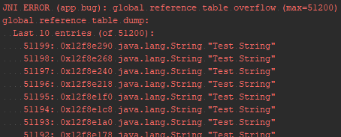
Local and Global References
JNI reference types: LocalRef, GlobalRef
JNI local table reference overflow
JNI global table reference overflow
Android 8.0 improvements
Notes:
In Android versions prior to Android 8.0, the number of local references is capped at a version-specific limit. Beginning in Android 8.0, Android supports unlimited local references
Також собі

Slide 7
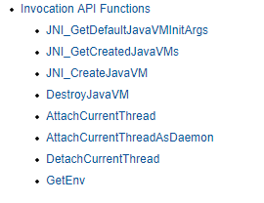
Native threads
What is Invocation API?
Thread local references.
Do not forget to attach native thread to the JVM

Slide 8
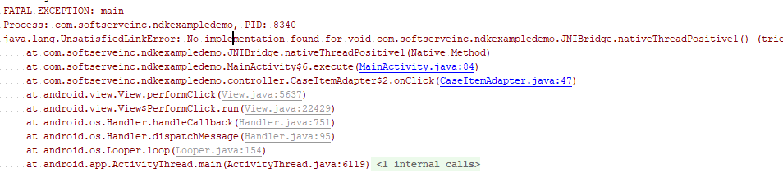


Linker problems
C linkage
Java obfuscation: ProGuard, DexGuard
extern "C" // JNI Functions }
Notes:
Можливі проблеми лінковки Java – JNI
Проблеми завантаження бібліотек: extern C, сігнатура функцій, рефакторінг
Обфускація proguard

Slide 9
Other typical mistakes
UTF-8 and UTF-16 strings
Caching method IDs, field IDs, and classes
Not checking for exceptions

Slide 10
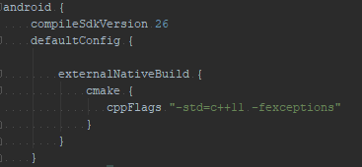
Exception handling
C++ exception support
-fexceptions

Slide 11
JNI exception handling
Pending exception:
Throw exception to Java via:
env->ExceptionCheck(); env->ExceptionClear();
env->ThrowNew(jclass clazz, const char* message); env->Throw(jthrowable obj);

Slide 12
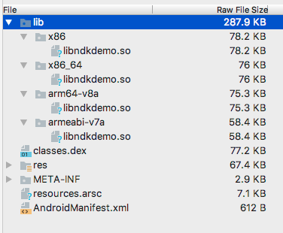
Reduce APK size by reducing C/C++ artefacts
Supported ABIs
Disable C++ exception support
-fexceptions
Disable RTTI
-frtti
Strip debug symbols
-ffunction-sections
-fdata-sections
-fvisibility=hidden

Slide 13
Crash handling

Slide 14
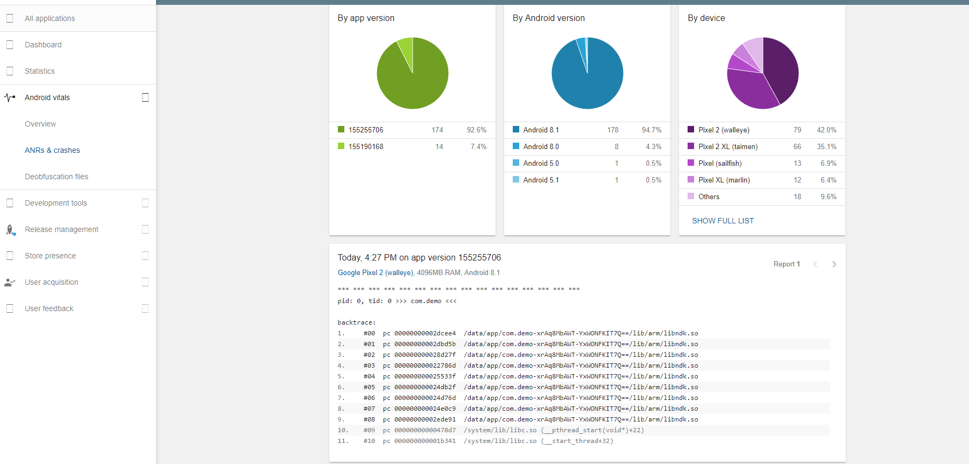

Slide 15
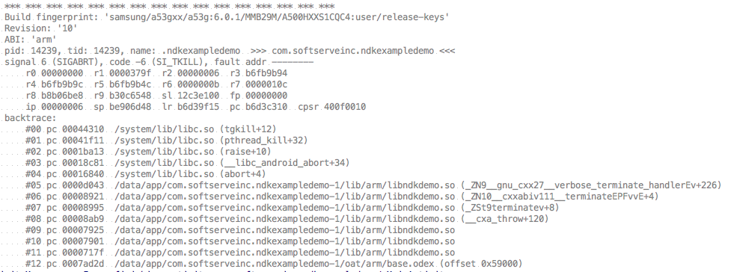
Crash handling

Slide 16
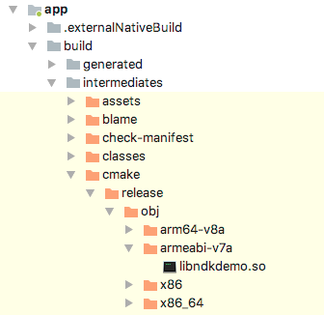
NDK tools
ndk-stack
backtrace
symbolic shared library
ndk-stack
Result stack

Slide 17
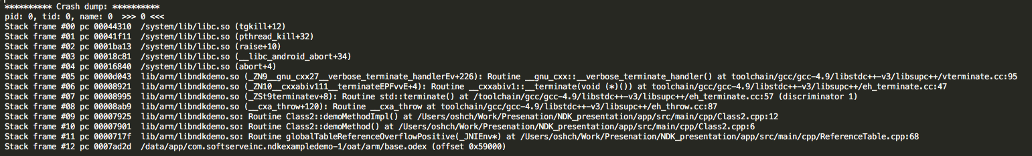
NDK tools

Slide 18
Own signal handler
static void on_signal (int sig, siginfo_t *siginfo, void *context) { printf ("Sending PID: %ld, UID: %ld\n", (long)siginfo->si_pid, (long)siginfo->si_uid); } void registerSignalHandler() { struct sigaction act; memset (&act, '\0', sizeof(act)); act.sa_sigaction = &on_signal; act.sa_flags = SA_SIGINFO; sigaction(SIGSEGV, &act, NULL) < 0) }

Slide 19
Questions ?

Slide 20
Thank you

Slide 21
Temporary.
- Welcome to Native world -- Introduction -- Project specific: Android, Java, C++. Why we need NDK? | - Common JNI/NDK problems -- JNIEnv, JavaVM variable issues -- Local table reference overflow -- Global table reference overflow -- JNI Thread issues. Attaching/Detaching ndk threads. -- Examples | - Exception Handling -- Handle exception from Java side -- Handle exception from JNI -- Handle C++ exception. How to enable it -- Examples | - NDK crash handling -- cmake/mk file configuration -- strip debug symbols -- ndk tools -- how desymbolicate crash log -- C++/NDK crash handling -- restrictions -- Examples

