Slide 1
NDK: Crashes, errors and common mistakes

Slide 2
Plan

Slide 3
- Welcome to Native world -- Introduction -- Project specific: Android, Java, C++. Why we need NDK? | - Common JNI/NDK problems -- JNIEnv, JavaVM variable issues -- Local table reference overflow -- Global table reference overflow -- JNI Thread issues. Attaching/Detaching ndk threads. -- Examples | - Exception Handling -- Handle exception from Java side -- Handle exception from JNI -- Handle C++ exception. How to enable it -- Examples | - NDK crash handling -- cmake/mk file configuration -- strip debug symbols -- ndk tools -- how desymbolicate crash log -- C++/NDK crash handling -- restrictions -- Examples

Slide 4
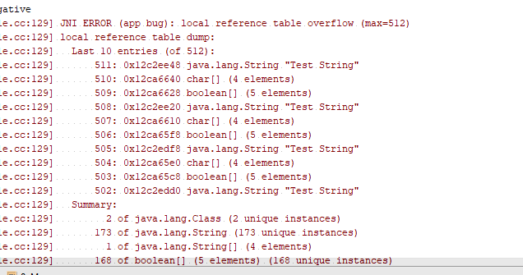

Local and Global References
JNI local table reference overflow
JNI global table reference overflow

Slide 5
Native threads

Slide 6
Exception handling

Slide 7
Reduce APK size by reducing C/C++ artefacts

Slide 8
Crash handling

Slide 9
Thank you

