Slide 1
NDK: JNI crashes, errors and common mistakes

Slide 2
Plan
Introduction
JNI table reference counting
Working with NDK native threads
Exception Handling
Different linking issues
Reduce the size of native libs
NDK crash handling and NDK tools

Slide 3

What is NDK?
The Android NDK is a toolset that lets you implement parts of your app in native code, using languages such as C and C++. For certain types of apps, this can help you reuse code libraries written in those languages.
The Java Native Interface (JNI) is a programming framework that enables Java code running in a Java Virtual Machine (JVM) to call and be called by native applications and libraries written in other languages such as C, C++ and assembly.

Slide 4
Why we use NDK/JNI?
Android Java
Legacy support
Security, performance solutions
Low-level platform specific API
C++ cross-platform solutions
JNI Layer
iOS Objective-C
Win Desktop C++
C/C++
Core
MacOS Objective-C
Win mobile C++

Slide 5
Common mistakes

Slide 6
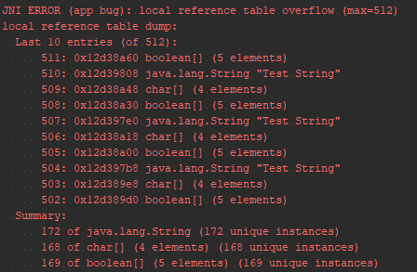
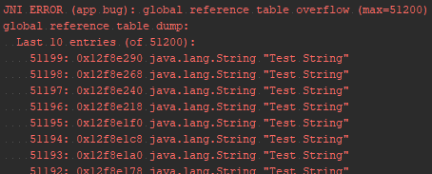
Local and Global References
JNI reference types
NewLocalRef, NewGlobalRef, NewWeakRef
Stashing objects without calling NewGlobalRef()
JNI local table reference overflow
JNI global table reference overflow
Android 8.0 improvements
for(int i = 0; i< 600; i++) { jstring testString = env->NewStringUTF("Test String"); jbooleanArray arrayB = env->NewBooleanArray(42); jcharArray arrayC = env->NewCharArray(42); // do something }
for(int i = 0; i< 100000; i++) { jstring testString = env->NewStringUTF("Test String"); jobject globalObject = env->NewGlobalRef(testString);
globalArray.push_back(globalObject); env->DeleteLocalRef(testString); }
Notes:
In Android versions prior to Android 8.0, the number of local references is capped at a version-specific limit. Beginning in Android 8.0, Android supports unlimited local references
Також собі

Slide 7
Native threads and Invocation API
JavaVM and JNIEnv
Attach native thread to the JVM
Thread local references.
All local references are accessible within one thread only
Invocation API
JNI_OnLoad
AttachCurrentThread
DetachCurrentThread
GetEnv

Slide 8
Linking problems
Runtime errors and exceptions:
JNI DETECTED ERROR IN APPLICATION
java.lang.UnsatisfiedLinkerError: No implementation found
java.lang.NoSuchMethodError: no method
C linkage
extern "C" {}
#define JNIEXPORT __attribute__ ((visibility ("default")))
Release mode and Java obfuscation
ProGuard, DexGuard
Library set
armeabi-v7a, arm64-v8a, x86, x86_64
Notes:
Можливі проблеми лінковки Java – JNI
Проблеми завантаження бібліотек: extern C, сігнатура функцій, рефакторінг
Обфускація proguard

Slide 9
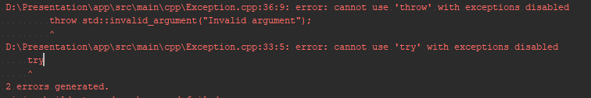
Exception handling
C++ exception support
-fexceptions
-fno-exceptions
android { compileSdkVersion 26 defaultConfig { applicationId "com.softserveinc.ndkexampledemo" minSdkVersion 21 targetSdkVersion 26 versionCode 1 versionName "1.0" externalNativeBuild { cmake { cppFlags "-std=c++11 -fexceptions" } } }

Slide 10
JNI exception handling
env->CallStaticVoidMethod(clazz, nativeCallbackWithException); if(env->ExceptionCheck()) {
jthrowable exception = env->ExceptionOccurred();
//Clear exception and only then parse it env->ExceptionClear();
jclass throwable_class = env->FindClass("java/lang/Throwable"); // Parse exception ...... }
Java pending exception:
env->ExceptionCheck();
env->ExceptionClear();
env->ExceptionOccurred();
Throw exception to Java:
env->ThrowNew(jclass clazz, const char* message);
env->Throw(jthrowable obj);
try { throw std::invalid_argument("Invalid argument"); } catch (const std::exception & exception) { jclass exClass = env->FindClass("java/lang/IllegalArgumentException"); env->ThrowNew(exClass, exception.what());
// Still here … }

Slide 11
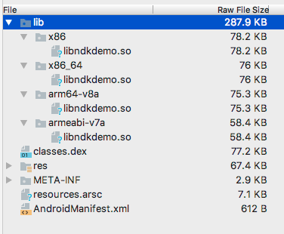
Reduce APK size by reducing C/C++ artefacts
Supported ABIs
Disable C++ exception support
-fno-exceptions
Disable RTTI
-frtti /-fno-rtti
Strip debug symbols
-fvisibility=hidden
-ffunction-sections
-fdata-sections

Slide 12



Configure your build
android { defaultConfig { externalNativeBuild { cmake { cppFlags "-std=c++11 " + "-frtti -fexceptions " + "-ffunction-sections " + "-fdata-sections " + "-fvisibility=hidden" } } } }
# C++ flags SET(CMAKE_CXX_FLAGS "${CMAKE_CXX_FLAGS} -std=c++11") SET(CMAKE_CXX_FLAGS "${CMAKE_CXX_FLAGS} -frtti -fexceptions") SET(CMAKE_CXX_FLAGS "${CMAKE_CXX_FLAGS} -fvisibility=hidden") # C flags SET(CMAKE_C_FLAGS "${CMAKE_C_FLAGS} -O0 -fvisibility=hidden") # Debug/release SET(CMAKE_CXX_FLAGS_DEBUG "${CMAKE_CXX_FLAGS_DEBUG} .... ") SET(CMAKE_CXX_FLAGS_RELEASE "${CMAKE_CXX_FLAGS_RELEASE} ....") SET(CMAKE_C_FLAGS_RELEASE "${CMAKE_C_FLAGS_RELEASE} .... ")
build.gradle
CMakeList.txt
Application.mk
APP_CFLAGS := -fstack-protector-all, ... APP_CPPFLAGS := -fstack-protector-all, ... APP_LDFLAGS := -Wl,--gc-sections, --strip-debug

Slide 13
Crash handling

Slide 14
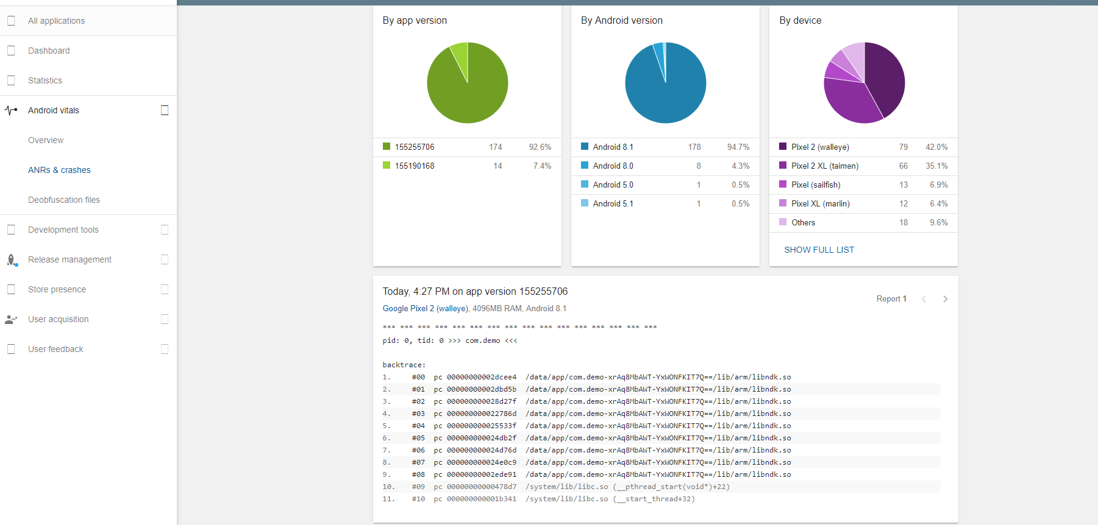

Slide 15
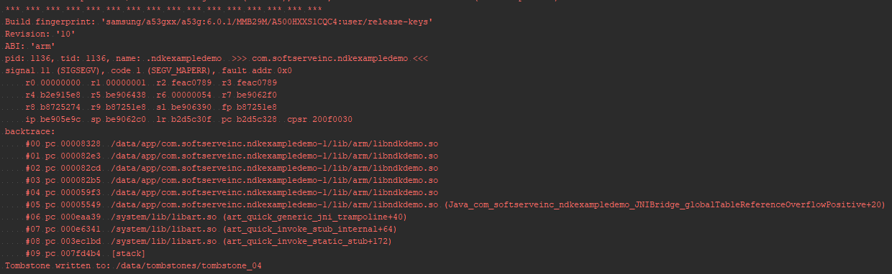
Crash handling

Slide 16
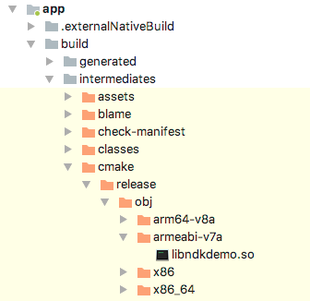
NDK tools
ndk-stack
backtrace
symbolic library
ndk-stack
Result stack

Slide 17
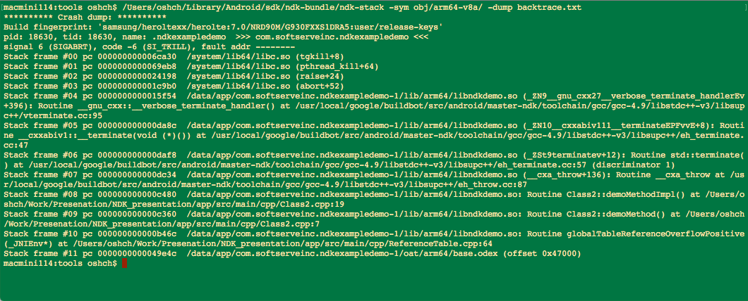
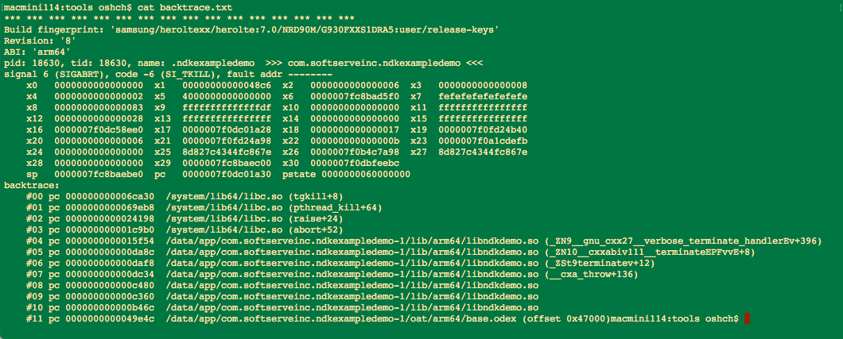
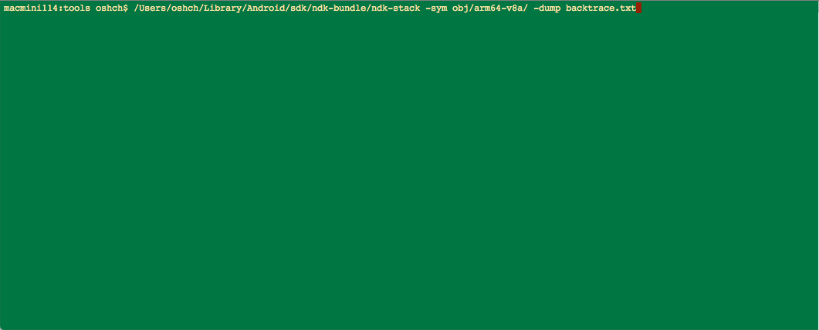
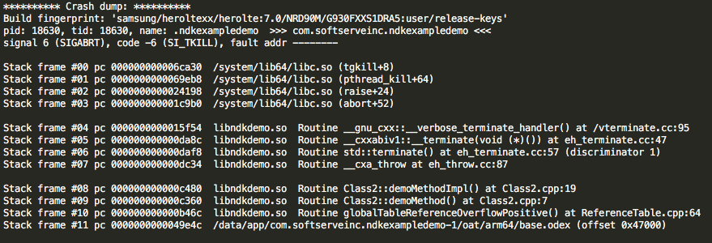
Results

Slide 18
Own signal handler
static void on_signal (int sig, siginfo_t *siginfo, void *context) { printf ("Sending PID: %ld, UID: %ld\n", (long)siginfo->si_pid, (long)siginfo->si_uid); } void registerSignalHandler() { struct sigaction act; memset (&act, '\0', sizeof(act)); act.sa_sigaction = &on_signal; act.sa_flags = SA_SIGINFO; sigaction(SIGSEGV, &act, NULL); }

Slide 19
Constrains
Async-safety
all functions calls must be reentrant
can‘t allocate any memory
Static storage duration
can’t pass state into the signal handler

Slide 20
Questions?
Thank you

