Slide 1
NDK: JNI crashes, errors and common mistakes

Slide 2
Plan
- Welcome to Native world -- Introduction -- Project specific: Android, Java, C++. Why we need NDK? | - Common JNI/NDK problems -- JNIEnv, JavaVM variable issues -- Local table reference overflow -- Global table reference overflow -- JNI Thread issues. Attaching/Detaching ndk threads. -- Examples | - Exception Handling -- Handle exception from Java side -- Handle exception from JNI -- Handle C++ exception. How to enable it -- Examples | - NDK crash handling -- cmake/mk file configuration -- strip debug symbols -- ndk tools -- how desymbolicate crash log -- C++/NDK crash handling -- restrictions -- Examples

Slide 3
Why we use NDK/JNI?
Legacy support
Security, performance solutions
Low-level platform specific API
C++ cross-platform solutions
Android Java Layer
JNI Layer
C/C++ Core
Win desktop C++
iOS Objective-C
MacOS Objective-C

Slide 4
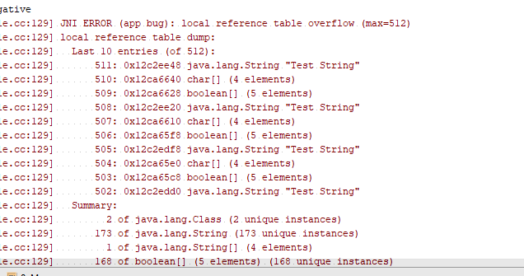

Local and Global References
JNI local table reference overflow
JNI global table reference overflow

Slide 5
Native threads
Do not forget to attach native thread to the JVM

Slide 6
Linker problems
Java obfuscation
Java
C++

Slide 7
Exception handling
How to enable C++ exception support

Slide 8
Reduce APK size by reducing C/C++ artefacts

Slide 9
Crash handling

Slide 10
Thank you

