Slide 1

MTS382 Database Systems and Applications

Slide 2
DBMS (DataBase Management System)

Slide 3








DBMS (DataBase Management System)

Slide 4

DBMS (DataBase Management System)
APP
User
APP
SQL
DBMS

Slide 5
Advantages:
Easy to set up and use.
No installation required.
Suitable for small to medium-sized databases.
High performance.
ACID-compliant.
Use Cases:
Mobile applications.
Embedded systems.
Prototyping and testing.
Features:
Lightweight.
Transactional.
Cross-platform.
Public domain license.
Notes:
Atomicity, Consistency, Isolation, and Durability.
ACID compliance ensures that database transactions are reliable, consistent, and durable,
even in the face of errors, system failures, or concurrent access by multiple users.
It is a fundamental concept in database systems design and is essential for maintaining data integrity and reliability.

Slide 6
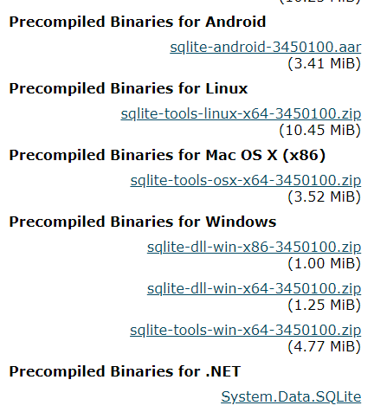
Download
https://www.sqlite.org/download.html
Click to download:
sqlite-tools-win32-x86-3450100.zip

Slide 7

Extract

Slide 8
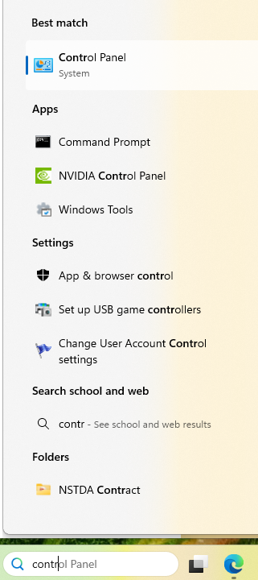
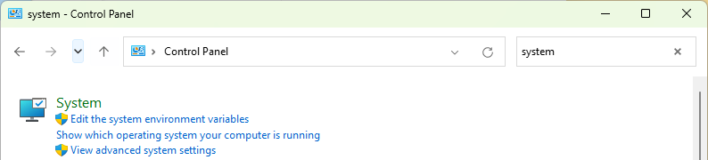
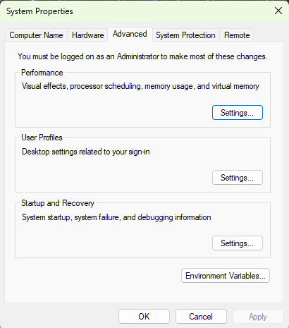
PATH environment
2
select “control Panel”
3
Search “system”
4
select
5
Click
1
Search “control Panel”

Slide 9
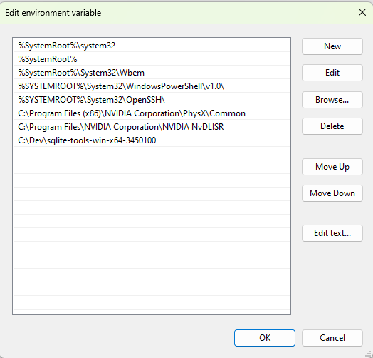
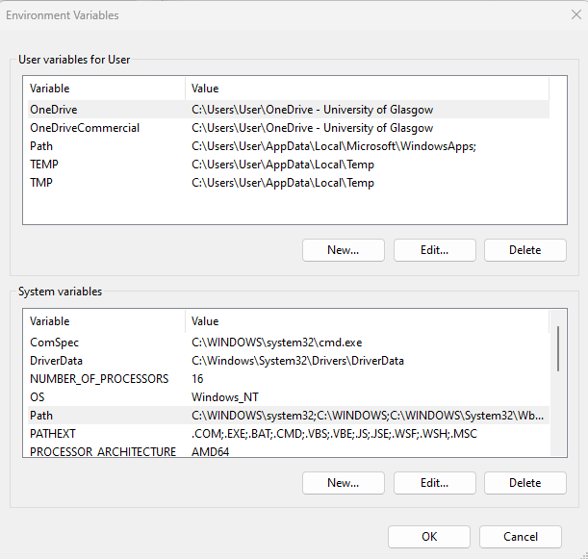
PATH environment
2
Double Click to add SQLite path
Click
1
Click
3

Slide 10
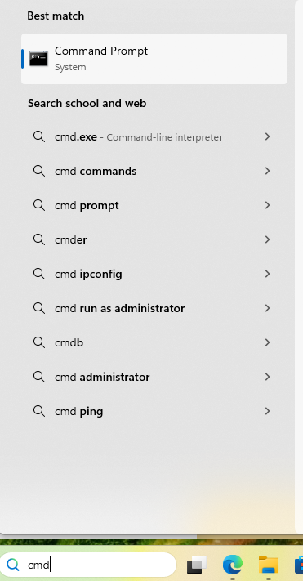
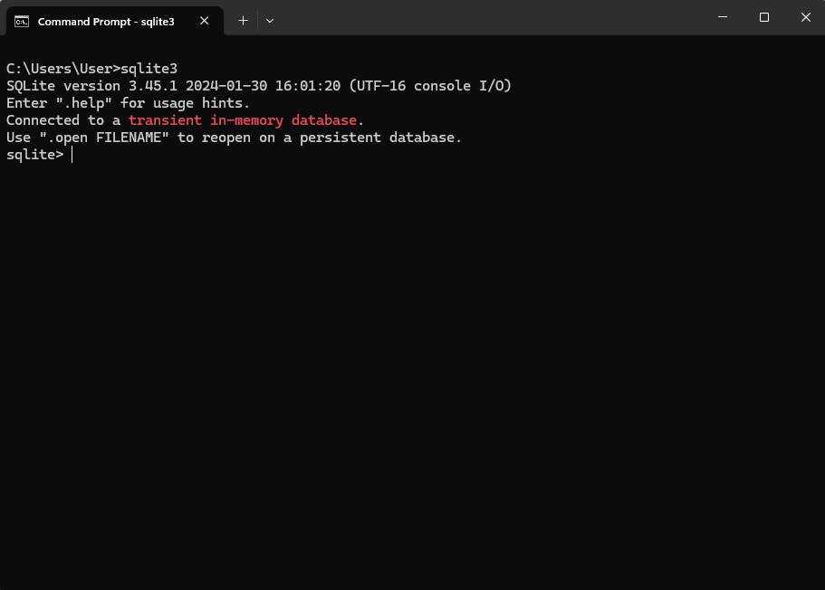
Hello SQLite
3
“sqlite3”
2
select “command prompt”
1
Search “cmd”

Slide 11
Commands
.help Show help text for PATTERN
.quit Stop interpreting input stream, exit if primary
.open ?FILE? Close existing database and reopen FILE
.databases List names and files of attached databases

Slide 12

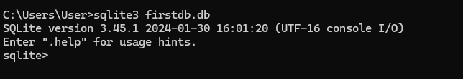
Create Database

Slide 13
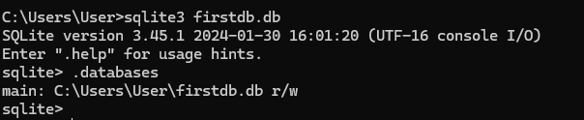
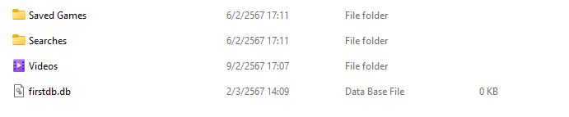
.databases

Slide 14
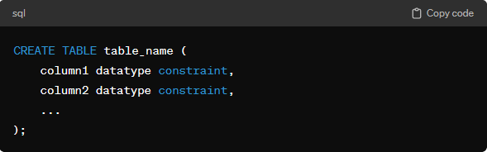
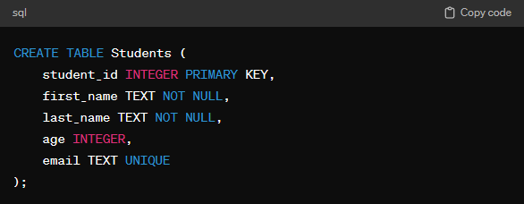
Create Tables

Slide 15
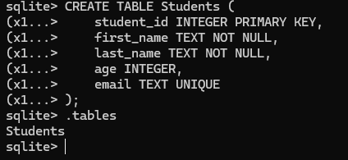
.tables

Slide 16
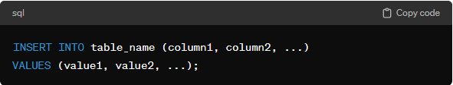
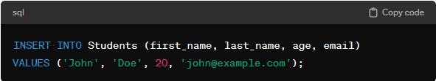
INSERT INTO Statement:

Slide 17


Basic SQL Queries: (SELECT Statement)

Slide 18
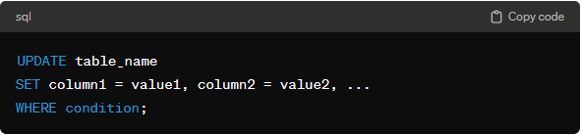
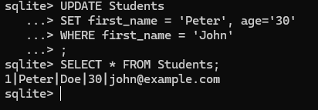
UPDATE Statement:

Slide 19


DELETE FROM Statement:

Slide 20


DROP TABLE: Remove a table from the database.

Slide 21
Exercise 1:
Create a table named Employees with columns employee_id, first_name, last_name, and department.
Insert data for a few employees into the Employees table.
Select all data from the Employees table.
Select specific columns for employees from the Employees table.
Update the department for a specific employee in the Employees table.
Delete a specific employee from the Employees table.

Slide 22
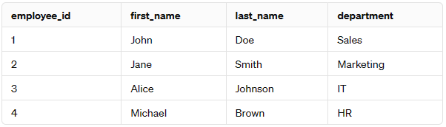
Exercise 1:

Slide 23
Exercise 1:
-- Create Employees table
CREATE TABLE Employees (
employee_id INTEGER,
first_name VARCHAR(50),
last_name VARCHAR(50),
department VARCHAR(50)
);
-- Insert data into Employees table
INSERT INTO Employees (employee_id, first_name, last_name, department) VALUES (1, 'John', 'Doe', 'Sales');
INSERT INTO Employees (employee_id, first_name, last_name, department) VALUES (1,'Jane', 'Smith', 'Marketing');
INSERT INTO Employees (employee_id, first_name, last_name, department) VALUES (2,'Alice', 'Johnson', 'IT');
INSERT INTO Employees (employee_id, first_name, last_name, department) VALUES (2, 'Michael', 'Brown', 'HR');

Slide 24
Exercise 1:
What if?
-- Create Employees table
CREATE TABLE Employees (
employee_id INTEGER PRIMARY KEY,
first_name VARCHAR(50),
last_name VARCHAR(50),
department VARCHAR(50)
);

Slide 25
DB Browser for SQLite
the DB Browser for SQLite

Slide 26
DB Browser for SQLite
Create and compact database files
Create, define, modify and delete tables
Create, define, and delete indexes
Browse, edit, add, and delete records
Search records
Import and export records as text
Import and export tables from/to CSV files
Import and export databases from/to SQL dump files
Issue SQL queries and inspect the results
Examine a log of all SQL commands issued by the application
Plot simple graphs based on table or query data

Slide 27
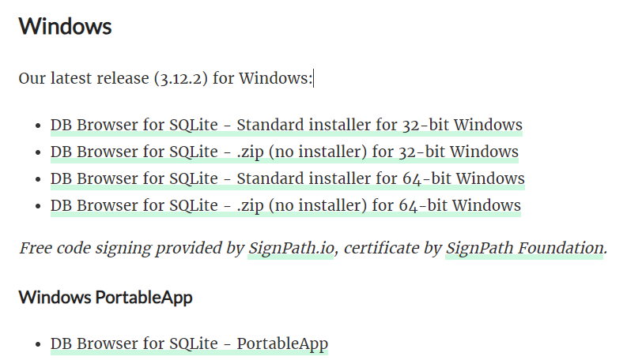
Downloads
https://sqlitebrowser.org/

Slide 28
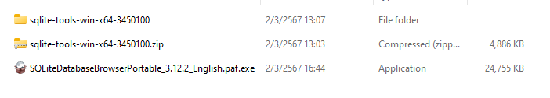
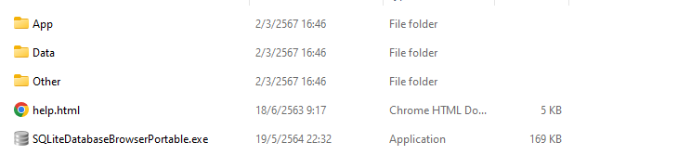
Installation:
Double click & install

Slide 29
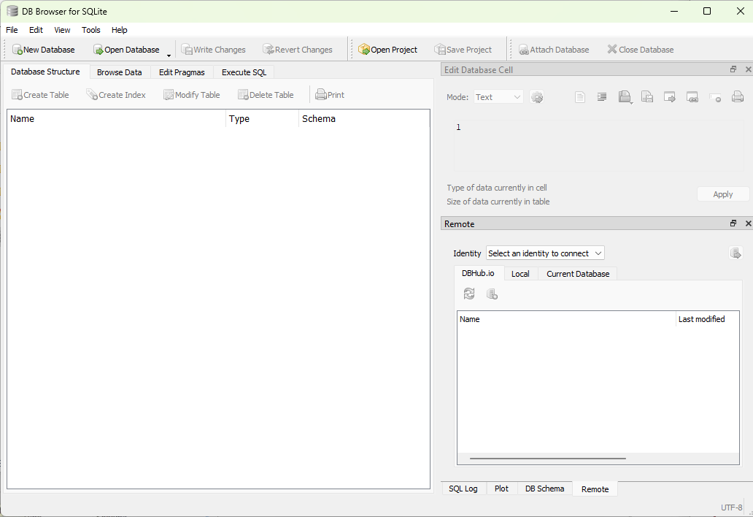
DB Browser for SQLite

Slide 30
DB Browser for SQLite (Create Database)
1
New database

Slide 31
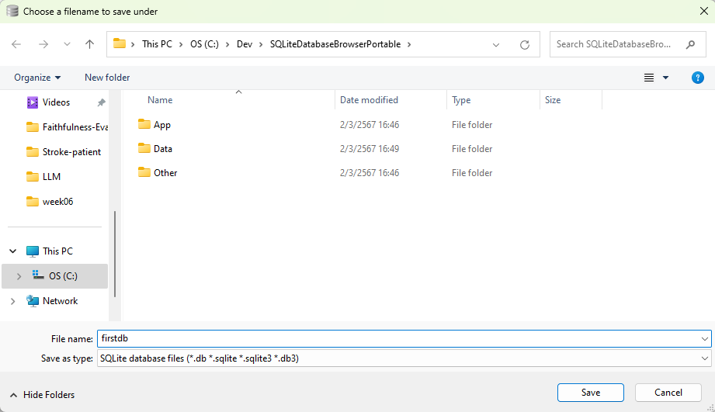
DB Browser for SQLite (Create Database)
2
Database name
3
save

Slide 32
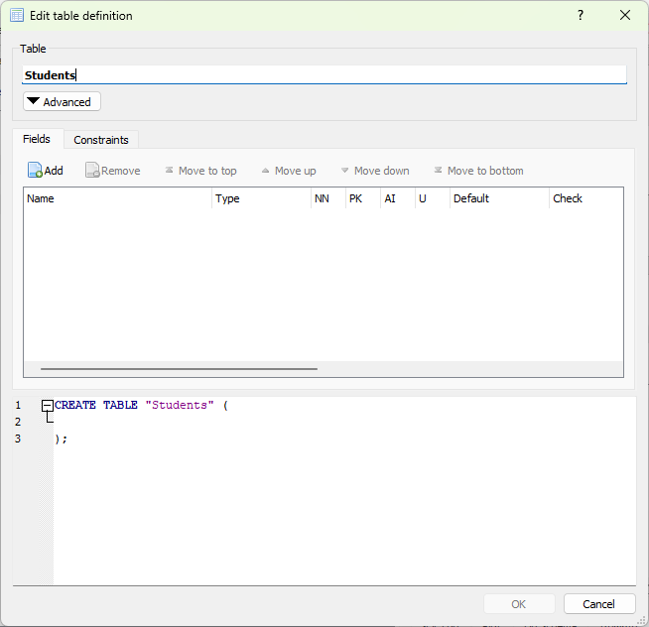
DB Browser for SQLite (Create Table)
1
Table name

Slide 33
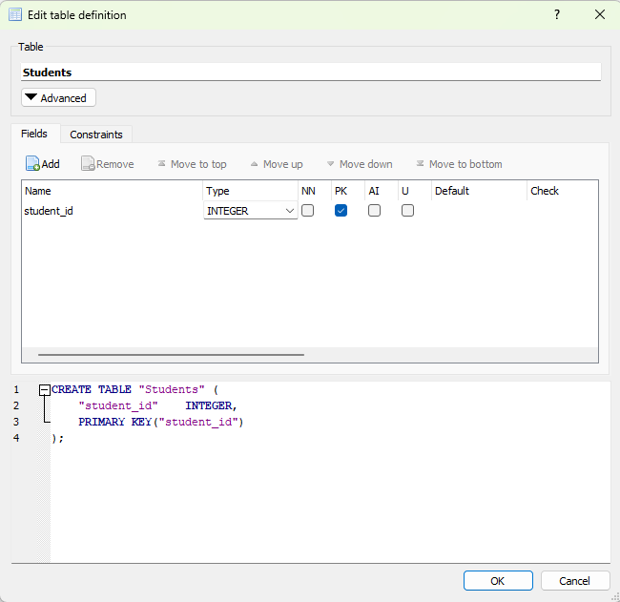
DB Browser for SQLite (Create Table)
Add
2
2
Attribute

Slide 34
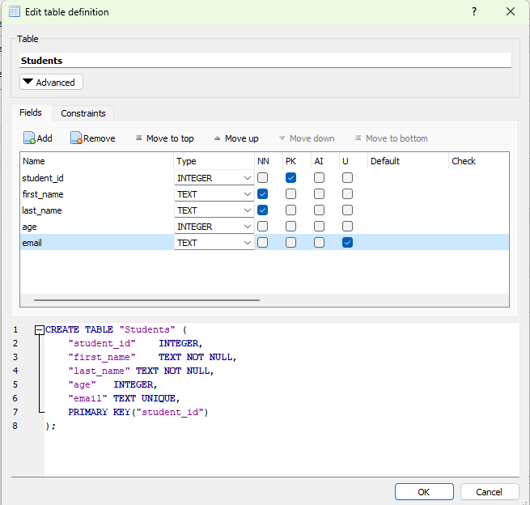
DB Browser for SQLite (Create Table)
2
3
OK

Slide 35
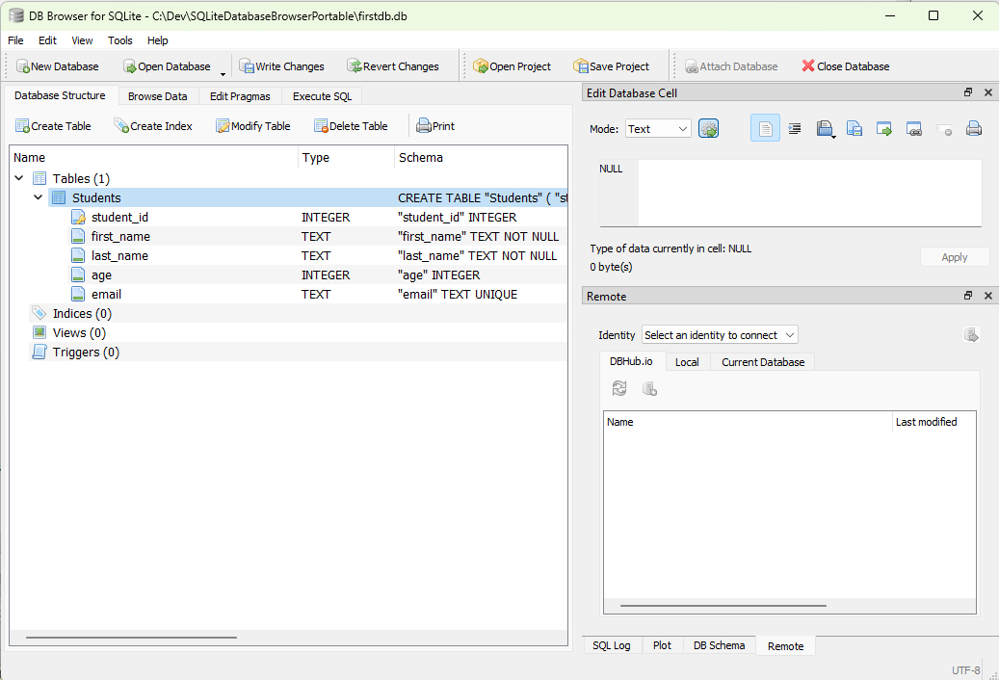
DB Browser for SQLite

Slide 36
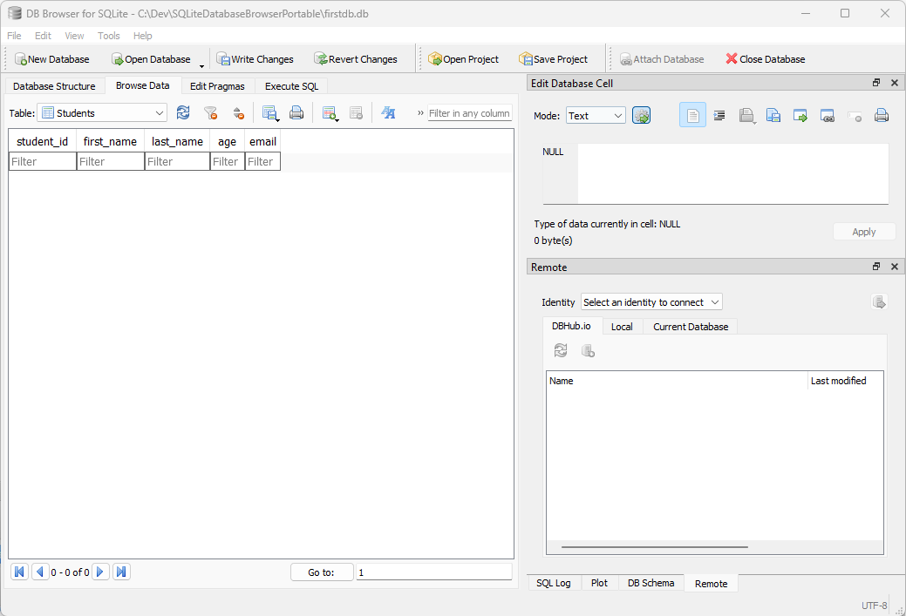
DB Browser for SQLite (Browse Data)
1
Click at Browse Data
2
Click to add new record

Slide 37
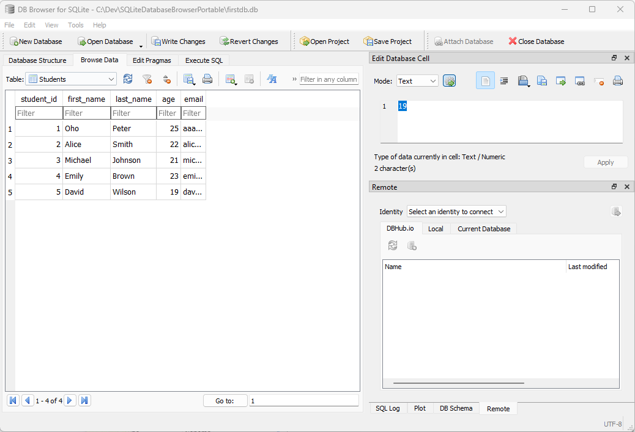
DB Browser for SQLite (Browse Data)
3

Slide 38
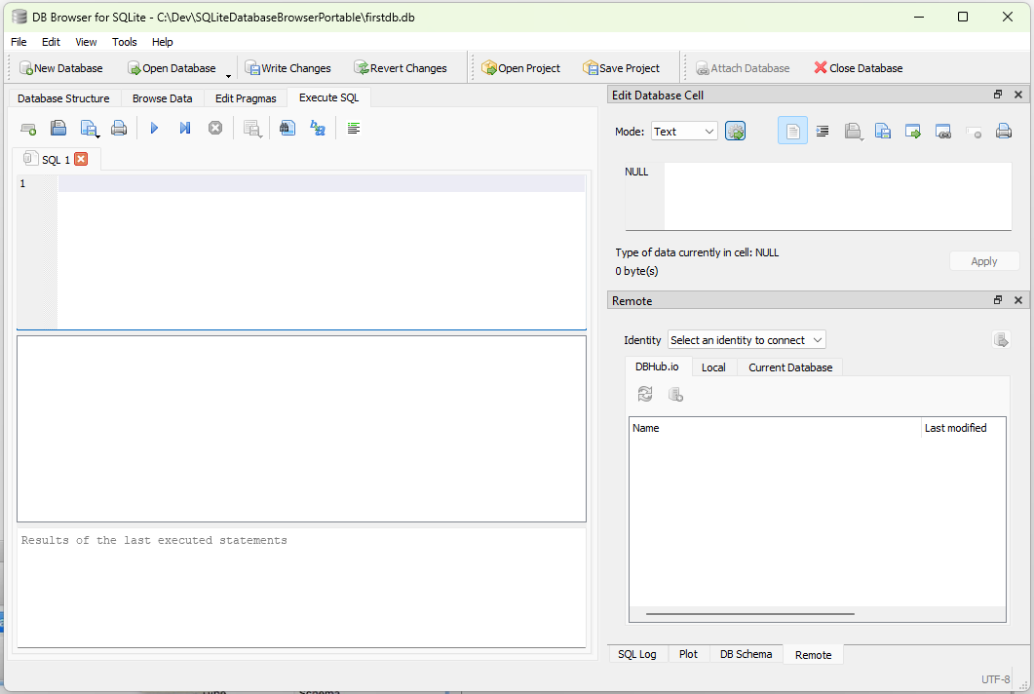
DB Browser for SQLite (Execute SQL)
1
Execute SQL

Slide 39
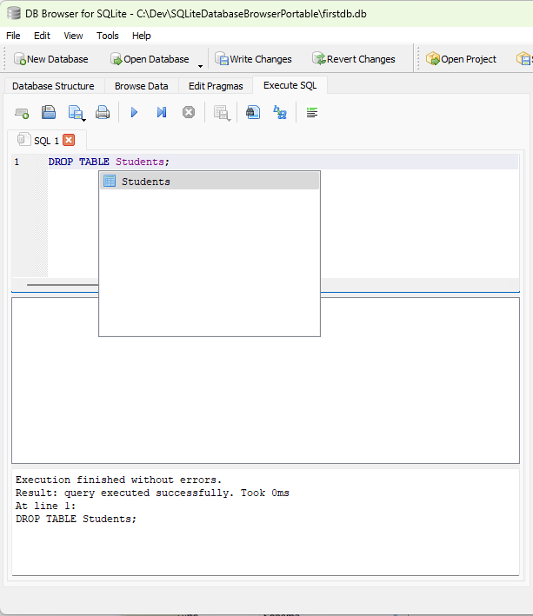
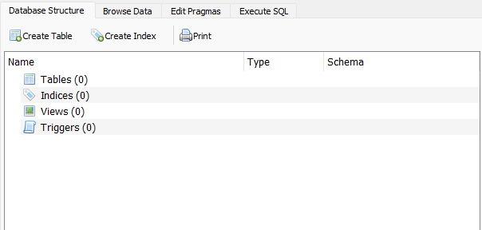
DB Browser for SQLite (Drop Table)
2
Run
1
Drop Table
3
Results

Slide 40
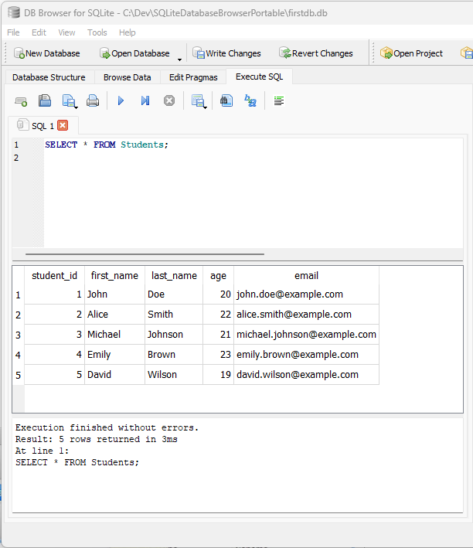
Exercise 2:
Using Browser for SQLite:
Create Table
Insert Data
Update/Delete

Slide 41
Why do we still need to learn SQL instead of using GUI tools?

Slide 42
Learning SQL:
Understanding Database Concepts
Portability
Fine-tuning Queries
Complex Operations
Scripting and Automation
Troubleshooting and Debugging
Flexibility and Control
Career Opportunities

Slide 43
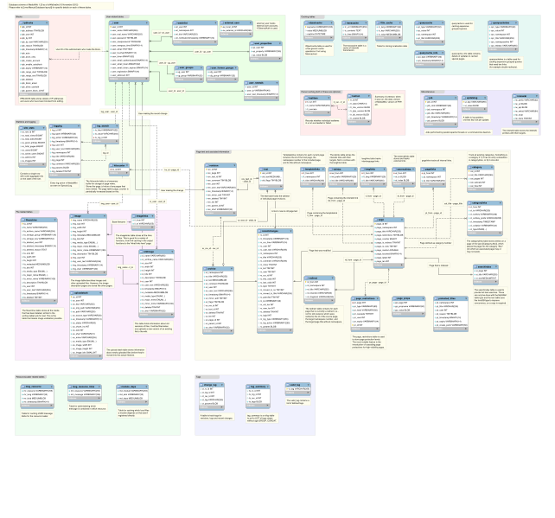

Slide 44
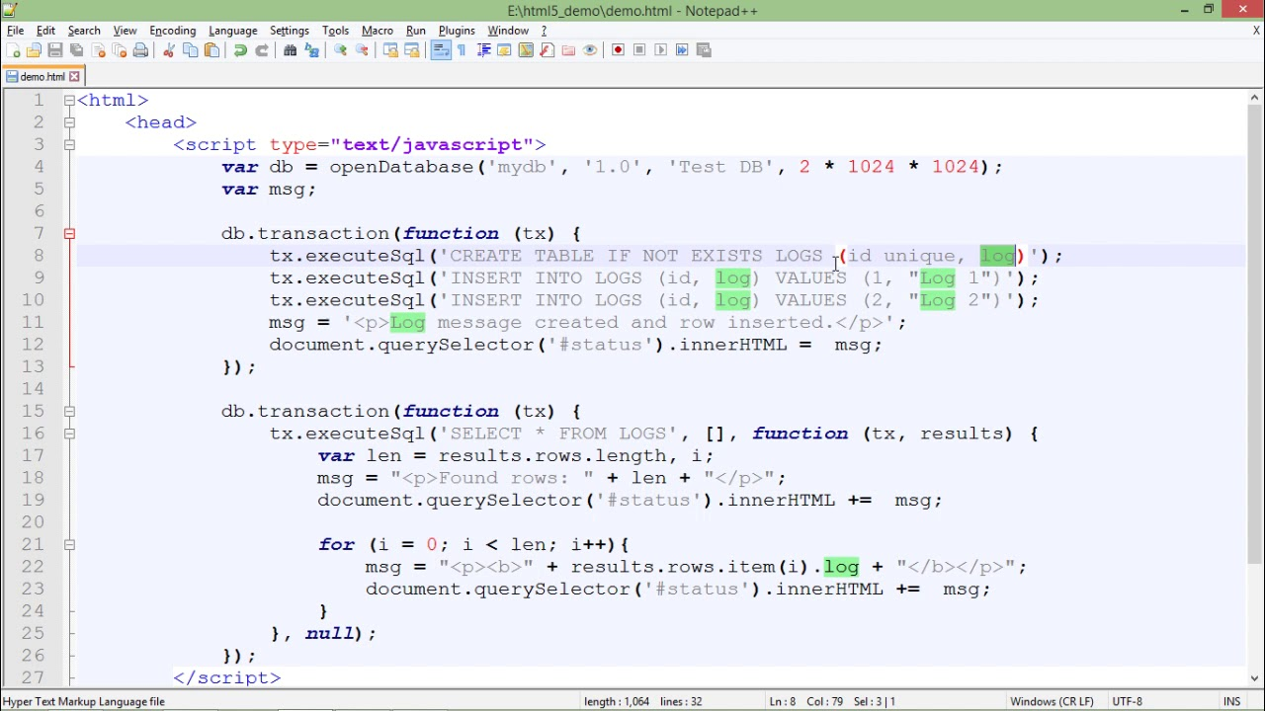

Slide 45
Create Relation

Slide 46
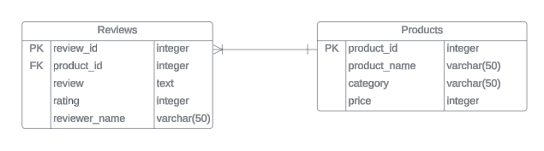
LAB: Create Relation
1. create a database named “CreateRelation”
2. From the given logical design of the relational database, type the SQL command to create REVIEWS and PRODUCTS. Save the CREATE TABLE command in a notepad to reuse the code.

Slide 47
LAB 2: Create Relation
3. After successfully create PRODUCTS relation, type the following command to insert sample data into PRODUCTS relation.
CREATE TABLE PRODUCTS(
);
INSERT INTO PRODUCTS VALUES(1,'Laptop', 'Electronics', 1200);
INSERT INTO PRODUCTS VALUES(2,'Running Shoes', 'Sports', 80);
INSERT INTO PRODUCTS VALUES(3,'Coffee Maker', 'Kitchen Appliances', 50);

Slide 48
LAB 2: Create Relation
3. After successfully create REVIEWS relation, type the following command to insert sample data into REVIEWS relation.
CREATE TABLE REVIEWS (
);
INSERT INTO REVIEWS VALUES(1, 1, 'Great product, very satisfied with the quality.', 5, 'John Doe');
INSERT INTO REVIEWS VALUES(2, 1, 'Could be better, but still a decent product.', 3, 'Jane Smith');
INSERT INTO REVIEWS VALUES(3, 2, 'Excellent service and fast delivery.', 5, 'Alice Johnson');
INSERT INTO REVIEWS VALUES(4, 3, 'Works as expected, good value for the price.', 4, 'Michael Brown');

Slide 49

LAB 2: Create Relation
Delete REVIEWS relation
Type SQL command to drop REVIEW relation and press button on the tool bar.
After executing the DROP TABLE command for the aircraft, the DBMS show a success execution of the statement in the Status window. The example is shown below:
DROP TABLE ;

Slide 50
LAB 2: Create Relation
Assignment 1
After executing DROP TABLE command for REVIEWS relation, can the relation be successfully deleted? If not, specify the error shown in the Status window.
Answer:

Slide 51
LAB 2: Create Relation
Assignment 2
DELETE PRODUCTS relation
Before deleting PRODUCTS relation, type CREATE TABLE command for REVIEWS relation and insert records into the relation again.
Type the command DROP TABLE PRODUCTS; and execute the command.
Assignment 2
After executing DROP TABLE command for PRODUCTS relation, there is an error shown in the Status window.
Describe the reason of the error when deleting the PRODUCTS relation.
Answer:

Slide 52
LAB 2: Create Relation
Deleting relation with dependency
The MODEL relation has a dependency to the REVIEWS relation through the foreign key product_id in the
PRODUCTS relation. If the PRODUCTS is deleted, the foreign key (product_id in REVIEWS) has no record to reference to.
Before deleting PRODUCTS relation, the foreign key must be disabled and the foreign key (product_id in
REVIEWS) must be properly refer to the valid record or value.
PRAGMA foreign_keys = OFF;
DROP TABLE PRODUCTS;
UPDATE REVIEWS SET product_id = NULL;
PRAGMA foreign_keys = ON;

