Slide 1
BAS240 Data Analytics Programming
LAB 2:
Basic data exploration exercises
Hands-on practice with data types conversion

Slide 2
Exploring Data with Pandas

Slide 3
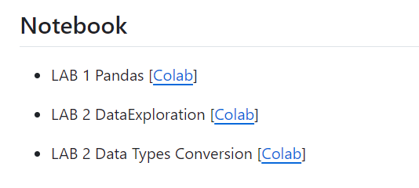
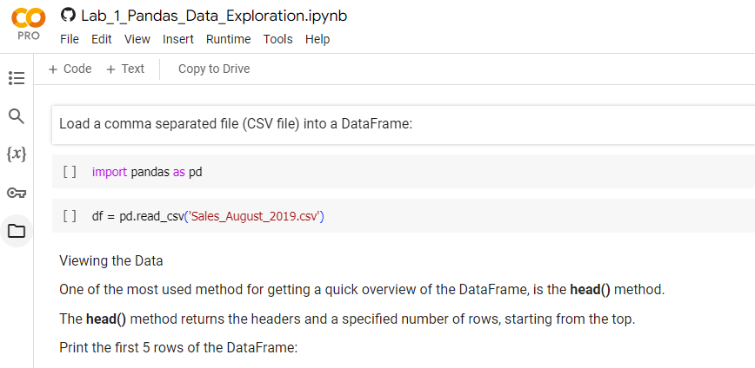
https://github.com/9meo/bas240/
1
Click to open
2
Copy to your drive

Slide 4
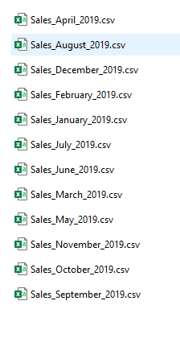
Loading Data into Colab
Download file:
https://github.com/9meo/bas240/raw/main/data/Sales_Data.zip
Extract:

Slide 5
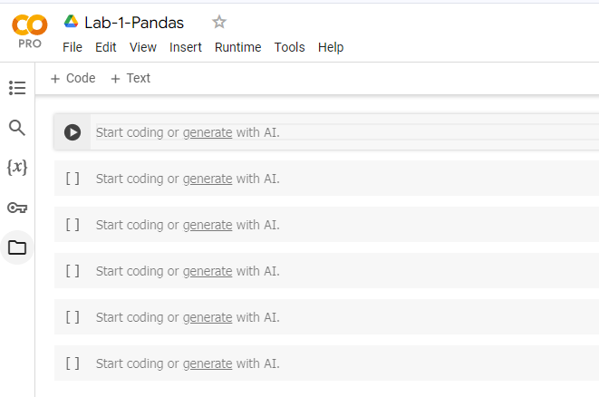
Loading Data into Colab
1
Click to expand

Slide 6
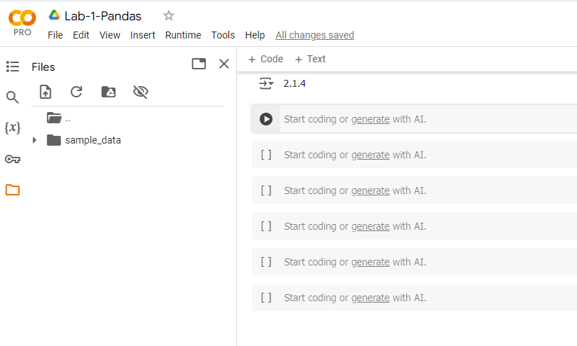
Loading Data into Colab
1
Click to upload

Slide 7
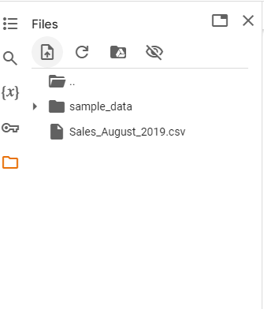
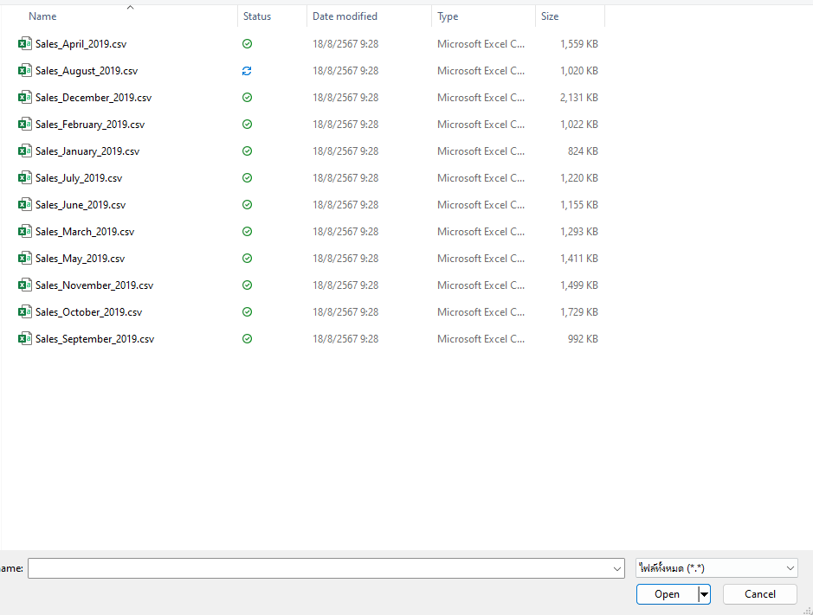
Browse & Select File to Upload
3
2
1
Uploaded file
Select file
Click to upload

Slide 8
Pandas data I/O
Pandas provides a high level interface to and from many file formats used in data science
.txt, csv, json , HTML, Excel(.xls xlsx ), pickle, HDF 5 , SQL, R,
For any given format, there is
A read_** function,
A to_** method attached to all Pandas data objects

Slide 9
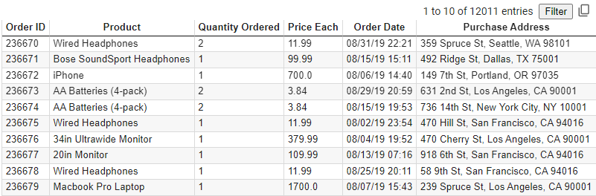
Read CSV Files
A simple way to store big data sets is to use CSV files (comma separated files).
CSV files contains plain text and is a well know format that can be read by everyone including Pandas.

Slide 10
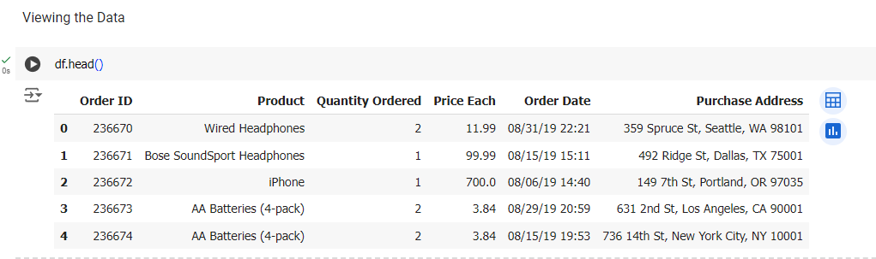
Viewing the Data
One of the most used method for getting a quick overview of the DataFrame, is the head() method.
The head() method returns the headers and a specified number of rows, starting from the top.

Slide 11
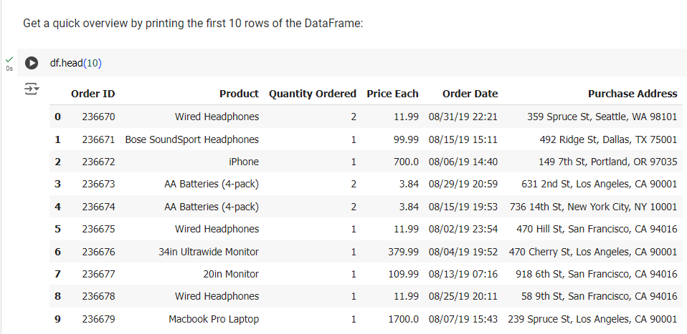

Slide 12
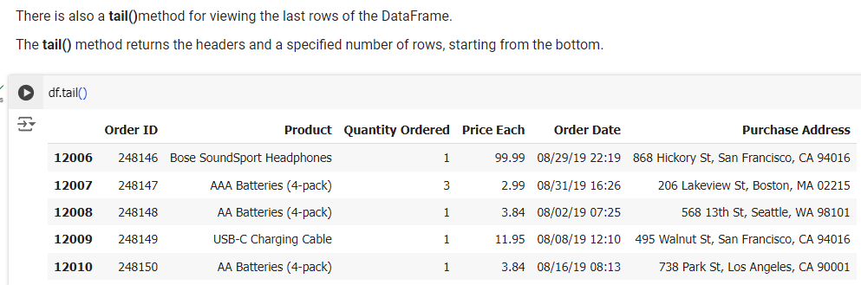
Viewing the Data

Slide 13
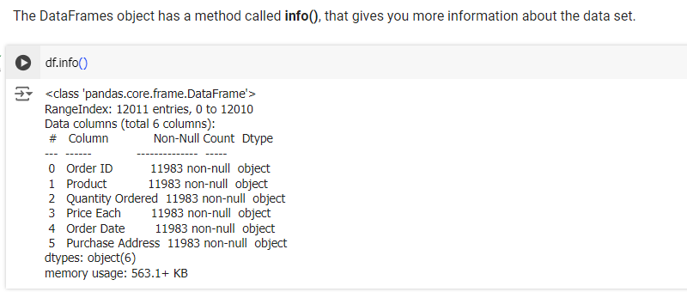
Info About the Data
The result tells us there are 12,011 rows and 6 columns:
And the name of each column, with the data type:
The info() method also tells us how many Non-Null values there are present in each column.
Empty values, or Null values, can be bad when analyzing data, and you should consider removing rows with empty values. This is a step towards what is called cleaning data.

Slide 14
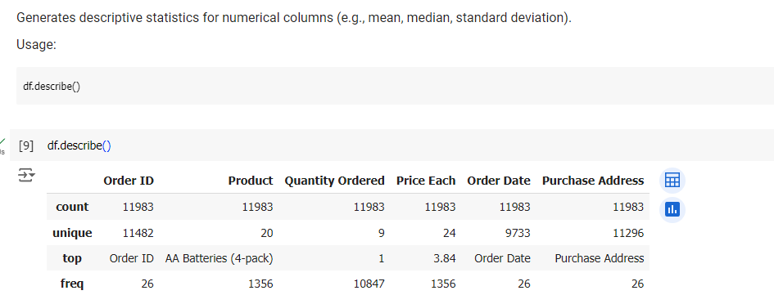
describe()

Slide 15
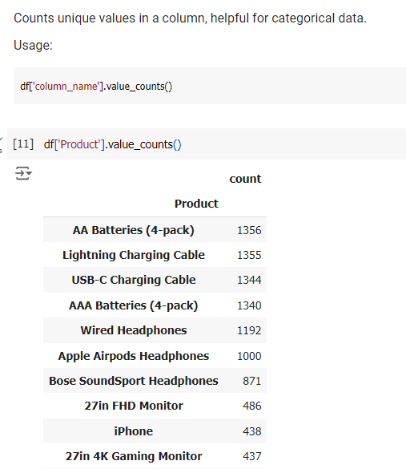
value_counts()

Slide 16
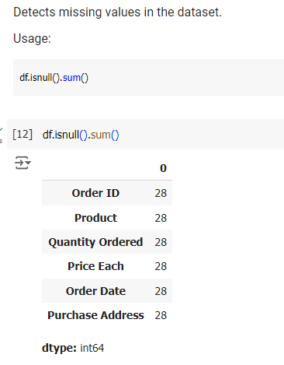
isnull() and sum()

Slide 17
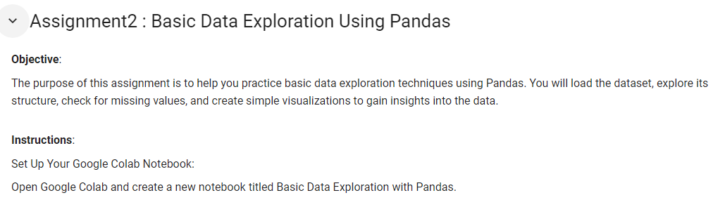

Slide 18
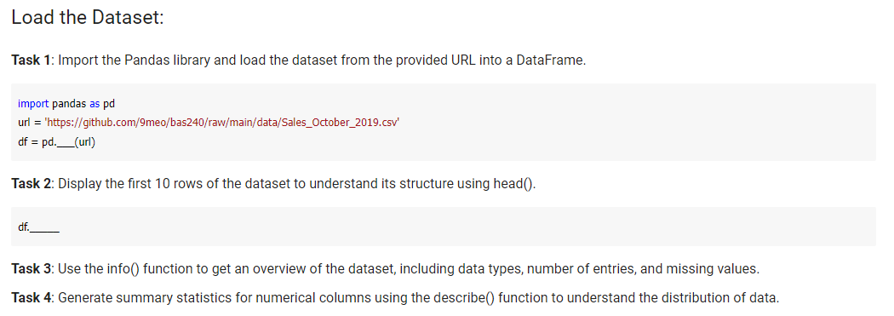

Slide 19
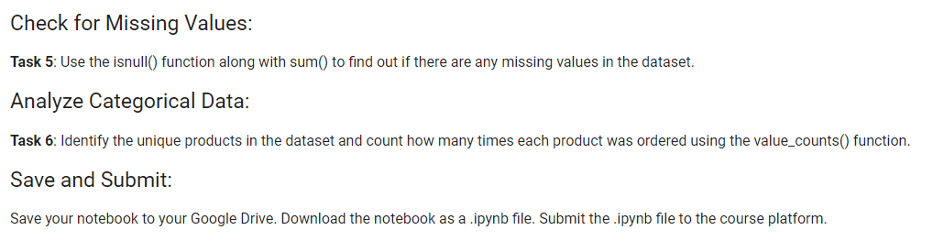

Slide 20
Data Types Conversion

Slide 21
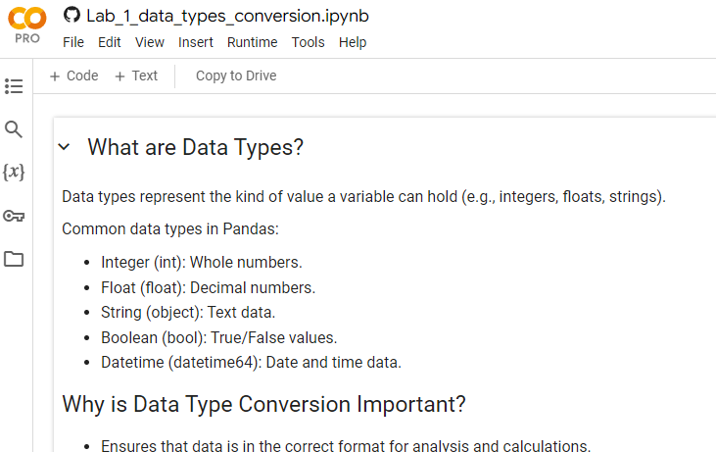
https://github.com/9meo/bas240/
1
Click to open
2
Copy to your drive

Slide 22
What are Data Types?
Data types represent the kind of value a variable can hold (e.g., integers, floats, strings).
Common data types in Pandas:
Integer (int): Whole numbers.
Float (float): Decimal numbers.
String (object): Text data.
Boolean (bool): True/False values.
Datetime (datetime64): Date and time data.

Slide 23
Why is Data Type Conversion Important?
Ensures that data is in the correct format for analysis and calculations.
Facilitates operations like sorting, filtering, and aggregating data.
Prevents errors in functions that expect specific data types.

Slide 24
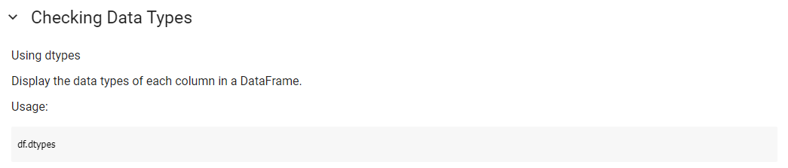
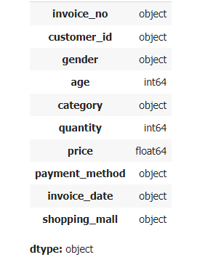

Slide 25
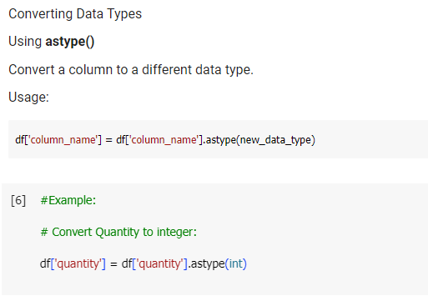

Slide 26
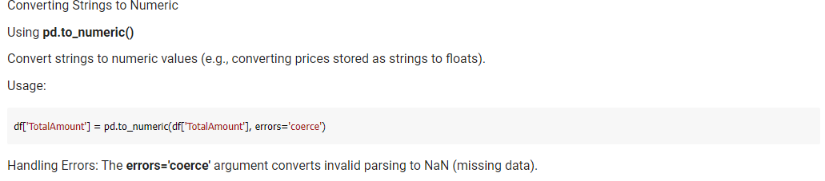

Slide 27
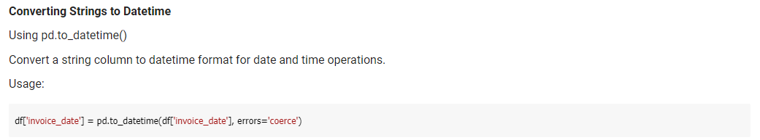

Slide 28
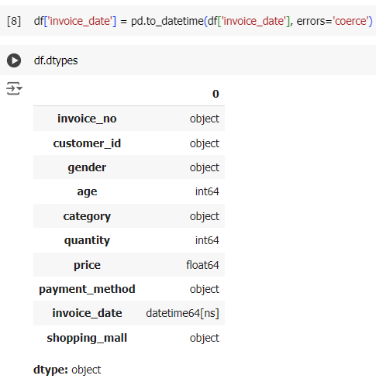
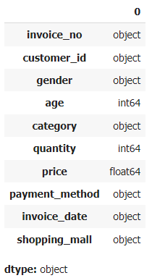

Slide 29
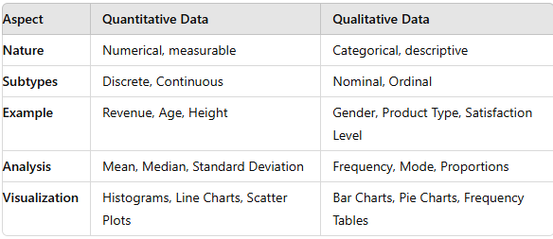
Quantitative vs. Qualitative

Slide 30
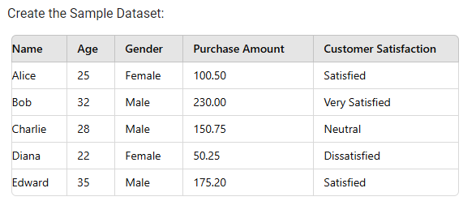

Slide 31
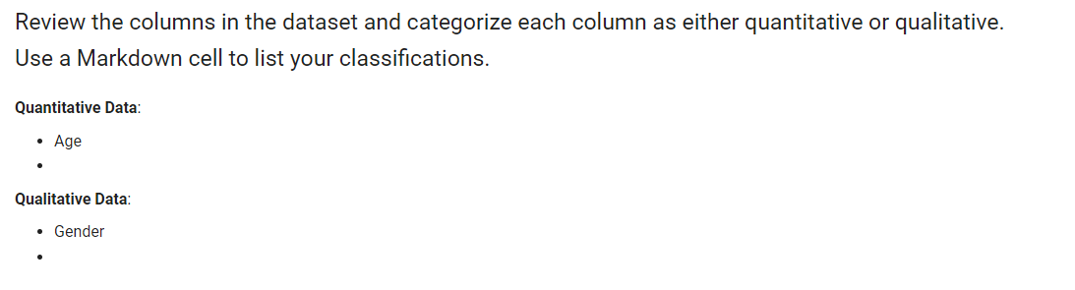

Slide 32
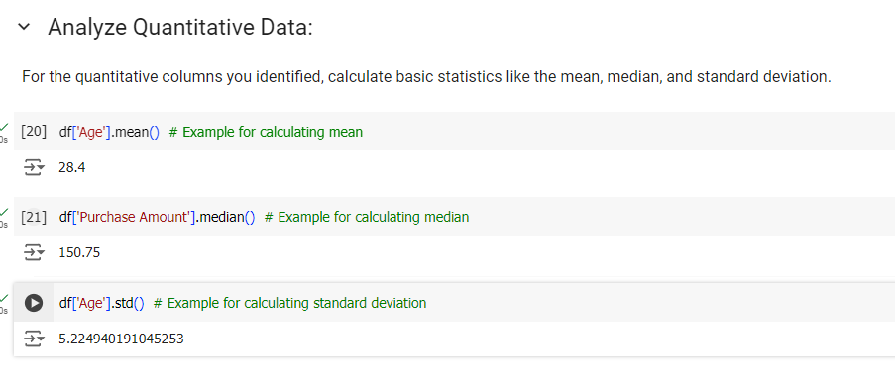
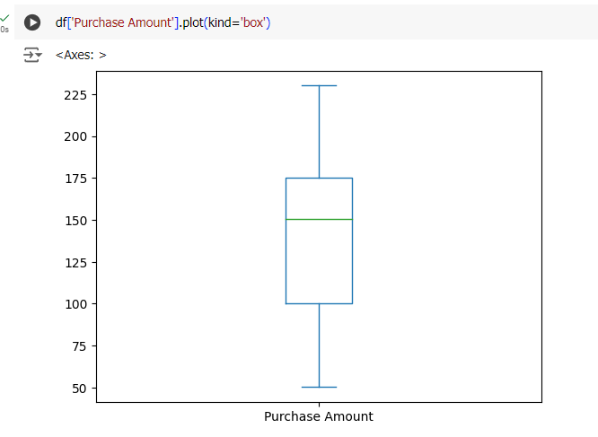

Slide 33
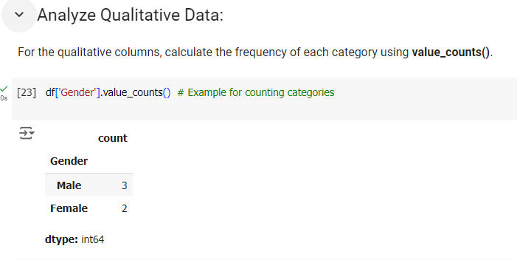
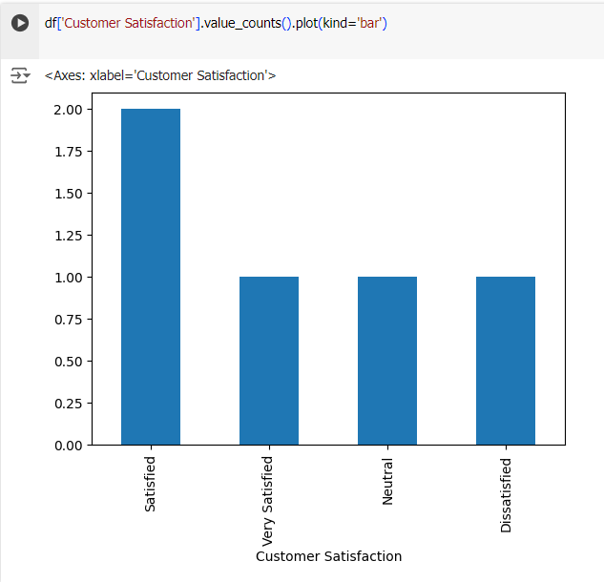

Slide 34
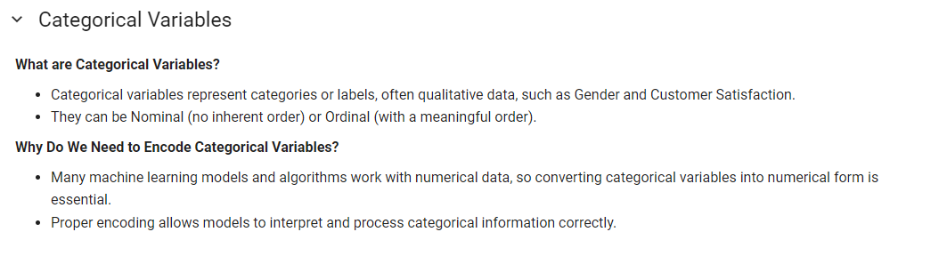

Slide 35
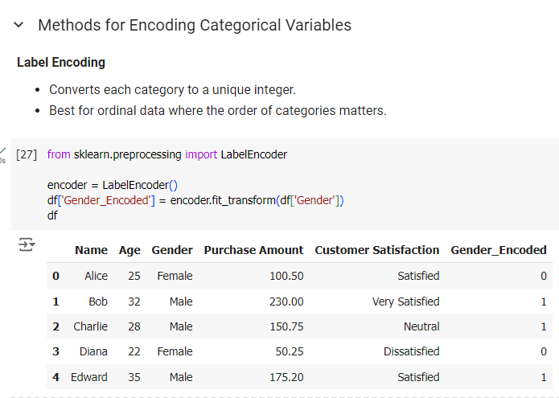
Original Categories: Female, Male
Encoded Values: 0, 1

Slide 36
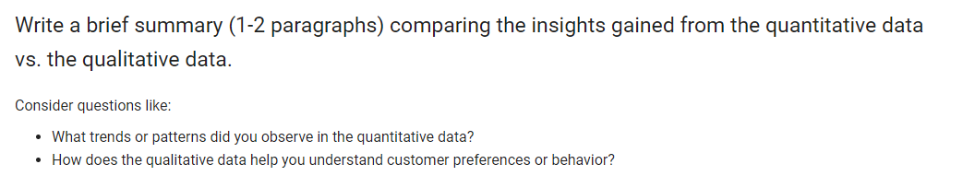

Slide 37
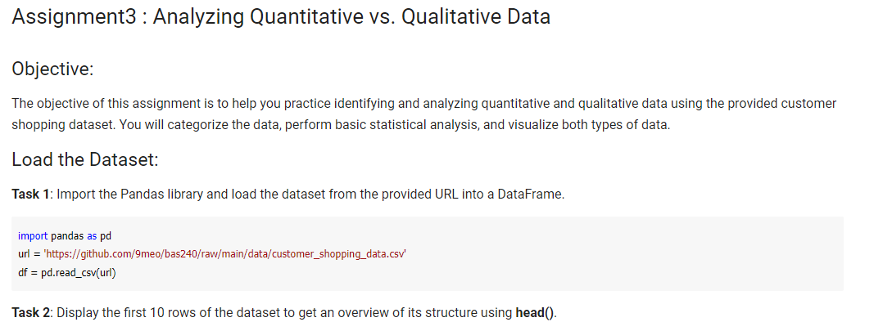

Slide 38
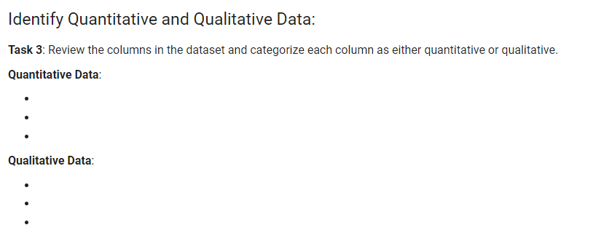

Slide 39
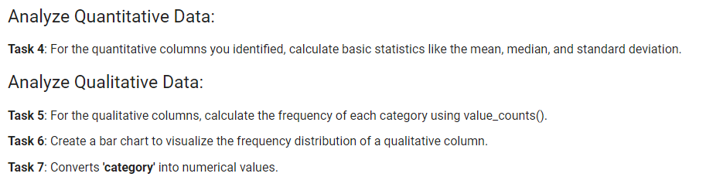

Slide 40
