Slide 1
BAS240 Data Analytics Programming
LAB 1:
Familiarization with data analytics tools and software

Slide 2
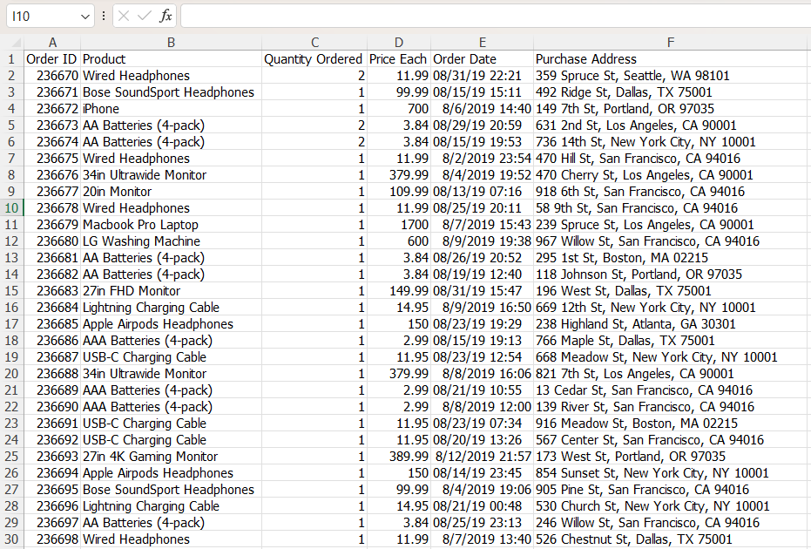
Data Analytic
How to answer following questions:
What is the total revenue generated in August 2019?
Which product had the highest sales volume in August 2019?
What is the most common time of day for purchases?
Which city generated the most revenue in August 2019?

Slide 3
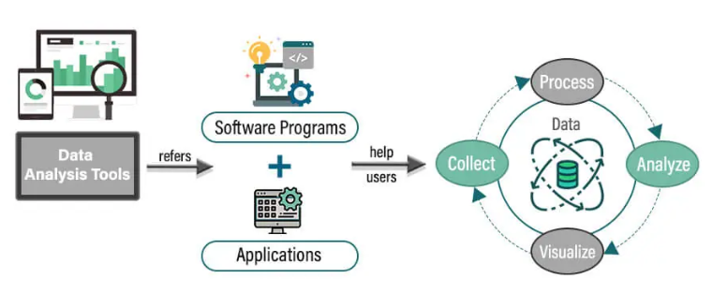
Data Analytic Tools
Data Analysis Tools:
software programs and applications that help users perform data analysis tasks.
Tasks:
Collect: Gathering data from various sources.
Process: Cleaning, transforming, and preparing the data for analysis.
Analyze: Performing data analysis to extract insights.
Visualize: Creating visual representations of the data to communicate findings.
src: https://www.educba.com/data-analysis-tools/

Slide 4
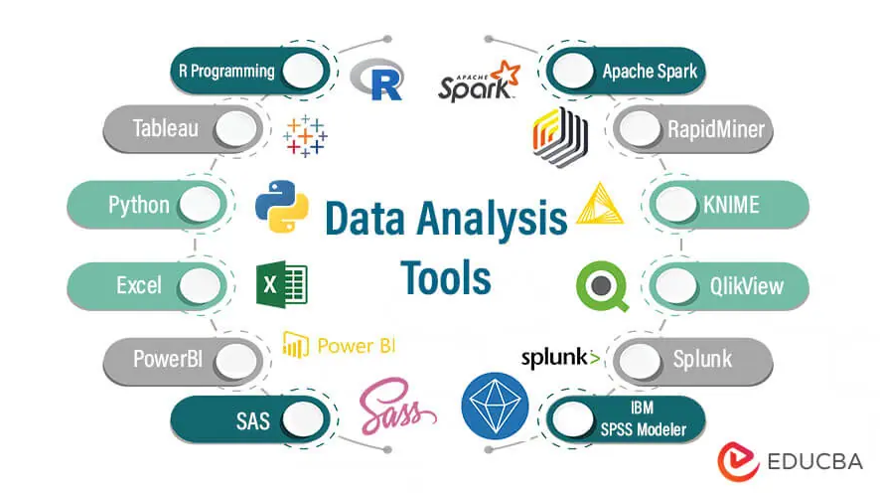
BAS240
src: https://www.educba.com/data-analysis-tools/

Slide 5


Data Analytic Tools
Python

Slide 6
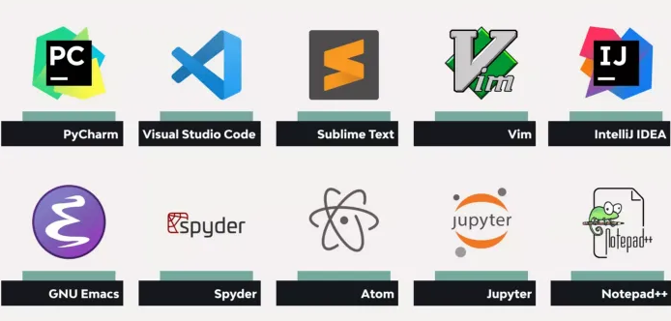
Python Editors:
BAS240

Slide 7

Getting Started with Google Colab
What is Google Colab?
Google Colab is a cloud-based Jupyter notebook environment that allows you to write and execute Python code in your browser.
Why use Colab?
No installation required—just a Google account.
Free access to GPUs and TPUs for more intensive computations.
Easy integration with Google Drive for file storage and sharing.

Slide 8
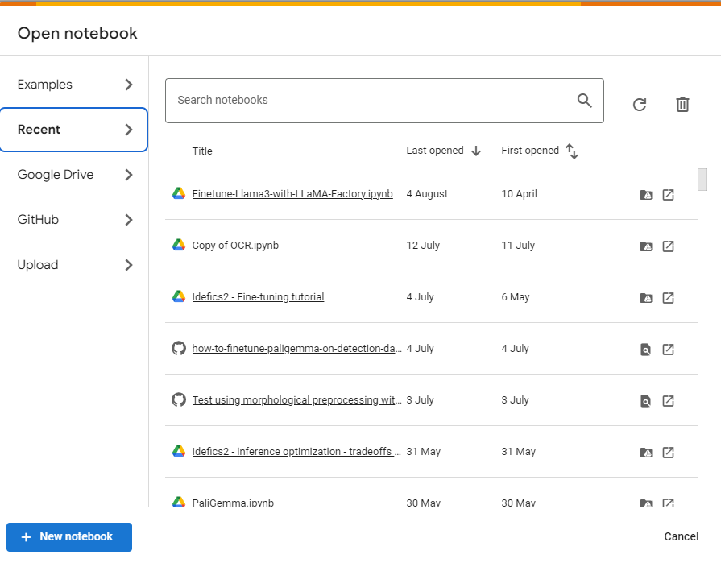

Accessing Google Colab:
Access Colab via https://colab.research.google.com
Create a new notebook
Click to create new notebook

Slide 9
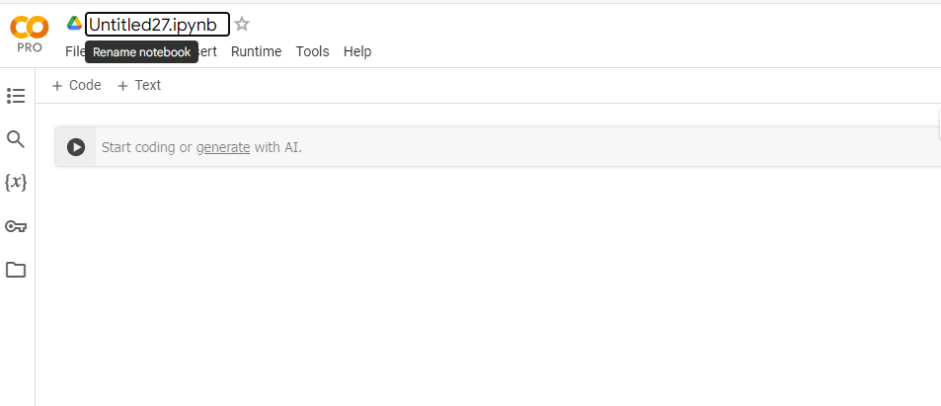
Rename the Notebook
Click to rename
“Lab-1-Pandas”

Slide 10
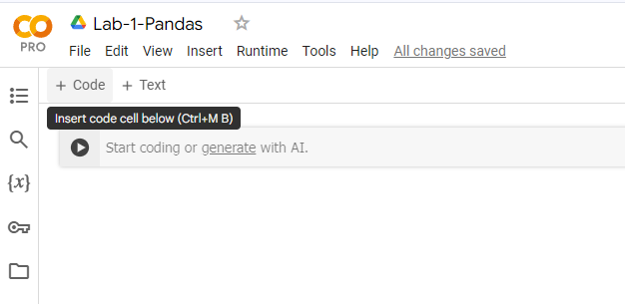
Insert Code
1
Insert code cell Ctrl+MB

Slide 11
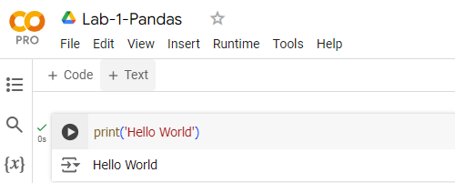
Running Code
1
Click to run or Ctrl/Shift + Enter
2
Result

Slide 12
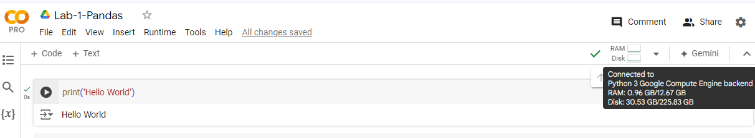
Colab Resource
1
2
Mouse over
Current Runtime

Slide 13
Cell:
1
3
Move cell up
Ctrl +MK
Delete cell
Ctrl +MD
2
Move cell down
Ctrl +MJ

Slide 14
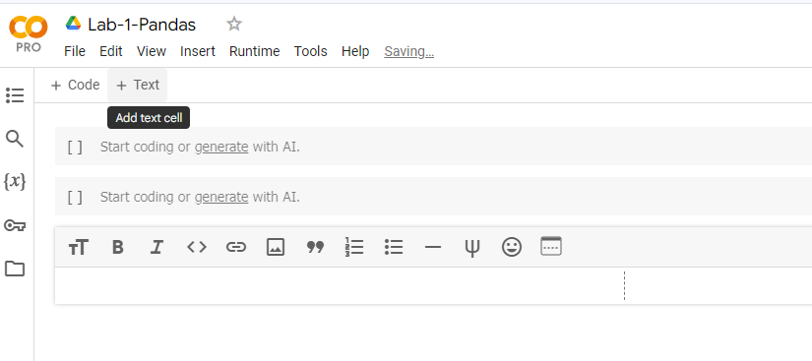
Insert Text
1
Insert Text
2

Slide 15
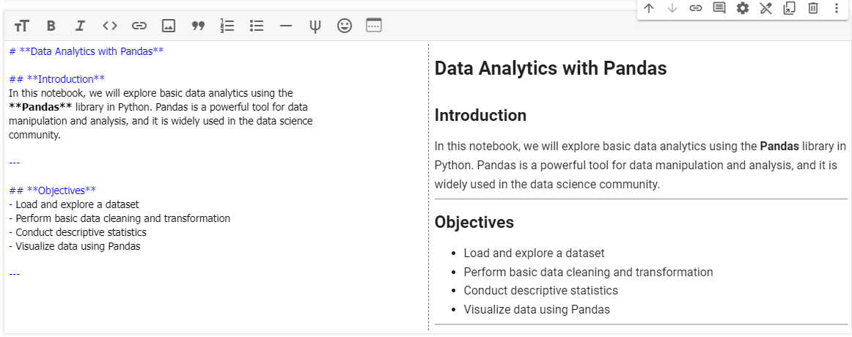
Example Markdown Text

Slide 16
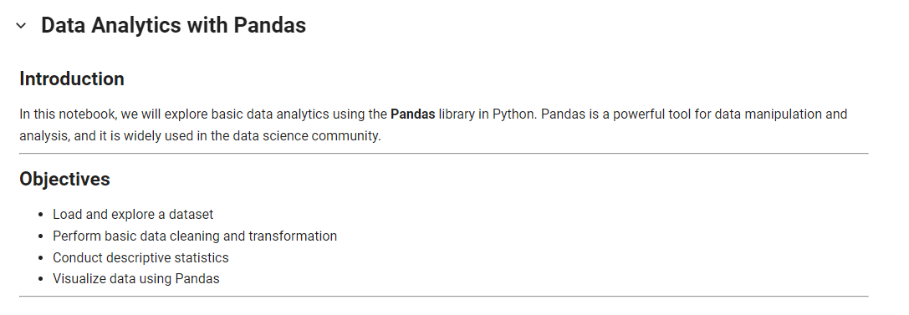
New Cell to See Result / Shift + Enter

Slide 17
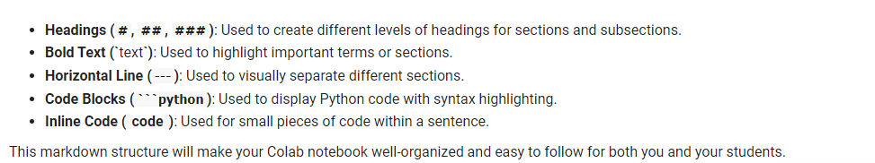
Explanation:

Slide 18
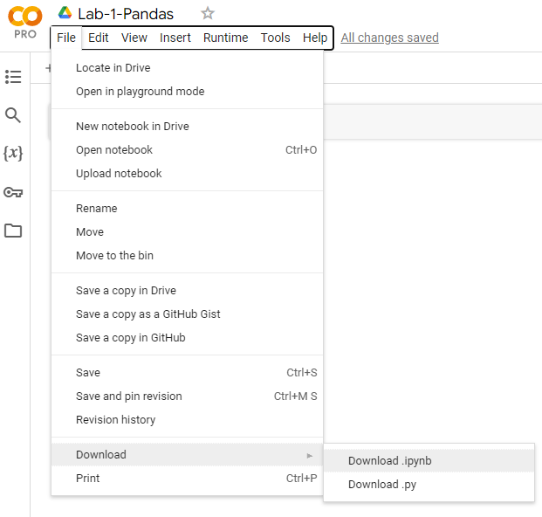
How to download notebook file for submission:
1
3
2

Slide 19
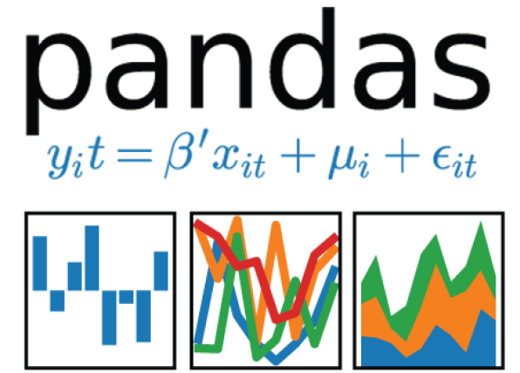

Slide 20
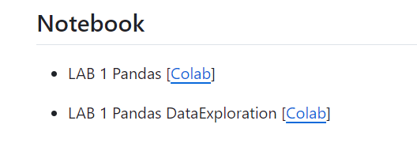

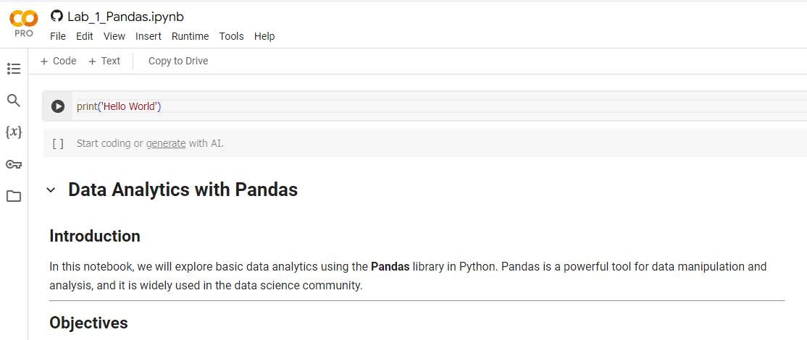
https://github.com/9meo/bas240/
1
Click to open
2
Copy to your drive

Slide 21

Install Pandas (if necessary):
Note: Pandas is pre-installed in Colab, but in case they need to install other libraries:

Slide 22
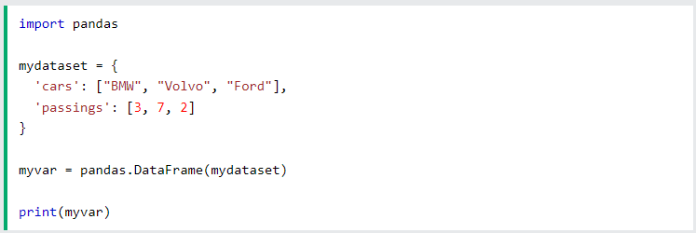

Import Pandas
Once Pandas is installed, import it in your applications by adding the import keyword:
Now Pandas is imported and ready to use.

Slide 23
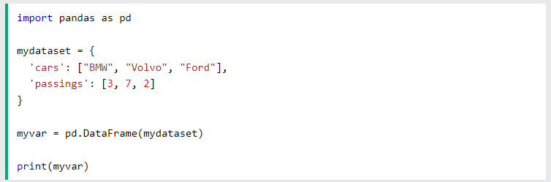
Pandas as pd
Create an alias with the as keyword while importing:
Now the Pandas package can be referred to as pd instead of pandas.

Slide 24


Checking Pandas Version
The version string is stored under __version__ attribute.

Slide 25
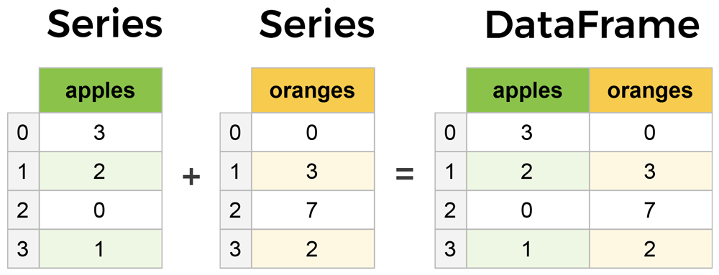
Panel + Data
Pandas is a powerful, open-source data analysis and manipulation library for Python.
Pandas’s data structures:
Series (1-dimensional)
DataFrames (2-dimensional)
Src: https://medium.com/@debopamdeycse19/introduction-to-pandas-for-data-science-d5a575e4cd9b

Slide 26
Pandas data structures
PANDA = PANel+ DAta+ S= multi-dimensional data in stats & econometrics. Introduces 3 size-mutable, labeled data-structures:
A Series is a 1D data-structure.
A DataFrame is a 2D data-structure that can be viewed as a dictionary of Series.
A Panel is a 3D data-structure that can be viewed as a dictionary of DataFrames

Slide 27
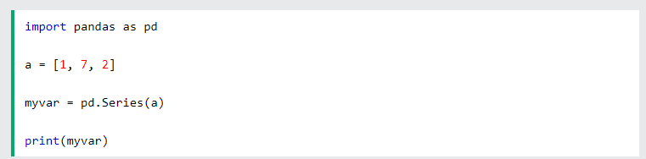
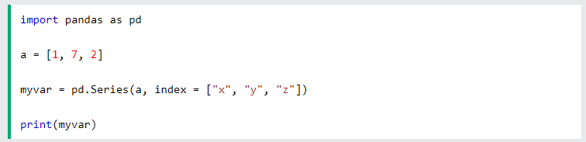
Series
A Pandas Series is like a column in a table.
It is a one-dimensional array holding data of any type.
Create a simple Pandas Series from a list:
Create your own labels:

Slide 28
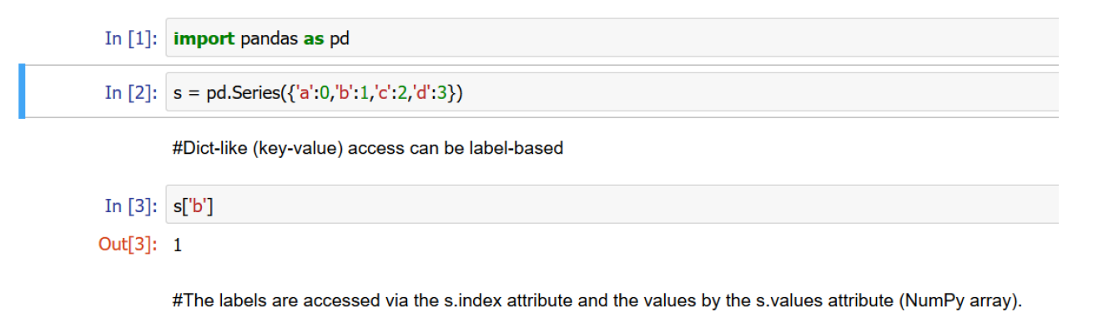
Series
Create a simple Pandas Series from a dictionary:

Slide 29
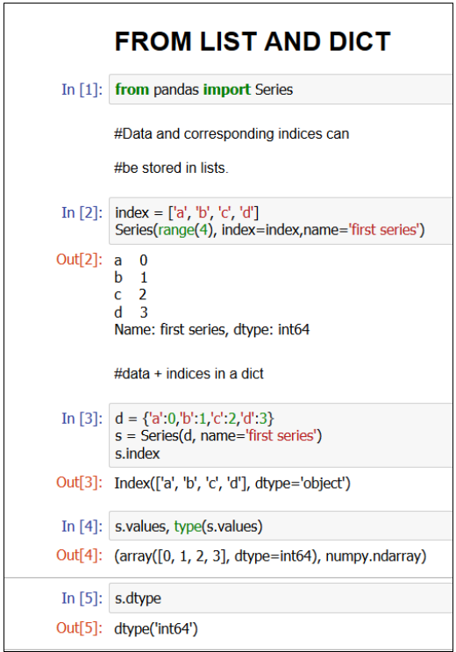
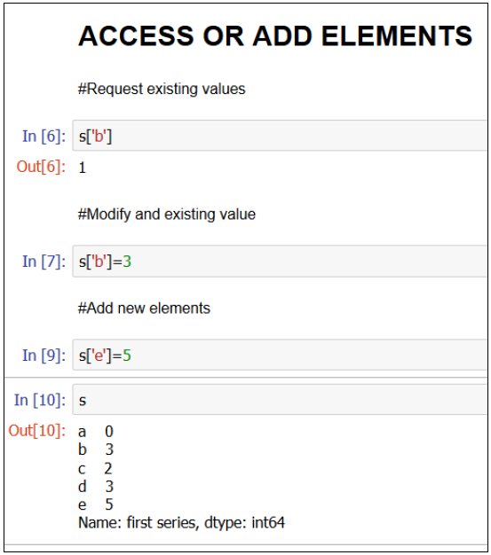
Creating Series:

Slide 30
DataFrame
Data sets in Pandas are usually multi-dimensional tables, called DataFrames.
Series is like a column, a DataFrame is the whole table.

Slide 31
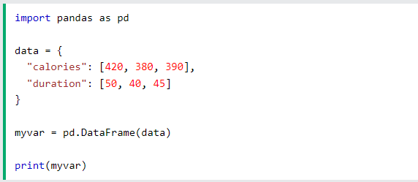
DataFrame
Create a DataFrame from two Series:

Slide 32
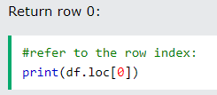
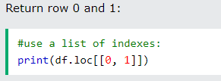
DataFrame
Pandas use the loc attribute to return one or more specified row(s)

Slide 33
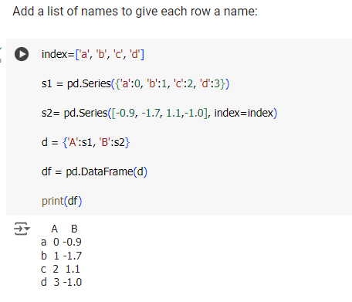
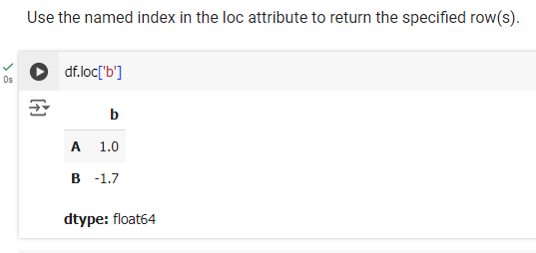
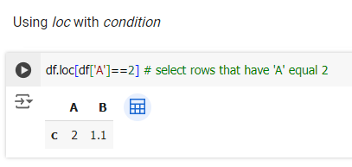
DataFrame

Slide 34
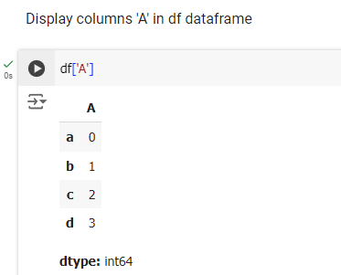
DataFrame

Slide 35
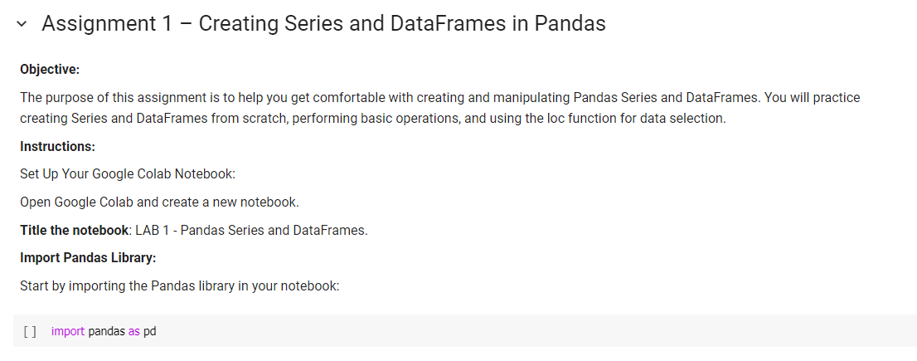

Slide 36
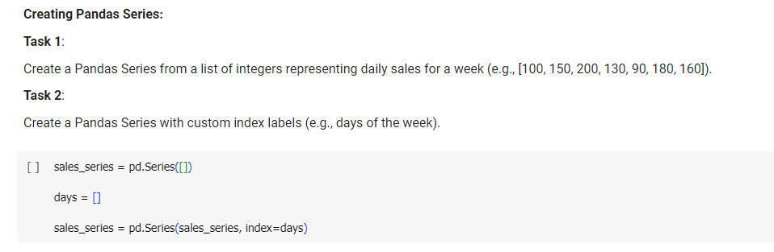

Slide 37
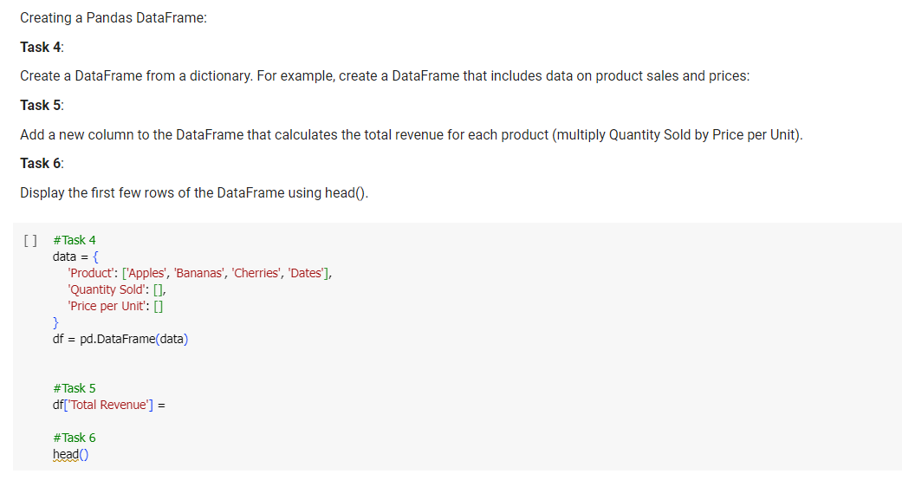

Slide 38
