Slide 1
BAS240 Data Analytics Programming
LAB 5:
Methods to Identify Outliers
Decision Tree

Slide 2
https://github.com/9meo/bas240/

Slide 3
Outliers
Outliers are data points that differ significantly from other observations in a dataset.
Identifying outliers is important in data preprocessing to ensure data quality, as they can skew results in statistical analyses.

Slide 4
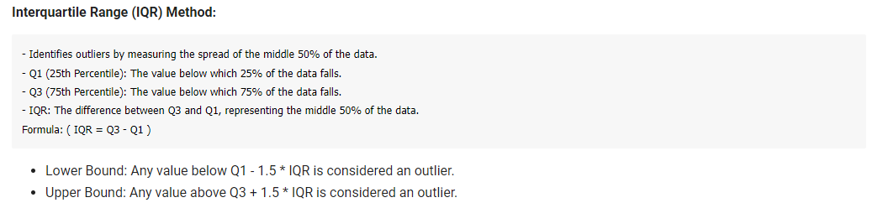
Methods to Identify Outliers

Slide 5
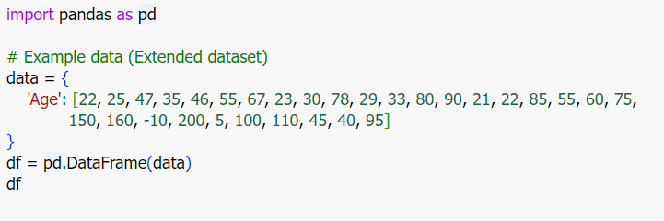
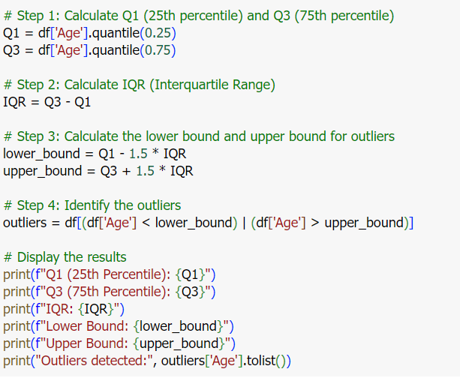

Slide 6
Methods to Identify Outliers
Boxplot Visualization: Visual representation to detect outliers based on quartiles and whiskers.

Slide 7
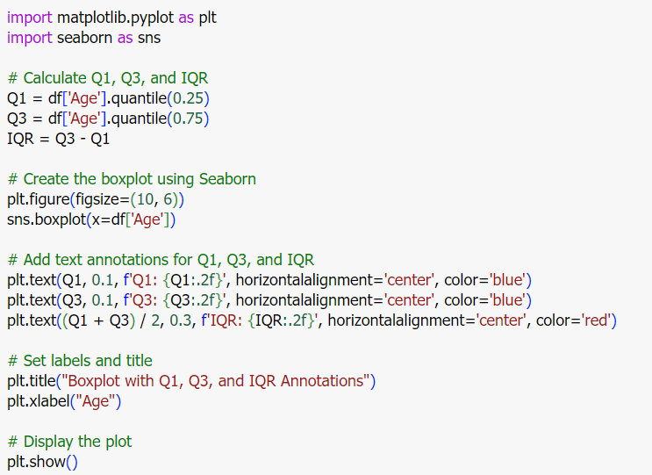
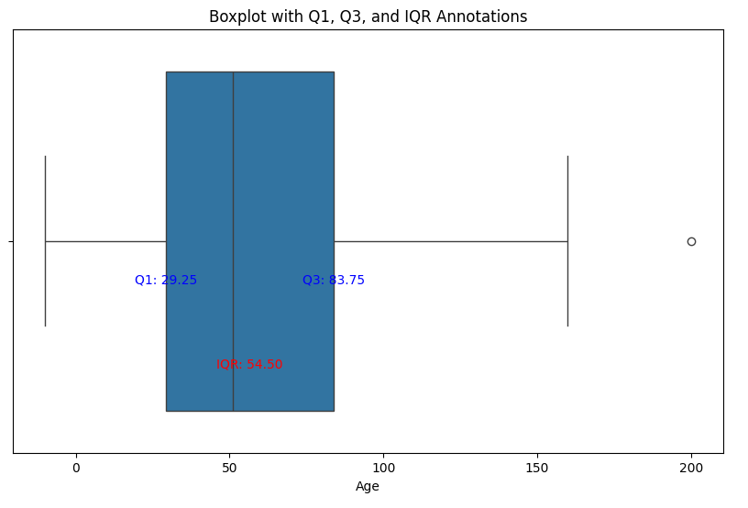

Slide 8
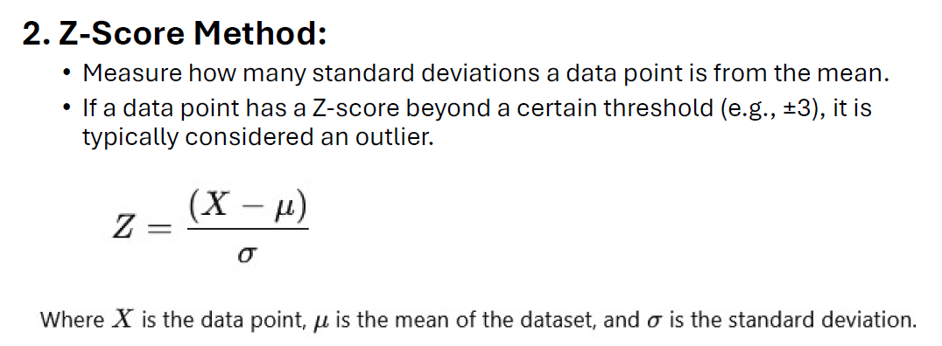
Methods to Identify Outliers

Slide 9
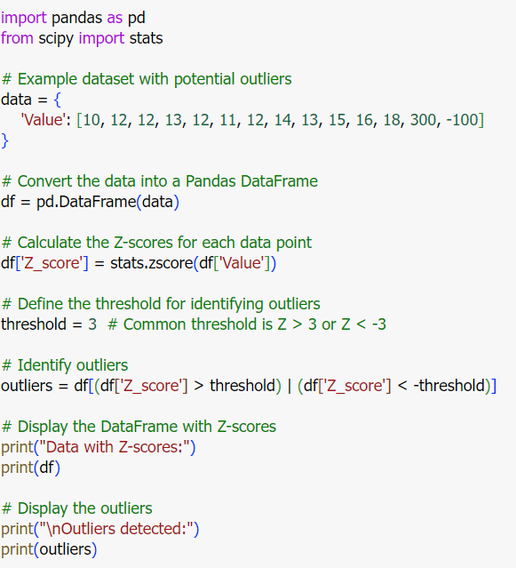
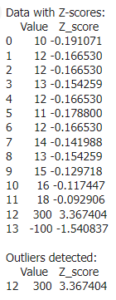

Slide 10
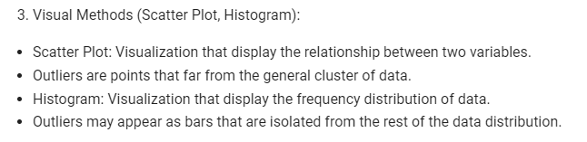

Slide 11
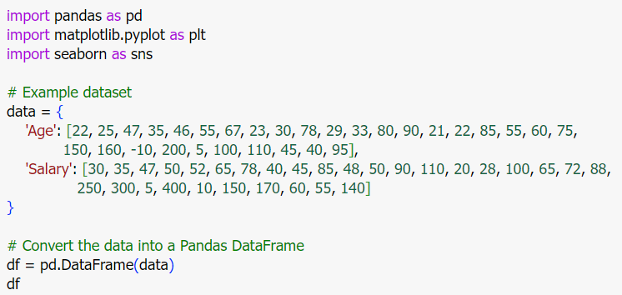

Slide 12
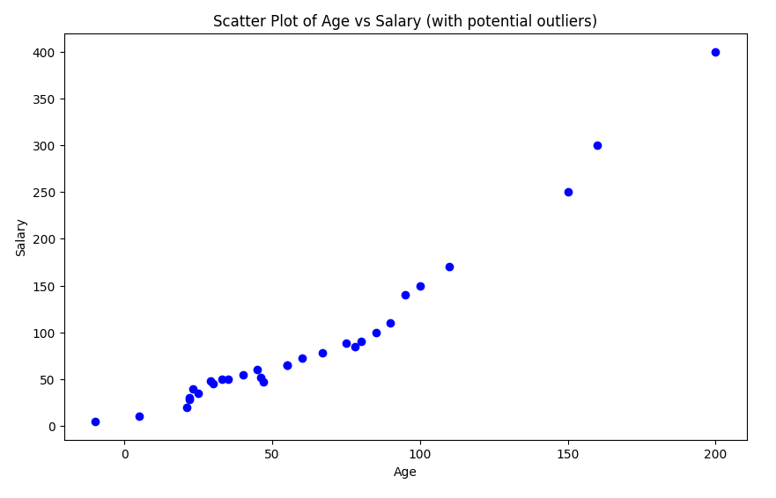
This plot will show the relationship between age and salary, where outliers are data points far away from the main cluster of points.

Slide 13
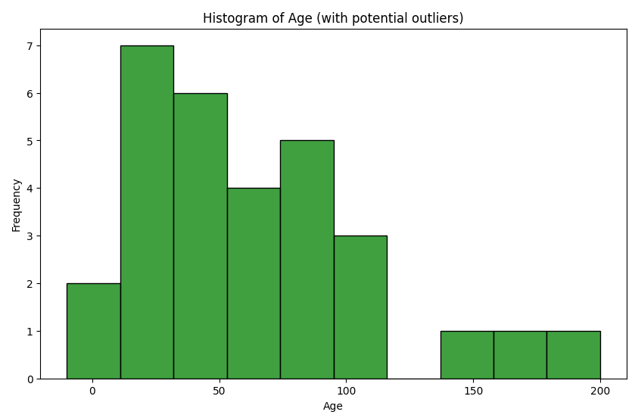
The histogram shows the frequency distribution of age values, and bars that are isolated (either very small or very large) will indicate potential outliers.

Slide 14
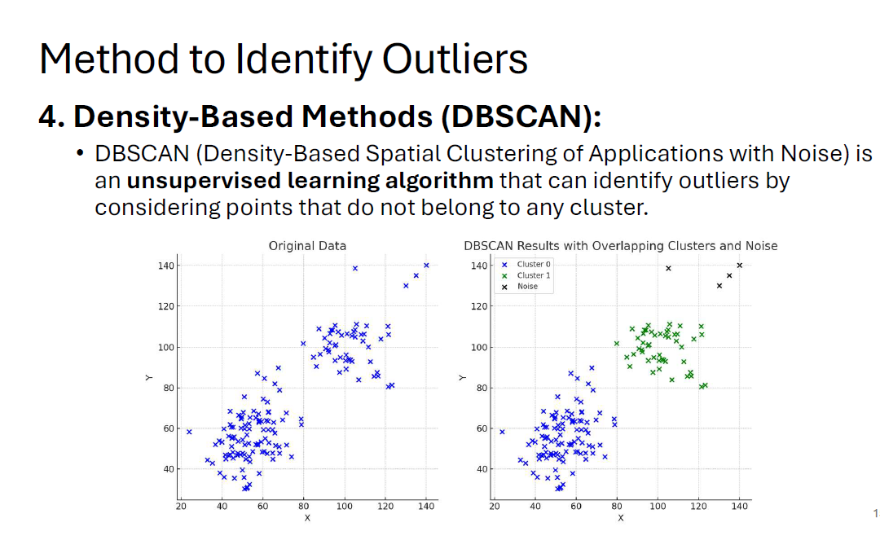

Slide 15
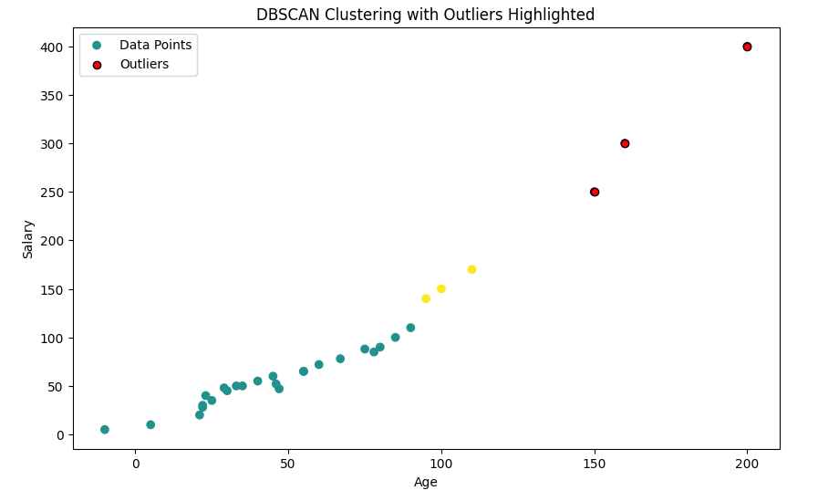

Slide 16
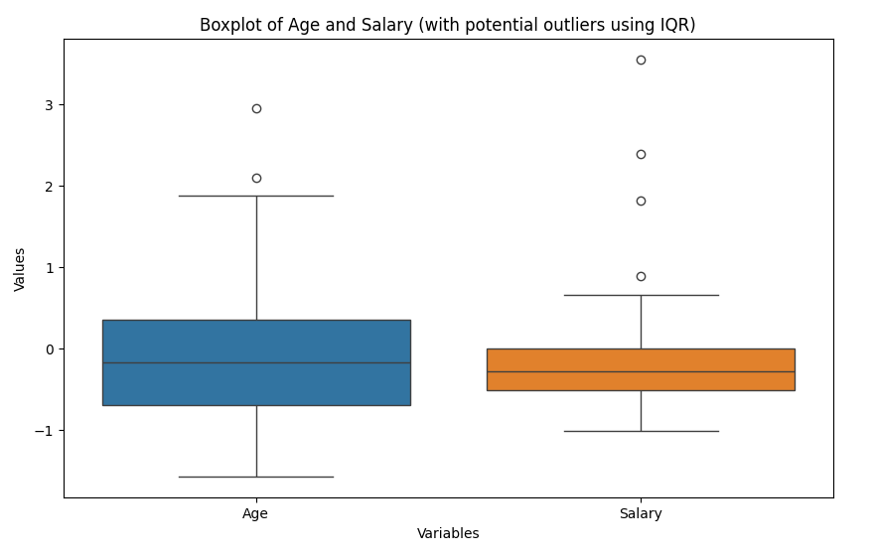
Data Preprocessing and Identifying Outlier
Detect outliers using IQR (Interquartile Range) method

Slide 17
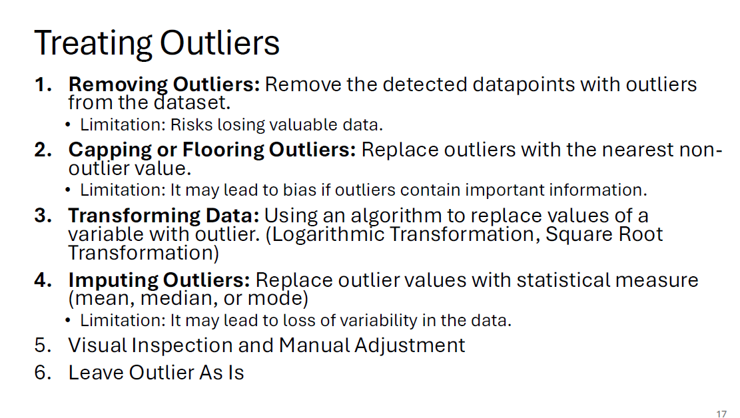

Slide 18
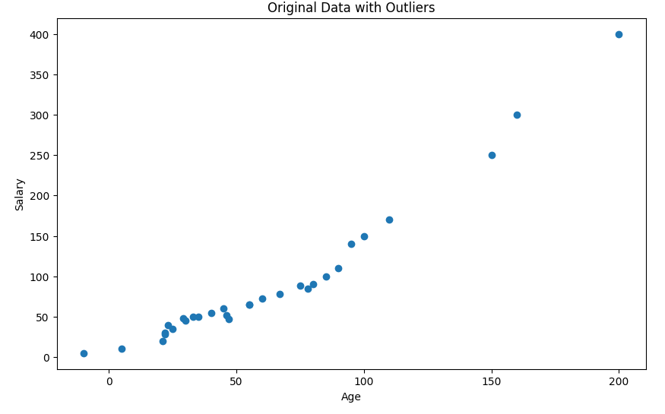
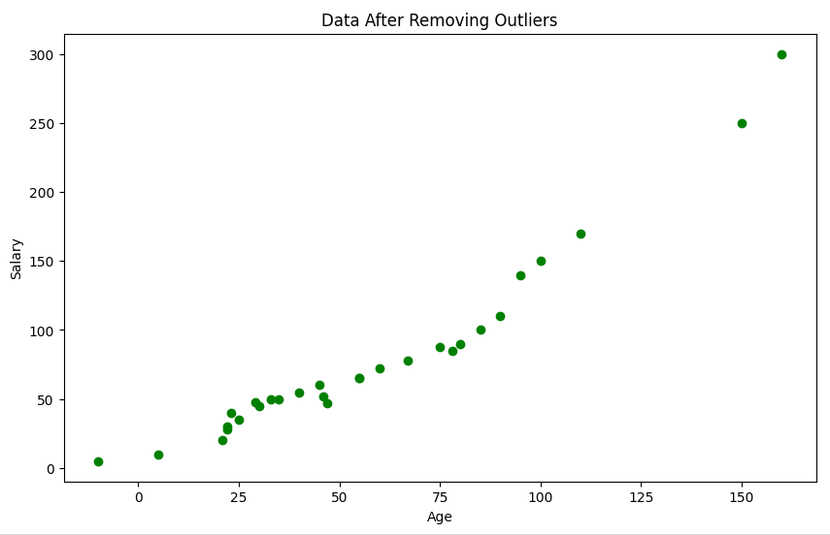
Simply remove the detected outliers from the dataset.

Slide 19
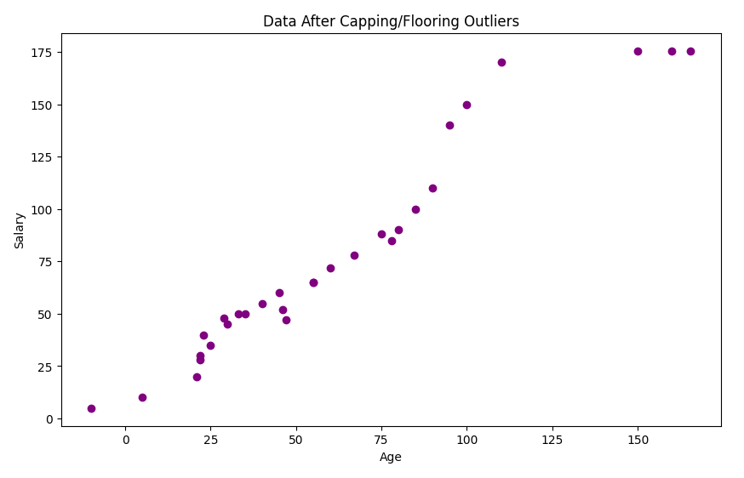
Replace the outliers with the nearest non-outlier value based on the IQR method.

Slide 20
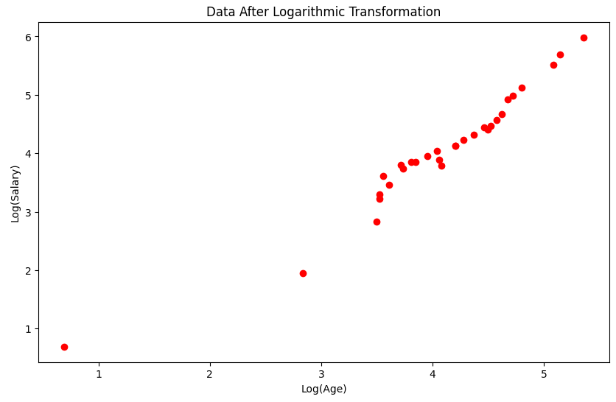
Apply a logarithmic transformation to reduce the impact of extreme values (outliers).

Slide 21
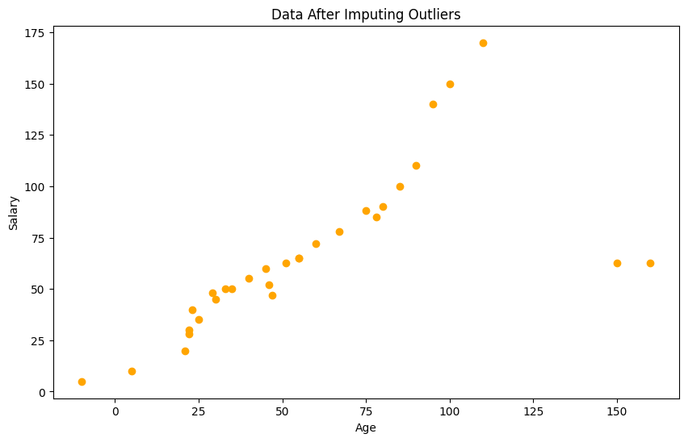
Replace outliers with a statistical measure, such as the median.

Slide 22
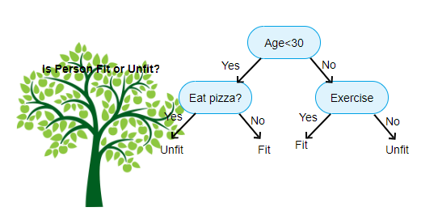
Decision Tree

Slide 23
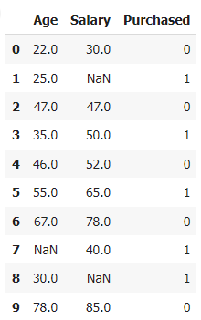
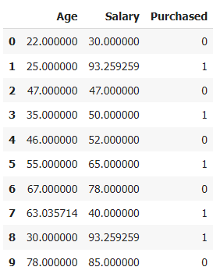
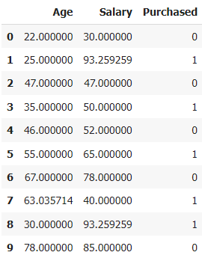
Fill missing values
Identify outliers

Slide 24
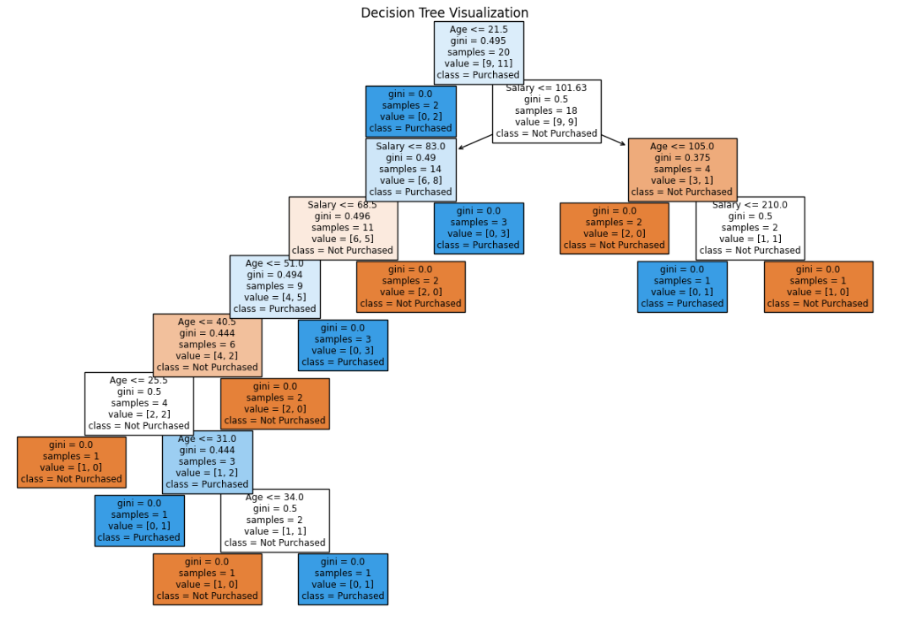

Slide 25
