Slide 1
MTS484
LAB 5:
Deep Neural Network
Hyperparameter Tuning & Data Splitting Methods

Slide 2
https://github.com/9meo/bas240/

Slide 3
Objectives of Today’s Class
Understand how to build a Deep Neural Network (DNN) using Keras.
Learn key hyperparameters and their impact on model performance.
Compare training/testing split with x-fold cross-validation.

Slide 4
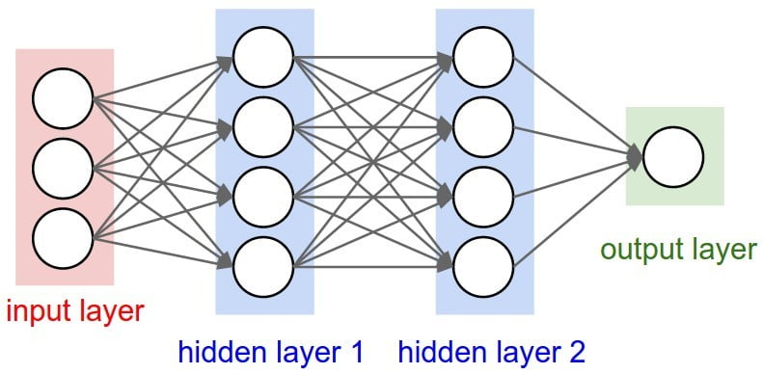
Introduction to Deep Neural Networks
What is a DNN?
A neural network with multiple hidden layers between input and output.
DNNs are effective for complex data patterns and high-dimensional data.
Applications of DNNs
Image recognition, natural language processing, predictive analytics, etc.

Slide 5
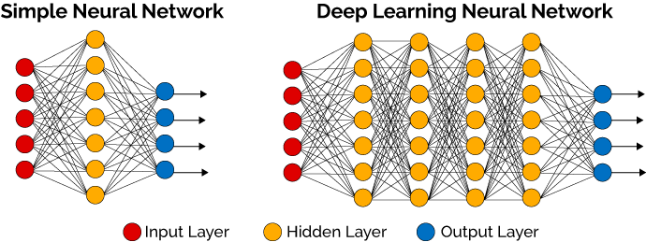
Introduction to Deep Neural Networks

Slide 7
https://www.facebook.com/watch/?v=1073610870547722

Slide 8
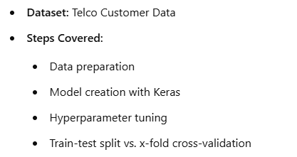
Overview of the Lab Structure

Slide 9
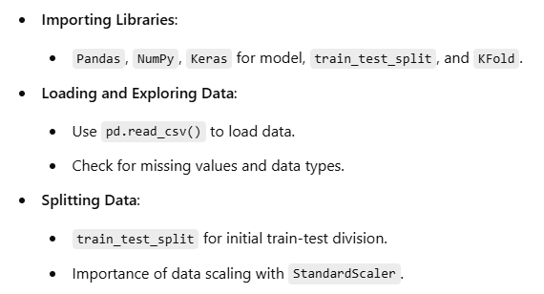
Step 1 - Data Preparation

Slide 10
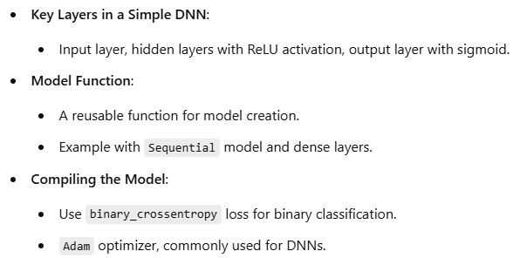
Step 2 - Building the DNN Model

Slide 11
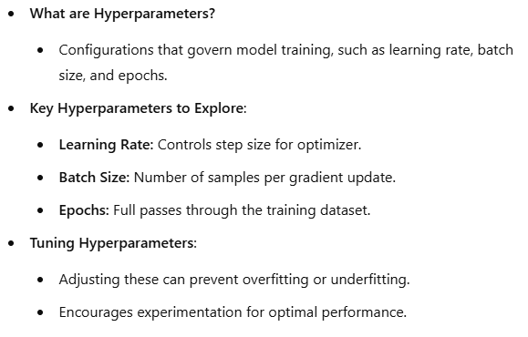
Step 3 - Hyperparameters in a DNN

Slide 12
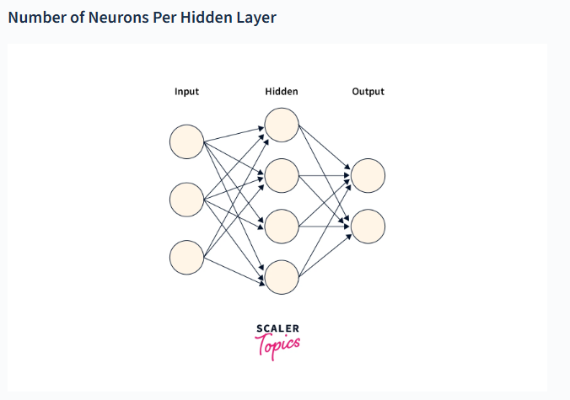

Slide 13
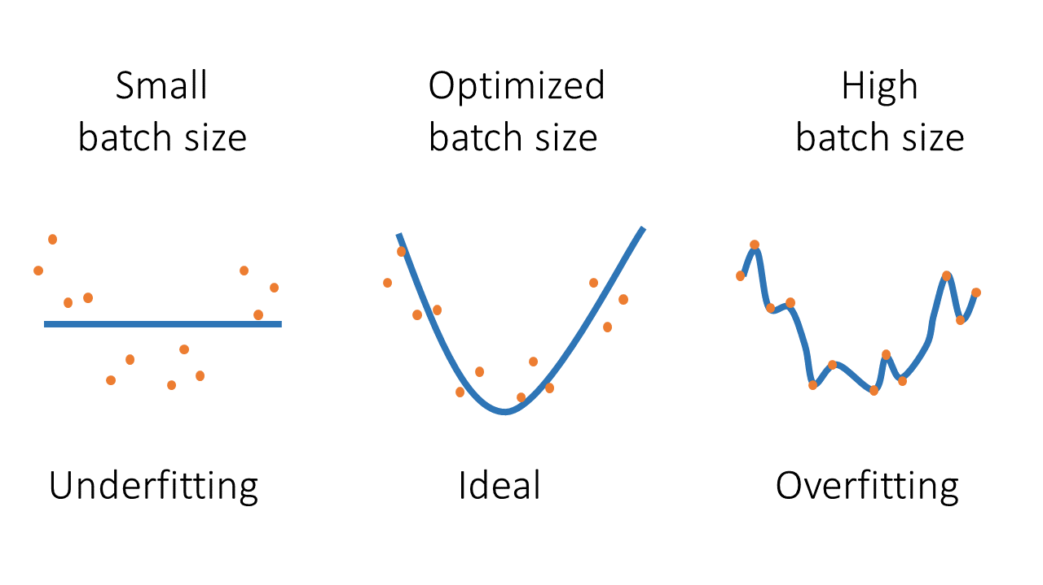
Batch Size

Slide 14
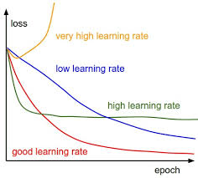
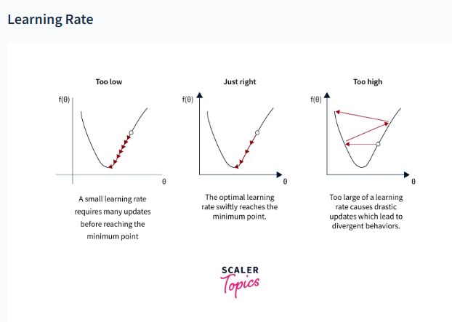
Learning Rate

Slide 15
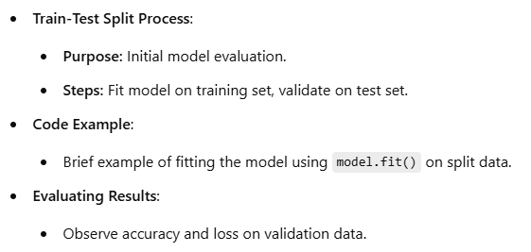
Step 4 - Training with Train-Test Split

Slide 16
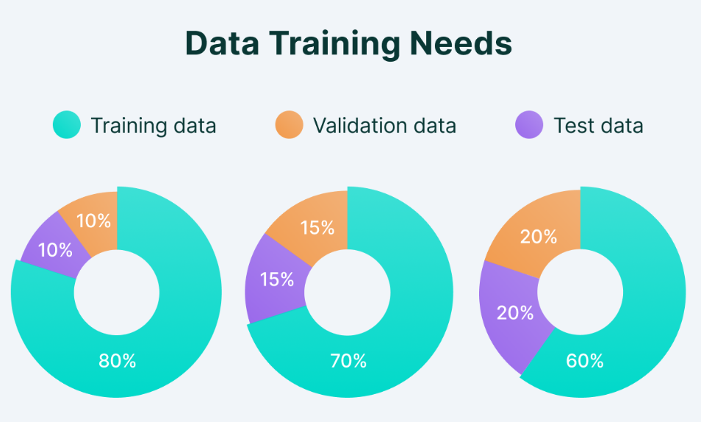
Step 4 - Training with Train-Test Split

Slide 17
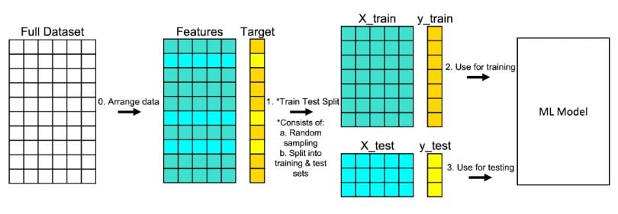
Step 4 - Training with Train-Test Split

Slide 18
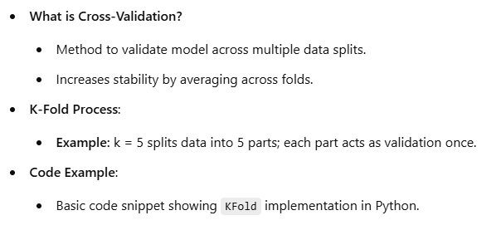
Step 5 - Training with x-Fold Cross-Validation

Slide 19
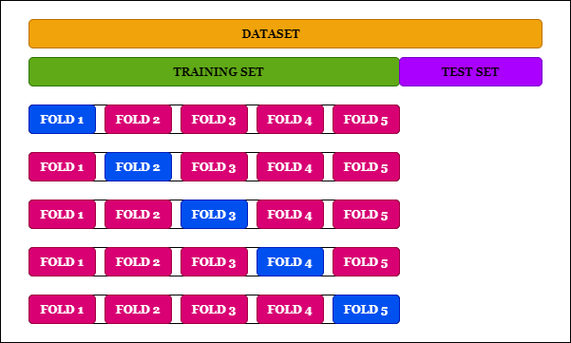
Step 5 - Training with x-Fold Cross-Validation

Slide 20
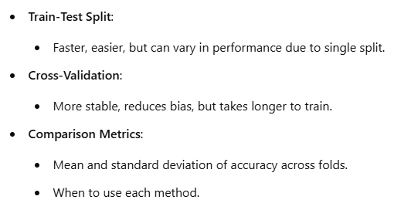
Comparing Train-Test Split and Cross-Validation

Slide 21
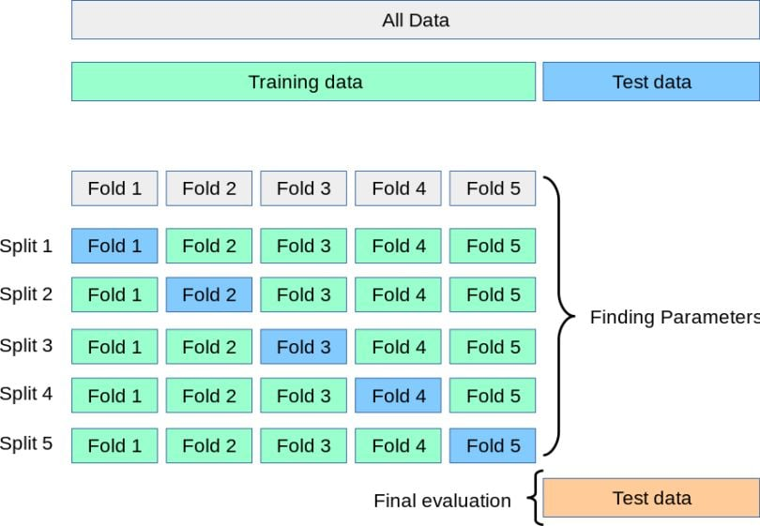

Slide 22
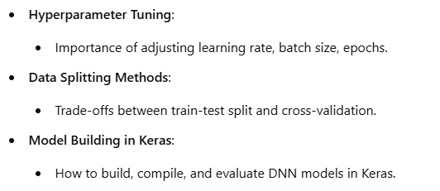
Key Takeaways

