Slide 1
BAS240 Data Analytics Programming
LAB 5:
Methods to Identify Outliers
Data Relationship
Joining Data

Slide 2
https://github.com/9meo/bas240/

Slide 3
Outliers
Outliers are data points that differ significantly from other observations in a dataset.
Identifying outliers is important in data preprocessing to ensure data quality, as they can skew results in statistical analyses.

Slide 4
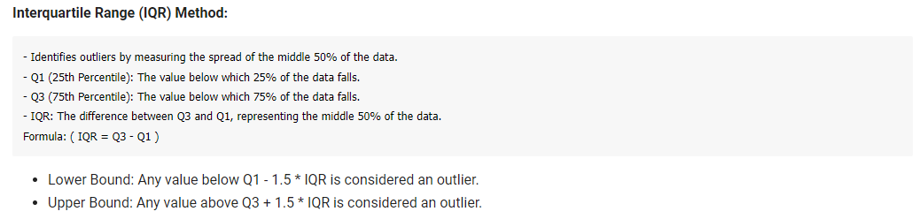
Methods to Identify Outliers

Slide 5
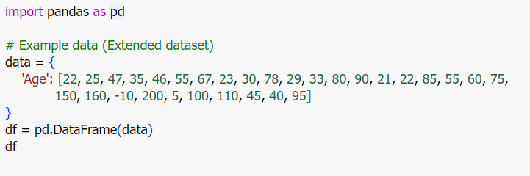
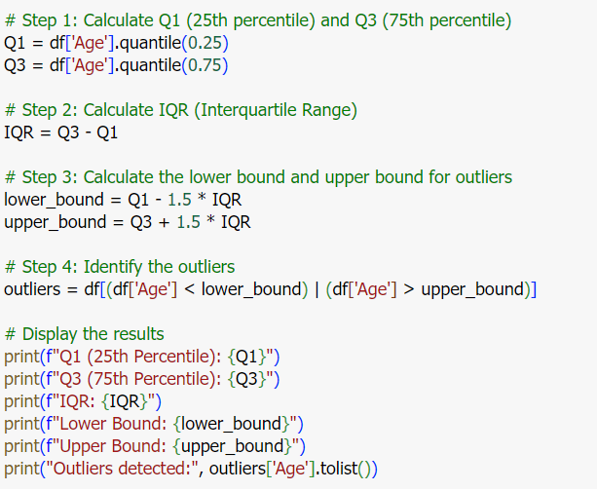

Slide 6
Methods to Identify Outliers
Boxplot Visualization: Visual representation to detect outliers based on quartiles and whiskers.

Slide 7
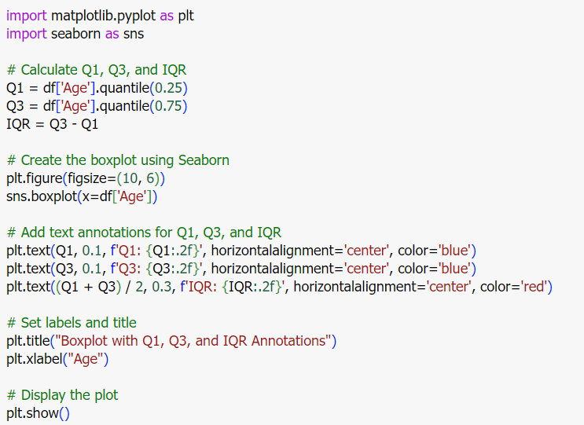
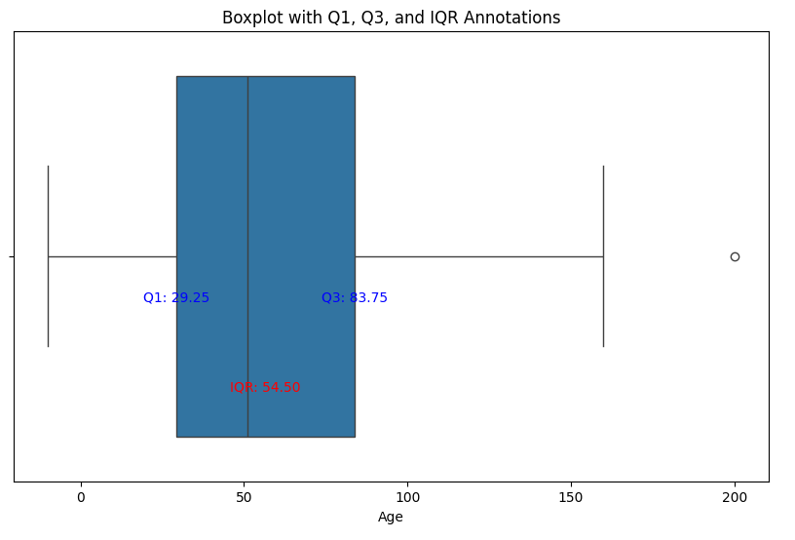

Slide 8
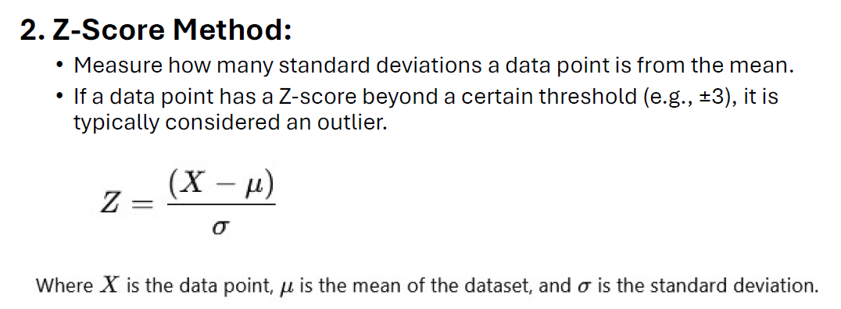
Methods to Identify Outliers

Slide 9
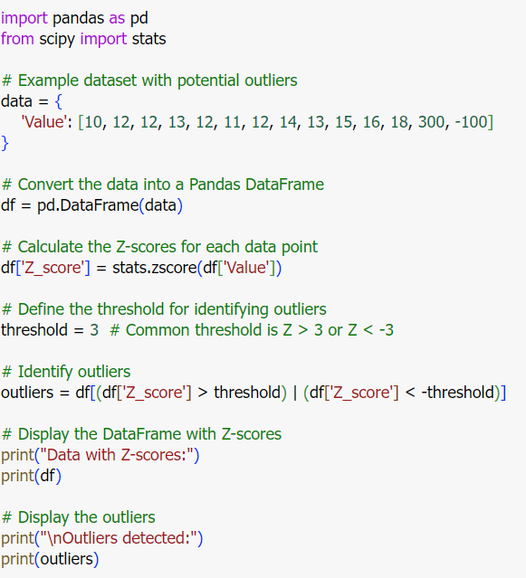
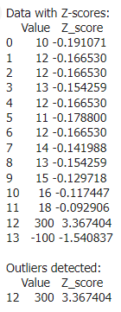

Slide 10
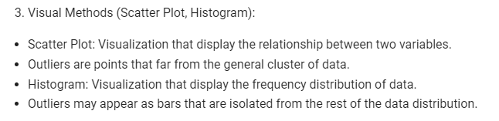

Slide 11
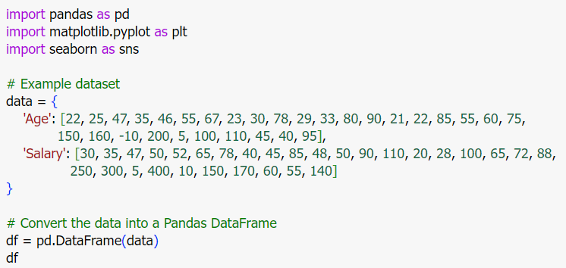

Slide 12
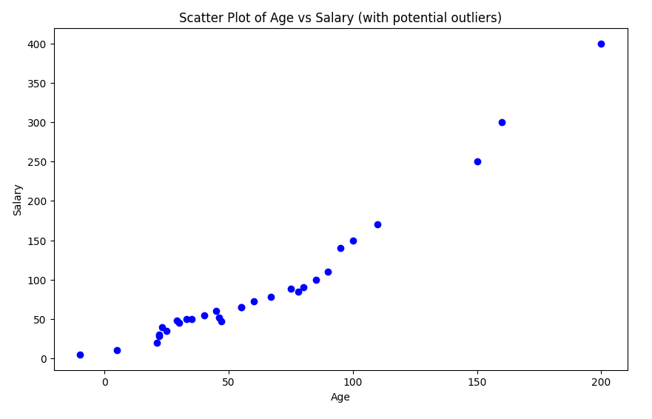
This plot will show the relationship between age and salary, where outliers are data points far away from the main cluster of points.

Slide 13
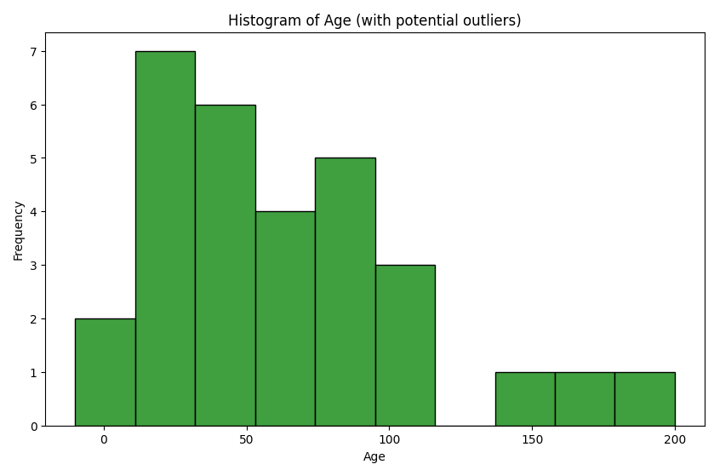
The histogram shows the frequency distribution of age values, and bars that are isolated (either very small or very large) will indicate potential outliers.

Slide 14
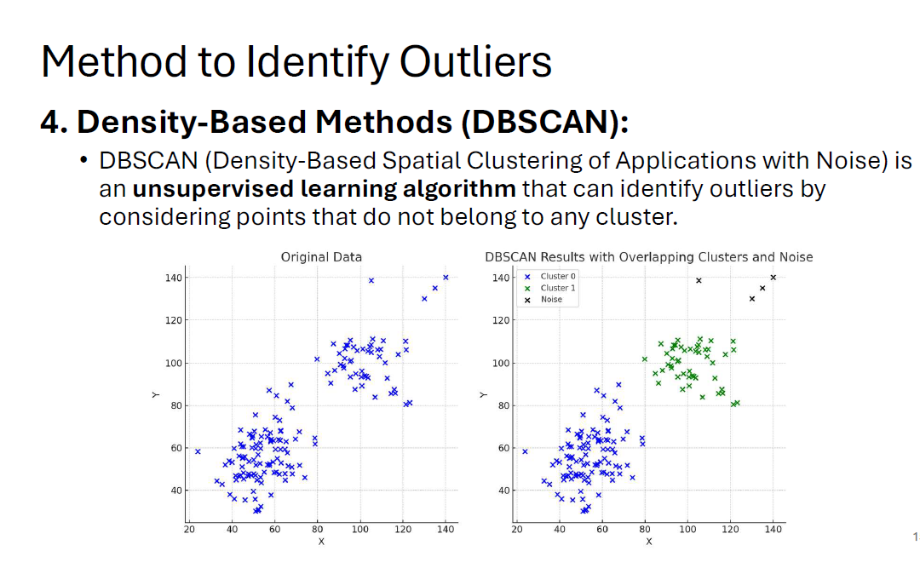

Slide 15
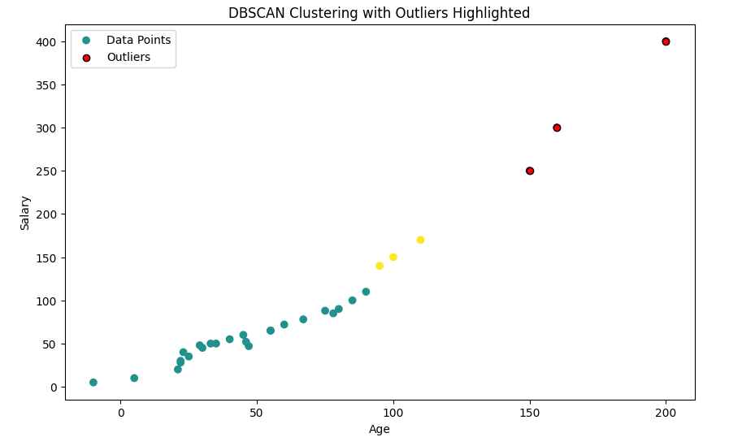

Slide 16
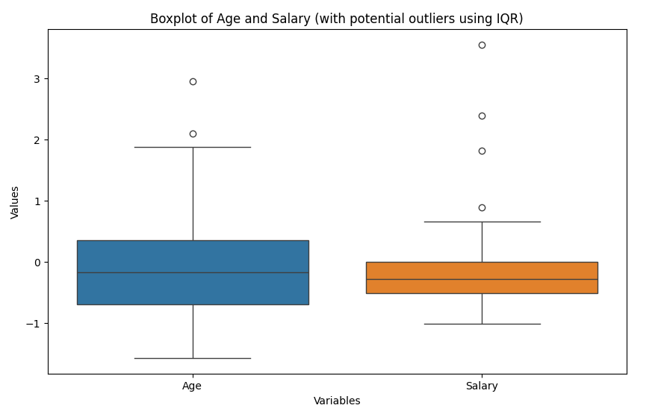
Data Preprocessing and Identifying Outlier
Detect outliers using IQR (Interquartile Range) method

Slide 17
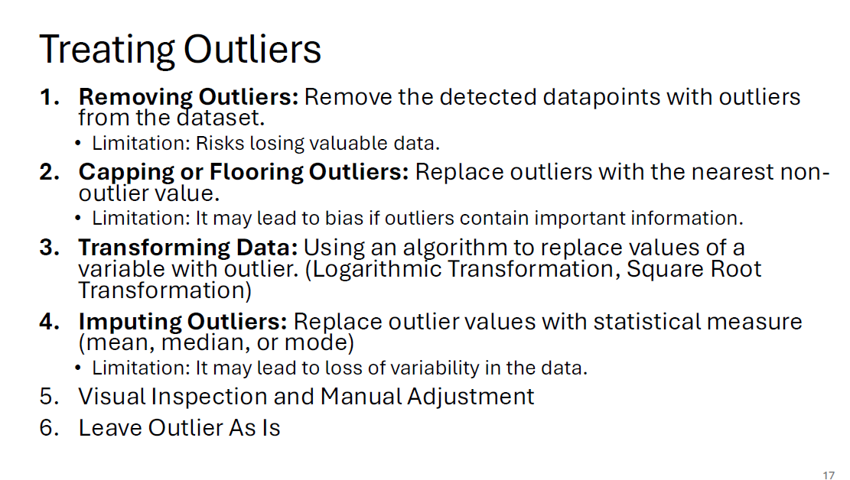

Slide 18
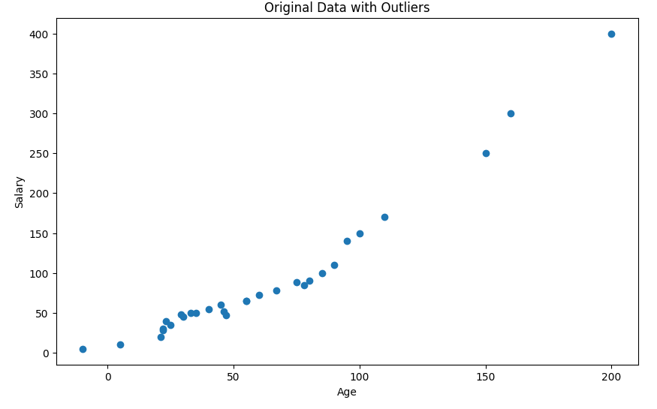
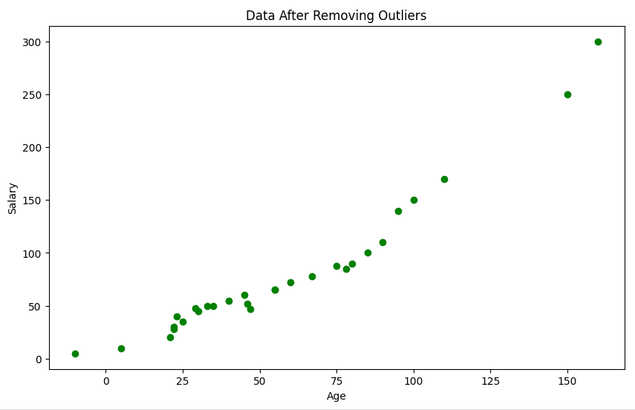
Simply remove the detected outliers from the dataset.

Slide 19
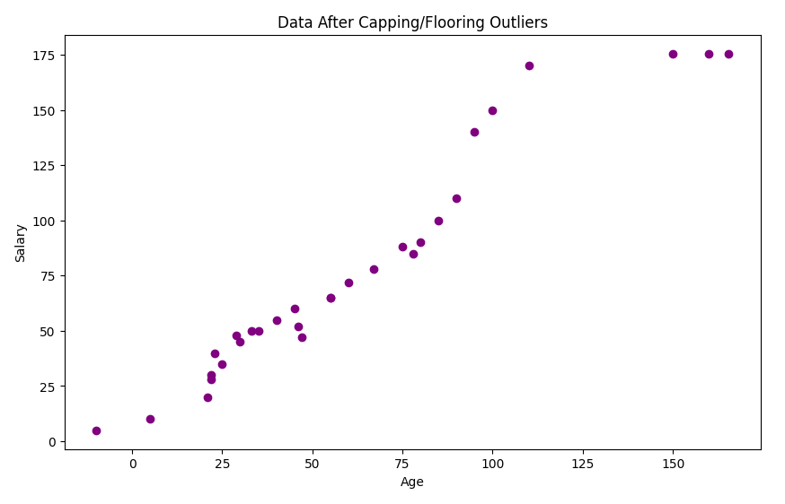
Replace the outliers with the nearest non-outlier value based on the IQR method.

Slide 20
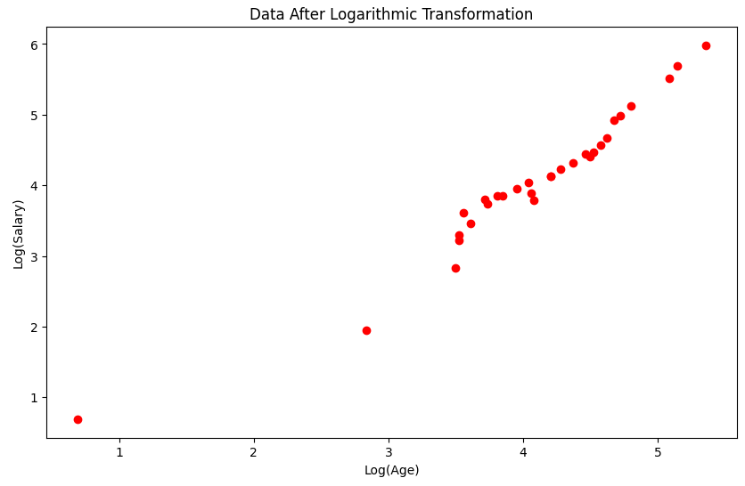
Apply a logarithmic transformation to reduce the impact of extreme values (outliers).

Slide 21
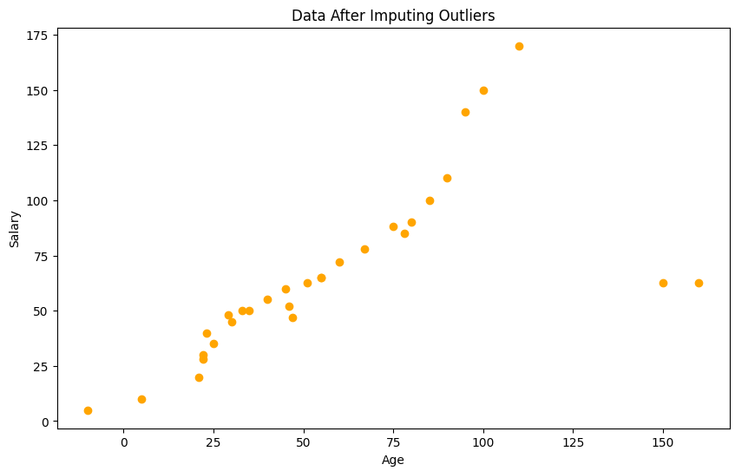
Replace outliers with a statistical measure, such as the median.

Slide 22
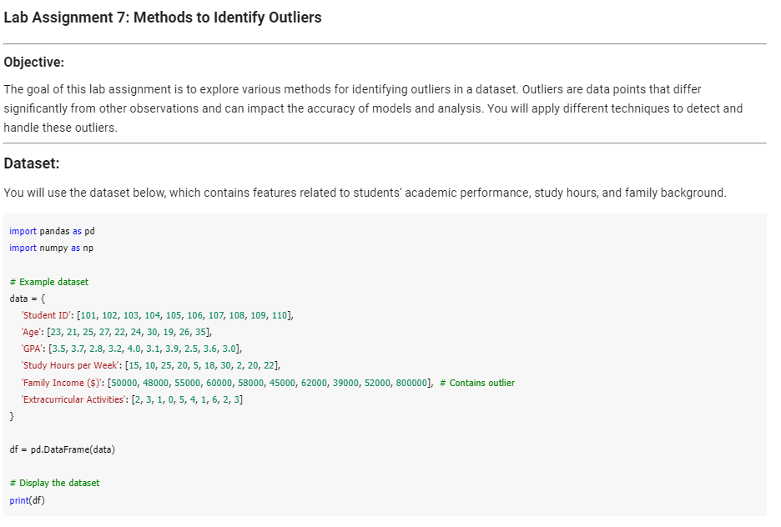

Slide 23
Data Relationships in Pandas

Slide 24
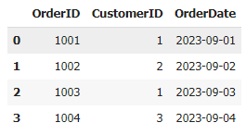
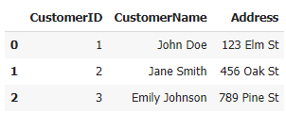
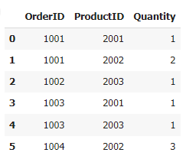
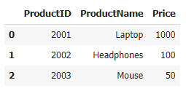
Count the number of orders made by "John Doe“
Retrieve all OrderID and OrderDate values for "Jane Smith“
List the ProductName and Quantity for OrderID 1001
Calculate the total revenue from all orders based on the product price and quantity ordered.

Slide 25
1. One-to-One Relationship
A one-to-one relationship occurs when each row in one dataset corresponds to exactly one row in another dataset.
Example:
You have two datasets:
One with EmployeeID and their Name.
Another with EmployeeID and their Email.

Slide 26
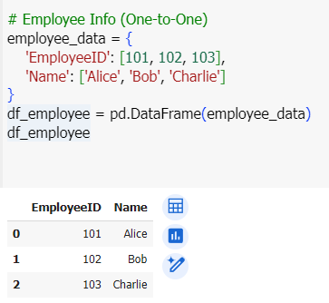
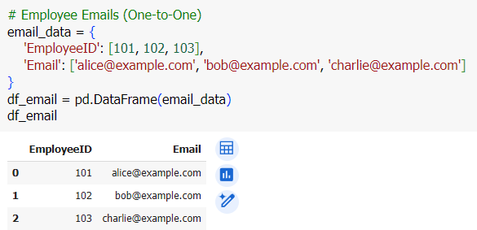

Slide 27
2. One-to-Many Relationship
In a one-to-many relationship, each record in one dataset can relate to multiple records in another dataset.
Example:
You have a dataset of Customers and another dataset of Orders. Each customer can place multiple orders.

Slide 28
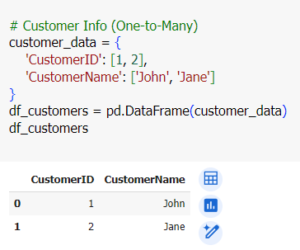
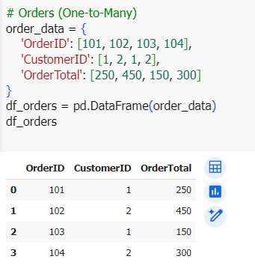

Slide 29
3. Many-to-Many Relationship
In a many-to-many relationship, multiple records in one dataset can relate to multiple records in another dataset. This requires an intermediary or "junction" table.
Example:
You have datasets of Students and Courses, where each student can enroll in multiple courses, and each course can have multiple students.

Slide 30
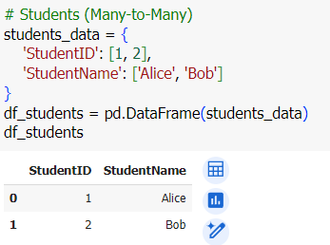
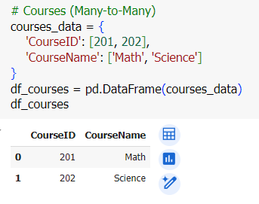
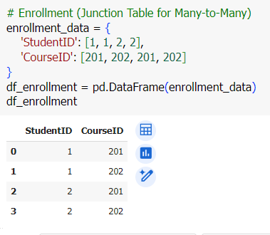

Slide 31
Merging the Table

Slide 32
Merging the Table
Merge Function àUser must specify column(s) to be used as reference to join the two tables.
pd.merge(<left_table>, <right_table>, on=‘<column_name>’,how = ‘<inner/outer/left/right>’)

Slide 33
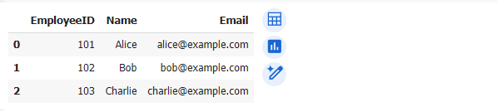
1. One-to-One Relationship
pd.merge(df_employee, df_email, on='EmployeeID')

Slide 34
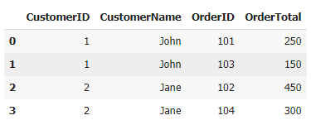
2. One-to-Many Relationship
pd.merge(df_customers, df_orders, on='CustomerID')

Slide 35
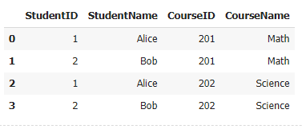
3. Many-to-Many Relationship
df_enrollment
df_courses
df_students
# Merge Students with Enrollment
df_student_courses = pd.merge(df_students, df_enrollment, on='StudentID')
# Merge with Courses
df_merged_many_to_many = pd.merge(df_student_courses, df_courses, on='CourseID')
Notes:
214

Slide 36
Joining Table

Slide 37
Join Function àPandas automatically find index to join the two tables.
<left_table>.join(<right_table>,how=‘<inner/outer/left/right>’)

Slide 38
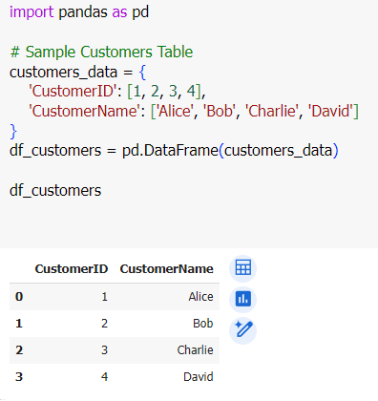
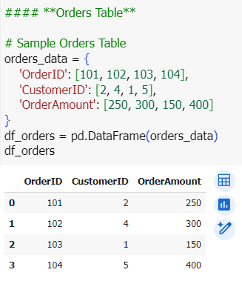

Slide 39
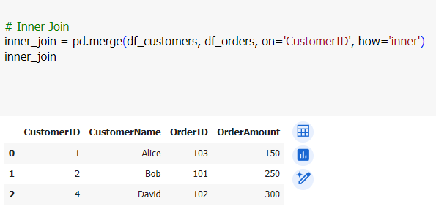
Inner Join
Definition: Keeps only rows with matching CustomerID in both datasets.

Slide 40
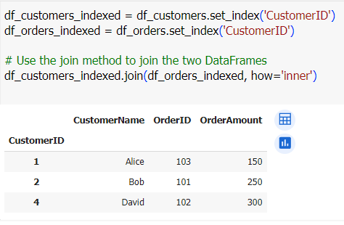
Inner Join

Slide 41
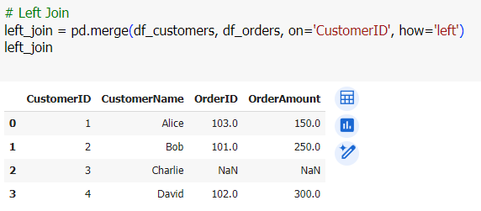
Left Join
Definition: Keeps all data from the left table (`Customers`), and fills in data from the right table (`Orders`). If there is no match, missing values are filled with `NaN`.

Slide 42
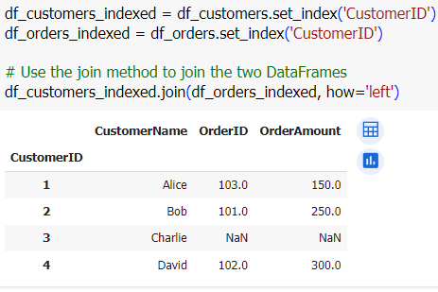
Left Join

Slide 43
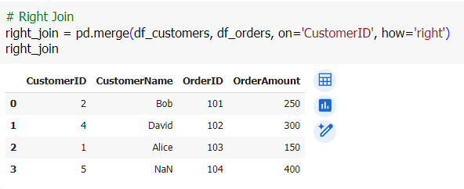
Right Join
Definition: Keeps all data from the right table (`Orders`), and fills in data from the left table (`Customers`). If there is no match, missing values are filled with `NaN`.

Slide 44
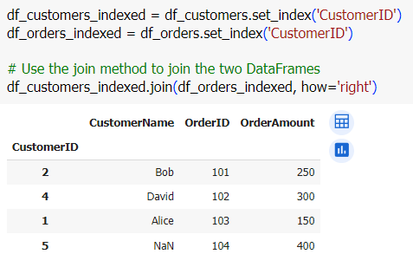
Right Join

Slide 45
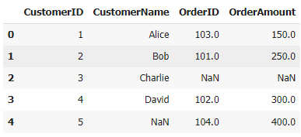
Outer Join
Definition: Keeps all rows from both tables, filling in missing values where there is no match.

Slide 46
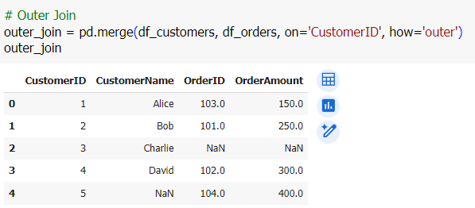
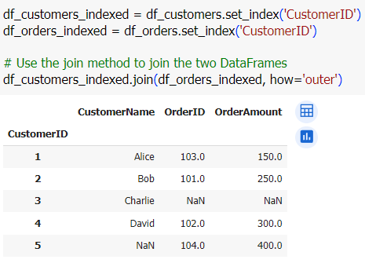
Outer Join

Slide 47
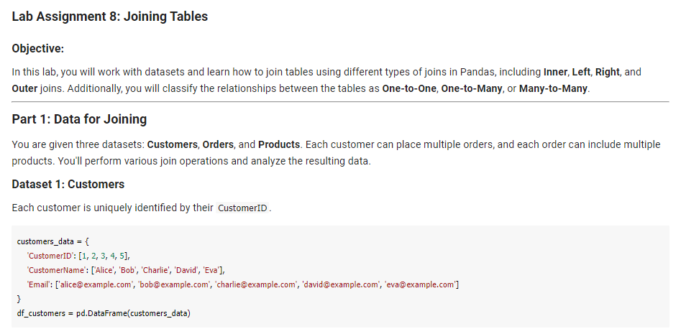

Slide 48
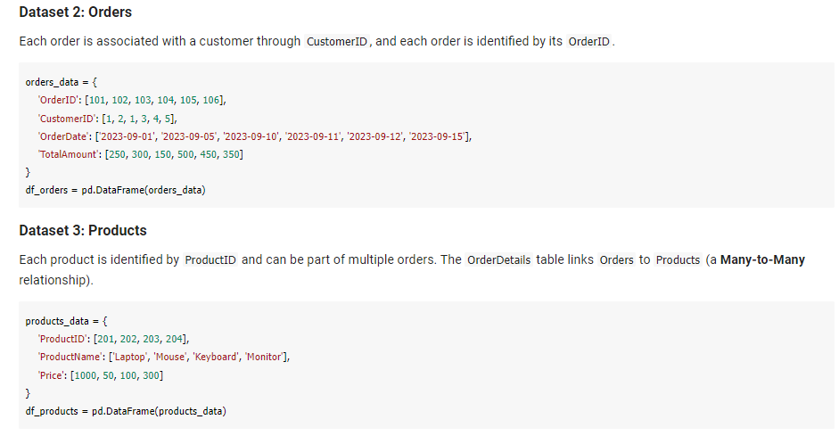

Slide 49
