Slide 1
BAS240 Data Analytics Programming
LAB 5:
Descriptive
Diagnostic
Predictive

Slide 2
https://github.com/9meo/bas240/

Slide 3
Descriptive Analysis
What happened? (Summarization)

Slide 4
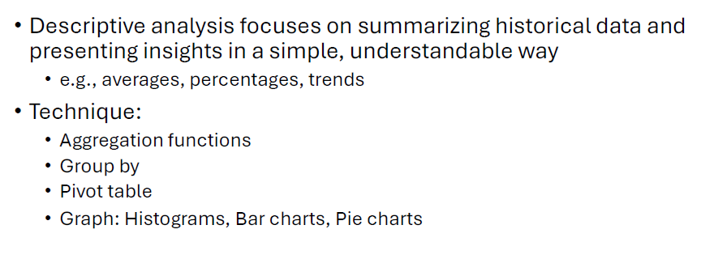
Descriptive Analysis

Slide 5

https://www.menti.com/alxxur9d3tbt

Slide 6
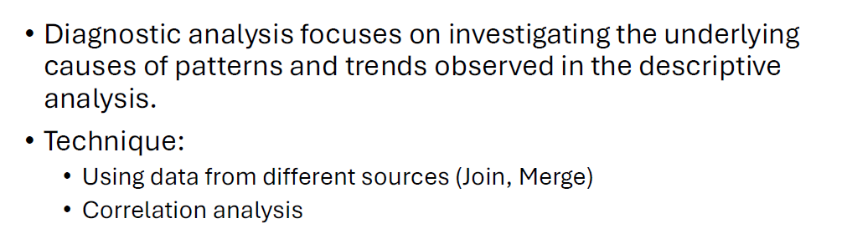
Diagnostic Analysis (Why did it happen?)

Slide 7
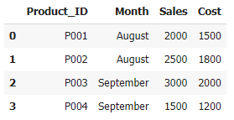
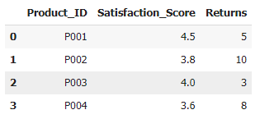
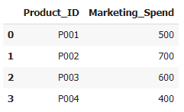
Import Pandas and Create Sample Datasets

Slide 8
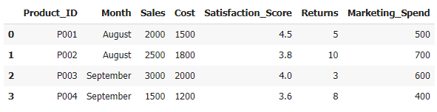
Merge Datasets
Explanation:
We first merge the sales data with customer satisfaction data using the Product_ID as the key.
Then, the combined dataframe is merged with the marketing spend data.

Slide 9
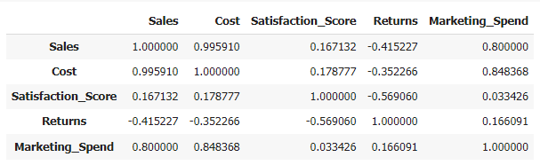
Correlation Analysis
Explanation:
We calculate the correlation matrix using .corr() to identify relationships between variables such as sales, costs, customer satisfaction, returns, and marketing spend.
Positive correlation values indicate a direct relationship, while negative values indicate an inverse relationship.

Slide 10

Investigate Potential Causes (Example)
Explanation:
We extract specific correlations, such as between Satisfaction Score and Sales, as well as Marketing Spend and Sales, to gain insight into the underlying causes of changes in sales.

Slide 11
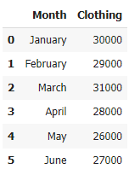
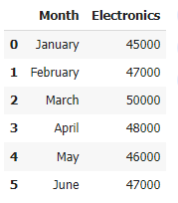
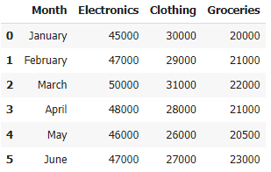
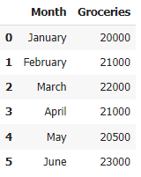
Example
Merge

Slide 12
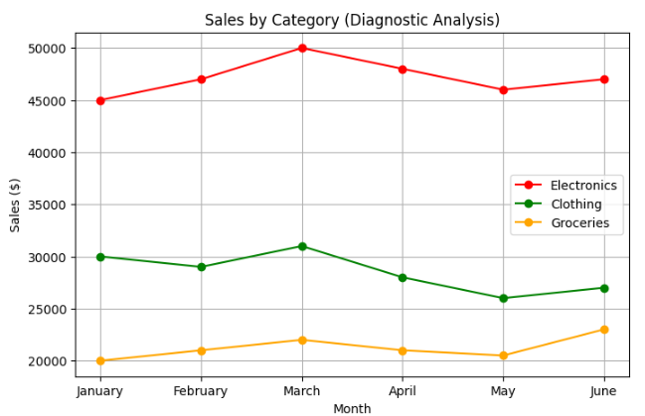

Slide 13
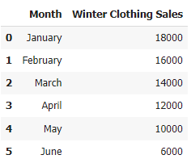
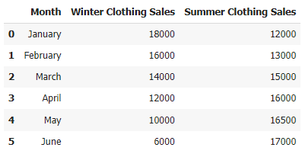
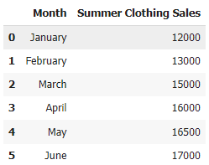
Example
Merge

Slide 14
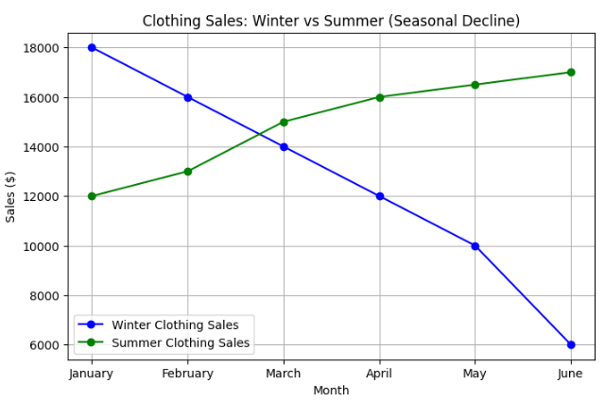

Slide 15
Predictive Analysis
What will happen?

Slide 16
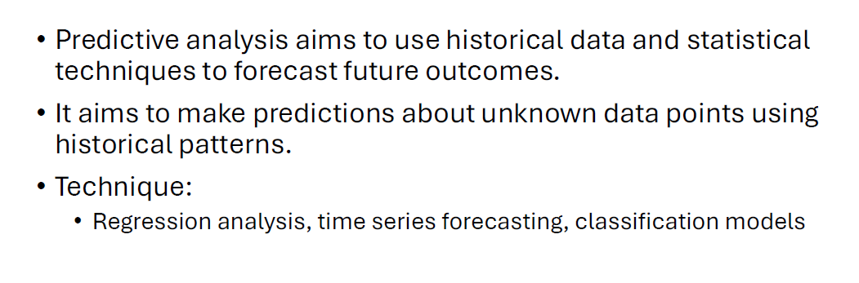
Predictive Analysis

Slide 17
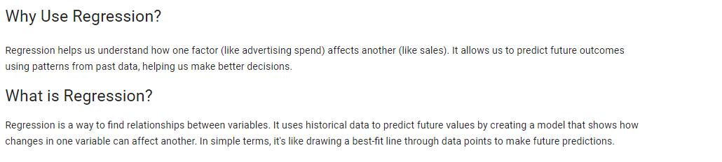
Regression

Slide 18
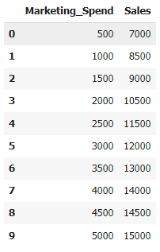
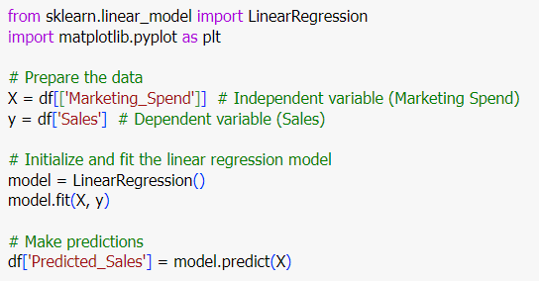
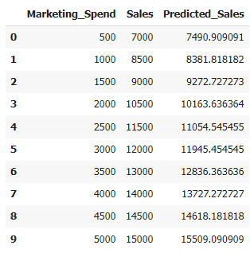
Example Data

Slide 19
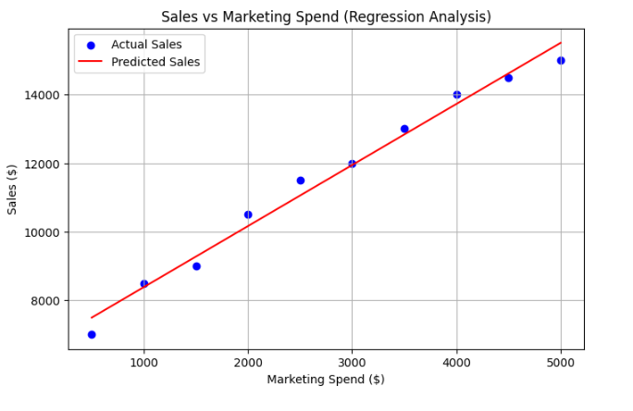

Slide 20
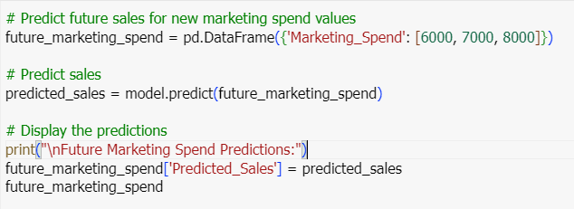
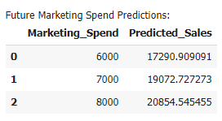
Predict Future Sales

Slide 21
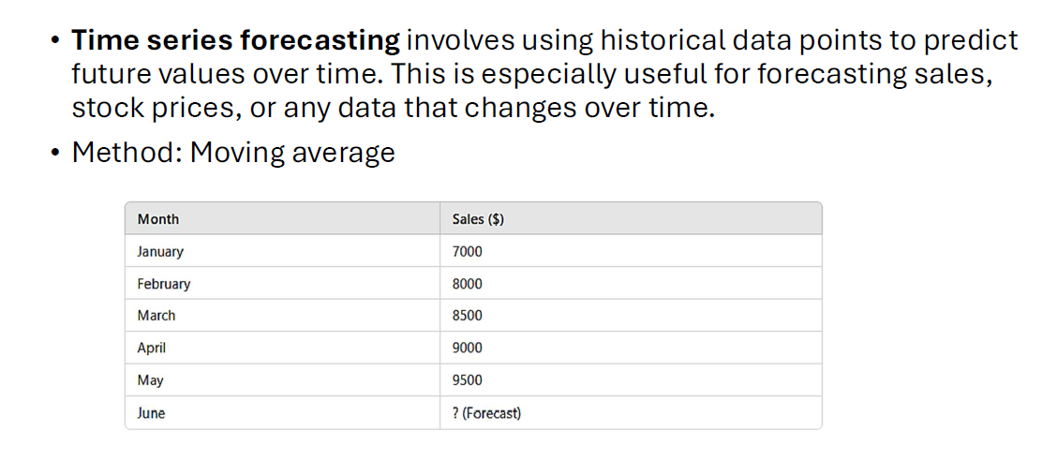
Time Series Forecasting

Slide 22
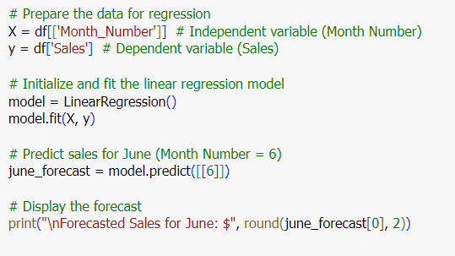
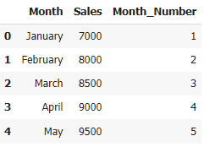

Slide 23
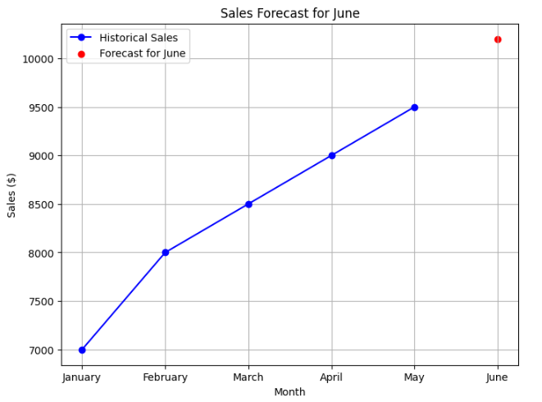

Slide 24
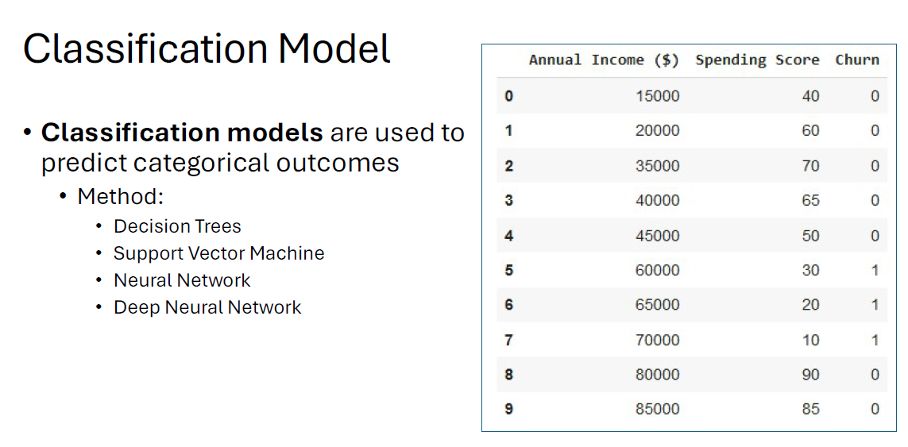

Slide 25
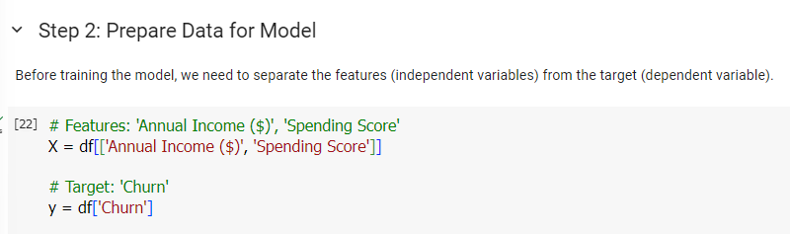
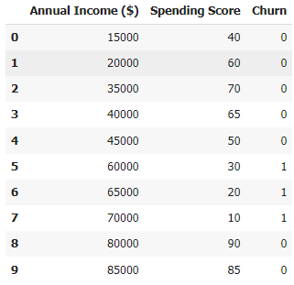
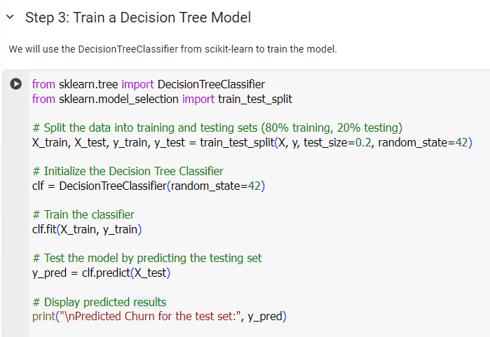

Slide 26
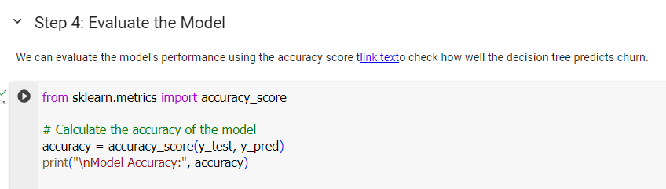

Slide 27
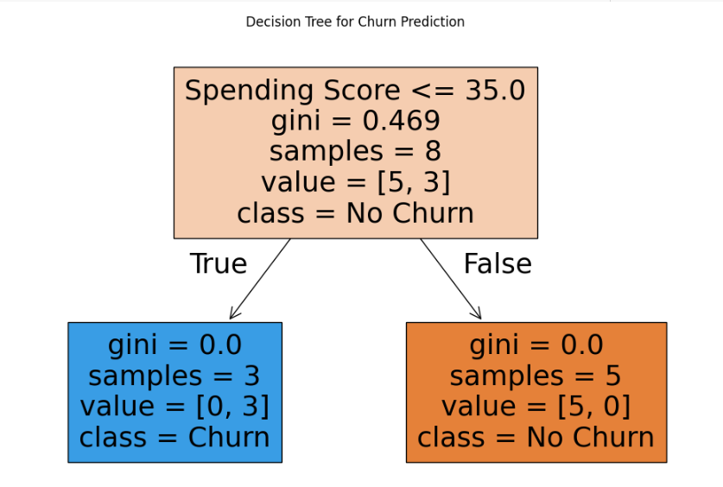

Slide 28
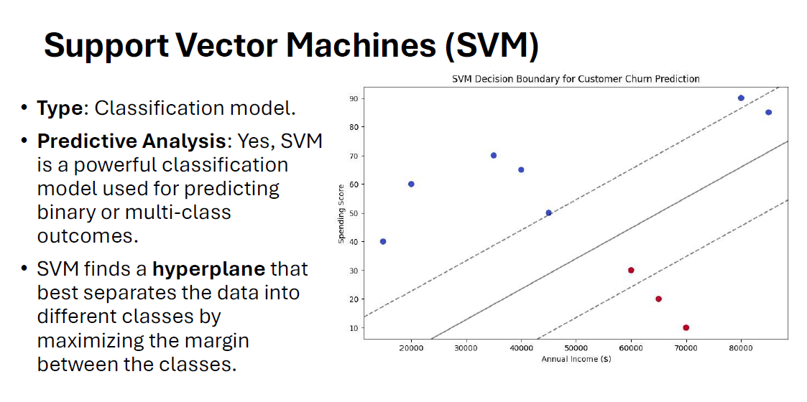

Slide 29
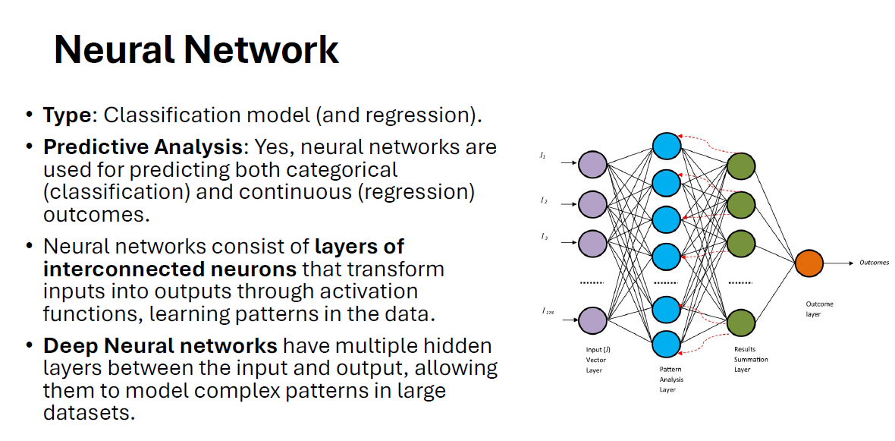

Slide 30
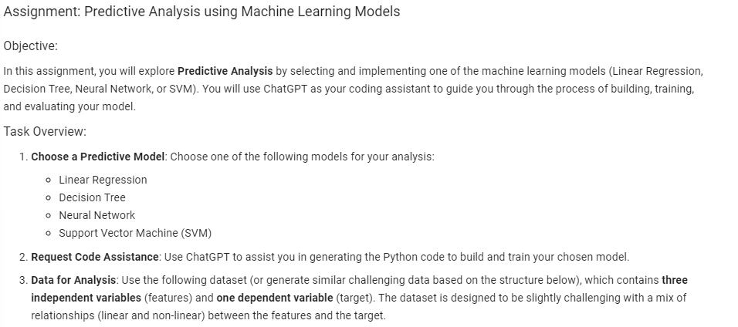

Slide 31
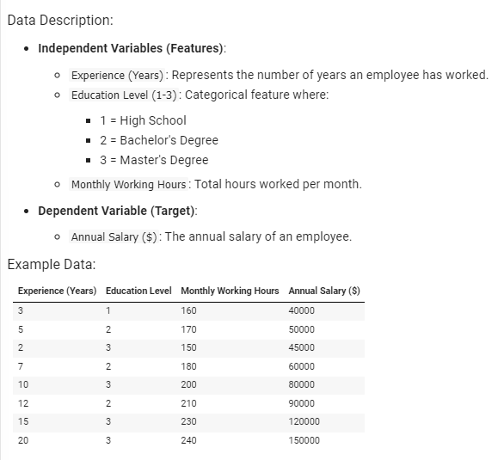

Slide 32
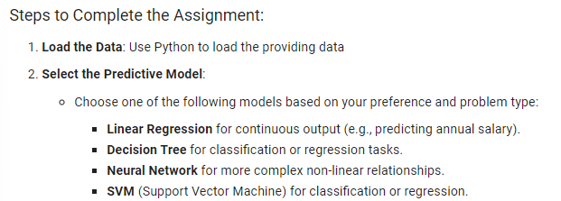

Slide 33
Additional Material
https://medium.com/@idowuadamo2904/machine-learning-for-price-prediction-a-step-by-step-guide-ad5913b5cec7
https://medium.com/datafabrica/mastering-prompt-engineering-for-time-series-analysis-dd66428b7490

Slide 34
Running LLM Locally

Slide 35
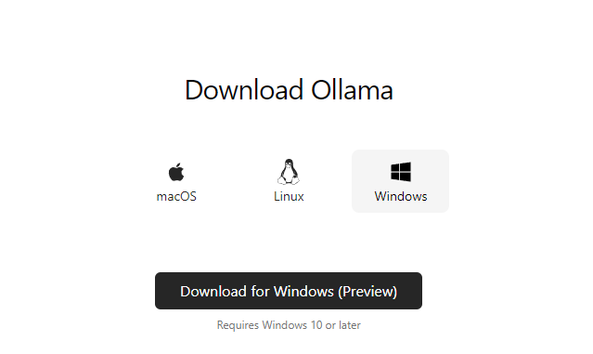
https://ollama.com/download

Slide 36
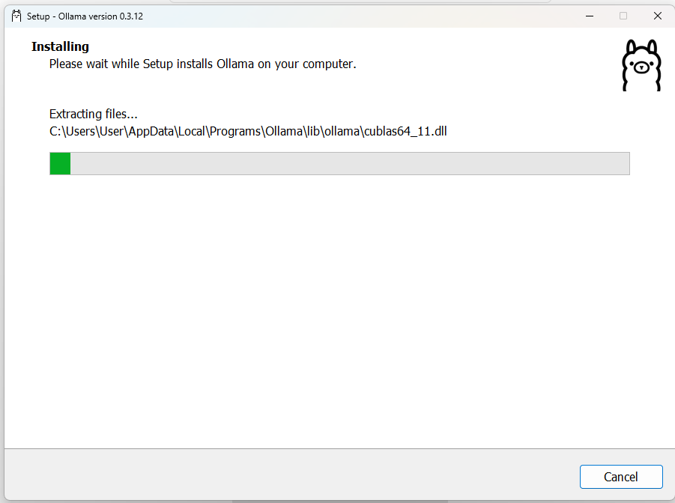

Slide 37

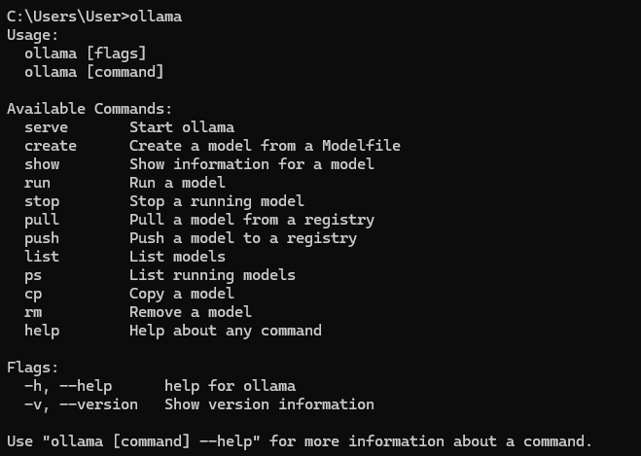

Slide 38

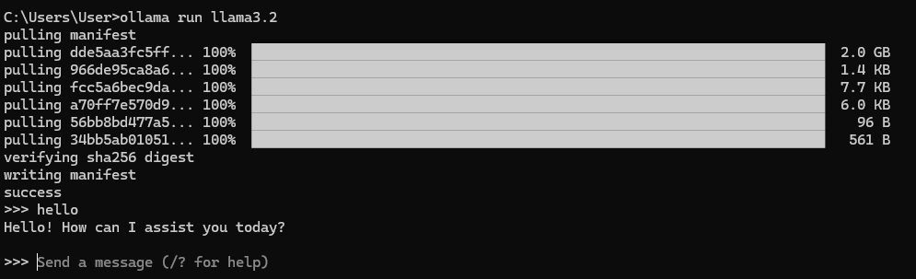

Slide 39
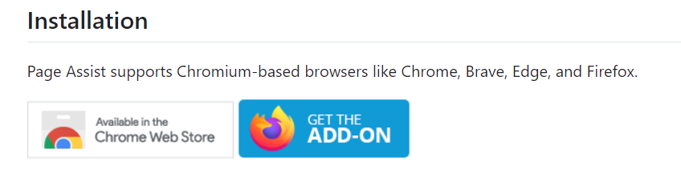
Install Ollama UI
https://github.com/n4ze3m/page-assist

Slide 40
