Slide 1
BAS240 Data Analytics Programming
LAB 7:
Large Language Models (LLMs)
Prompting LLMs
LLM and Data Analytic

Slide 2
https://github.com/9meo/bas240/

Slide 3
Large Language Models (LLMs)

Slide 4

01 What is an LLM?

Slide 5
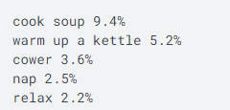

What is a language model?
A language model is a machine learning model that aims to predict and generate plausible language. Autocomplete is a language model, for example.
These models work by estimating the probability of a token or sequence of tokens occurring within a longer sequence of tokens. Consider the following sentence:

Slide 6
What is a large language model?
A large language model (LLM) is an advanced AI that can predict and generate text at the level of sentences, paragraphs, or entire documents.
Over time, LLMs have grown significantly in size and capability due to improvements in computing power, larger datasets, and better techniques for handling long text sequences.

Slide 7
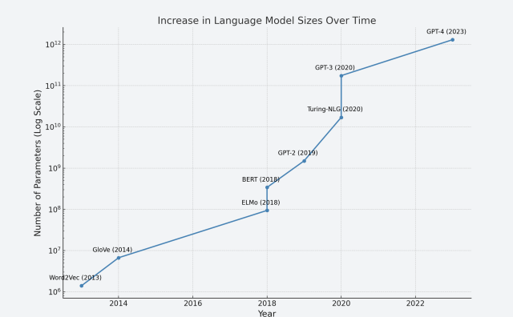
How large is large?

Slide 8
What are LLM parameters?

Slide 9
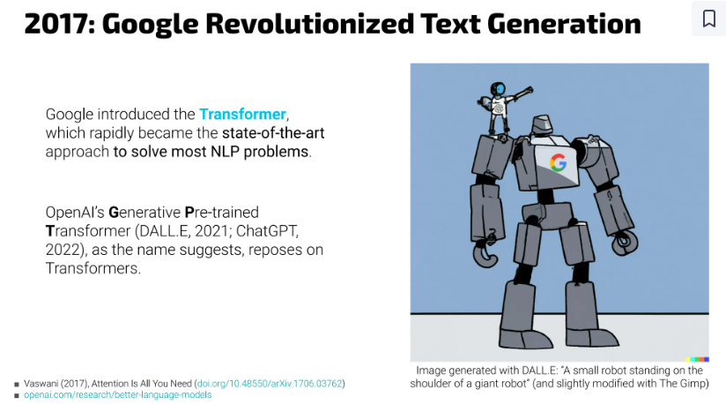
How large is large?

Slide 10
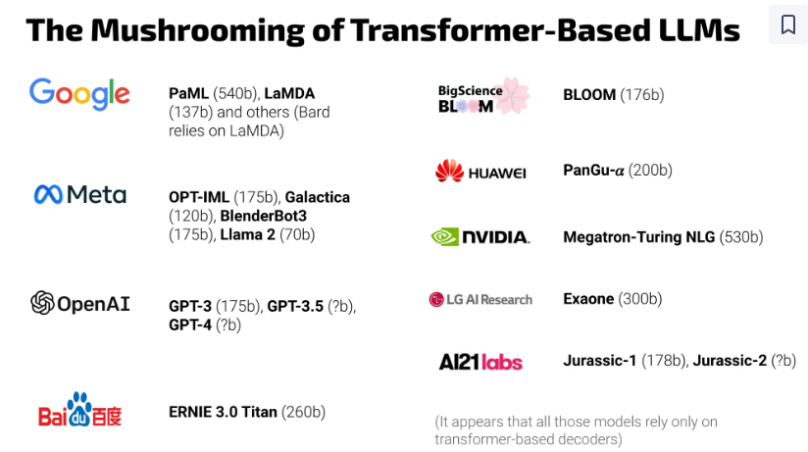

Slide 11
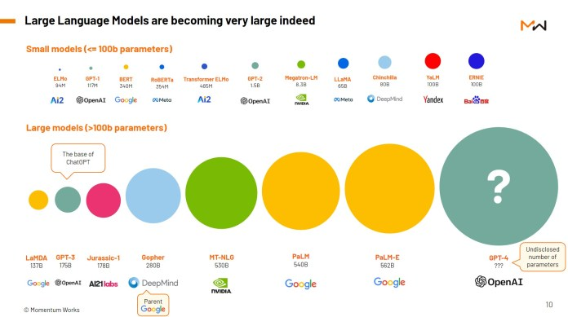
https://thelowdown.momentum.asia/the-emergence-of-large-language-models-llms/

Slide 12
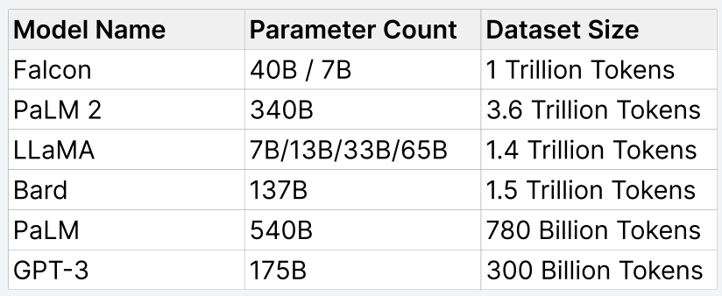
How large is large?

Slide 13
Open Source vs Close LLM
Open-source models are made available to the public for free.
Llama
Gemma
Closed models, on the other hand, are proprietary and usually not freely accessible to the public.
Gemini
GPT-3.5, GPT-4, GPT-4o
Claude

Slide 14
LLM Capabilities
Conversational Agents
Text Summarization
Semantic Search
Sentiment Analysis
Language Translation
Code Generation
Content Generation

Slide 15

Commonly Used GPUs/Memory
Nvidia V100 - 16GB VRAM
Nvidia A10G - 24GB VRAM
Nvidia A100 - 40/80GB VRAM
Nvidia H100 - 80GB VRAM

Slide 16
Limitation

Slide 17
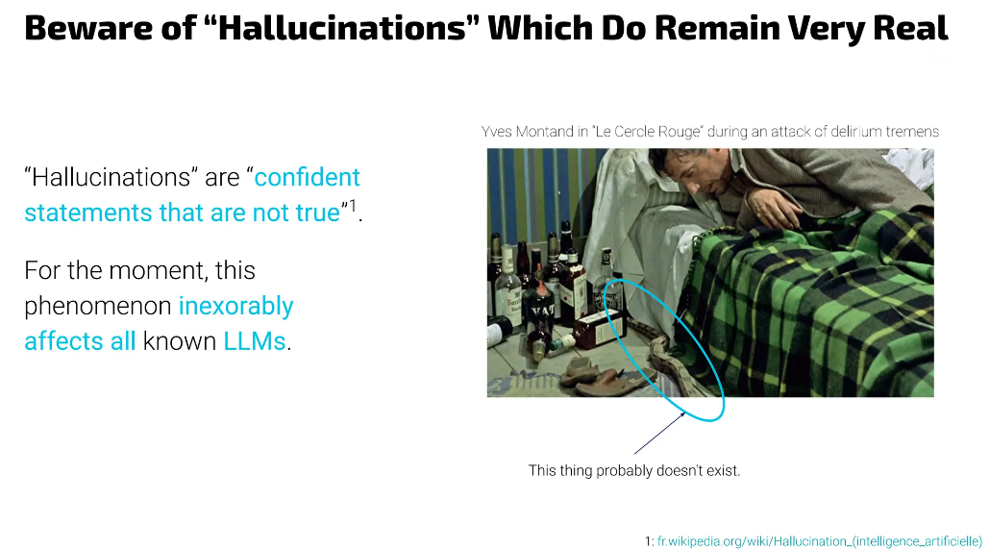

Slide 18
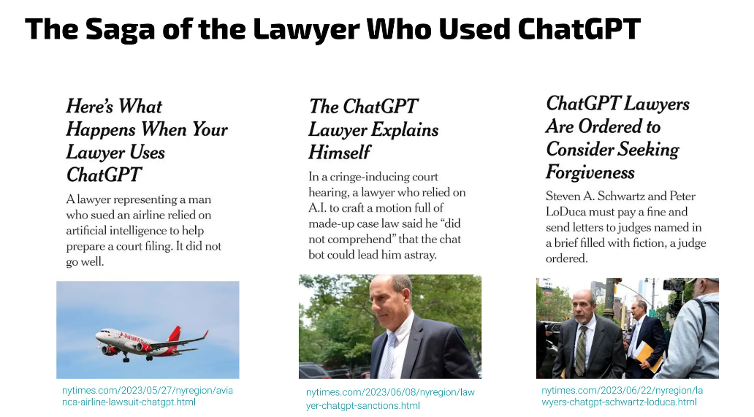

Slide 19
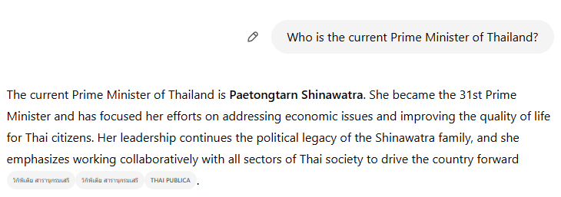
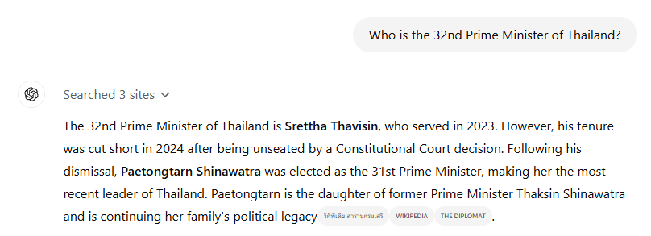
It won't write about anything after 2021

Slide 20
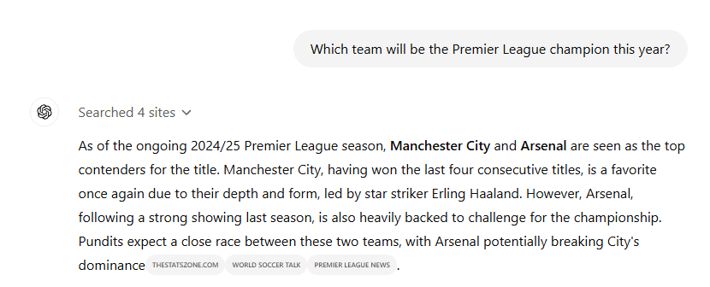

It won't predict future results of sports events or political contests

Slide 21
LLMs Are Bad at Math
LLMs are “stochastic parrots,” a term coined by researcher Emily Bender, to describe that while LLMs can generate language that sounds convincing to a human, they don’t understand the meaning of the language they are “parroting.” And unlike symbolic computation systems, LLMs are non-deterministic, meaning that for the same input, the model won’t necessarily yield the same output every time.

Slide 22
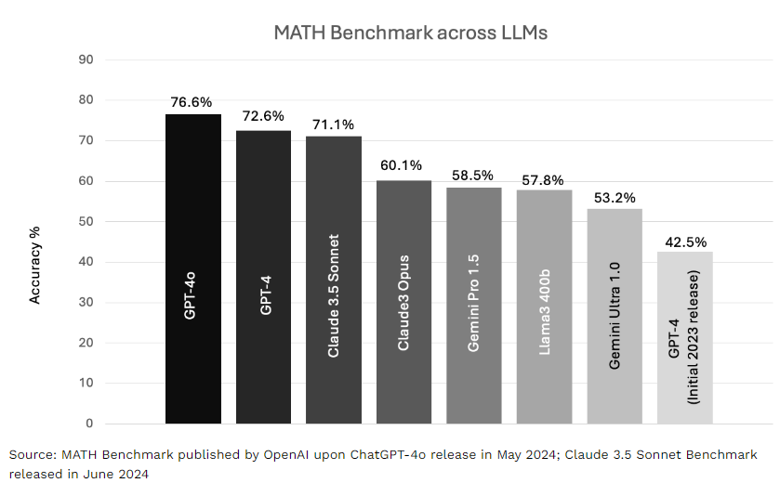
LLMs Are Bad at Math
https://www.reachcapital.com/2024/07/16/why-llms-are-bad-at-math-and-how-they-can-be-better/

Slide 23

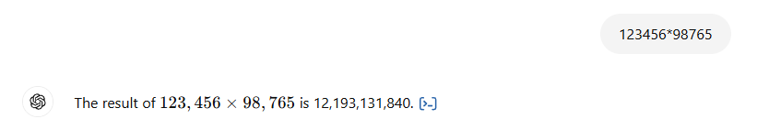
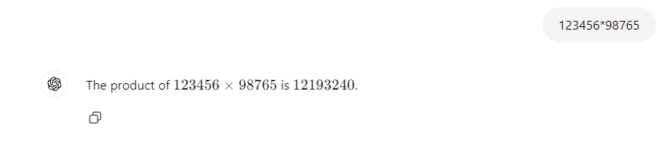
LLMs Are Bad at Math

Slide 24
Prompting LLMs

Slide 25
Prompting LLMs
Zero-Shot
In-Context-Learning
Thought generation

Slide 26
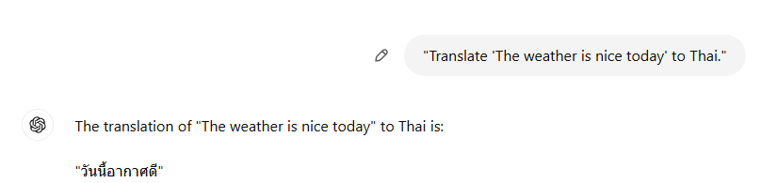
Zero-Shot
Asking the model to perform a task without providing any task-specific examples.

Slide 27
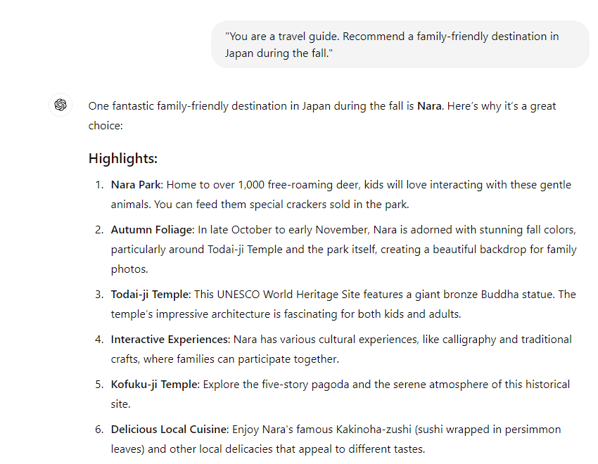

Zero-Shot Role Prompting involves asking the LLM to adopt a specific role or persona without giving it any prior examples of how to act in that role. The model uses its general knowledge to simulate the role based on your request.

Slide 28
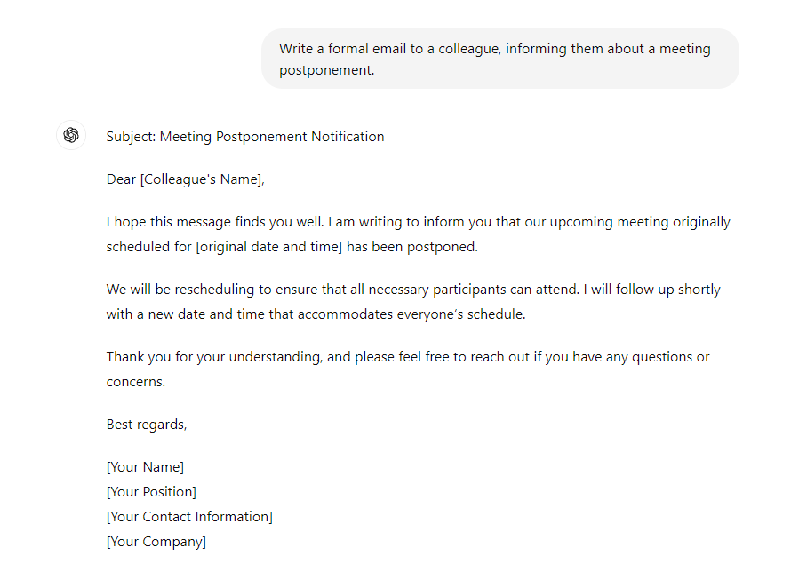
Zero-Shot Style Prompting involves asking an LLM to write in a specific style or tone without providing it with examples of that style. The model uses its understanding of language to adapt its response accordingly.

Slide 29

Zero-Shot Emotion Prompting involves asking an LLM to respond in a specific emotional tone without providing examples. The model will generate a response that conveys the desired emotion based on the prompt.

Slide 30
In-Context-Learning

Slide 31
In-Context Learning involves providing the LLM with examples within the prompt so it can infer how to perform the task based on those examples. This allows the model to understand the pattern and apply it to similar tasks.
Example of In-Context Learning:
Prompt: "Translate the following sentences from English to Thai:
'Hello' -> 'สวัสดี'
'Thank you' -> 'ขอบคุณ'
'Goodbye' -> 'ลาก่อน'
Now, translate: 'How are you?'"
LLM Response (In-Context Learning): "How are you?" -> "คุณสบายดีไหม"

Slide 32
"Classify the sentiment of the following sentences as Positive, Negative, or Neutral:
'I love this movie, it was fantastic!' -> Positive
'The food was terrible, I’ll never go back there.' -> Negative
'The weather is fine, nothing special.' -> Neutral
Now, classify the sentiment of this sentence: 'This new phone is amazing, I’m so happy with it!'"

Slide 33
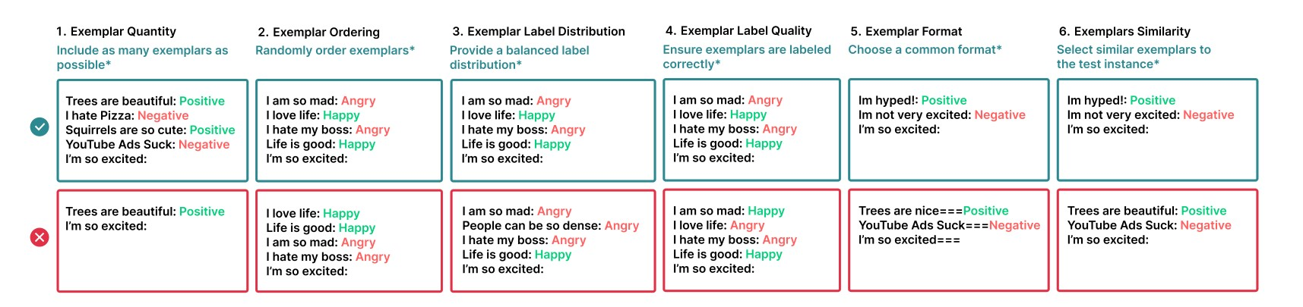
Exemplar Design Decision

Slide 34
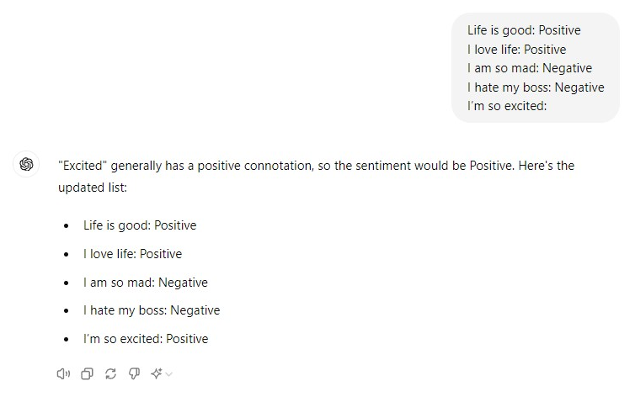
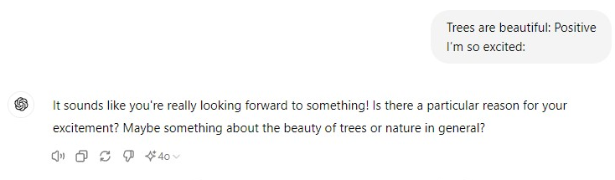

Slide 35
Thought generation

Slide 36
Zero-Shot Chain of Thought (CoT) involves asking an LLM to reason through a problem step-by-step without being given any explicit examples of how to do so. This technique encourages the model to break down a task and reason through its steps logically before arriving at an answer.

Slide 37
Prompt: "A train travels from Station A to Station B at a speed of 60 km/h. The distance between the two stations is 180 km. How long does the journey take? Think step by step before giving the answer."
LLM Response (Zero-Shot CoT): "First, we know that speed is equal to distance divided by time. The train is traveling at 60 km/h, and the distance between the stations is 180 km. Now, to calculate the time, we can use the formula: Time = Distance / Speed. In this case, the time is 180 km / 60 km/h = 3 hours. So, the journey takes 3 hours."

Slide 38
Analogical Prompting involves asking the LLM to solve a problem or task by drawing parallels or analogies with a related example.
The model is prompted to use its understanding of similar situations to reason and generate an answer for a new task.

Slide 39
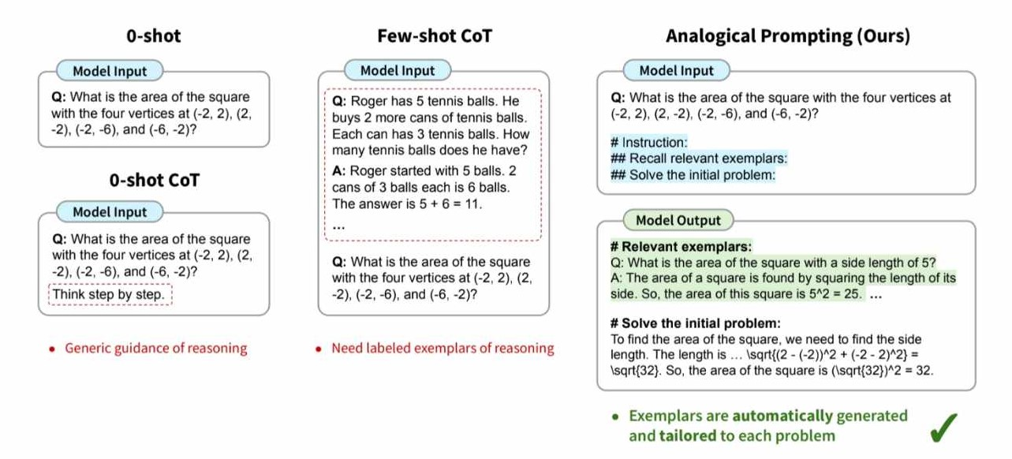
Analogical Prompting

Slide 40
Prompt: "Solving a math problem is like following a recipe. Just as you follow steps to cook a meal, you follow steps to find the solution to a problem. For example, in a recipe, you first gather ingredients, then follow instructions step by step. Similarly, to solve a math problem, you first identify the given information, then apply formulas or methods step by step. Now, solve this math problem using the same logic: If I have 10 apples and I give 3 to my friend, how many do I have left?"
LLM Response (Analogical Prompting): "Just like in a recipe where you start by identifying the ingredients, in this math problem, we start by identifying the given information: you have 10 apples. Next, just as in cooking where you follow a process, in the problem, you give away 3 apples, so we subtract 3 from 10. Finally, just as the result of following the recipe is the meal, the result of our math process is the answer. 10 - 3 = 7. So, you have 7 apples left."

Slide 41
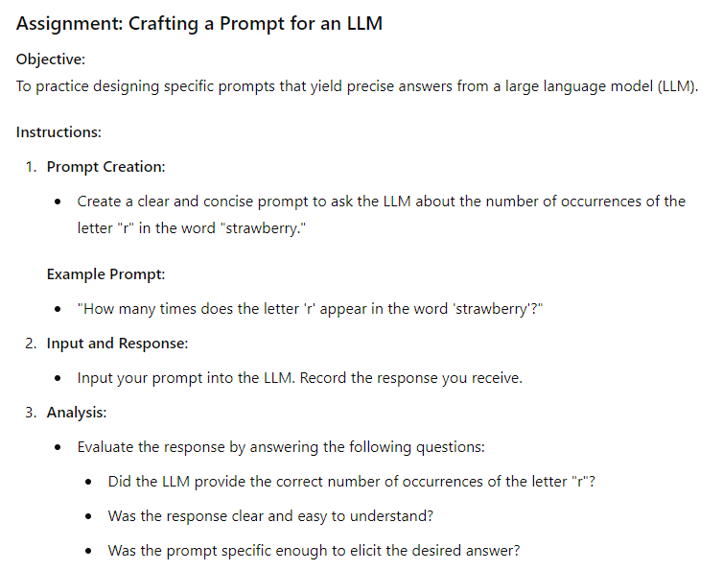

Slide 42
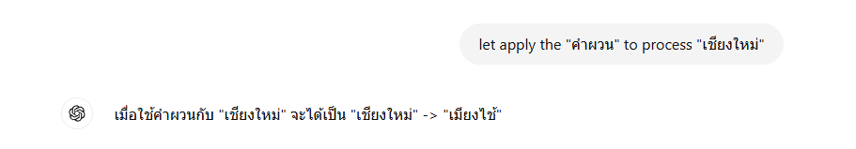
Assignment 2:
"คำผวน" (Kham Phuan) is a type of Thai wordplay where the sounds or syllables of words are swapped to create new words or phrases. This often results in humorous or playful meanings. It's commonly used for fun, jokes, or coded messages.
For example:
Original: "รถยนต์" (rot-yon) Swapped: "ยนตรถ" (yon-rot)

Slide 43
LLM and Data Analytic

Slide 44
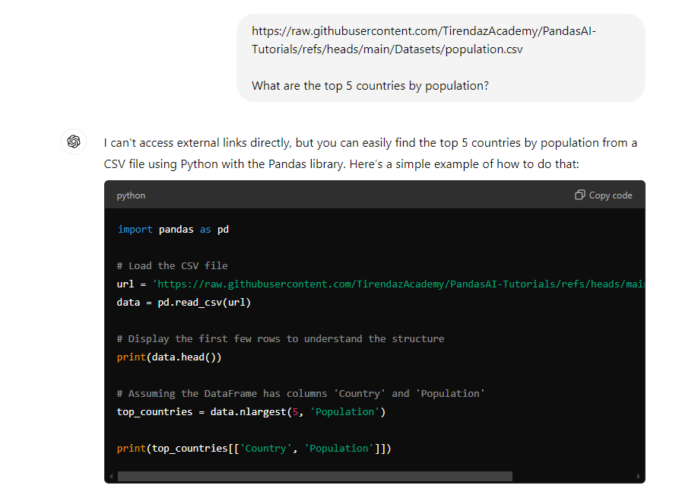
LLM and Data Analytic

Slide 45
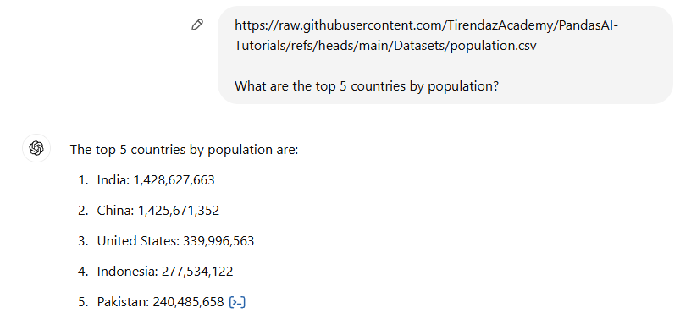
LLM and Data Analytic

Slide 46
PandasAI
https://www.youtube.com/watch?v=kh61wEy9GYM

