Slide 1
BAS240 Data Analytics Programming
LAB 3:
Aggregation
Pivot Table
Unpivot

Slide 2
https://github.com/9meo/bas240/

Slide 3
Data Aggregation
A process of summarizing or combining multiple pieces of data into a single, unified dataset or value.
By applying operations/functions to group and condense data into a more digestible form.
Operation/function: summing, averaging, counting, or finding the minimum or maximum

Slide 4
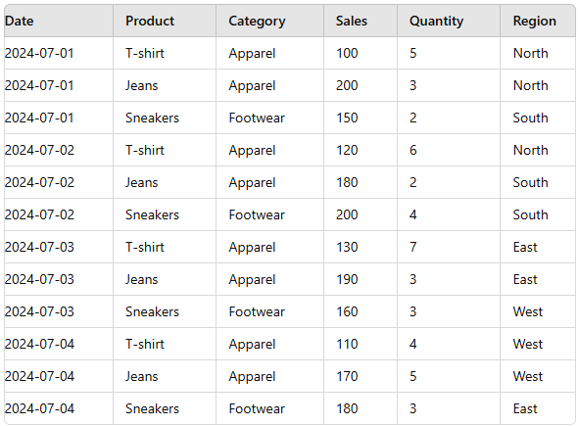
Example
Total sale
Total quantity sold
Total quantity sold of each product
Average sale per day
Total sales revenue for each product?
Total sales revenue generated by the "Apparel" category across all regions?
Which region had the highest total sales for the "Footwear" category?

Slide 5
Example
Total sale
df['Sales'].sum()

Slide 6
Example
Total quantity sold
df['Quantity'].sum()

Slide 7
Example
Total quantity sold
df['Quantity'].sum()

Slide 8
GROUPBY
The groupby function in pandas is a powerful tool that allows you to group data based on one or more columns and then apply aggregate functions to each group.
How groupby Works:
Splitting the Data: The data is split into groups based on the values in one or more columns. Each unique value (or combination of values) forms a group.
Applying a Function: Once the data is grouped, you can apply aggregate functions (like sum, mean, max, min, count, etc.) to each group independently.
Combining the Results: The results of the function applied to each group are combined into a new DataFrame or Series, where each row represents a group and the values represent the result of the aggregation.

Slide 9
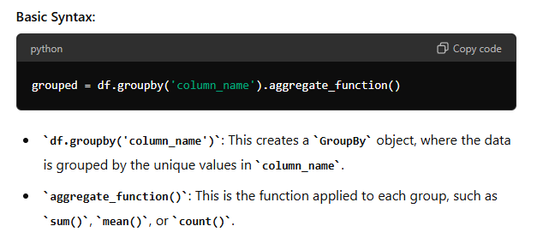
GROUPBY

Slide 10
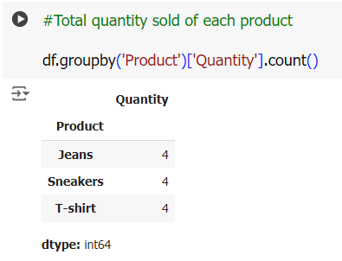
Example
Total quantity sold of each product

Slide 11
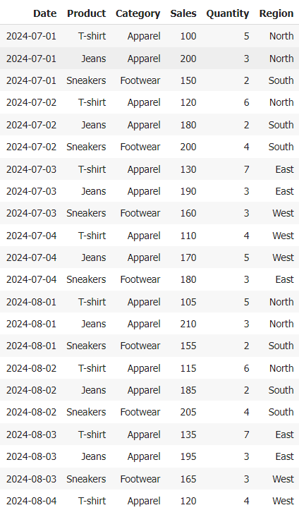


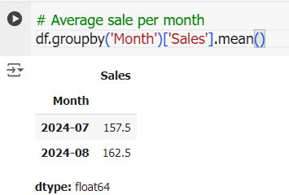
Example
Average sale per month

Slide 12
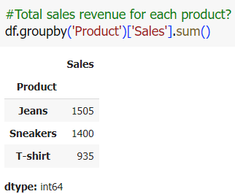
Example
Total sales revenue for each product?

Slide 13

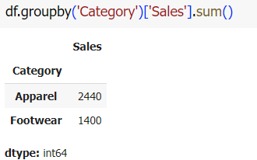
Example
Total sales revenue generated by the "Apparel" category across all regions?

Slide 14
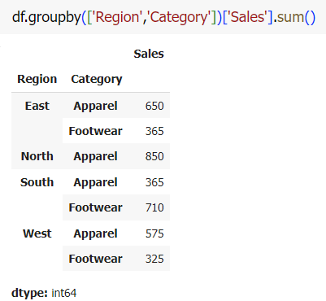
Example
Which region had the highest total sales for the "Footwear" category?

Slide 15
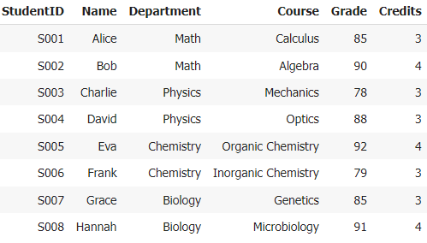
Assignment 4 Data Aggregation

Slide 16
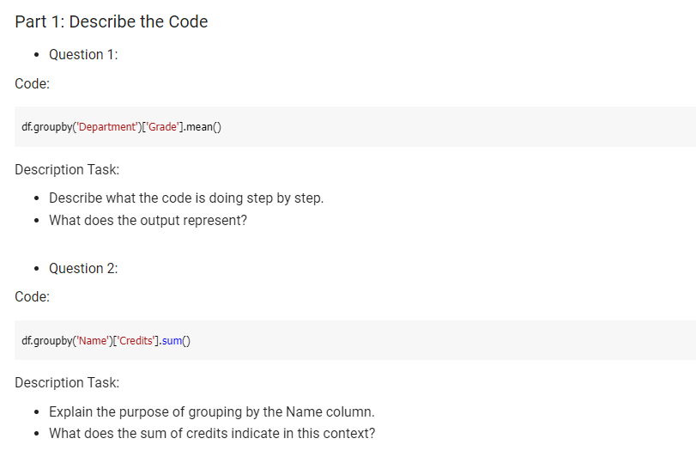
Assignment 4 Data Aggregation

Slide 17
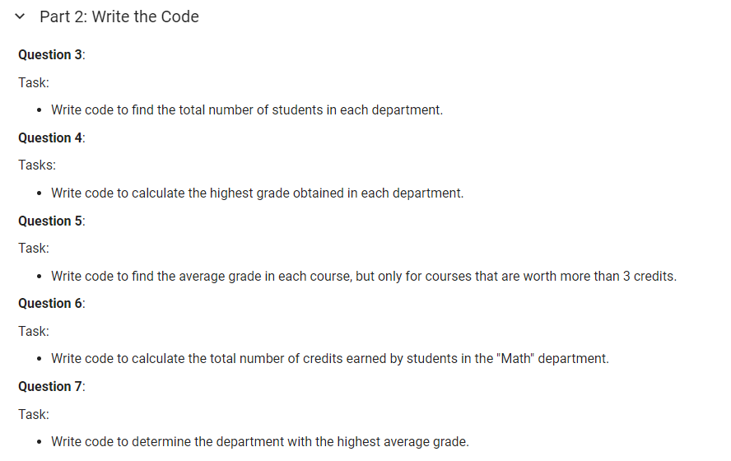
Assignment 4 Data Aggregation

Slide 18
Pivot Table

Slide 19
https://github.com/9meo/bas240/

Slide 20
What is a Pivot Table?
A pivot table is a powerful data analysis tool that helps to summarize and reorganize data in a structured format.
Take large datasets and "pivot" the data.
Transforming rows into columns and columns into rows to provide a more comprehensive view of the data.

Slide 21
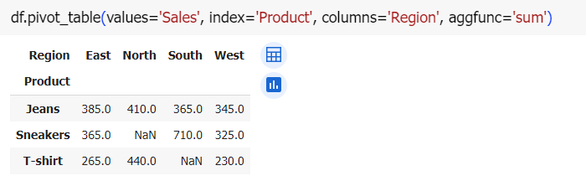
Example
Total Sales by Product and Region

Slide 22
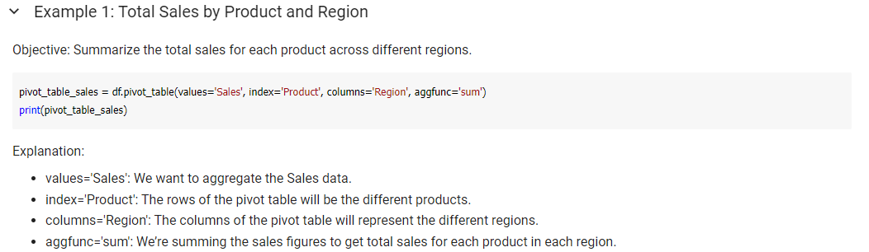

Slide 23


Slide 24
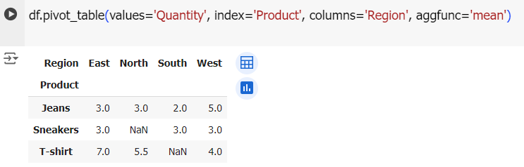
Example
Average Quantity Sold by Product and Region

Slide 25
Why Use Pivot Tables?
Pivot tables help you:
Summarize Large Data: Quickly aggregate and summarize data to see patterns and trends.
Organize Data: Transform data into an easily understandable format.
Analyze Relationships: Compare different aspects of your data, like product performance across regions.

Slide 26
Unpivot Table
Unpivot table takes a summary or wide-format table and transforms it back into a more detailed, longer format.
Unpivoting (also known as "melting") is the process of transforming data from a wide format, where each column represents a variable, to a long format, where each row represents a single observation.
This is particularly useful when you need to prepare data for analysis or visualization, as many tools and functions work better with long-format data.

Slide 27
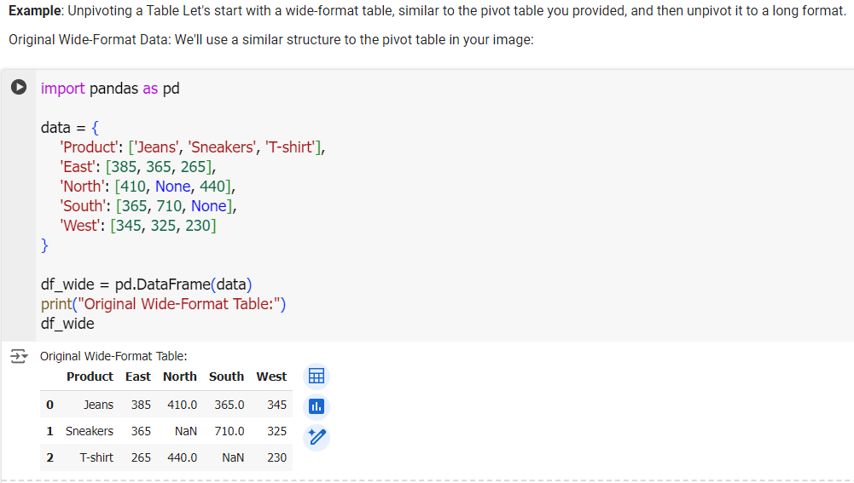

Slide 28
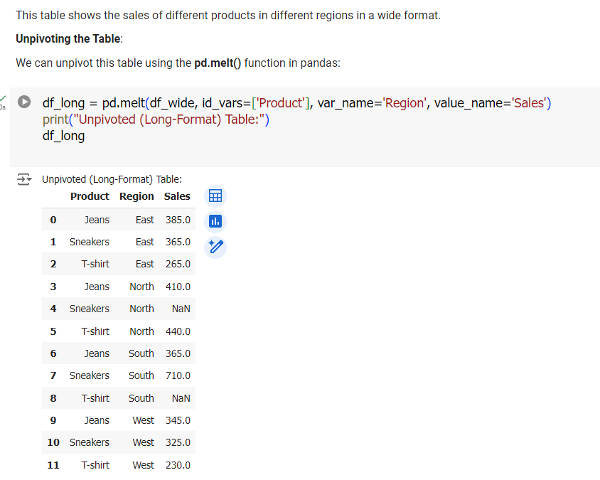

Slide 29
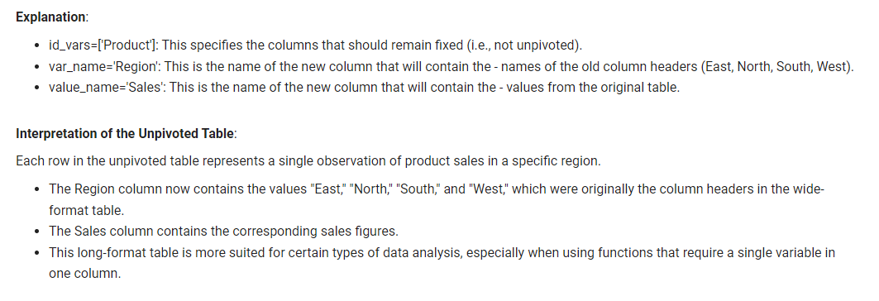

Slide 30
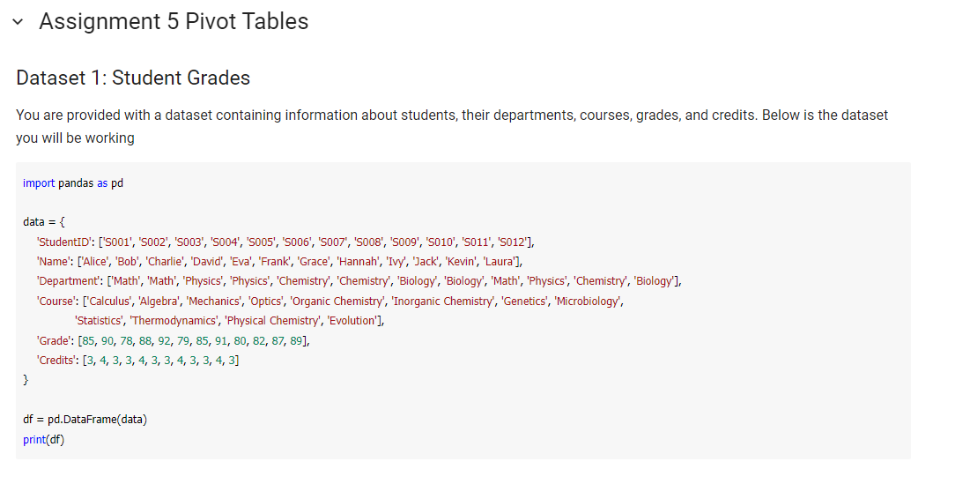

Slide 31
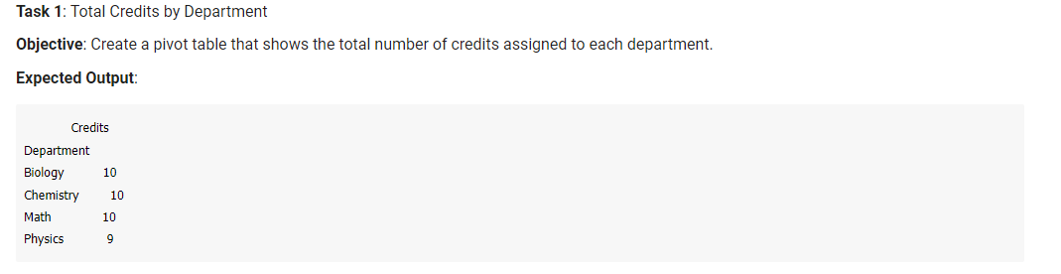

Slide 32
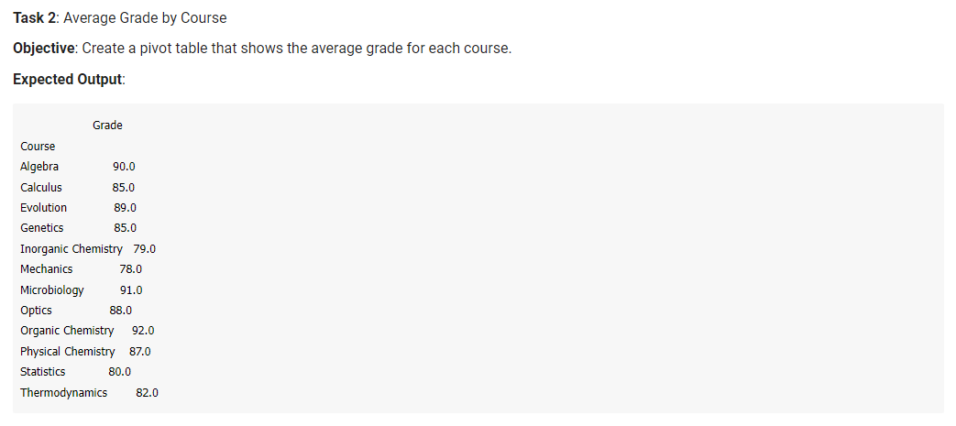

Slide 33
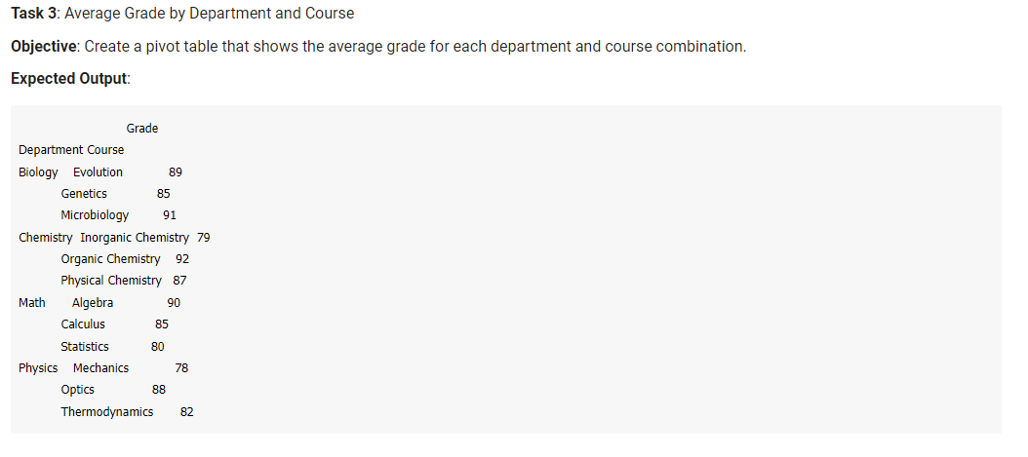

Slide 34
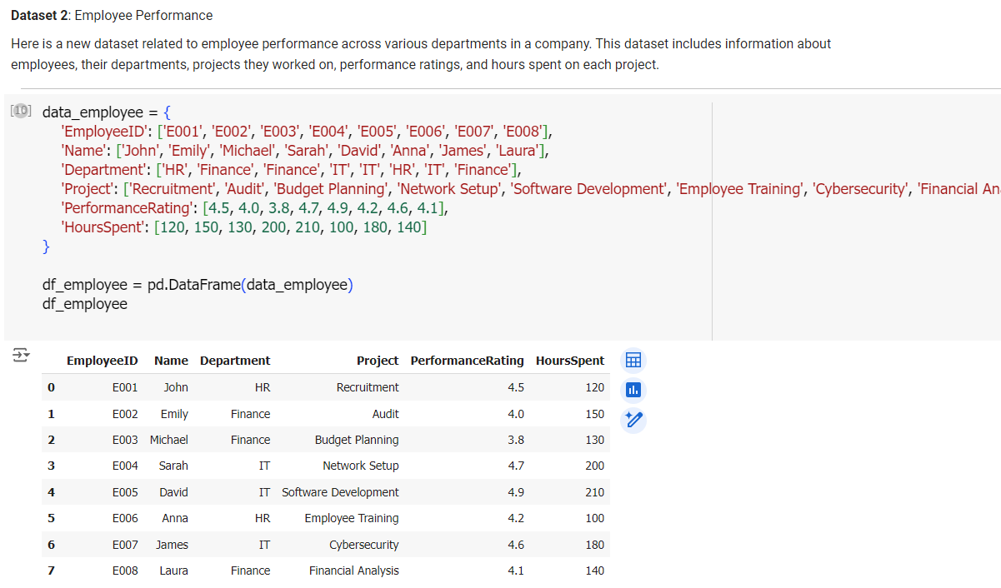

Slide 35
