Slide 1
BAS240 Data Analytics Programming
LAB 4:
Data Processing
Exploratory Data Analysis

Slide 2
https://github.com/9meo/bas240/

Slide 3
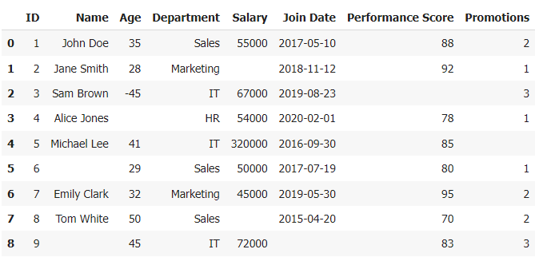
Example Dataset: Employee Performance Data
Missing Values

Slide 4
Example Dataset: Employee Performance Data
Inconsistent Data

Slide 5
Example Dataset: Employee Performance Data
Outliers

Slide 6
Example Dataset: Employee Performance Data
Data Type Issues
The "Join Date" column may need to be converted into a proper date format for consistency.

Slide 7
Data Preprocessing
• Data Preprocessing: A process of transforming raw data into a clean
and usable format before it is used in analysis, machine learning, or
any other data-driven tasks.
• This process involves several steps to prepare the data, ensuring
that it is complete, consistent, and free of errors.
• Complete: No missing data
• Consistent: Format, Data type
• Free of errors: Incorrect data entry → Outlier
• Effective data preprocessing is essential for improving the accuracy
and efficiency of data models and analyses.

Slide 8
Key Steps in Data Preprocessing
1. Data Cleaning:
Data cleaning is an essential step to ensure the quality of the dataset before analysis or model development.
Handling Missing Values:
Identification
Dealing with Missing Values

Slide 9
Handling Missing Values
Identification:
Identify any missing values in the dataset.
Missing data can lead to biased results or errors in the analysis.

Slide 10
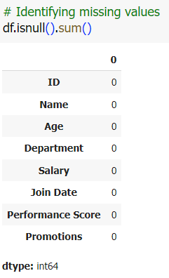
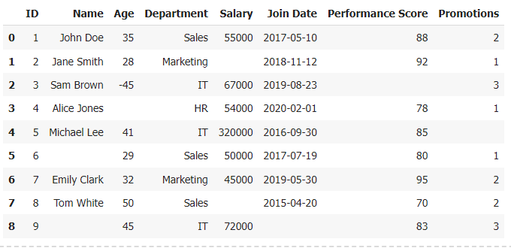
Example (Identification)

Slide 11
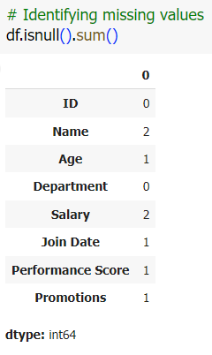
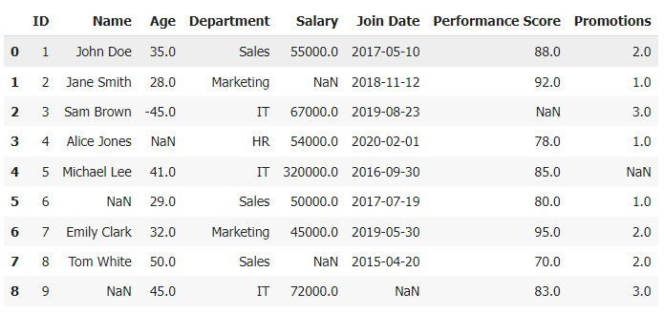
Example (Identification)

Slide 12
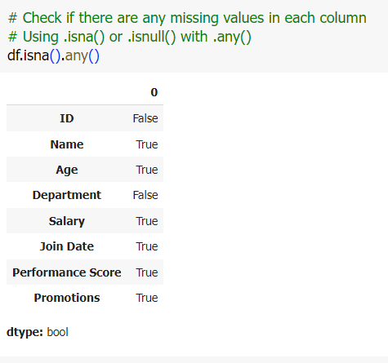
Example (Identification)

Slide 13
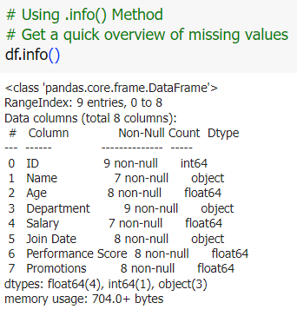
Example (Identification)

Slide 14
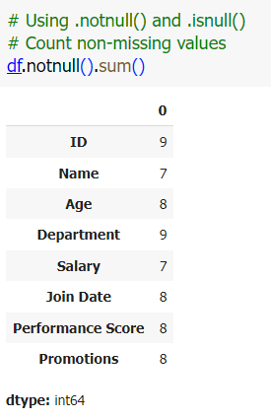
Example (Identification)

Slide 15
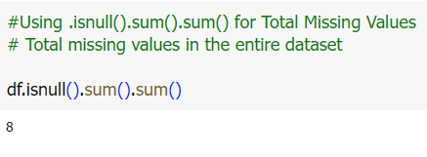
Example (Identification)

Slide 16
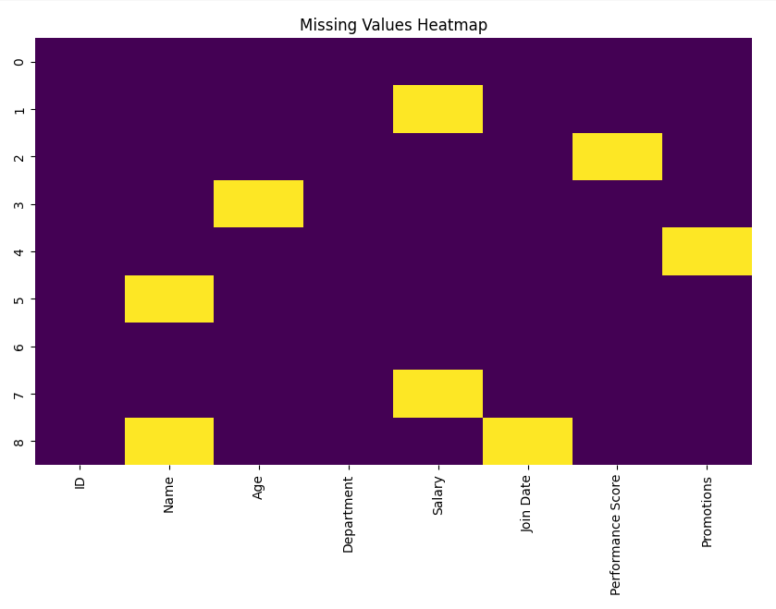
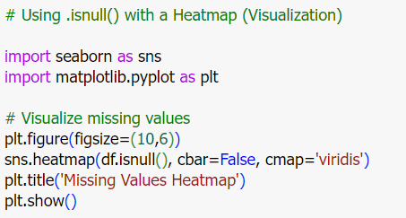
Example (Identification)

Slide 17
Handling Missing Values:
Methods to deal with missing value
1. Removal of Missing Values:
Remove any rows or columns that contain missing values.
Remove only the specific cases (i.e., values)
2. Imputation of Missing Values
Replace missing values with the mean, median, or mode of the non-missing values.
Replace with the previous or next valid value to fill in missing data.
Estimate missing values based on the values of the nearest neighbors. (K-nearest neighbors)
Use a regression model to predict and fill in missing values based on other variables.

Slide 18
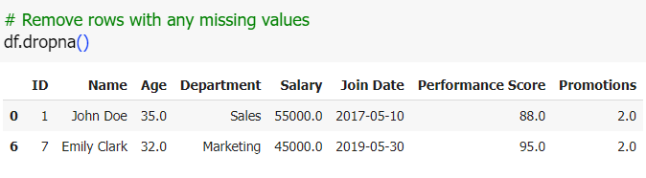
Removal of Missing Values

Slide 19
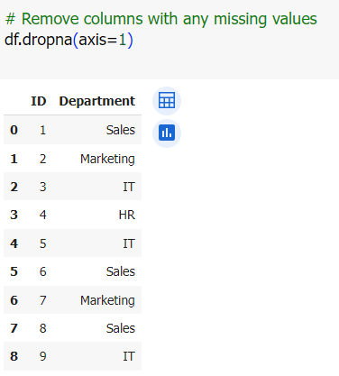
Removal of Missing Values

Slide 20
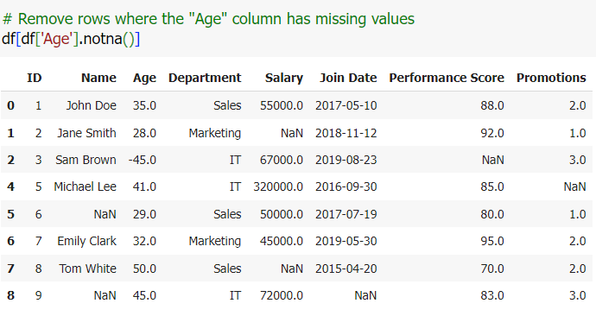
Removal of Missing Values

Slide 21
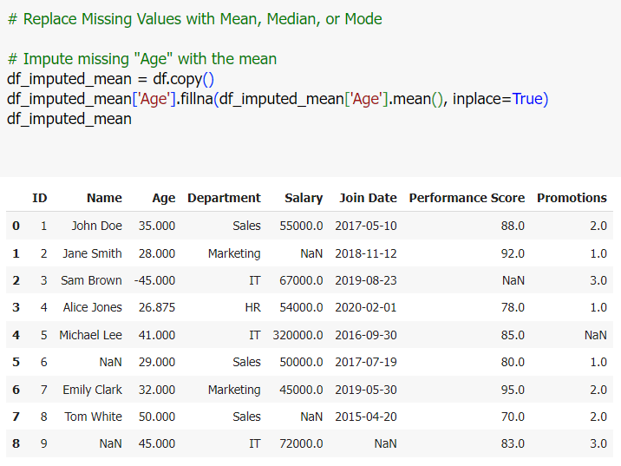
Imputation of Missing Values

Slide 22
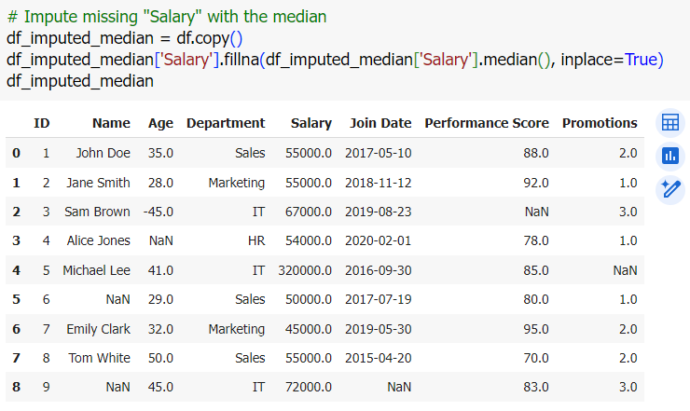
Imputation of Missing Values

Slide 23
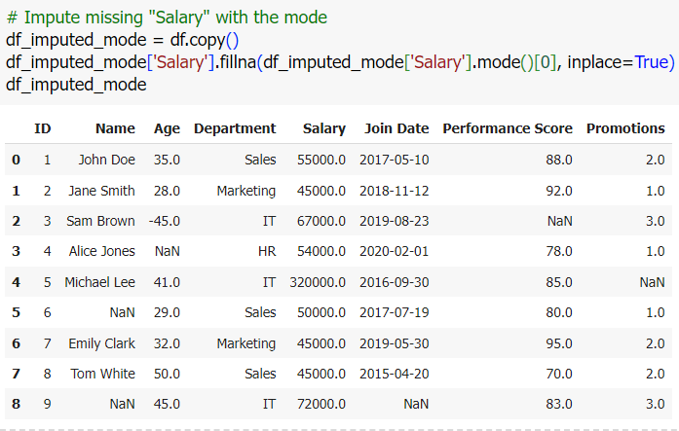
Imputation of Missing Values

Slide 24
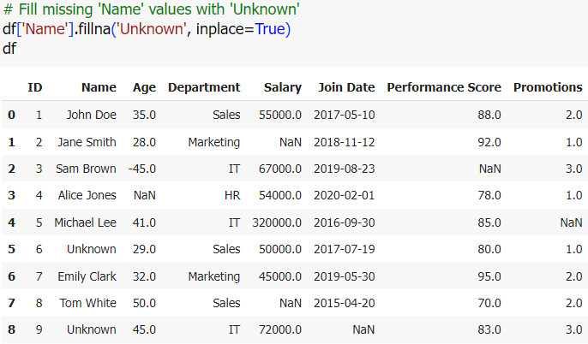
Imputation of Missing Values

Slide 25
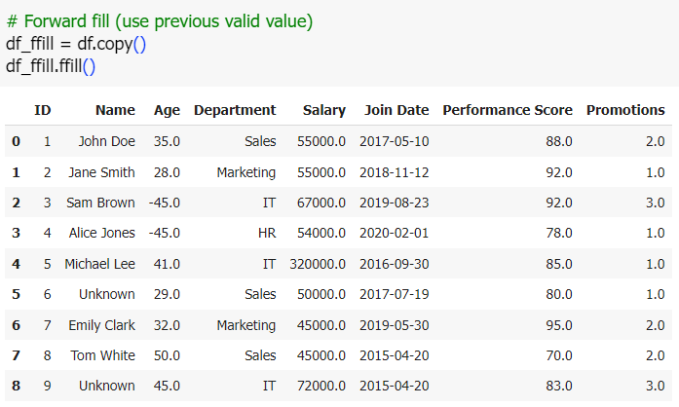
Replace Missing Values with Forward/Backward Fill

Slide 26
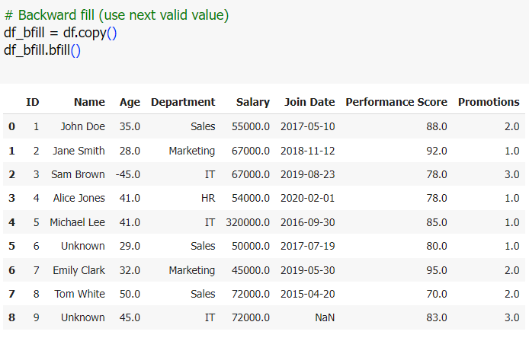
Replace Missing Values with Forward/Backward Fill

Slide 27
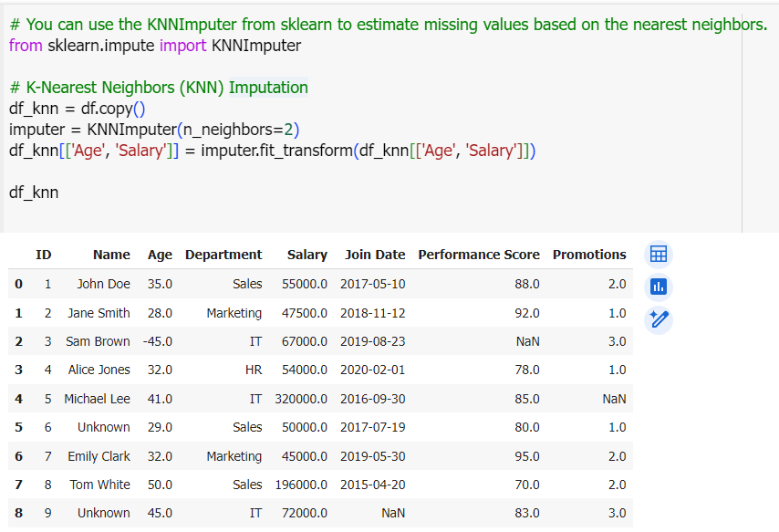
Estimate Missing Values with K-Nearest Neighbors (KNN Imputation)

Slide 28
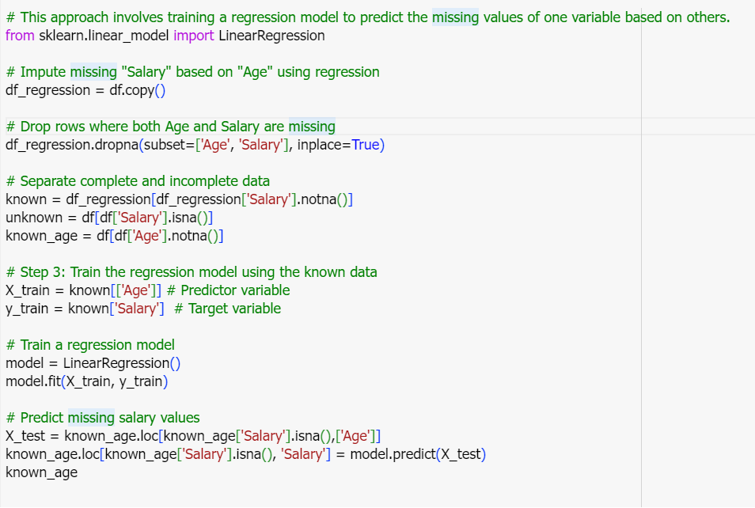
Predict Missing Values Using a Regression Model

Slide 29
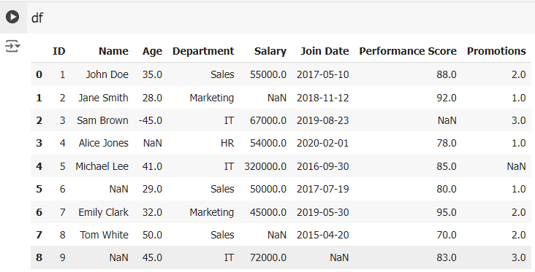
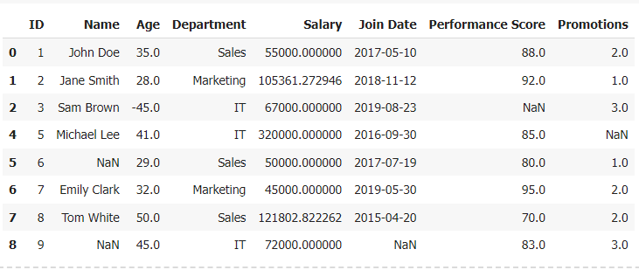

Slide 30
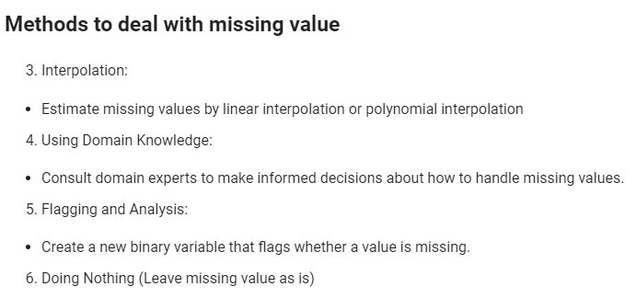

Slide 31
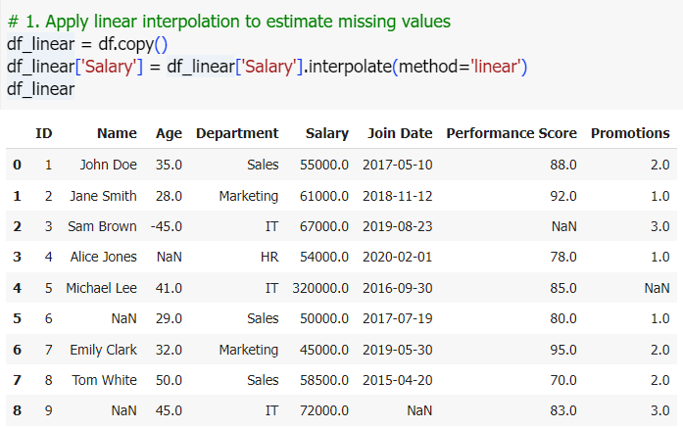
Interpolation
Estimate missing values by linear interpolation or polynomial interpolation

Slide 32
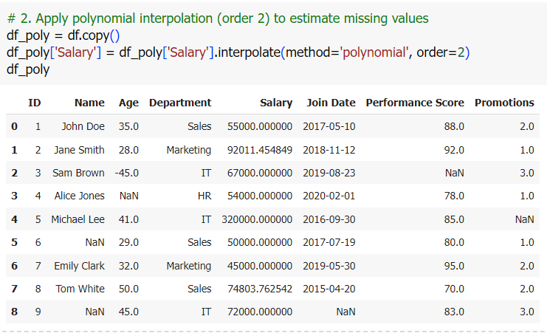
Interpolation

Slide 33
Key Steps in Data Preprocessing
2. Data Transformation:
Normalization/Standardization: Scaling the data so that it fits within a specific range (normalization) or has a mean of 0 and a standard deviation of 1(standardization) → making it easier to compare different variables.
Encoding Categorical Variables: Converting categorical data (e.g., gender, color) into numerical form so it can be used in machine learning models (e.g., one-hot encoding, label encoding).
Binning: Converting continuous variables into discrete bins or categories to reduce the impact of minor observation errors.

Slide 34
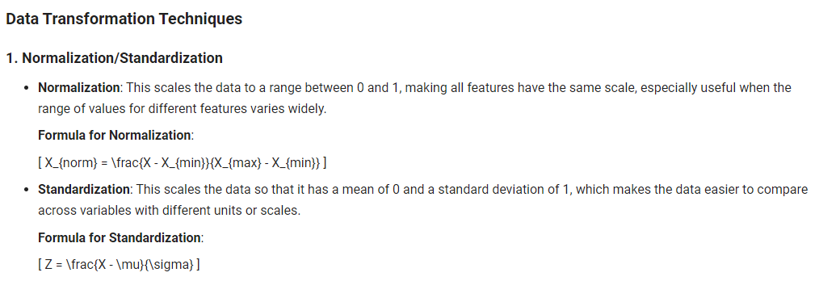

Slide 35
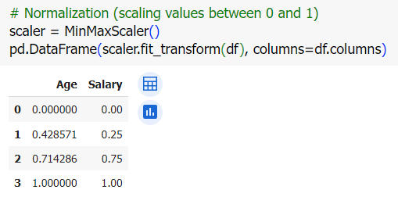
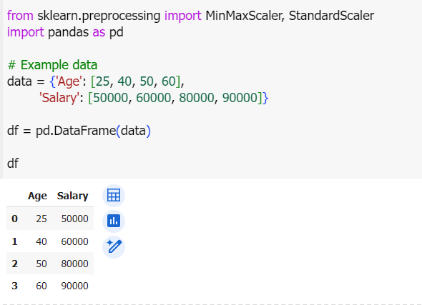
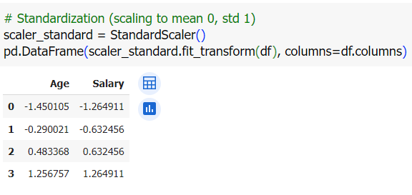

Slide 36
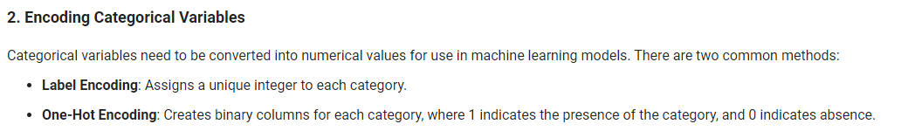

Slide 37
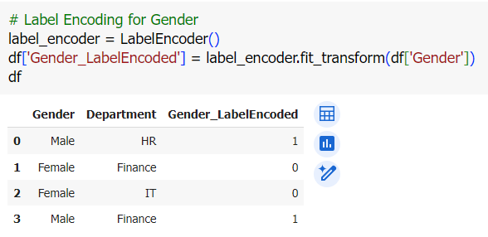
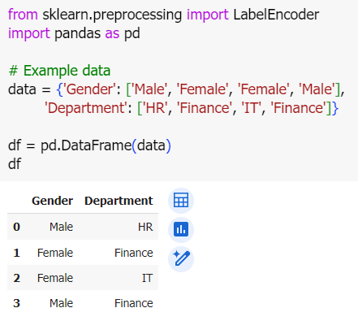
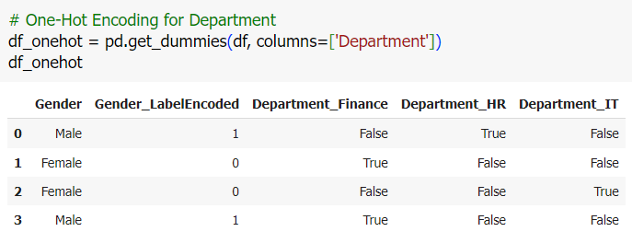

Slide 38
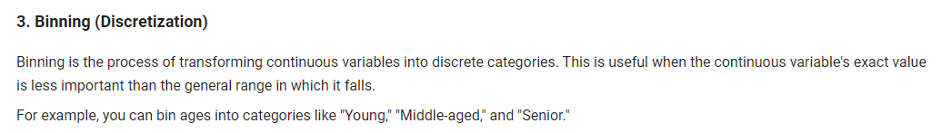

Slide 39
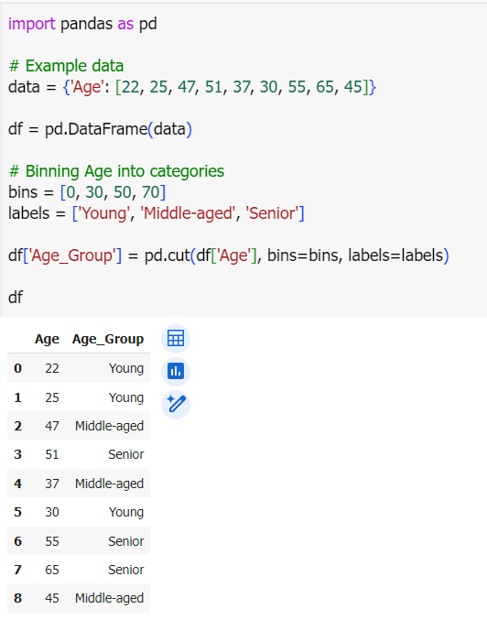

Slide 40
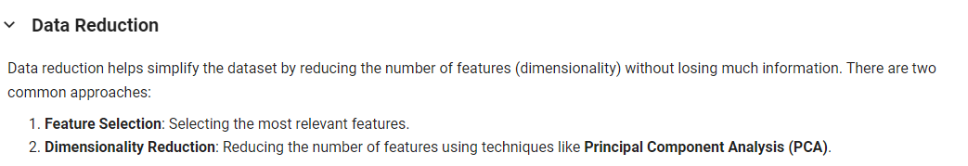

Slide 41
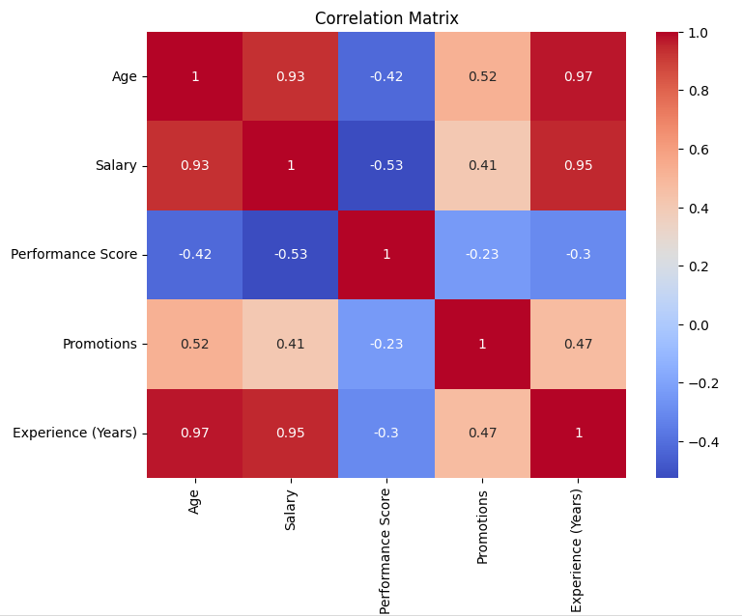
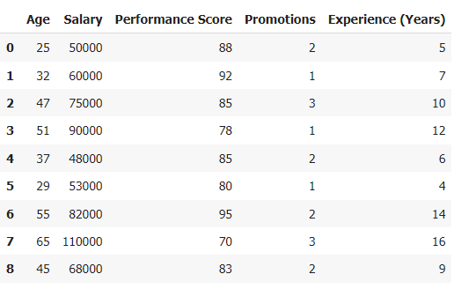
1. Feature Selection
Feature selection helps identify the most relevant features that contribute significantly to the target variable. We can use methods like correlation or statistical tests for this.
features that have a strong correlation (positive or negative) with each other or the target variable can be considered for selection.

Slide 42
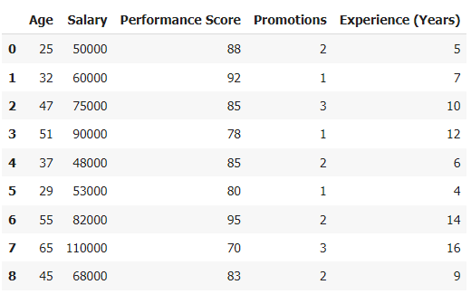
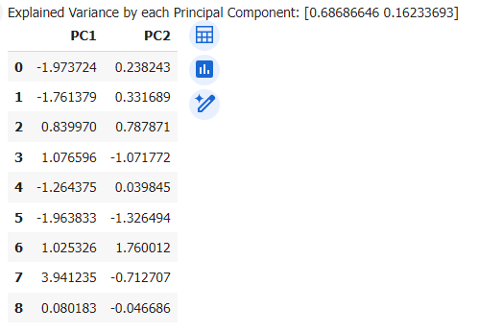
2. Dimensionality Reduction using PCA
Principal Component Analysis (PCA) is a common technique used for dimensionality reduction. It transforms the original features into a smaller set of new features (principal components) that retain most of the variance in the data.

Slide 43
Exploratory Data Analysis

Slide 44
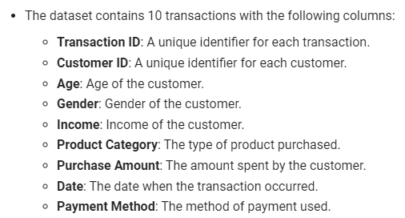
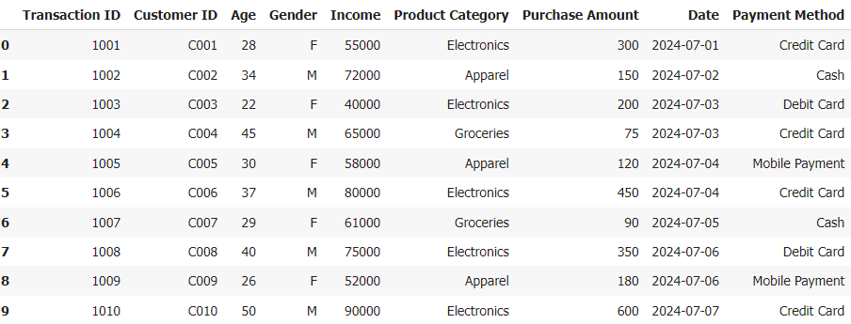
Exploratory Data Analysis (EDA)
Using the dataset presented in the image, here are some key steps and techniques that can be applied for EDA:
1. Overview of the Dataset

Slide 45
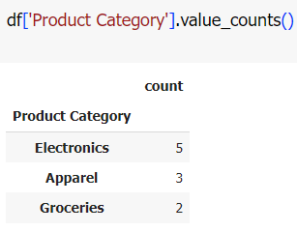
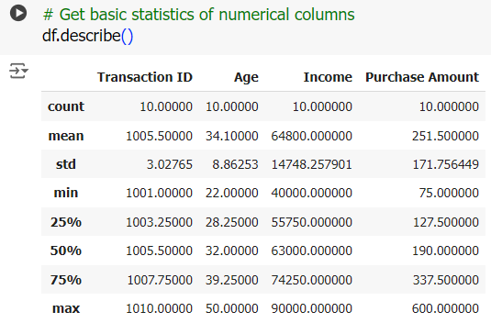
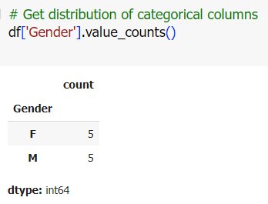
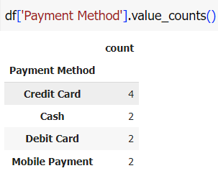
Exploratory Data Analysis (EDA)
2. Basic Statistics (Summary)
Goal: Get an overview of the distribution of numerical data and categorical data.

Slide 46
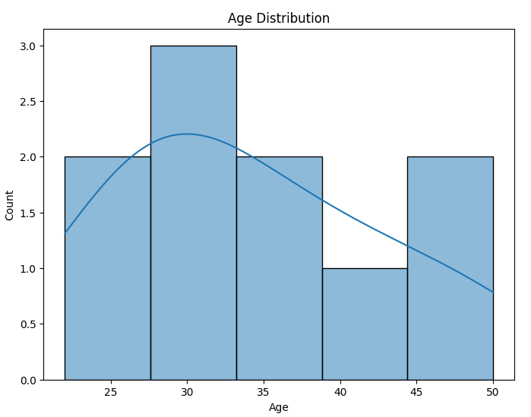
Exploratory Data Analysis (EDA)
3. Visualizations
Visualizations can help detect patterns, trends, and outliers.
Age Distribution:
Goal: Visualize the age distribution of customers.

Slide 47
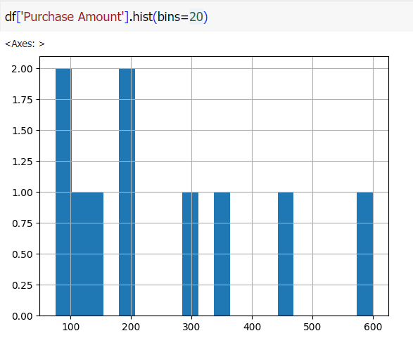
Distribution of Purchase Amount

Slide 48

Distribution of Income

Slide 49


Scatter plot of Income vs Purchase Amount

Slide 50




Slide 51



