Slide 1
[Hard]Core Data
Getting down and dirty with an older API

Slide 2
What is it?
Object graph management
Persistence framework

Slide 3
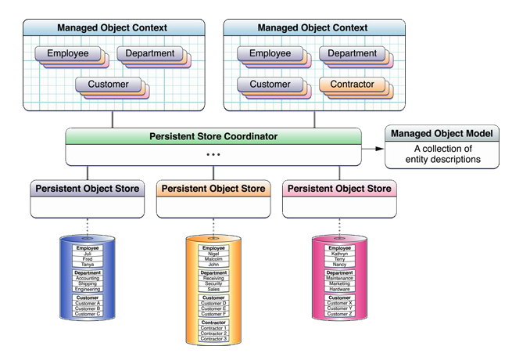
The Core Data Stack

Slide 4
Persistent object store
Two general kinds of store
  Atomic Store
  Incremental Store
Core Data creates and manages the store (db or whatever) , you don’t

Slide 5
Persistent Store Coordinator
Can have many persistent stores
Can have only ONE managed object model
Presents a unified façade of all its data

Slide 6
Managed Object Model
Collection of Entities
Entities have attributes and relationships
Persistent store structure is based on model and must remain consistent with it
Nifty graphical editor

Slide 7
Managed Object Context
“Scratch pad” for working on managed objects
Objects are fetched from store or inserted
Changes exist in memory until saved
You can have multiple contexts at the same time with the same objects (more on this later)

Slide 8
Managed Objects
Inherit from NSManagedObject
KVO compliant
Belong to a context
Correspond to “a row in a table”
Don’t give them a lot of functionality
Cannot be used in another thread/context

Slide 9
CoreData Concurrency
Pre – iOS 5 -> Thread confinement
iOS 5 onward -> Concurrency Types
  Main Queue
  Private Queue
  Confinement

Slide 10
Minimizing Merge Conflicts
Pre – iOS 5 -> Locking
iOS 5 onward -> Parent/Child Relationship
  When child context is saved, merges changes to parent context
  Only merges one generation upward

Slide 11
Keeping the UI Responsive
Write Context
Private Queue
Main Context
Main Queue
Sync Context
Private Queue
Temp Context
Private Queue
Test Context
Private Queue

Slide 12
Fetched Results Controller
Manages the fetching of objects that match a predicate
Notifies its delegate when there are changes to the underlying data of any objects that match its predicate
Objects can be returned by NSIndexPath

Slide 13
Disclaimer
The coding you will see in this presentation is for demonstration purposes only. You will not hold the presenter responsible if you blindly copy and paste strange constructs seen here into your code and wreak havoc on your app or the world at large.

Slide 14
Lets see some code

Slide 15
Pros & Cons
Pros
  Lots of free functionality – graph management, persistence, event-driven UI
  Performance enhancing
  Plays nice with Collection / Table Views
Cons
  Coding can feel boilerplate-y and tedious
  Need to be careful making changes especially if using KVO

Slide 16
Fin
Ask questions here.

