Slide 2
Breakout Box
1V⁺
1I⁺
2V⁺
2I⁺
3V⁺
3I⁺
Marking on mount next to pad
3
1
5
3
7
5
9
7
11
13
1V⁺
1V⁻
1I⁻
2V⁻
2I⁻
3V⁻
3I⁻
3
1
4
2
6
4
8
6
10
8
12
14
Break-out box number
Switch Matrix pin number
* At the moment, switch matrix 7 does not work. This has been resolved by physically connecting switch cable 9 to BB 9. In the software this is still SM pin 7.
Plug the rotator option box into the PPMS and plug the breakout box cable into the option box.
Make sure the breakout box is wired to the switch matrix according to the above diagram.
Use the above diagram to check your work converting mount pins to switch pins.

Slide 3
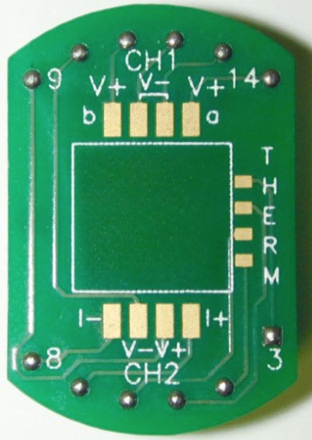
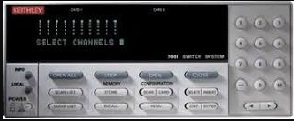
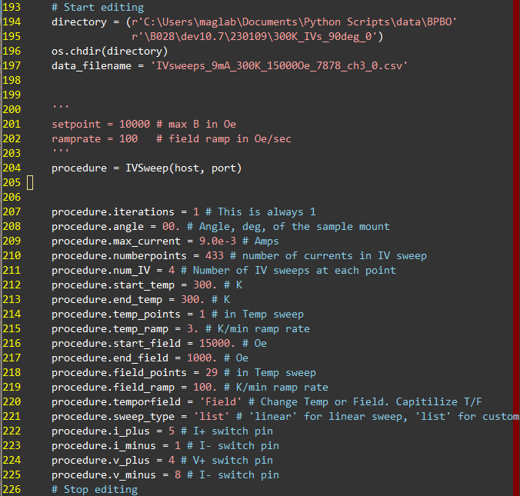
SHH with IV sweeps
High-Level Science Needs
One measurement will be at a fixed temp and H direction, changing H magnitude.
Both out-of-plane and in-plane (H || I) field orientations.
Perform a quick field sweep to determine the coercivity of the magnet and make sure the field measurement occurs in the high-field limit.
Set Up The program
Use the computer on the cart next to the PPMS.
Open the program in Atom or gvim.
Edit at the bottom, starting at the “#Start editing” line.
Set all the parameters to the correct value for your measurement, down to the “#Stop editing” line.
Analysis
Copy the field_vals.txt file from another directory into the directory with your data, and modify it with your actual field values.
Run IV_sweep_quickplot.py from the analysis directory, modified in main() to read from your directory, and write the summary file name your prefer.
Use your software of choice to plot and fit the data and correct for spurious contributions.
Mount pins
Switch pins
Rotator Mount:
Mount pins – 6 = Switch pins
Puck Mount:
Mount pins – 2 = Switch pins
Successful parameters for ‘SHH’ of BPBO/PMA at 300K.
Mount pins are the numbers of the pads you wirebond to. Switch pins are the numbers that you type into the program.
Run the Program
Make sure socket server is running on PPMS MultiVu computer. If not:
C:\Users\QDUser\Documents\python\00.02.01>python qd_socket_server.py DYNACOOL –ip=128.104.184.130
To run a measurement (on cart cpu):
C:\Users\maglab\Documents\qdppms>python IV_sweep.py
Navigate to the directory, then to run only type with is AFTER the “>”.

Slide 4
In MultiVu, select “Utilities” “Activate Option” “rotator” “Activate” “high res”

