Slide 2
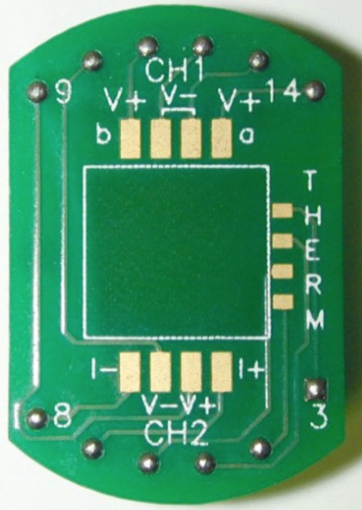
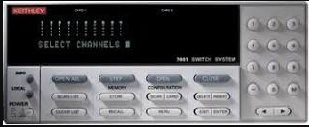
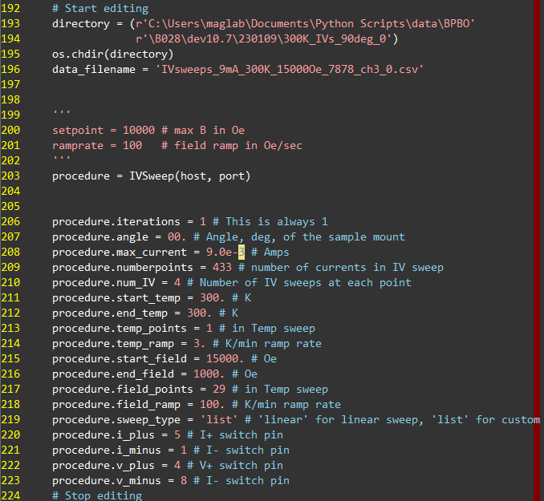
SHH with IV sweeps
Set Up The program
Use the computer on the cart next to the PPMS.
Open the program in Atom or gvim.
Edit at the bottom, starting at the “#Start editing” line.
Set all the parameters to the correct value for your measurement, down to the “#Stop editing” line.
Mount pins
Switch pins
Rotator Mount:
Mount pins – 6 = Switch pins
Puck Mount:
Mount pins – 2 = Switch pins
Mount pins are the numbers of the pads you wirebond to. Switch pins are the numbers that you type into the program.
Run the Program
Successful parameters for ‘SHH’ of BPBO/PMA at 300K.
C:\Users\maglab\Documents\qdppms>py IV_sweep.py
Navigate to the directory, then to run only type with is AFTER the “>”.
High-Level Science Needs
One measurement will be at a fixed temp and H direction, changing H magnitude.
Both out-of-plane and in-plane (H || I) field orientations.
Perform a quick field sweep to determine the coercivity of the magnet and make sure the field measurement occurs in the high-field limit.

