Slide 1


Slide 2

Instructor
Name:
Experience:
Proficiency:

Slide 3
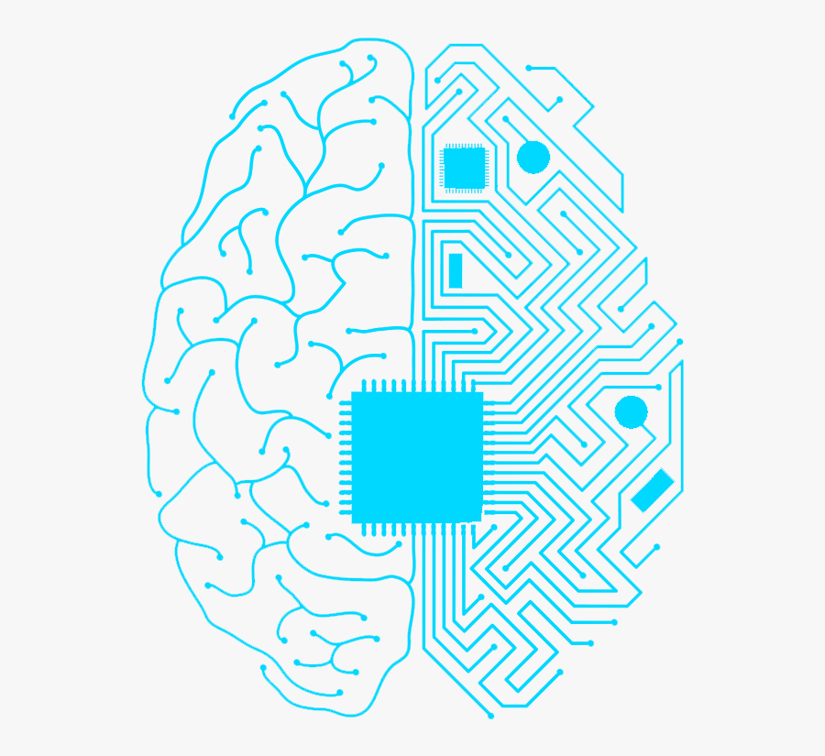
.
Deep Learning Roadmap
Day | Module | Hours
Day 1 | Introduction to Deep Learning | 3
Day 2 | Deep Learning Architectures & Training | 3

Slide 4
Day 1: Agenda
Overview of Artificial Neural Networks (ANNs)
Neural Network Basics
Model Representation in Deep Learning
Deep Learning Applications
Training Deep Learning Models
Building a Simple Artificial Neural Network
Practical Example and Hands-On: ANN
Convolutional Neural Networks (CNNs)
Practical Example and Hands-On: CNN

Slide 5
Introduction to Deep Learning
Subset of machine learning using neural networks to learn from data.
Why Deep Learning Matters:
Accuracy: Achieves state-of-the-art results in complex tasks.
Versatility: Applicable to various domains.
Automation: Automates tasks, saving time and resources.
Innovation: Drives research breakthroughs.
Economic Impact: Enhances productivity and creates new opportunities.

Slide 6
Artificial Neural Networks (ANNs)
Introduction to ANNs:
Computational models inspired by the human brain.
Consist of interconnected nodes for data processing and predictions.
Used in machine learning and deep learning.
Historical Background:
Perceptrons (1950s): Early neural network model for binary classification.
Backpropagation (1980s): Algorithm enabling training of multi-layer neural networks.

Slide 7
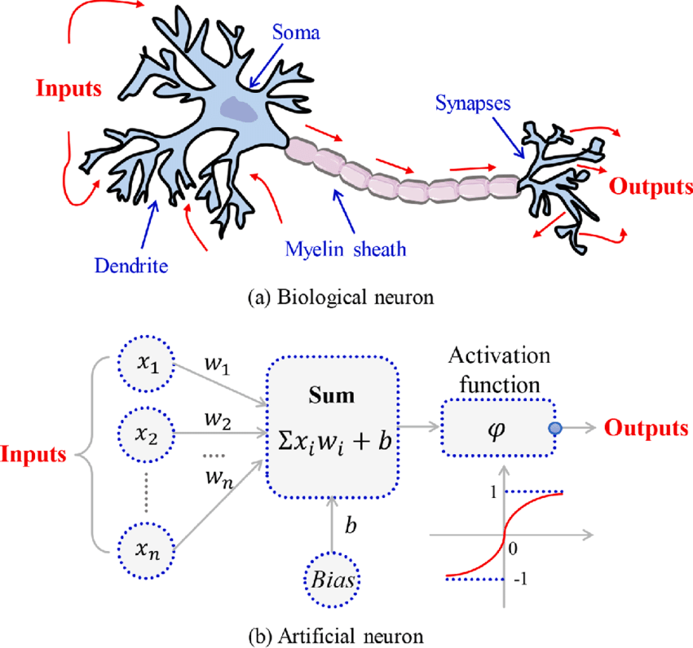
Comparison with Biological Neurons
Computational models inspired by the human brain.
ANNs are simplified models inspired by biological neurons.
Biological neurons are more complex, communicate differently, and adapt through synaptic plasticity.
ANNs use mathematical algorithms and structured connections, lacking the parallelism and complexity of biological brains.

Slide 8
Neural Network Basics
Components of a Neural Network:
Neurons (Nodes): Basic processing units that receive inputs and produce outputs.
Weights: Connection strengths that are learned during training.
Biases: Parameters for shift and flexibility in modeling.
Layers: Organized groups of neurons, including input, hidden, and output layers.

Slide 9
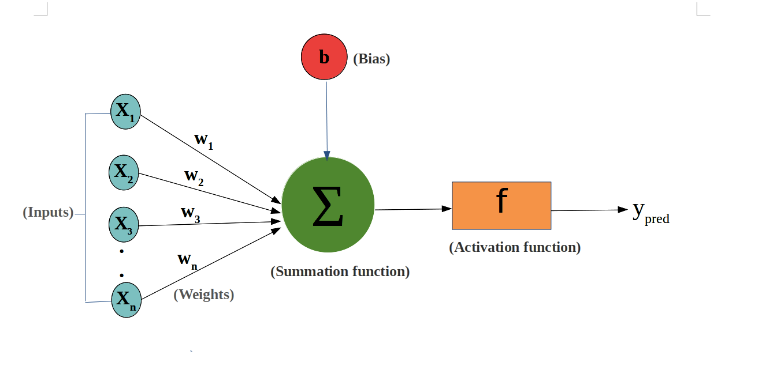
Neural Network Basics

Slide 10
Neural Network Basics
Neurons, Weights, Biases, Activation Functions:
Neurons: Compute weighted input sum, apply activation function for output.
Weights: Adjust importance of inputs during training.
Biases: Enable non-zero output with all-zero inputs for modeling complexity.
Activation Functions: Introduce non-linearity, control neuron firing (output). Common functions: sigmoid, ReLU, tanh.

Slide 11
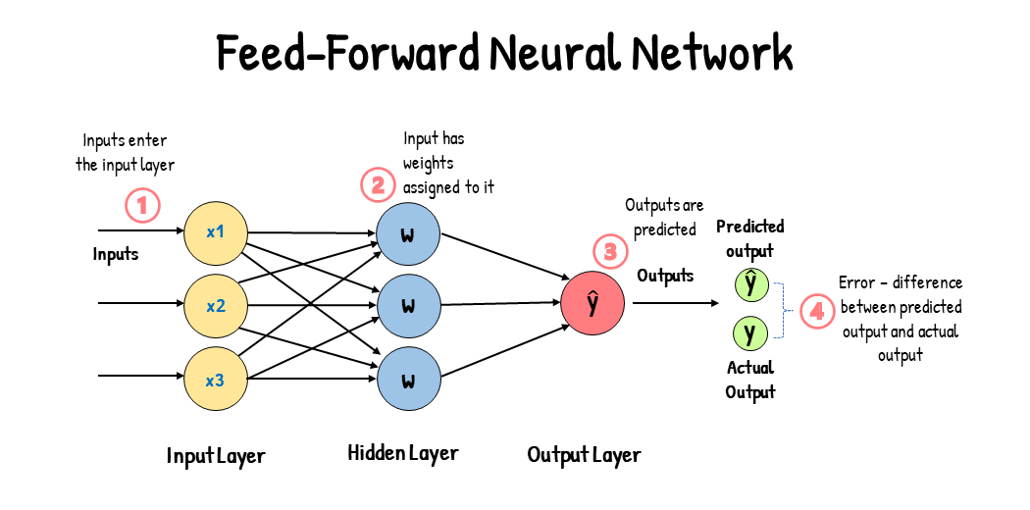
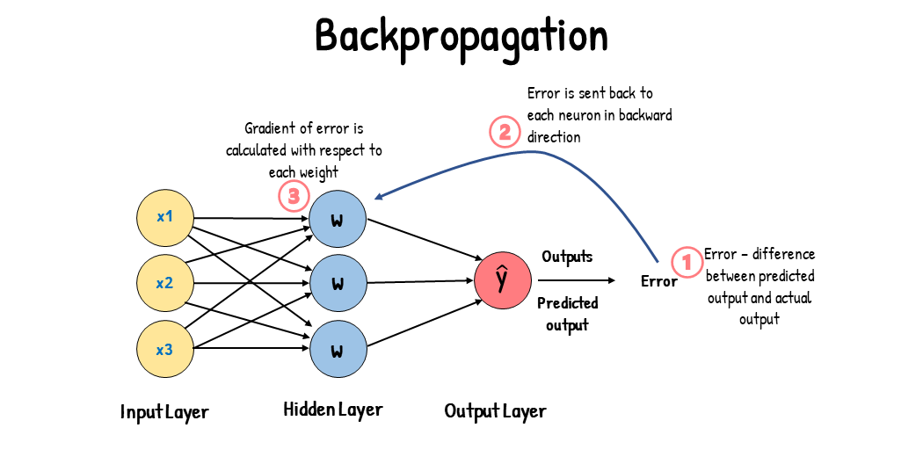
Neural Network Basics
Feedforward and Backpropagation:
Feedforward: Data flows from input through hidden layers to output for predictions.
Backpropagation: Training process involving error calculation, error propagation, and weight/bias adjustment using optimization methods like gradient descent to refine the model.

Slide 12
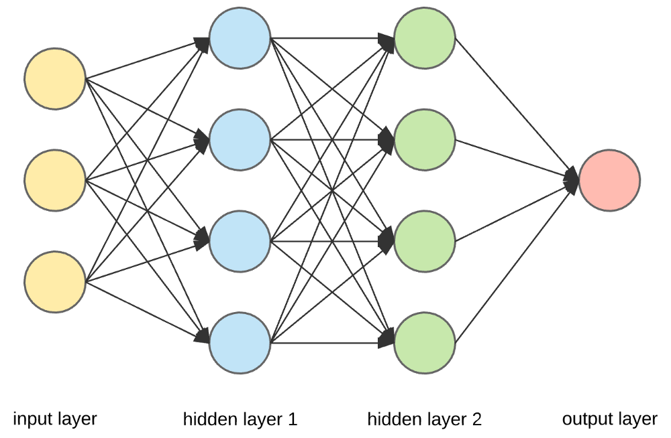
Model Representation in Deep Learning
Understanding Network Architecture:
Network Architecture: It refers to the structure and layout of a neural network, including the number of layers, the number of nodes in each layer, and how these layers are interconnected.

Slide 13
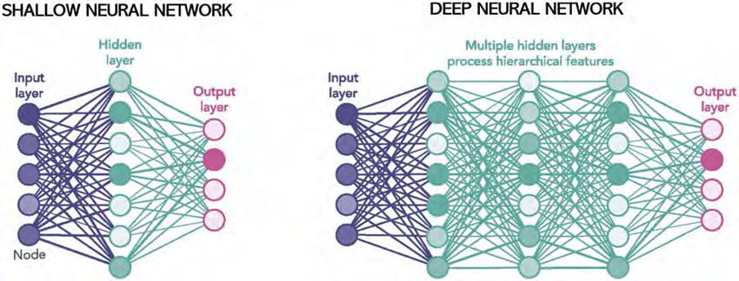
Model Representation in Deep Learning
Deep vs. Shallow Networks:
Deep Networks: Have multiple hidden layers for learning complex, hierarchical features. Ideal for complex tasks like image and speech recognition.
Shallow Networks: Lack hidden layers, suited for simpler tasks or when dealing with low-dimensional data.

Slide 14
Model Representation in Deep Learning
Layers, Nodes, and Their Roles:
Layers: Input, hidden, and output layers' structure the network.
Input Layer: Receives raw data with nodes matching input features.
Hidden Layers: Process data to extract key features; number varies by network and problem.
Output Layer: Provides predictions; node count depends on the task (e.g., binary or multi-class classification).
Nodes (Neurons): Compute weighted sums, apply activation functions, and produce layer-specific outputs.

Slide 15
Deep Learning Applications
Computer Vision:
Image Classification
Object Detection
Natural Language Processing (NLP):
Sentiment Analysis
Language Translation
Autonomous Vehicles:
Perception and Decision-Making
Healthcare:
Medical Imaging
Drug Discovery
Finance:
Fraud Detection
Stock Market Prediction
Speech Recognition:
Virtual Assistants
Transcription Services
Gaming:
Intelligent Agents
Recommendation Systems:
Personalized Content Recommendations
Manufacturing:
Quality Control
Predictive Maintenance
Agriculture:
Crop Monitoring
Disease Detection

Slide 16
Activation Functions
Sigmoid:
Purpose: Used for binary classification.
Output: Between 0 and 1.
Drawback: Suffers from vanishing gradients.
ReLU (Rectified Linear Unit):
Purpose: Most common, learns complex patterns.
Output: 0 or positive values.
Issue: Can suffer from the "dying ReLU" problem.
Tanh (Hyperbolic Tangent):
Purpose: Used in hidden layers.
Output: Between -1 and 1.
Benefit: Zero-centered, mitigates vanishing gradient.
Leaky ReLU:
Purpose: Addresses the "dying ReLU" issue.
Output: 0 or a small gradient.
Hyperparameter: α (slope).
Softmax:
Purpose: Used for multi-class classification.
Output: Normalized probabilities.
Converts scores to probabilities.

Slide 17
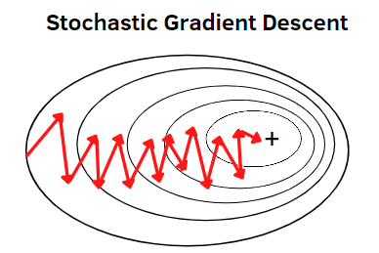
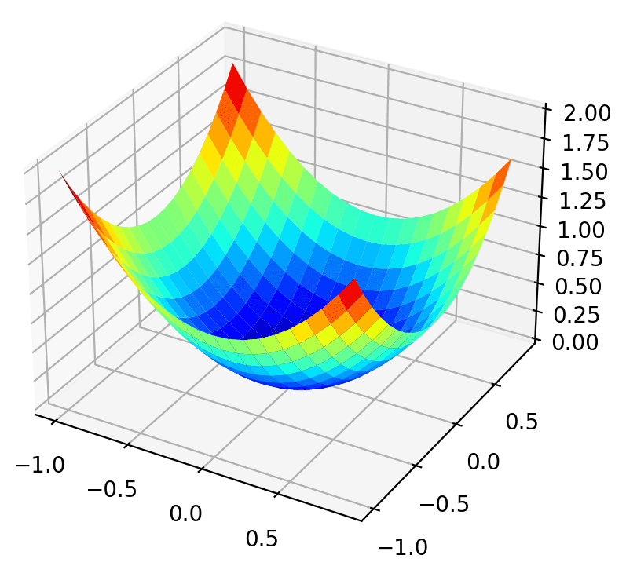
Training Deep Learning Models
Optimization Algorithms:
SGD: Updates weights from random data batches.
Adam: Adapts learning rates, suited for various models.
Loss Functions:
MSE: Regression tasks.
Cross-Entropy: Classification tasks.
Learning Rate Scheduling:
Decay: Gradual learning rate reduction.
Step & Exponential Decay: Specific reductions over time.
These methods optimize training for better model performance.

Slide 18
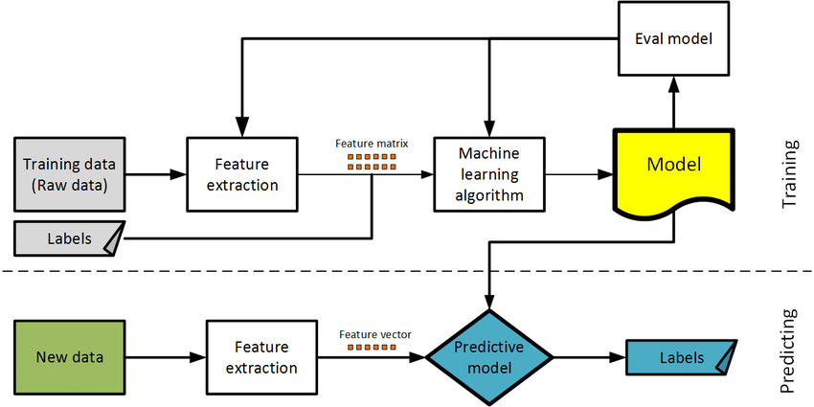
Training Deep Learning Models

Slide 19
Neural Networks in Practice
Deep Learning Frameworks:
TensorFlow and PyTorch are popular frameworks for building and training neural networks.
Hardware:
GPUs and TPUs accelerate neural network training.
Challenges:
Data quality, model complexity, overfitting, and interpretability are common challenges.
Ethical Considerations:
Address bias and fairness, privacy, security, and transparency in neural network applications.

Slide 20
Artificial Neural Network (ANN)
Setting up a development environment
Choosing a deep learning framework (e.g., TensorFlow)
Load and preprocess data
Constructing a network architecture
Training the model
Metrics and evaluation

Slide 21
Model Evaluation and Hyperparameter Tuning
Metrics for Model Evaluation:
Accuracy: Overall correct predictions.
Precision and Recall: Balance for imbalanced datasets.
F1 Score: A combination of precision and recall.
Confusion Matrix: Detailed view of model performance.
Validation and Test Datasets:
Validation Dataset: Used for hyperparameter tuning during training.
Test Dataset: Evaluates final model performance on unseen data.

Slide 22
Model Evaluation and Hyperparameter Tuning
Hyperparameter Tuning:
Hyperparameters: Manual settings for the model, like learning rate and layer sizes.
Hyperparameter Tuning: The process of optimizing these settings.
Techniques: Grid search, random search, and automated tools like Keras Tuner or GridSearchCV.

Slide 23
Regularization Techniques
Overfitting and Underfitting:
Overfitting: Model too complex.
Underfitting: Model too simple.
L1 and L2 Regularization:
L1 (Lasso): Encourages sparsity.
L2 (Ridge): Discourages large weights.
Dropout:
Randomly deactivates neurons during training.
Batch Normalization:
Normalizes inputs, stabilizes training.

Slide 24
Hands-on: Simple ANN
Dataset: MNIST Dataset (Digit Recognition)
Build a Simple Artificial Neural Network.
Notes:
Note:- Use Jupyter file for this question - Simple Neural Network - Bank Marketing Dataset.ipynb

Slide 25
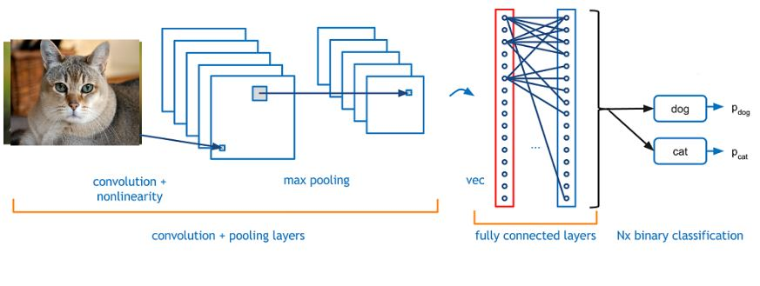
Convolutional Neural Networks (CNNs)
CNNs are specialized for grid-like data.
Ideal for computer vision tasks due to hierarchical feature learning.
Architecture and Components:
Convolutional Layers: Detect features.
Pooling Layers: Downsample and focus on essential data.
Fully Connected Layers: Perform classification tasks.

Slide 26
Convolutional Neural Networks (CNNs)
Use Cases in Computer Vision:
Image Classification
Object Detection
Facial Recognition
Image Segmentation
Image Generation
Scene Understanding
Visual Question Answering
Style Transfer
CNNs automate feature extraction and learning, transforming computer vision applications in various fields.

Slide 27
Building and Training a CNN
Data Preparation: Choose a dataset, split into training and testing sets.
Model Architecture: Design CNN structure with convolutional, pooling, and fully connected layers.
Convolutional Layers: Specify filters for feature extraction.
Pooling Layers: Reduce complexity with pooling layers.
Fully Connected Layers: Add classification/regression layers.
Compilation: Define loss, optimizer (e.g., Adam), and metrics.
Training: Train with fit() method, setting epochs and batch size.
Evaluation: Assess model performance on a test dataset.
Fine-Tuning: Optimize hyperparameters and architecture if needed.

Slide 28
Hands-on: CNN
Dataset: CIFAR-10 Dataset
Build a CNN.
Notes:
Note:- Use Jupyter file for this question - Image Classification - CIFAR 10 Dataset (In-built).ipynb

Slide 29
Questions ?

Slide 30
Thank You !

