Slide 1
Keras

Slide 2
Keras
Keras開發模式
Keras模組

Slide 3
Keras

Slide 4
Keras
https://www.tensorflow.org/guide/keras/overview
tf.keras 是用於構建和訓練深度學習模型的 TensorFlow 高階 API。
利用此 API，可實現快速原型設計、先進的研究和生產，它具有以下三大優勢：
[1]方便用戶使用
Keras 具有針對常見用例做出優化的簡單而一致的介面。它可針對使用者錯誤提供切實可行的清晰回饋。
[2]模塊化和可組合
將可配置的構造塊組合在一起就可以構建 Keras 模型，並且幾乎不受限制。
[3]易於擴展
可以編寫自訂構造塊，表達新的研究創意；並且可以創建新層、指標、損失函數並開發先進的模型。

Slide 5
Keras vs tf.keras
https://zhuanlan.zhihu.com/p/89017996

Slide 6
Keras開發

Slide 7
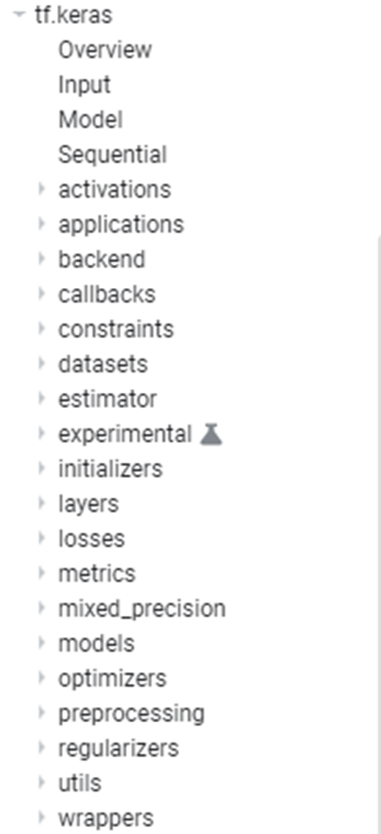

Slide 8
起手式
資料預處理
Data Preprocessing
構建模型
訓練模型
評估
預測
compile()
fit()
evaluate()
predict()
summary()
列出模型的結構
[1]Build the Model: Sequential or Functional API
[2]config the model with losses and metrics with model.compile()
[3]train the model with model.fit()
[4]use the model to do prediction with model.predict()

Slide 9
構建模型

Slide 10
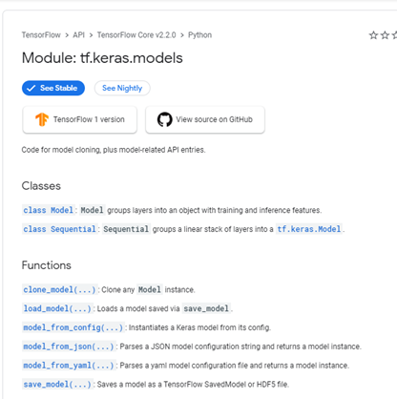
https://www.tensorflow.org/api_docs/python/tf/keras/models

Slide 11
Keras models[開發模式]
Keras models[開發模式]:
Sequential model
the Model class used with the functional API.
Subclass 模式
共同的方法與屬性[methods and attributes in common]
model.layers
…………..
model.summary()
…………..
model.to_json()
…………..
model.save_weights(filepath)
model.load_weights(filepath, by_name=False)

Slide 12
Keras Sequential model
https://www.tensorflow.org/versions/r2.2/api_docs/python/tf/keras/Sequential
The Sequential model is a linear stack of layers.
堆積木模式
from keras.models import Sequential
from keras.layers import Dense, Activation
model = Sequential([
Dense(32, input_shape=(784,)),
Activation('relu'),
Dense(10),
Activation('softmax'),
])
這是一個Sequential物件
擁有許多methods
add
get_layer
compile
evaluate
fit
predict
Pop:Removes the last layer in the model.
也可以這樣寫
model = Sequential()
model.add(Dense(32, input_dim=784))
model.add(Activation('relu'))
……………….

Slide 13
Model class API[Functional API]
from keras.models import Model
from keras.layers import Input, Dense
a = Input(shape=(32,))
b = Dense(32)(a)
model = Model(inputs=a, outputs=b)

Slide 14
tf.keras.Model類別
groups layers into an object with training and inference features
tf.keras.Model(
*args, **kwargs
)
Methods
Model.XXX now supports generators, so there is no longer any need to use this endpoint.
compile()
evaluate()
fit()
predict()
summary()
evaluate_generator()
fit_generator()
predict_generator()

Slide 15
Keras Sequential
from tensorflow.keras import Sequential
from tensorflow.keras.layers import Dense
model = Sequential()
model.add(Dense(512, activation='relu', input_dim=784))
model.add(Dense(10, activation='softmax'))
Model class API[Functional API]
from tensorflow.keras import Model
from tensorflow.keras.layers import Input, Dense
A = Input(shape=(784,)) # 將 Input 層的輸出張量 (傳回值) 指定給 A
B = Dense(512, activation='relu')(A)
C = Dense(10, activation='softmax')(B)
model = Model(A, C)
# 用【最初的輸入張量】和【最後的輸出張量】來建立模型

Slide 16
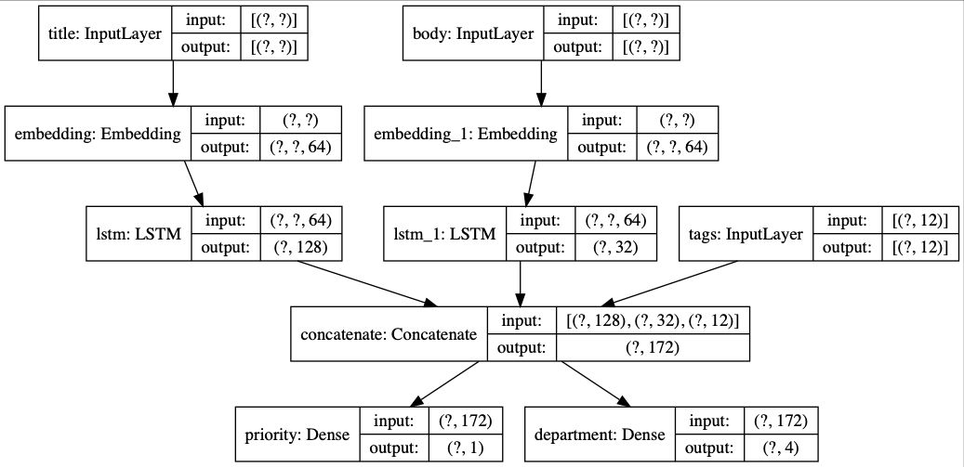
multi-input or multi-output models

Slide 17
from tensorflow.keras.models import Model
from tensorflow.keras.layers import (Input, Dense, Embedding, LSTM, Conv2D, MaxPooling2D, Flatten, concatenate)
att_in = Input(shape=(2,), name='att')
att = Dense(16, activation='relu')(att_in)
txt_in = Input(shape=(100,), name='txt')
txt = Embedding(1000, 32)(txt_in)
txt = LSTM(32)(txt)
img_in = Input(shape=(32, 32, 3), name='img') # 圖片的輸入 shape=(None, 32,32,3)
img = Conv2D(32, (3, 3), activation='relu')(img_in)
img = MaxPooling2D((2,2))(img)
img = Conv2D(32, (3, 3), activation='relu')(img)
img = MaxPooling2D((2,2))(img)
img = Flatten()(img)
out = concatenate([att, txt, img], axis=-1) # 用輔助函式串接 3 個張量
out = Dense(28, activation='relu')(out)
out = Dense(1)(out)
model = Model([att_in, txt_in, img_in], out)
model.compile(optimizer='rmsprop', loss='mse', metrics=['mae'])
model.summary()

Slide 18
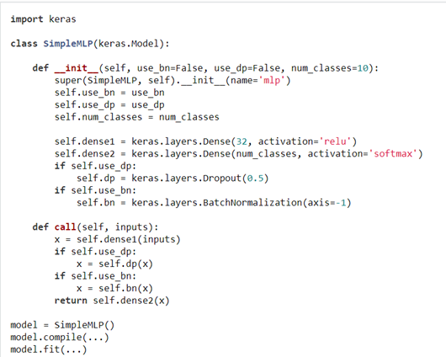
使用Model開發自己的程式
https://keras.io/models/about-keras-models/

Slide 19
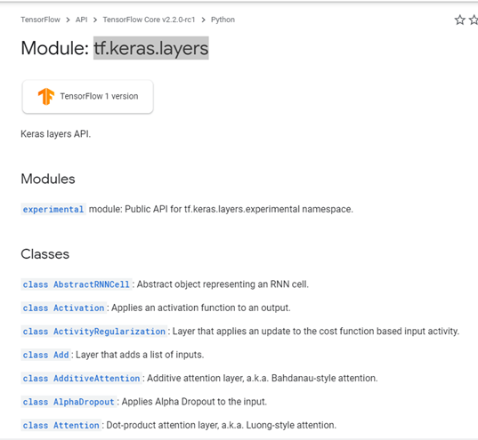
tf.keras.layers
https://www.tensorflow.org/versions/r2.2/api_docs/python/tf/keras/layers

Slide 20
tf.keras.layers.Dense 全連接層
tf.keras.layers.Dense(
units,
activation=None,
use_bias=True,
kernel_initializer='glorot_uniform',
bias_initializer='zeros',
kernel_regularizer=None,
bias_regularizer=None,
activity_regularizer=None,
kernel_constraint=None,
bias_constraint=None,
**kwargs
)
Positive integer, dimensionality of the output space
tf.keras.initializers
tf.keras.regularizers

Slide 21
# as first layer in a sequential model:
model = Sequential()
model.add(Dense(32, input_shape=(16,)))
# now the model will take as input arrays of shape (*, 16)
# and output arrays of shape (*, 32)
# after the first layer, you don't need to specify
# the size of the input anymore:
model.add(Dense(32))

Slide 22
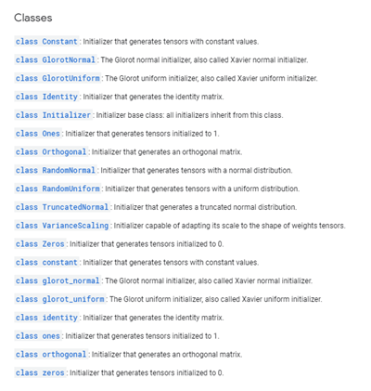
tf.keras.initializers
https://www.tensorflow.org/versions/r2.2/api_docs/python/tf/keras/initializers

Slide 23
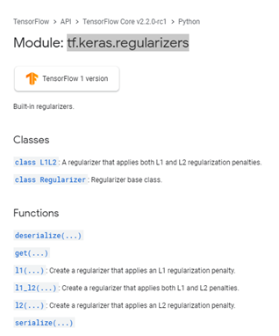
tf.keras.regularizers
https://www.tensorflow.org/versions/r2.2/api_docs/python/tf/keras/regularizers

Slide 24
設定
compile(
optimizer='rmsprop',
loss=None,
metrics=None,
loss_weights=None,
sample_weight_mode=None,
weighted_metrics=None,
**kwargs
)
tf.keras.optimizers
指定優化器
指定損失函數
tf.keras.losses
指定評估指標
tf.keras.metrics

Slide 25
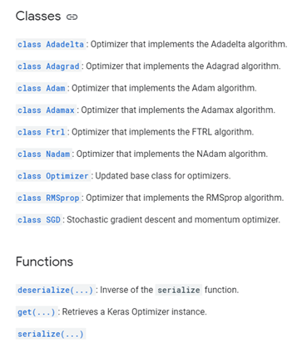
tf.keras.optimizers
https://www.tensorflow.org/versions/r2.2/api_docs/python/tf/keras/optimizers

Slide 26
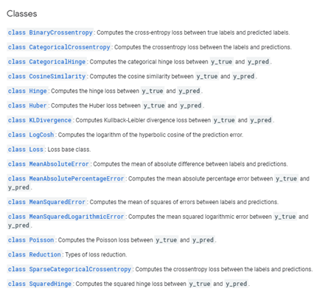
tf.keras.losses
https://www.tensorflow.org/versions/r2.2/api_docs/python/tf/keras/losses

Slide 27
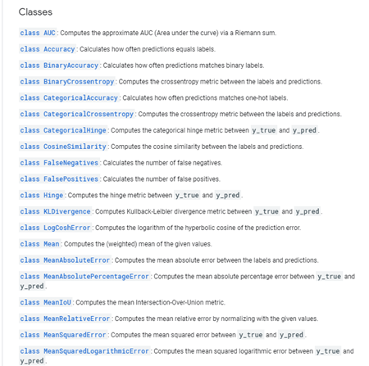
tf.keras.metrics
A metric is a function that is used to judge the performance of your model.
Metric functions are to be supplied in the metrics parameter when a model is compiled.
https://www.tensorflow.org/versions/r2.2/api_docs/python/tf/keras/metrics

Slide 28
訓練模型

Slide 29
fit(
x=None, y=None,
batch_size=None, epochs=1, verbose=1,
callbacks=None,
validation_split=0.0, validation_data=None,
shuffle=True, class_weight=None,
sample_weight=None,
initial_epoch=0, steps_per_epoch=None,
validation_steps=None,
validation_batch_size=None,
validation_freq=1,
max_queue_size=10, workers=1,
use_multiprocessing=False,
**kwargs
)
https://www.tensorflow.org/versions/r2.2/api_docs/python/tf/keras/Sequential

Slide 30
模型的準確度
Evaluate accuracy

Slide 31
https://www.tensorflow.org/versions/r2.2/api_docs/python/tf/keras/Sequential
Returns the loss value & metrics values for the model in test mode.
evaluate(
x=None, y=None,
batch_size=None,
verbose=1,
sample_weight=None,
steps=None,
callbacks=None,
max_queue_size=10,
workers=1,
use_multiprocessing=False,
return_dict=False
)
verbose: 0 or 1. Verbosity mode.
0 = silent, 1 = progress bar.

Slide 32
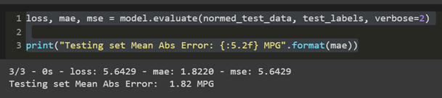
通過使用 測試集 來檢驗模型的效果如何
這告訴我們，當我們在現實世界中使用這個模型時，我們可以期望它預測得有多好
loss, mae, mse = model.evaluate(normed_test_data, test_labels, verbose=2)
print("Testing set Mean Abs Error: {:5.2f} MPG".format(mae))

Slide 33
預測

Slide 34
predict(
x,
batch_size=None,
verbose=0,
steps=None,
callbacks=None,
max_queue_size=10,
workers=1,
use_multiprocessing=False
)

Slide 35
probability_model = tf.keras.Sequential([model,
tf.keras.layers.Softmax()])
predictions = probability_model.predict(test_images)
np.argmax(predictions[0])
test_labels[0]

Slide 36
Keras模組

Slide 37
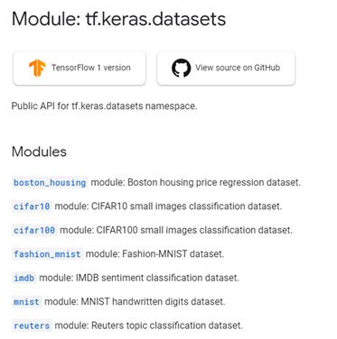
Keras built-in Datasets[內建的資料集]
https://www.tensorflow.org/api_docs/python/tf/keras/datasets

Slide 38
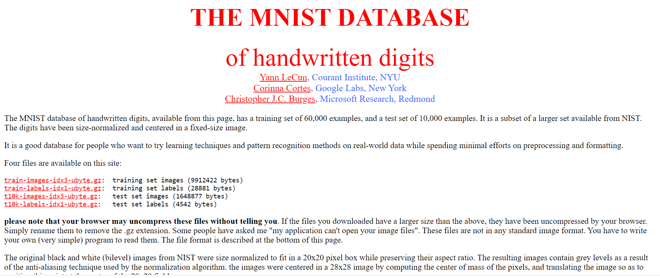
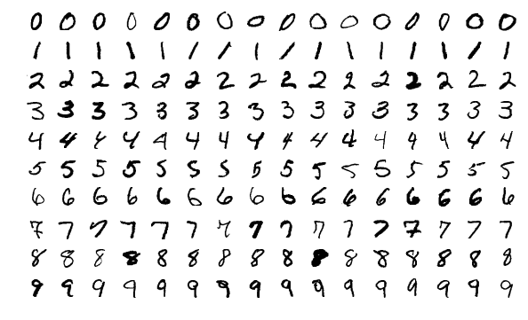

Slide 39
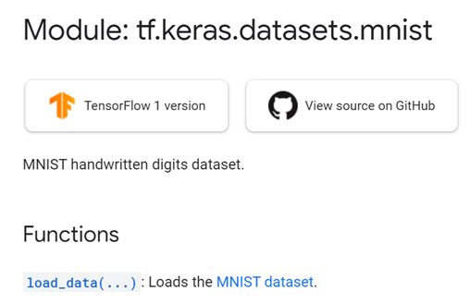
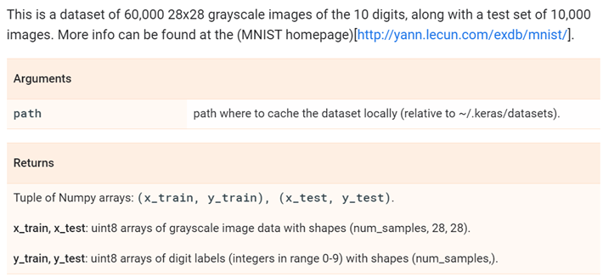
https://www.tensorflow.org/api_docs/python/tf/keras/datasets/mnist/load_data
tf.keras.datasets.mnist.load_data(
path='mnist.npz'
)

Slide 40
tf.keras.datasets.mnist.load_data() 實測
import tensorflow as tf
(x_train, y_train), (x_test, y_test) =
tf.keras.datasets.mnist.load_data()
# 28 x 28 images of hand-written digits 0-9
import matplotlib.pyplot as plt
plt.imshow(x_train[0])
print(x_train[0])
plt.imshow(x_train[0],cmap=plt.cm.binary)

Slide 41
Keras Preprocessing預處理
https://www.tensorflow.org/api_docs/python/tf/keras/preprocessing
Image Preprocessing | Set of tools for real-time data augmentation on image data. keras.preprocessing.image.ImageDataGenerator() https://keras.io/preprocessing/image/
Sequence Preprocessing | Utilities for preprocessing sequence data https://www.tensorflow.org/api_docs/python/tf/keras/preprocessing/sequence
Text Preprocessing | Utilities for text input preprocessing. https://www.tensorflow.org/api_docs/python/tf/keras/preprocessing/text

Slide 42
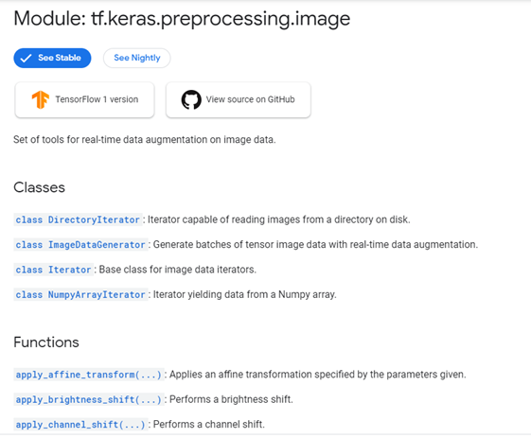
https://www.tensorflow.org/api_docs/python/tf/keras/preprocessing/image
使用 ImageDataGenerator
做資料擴增

Slide 43
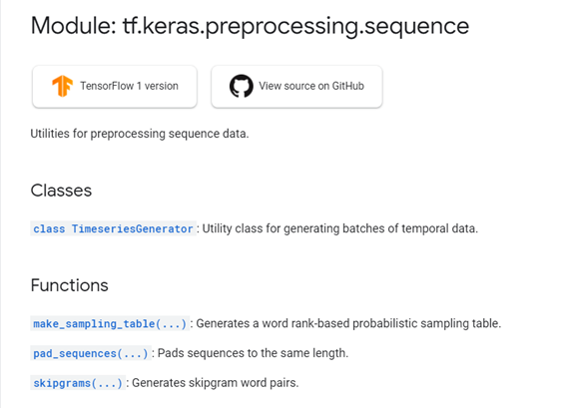
https://www.tensorflow.org/api_docs/python/tf/keras/preprocessing/sequence

Slide 44
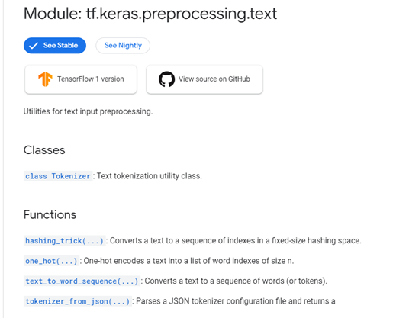
https://www.tensorflow.org/api_docs/python/tf/keras/preprocessing/text

Slide 45
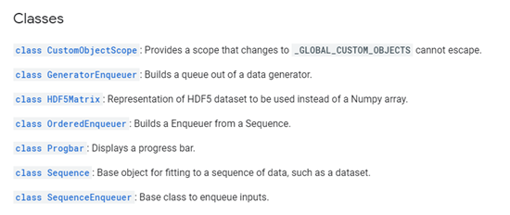
tf.keras.utils

Slide 46
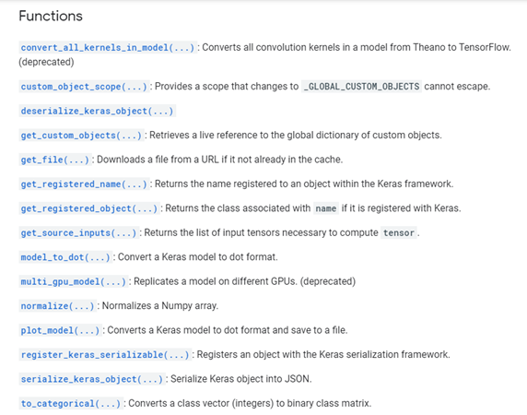

Slide 47
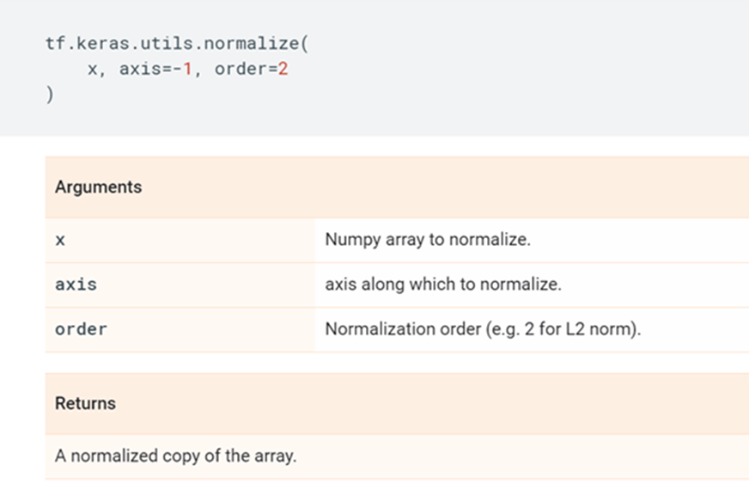
tf.keras.utils.normalize()
https://www.tensorflow.org/api_docs/python/tf/keras/utils/normalize

Slide 48
tf.keras.utils.normalize()實測
import tensorflow as tf
(x_train, y_train), (x_test, y_test) =
tf.keras.datasets.mnist.load_data()
# 28 x 28 images of hand-written digits 0-9
import matplotlib.pyplot as plt
plt.imshow(x_train[0])
print(x_train[0])
plt.imshow(x_train[0],cmap=plt.cm.binary)
x_train = tf.keras.utils.normalize(x_train,axis = 1)
x_test = tf.keras.utils.normalize(x_test, axis = 1)
plt.imshow(x_train[0])
print(x_train[0])
plt.imshow(x_train[0],cmap=plt.cm.binary)

