Slide 1

Posture IQ ME5 Security Posture Assessment Agent
Accelerating security evaluations — from weeks to minutes
Notes:
AI-generated content may be incorrect. ---

Slide 2

$4.44M
Average cost of a data breach — the risk our customers are carrying today.
Security investment alone can't prevent this. Assessment does.

Slide 3

Licensed ≠ Protected
The Gap Is Assessment
The tools aren't the problem. Microsoft 365, Defender, Purview — they're best-in-class. But buying security and being protected are two very different things.
The gap lives between deployment and validation. Most organizations never close it.
Security posture degrades silently. Without assessment, you don't know what you don't know.

Slide 4

The World Before ME5 Agent
4
12+
90
Portals
Sub-pages
Minutes
Secure Score, Defender, Purview, Entra
Blades within blades
Just to collect data
1
Assessment
Lots Manual Effort
Four portals. Dozens of blades. Many hours just to collect and curate data — before a single insight is shared with a customer.
Notes:
- Direct portal URLs for the 4 security portals referenced on Slide 4
1. Microsoft Secure Score (Microsoft 365 Defender)
Portal: Microsoft 365 Defender URL: https://security.microsoft.com/securescore
This is where the Microsoft Secure Score experience lives today (no longer a standalone portal).
2. Microsoft Defender (Unified Security Portal)
Portal: Microsoft 365 Defender URL: https://security.microsoft.com
In the left-hand navigation, select: Assets → Devices This lands you directly in Defender for Endpoint device inventory.
From there you can access:
- Device details
- Vulnerability management
- Security recommendations
- Alerts & incidents tied to endpoints
Covers Defender for Endpoint, Office 365, Identity, Cloud Apps, incidents, alerts, etc.
3. Microsoft Purview (Compliance Portal)
Portal: Microsoft Purview compliance portal URL: https://compliance.microsoft.com
Used for data loss prevention, information protection, eDiscovery, insider risk, communication compliance.
4. Microsoft Entra (Identity & Access)
Portal: Microsoft Entra admin center URL: https://entra.microsoft.com
Identity configuration: Conditional Access, Identity Protection, authentication methods, permissions, tenants.
(Optional) One-liner you can add to Slide 4 (speaker notes)
“In a typical assessment, we jump across four separate portals—Defender, Secure Score, Purview, and Entra—navigating dozens of blades just to collect raw data.”
If you want, I can:
Shorten these into slide-friendly labels
Add icons + QR codes
Or align each URL to the exact blade your agent queries (e.g., Secure Score recommendations vs overall score)

Slide 5

LIVE DEMO
Run a full security assessment.
One conversation. Live data. Everything you just saw — replaced.
Watch it happen in real time, right now, against a real Microsoft 365 environment.

Slide 6
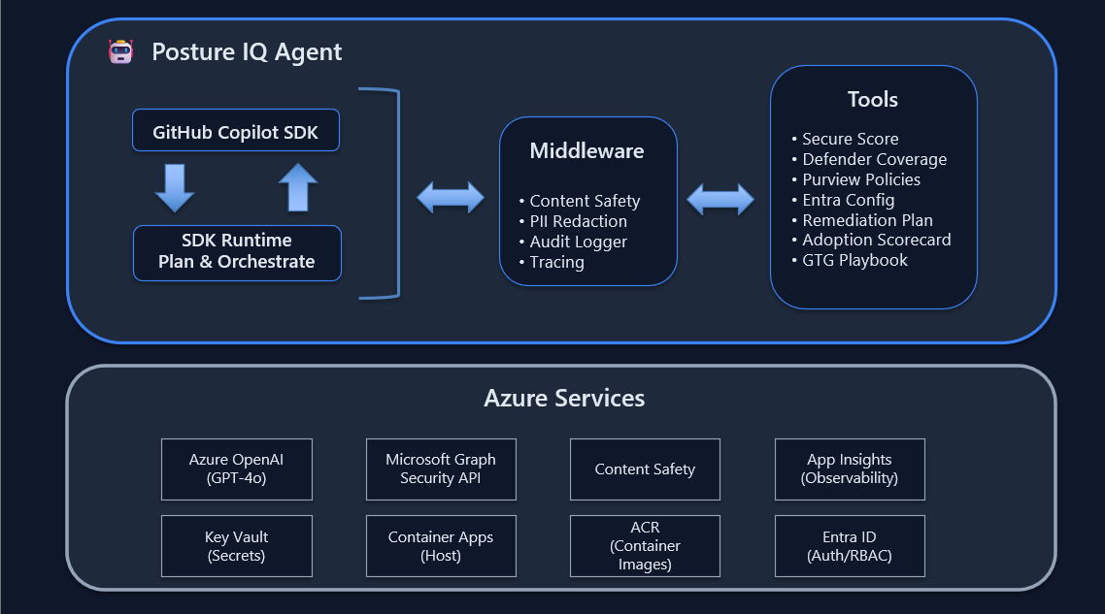
How It Works
Architecture Built for Trust
Copilot SDK Runtime
We didn't build a planner. We declared intent. The SDK runtime orchestrates everything — dynamically, in real time.
Simple enough for business leaders. Rigorous enough for engineers.
Copilot SDK
8 Specialized Tools
Guardrails by Design

Slide 7

Security That Doesn't Compromise
If a security agent isn't secure, it has no credibility. Every design decision was made to earn yours — and your customers'.
Read-Only
PII-Safe
Zero write permissions. The agent observes — it never modifies tenant configuration.
No personal data is stored, transmitted, or surfaced. Compliance-ready by design.
Immutably Audited
Every action is logged and tamper-proof. Full traceability for every assessment run.

Slide 8
Weeks → Minutes.
Why This Wins for Your Business
We turned week-long security assessment into minutes of conversation — safely, repeatably, and at scale.
At enterprise scale.
This isn't a productivity gain. It's a Strategic Shift in how account teams Deliver security value — and how organizations understand their own risk posture.
ENTERPRISE READY
AUDIT SAFE

