Slide 1
情感地图
PRESENTED BY 唇边轻启的欲念之火

Slide 2





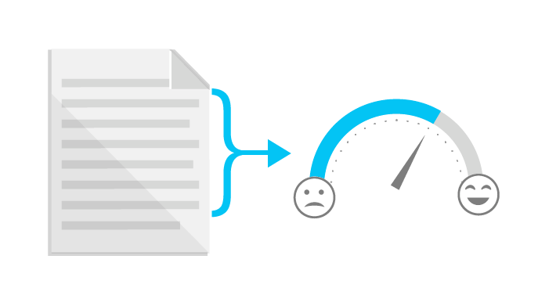



Idea To Product
...

Slide 3
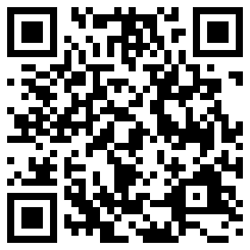
Talk is cheap, show you the demo.
http://hackthon17write.chinacloudapp.cn/

Slide 4



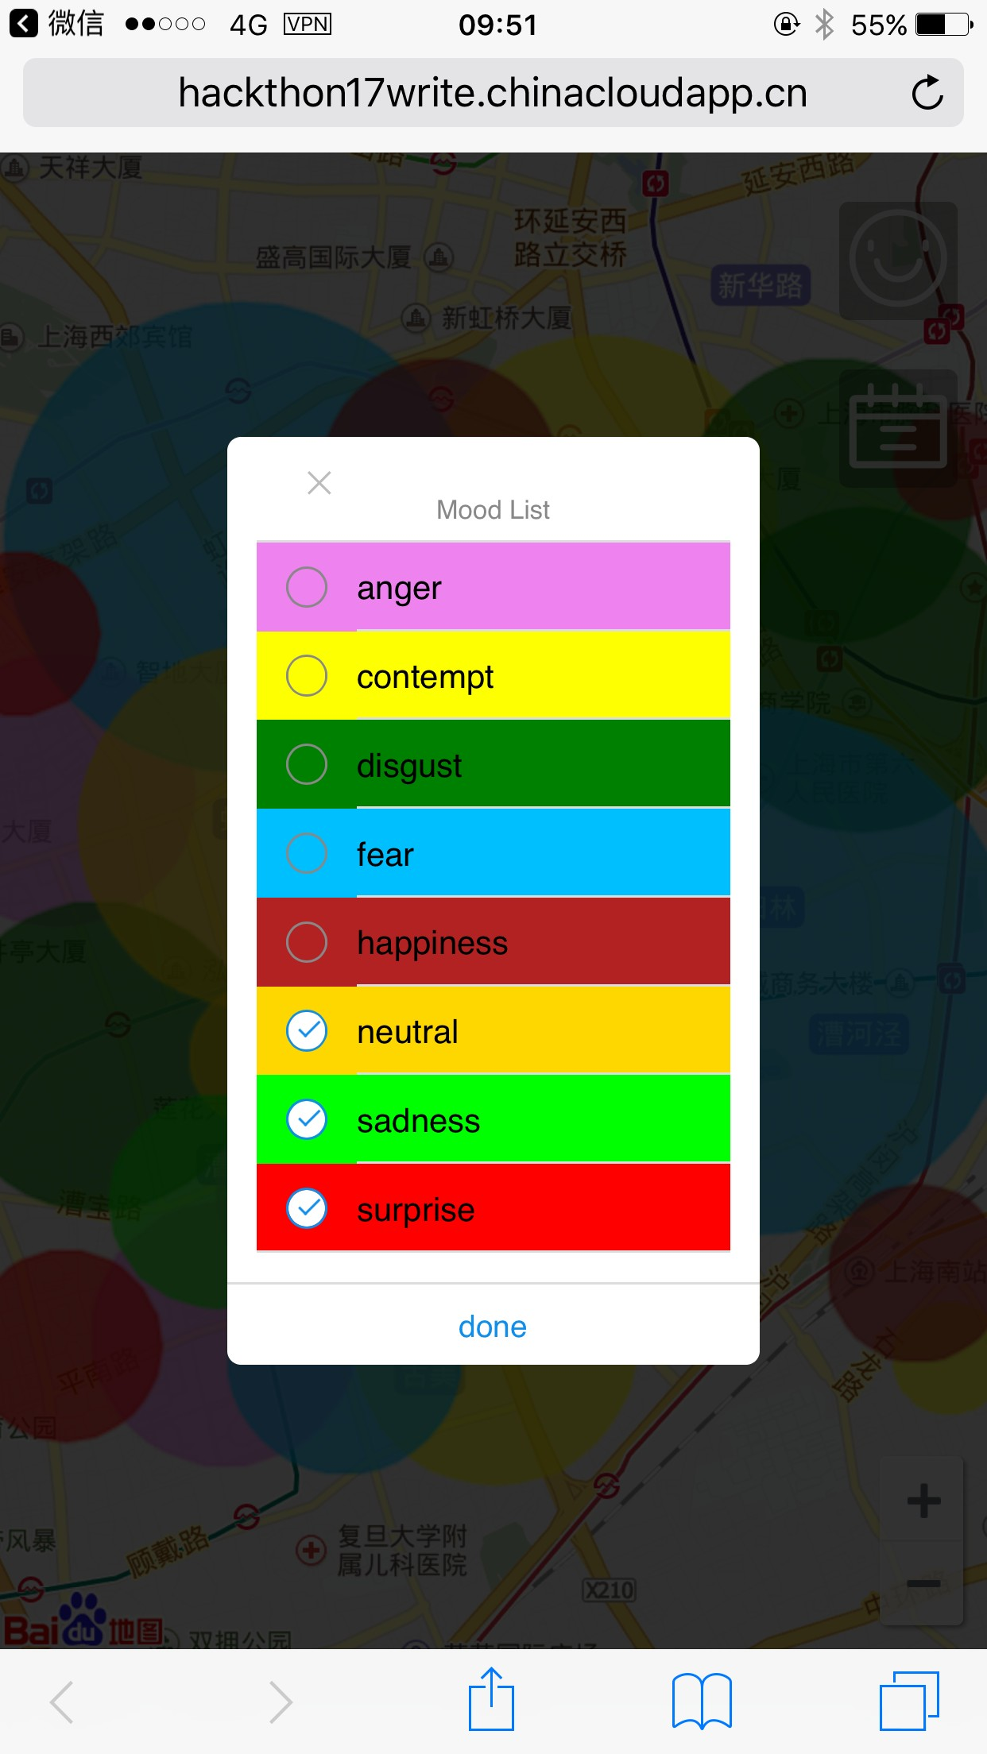
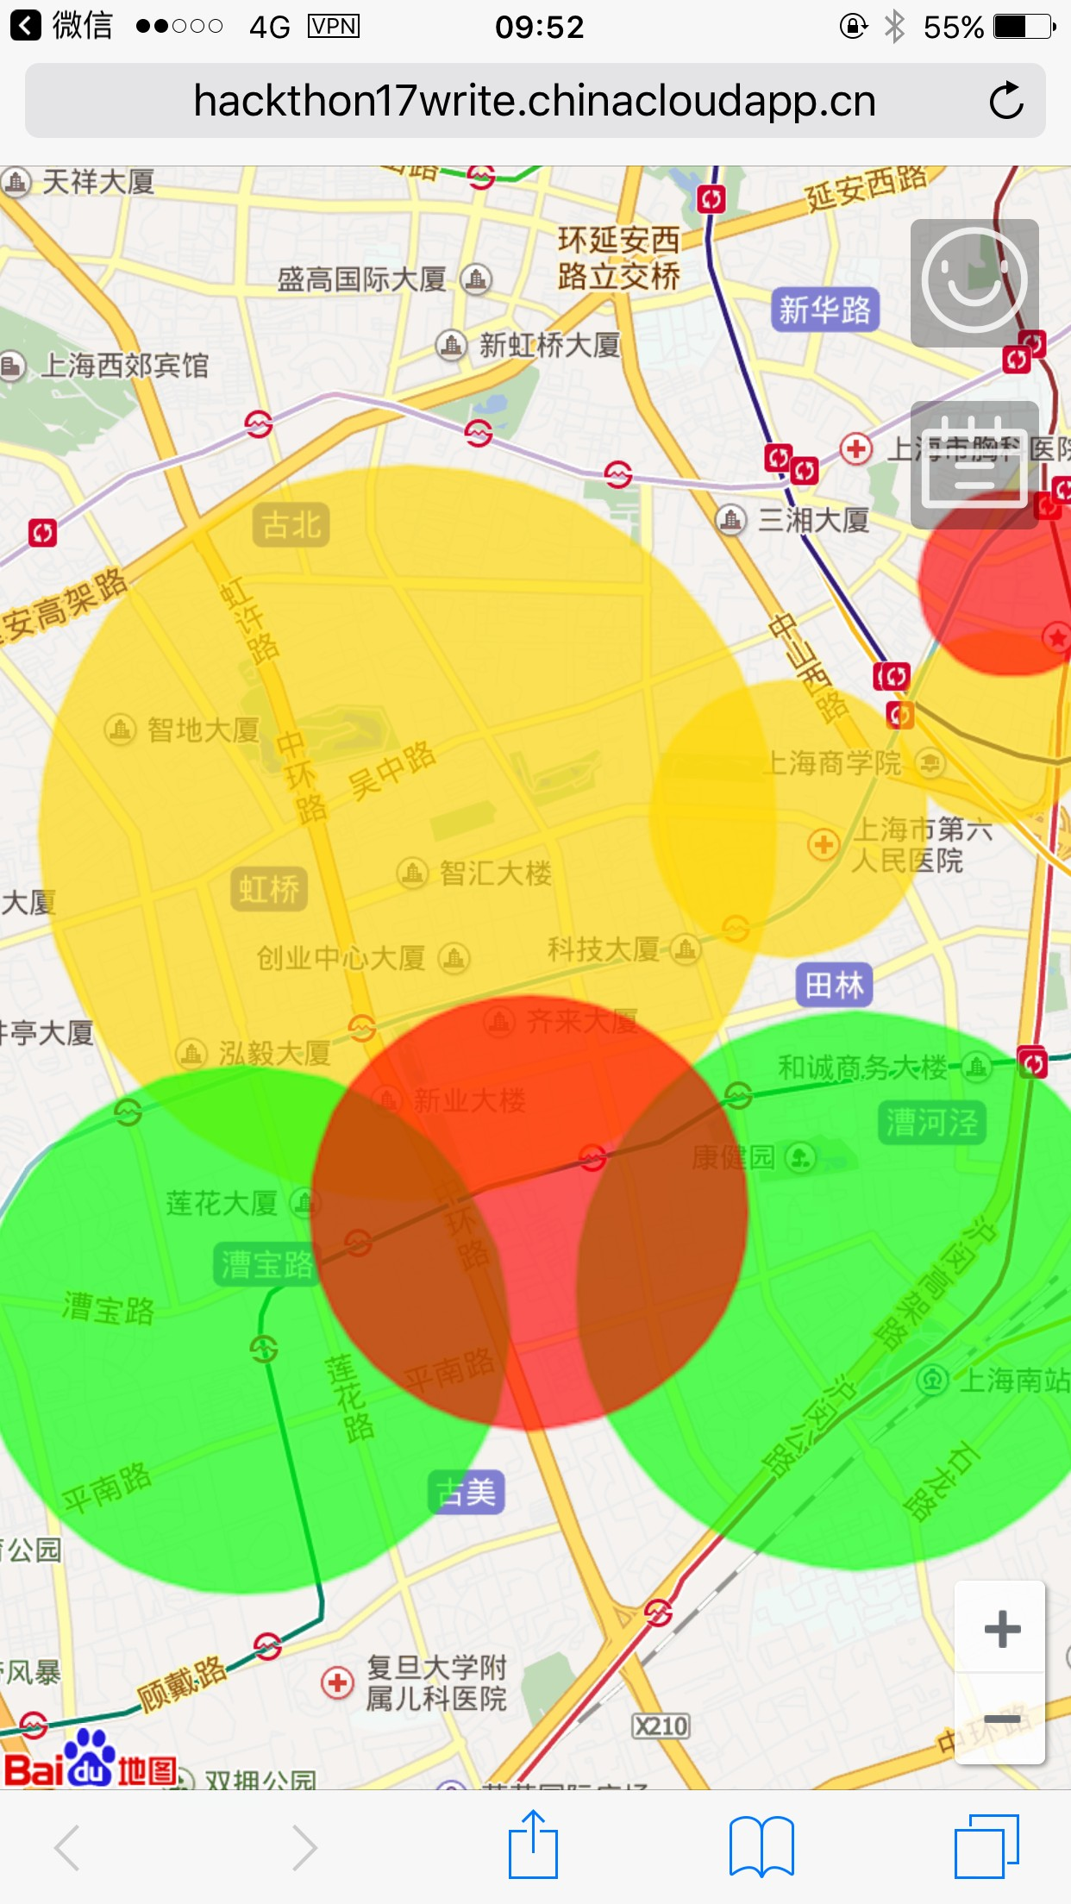
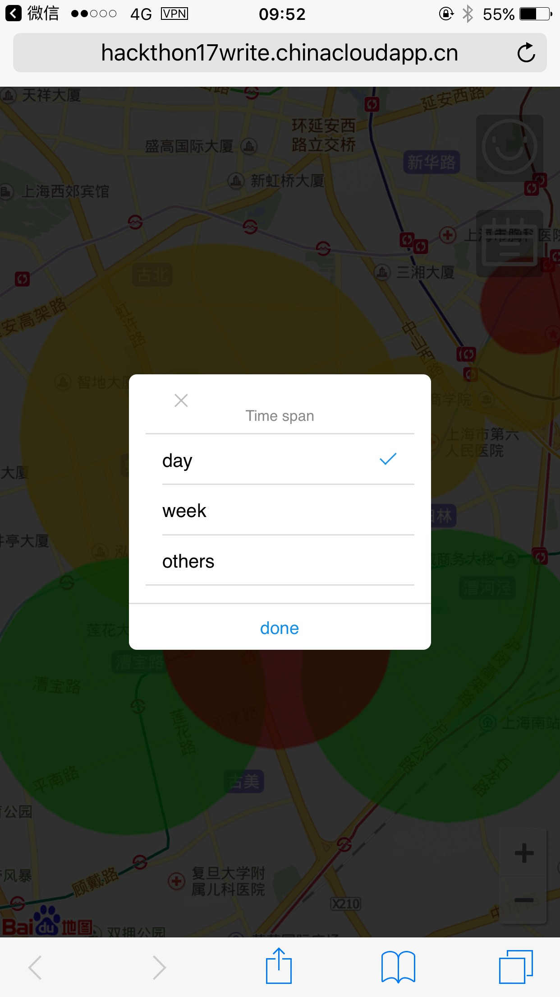
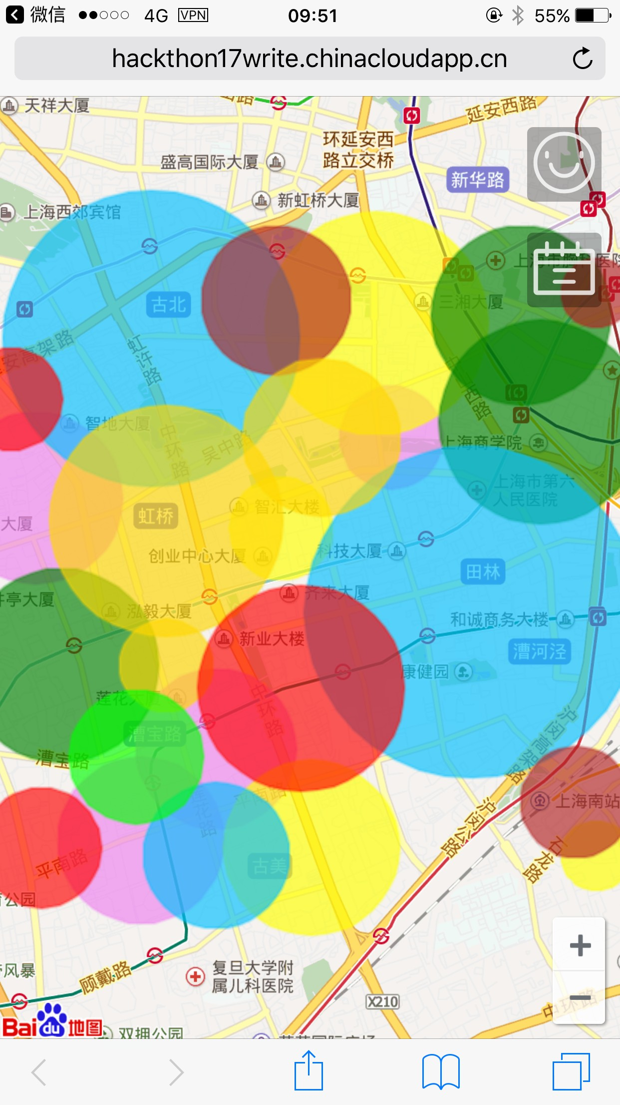
Talk is cheap, show you the demo.

Slide 5
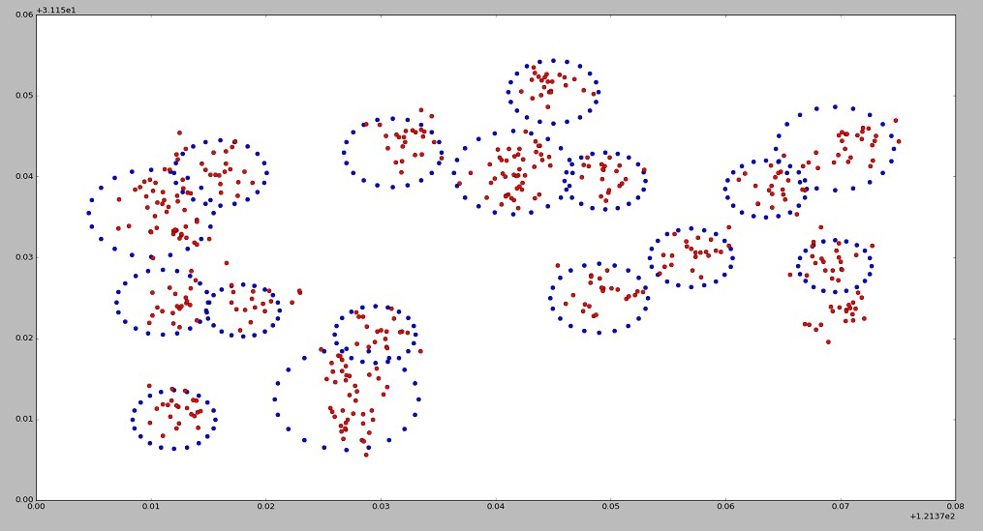
We love algorithm.

Slide 6
Choose your own circle.
TODO

Slide 7






Scalability is everything.
React
Writer
Postgres
Server

Slide 8
THANK YOU!
PRESENTED BY 唇边轻启的欲念之火

