Slide 1
SatietyTM
Grox

Slide 2



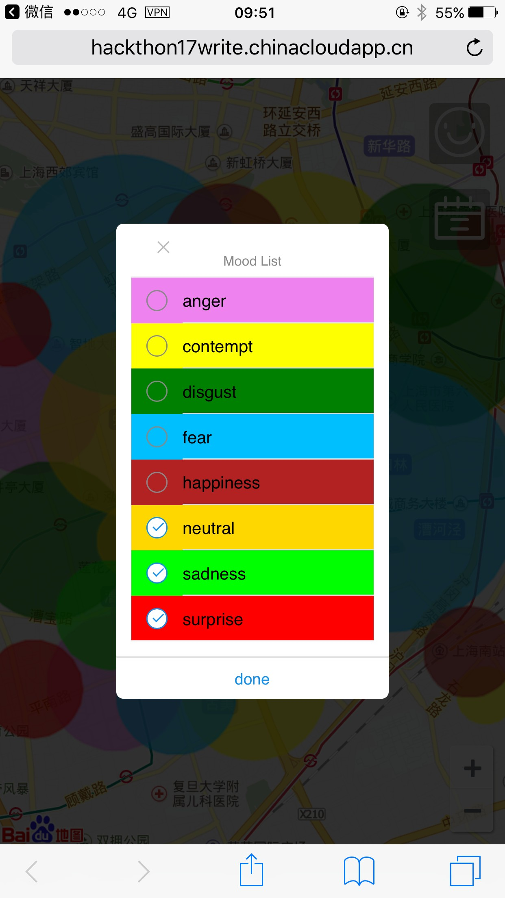
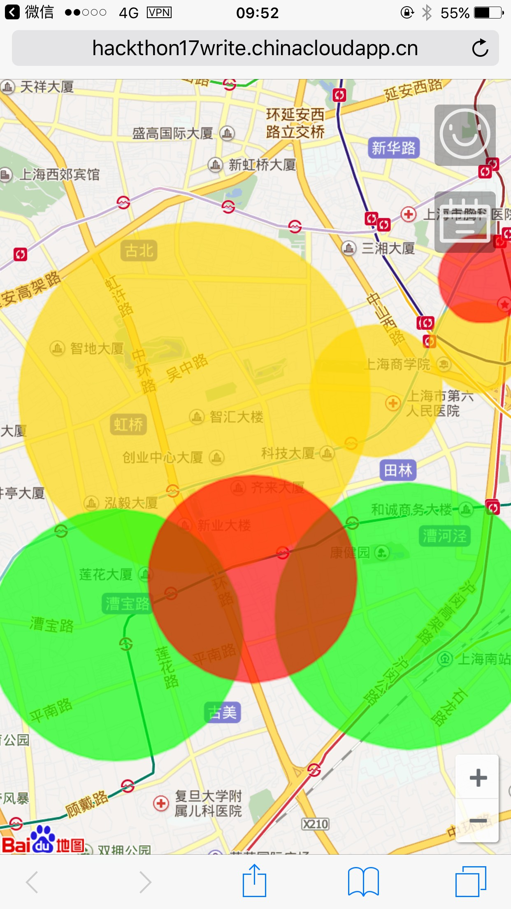
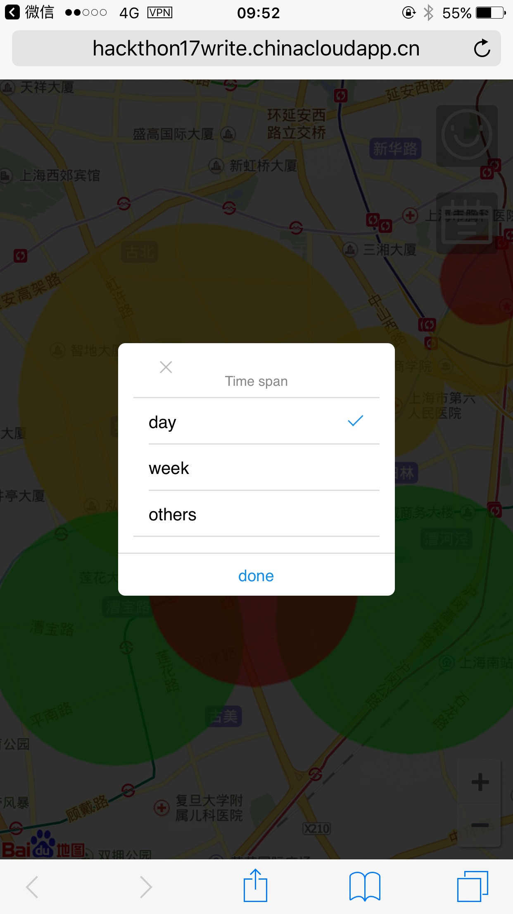
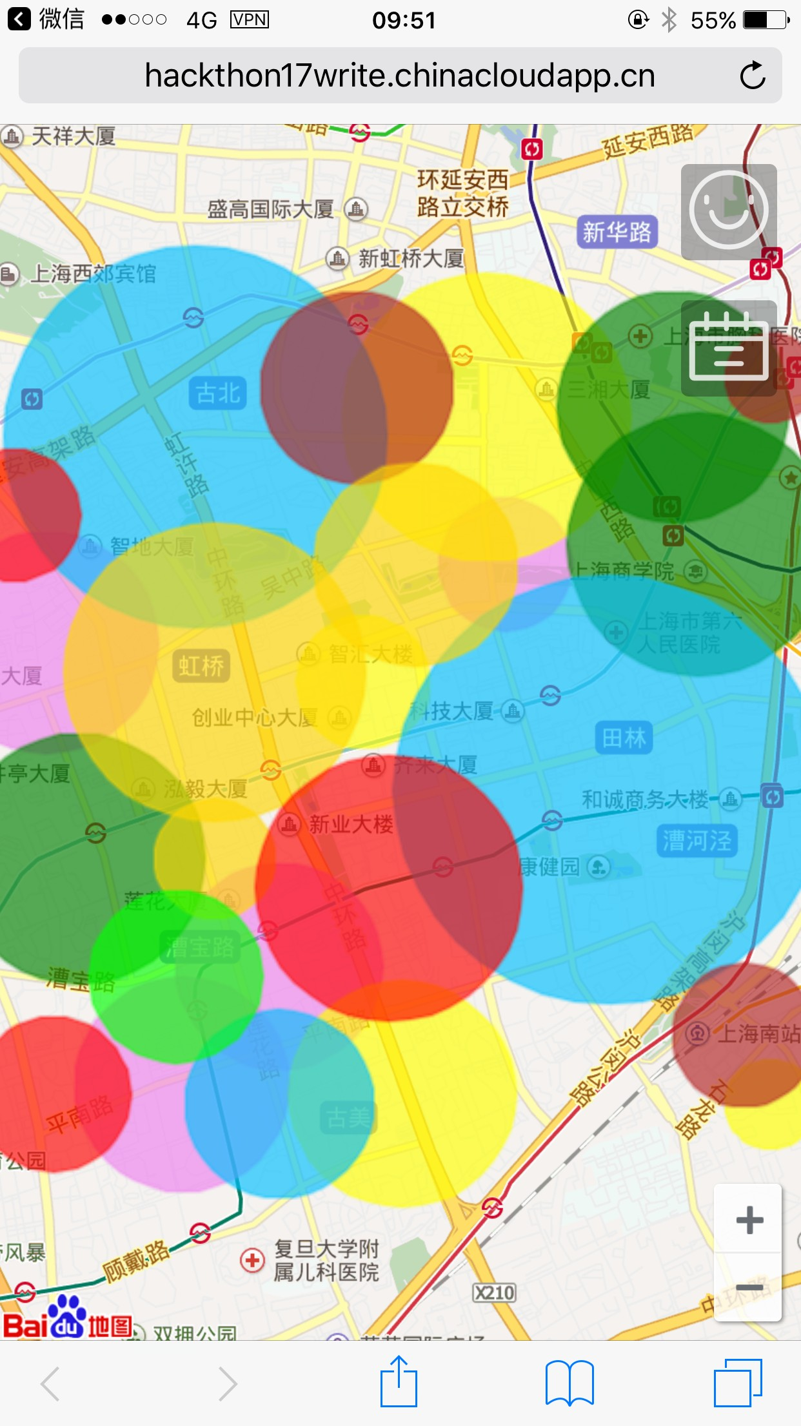
Talk is cheap, show you the demo.

Slide 3





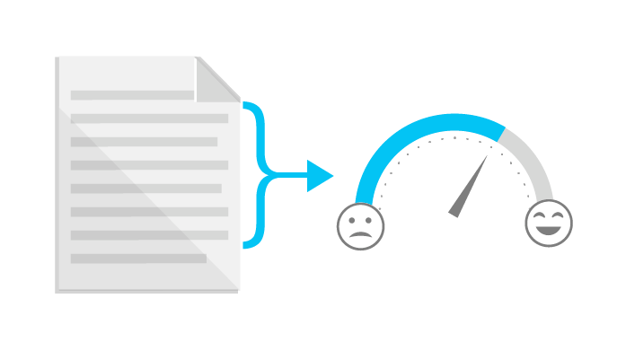



Idea To Product
...

Slide 4
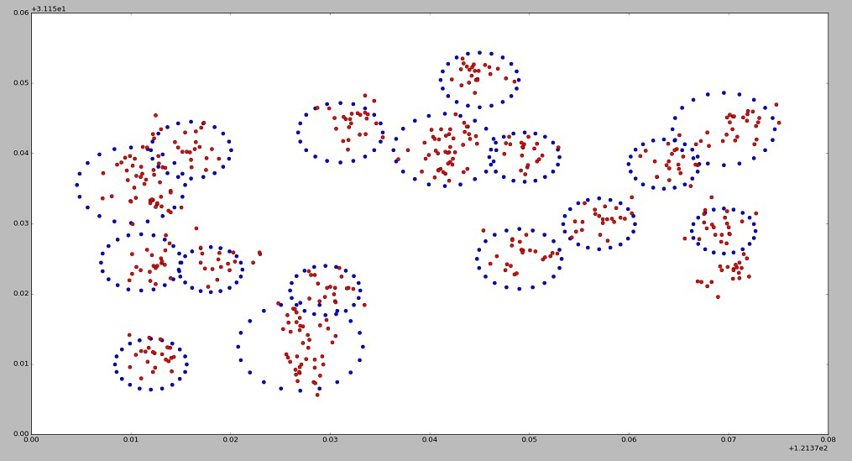
We love algorithm.

Slide 5






Scalability is everything.
React
Writer
Postgres
Server

Slide 6
THANK YOU!
Grox

