Slide 2
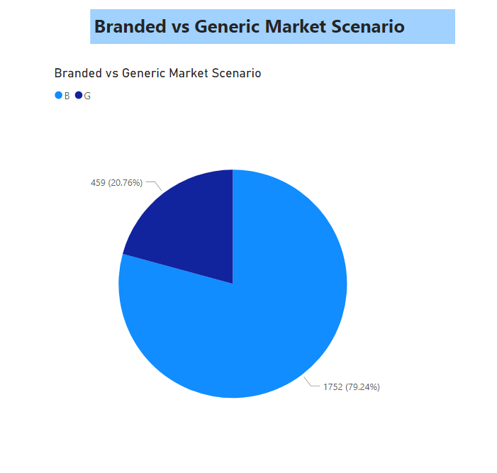
Here, We can see the proportions of Branded and Generic product in the market on the basis of given data.
Market is more occupied by branded products with around 79% as compared to generic product with 20.76%

Slide 3
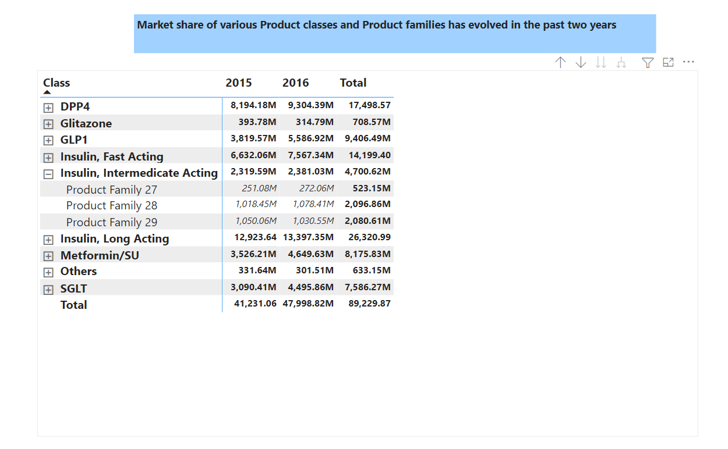
From above metrics, we can analyse the changes of values of any product families corresponding
to their classes.

Slide 4
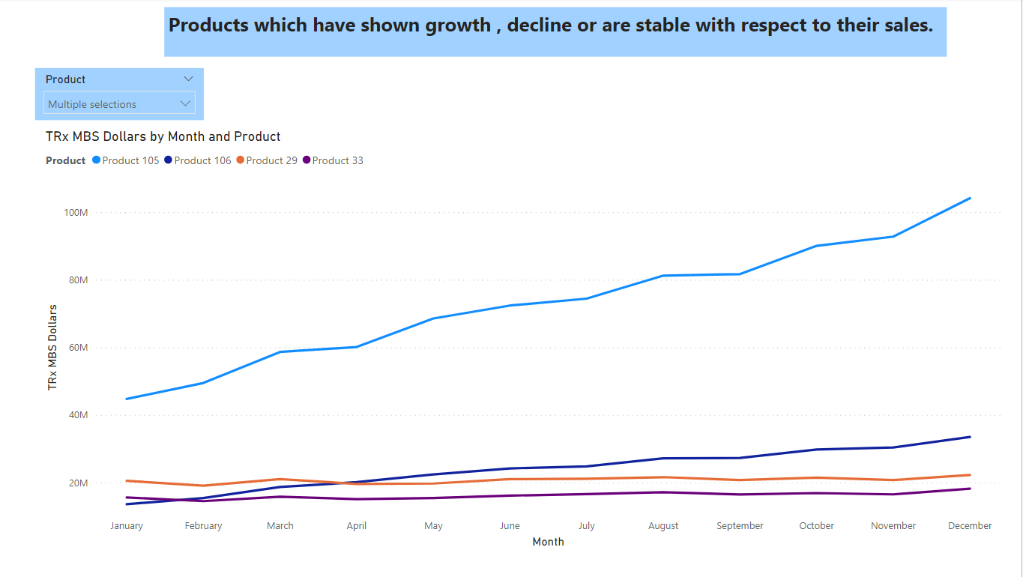
Here, we can see the trend of any product by utilising the slicer and line chart. We can see
single or multiple product trends by selecting product from slicer.

Slide 5
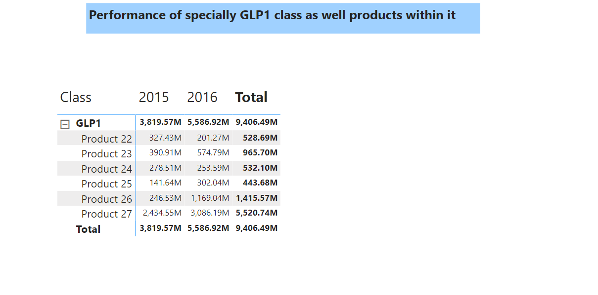
From above metrics, we can analyse the changes of values of any product corresponding
to the GLP1 product class.

