Slide 1
WTF is GIT?
a humble talk by Sergey Arkhipov
in MERA on 15 Nov 2011

Slide 2
WTF is GIT?
Agenda
What is GIT?
GIT vs ClearCase
Fully distributed
GIT workflow
Musthave commands
Credits

Slide 3
What is GIT?

Slide 4
What is GIT?
Git is an open source,
distributed version control
system designed for speed
and efficiency.

Slide 5
What is GIT?
Git is an open source,
distributed version control
system designed for speed
and efficiency.

Slide 6
Snapshots, not patches!

Slide 7
What is GIT?
Snapshot, not patches!
Delta
storage
Snapshot
storage

Slide 8
What is GIT?
Snapshot, not patches!
Delta
storage
C1
spam.py
eggs.py
build.xml
Snapshot
storage

Slide 9
What is GIT?
Snapshot, not patches!
Delta
storage
C1
C2
spam.py
Δ1
eggs.py
build.xml
Δ1
Snapshot
storage

Slide 10
What is GIT?
Snapshot, not patches!
Delta
storage
C1
C2
C3
spam.py
Δ1
Δ2
eggs.py
Δ2
build.xml
Δ1
Snapshot
storage

Slide 11
What is GIT?
Snapshot, not patches!
Delta
storage
C1
C2
C3
C4
spam.py
Δ1
Δ2
eggs.py
Δ2
build.xml
Δ1
Δ3
Snapshot
storage

Slide 12
What is GIT?
Snapshot, not patches!
Delta
storage
C1
spam.py
eggs.py
build.xml
Snapshot
storage
C1
A
B
C

Slide 13
What is GIT?
Snapshot, not patches!
Delta
storage
C1
C2
spam.py
Δ1
eggs.py
build.xml
Δ1
Snapshot
storage
C1
C2
A
A1
B
B1
C
C1

Slide 14
What is GIT?
Snapshot, not patches!
Delta
storage
C1
C2
spam.py
Δ1
eggs.py
build.xml
Δ1
Snapshot
storage
C1
C2
A
A1
B
B1
C
C1

Slide 15
What is GIT?
Snapshot, not patches!
Delta
storage
C1
C2
C3
spam.py
Δ1
Δ2
eggs.py
Δ2
build.xml
Δ1
Snapshot
storage
C1
C2
C3
A
A1
A2
B
B1
B2
C
C1
C2

Slide 16
What is GIT?
Snapshot, not patches!
Delta
storage
C1
C2
C3
spam.py
Δ1
Δ2
eggs.py
Δ2
build.xml
Δ1
Snapshot
storage
C1
C2
C3
A
A1
A2
B
B1
B2
C
C1
C2

Slide 17
What is GIT?
Snapshot, not patches!
Delta
storage
C1
C2
C3
C4
spam.py
Δ1
Δ2
eggs.py
Δ2
build.xml
Δ1
Δ3
Snapshot
storage
C1
C2
C3
C4
A
A1
A2
A3
B
B1
B2
B3
C
C1
C2
C3

Slide 18
What is GIT?
Snapshot, not patches!
Delta
storage
C1
C2
C3
C4
spam.py
Δ1
Δ2
eggs.py
Δ2
build.xml
Δ1
Δ3
Snapshot
storage
C1
C2
C3
C4
A
A1
A2
A3
B
B1
B2
B3
C
C1
C2
C3

Slide 19
What is GIT?
Snapshot, not patches!
Delta
storage
C1
C2
C3
C4
spam.py
Δ1
Δ2
eggs.py
Δ2
build.xml
Δ1
Δ3
Snapshot
storage
C1
C2
C3
C4
A
A1
A2
A3
B
B1
B2
B3
C
C1
C2
C3

Slide 20
What is GIT?
Snapshot, not patches!
Delta
storage
C1
C2
C3
C4
spam.py
Δ1
Δ2
eggs.py
Δ2
build.xml
Δ1
Δ3
Snapshot
storage
C1
C2
C3
C4
A
A1
A2
A3
B
B1
B2
B3
C
C1
C2
C3

Slide 21
What is GIT?
Snapshot, not patches!
Delta
storage
C1
C2
C3
C4
spam.py
Δ1
Δ2
eggs.py
Δ2
build.xml
Δ1
Δ3
Snapshot
storage
C1
C2
C3
C4
A
A1
A2
A3
B
B1
B2
B3
C
C1
C2
C3

Slide 22
OK.
But how is this different to
our beloved ClearCase?

Slide 23
GIT vs ClearCase

Slide 24
GIT vs ClearCase

Slide 25
GIT vs ClearCase

Slide 26
GIT vs ClearCase

Slide 27
GIT vs ClearCase

Slide 28
GIT vs ClearCase

Slide 29
GIT vs ClearCase

Slide 30
GIT vs ClearCase

Slide 31
Everything looks great, but…

Slide 32
GIT vs ClearCase
After 1 year…

Slide 33
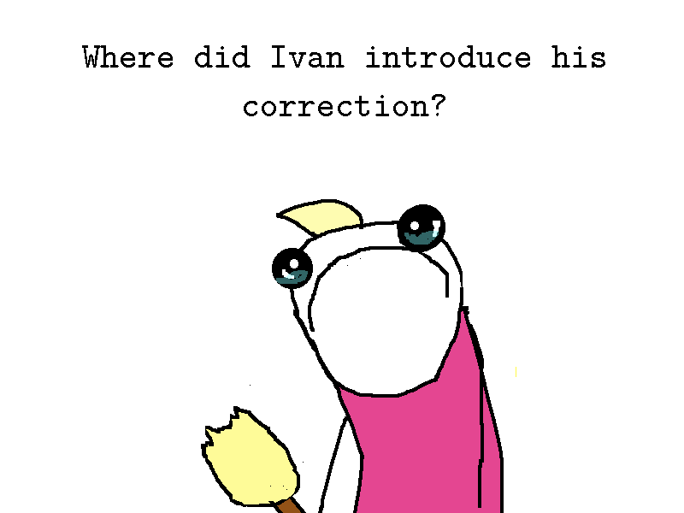
GIT vs ClearCase

Slide 34
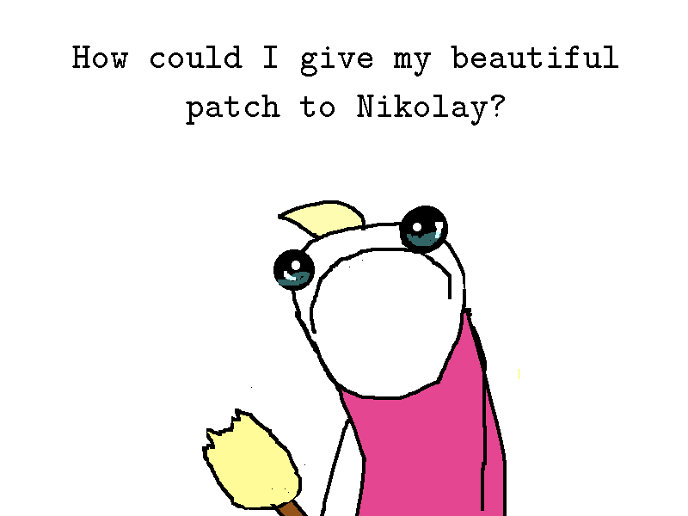
GIT vs ClearCase

Slide 35
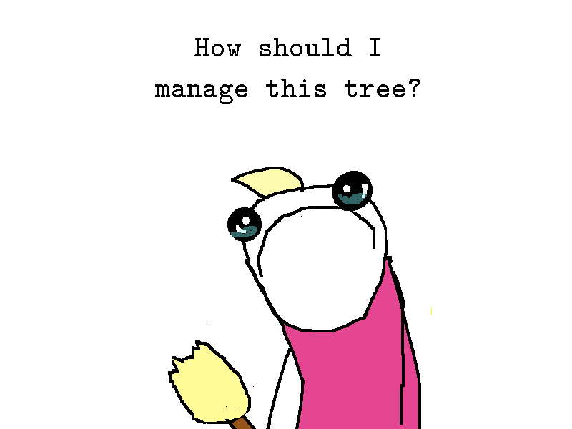
GIT vs ClearCase

Slide 36
?

Slide 37
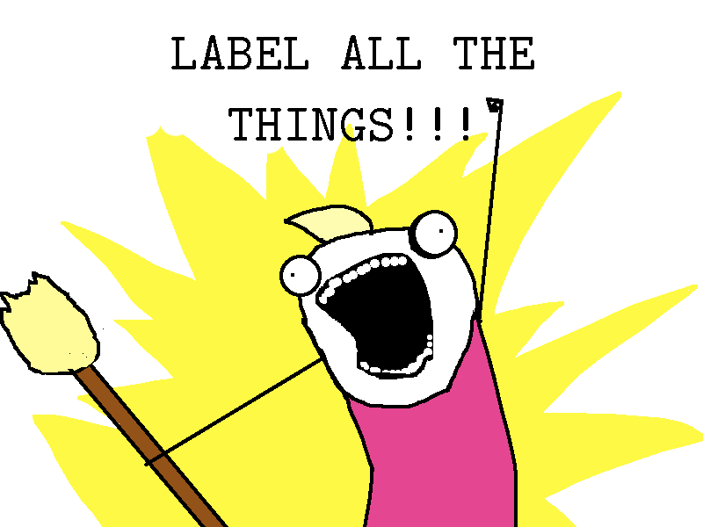
GIT vs ClearCase

Slide 38
GIT vs ClearCase
D1_LULZ_MERA
D1_XXYX_MERA
D1_MAIN_MERA
D2_LULZ_MERA
D3_XAYX_MERA
D3_LULZ_MERA
D3_ZZZ_MERA
D5_MAIN_MERA
D4_XAYX_MERA
D1_WOOT_MERA

Slide 39
GIT vs ClearCase
D1_LULZ_MERA
D1_XXYX_MERA
D1_FEAT_MERA
D1_MAIN_MERA
D16_SUPA_MERA
D1_ARGH_MERA
D2_LULZ_MERA
D1_KILL_MERA
D3_MAIN_MERA
D3_XAYX_MERA
D3_LULZ_MERA
D3_ZZZ_MERA
D5_MAIN_MERA
D4_XAYX_MERA
D1_WOOT_MERA

Slide 40
GIT vs ClearCase
D1_LULZ_MERA
D1_XXYX_MERA
D1_FEAT_MERA
D1_MAIN_MERA
D8_EVERYTHING
D16_SUPA_MERA
D1_ARGH_MERA
D2_LULZ_MERA
D1_KILL_MERA
D46_LBL1_MERA
D3_MAIN_MERA
D3_XAYX_MERA
D8_PHHH_MERA
D34_LOLD_MERA
D3_LULZ_MERA
D3_ZZZ_MERA
D1_15L5_MERA
D5_MAIN_MERA
D4_XAYX_MERA
D1_WOOT_MERA
NBC_SO_NBC
D4_1l1l_MERA
SIMPLE_LABEL

Slide 41
GIT vs ClearCase
D1_LULZ_MERA
D18_XYZ_MERA
D1_XXYX_MERA
D1_FEAT_MERA
D1_MAIN_MERA
D8_EVERYTHING
D16_SUPA_MERA
D1_WRONG_MERA
D1_ARGH_MERA
D2_LULZ_MERA
D1_KILL_MERA
D15_XYZ_MERA
D46_LBL1_MERA
D46_XYZ_MERA
D3_MAIN_MERA
D3_XAYX_MERA
D8_PHHH_MERA
D34_LOLD_MERA
D3_LULZ_MERA
D46_XYZ_MERA
D3_ZZZ_MERA
D46_HMM_MERA
D1_15L5_MERA
D5_MAIN_MERA
D4_XAYX_MERA
TIRED_TO_COPYPASTE
D1_WOOT_MERA
D46_666_MERA
NBC_SO_NBC
D4_1l1l_MERA
SIMPLE_LABEL

Slide 42
GIT vs ClearCase
D1_LULZ_MERA
D1_XXYX_MERA
D1_GUYS_ARE_YOU_HAPPY_MERA
D1_FEAT_MERA
D1_MAIN_MERA
D8_EVERYTHING
D16_SUPA_MERA
D1_ARGH_MERA
D2_LULZ_MERA
D1_KILL_MERA
D46_LBL1_MERA
D3_MAIN_MERA
D3_XAYX_MERA
D8_PHHH_MERA
D34_LOLD_MERA
D3_LULZ_MERA
D3_ZZZ_MERA
D1_15L5_MERA
D5_MAIN_MERA
D4_XAYX_MERA
D1_WOOT_MERA
NBC_SO_NBC
D4_1l1l_MERA
SIMPLE_LABEL

Slide 43
Are you really happy?

Slide 44

GIT vs ClearCase
Ordinary ClearCase user

Slide 45

GIT vs ClearCase
Ordinary GIT user

Slide 46
Have you ever realized
what your ClearCase view
really is?

Slide 47
GIT vs ClearCase
sum.c
subtract.c
multiply.c

Slide 48
GIT vs ClearCase
sum.c
subtract.c
multiply.c

Slide 49
GIT vs ClearCase
sum.c
subtract.c
multiply.c
D1_YYY_MERA
D1_ZZZBLU_MERA
D2_XXXBLU_MERA

Slide 50
GIT vs ClearCase
sum.c
subtract.c
multiply.c
D2_YYY_MERA
D3_ZZZ_MERA
D2_XXX_MERA

Slide 51
GIT vs ClearCase
sum.c
subtract.c
multiply.c
D5_YYY_MERA
D12_XXX_MERA
D95_ZZZ_MERA

Slide 52
Any ideas about evolution of
your view?

Slide 53
GIT vs ClearCase
sum.c
subtract.c
multiply.c

Slide 54
GIT vs ClearCase
sum.c
subtract.c
multiply.c

Slide 55
GIT vs ClearCase
sum.c
subtract.c
multiply.c

Slide 56
GIT vs ClearCase
sum.c
subtract.c
multiply.c

Slide 57
GIT vs ClearCase
sum.c
subtract.c
multiply.c
A1
C1
B1
A2
C2
B2
A3
B3
C3

Slide 58
GIT vs ClearCase
A1
B1
C1
A2
B2
C2
A3
B3
C3

Slide 59
GIT vs ClearCase
A1
B1
C1
A2
B2
C2
A3
B3
C3

Slide 60
GIT vs ClearCase
A1
B1
C1
Snapshot 1
Snapshot 2
A2
B2
C2
A3
B3
C3
Snapshot 3

Slide 61
GIT vs ClearCase
Snapshot 1
A1
B1
C1
Snapshot 2
A2
B2
C2
Snapshot 3
A3
B3
C3

Slide 62
Do not lie yourself.
You do not deal with labels.
You deal with snapshots.

Slide 63
GIT vs ClearCase
'Baseline' means 'snapshot' in GIT terms.
But to deliver you correct snapshots there is the team of masterminds who supports label system and makes centralized system redundant.
Each config spec includes over 9000 different labels to create 1 snapshot.

Slide 64
Over 9000 labels
to create 1 snapshot

Slide 65
GIT vs ClearCase
And if you want to extend your snapshot, you need to add much more additional rules.
Each rule defines how your local copy of ClearCase will have to request information about certain file or diff by network.
Each operation is performed over the network which causes mortal delays. Everything is very slow.
Without network you cannot even open file or build something.
You need to explain your ClearCase by unreadable labels and awkward rules time after time which snapshot you need instead of straight using it.

Slide 66
GIT vs ClearCase
GIT have no such restrictions by design
GIT initialy operates snapshots, there is no need in any explicit determining which set of labels you need.
Everything is local. You may pull changes from master repository and continue your work even in aircraft, with branches and whole development story. You may check earliest version even you lost in Tundra without any internet signs.
Your repository is your own game. You can develop in any way you want. Just send your changes into central repository at time.
Operations are really rapid and easy. If you want to select LSV or branch, you do not need to ask central repository for proper set of rules. Just use it!

Slide 67
Examples

Slide 68
GIT vs ClearCase
Choosing baseline
ClearCase way
Git way
$ select_config CPP_DESIGN
waiting for 2 minutes
selecting latest baseline
having a cup of tea
excluding components
Pushing 'Set' button
waiting for 2 minutes
closing application
waiting for 1 minute
working
$ git checkout BASELINE
working

Slide 69
GIT vs ClearCase
Branching
ClearCase way
Git way
$ ct mkbrtype hardcore_branch
$ ctedcs
Typing something like
element * CHECKEDOUT
element <path> …/hardcore_branch/LATEST
element <path> /main/cppdev/LATEST -mkbranch hardcore_branch
$ ct co -nc <path>/<file>
Working if noone checkedout a file
$ git checkout -b hardcore_branch
working

Slide 70
GIT vs ClearCase
Building your software
ClearCase
GIT
$ cat ./cc_build.sh
ct_set_needed_cs -version <LSV> -baseline <BASELINE>
cd <path to one our famed component>
<build command>
$ cat ./git_build.sh
git checkout BASELINE
cd <path to one our famed component>
<build command>

Slide 71
GIT vs ClearCase
Building your software
ClearCase
GIT
$ time -p ./cc_build.sh > /dev/null
real 1053
user 266
sys 78.72
$ time -p ./git_build.sh > /dev/null
real 58.28
user 21.20
sys 35.14

Slide 72
GIT vs ClearCase
Building your software
ClearCase
GIT
$ /usr/bin/time -p
./cc_build.sh > /dev/null
real 1053
user 266
sys 78.72
$ /usr/bin/time -p
./git_build.sh > /dev/null
real 58.28
user 21.20
sys 35.14
17.5 minutes vs 1 minute!

Slide 73
Do you really like ClearCase?

Slide 74
Or you just have not used
something completely different before?

Slide 75
GIT vs ClearCase
GIT support your actual way of developing software by design. You do not need to juggle tons of labels being in a jail of ClearCase ancient restrictions.
ClearCase does not allow to use modern convenient ways of developing 'out of box'. It provides you with hardcore methods for hacking it only.
Everytime you need something from ClearCase, you need to modify your config spec which already contains text with size around a two volumes of 'War and Peace' book instead of telling it what you really want to get.
You do not use ClearCase to simplify your job, everytime you appeal to it to get anything.

Slide 76
Fully distrubuted

Slide 77
What is GIT?
Git is an open source,
distributed version control
system designed for speed
and efficiency.

Slide 78
Fully distributed
(almost) everything is local
which means
everything is fast;
every clone is backup;
work offline;
every known remote repo is branch;

Slide 79
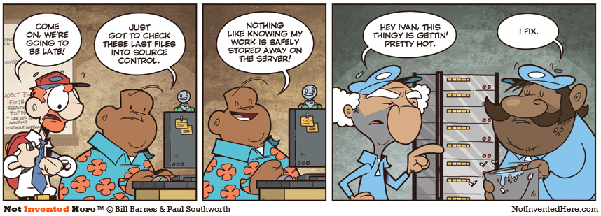
Fully distributed

Slide 80
Fully distributed
Integration
repository
Trunk
repository
Central network repositories
Ivan's
repository
Natasha's
repository
Nikolay's
repository

Slide 81
Fully distributed
Integration
repository
Trunk
repository
Central network repositories
Designer
QA
Designer
Ivan's
repository
Natasha's
repository
Nikolay's
repository

Slide 82
Fully distributed
Integration
repository
Trunk
repository
master
master
Central network repositories
Ivan's
repository
Natasha's
repository
Nikolay's
repository
master
master
master

Slide 83
Fully distributed
Integration
repository
Trunk
repository
master
master
Central network repositories
Ivan's
repository
Natasha's
repository
Nikolay's
repository
master
master
master

Slide 84
Fully distributed
Integration
repository
Trunk
repository
master
master
Central network repositories
Ivan's
repository
Natasha's
repository
Nikolay's
repository
master
master
master

Slide 85
Fully distributed
Integration
repository
Trunk
repository
master
master
Central network repositories
Ivan's
repository
Natasha's
repository
Nikolay's
repository
master
master
master
feature_x
feature_x

Slide 86
Fully distributed
Integration
repository
Trunk
repository
master
master
Central network repositories
Ivan's
repository
Natasha's
repository
Nikolay's
repository
master
master
master
feature_x
test_y
feature_x

Slide 87
Fully distributed
Integration
repository
Trunk
repository
master
master
Central network repositories
Ivan's
repository
Natasha's
repository
Nikolay's
repository
master
master
master
feature_x
test_y
feature_x

Slide 88
Fully distributed
Integration
repository
Trunk
repository
master
master
Central network repositories
BUG!!!
Ivan's
repository
Natasha's
repository
Nikolay's
repository
master
master
master
feature_x
test_y
feature_x

Slide 89
Fully distributed
Integration
repository
Trunk
repository
master
master
Central network repositories
I take it.
BUG!!!
Ivan's
repository
Natasha's
repository
Nikolay's
repository
master
master
master
feature_x
test_y
feature_x

Slide 90
Fully distributed
Integration
repository
Trunk
repository
master
master
Central network repositories
Ivan's
repository
Natasha's
repository
Nikolay's
repository
master
master
master
feature_x
test_y
feature_x
bug_y

Slide 91
Fully distributed
Integration
repository
Trunk
repository
master
master
Central network repositories
Ready!
Ivan's
repository
Natasha's
repository
Nikolay's
repository
master
master
master
feature_x
test_y
feature_x
bug_y

Slide 92
Fully distributed
Integration
repository
Trunk
repository
master
master
Central network repositories
Ivan's
repository
Natasha's
repository
Nikolay's
repository
master
master
master
feature_x
test_y
feature_x
bug_y

Slide 93
Fully distributed
Integration
repository
Trunk
repository
master
master
maintenence
Central network repositories
Ivan, I've done my part
Ivan's
repository
Natasha's
repository
Nikolay's
repository
master
master
master
feature_x
test_y
feature_x

Slide 94
Fully distributed
Integration
repository
Trunk
repository
master
master
maintenence
Central network repositories
Ivan's
repository
Natasha's
repository
Nikolay's
repository
master
master
master
feature_x
test_y
feature_x

Slide 95
Fully distributed
Integration
repository
Trunk
repository
master
master
maintenence
Central network repositories
Looks OK!
Ivan's
repository
Natasha's
repository
Nikolay's
repository
master
master
master
feature_x
feature_x

Slide 96
Fully distributed
Integration
repository
Trunk
repository
master
master
maintenence
Central network repositories
Ivan's
repository
Natasha's
repository
Nikolay's
repository
master
master
master
feature_x
test_z
feature_x

Slide 97
Fully distributed
Network down
BUG!!!
Ivan's
repository
Natasha's
repository
Nikolay's
repository
master
master
master
feature_x
test_z
feature_x

Slide 98
Fully distributed
Network down
BUG!!!
I take it.
Ivan's
repository
Natasha's
repository
Nikolay's
repository
master
master
master
feature_x
test_z
feature_x

Slide 99
Fully distributed
Network down
Ivan's
repository
Natasha's
repository
Nikolay's
repository
master
master
master
feature_x
test_z
feature_x
bugfix_z

Slide 100
Fully distributed
Network down
Ready
Ivan's
repository
Natasha's
repository
Nikolay's
repository
master
master
master
feature_x
test_z
feature_x
bugfix_z

Slide 101
Fully distributed
Network down
Ivan's
repository
Natasha's
repository
Nikolay's
repository
master
master
master
feature_x
test_z
feature_x
bugfix_z

Slide 102
Fully distributed
Network down
Looks OK!
Ivan's
repository
Natasha's
repository
Nikolay's
repository
master
master
master
feature_x
feature_x
bugfix_z

Slide 103
Fully distributed
Integration
repository
Trunk
repository
master
master
maintenence
Central network repositories
Ivan's
repository
Natasha's
repository
Nikolay's
repository
master
master
master
feature_x
feature_x
bugfix_z

Slide 104
Fully distributed
Integration
repository
Trunk
repository
master
master
maintenence
Central network repositories
Ivan's
repository
Natasha's
repository
Nikolay's
repository
master
master
master
feature_x
feature_x

Slide 105
Fully distributed
Integration
repository
Trunk
repository
master
master
maintenence
Central network repositories
Ready. Need to rebase.
Ivan's
repository
Natasha's
repository
Nikolay's
repository
master
master
master
feature_x
feature_x

Slide 106
Fully distributed
Integration
repository
Trunk
repository
master
master
maintenence
Central network repositories
Ivan's
repository
Natasha's
repository
Nikolay's
repository
master
master
master
feature_x
feature_x

Slide 107
Fully distributed
Integration
repository
Trunk
repository
master
master
maintenence
Central network repositories
Ivan's
repository
Natasha's
repository
Nikolay's
repository
master
master
master
feature_x
feature_x

Slide 108
Fully distributed
Integration
repository
Trunk
repository
master
master
maintenence
Central network repositories
New feature is ready!
New feature is ready!
Ivan's
repository
Natasha's
repository
Nikolay's
repository
master
master
master

Slide 109
Fully distributed
Integration
repository
Trunk
repository
master
master
maintenence
Central network repositories
Have you said that new bugs are ready?
Ivan's
repository
Natasha's
repository
Nikolay's
repository
master
master
master

Slide 110
Fully distributed
Integration
repository
Trunk
repository
master
master
maintenence
Central network repositories
:(
:(
Ivan's
repository
Natasha's
repository
Nikolay's
repository
master
master
master

Slide 111
Fully distributed
Integration
repository
Trunk
repository
master
master
maintenence
Central network repositories
Ivan's
repository
Natasha's
repository
Nikolay's
repository
master
master
master
regressions

Slide 112
Fully distributed
Integration
repository
Trunk
repository
master
master
maintenence
Central network repositories
Old feature looks done
Ivan's
repository
Natasha's
repository
Nikolay's
repository
master
master
master
regressions

Slide 113
Fully distributed
Integration
repository
Trunk
repository
master
master
maintenence
Central network repositories
Ivan's
repository
Natasha's
repository
Nikolay's
repository
master
master
master

Slide 114
Fully distributed
Integration
repository
Trunk
repository
master
master
Central network repositories
Ivan's
repository
Natasha's
repository
Nikolay's
repository
master
master
master

Slide 115
GIT workflow

Slide 116
GIT workflow
Create your branch
Edit files
Stage your changes
Commit the changes
Rebase your branch from master
Merge to master
Push to central repository

Slide 117
Branches

Slide 118
GIT workflow
Branching in details
HEAD
master
A1

Slide 119
GIT workflow
Branching in details
HEAD
master
A1
A2

Slide 120
GIT workflow
Branching in details
HEAD
master
A1
A2
A3
git branch branch

Slide 121
GIT workflow
Branching in details
HEAD
master
A1
A2
A3
branch

Slide 122
GIT workflow
Branching in details
HEAD
master
A1
A2
A3
branch
git checkout branch

Slide 123
GIT workflow
Branching in details
master
A1
A2
A3
branch
HEAD

Slide 124
GIT workflow
Branching in details
master
A1
A2
A3
A4
branch
HEAD

Slide 125
GIT workflow
Branching in details
master
A1
A2
A3
A4
A5
branch
HEAD

Slide 126
GIT workflow
Branching in details
master
A1
A2
A3
A4
A5
branch
HEAD
git checkout master

Slide 127
GIT workflow
Branching in details
HEAD
master
A1
A2
A3
A4
A5
branch

Slide 128

What's up, folks?
This presentation contains 256 slides and looks like that you have reached midway.
Congrats!

Slide 129
GIT workflow
Branching in details
HEAD
master
A1
A2
A3
A4
A5
branch

Slide 130
GIT workflow
Branching in details
HEAD
master
A1
A2
A3
A6
A4
A5
branch

Slide 131
GIT workflow
Branching in details
HEAD
master
A1
A2
A3
A6
A7
A4
A5
branch

Slide 132
GIT workflow
Branching in details
Branch pointer always points on the head of branch;
Creating branch = creating pointer to commit. 41 bytes on your disk;
Removing branch is removing pointer.
Obsolete commits is removed by GIT's GC;
HEAD meta-tag points to current active branch;
One task = one branch.

Slide 133
GIT workflow
Branching in details
Branch pointer always points on the head of a branch;
Creating branch = creating pointer to commit. 41 bytes on your disk;
Removing branch is removing pointer.
Obsolete commits is removed by GIT's GC;
HEAD meta-tag points to a current active branch;
One task = one branch.

Slide 134
GIT workflow
Create your branch
Edit files
Stage your changes
Commit the changes
Rebase your branch from master
Merge to master
Push to central repository

Slide 135
Staging and commiting

Slide 136
GIT workflow
Staging and commiting
Working directory
Index
Repository

Slide 137
GIT workflow
Staging and commiting
A working copy
of your project
Working directory
Index
Repository

Slide 138
GIT workflow
Staging and commiting
Working directory
Staging area
Index
Repository

Slide 139
GIT workflow
Staging and commiting
Working directory
Index
Object database
Repository

Slide 140
GIT workflow
Staging and commiting
$ git status
# On branch master
#
# Initial commit
#
nothing to commit (create/copy files and use "git add" to track)

Slide 141
GIT workflow
Staging and commiting
$ git status
# On branch master
#
# Initial commit
#
nothing to commit (create/copy files and use "git add" to track)

Slide 142
GIT workflow
Staging and commiting
$ emacs helloworld.c
$ cat helloworld.c
/* This is a classic 'hello world' app */
int
main (int argc, char** argv) {
puts("Hello, brave new world!");
return 0;
}

Slide 143
GIT workflow
Staging and commiting
$ git status
# On branch master
#
# Initial commit
#
# Untracked files:
# (use "git add <file>..." to include in what will be committed)
#
# helloworld.c
nothing added to commit but untracked files present (use "git add" to track)

Slide 144
GIT workflow
Staging and commiting
$ git status
# On branch master
#
# Initial commit
#
# Untracked files:
# (use "git add <file>..." to include in what will be committed)
#
# helloworld.c
nothing added to commit but untracked files present (use "git add" to track)

Slide 145
GIT workflow
Staging and commiting
$ git add helloworld.c
$ git status
# On branch master
#
# Initial commit
#
# Changes to be committed:
# (use "git rm --cached <file>..." to unstage)
#
# new file: helloworld.c
#

Slide 146
GIT workflow
Staging and commiting
$ git add helloworld.c
$ git status
# On branch master
#
# Initial commit
#
# Changes to be committed:
# (use "git rm --cached <file>..." to unstage)
#
# new file: helloworld.c
#

Slide 147
GIT workflow
Staging and commiting
$ git commit -m "Useful comment"
[master (root-commit) 23409d6] Useful comment
1 files changed, 7 insertions(+), 0 deletions(-)
create mode 100644 helloworld.c

Slide 148
GIT workflow
Staging and commiting
$ emacs helloworld.c
$ cat helloworld.c
/* This is a classic 'hello world' app */
#include <stdio.h>
int
main (int argc, char** argv) {
puts("Hello, brave new world!");
return 0;
}

Slide 149
GIT workflow
Staging and commiting
$ git status
# On branch master
# Changes not staged for commit:
# (use "git add <file>..." to update what will be committed)
# (use "git checkout -- <file>..." to discard changes in working directory)
#
# modified: helloworld.c
#
no changes added to commit (use "git add" and/or "git commit -a")

Slide 150
GIT workflow
Staging and commiting
$ git status
# On branch master
# Changes not staged for commit:
# (use "git add <file>..." to update what will be committed)
# (use "git checkout -- <file>..." to discard changes in working directory)
#
# modified: helloworld.c
#
no changes added to commit (use "git add" and/or "git commit -a")

Slide 151
GIT workflow
Staging and commiting
$ git status
# On branch master
# Changes not staged for commit:
# (use "git add <file>..." to update what will be committed)
# (use "git checkout -- <file>..." to discard changes in working directory)
#
# modified: helloworld.c
#
no changes added to commit (use "git add" and/or "git commit -a")

Slide 152
GIT workflow
Staging and commiting
$ git diff
--- a/helloworld.c
+++ b/helloworld.c
@@ -1,5 +1,7 @@
/* This is a classic 'hello world' app */
+#include <stdio.h>
+
int
main (int argc, char** argv) {
puts("Hello, brave new world!");

Slide 153
GIT workflow
Staging and commiting
$ git diff
--- a/helloworld.c
+++ b/helloworld.c
@@ -1,5 +1,7 @@
/* This is a classic 'hello world' app */
+#include <stdio.h>
+
int
main (int argc, char** argv) {
puts("Hello, brave new world!");

Slide 154
GIT workflow
Staging and commiting
$ git diff
--- a/helloworld.c
+++ b/helloworld.c
@@ -1,5 +1,7 @@
/* This is a classic 'hello world' app */
+#include <stdio.h>
+
int
main (int argc, char** argv) {
puts("Hello, brave new world!");

Slide 155
GIT workflow
Staging and commiting
$ git add helloworld.c
$ git status
# On branch master
# Changes to be committed:
# (use "git reset HEAD <file>..." to unstage)
#
# modified: helloworld.c
#

Slide 156
GIT workflow
Staging and commiting
$ emacs helloworld.c
$ cat helloworld.c
/* This is a classic 'hello world' app */
#include <stdio.h>
int
main (int argc, char** argv) {
printf("Hello, brave new world!\n");
return 0;
}

Slide 157
GIT workflow
Staging and commiting
$ git status
# On branch master
# Changes to be committed:
# (use "git reset HEAD <file>..." to unstage)
#
# modified: helloworld.c
#
# Changes not staged for commit:
# (use "git add <file>..." to update what will be committed)
# (use "git checkout -- <file>..." to discard changes in working directory)
#
# modified: helloworld.c
#

Slide 158
GIT workflow
Staging and commiting
$ git status
# On branch master
# Changes to be committed:
# (use "git reset HEAD <file>..." to unstage)
#
# modified: helloworld.c
#
# Changes not staged for commit:
# (use "git add <file>..." to update what will be committed)
# (use "git checkout -- <file>..." to discard changes in working directory)
#
# modified: helloworld.c
#

Slide 159
GIT workflow
Staging and commiting
$ git diff
--- a/helloworld.c
+++ b/helloworld.c
@@ -4,6 +4,6 @@
int
main (int argc, char** argv) {
- puts("Hello, brave new world!");
+ printf("Hello, brave new world!\n");
return 0;
}

Slide 160
GIT workflow
Staging and commiting
$ git diff
--- a/helloworld.c
+++ b/helloworld.c
@@ -4,6 +4,6 @@
int
main (int argc, char** argv) {
- puts("Hello, brave new world!");
+ printf("Hello, brave new world!\n");
return 0;
}

Slide 161
WTF?

Slide 162
GIT workflow
Staging and commiting
Working directory
Index
Repository

Slide 163
GIT workflow
Staging and commiting
Working directory
git add
Index
Repository

Slide 164
GIT workflow
Staging and commiting
Working directory
git add
Index
git commit
Repository

Slide 165
GIT workflow
Staging and commiting
$ git status
# On branch master
# Changes to be committed:
# (use "git reset HEAD <file>..." to unstage)
#
# modified: helloworld.c
#
# Changes not staged for commit:
# (use "git add <file>..." to update what will be committed)
# (use "git checkout -- <file>..." to discard changes in working directory)
#
# modified: helloworld.c
#

Slide 166
GIT workflow
Staging and commiting
$ git status
# On branch master
# Changes that are staged:
# (use "git reset HEAD <file>..." to unstage)
#
# modified: helloworld.c
#
# Changes that are not staged:
# (use "git add <file>..." to update what will be committed)
# (use "git checkout -- <file>..." to discard changes in working directory)
#
# modified: helloworld.c
#

Slide 167
GIT workflow
Staging and commiting
$ git status
# On branch master
# Changes to be committed:
# (use "git reset HEAD <file>..." to unstage)
#
# modified: helloworld.c
#
# Changes not staged for commit:
# (use "git add <file>..." to update what will be committed)
# (use "git checkout -- <file>..." to discard changes in working directory)
#
# modified: helloworld.c
#
Staged

Slide 168
GIT workflow
Staging and commiting
$ git status
# On branch master
# Changes to be committed:
# (use "git reset HEAD <file>..." to unstage)
#
# modified: helloworld.c
#
# Changes not staged for commit:
# (use "git add <file>..." to update what will be committed)
# (use "git checkout -- <file>..." to discard changes in working directory)
#
# modified: helloworld.c
#
Not staged

Slide 169
GIT workflow
Staging and commiting
You have to stage a file
after you edit it

Slide 170
GIT workflow
Staging and commiting
You have to stage a file
after you edit it

Slide 171
GIT workflow
Staging and commiting
You have to stage a file
after you edit it

Slide 172
GIT workflow
Staging and commiting
$ git commit -a
Hello world of a new generation.
# Please enter the commit message for your changes. Lines starting
# with '#' will be ignored, and an empty message aborts the commit.
# On branch master
# Changes to be committed:
# (use "git reset HEAD <file>..." to unstage)
#
# modified: helloworld.c
#

Slide 173
GIT workflow
Staging and commiting
[master 4bbbef9] Hello world of a new generation.
1 files changed, 3 insertions(+), 1 deletions(-)

Slide 174
GIT workflow
Staging and commiting
[master 4bbbef9] Hello world of a new generation.
1 files changed, 3 insertions(+), 1 deletions(-)

Slide 175
GIT workflow
Staging and commiting
4bbbef9

Slide 176
GIT workflow
Staging and commiting
4bbbef94bbbef9b703c8197ec34cb90382c7b8fd5046a9a

Slide 177
GIT workflow
Staging and commiting
$ tree -a
.
├── .git
│ ├── branches
│ ├── COMMIT_EDITMSG
│ ├── config
│ ├── description
│ ├── HEAD
│ ├── hooks
│ │ ├── applypatch-msg.sample
│ │ ├── ...
│ ├── index
│ ├── info
│ │ └── exclude
│ ├── logs
│ │ ├── HEAD
│ │ └── refs
│ │ └── heads
│ │ └── master
│ ├── objects
│ │ ├── 23
│ │ │ └── 409d6895e7cb65306d4ed7d0c558ced6c82753
│ │ ├── ...
│ │ ├── info
│ │ └── pack
│ └── refs
│ ├── heads
│ │ └── master
│ └── tags
└── helloworld.c

Slide 178
GIT workflow
Staging and commiting
4bbbef94bbbef9b703c8197ec34cb90382c7b8fd5046a9a
commit
Size
Tree
c4ec5
Parent
d8a16
Author
Ivan
Commiter
Petr
Hello world of a new generation.

Slide 179
GIT workflow
Staging and commiting
4bbbef94bbbef9b703c8197ec34cb90382c7b8fd5046a9a
commit
Size
./
c4ec5
Tree
c4ec5
Parent
d8a16
helloworld.c
c4ec5
Author
Ivan
Commiter
Petr
Hello world of a new generation.

Slide 180
GIT workflow
Staging and commiting
4bbbef94bbbef9b703c8197ec34cb90382c7b8fd5046a9a
commit
Size
commit
Size
Tree
cfbb1
Tree
c4ec5
Parent
cae87
Parent
d8a16
Author
Ivan
Author
Ivan
Commiter
Petr
Commiter
Petr
Initial commit.
Hello world of a new generation.

Slide 181
GIT workflow
Staging and commiting
Repository
c1e
fa8
135
47b
aba
a5b
ccc
cfe
c0d
0aa
17f
ffe
9b4
400
813

Slide 182
GIT workflow
Staging and commiting
Repository
c1e
fa8
135
git checkout 47b
47b
aba
a5b
ccc
cfe
c0d
0aa
17f
ffe
9b4
400
813

Slide 183
GIT workflow
Staging and commiting
Repository
c1e
fa8
135
git checkout
47b
aba
a5b
47b
ccc
cfe
c0d
0aa
17f
ffe
9b4
400
813

Slide 184
GIT workflow
Staging and commiting
Repository
c1e
fa8
135
git checkout
47b
aba
a5b
47b
ccc
cfe
c0d
0aa
17f
ffe
9b4
400
813

Slide 185
GIT workflow
Staging and commiting
Repository | Index
c1e
fa8
135
./
ccc
47b
aba
a5b
helloworld.c
cfe
ccc
cfe
c0d
farewell.c
aba
0aa
17f
ffe
9b4
400
813

Slide 186
GIT workflow
Staging and commiting
Repository | Index | Working directory
c1e
fa8
135
./
ccc
./
47b
aba
a5b
helloworld.c
cfe
helloworld.c
ccc
cfe
c0d
farewell.c
aba
farewell.c
0aa
17f
ffe
9b4
400
813

Slide 187
GIT workflow
Staging and commiting
Repository | Index | Working directory
c1e
fa8
135
./
ccc
./
47b
aba
a5b
helloworld.c
cfe
helloworld.c
ccc
cfe
c0d
farewell.c
aba
farewell.c
0aa
17f
ffe
9b4
400
813

Slide 188
GIT workflow
Staging and commiting
Repository | Index | Working directory
c1e
fa8
135
./
ccc
./
47b
aba
a5b
helloworld.c
cfe
helloworld.c
ccc
cfe
c0d
farewell.c
aba
farewell.c
0aa
17f
ffe
9b4
400
813

Slide 189
GIT workflow
Staging and commiting
Repository | Index | Working directory
c1e
fa8
135
./
ccc
./
47b
aba
a5b
helloworld.c
cfe
helloworld.c
ccc
cfe
c0d
farewell.c
aba
farewell.c
0aa
17f
ffe
git add
9b4
400
813

Slide 190
GIT workflow
Staging and commiting
Repository | Index | Working directory
c1e
fa8
135
./
ccc
./
47b
aba
a5b
helloworld.c
cfe
helloworld.c
ccc
cfe
c0d
farewell.c
aba
farewell.c
0aa
17f
ffe
9b4
400
813

Slide 191
GIT workflow
Staging and commiting
Repository | Index | Working directory
c1e
fa8
135
./
ccc
./
13a
47b
aba
a5b
helloworld.c
cfe
helloworld.c
afa
ccc
cfe
c0d
farewell.c
aba
farewell.c
0aa
17f
ffe
9b4
400
813

Slide 192
GIT workflow
Staging and commiting
Repository | Index | Working directory
c1e
fa8
135
./
ccc
./
13a
47b
aba
a5b
helloworld.c
cfe
helloworld.c
afa
ccc
cfe
c0d
farewell.c
aba
farewell.c
0aa
17f
ffe
git commit
9b4
400
813

Slide 193
GIT workflow
Staging and commiting
Repository | Index | Working directory
c1e
fa8
135
./
ccc
./
13a
47b
aba
a5b
helloworld.c
cfe
helloworld.c
afa
ccc
cfe
c0d
farewell.c
aba
farewell.c
0aa
17f
ffe
9b4
400
13a
813
afa
ae7

Slide 194
GIT workflow
Staging and commiting
Repository | Index | Working directory
c1e
fa8
135
./
13a
./
47b
aba
a5b
helloworld.c
afa
helloworld.c
ccc
cfe
c0d
farewell.c
aba
farewell.c
0aa
17f
ffe
9b4
400
13a
813
afa
ae7

Slide 195
GIT workflow
Staging and commiting
Repository | Index | Working directory
c1e
fa8
135
./
13a
./
47b
aba
a5b
helloworld.c
afa
helloworld.c
ccc
cfe
c0d
farewell.c
aba
farewell.c
0aa
17f
ffe
9b4
400
13a
813
afa
ae7

Slide 196
GIT workflow
Create your branch
Edit files
Stage your changes
Commit the changes
Rebase your branch from master
Merge to master
Push to central repository

Slide 197
Rebasing

Slide 198
GIT workflow
Rebasing
master
A1
A2
A3
A6
A7
A4
A5
branch
HEAD

Slide 199
GIT workflow
Rebasing
master
A1
A2
A3
A6
A7
A4
A5
git rebase master
branch
HEAD

Slide 200
GIT workflow
Rebasing
master
A1
A2
A3
A6
A7
A8
A9
branch
HEAD

Slide 201
Huh?
Where is my A4 and A5?
What is happening?

Slide 202
GIT workflow
Rebasing
master
A1
A2
A3
A6
A7
A4
A5
git rebase master
branch
HEAD

Slide 203
GIT workflow
Rebasing
master
A1
A2
A3
A6
A7
A4
A5
A8
branch
A8 = A7 with A4 patch
HEAD

Slide 204
GIT workflow
Rebasing
master
A1
A2
A3
A6
A7
A4
A5
A8
A9
branch
A9 = A8 with A5 patch
HEAD

Slide 205
GIT workflow
Rebasing
master
A1
A2
A3
A6
A7
A4
A5
A8
A9
branch
HEAD

Slide 206
GIT workflow
Rebasing
master
A1
A2
A3
A6
A7
A4
A5
A8
A9
branch
HEAD

Slide 207
GIT workflow
Rebasing
master
A1
A2
A3
A6
A7
A8
A9
branch
HEAD

Slide 208
GIT workflow
Rebasing
master
A1
A2
A3
A6
A7
A8
A9
branch
HEAD

Slide 209
GIT workflow
Rebasing
Never rebase when you are on a shared branch

Slide 210
GIT workflow
Rebasing
Never rebase when you are on a shared branch

Slide 211
GIT workflow
Rebasing
Never rebase a shared branch

Slide 212
GIT workflow
Rebasing
master
A1
A2
A3
A6
A7
A4
A5
branch
HEAD

Slide 213
GIT workflow
Rebasing
master
A1
A2
A3
A6
A7
A4
A5
branch
git checkout master
HEAD

Slide 214
GIT workflow
Rebasing
HEAD
master
A1
A2
A3
A6
A7
A4
A5
branch

Slide 215
GIT workflow
Rebasing
HEAD
master
A1
A2
A3
A6
A7
A4
A5
branch
git rebase branch

Slide 216
GIT workflow
Rebasing
HEAD
master
A1
A2
A3
A6
A7
A4
A5
branch

Slide 217
GIT workflow
Rebasing
HEAD
master
A1
A2
A3
A6
A7
A4
A5
A8
branch
A8 = A5 with A6 patch

Slide 218
GIT workflow
Rebasing
HEAD
master
A1
A2
A3
A6
A7
A4
A5
A8
A9
branch
A9 = A8 with A7 patch

Slide 219
GIT workflow
Rebasing
A1
A2
A3
A6
A7
HEAD
master
A4
A5
A8
A9
Now A6 and A7 commits will be deleted. Forever.
branch

Slide 220
GIT workflow
Rebasing
HEAD
master
A1
A2
A3
A4
A5
A8
A9
branch
You have broken common branch. If you push it somewhere, it will break other's ones.

Slide 221
GIT workflow
Rebasing
Never rebase
a shared branch,
you idiot!

Slide 222
GIT workflow
Create your branch
Edit files
Stage your changes
Commit the changes
Rebase your branch from master
Merge to master
Push to central repository

Slide 223
Merges

Slide 224
GIT workflow
Merges
HEAD
master
A1
A2
A3
A6
A7
A4
A5
branch

Slide 225
GIT workflow
Merges
HEAD
master
A1
A2
A3
A6
A7
A4
A5
branch
git merge branch

Slide 226
GIT workflow
Merges
HEAD
master
A1
A2
A3
A6
A7
A8
A4
A5
branch

Slide 227
Have you really thought
that GIT have
complicated merges?

Slide 228
GIT workflow
Create your branch
Edit files
Stage your changes
Commit the changes
Rebase your branch from master
Merge to master
Push to central repository

Slide 229
Push and pull

Slide 230
GIT workflow
Push and pull
master
Remote repository
A1
A2
A3
A4
A5
A6
A7
A8
A9
A10
hotfix
HEAD
master
Local repository
A1
A2
A3
A4
A11
A13
feature

Slide 231
GIT workflow
Push and pull
git fetch

Slide 232
GIT workflow
Push and pull
master
Remote repository
A1
A2
A3
A4
A5
A6
A7
A8
A9
A10
hotfix
HEAD
master
Local repository
A1
A2
A3
A4
git fetch remote
A11
A13
feature

Slide 233
GIT workflow
Push and pull
master
Remote repository
A1
A2
A3
A4
A5
A6
A7
A8
A9
A10
A10
hotfix
HEAD
master
Local repository
A1
A2
A3
A4
A5
A6
A11
A13
A7
A8
A9
A10
feature

Slide 234
GIT workflow
Push and pull
master
Remote repository
A1
A2
A3
A4
A5
A6
A7
A8
A9
A10
A10
hotfix
HEAD
master
Local repository
A1
A2
A3
A4
A5
A6
A11
A13
A7
A8
A9
A10
feature

Slide 235
GIT workflow
Push and pull
master
Remote repository
A1
A2
A3
A4
A5
A6
A7
A8
A9
A10
A10
hotfix
HEAD
master
remote/master
Local repository
A1
A2
A3
A4
A5
A6
A11
A13
A7
A8
A9
A10
feature
remote/hotfix

Slide 236
GIT workflow
Push and pull
git pull

Slide 237
GIT workflow
Push and pull
pull = fetch + merge

Slide 238
GIT workflow
Push and pull
git push

Slide 239
GIT workflow
Push and pull
master
Remote repository
A1
A2
A3
A4
A5
A6
A7
A8
A9
A10
hotfix
HEAD
master
Local repository
A1
A2
A3
A4
A11
A13
feature

Slide 240
GIT workflow
Push and pull
master
Remote repository
A1
A2
A3
A4
A5
A6
A7
A8
A9
A10
hotfix
HEAD
master
Local repository
A1
A2
A3
git push remote feature
A4
A11
A13
feature

Slide 241
GIT workflow
Push and pull
master
Remote repository
A1
A2
A3
A4
A5
A6
A11
A13
A7
A8
A9
A10
hotfix
HEAD
master
Local repository
A1
A2
A3
A4
A11
A13
feature

Slide 242
GIT workflow
Push and pull
master
Remote repository
A1
A2
A3
A4
A5
A6
A11
A13
A7
A8
A9
A10
hotfix
HEAD
master
Local repository
A1
A2
A3
A4
A11
A13
feature

Slide 243
GIT workflow
Push and pull
master
Remote repository
A1
A2
A3
A4
A5
A6
A11
A13
A7
A8
A9
A10
feature
hotfix
HEAD
master
Local repository
A1
A2
A3
A4
A11
A13
feature

Slide 244
GIT workflow
Push and pull
master
Remote repository
A1
A2
A3
A4
A5
A6
A11
A13
A7
A8
A9
A10
feature
hotfix
HEAD
master
Local repository
A1
A2
A3
A4
git push remote master
A11
A13
feature

Slide 245
GIT workflow
Push and pull
master
Remote repository
To <url>
! [rejected] master -> master (non-fast-forward)
error: failed to push some refs to '<url>'
To prevent you from losing history,
Non-fast-forward updates were rejected
Merge the remote changes (e.g. 'git pull')
before pushing again. See the 'Note about
fast-forwards' section of 'git push —help'
for details.
A1
A2
A3
A4
A5
A6
A11
A13
A7
A8
A9
A10
feature
hotfix
HEAD
master
Local repository
A1
A2
A3
A4
A11
A13
feature

Slide 246
GIT workflow
Push and pull
master
Remote repository
To <url>
! [rejected] master -> master (non-fast-forward)
error: failed to push some refs to '<url>'
To prevent you from losing history,
Non-fast-forward updates were rejected
Merge the remote changes (e.g. 'git pull')
before pushing again. See the 'Note about
fast-forwards' section of 'git push —help'
for details.
A1
A2
A3
A4
A5
A6
A11
A13
A7
A8
A9
A10
feature
hotfix
HEAD
master
Local repository
A1
A2
A3
A4
A11
A13
feature

Slide 247
GIT workflow
Push and pull
git push is about
fast-forward merges

Slide 248
GIT workflow
Push and pull
Always pull before push!

Slide 249
GIT workflow
Push and pull
Always pull before push!

Slide 250
GIT workflow
Create your branch
Edit files
Stage your changes
Commit the changes
Rebase your branch from master
Merge to master
Push to central repository

Slide 251
There is only 5 slides left.
Cheer up!

Slide 252
Must-have commands

Slide 253
Must-have commands
git diff | git remote
git clone | git merge
git add | git log
git commit | git push
git branch | git pull
git commit | git fetch
12
commands

Slide 254
Credits

Slide 255
Credits
Git Community Book
ProGit
Help on GitHub
Linus Torvalds on GIT
StackOverflow GIT tag
GIT Magic
GIT Immersion
GITCasts
GIT Wizardry
GIT Manual
GIT official site
GIT Reference

Slide 256
that's it!

