Slide 1
PMI data science challenge: Cabspotting
Sreetama BASU

Slide 2
Key questions
The goal of this data science challenge is twofold:
1. To calculate the potential for a yearly reduction in CO2 emissions, caused by the taxi cabs roaming without passengers. In your calculation please assume that the taxicab fleet is changing at the rate of 15% per month (from combustion engine-powered vehicles to electric vehicles). Assume also that the average passenger vehicle emits about 404 grams of CO2 per mile.
2. To build a predictor for taxi drivers, predicting the next place a passenger will hail a cab.
3. (Bonus question) Identify clusters of taxi cabs that you find being relevant from the taxi cab company point of view.

Slide 3
Presentation outline
EDA
(Bonus question) Identify clusters of taxi cabs that you find being relevant from the taxi cab company point of view.
A predictor for taxi drivers, predicting the next place a passenger will hail a cab.
To calculate the potential for a yearly reduction in CO2 emissions, caused by the taxi cabs roaming without passengers. In your calculation please assume that the taxicab fleet is changing at the rate of 15% per month (from combustion engine-powered vehicles to electric vehicles). Assume also that the average passenger vehicle emits about 404 grams of CO2 per mile.
Next steps

Slide 4
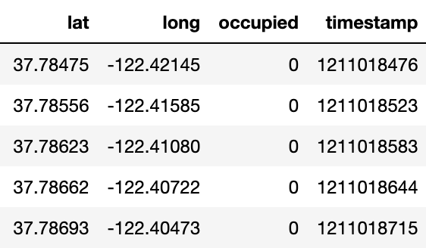
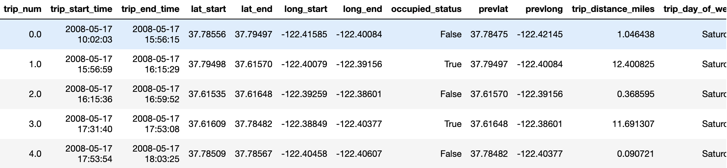
Data description and transforms
Given data for each taxi
Transformed data for each taxi

Slide 5
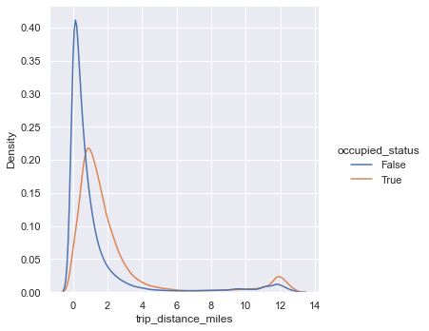
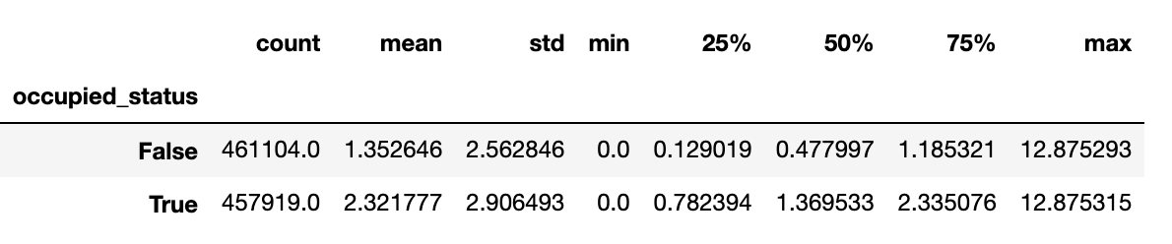
EDA 1: trip distance distributions of occupied and unoccupied taxis
Rows were filtered by 99th percentile of trip distance (12.87 miles, removed ~9K rows)
Both distributions are bimodal.
Potential further explorations: Investigate the second peak of longer (10-15 miles) of unoccupied trips

Slide 6
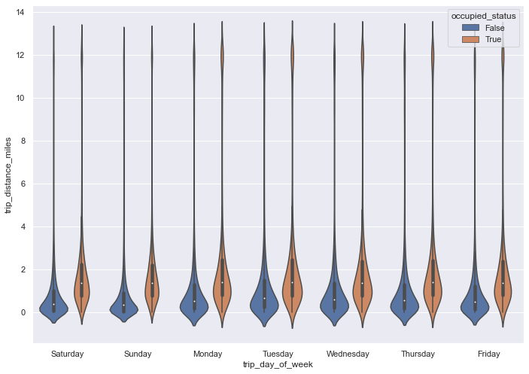
EDA 1: distance distributions of occupied and unoccupied trips
Distributions are bimodal.
No obvious difference in trends of occupancy among the days

Slide 7
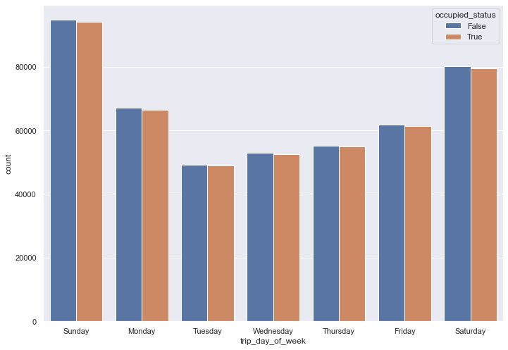
EDA 2: distributions of counts of occupied and unoccupied trips
Counts of occupied and unoccupied trips are balanced on all days
Weekends have higher counts compared to weekdays

Slide 8
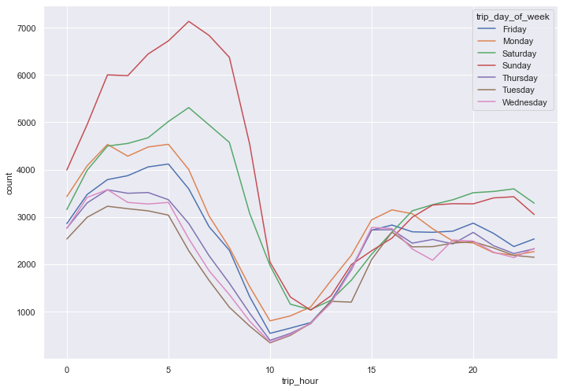
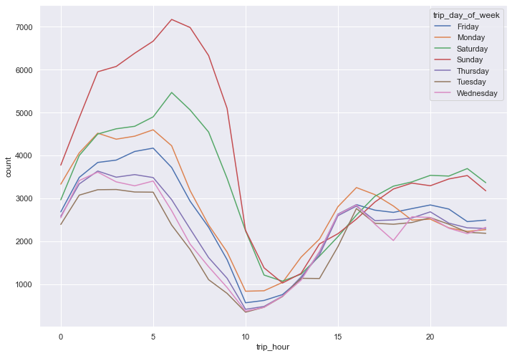
EDA 3: hourly counts of occupied and unoccupied trips for all days
Low trip counts observed for middle of the day, increased activity before 9h and after 15h.
Occupied
Unoccupied

Slide 9
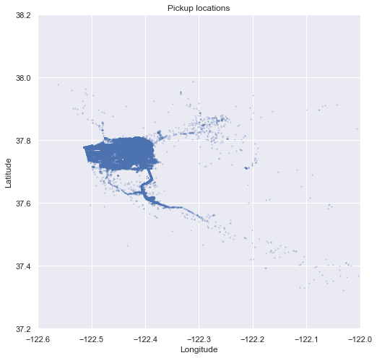
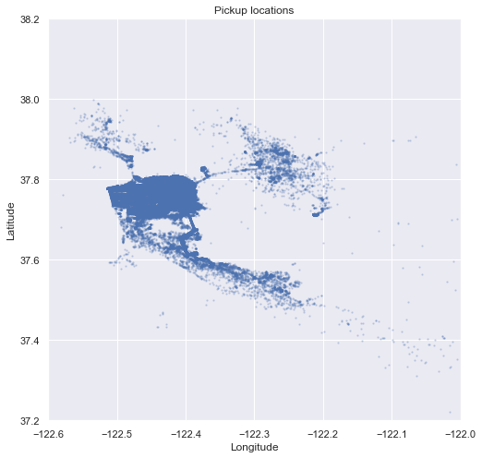
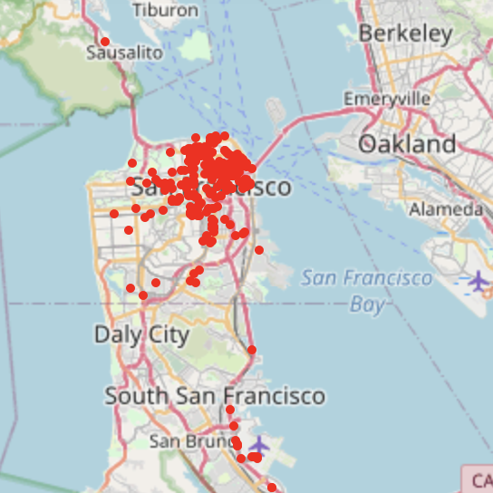
EDA 4: distribution of start locations of occupied and empty trips
Occupied
Unoccupied
Occupied
(Bonus question) Identify clusters of taxi cabs that you find being relevant from the taxi cab company point of view : the difference between the 2 maps

Slide 10
Question 2: A predictor for taxi drivers, predicting the next place a passenger will hail a cab.
Model 1: Predict lat long for next pickup (regression)
Model 2: Predict location (lat long) will have passenger or not (classification)

Slide 11
Model 1: Predict lat long for next pickup (regression)
Model Input: last available location, and time of day and week day (one-hot encoded)
Model Output: next pick up location [latitude, longitude]
 | Coefficient of determination(R2) | Mean Absolute error train/test
Random Forest regressor | 0.98/ 0.95 | 0.00043/ 0.00112
Gradient boosted regressor | 0.91/ 0.98 | 0.00106/ 0.00105
KNN regression | 0.92/0.94 | 0.00126/0.00156
Linear regression | 0.84/0.83 | 0.00279/0.00278
Is 0.00105 a low error?
A degree of longitude at 40° north or south the distance between a degree of longitude is 53 miles (85 km) - this is applicable for SF at 37 degrees north latitude. therefore, a MAE of 0.00105 implies error of 0.06*0.06 miles square which is still a large area.

Slide 12
Model 2: Predict location (lat long) will have passenger or not (classification)
Model Input: last available location, next pick up location [latitude, longitude], time of day and week day (one-hot encoded)
Model Output: occupied status = [True, False]
 | Accuracy [train/test]
Random Forest classifier | 1.00/ 0.67
Gradient boosted classifier | 0.61/ 0.61
KNN classifier | 0.75/0.62
baseline | ~50% [from EDA]
Richer features needed, current set of feature increases model accuracy by 10-17% compared to baseline prediction performance!
Hyperparameter optimization may further improve model performances

Slide 13
Question 1. To calculate the potential for a yearly reduction in CO2 emissions, caused by the taxi cabs roaming without passengers. In your calculation please assume that the taxicab fleet is changing at the rate of 15% per month (from combustion engine-powered vehicles to electric vehicles). Assume also that the average passenger vehicle emits about 404 grams of CO2 per mile.

Slide 14
Potential for annual Co2 emission reduction
Monthly total miles of 537 taxis roaming w/o passengers from aggregation of “unoccupied” records and miles monthly_MCE: 680366 miles
Assumption:
this sample of 527 taxis are reflective of the population,
all taxis having combustion engines at month 1, and from month 2 to month 12 with 15% conversion of taxis to electric engine, the MCE reduces by 15% each month
Expected annual miles with electric vehicles, MEV=3890596
Expected annual miles with combustion engine vehicles, MCE= 8164392(monthly_MCE *12)
Thus, the potential for reduction is (MCE-MEV)/MCE = 52.35%

Slide 15
Next Steps
Informed data cleaning with knowledge of taxi trace acquisition
Adding more meaningful features for pickup prediction model, for example weather data, current “empty” taxi density data, local events, holidays etc
Demand heatmaps per hour
Discretized region definition of the city and hotspots.
Better visualizations with overlays on actual city map

