Slide 1

libcamera software ISP status update
Hans de Goede
Qualcomm Technologies NL BV
Hans de Goede
Qualcomm Technologies NL BV
Hans de Goede
Senior Staff Engineer, Qualcomm Technologies NL BV
Bryan O’Donoghue
Kernel Engineer, Linaro

Slide 2
Introductions
Hans
  Senior staff engineer @ Qualcomm Technologies NL BV
  Kernel subsystem co-maintainer for UVC, drivers/platform/x86
  https://git.kernel.org/pub/scm/linux/kernel/git/hansg/linux.git/
  hansg @ #libcamera, “Fedora ARM”
Bryan
  Kernel engineer @ Linaro
  Kernel media-committers maintainer - Qualcomm CAMSS, Iris, Venus
    https://git.codelinaro.org/bryan.odonoghue/kernel
    https://gitlab.freedesktop.org/linux-media/users/bodonoghue.git
    https://github.com/0xB0D
  bryanodonoghue @ #linux-media #linux #aarch64-laptops #libcamera #linux-msm

Slide 3
Topics
Bayer Encoding
CSI2 MIPI Cameras
What is a Hard ISP - what are the 3As ?
CPUISP
GPUISP
Color Correction Matrix support
Linux distributions shipping softISP to support MIPI cams OOTB
Demo

Slide 4
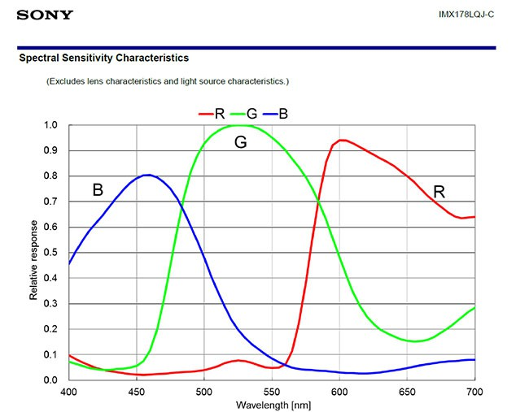
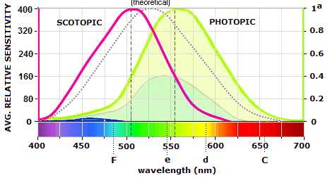
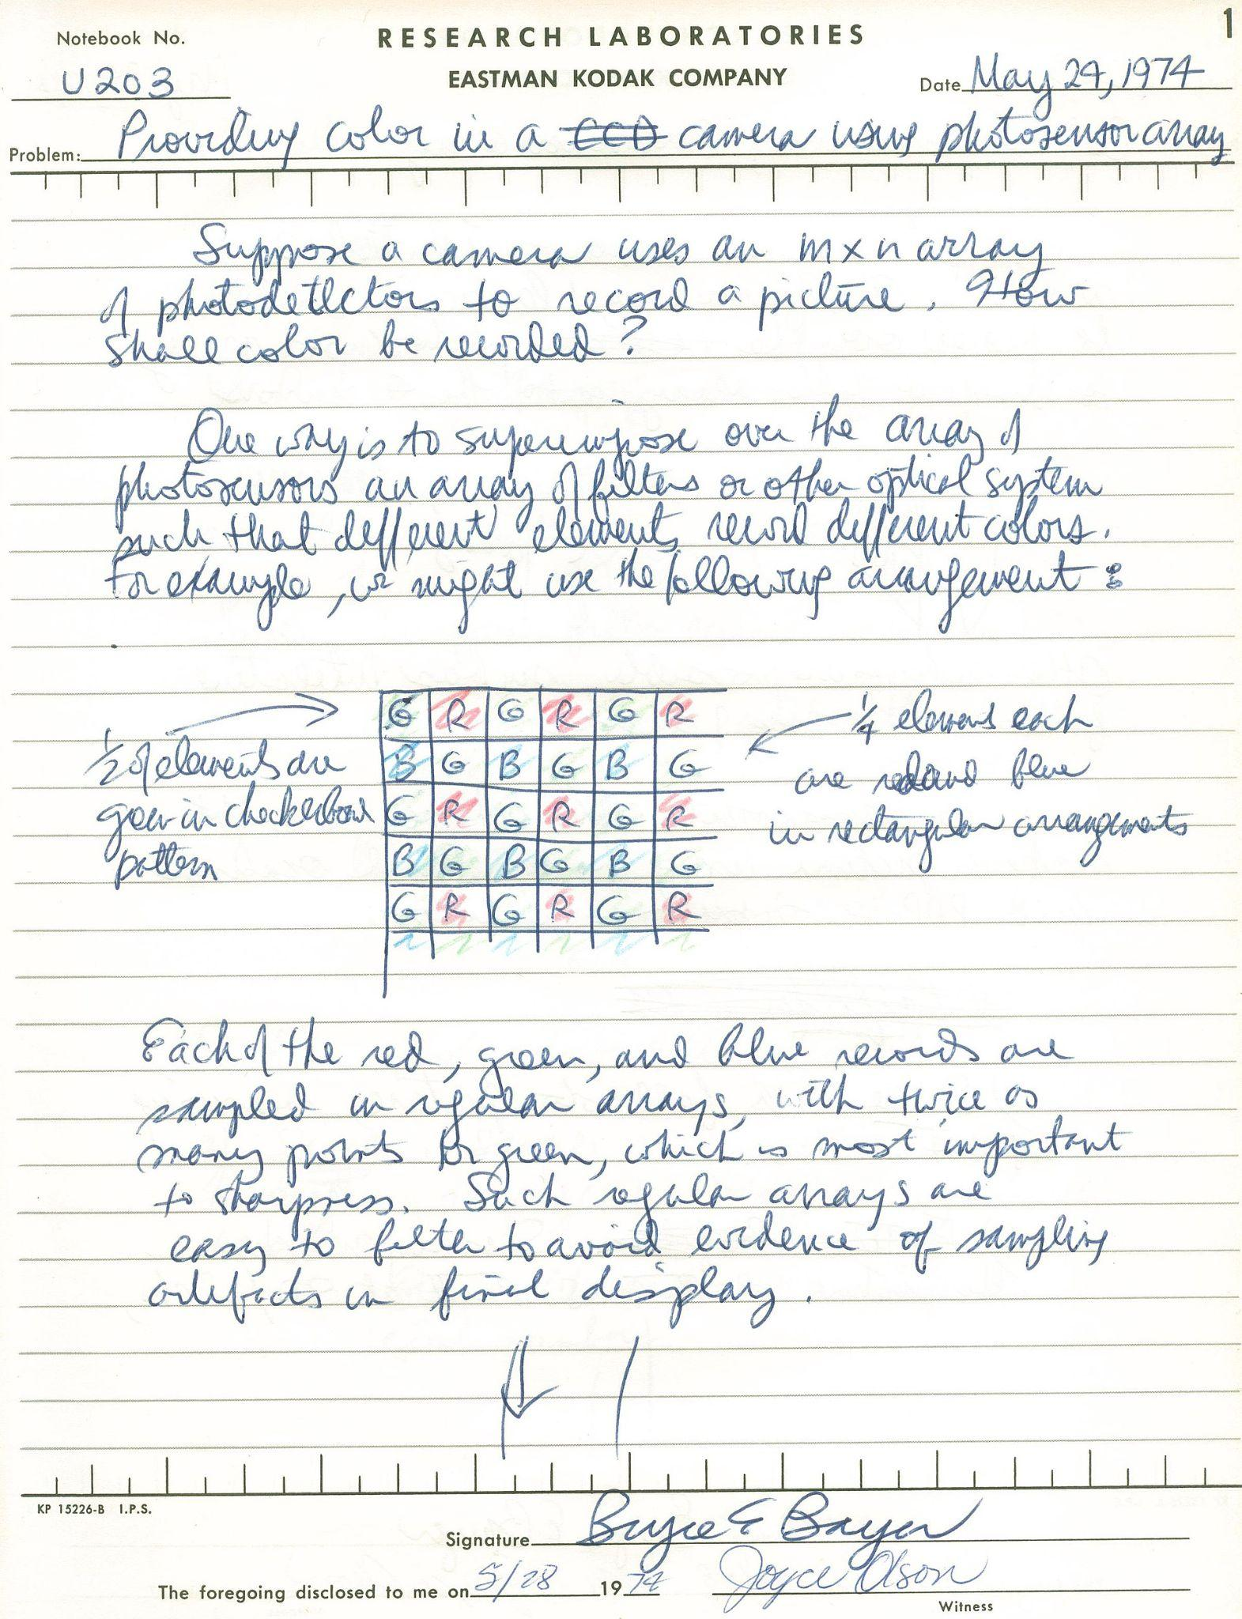
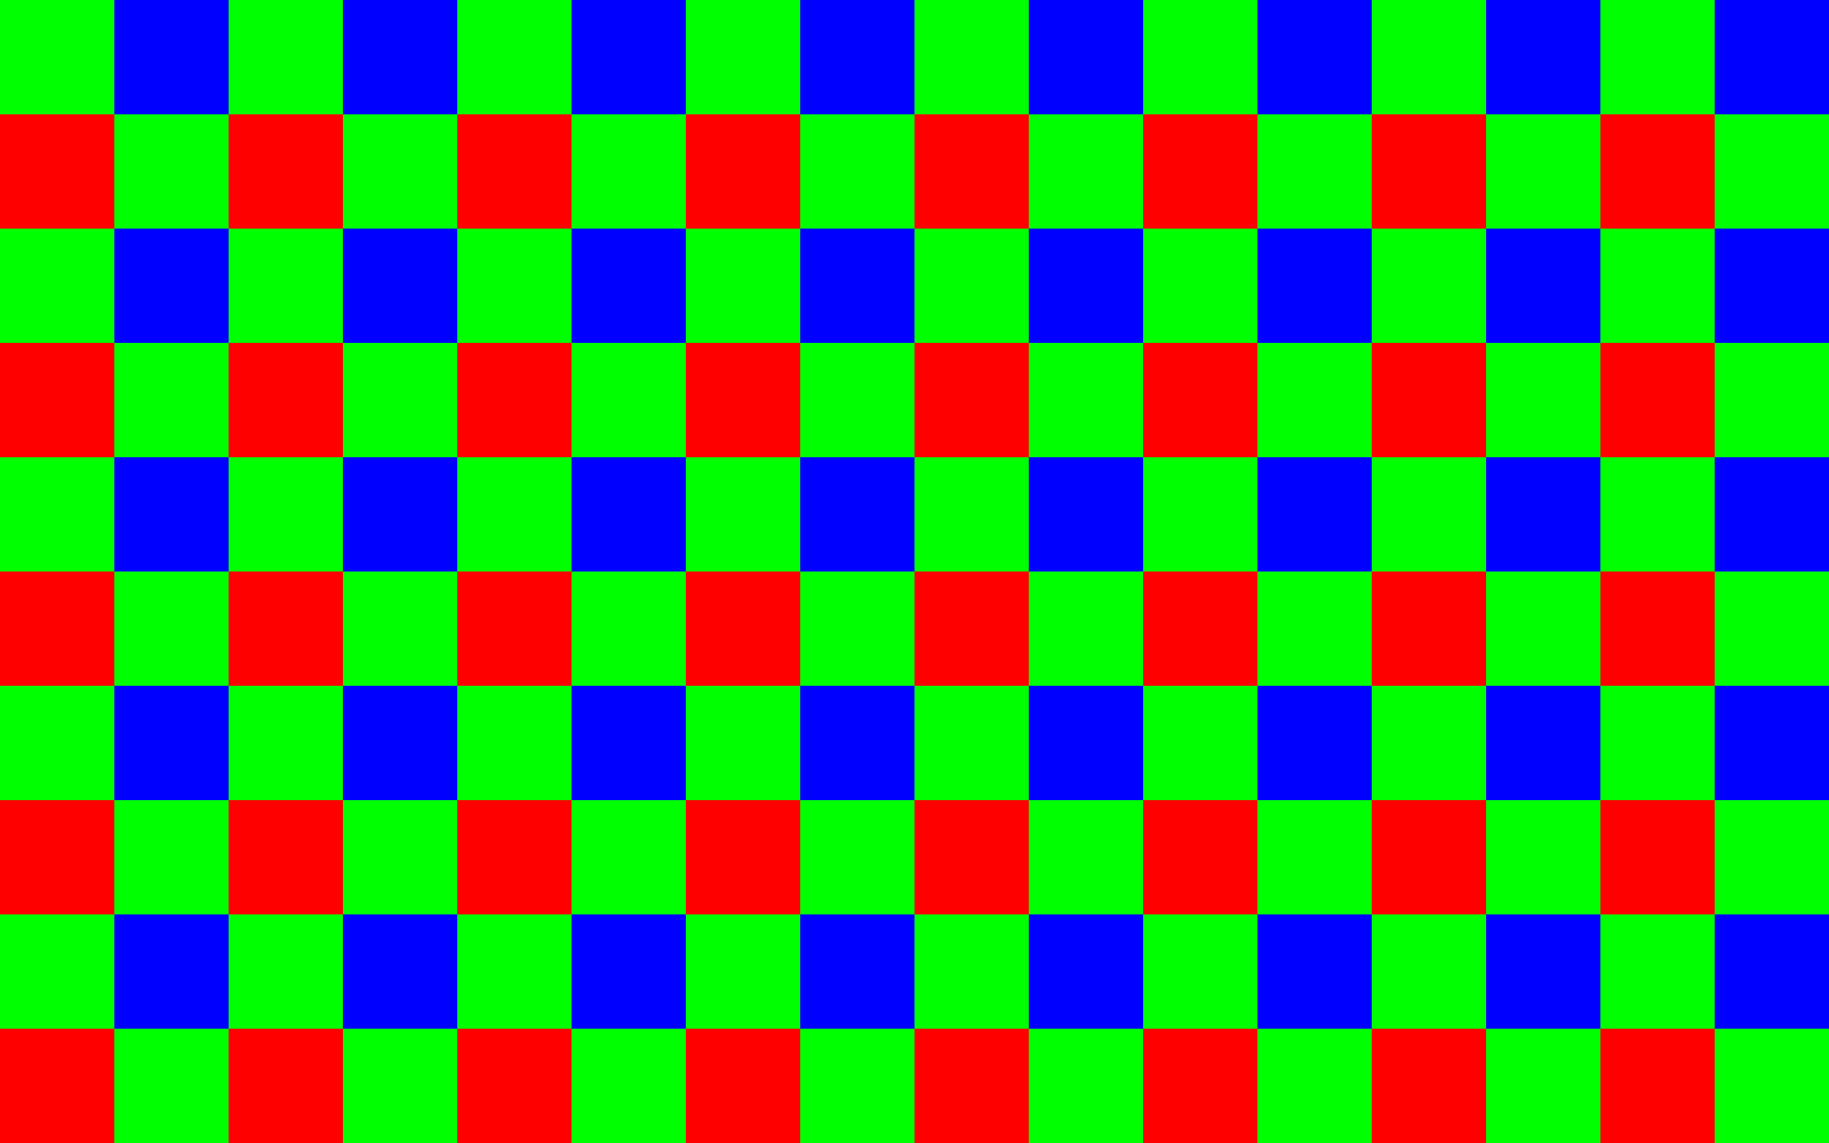
Bayer Encoding
Human eye is composed of “rods” and “cones”
  Rods Scotopic
  Cones Photopic - sensitive to light around 550 nm
  Most sensitive to “greenish yellow” colours
Most RGB sensors don’t capture RGB
  Contain monochrome sensors
Sensors overlaid with a “mosaic” pattern of Red, Green, Blue
  Bruce Bayer Eastman Kodak 1974
  Bayer encoding
Problem - each pixel contains only one colour
  Approximate based on proximate pixels
  Called “interpolation”
Methods
  Label
  Nearest
  Bilinear
  Malar-He-Cutler

Slide 5
CSI2 MIPI Cameras
USB - UVC Cameras
  What you might consider a “standard” camera
  Enormously expensive and power consuming
  USB is an entire data communications protocol
CSI2 MIPI Sensors
  Proliferation of these sensors due to mobile phone economies of scale
CSI2 standard
  A PHY level analogue signal
Unprocessed output images from most MIPI sensors
  Various type of Bayer encoded data
  Libcamera
    Integration of MIPI Cameras into standard Linux user-space
Raspberry Pi
Intel IPU3 / IPU6 / IPU7
Qualcomm Linux on upstream stacks

Slide 6
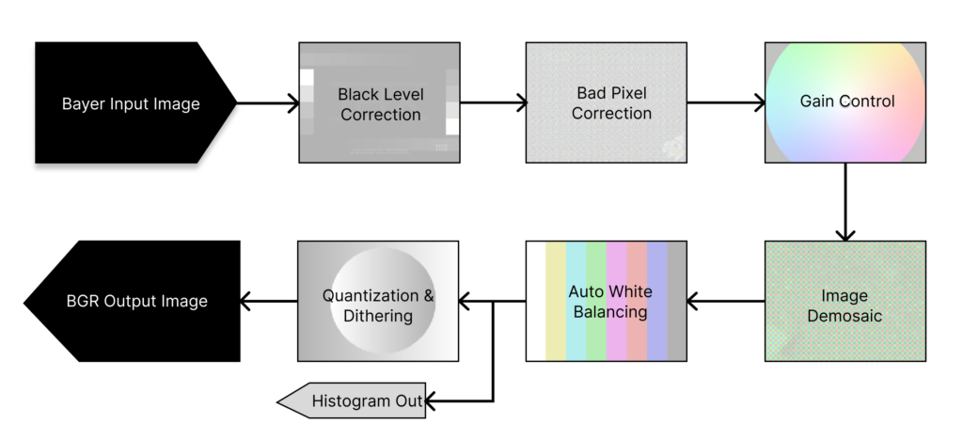
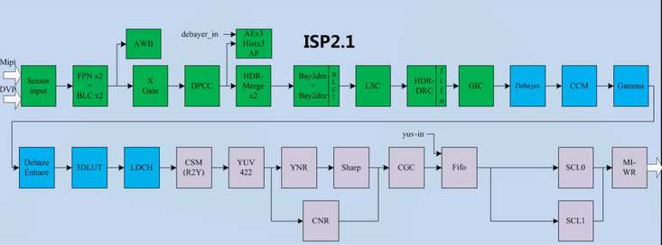
What is a HardISP?
HardISP
  Hardware Image Signal Processor
  A specialised silicon or firmware block - usually both
  Principle of data locality - process close to sensor input
Debayers
Implements 3As
  Autofocus (AF)
  Auto White Balance (AWB)
  Auto Exposure / Gain (AG)
More advanced “secret sauce” algorithms
  Sensor tunings (joking but not joking)
  Skin tones
  Low light noise reductions
  Contrast
  Lens flare reductions

Slide 7
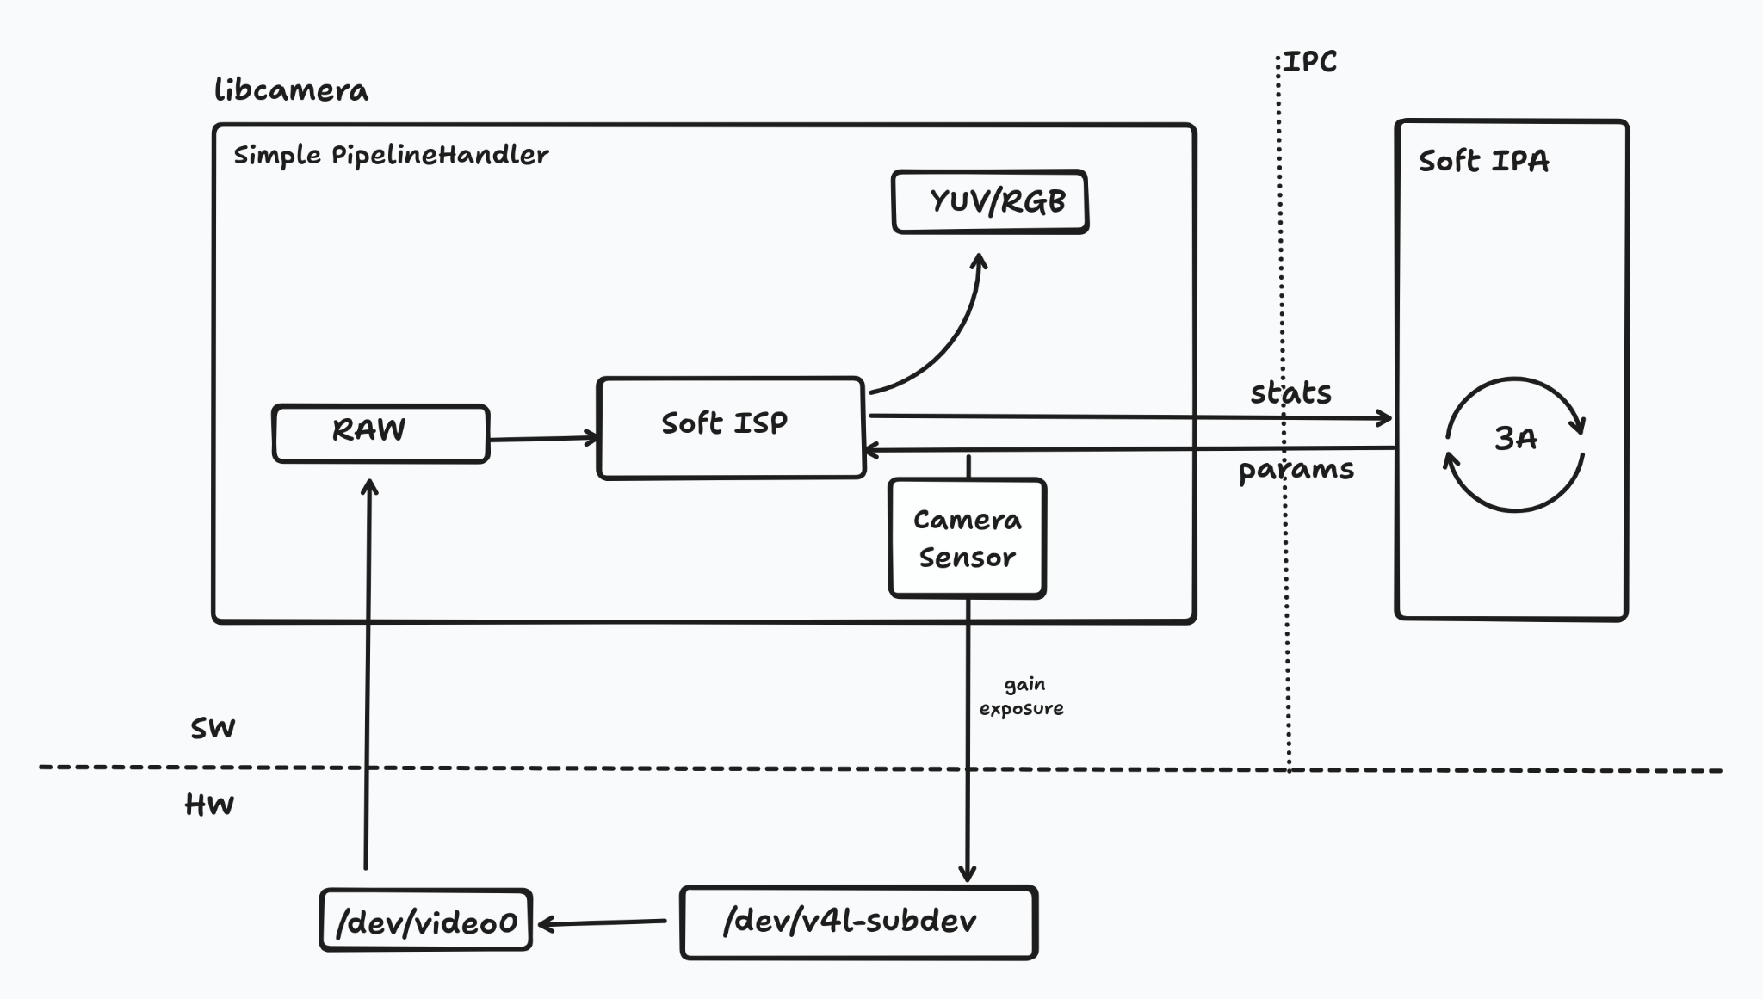
CPUISP
Libcamera an open source library to handle v4l2 complex cameras
Different “pipelines” handle different hardware implementations
  RPI has a full hardware ISP pipeline
  A generic simple pipeline handler for RAW bayer cameras exists
A software ISP implemented in the CPU has been upstreamed
  Debayer histogram and parameters generated and applied in CPU
  Auto White Balance
  Auto Gain
  Gamma correction
Performance and features
  Works on all tested Qualcomm platforms
    sdm845, sm8250, sc8280xp, x1e80100
  Works on x86 IPU6
  Too much for lower-end ARM systems
    TI Sitara AM64x
    i.MX8M

Slide 8
GPUISP
GPUs are massively parallel pixel pixel processing engines
Libcamera already contains simple debayer shaders in a QT application
Shaders debayer 8 bit RAW as well as 10/12 bit MIPI
  Vertex/Fragment shaders already upstream and somewhat validated
  Objective to reuse these shaders unmodified
GLES 2.0 not OpenGL
  To support the greatest range of hardware possible
  Places constraints on some of the techniques we can use to attack the problem
  eGL 1.0 was our first target but for a number of reasons it is undesirable
  GLES 2.0 released March 2007 => nearly 20 years of supported hardware
Allows implementing features CPU can’t handle
  Denoise
  Dead pixel correction
  Lens Shading

Slide 9
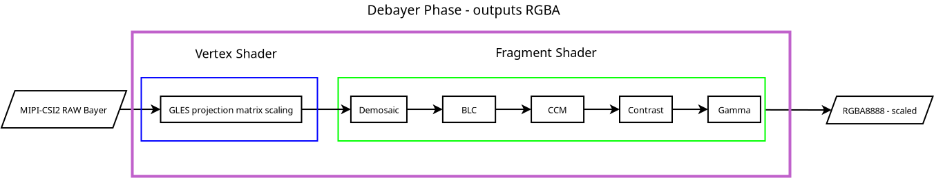
GPUISP current – single pass vertex/fragment shader

Slide 10
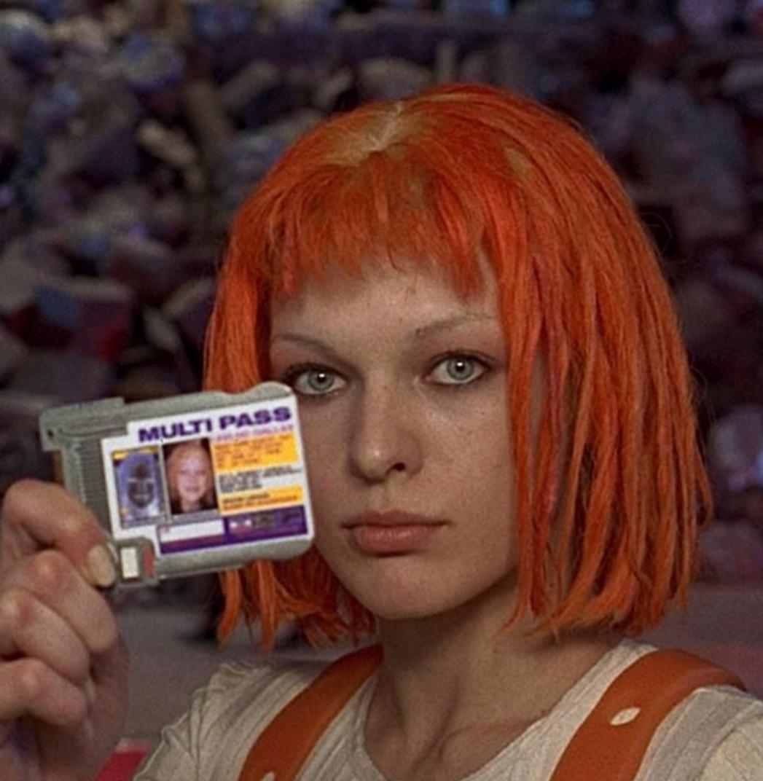
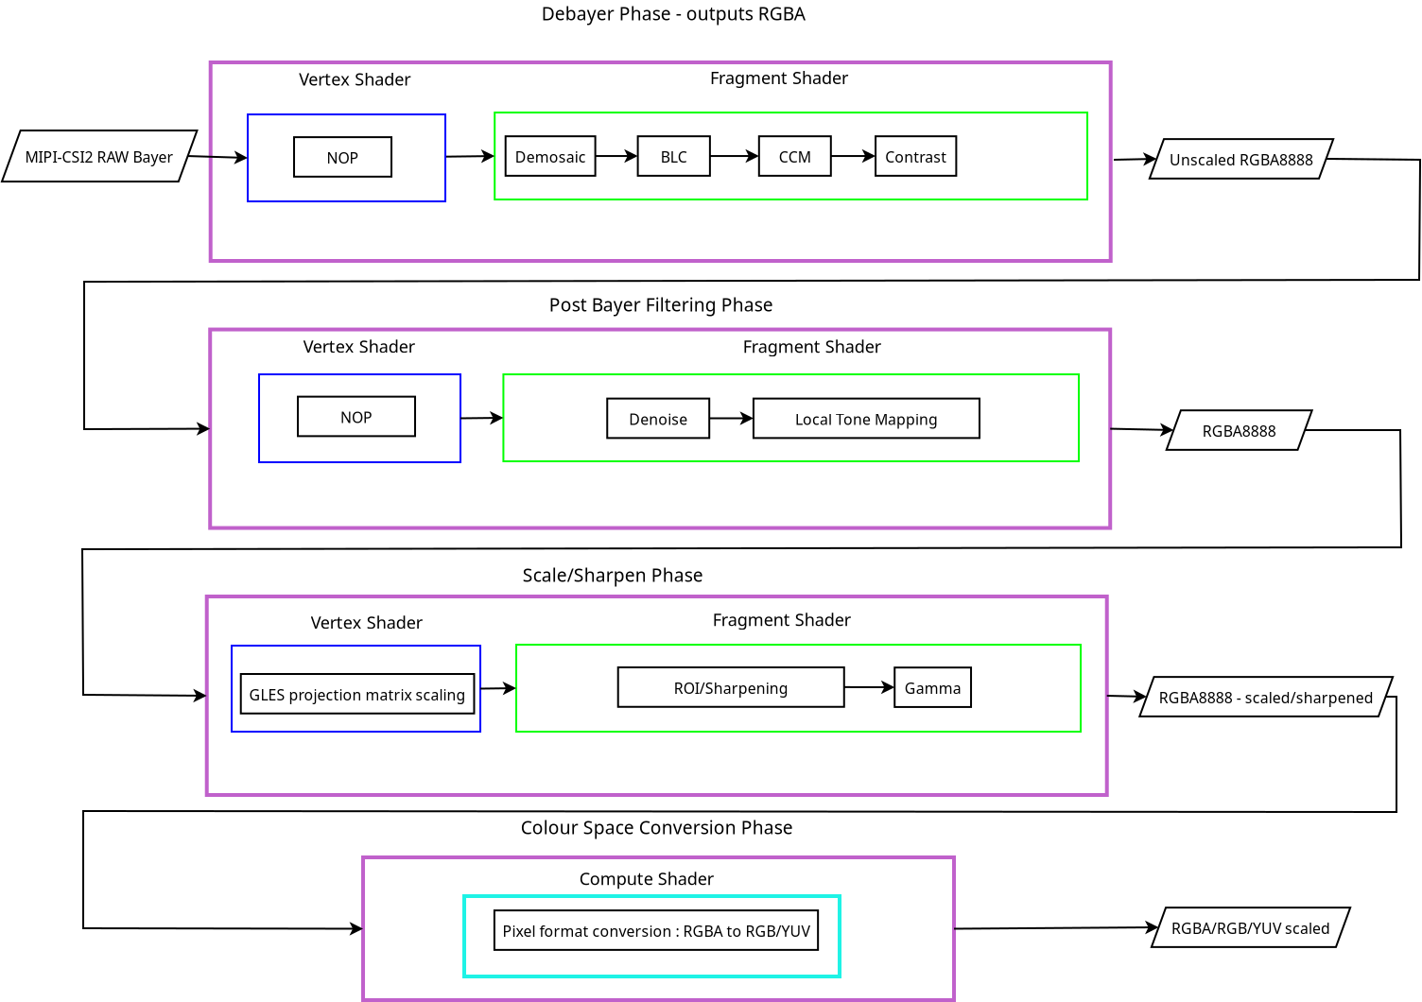
GPUISP next – multi pass

Slide 11
Next steps
GPUISP features being worked on:
    Lens shade correction (HHS Delft student group)
    Multi pass GPUISP (Bryan)
    Denoise (Milan Zamazal, Red Hat)
GPUISP possible future features:
    Multi-pass support
    Lens distortion correction
    Dead Pixel correction
    Sobel Filter/Digital autofocus
    Lens flare correction
Calibrate camera modules for better colors (per module CCMs)

Slide 12
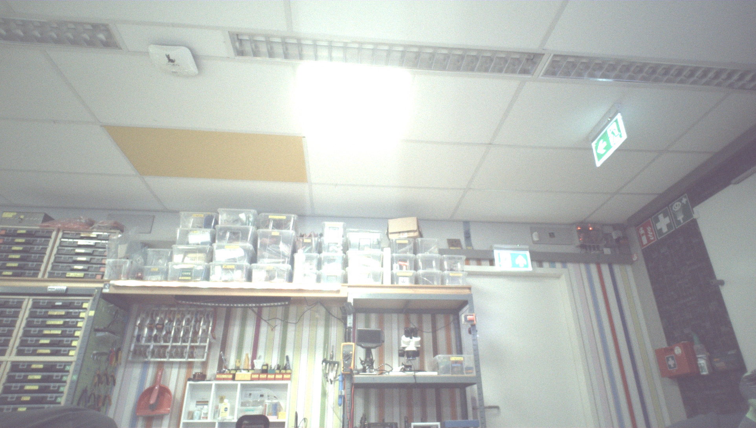
Example image without LSC

Slide 13
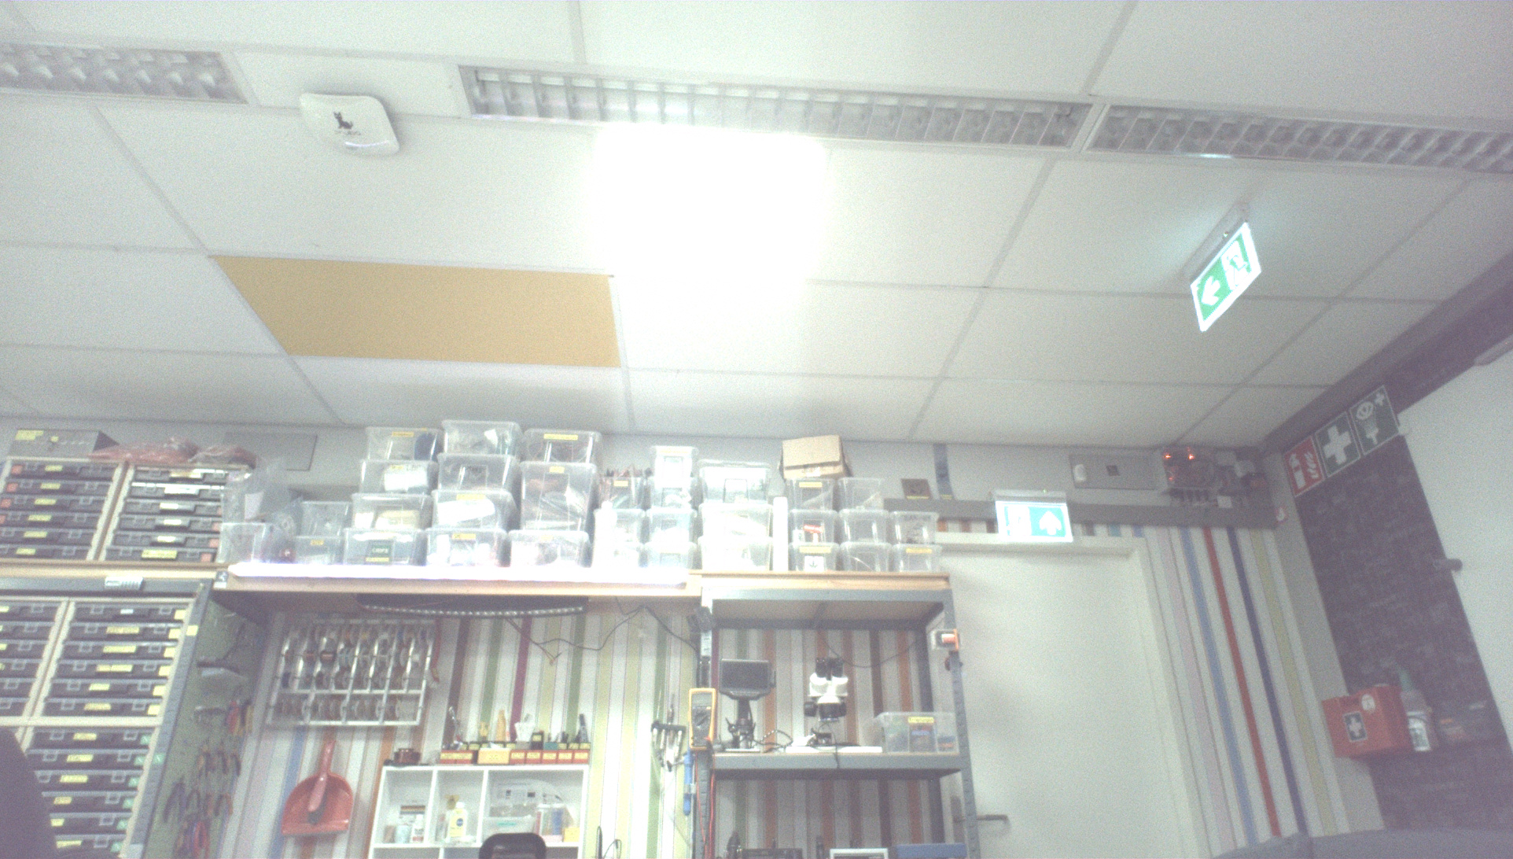
Example image with LSC

Slide 14
Color Calibration Matrix support
GPUISP uses an identity CCM by default
Camera module (sensor + lens) calibration can give us per color-temperature matrices for more accurate controls
Camera module calibration also give us Lens Shading Correction (LSC) tables
Using a CCM also allows implementation a saturation control to make colors “pop” more
Saturation control goes from 0.0 to 2.0 with 1.0 being neutral colors
May change the softISP default to 1.2 for more vibrant colors to get libcamera closer to proprietary stacks which seem to also do this

Slide 15
Linux distros shipping softISP for OOTB MIPI cam support
Fedora has been shipping the softISP since Fedora 42 for OOTB support of Intel IPU6 and IPU7 MIPI cameras
Postmarket OS and other mobile distros are using the softISP for camera support
  Models on which PMOS + GPUSIP has successfully been tested:
    Pixel 3a
    One Plus 6
    Fairphone 5
    Librem5
    PinePhone

Slide 16
Demo

Slide 17
Thank you !
Bedankt !
Go raibh maith agaibh!

Slide 18
Thank you !
Bedankt !
Go raibh maith agaibh!
Nothing in these materials is an offer to sell any of the components or devices referenced herein.
© Qualcomm Technologies, Inc. and/or its affiliated companies. All Rights Reserved.
Qualcomm and Snapdragon are trademarks or registered trademarks of Qualcomm Incorporated.
Other products and brand names may be trademarks or registered trademarks of their respective owners.
References in this presentation to “Qualcomm” may mean Qualcomm Incorporated,
Qualcomm Technologies, Inc., and/or other subsidiaries or business units within
the Qualcomm corporate structure, as applicable. Qualcomm Incorporated includes our licensing business, QTL, and the vast majority of our patent portfolio. Qualcomm Technologies, Inc., a subsidiary of Qualcomm Incorporated, operates, along with its subsidiaries, substantially all of our engineering, research and development functions, and substantially all of our products and services businesses, including our QCT semiconductor business.
Snapdragon and Qualcomm branded products are products of Qualcomm Technologies, Inc. and/or its subsidiaries. Qualcomm patenteds are licensed by Qualcomm Incorporated.

