Slide 1

The impact of taxation and minimum legal drinking age on young adults: An example in Lithuania
Alex Tran, PhD
Centre for Addiction and Mental Health
Toronto, Canada
November 30th 2022

Slide 2
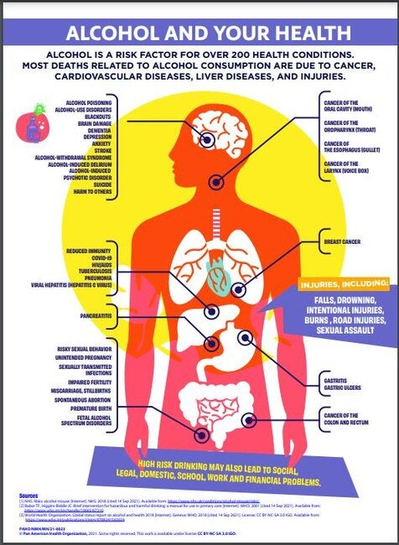
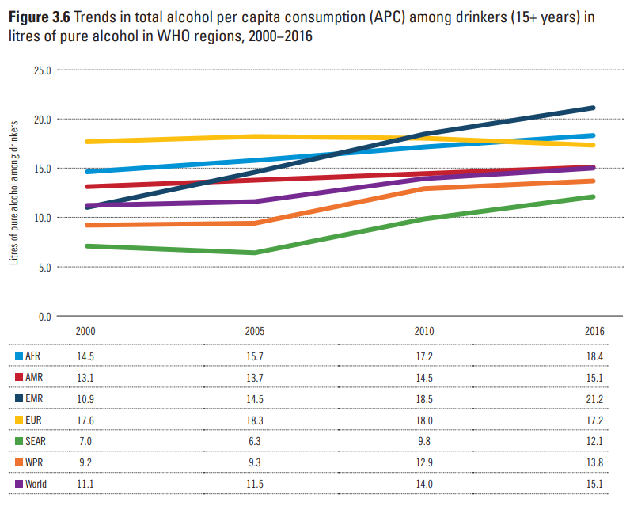
Alcohol and public health
Alcohol consumption poses a significant public health risk, consumption is among the highest in the European region. (World Health Organization, 2018; Vos et al., 2020)
Consumption is projected to rise globally by 2030, while rates of abstention are dropping (Manthey et al., 2019)

Slide 3

Taxation and alcohol
$$$
$$
A review and meta-analysis of studies showed a medium effect size of taxation on alcohol-related disease, r = .347. (Wagenaar et al., 2010)
Price changes may not affect all part of the population equally e.g., heavy drinkers, those with limited income– young adults and elderly (Elder et al., 2010; Nelson & Moran, 2019)
$
$

Slide 4



Other policy changes and alcohol-related harm
Alcohol consumption and harm can be reduced through public policy
Minimum unit pricing
Tougher drink-driving laws
Minimum legal drinking-age
Marketing restrictions
(Babor et al., 2010; Stockwell et al., 2020; Neufeld & Rehm, 2018)

Slide 5
Alcohol consumption in adolescence
Young adults are especially vulnerable population; patterns of drinking are usually hazardous (binge drinking) can carry on throughout life (Buchmann et al., 2009; Morgenstern et al., 2011)
Young adult brains are still developing, they lack impulse control and are undergoing a critical growth period (Crews et al., 2007; Kelder et al., 1994)
Perceptions of peer use are strong predictors of consumption (Song et al., 2012; Pederson et al., 2013)
Alcohol is an addictive substance, with large global burden of disease

Slide 6




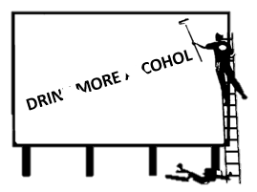
WHO best buy’s
The World Health Organization (WHO) has identified 3 categories of public policy that are effective and cost-effective in reducing alcohol-attributable harm (Chisholm et al., 2018);
Taxation
Decreased availability
Bans on marketing and advertising

Slide 7
A natural experiment in Lithuania
Lithuania is a high income country, part of the EU
Enacted a number of tough policy changes (natural experiment, generalizable to other EU countries)
Monthly data of mortality rates available; smaller country with comprehensive national data reporting system
Implemented multiple ‘best buys’ in short period (Štelemėkas et al., 2021; Miščikienė et al., 2020)

Slide 8
Study 1
Can we separate the effects of taxation from general trends in mortality in young adults?
Tran, A., Manthey, J., Lange, S., Jiang, H., Štelemėkas, M., Liutkutė-Gumarov, V., ... & Rehm, J. (2021). Alcohol control policies add to secular trends in all-cause mortality rates in young adults. Scientific reports, 11(1), 1-9.

Slide 9
Methods
Monthly all-cause mortality rates for various 10-year age groups
Data collected from 2001 to 2018
Employed a joinpoint analysis (general trends) and an interrupted time series analysis (effect of policies while controlling for seasonality; Beard et al., 2019)

Slide 10
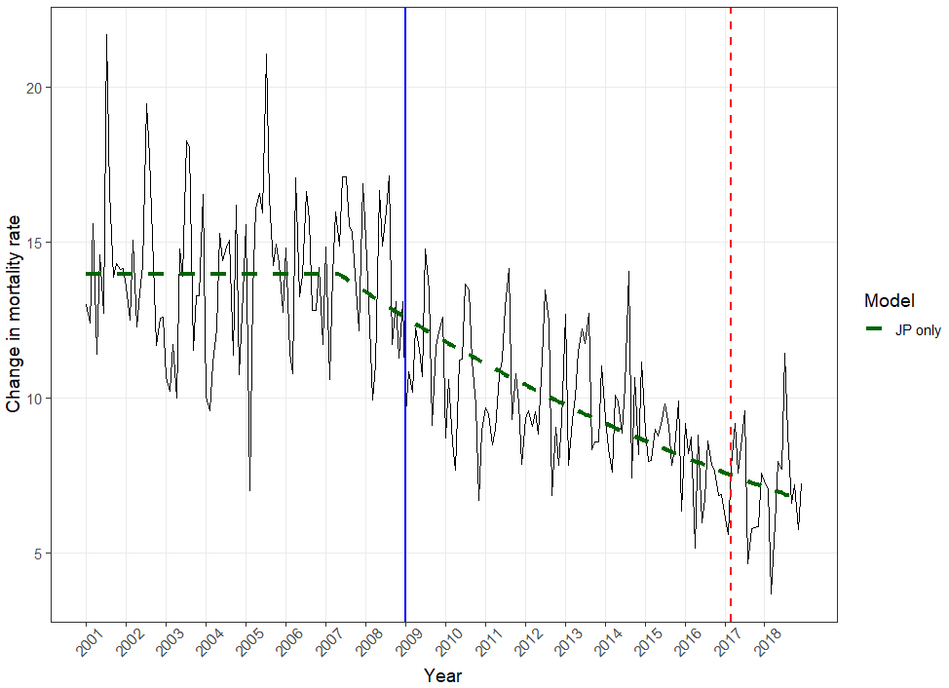
All-cause mortality rate trends (20 – 29)

Slide 11
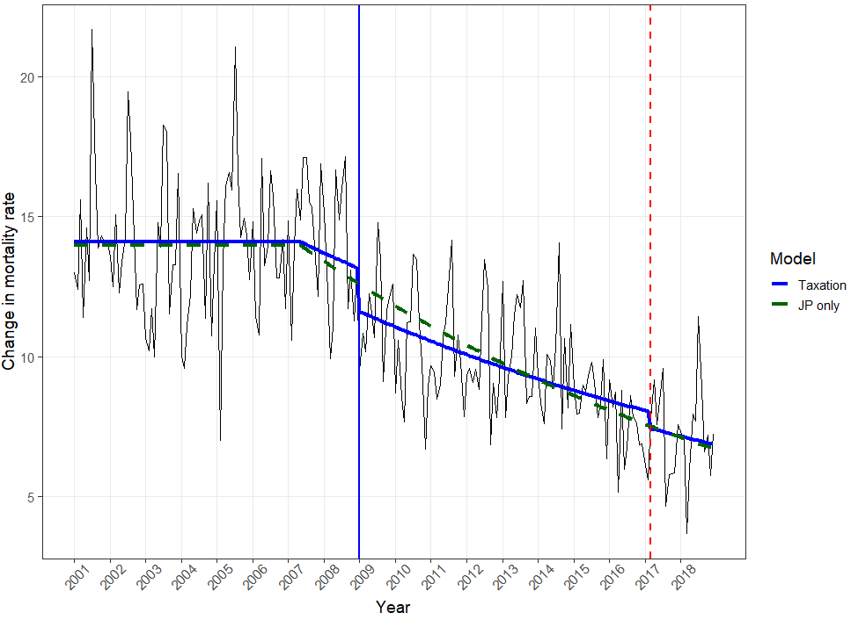
Taxation policies model included (20 – 29)

Slide 12
Age groups | Policy 2009 |  |  | Policy 2017
 | Model 1: Joinpoint analysis, mean predicted value for 2009 | Model 2: Model 1 + Policy Effect, mean predicted value for 2009 | t-value and p-value of 2009 Policy in Model 2 | Model 1: Joinpoint analysis, mean predicted value for 2017 | Model 2: Model 1 + Policy Effect, mean predicted value for 2017 | t-value and p-value of 2017 Policy in Model 2
20-29 | 12.23 | 11.35 | t(212) = -3.05, p = .0026 | 7.28 | 7.27 | t(212) = -1.193, p = .23
30-39 | 23.21 | 23.12 | t(212) = -0.669, p = .50 | 17.78 | 16.69 | t(212) = -2.554, p = .011

Slide 13
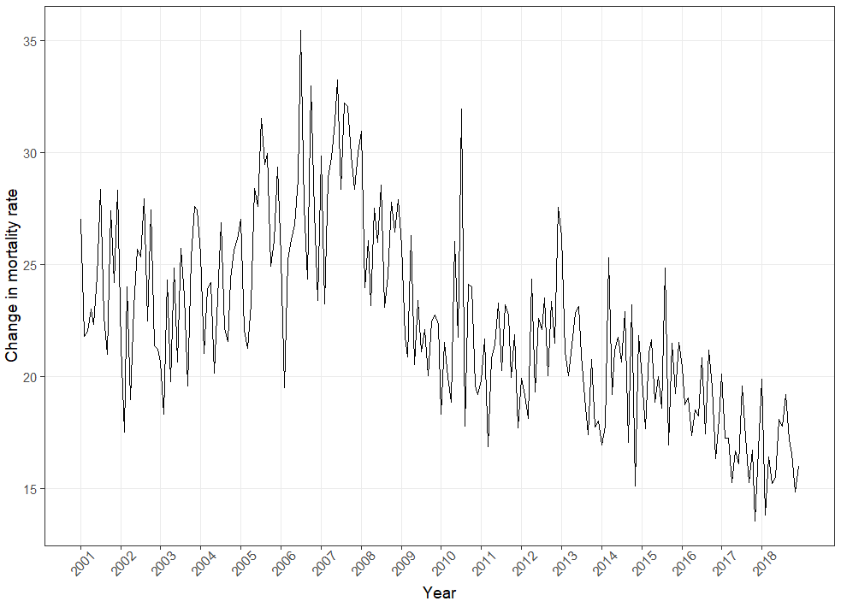

Slide 14
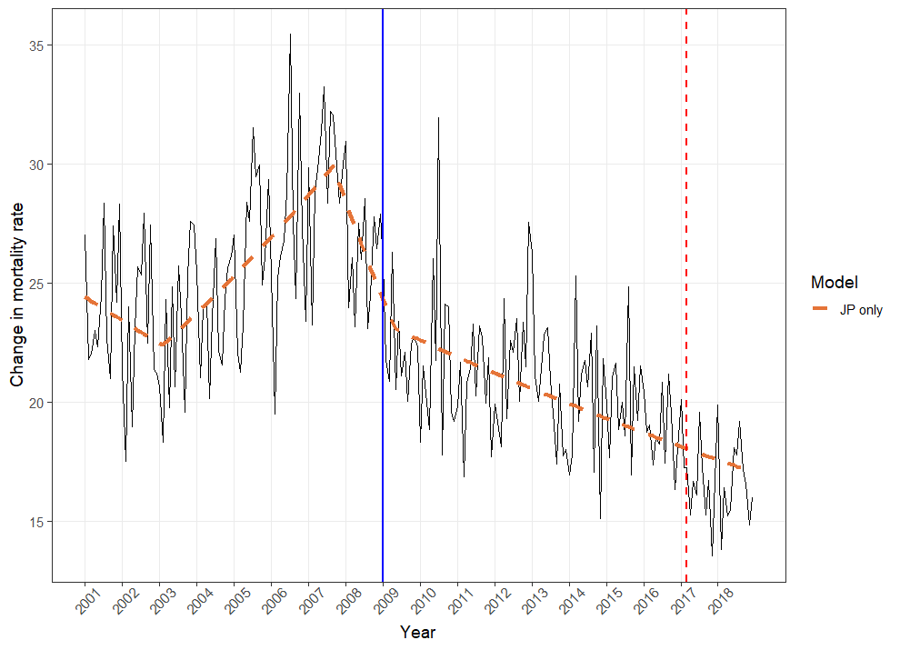

Slide 15
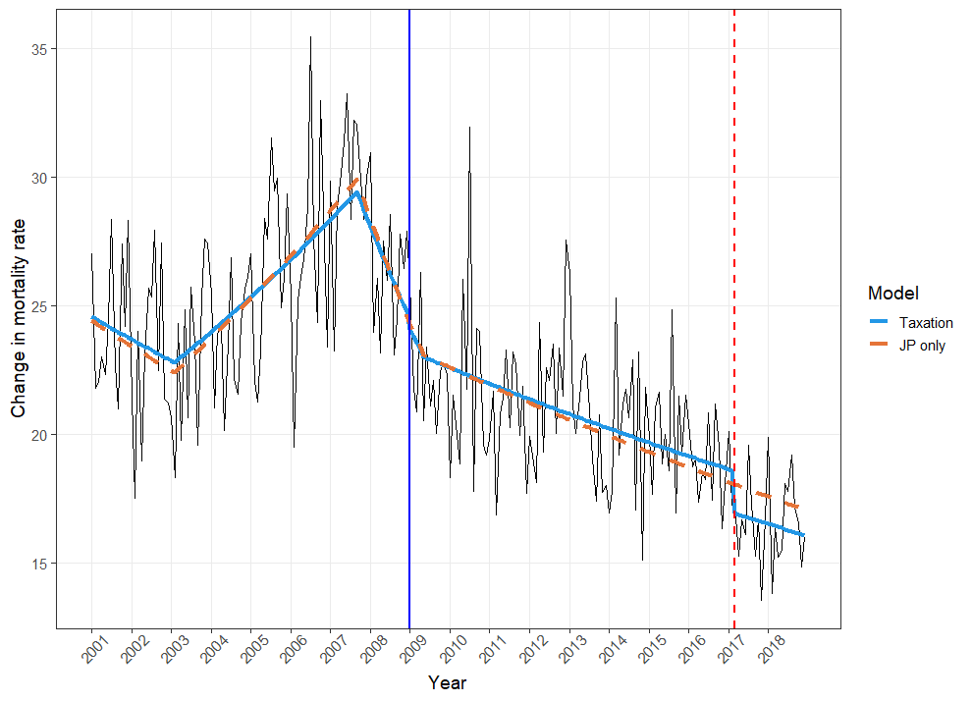

Slide 16
Age groups | Policy 2009 |  |  | Policy 2017
 | Model 1: Joinpoint analysis, mean predicted value for 2009 | Model 2: Model 1 + Policy Effect, mean predicted value for 2009 | t-value and p-value of 2009 Policy in Model 2 | Model 1: Joinpoint analysis, mean predicted value for 2017 | Model 2: Model 1 + Policy Effect, mean predicted value for 2017 | t-value and p-value of 2017 Policy in Model 2
20-29 | 12.23 | 11.35 | t(212) = -3.05, p = .0026 | 7.28 | 7.27 | t(212) = -1.193, p = .23
30-39 | 23.21 | 23.12 | t(212) = -0.669, p = .50 | 17.78 | 16.69 | t(212) = -2.554, p = .011

Slide 17
Study 2
Do minimum legal drinking age (MLDA) policies affect young drinkers?
Tran, A., Jiang, H., Lange, S., Livingston, M., Manthey, J., Neufeld, M., ... & Rehm, J. (2022). The Impact of Increasing the Minimum Legal Drinking Age from 18 to 20 Years in Lithuania on All-Cause Mortality in Young Adults—An Interrupted Time-Series Analysis. Alcohol and alcoholism, 57(4), 513-519.

Slide 18
Methods
Monthly all-cause and cause-specific mortality rates for 3 age groups, 15 – 17, 18 – 19, 20 – 22 years of age
Data collected from 2001 to 2018
Employed an interrupted time series analysis to test the effect of MLDA on 18 – 19 year olds (other ages served as control groups)

Slide 19
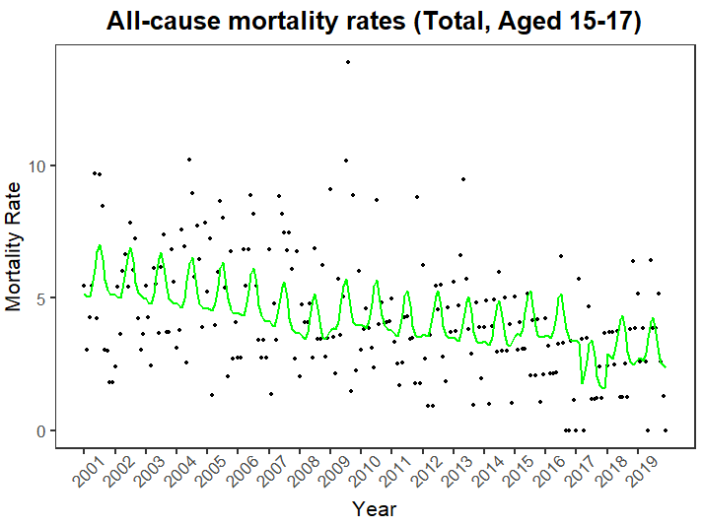

Slide 20
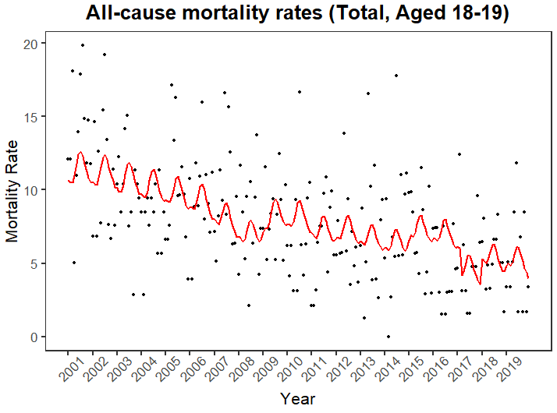

Slide 21
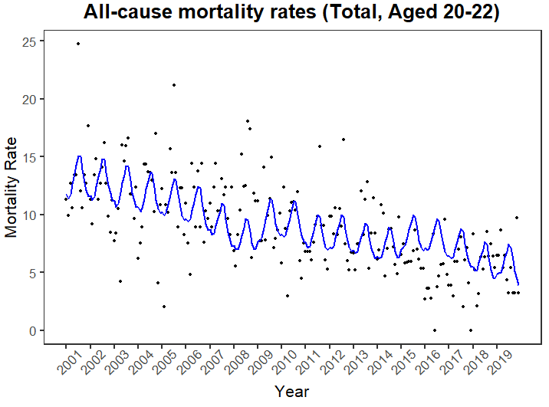

Slide 22
Control time series | Estimated effect | Standard Error | t-value | p-value | Adjusted-R²
Total, aged 18 – 19 minus Total, aged 15 - 17 |  |  |  |  | 0.015
Intercept | 3.82 | 0.28 | 13.73 | p < .0001
Policy 2018 | -1.70 | 0.85 | -1.98 | p = .049
Seasonality (smooth term) |  |  |  | p > .95
AR(0) MA(1)
Men, aged 18 – 19 minus Men, aged 15 - 17 |  |  |  |  | 0.024
Intercept | 6.56 | 0.49 | 13.35 | p < .0001
Policy 2018 | -3.62 | 1.51 | -2.39 | p = .018
Seasonality (smooth term) |  |  |  | p > .36
AR(0) MA(1)
Men, aged 18 – 19 minus Women, aged 18 - 19 |  |  |  |  | 0.12
Intercept | 3.82 | 0.28 | 13.73 | p < .0001
Policy 2018 | -5.73 | 2.10 | -2.73 | p = .0069
Seasonality (smooth term) |  |  |  | p <.0008
AR(0) MA(1)
Total, aged 18 – 19 minus Total, aged 20 - 22 |  |  |  |  | 0.004
Intercept | 9.48 | 0.68 | 13.85 | p < .0001
Policy 2018 | -0.73 | 0.88 | -0.84 | p = .40
Seasonality (smooth term) |  |  |  | p > .19
AR(0) MA(1)

Slide 23
Adolescents 15 – 17 years of age
Model 2(Total) |  |  |  |  | 0.22
Intercept | 6.24 | 0.46 | 13.60 | p < .0001
GDP | -0.00061 | 0.00015 | -3.97 | p <.0001
Policy 2017 | -1.46 | 0.76 | -1.90 | p = 0.059
Policy 2018 | 1.26 | 0.86 | 1.47 | p = .14
Seasonality (smooth term) |  |  |  | p < .0001
AR(5) MA)(1)

Slide 24
Young adults 18 – 19 years of age
Model 2 (Total) |  |  |  |  | 0.27
Intercept | 12.76 | .70 | 18.27 | p < .0001
GDP per capita | -0.0015 | 0.00023 | -6.63 | p <.0001
Policy 2017 | -1.71 | 1.17 | -1.46 | p = .15
Policy 2018 | 1.63 | 1.31 | 1.25 | p = .21
Seasonality (smooth term) |  |  |  | p < .001
AR(1) MA(0)

Slide 25
Young adults 20 – 22 years of age
Model 2(Total) |  |  |  |  | 0.42
Intercept | 14.32 | 0.70 | 20.33 | p < .0001
GDP | -0.0016 | 0.00023 | -7.02 | p <.0001
Policy 2017 | -2.63 | 1.17 | -2.24 | p = .026
Policy 2018 | 2.05 | 1.31 | -1.56 | p = .12
Seasonality (smooth term) |  |  |  | p < .0001
AR(0) MA(2)

Slide 26
Study 3
How do taxation policies affect liver cirrhosis deaths and hospitalizations?
Tran, A., Llamosas-Falcon, L., Jiang H., Lange, S., Kim, V., K., Štelemėkas, M., Petkevičienė, J., Radišauskas, R., & Jürgen Rehm, J., (submitted). Age-specific effects of alcohol control policies on liver cirrhosis hospitalizations and mortality rates in Lithuania.

Slide 27
Methods
Monthly hospitalizations and mortality rates due to liver cirrhosis
Data collected from 2001 to 2019
Employed an interrupted time series analysis to test two taxation policies, and one availability policy on 4 different age groups (15 – 34, 35 – 54, 55 – 74, and 75+ years of age)

Slide 28
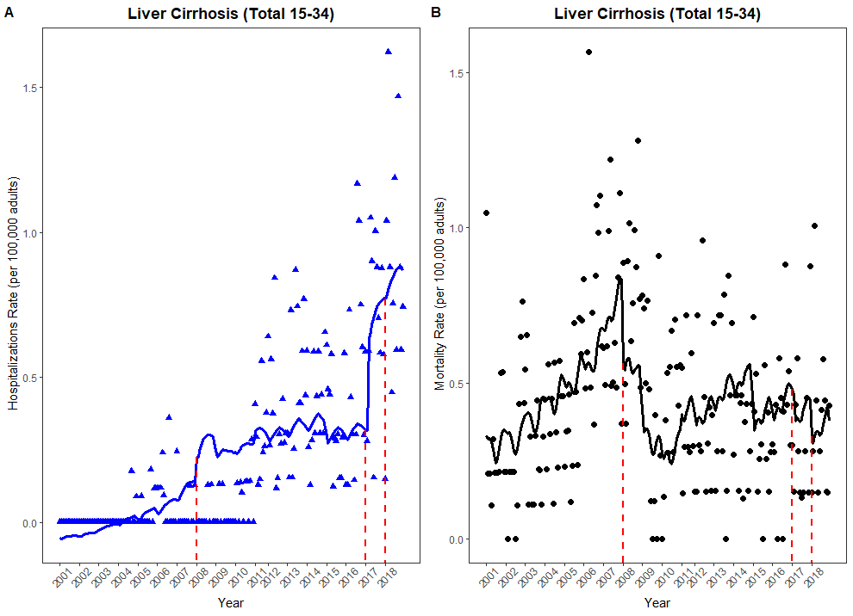

Slide 29
What do the data show?
Policy effects on all-cause mortality in young adults;
All-cause mortality rates decrease following taxation in those <30 years of age
In adolescents specifically, there is a decrease in all-cause mortality following MLDA when modelled alone (however confounded by additional, earlier policies)
Policy effects on liver cirrhosis;
Taxation appears to have a detrimental effect on hospitalizations, indicating a need to implement more than just taxation

Slide 30
Conclusions
Young people MLDA seems to be effective, even when controlling for mortality rates among other adolescents
However, due to close proximity of other policies, difficult to attribute the entire effect to MLDA
Taxation reduces all-cause mortality in younger adults (20 – 39 years of age), even when controlling for general overall trends
However these effects are important to consider along side hospitalization changes
How can we improve?
Addition of policies not aimed at the broad market, but also to specific age groups;
Advertising and marketing, reduce the perceived acceptability of consumption (social media is now a problem, hard to police; Galkus et al., 2022)
Minimum unit pricing (all taxation not the same, need to consider changes in GDP and affordability of alcohol)

Slide 31
Questions?
Alexander.tran@camh.ca

