Slide 1

Joinpoint Analysis in Time Series Data
Alexander Tran, Postdoctoral Fellow
Institute for Mental Health Policy Research & Campbell Family Mental Health Research Institute, Centre for Addiction and Mental Health (CAMH), Canada

Slide 2
What is a joinpoint analysis?
Time series data has trends that change at different points
Simple trends can sometimes be visible when plotting data
How do we quantify these changes?
How can we determine (without estimation) where these changes occur?

Slide 3
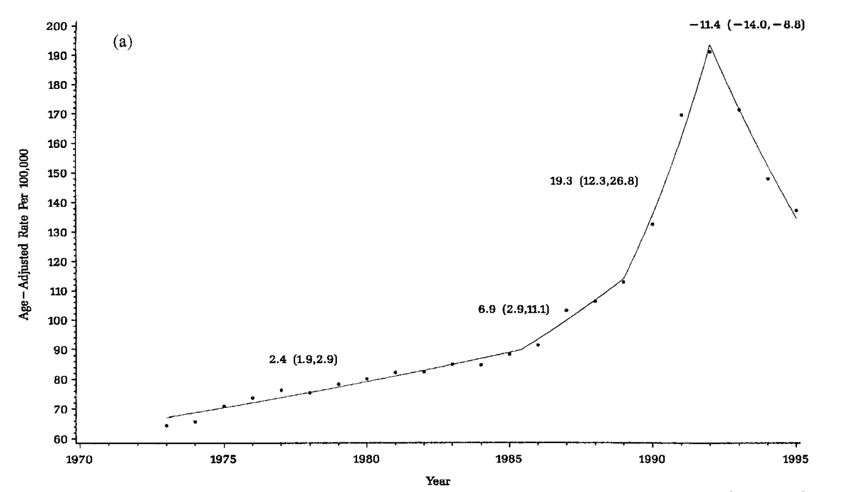
What is a joinpoint analysis?
Notes:
Prostate cancer example, incidence rates after introducing a new screening technique; Kim, H. J., Fay, M. P., Feuer, E. J., & Midthune, D. N. (2000). Permutation tests for joinpoint regression with applications to cancer rates. Statistics in medicine, 19(3), 335-351.

Slide 4
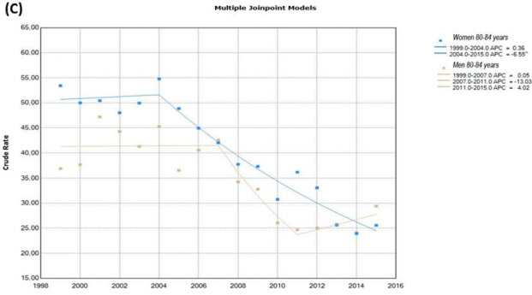
What is a joinpoint analysis?
APC= Annual Percentage Change
Notes:
Dragomirescu, I., Llorca, J., Gómez-Acebo, I., & Dierssen-Sotos, T. (2019). A join point regression analysis of trends in mortality due to osteoporosis in Spain. Scientific reports, 9(1), 1-8.

Slide 5
What is a joinpoint analysis?
Using joinpoint analysis, we can identify general linear segments
where they occur, and with statistical precision, the changes in slope in data
A joinpoint is determined by testing the null hypothesis that there is only a single slope in the data, stepwise manner, against 2 or more slopes in the dataset
Eventually the location where these segment changes occur is identified (a joinpoint)

Slide 6
What is a joinpoint analysis?
Why is this analysis helpful?
We can use it to identify secular changes in the data (e.g., large economic or political trends)
Can be used to test or show our hypothesized effects, or to remove variance of these trends

Slide 7
Alcohol policy and all-cause mortality in Lithuania
A JP Analysis example

Slide 8
Alcohol policy and all-cause mortality in Lithuania
All-cause mortality for 2001 – 2018 was collected in Lithuania
Analysis follow up from on Štelemėkas et al. (2020); alcohol control policy effects on all-cause mortality
18 different policies implemented during the time frame
2 policies (implemented in 2009 and in 2017) found to have a significant effect on all-cause mortality

Slide 9
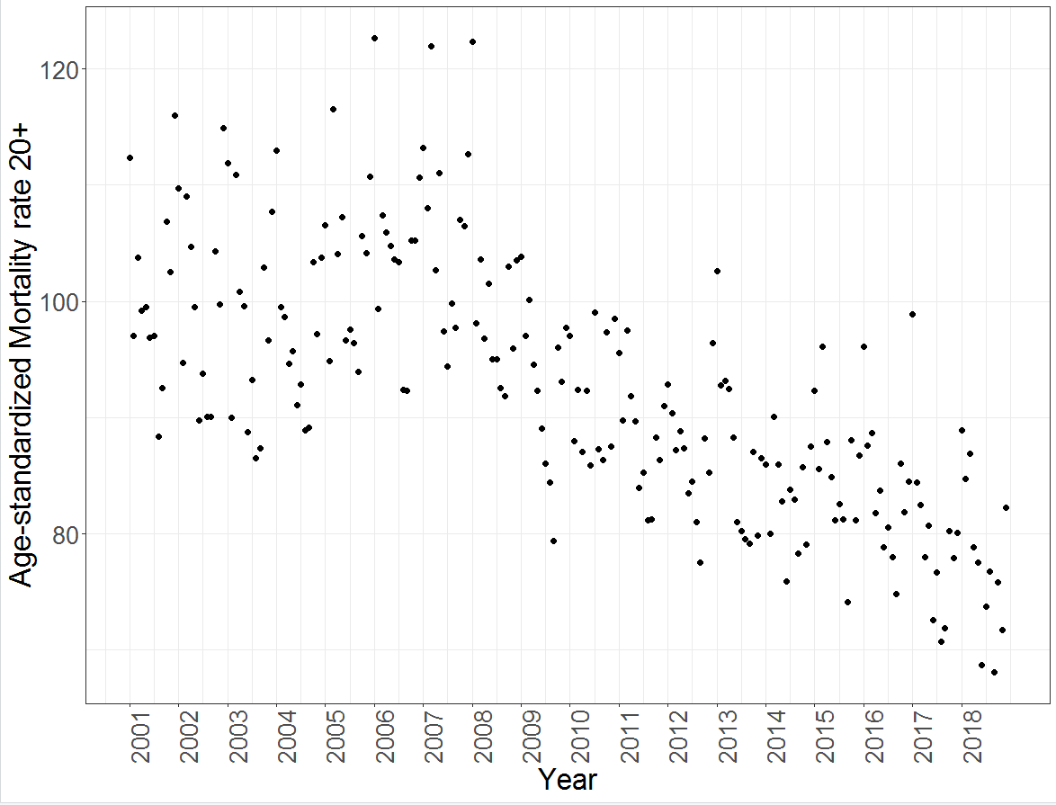
Alcohol policy and all-cause mortality in Lithuania

Slide 10
Alcohol policy and all-cause mortality in Lithuania
The aim was to test the impact of policies above and beyond the general trends– employing a JP analysis
Time series data were input into the JP program (x = months, y = all-cause mortality rates)
Resulting output was further analyzed using a GAMM (to control for seasonality and autocorrelation effect) to test for impact of policy effects

Slide 11
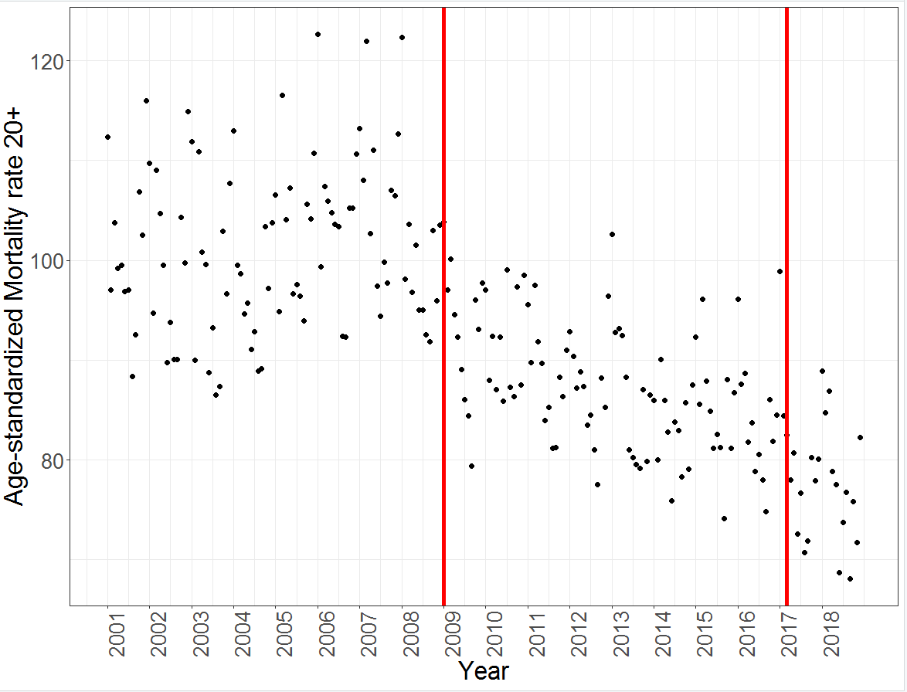
Alcohol policy and all-cause mortality in Lithuania
2009 (Policy 2)
2017 (Policy 6)
Notes:
Remove red line

Slide 12
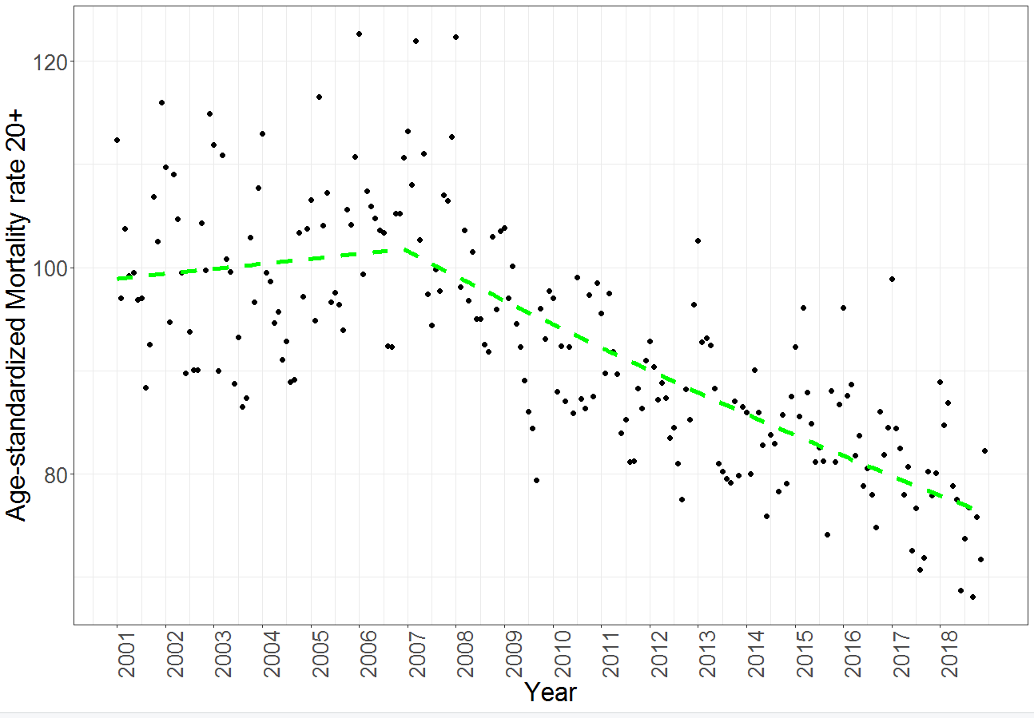
Alcohol policy and all-cause mortality in Lithuania: JP Analysis output
Showed a single joinpoint at month 72 (December 2006) followed by a single downward trend

Slide 13
Alcohol policy and all-cause mortality in Lithuania: GAMM
Predicted values from JP analysis were then entered into a GAMM (Model 1) served as a base model
The JP analysis was then entered into a GAMM along with policy effects (Model 2) to test for improvement in the model

Slide 14
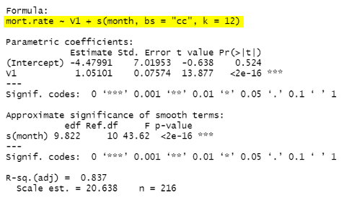
Model 1

Slide 15
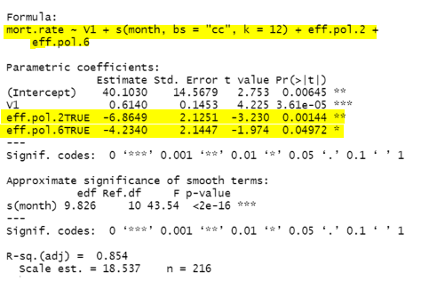
Model 2
Notes:
Highlight the effect policies

Slide 16
Alcohol policy and all-cause mortality in Lithuania: Model fits
Test of the models showed significant improvement in fit when policies were included using the anova() function in R

Slide 17
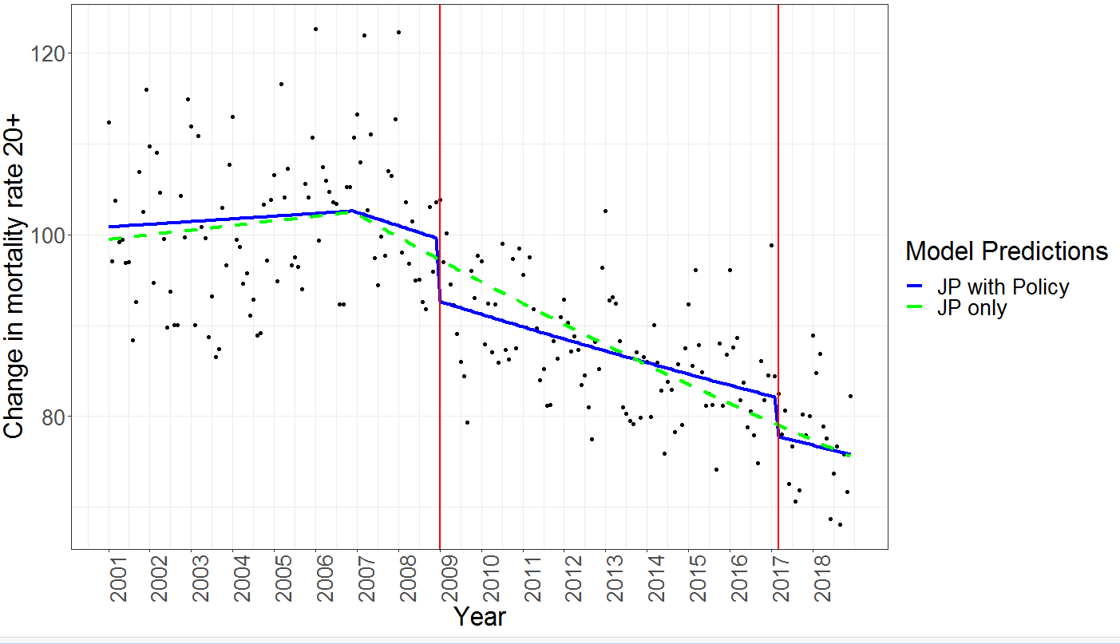
Alcohol policy and all-cause mortality in Lithuania: Model comparison

Slide 18
Alcohol policy and all-cause mortality in Lithuania: Conclusions
There was a significant effect of alcohol policy on all-cause mortality rates in Lithuania (Štelemėkas et al., 2020)
Using a JP analysis, it appears that this effect is still significant, even when controlling for larger overall trends

Slide 19
How do we use the JP program?

Slide 20
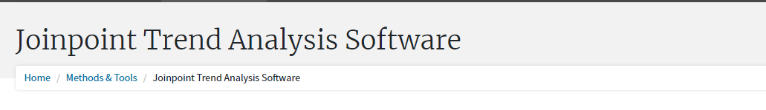
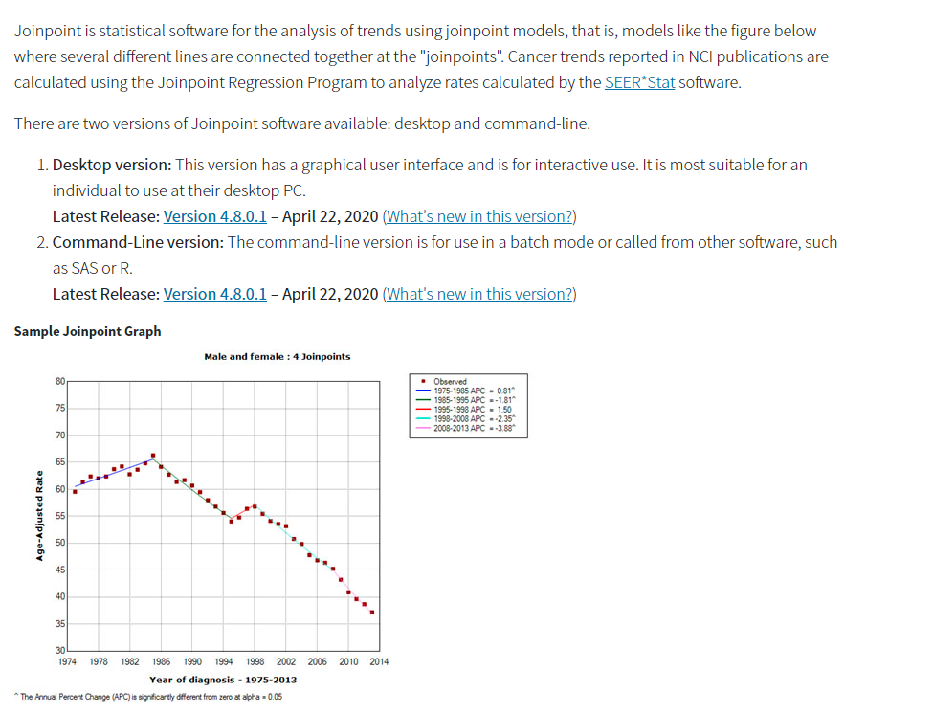
Notes:
The program can be found here:
https://surveillance.cancer.gov/joinpoint/
Users must fill out a consent/copyright form and register to receive the software

Slide 21
Software download
Can use the GUI (graphical user interface; will not be covered in this workshop)
Simpler interface, some help with setting parameters on website
Command-line (R-compatible)
Flexible, analysis code can be saved for future use
BUT very challenging, not many help-documents be prepared to problem-solve
Notes:
Two versions are available, some may be familiar with the GUI/graphical version, it may be easier to use, however for this workshop we will be using the program through R and a windows-based command line (will not be using Mac OSX or UNIX operating systems… sorry).
The command-line version can be run directly from R using the system() function, or it can be run from command prompt as well (open cmd, change directory to directory/folder that contains the .exe file)

Slide 22
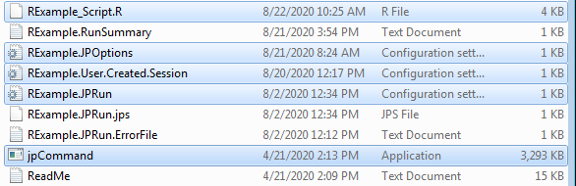
Software (R-compatible command-line)
Comes with several files, including basic R-script files
Requires the program (jpCommand.exe) and 3 primary files:
JPRun – initiatialization file, will be generated with the R script
Options file – modify parameters of your models
User Created Session file – Directs program to dataset, and relevant variables
Notes:
Software package comes with some simple templates that can be modified using the Read Me, they are text files saved with a .ini extension. The files have a basic structure that must be followed, so best to use the template (copy/paste the file). It also comes with an example R script, however the script only runs the .exe file and creates a initialization file– might require some trial and error to get the .exe file to work
(needs to have /path/to/jpCommand.exe space /path/to/JPRun.ini on the same line– will describe and demonstrate)

Slide 23
Read Me!
Very light documentation…. does not describe functions in detail
Contact me for questions: Alexander.tran@camh.ca
However, readme file lists many parameters that can be modified and tested for different outputs!
Notes:
The Read Me is quite extensive in terms of the options available, however the actual description of the program, or errors you might encounter are not present. It may be a bit frustrating to use at first, but eventually you will get the hang of it. Most important is to ensure all the .ini files point to the same folder/directory

Slide 24
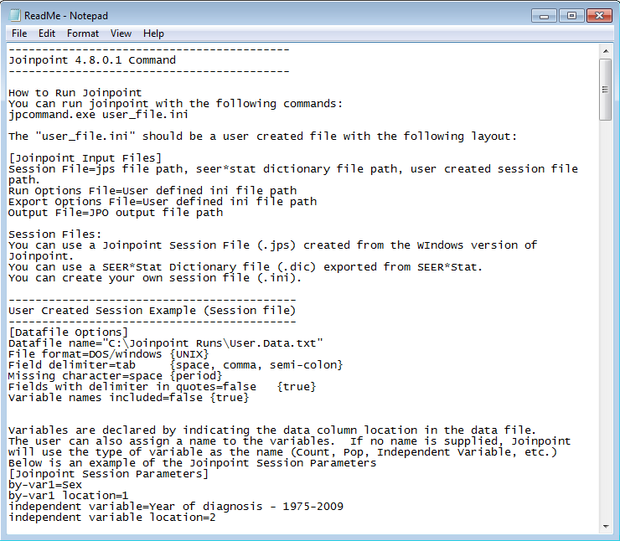

Slide 25
Joinpoint analysis: A simple example
The script creates an artificial dataset, with two variables that can be modelled by the JP program
popndat$simple and popndat$outcom_var
This tutorial will demonstrate the JP program on popndat$simple

Slide 26
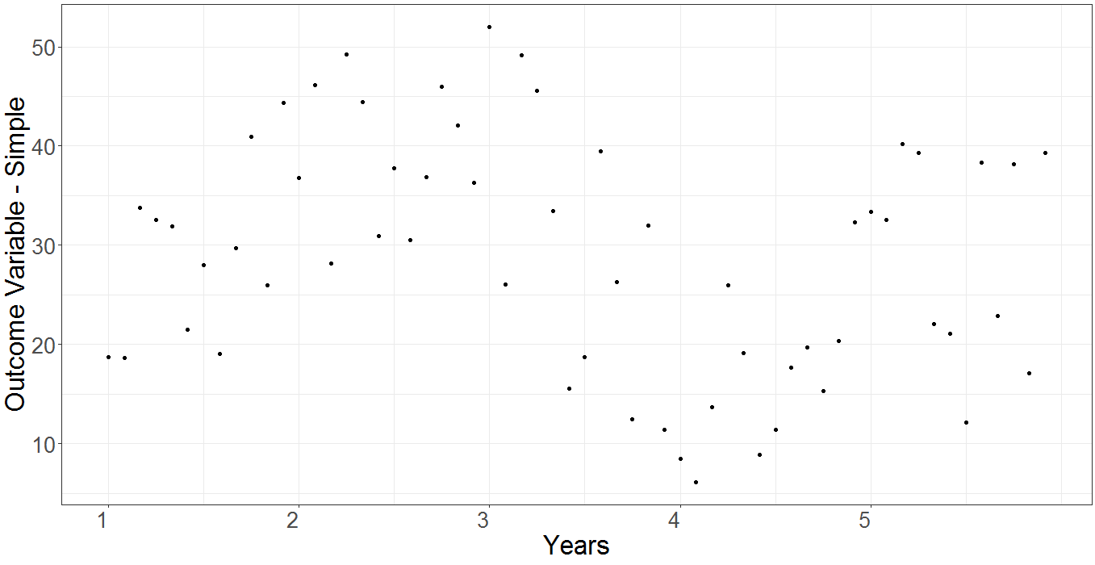
Joinpoint analysis: A simple example

Slide 27
Joinpoint analysis: A simple example
Options file and User Created Session file are both created/edited manually using a text editor
User Session file: Directs program to dataset (comes with a template)
Input data file location
DOS/Windows
Data delimiter (default is tab, can be space, comma, semi-colon)
Avoid fields with special chars (i.e., delimiters)
Data file can include variable names (off by default)
IV name (to be assigned by JP, not based on dataset)
IV location
DV name
DV location
Notes:
User Session file calls the data file (a .txt file) and reads characteristics of the dataset (e.g., which variable to use, how the data are separated in the file etc.)

Slide 28
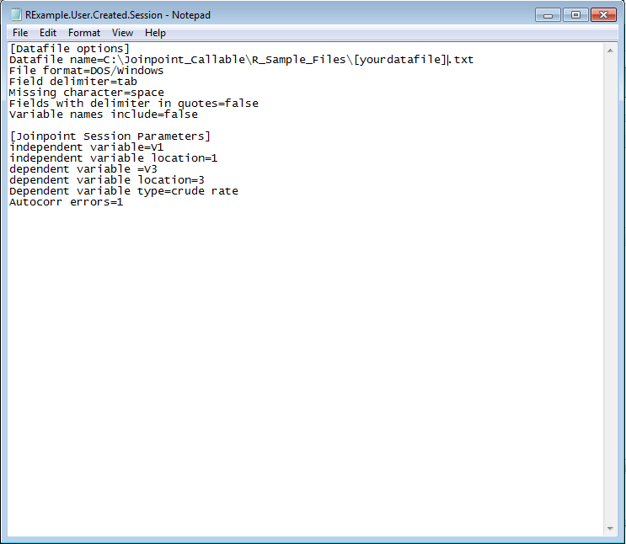

Slide 29
Joinpoint analysis: A simple example
Options file and User Created Session file are both created/edited manually using a text editor
User Session file: Directs program to dataset (comes with a template)
Input data file location
DOS/Windows
Data delimiter (default is tab, can be space, comma, semi-colon)
Avoid fields with special chars (i.e., delimiters)
Data file can include variable names (off by default)
IV name (to be assigned by JP, not based on dataset)
IV location
DV name
DV location
Notes:
User Session file calls the data file (a .txt file) and reads characteristics of the dataset (e.g., which variable to use, how the data are separated in the file etc.)

Slide 30
Joinpoint analysis: A simple example
Options file: Parameters to edit for analysis
[Session options]
Set minimum joinpoints
Set maximum joinpoints (informed by visual inspection, aprior etc.)
Default is 4499 permutations
Can estimate autocorrelation
Select significance values
Model selection method (permutation default)
Etc.
[Export options]
Increase precision of output and output files
Use default parameters for simplicity
Notes:
The Options file has the most flexibility available. Can change numerous parameters for the JP analysis, notably the number of joinpoints, the number of permutations, and the number of model samples.

Slide 31
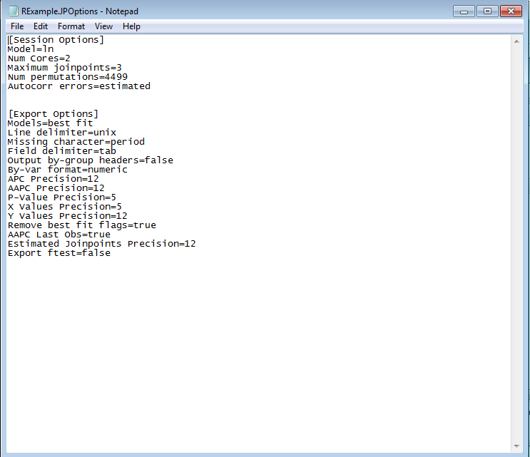

Slide 32
Joinpoint analysis: A simple example
Ensure that all files are in the same location/directory:
Options file, User Session file, dataset.txt, and jpCommand.exe
Set working directory
Note: Windows uses backslash(“\”) to separate directory
E.g., C:\Joinpoint_Callable\R_Sample_Files
So when copying and pasting in to R-Studio, change to forwardslash (“/”) to avoid this error
C:/Joinpoint_Callable/R_Sample_Files
Notes:
First make sure all files are together in the same directory, as the R code is written to call both the program and .ini file together

Slide 33
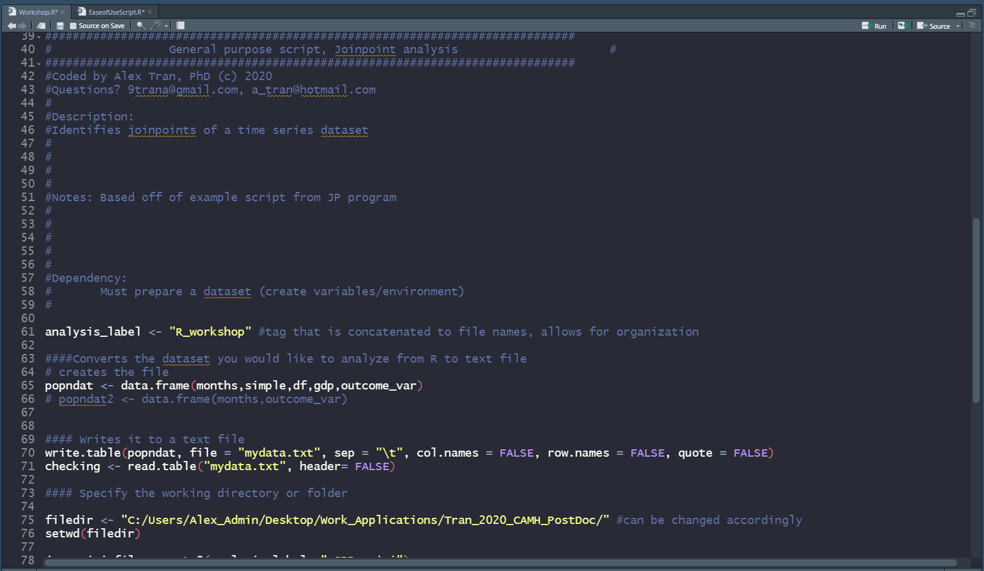

Slide 34


Joinpoint analysis: A simple example
Label your analysis:
Prepare the dataset:
Select relevant variables
Note: to avoid problems, include col.names = false, row.names = false—removes extra index column and headers
Write to a .txt file
Notes:
To keep organized, it is helpful to label your analysis, and the resulting output files,

Slide 35
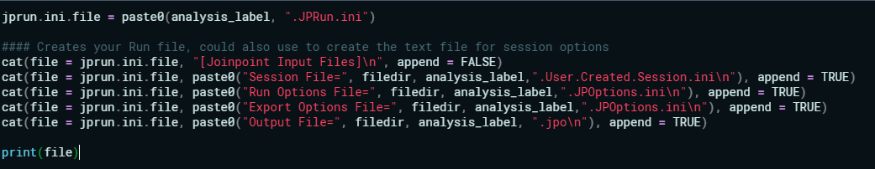
Joinpoint analysis: A simple example
R script will create JPRun.ini file in this section

Slide 36
Joinpoint analysis: A simple example
Run the program!
Depending on parameters (number of permutations, number of joinpoints) can take 30+ minutes to several hours
This means the program is running
Otherwise, error codes will display along with error.txt file
Notes:
Dataset size, number of permutations, and number of joinpoints are main variables that predict analysis time.

Slide 37
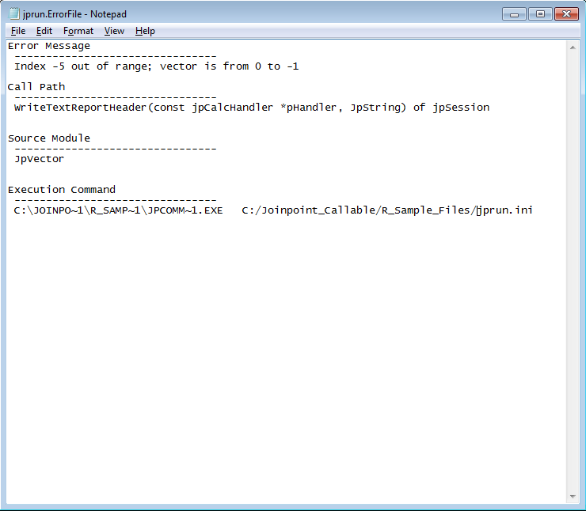

Slide 38

Joinpoint analysis: A simple example
Output:
AAPC (average percentage change, across all segments)
Report (test statistics, slope, segment lengths)
APC (average percentage change) per segment
Model data
Code below will read the text files and import into R

Slide 39
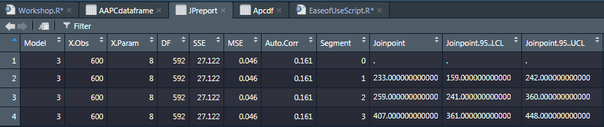
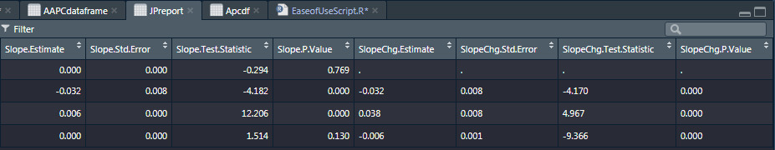
Joinpoint analysis: A simple example
Sample Output:

Slide 40
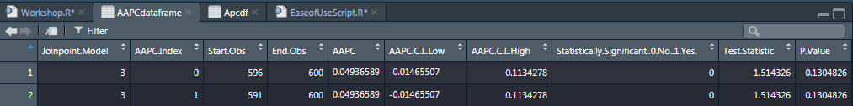
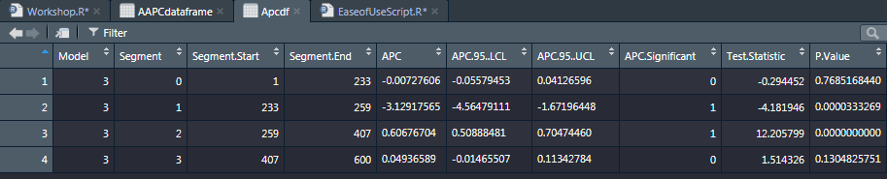
Joinpoint analysis: A simple example
Sample Output:

Slide 41
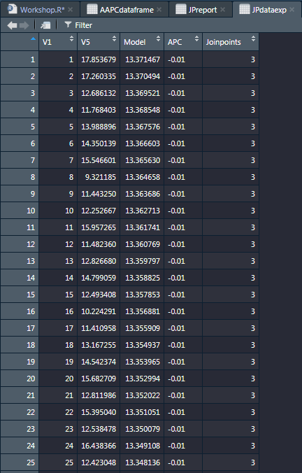

Slide 42
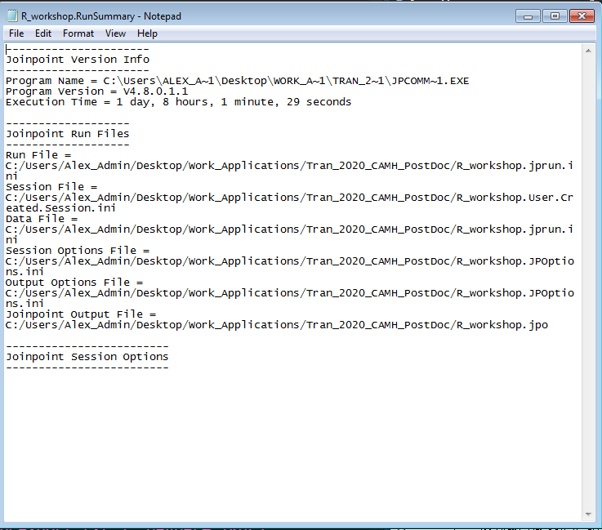

Slide 43
Joinpoint analysis: A simple example

Slide 44
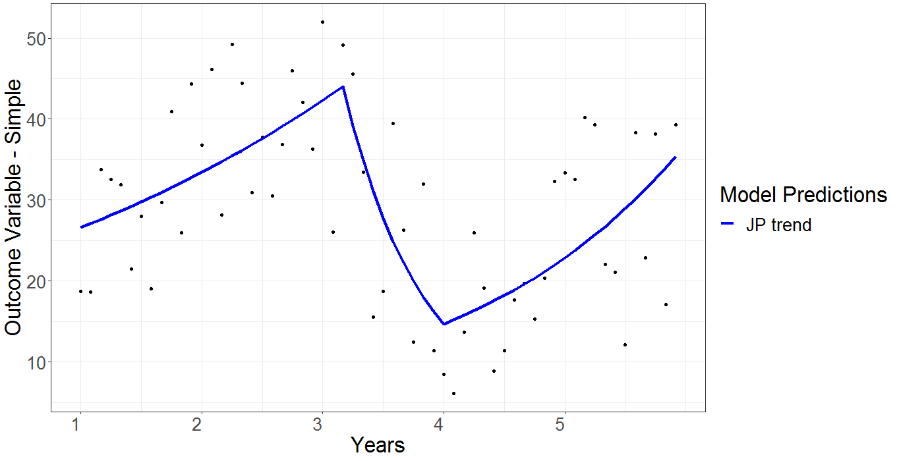
Joinpoint analysis: A simple example

Slide 45

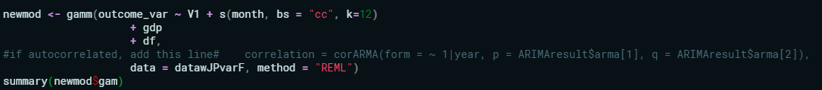
Joinpoint analysis: Additional steps
Run the model alone to see the fit
Can combine the predicted values from the joinpoint analysis model (output) with other variables in a dataset
Run a new model that includes additional predictors with JP output
Notes:
Compare models with the JP analysis and without to see how effect it is or if additional variables also help explain the trends.

Slide 46
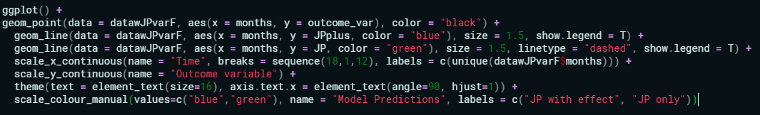
Joinpoint analysis: Additional steps
Using ggplot, plot the different models
Notes:
Graphing is up to you, here is some sample code that can be used and repurposed for your dataset. GGPlot is a well developed package with a lot of documentation.

Slide 47
Joinpoint analysis: Final tips
Run simultaneous analyses using command-line (running JP in R-console will occupy R until the analysis is complete)
Ask me if interested!
Name EVERYTHING… and move your files after each analysis
The program outputs MANY files and will overwrite files without warning, so if you are running many analyses have a good organizational system
Use file timestamps
The output files will indicate when the analysis was run, to help you determine if you
Important to remember that these analyses are designed to measure linear trends! (must also keep in mind seasonal trends)

Slide 48
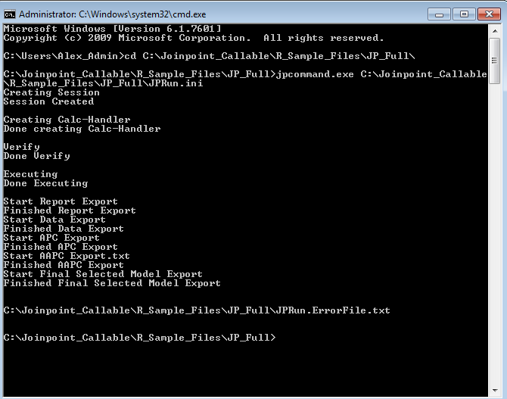

Slide 49
References
https://surveillance.cancer.gov/joinpoint/
Kim, H. J., Fay, M. P., Feuer, E. J., & Midthune, D. N. (2000). Permutation tests for joinpoint regression with applications to cancer rates. Statistics in medicine, 19(3), 335-351.
Dragomirescu, I., Llorca, J., Gómez-Acebo, I., & Dierssen-Sotos, T. (2019). A join point regression analysis of trends in mortality due to osteoporosis in Spain. Scientific reports, 9(1), 1-8.

Slide 50
Questions?
Contact me!
alexander.tran@camh.ca

