Slide 1
Concrete resolve:
Concreteness increases approach motivation and helps behaviourally inhibited people become more persistent, determined and tenacious
Notes:
Look at text in studies, what did people write about, negate the idea that its valence based? Maybe concrete has no valence == Mickey model?
ADD META-ANALYSIS DETAILS TO SUPPLEMENT, ONLY 6 IN TABLE IN DISSERTATION
Thank you everybody for coming today and sharing this very special moment with me, as I present my primary line of work throughout my PhD.

Slide 2

Motivation and me
Notes:
For those of you who know me, I am an avid exerciser. In my experience I have found that exercise behaviour poses a conundrum to motivational researchers, clinicians and lay people alike. Exercise is one of those things that everyone knows is good for you, yet all of us struggle to adhere to a consistent exercise routine. Even I, someone who enjoys and values exercise find myself having difficult motivating myself to get off the couch and go to the gym. Why is this?

Slide 3

















What have motivational researchers found?
Action
Oriented
Mindset
Arousal
Level
Approach
Motivation
Attention
and
conflict monitoring
Extrinsic
Motivation
Deliberative
Mindset
Feedback
loops
BAS
Activation
BIS
Activation
Goal
Setting
Promotion focus
Intrinsic motivation
Abstraction
Prevention
Focus
Trait
BIS
Self-control
Concreteness
Notes:
Delving into the motivation literature, I found that this area of research is vast and complex, with many psychological constructs contributing to motivated behaviour. In the context the unique context that I am interested in, however, some constructs are more central to predicting persistence than others.

Slide 4
Goal conflict
Behavioural inhibition system (BIS) detects goal conflict
  1) Inhibits ongoing goals, 2) ↑ hesitation, 3) ↑ scanning for alternatives
  BIS-activation ↓ persistence (Bosc et al., 2017; Alquist et al., 2018; Gray & McNaughton, 2000)
Goal conflict ↓ goal-striving and attainment (Boudreaux & Oser 2013; Emmons et al., 1993)
Notes:
What is unique about exercise and self-regulation? By nature, exercise is a conflicting task. Although we may acknowledge the idea that exercise is good, the behaviour itself is aversive; it is exhausting, painful, and time consuming. These conflicting cues are detected by a primitive neural system, the behavioural inhibition system or BIS. It has 3 main functions. In the context of motivated behaviour, the BIS has been shown to reduce persistence across species. These comparative psychology studies support social psychology studies demonstrating that goal conflict can reduce goal-striving and attainment

Slide 5
Approach motivation
Behavioural activation system (BAS) leads to approach motivation
  BAS ↑ approach behaviour (Gray & McNaughton, 2000; Olds & Milner, 1954; Wise, 2004)
  Approach motivation = impulse to go toward (Harmon-Jones et al., 2013)
Approach motivation is related to determination and effort (Price et al., 2013; Harmon-Jones et al., 2011; Hughes et al., 2014)
Notes:
Why is goal conflict problematic? It can suppress approach motivation. The BIS will down-regulate the behavioural activation system or BAS. The BAS is a reward-sensitive system responsible for generating approach motivation, and facilitating approach toward desired goals. Researchers have found that approach motivation is the basic impulse to go toward something and some have shown that it is tied to determination.

Slide 6

Joint subsystems hypothesis of BIS and BAS (Corr, 2004)
Approach
Motivation
BAS
Activation
BIS
Activation
Trait
BIS
Abstraction
Concreteness
Notes:
An important aspect of the relationship between the BIS and BAS is that they act on one another in a reciprocal manner, similar to a balance scale. When BIS activation is high, BAS is down-regulated, and vice versa. Conflicted goals then, should be particularly problematic as they should suppress BAS-activation.

Slide 7
How do we re-establish approach?
Construal level theory: concrete vs. abstract mindsets (Liberman & Trope, 2010)
Past work, abstraction > concreteness
  Abstract = ↑ self-control (Fujita et al., 2006)
  Abstract = ↑ delayed gratification (Metcalfe & Mischel, 1989)
  affirmations (↑ abstract) = ↑ self-control, academic performance, weight-loss (Schmeichel & Vohs, 2009; Cohen et al., 2009; Logel & Cohen, 2012)
BUT
  Abstraction to be threatening for people high in BIS-related traits (e.g., Libby et al., 2011; Marigold et al., 2015)
  Concreteness might ↓ conflict to restore approach motivation
Notes:
My intuitions were that mindset is an important component. I found that mounting those first steps (e.g., putting my shoes) effectively motivated me to follow through. From a construal level theory perspective, this is a more conc mindset, one focused on specific how of behaviour is detail oriented and focused on the immediate now. Alternatively, people can have an abstract mindset, one that is general, why of behaviour, is broad and decontextualized and focused on the distant future. My intuitions however were in direct contrast with CLT research, which showed broadly that abstraction is superior to concreteness in self-control and decision making. CLT research not in the domain of motivation and self-regulation showed that abstraction can be threatening to people high on traits related to the BIS, and instead concreteness was beneficial. This work hints at the possibility that concreteness may reduce conflict and be a means to restoring approach motivation

Slide 8








Approach
Motivation
BAS
Activation
BIS
Activation
Trait
BIS
Abstraction
Concreteness
Approach
Motivation
BAS
Activation
BIS
Activation
Trait
BIS
Abstraction
Concreteness
Concreteness
Notes:
To tie these constructs into a meaningful example; it may be that in exercise, people may mount an abstract mindset activate the BAS, and feel approach motivated, however the conflicting cues that are present in exercise, for instance the fact that it is time consuming, requires energy and might be painful, triggers the BIS; through their reciprocal action, the BIS down-regulations BAS and eliminates approach motivation. I propose that a concrete mindset will filter out these negative cues, promote a narrow, singular focus, allowing for BAS-activation and restoring approach. In turn this should lead to improved task persistence.

Slide 9
Approach
Motivation
BAS
Activation
BIS
Activation
Trait
BIS
Abstraction
Concreteness
Notes:
A simpler way to envision this model is that the basic neural system interact with mindset to predict approach motivation and subsequent persistence.

Slide 10
The present research
When is concreteness effective? Can it ↑ approach motivation and persistence?
General hypothesis; BIS X concrete-abstract, predicts persistence
  Under high BIS-activation, concreteness ↑ approach (BAS) and ↑ persistence
Notes:
In the present work, I aimed to identify the conditions under which a concrete mindset may be effective. I tested whether this mindset can increase motivation and persistence, with the general hypothesis that BIS interacts with concreteness to predict persistence, and more specifically that when high in BIS, concreteness restores approach and increases persistence.

Slide 11



Overall design for Studies 1-3
Manipulated concrete vs. abstract (how vs. why; Freitas et al., 2004)
Trait BIS-activation; chronic tendency to experience conflict (Carver & White, 1994)
Persistence
Abstraction
Concreteness
Trait
BIS

Slide 12




Study 1
Study 2
Study 3
Study 4

Slide 13
Study 1
t (327) = -2.93, p = .004, d = .32
t (327) = -2.58, p = .01, d = .28
Notes:
Main effect: F (1, 332) = .43, p = .510
conc = 421.78
abs = 407.67

Slide 14
Abstraction
Concreteness
BAS
Activation
BIS
Activation
Approach
Motivation
Trait
BIS

Slide 15
Study 2: Handgrip
t (129) = -2.52., p =.01, d = .44
t (129) = -2.77, p =.006, d = .49
Notes:
Main effect: F (1, 134) = 1.76, p = .186
conc = 77.37
abs = 70.84

Slide 16
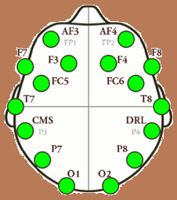
Study 2: Approach motivation (LFA)
t (103) = -1.73, p =.08, d = .34
t (103) = -1.49 p = .13, d = .29

Slide 17
Approach
Motivation
+
Abstraction
Concreteness
BAS
Activation
BIS
Activation
Approach
Motivation
Trait
BIS

Slide 18
Study 3: Self-reported approach
t (107) = -3.21, p = .002, d = .62
t (107) = -4.05, p = .0001, d = .78
Notes:
Conc vs. Abs → BAS-Drive main effect: F (1, 111) = 6.18, p = .014
conc = 3.80
Abs = 3.46
Put in means here of BAS, to justify that approach worked?

Slide 19
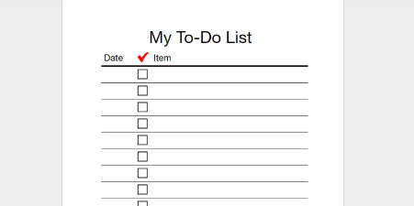
Study 3: Personal Projects
t (107) = -2.20, p = .03, d = .42
t (107) = -2.63, p = .01, d = .51
Notes:
Conc vs. Abs → PPA main effect: F (1, 111) = 3.15, p = .079
Conc = 4.14
Abs = 3.95

Slide 20
Self-reported
Approach
β = -.71*
β = .16*
BIS X Conc-Abs
indirect effect β = -.11*
Personal Goal Persistence
total effect β = -.36
direct effect β = -.25
Notes:
b = -.11, 95% CI [-.30, -.02].
Importantly, this mediation effect was significant at high BIS, b = -.12, 95% CI [-.28, -.03] and not at low BIS, b = .02, 95% CI [-.04, .12].

Slide 21
Abstraction
Concreteness
BAS
Activation
BIS
Activation
Approach
Motivation
Trait
BIS

Slide 22
Study 1
Study 2
Study 3

Slide 23
Abstraction
Concreteness
BAS
Activation
BIS
Activation
Approach
Motivation
Trait
BIS

Slide 24
Study 1
Study 2
Study 3
Study 4

Slide 25
Pilot studies
1) Does state BIS ↓ performance?
2) Is approach motivation → persistence direct, or indirect?
Pilot a
  Approach prime (vs. control) = ↑ data entry persistence (direct)
Pilot b
  Approach vs (conflict) → ↓MC → ↓ experienced conflict (i.e., BIS)→ ↑ anagram persistence (indirect, BIS reduced performance)
Notes:
Pilot a: BAS
F (2,96) = .89, p = .410
app = 3.44
invig = 3.56
Control = 3.32
Pilot b: BAS
F (1,45) = 3.50, p = .068
app = 3.61
frust = 3.26
Pilot b: FU
F (1,45) = .07, p > .79.
Pilot b: MC items were, ‘frustrated’ and ‘an urge to quit or give up’ | “Two part study” to remove influence of manipulation, and so makes FU seem more directed toward anagram, but needed a direct reference (Study 4)

Slide 26




Abstraction
Experienced
Conflict
Concreteness
BAS
Activation
BIS
Activation
Approach
Motivation
Trait
BIS
Notes:
FU and trait BIS, clear that high trait BIS has more state BIS activation, so we are now just manipulating it instead of assuming high trait has BIS-activated ambiently; full FU = .68 (Corr, 2017; BIS) .404 (Carver & White), .5 (Prevention Focus), .72 (Uncer Aver) and .53 (Stress);

Slide 27
Study 4: Pilot a vs. Pilot b
How does approach motivation increase persistence? Direct, or indirect?
Within-subjects
Manipulated approach vs. conflict
Persistence = performance at a word-generating task, experienced conflict (BIS)

Slide 28
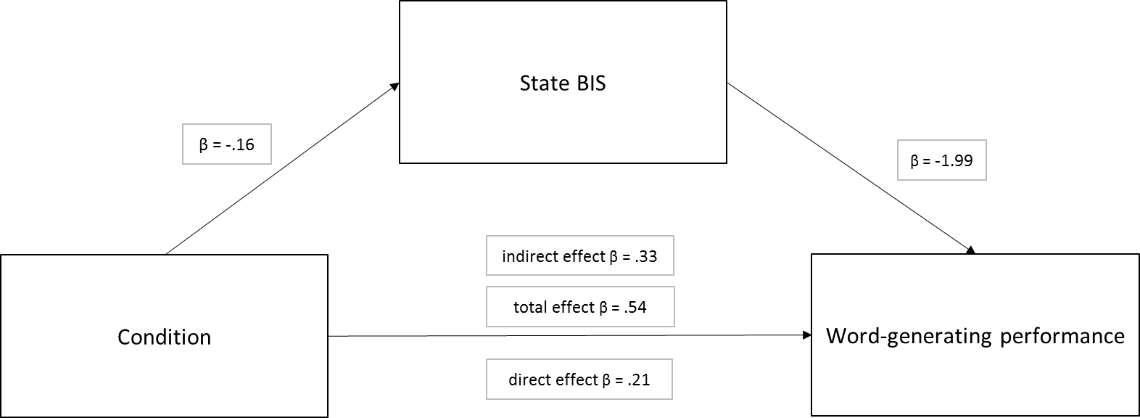
Study 4
Experienced
Conflict
*
Approach vs.
Conflict
Indirect Effect: β = .32, 95% CI, [.06, .85]
Notes:
bothered, confused, uncomfortable, mixed, uneasy, torn (didn’t use conflicted, basically manipulation check, and same words as face-valid prime)
(these items were shown to be strongest of FU to persistence mediation in Alquist et al., 2018)

Slide 29
Abstraction
Experienced
Conflict
Concreteness
BAS
Activation
BIS
Activation
Approach
Motivation
Trait
BIS
Notes:
Inzlicht: BIS-activation or depletion should increase approach motivation, not decrease it; agree, toward alternative goals that are not conflicted, that have easily seeable reward, not to the current goal in conflict, e.g., Ian-RAM, people reactively approach unconflicted goals. Concreteness, instead, narrows options, reduces conflict and pull of alternative options, helps stay focused
Inzlicht: I think it’s a drop in motivation, literature on SC failure says increase in approach motivation
Me: Why is my approach motivation prime not going to easiest rewarding thing (quitting) if SC literature is correct? If pure approach motivation drives you to available rewards, then prime should cause people to quit. This is the prediction by depletion, increased approach is the reason for failure (Inzlicht, Schmeichel, & Macrae, 2014)? UNLESS something about my manipulation, not really approach-y, but passed MC…
Inzlicht: Conflict caused “depletion” and more approach motivation, leading to reduced performance. Approach prime also kind of like depletion. Me: unlikely given retrospective MC showed higher approach though
Price, Hortesius & Harmon-Jones (2013) found determined face + LFA (approach motivation) increased anagram performance; Harmon-Jones et al., 2011, approach motivation (i.e., angry faces) resembles determination | cite his work, reward (hand holding) improves self-control?
Isn’t self-control challenging because it is about conflict? I think we need to manage conflict (i.e., BIS-activation); Gray & McNaughton theory would predict this is through approach

Slide 30
Discussion
Concreteness (in high BIS) can promote persistence
  Concrete mindset ↑ approach motivation, presumably ↓ experienced conflict and allows for ↑ persistence
Support for BIS and BAS in persistence
  Experienced conflict (BIS) impairs task persistence (Pilot b, Study 4)
  Approach motivation (BAS) indirectly predicts persistence
Applies to conflict in real-life goals (e.g., Study 3)
Mindset (concrete-abstract) should match task (high-low BIS)

Slide 31
Limitations and Future Directions
Concreteness = ↑ or abstraction = ↓, persistence?
BAS/approach measures are introspective (some EEG evidence)
  Implicit, cognitive-behavioural measures of approach motivation (Robinson, Boyd, Liu, 2013)
Lack direct evidence for goal conflict; implied in BIS-activation (Gray & McNaughton, 2000)
  Study 4, some evidence (task-specific conflict)
Countering BIS via BAS could have a down-side
BAS should be considered alongside other motivation constructs
Notes:
Avoidance motivation and persistence? Abby***
If I think this is the mechanism; concreteness → approach motivation → reduced | conflict or feelings of conflict, or entropy |, I should elongate the task and measure entropy. Does it continue to increase? If so, then a concrete mindset would become more and more relevant.
OR; Try to induce concreteness directly during the task within the instructions: i.e., is concreteness happening during the task, maintain concreteness (or abstraction) even if you encounter conflict to see actual process, does it reduce entropy as expected?
Need more BIS evidence in process; how to measure? only marginal effect on entropy | BIS-activation never actually measured; implied by conflict manipulation, and FU measure is a good proxy, but need to narrow down a definitive way of measuring/operationalizing it to test these joint subsystems and further work on BIS/BAS
Is BIS-activation = ERN or other anxiety disorders? What about normal population? Can we find behavioural correlates of anxiety? As characteristics have been identified in rat behaviours | measures of hesitation?
Glucose rinse for BAS?
Molden et al., 2012
Hagger & Chatzisarantis, 2013
Need to understand the limitations to concreteness
Has been proposed to be related to SC failure (Bruyneel & Dewitte, 2012; Fujita et al., 2006)
Concrete mindsets are action-oriented (and related to motor areas in the brain, Gilead et al., 2014)
Might not be desirable for tasks that require care, and slow, thoughtful, deliberation
Question to be answered: Concreteness is more approach-y; connection of approach and narrow, ignoring aversive stimuli | some literature finds promotion/approach linked to abstract; predict opposite, so where is the main effect if there is one? Manip approach narrows, but manip prom = approach…seem to suggest conc vs. abs mindset respectively, which is right?
Approach has the potential to make you persistent, it is just about what that persistence is toward (socially adaptive, maladaptive); it is what drives addictions/impulsivity behaviours, too much conflict= inhibit current task, go to something less inhibited, or easier
Not really task specific state BAS immediately after manip in S3, but seems task specific in PPA, and mediates to this; so idea that generalized approach is sparked by concreteness, which remains contained in one specific task? Need to think about task-specific approach vs. generalized state
Don’t want generalized state; want it to be directed. Maybe that is why did not work for Pilot a (state BAS was general, after typing; would think if depleted want to go after something and report high BAS; look at self-cont and increased APP motvn paper- Schmeichel)
If depletion heightens BAS across board; evidence in Study 3, average BAS-D was pretty high: also remember in that Study, was really long in terms of materials, shows importance of concreteness (cite time on average it took for EnviroRICK)

Slide 32
Concluding comments
Concrete mindset is not always bad, abstraction is not always good
  Real-life goals are faced with conflict, a concrete mindset might be important for persistence
Multi-disciplinary methods help to identify processes at various levels
  Neuro processes and theory at the micro-level predicted changes in macro-level behaviours

Slide 33

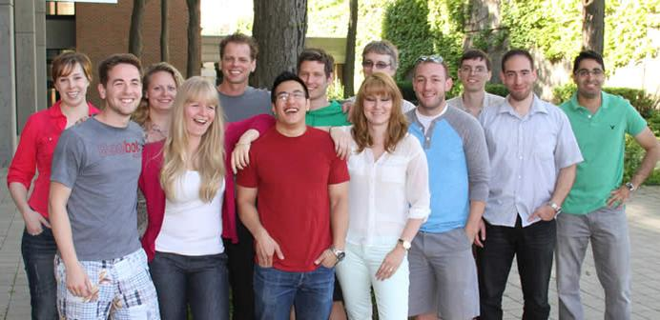

Questions?
Waterloo Colleagues:
Franki Kung
Chris Lok
Alex Huynh
Hansky Santos
Linden Timoney
Sherman Kwok
Kassandra Kortes
Jeff Hughes
Amrit Litt
Amy Yeung
Harrison Oakes
Cameron Smith
Emily Cyr
Erik Jansen
Jane Klinger
Matthew Wilmot
Notes:
Why don’t I have a main effect? Could be manipulation, not abstract/concrete enough, could be DV, not a good measure as others? My task is about conflict.
-Avoidance and persistence: motvn clarity? But approach seems to be a part at least
-Doing whats in front of you?
-BAS-activation with glucose rinse?
-Free-floating or task specific BAS and BIS?
-Process and states of approach and conflict (within task)

Slide 34
Experienced
Conflict
Abstraction
Abstraction
Concreteness
Concreteness
BAS
Activation
BIS
Activation
Approach
Motivation
Trait
BIS
Notes:
Could it be that it is being funneled through conc/abs?

Slide 35




Experienced
Conflict
Notes:
Could it be that it is being funneled through conc/abs?

Slide 36
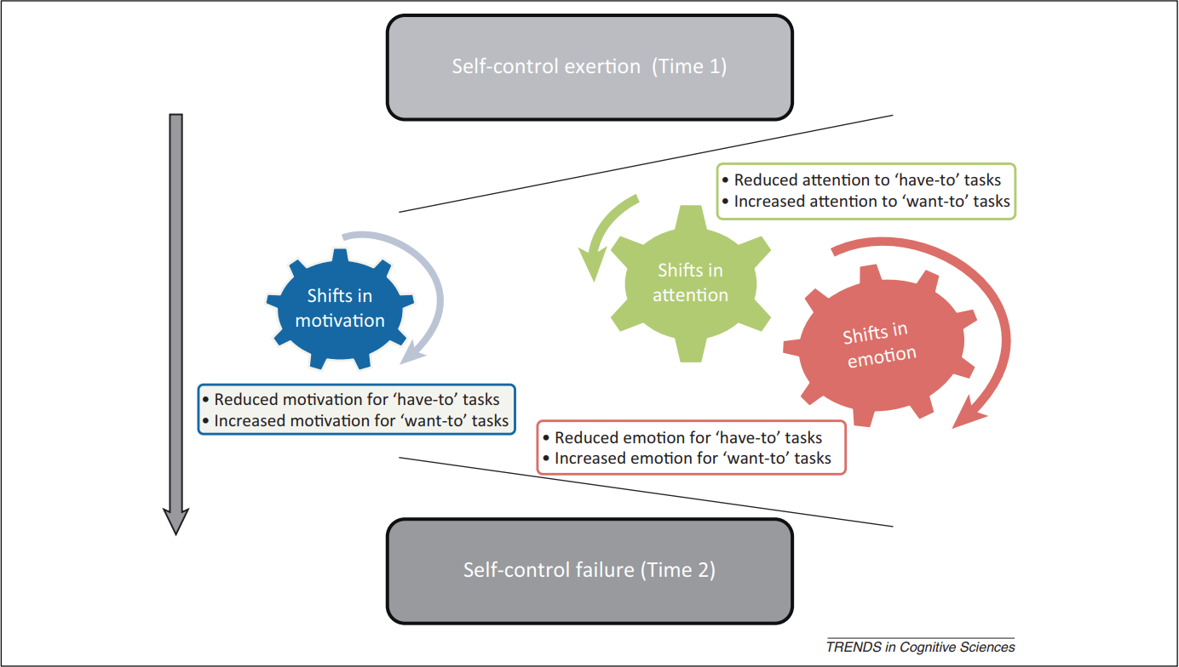
Abstraction
Concreteness

Slide 37
Study 1 Extras

Slide 38
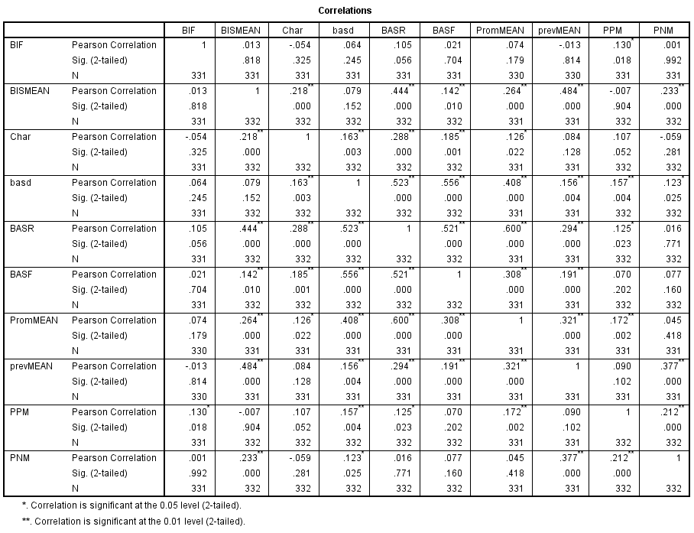
Notes:
BIF: F (1, 332) = 6.22, p = .013,

Slide 39
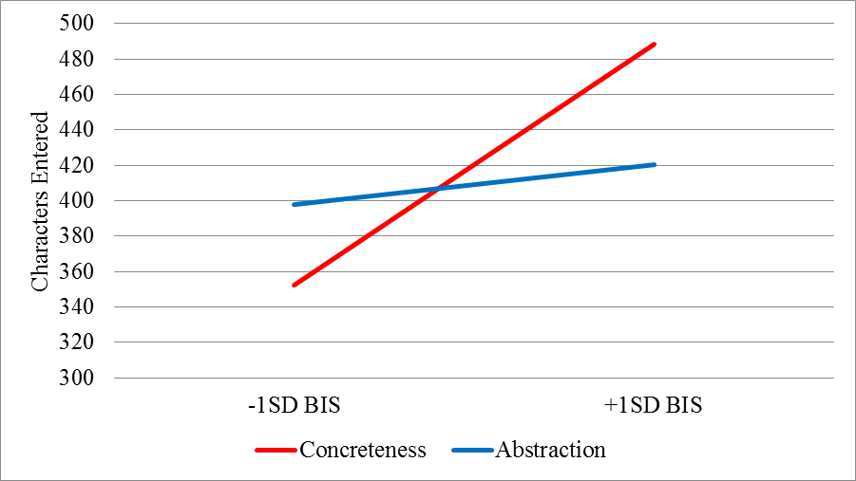
Study 1: Results
t (327) = -2.93, p = .004, d = .32
Simple effect at LOW BIS t (327) = 1.66, p = .097, d = .18 Simple slope of BIS in concrete t (327) = 4.11, p < .001 d = .45

Slide 40
Study 1: Results (BIF x BIS)
Notes:
t (327) = -.964, p = .33
t (327) = -1.57, p =.12

Slide 41
Study 2 Extras

Slide 42
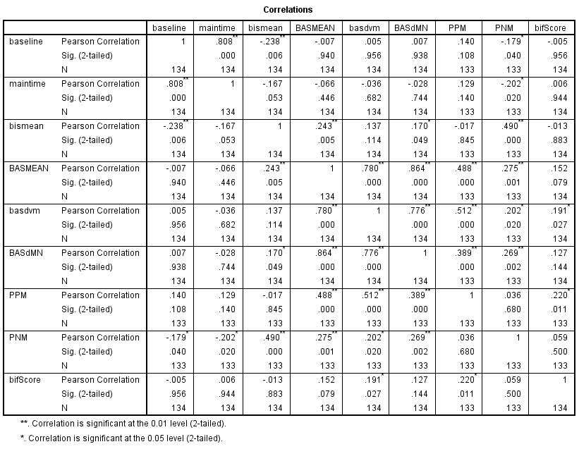

Slide 43
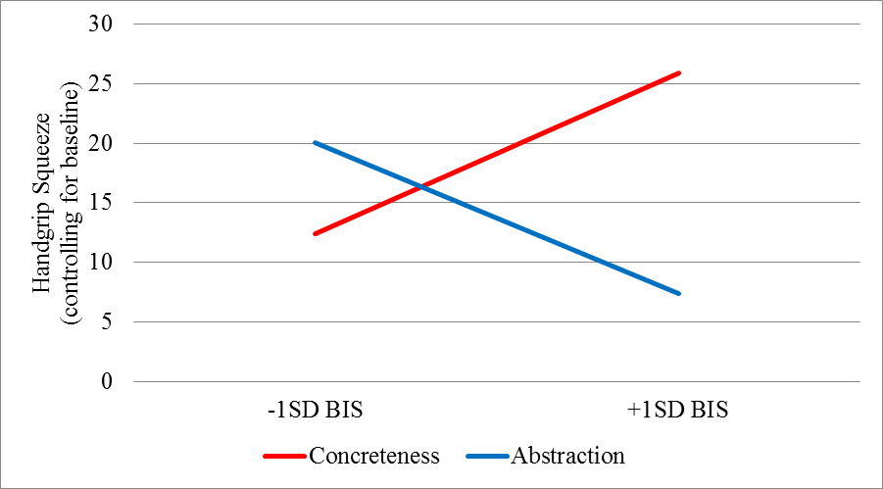
Study 2: Results
t (129) = -2.52., p =.01, d = .44
Simple effect at LOW BIS t (129) = .85, p = .39, d = .15 Simple slope of BIS in concrete t (129) = 2.28, p = .046, d = .40

Slide 44
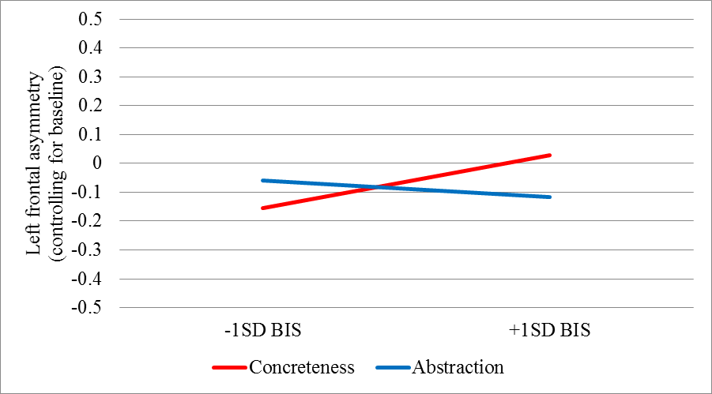
Study 2: Results
t (103) = -1.73, p =.08, d = .34
Simple effect at LOW BIS t (103) = .97, p = .33, d = .19 Simple slope of BIS in concrete t (103) = 1.96, p = .053, d = .39

Slide 45
Study 3 Extras

Slide 46
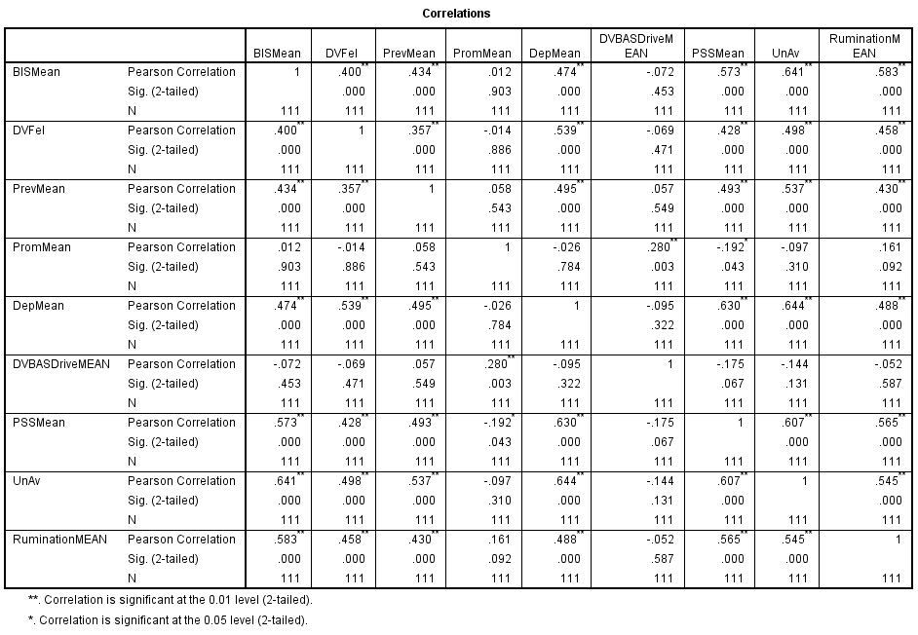

Slide 47
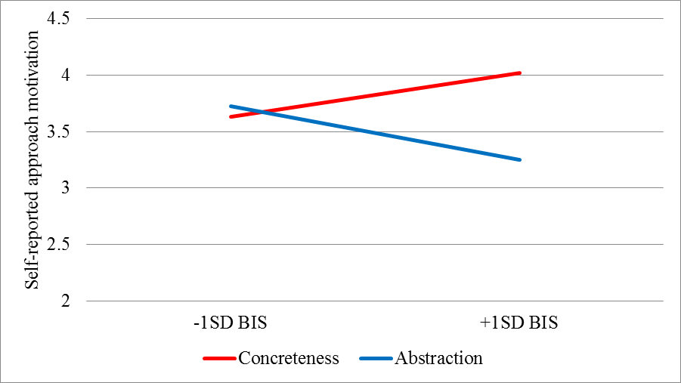
Study 3: Results
t (107) = -3.21, p = .002, d = .62
Simple effect at LOW BIS t (107) = .49, p = .62, d = .10 Simple slope of BIS in concrete t (107) = 3.10, p = .002, d = .60

Slide 48
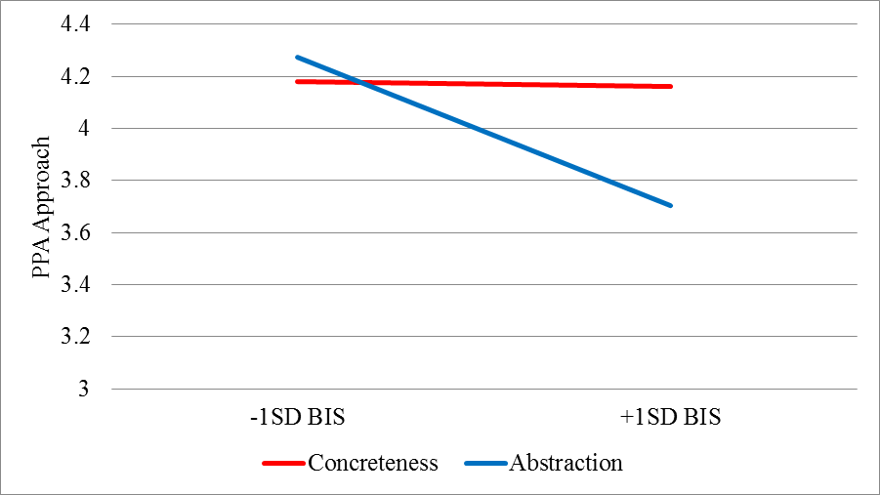
Study 3: Results
t (107) = -2.20, p = .03, d = .42
Simple effect at LOW BIS t (107) = .49, p = .63, d = .09 Simple slope of BIS in concrete t (107) = .72, p = .47, d = .14

Slide 49
Pilot Study Extras

Slide 50
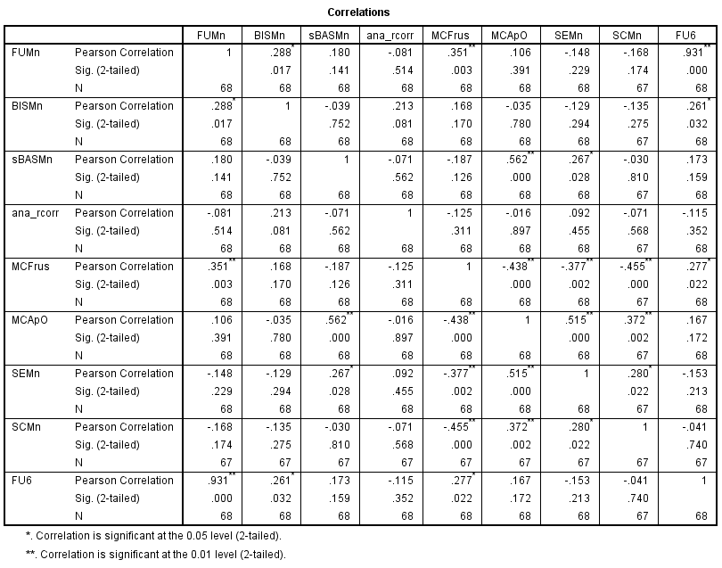

Slide 51
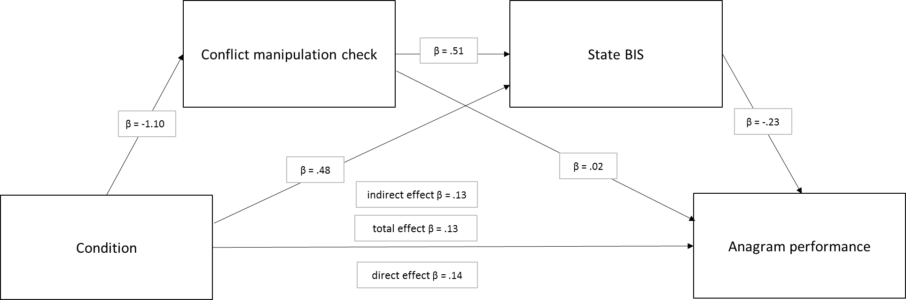

Slide 52
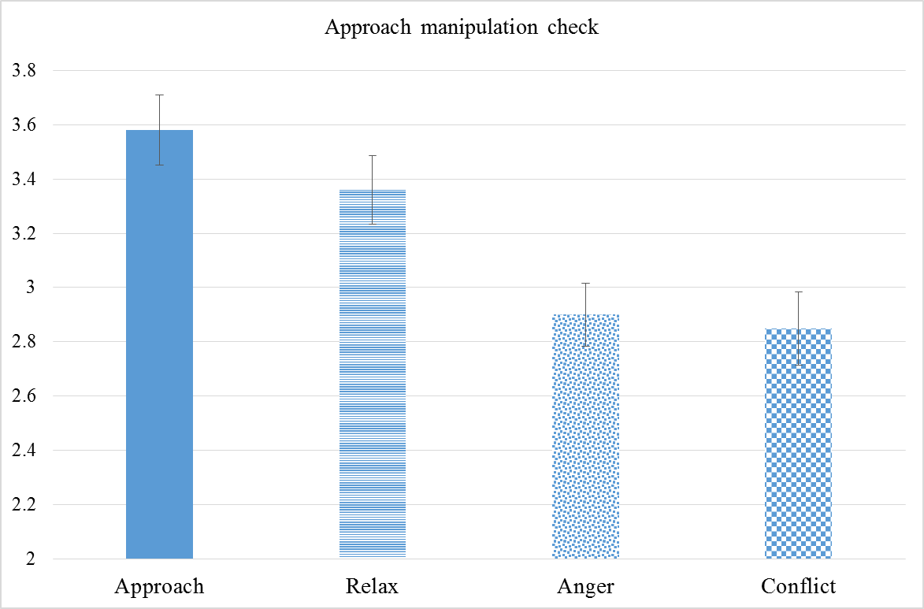
Pilot Study b
F (3, 101) = 7.64, p < .001

Slide 53
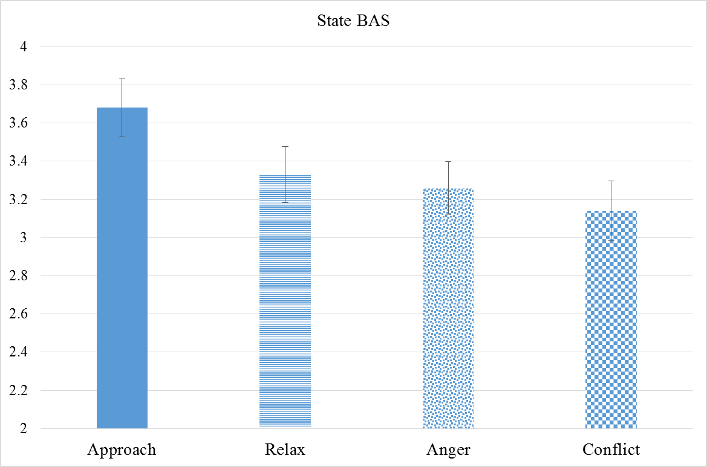
Pilot Study b
F (3, 104) = 3.93, p = .011
Notes:
F (3, 104) = 3.93, p = .011 and pairwise comparisons showed significant differences between the approach and anger condition (p = .043), the conflict condition (p = .001), the relaxation condition (p = .048) but no other comparisons were significant (ps >. 18).
Marginal increase in state BAS (free-floating, not directed to a task, kind of MC?)
Did not mediate to persistence

Slide 54
Study 4 Extras

Slide 55
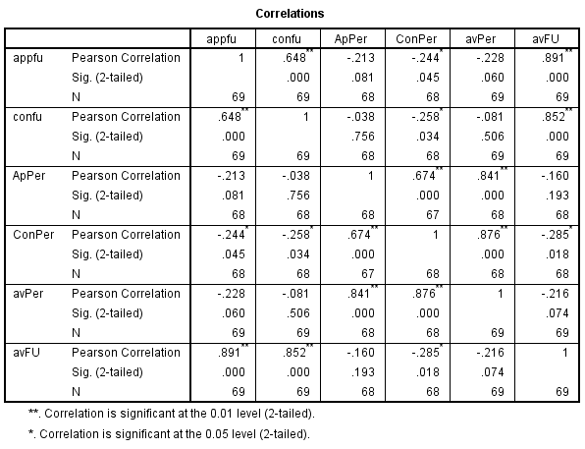

Slide 56
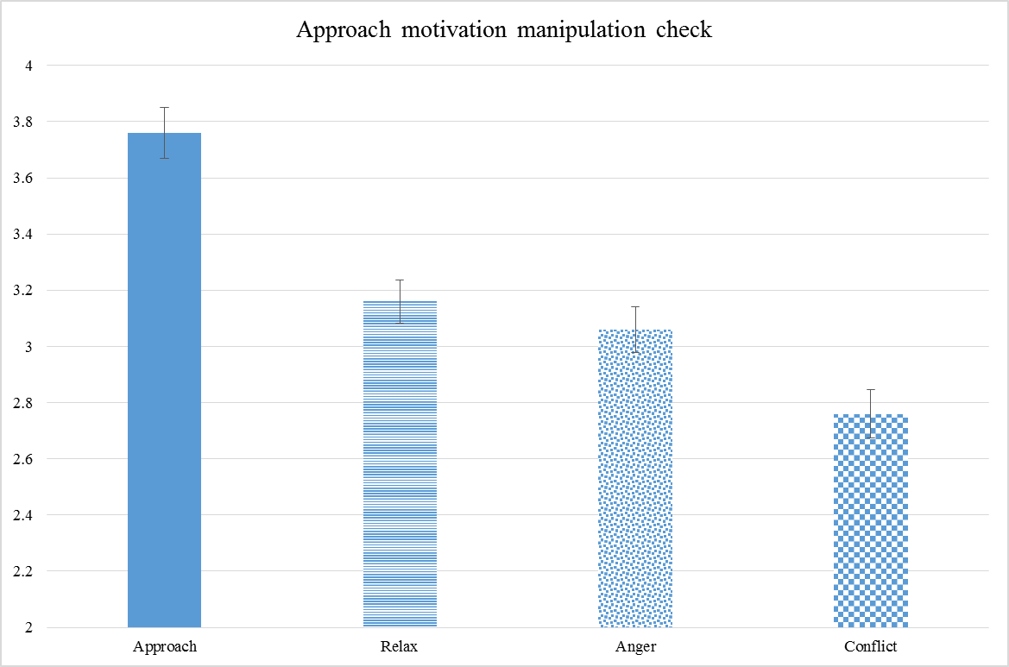
Study 4

Slide 57
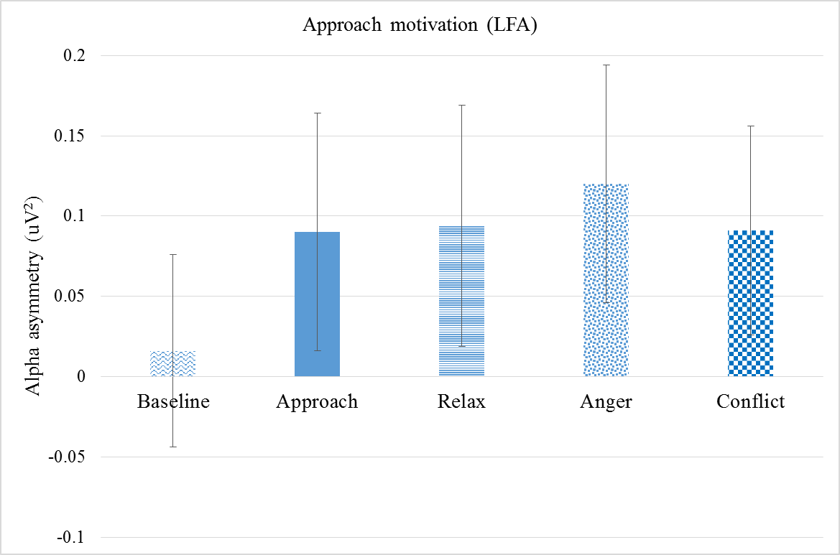
Study 4

Slide 58
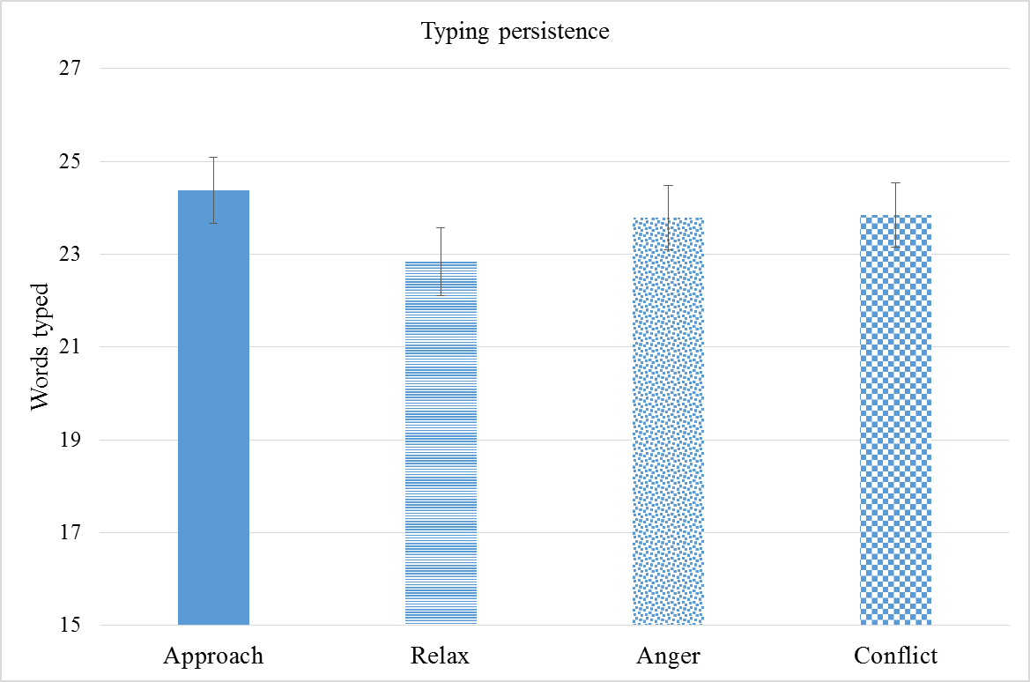
Study 4

Slide 59
Meta-analyzed effects
Effects included;
  Master’s study (cycling)
  Study 1: characters
  Study 2: handgrip, LFA after manip, LFA after handgrip
  Study 3: self-reported approach, PPA
Low BIS Simple Effect: d = -.11, p =.24
Simple Slope in Concrete: d = .37, p = .0017
Simple Slope in Abstract: d = -.20, p =.44

Slide 60
A note on behaviour as motivation
“The distinction between motor deficits (wants to but can not) and motivational deficits (can but does not want to) is troublesome; there is little agreement about a definition of motivational function that distinguishes it, operationally, from motor function” (Wise, 2004)

