Slide 1

Johnny Bae | Upumoni Logologo | Lydia Hefel

Slide 2
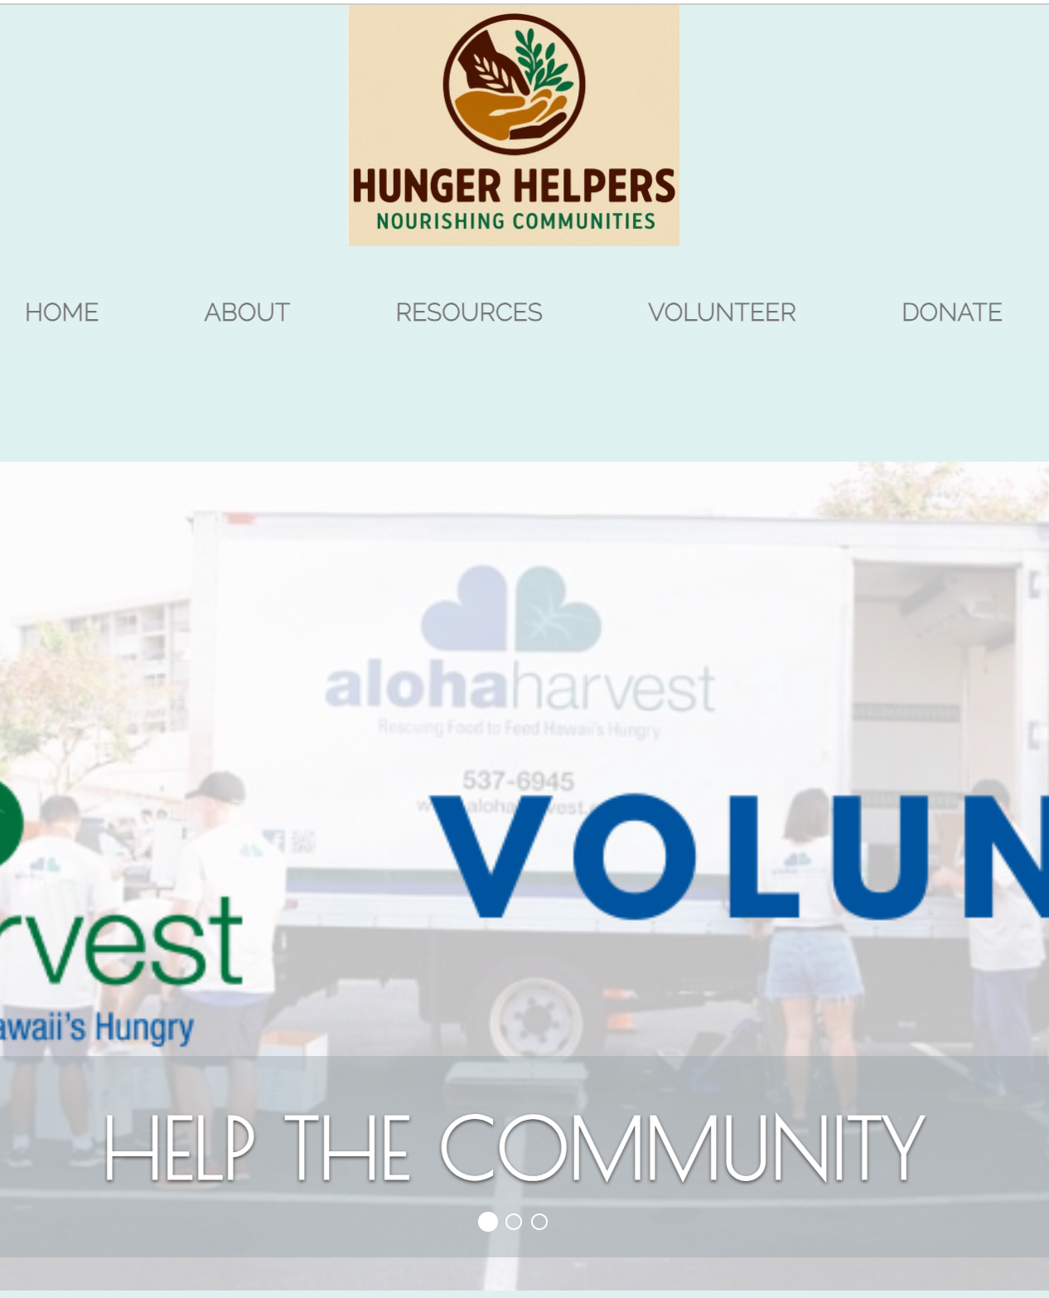
INTRODUCTION
Food Insecurity is a significant issue affecting many communities, particularly in food-scarce areas. However, there is no centralized platform that aggregates food resources, donation opportunities, and community service efforts. Our project aims to address this gap by developing a website that provides vital information about food resources, community service opportunities, and donation options, helping individuals and families in need.

Slide 3
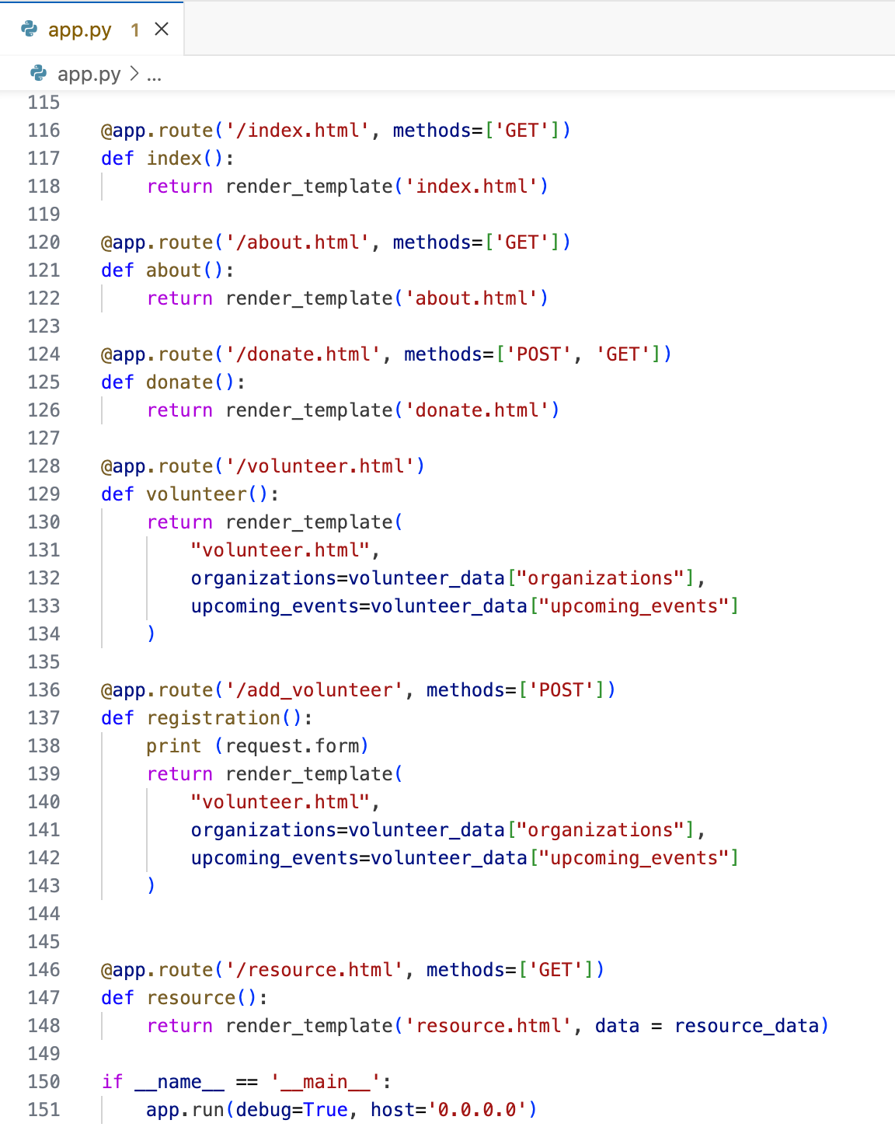
API
Flask is used as the backend framework to manage routes and serve dynamic content
Main routes include:
/: Home page introduction
/about: Project background and mission
/resource: Food and service resource information
/volunteer: Displays orgs, events, and registration
/donate: Donation locations and methods

Slide 4
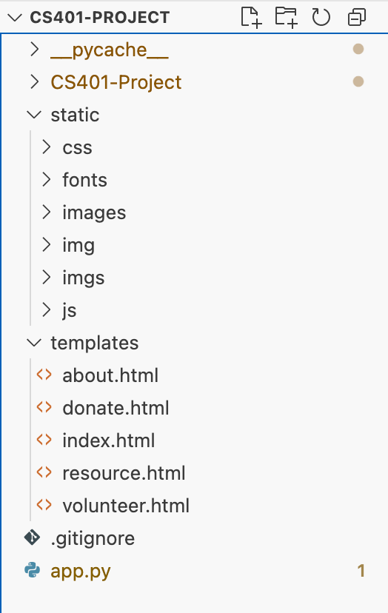
FRONT END DESIGN
Built using HTML, CSS, Bootstrap, and Flask templates
Each route has a dedicated HTML file under templates/(e.g.,index.html,about.html,resource.html, volunteer.html, donate.html)
Navigation bar included on every page for accessibility and smooth transitions
Consistent branding with shared styles, fonts, and layout components
Use of tabs, cards, modals, and a responsive grid system for clean UX
Static files (CSS, JS, images) are served from the static/ directory

Slide 5

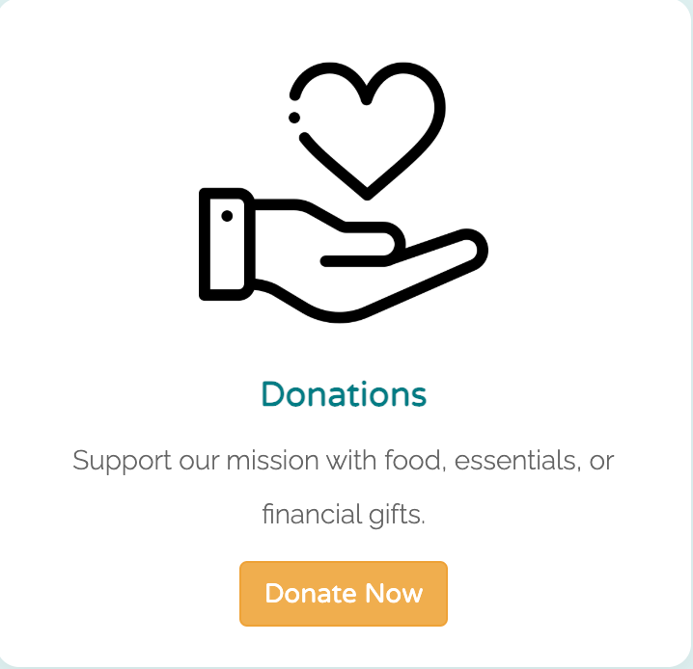
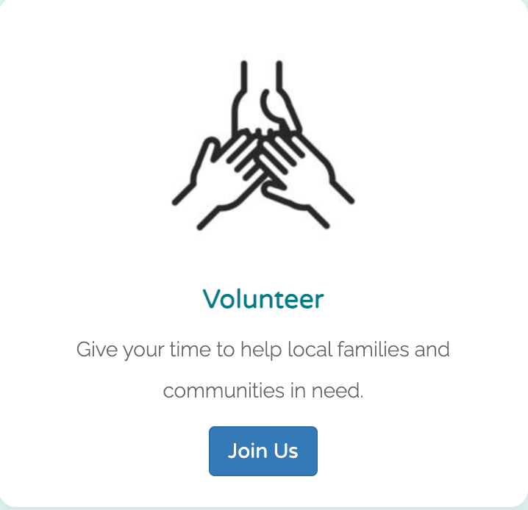
THREE MODELS
Resource
Volunteer
Donate

Slide 6
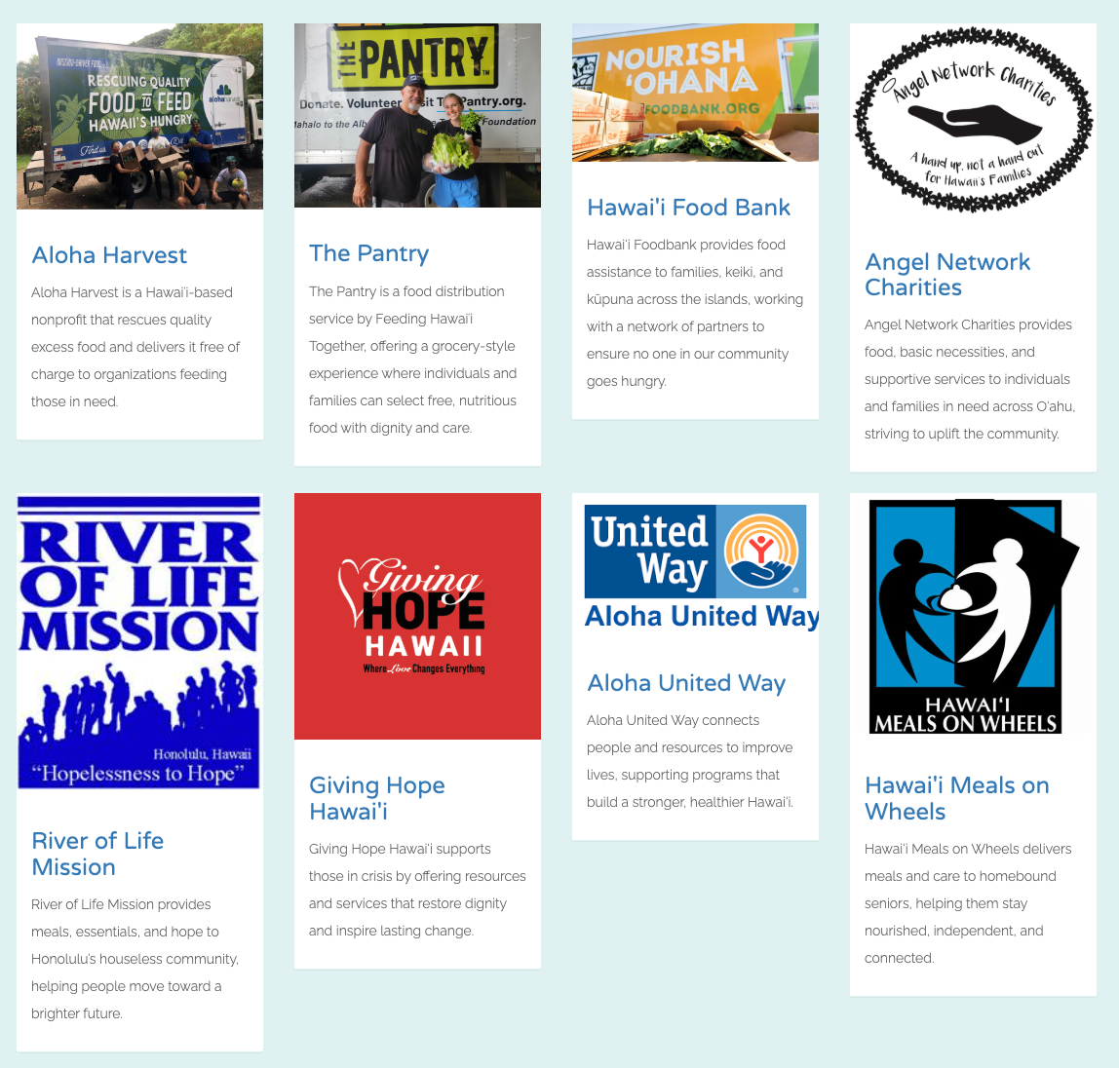
CHALLENGES
Some of the biggest challenges we faced included:
Image Formatting: Getting different-sized images (especially logos and team photos) to display consistently.
Mobile Responsiveness: Ensuring the site looked good on smaller screens using Bootstrap grid classes.
Code Collaboration: Learning how to push/pull from GitHub and avoid merge conflicts while working as a team.

Slide 7
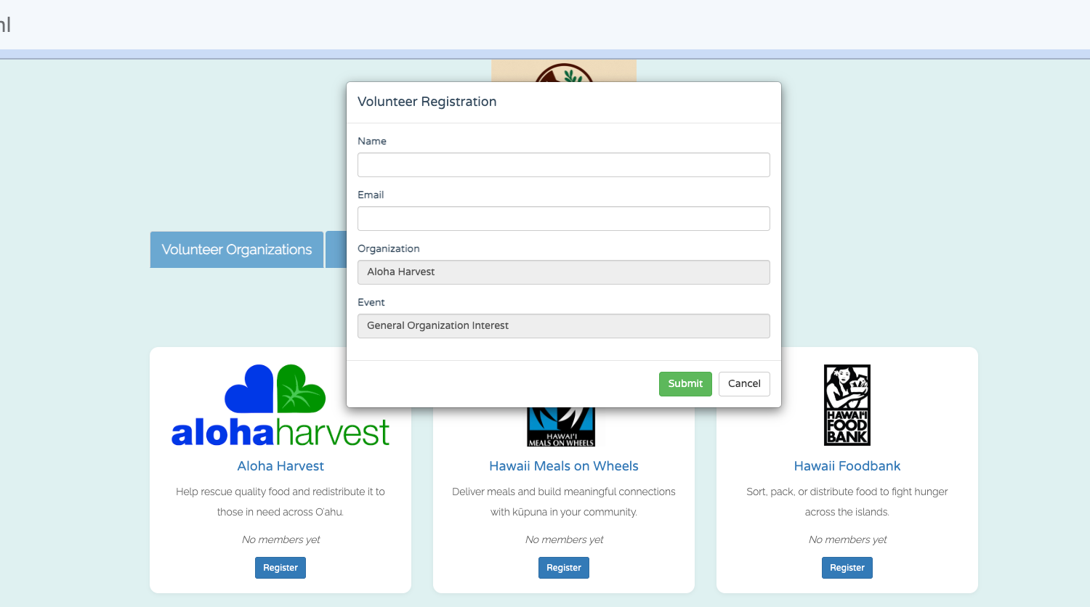
IMPROVEMENTS
In future development, we plan to:
Add form functionality for users to sign up to volunteer or request food help.
Create a login system with user authentication.
Implement a database to store and dynamically render organization and event data.
Add an interactive calendar or RSVP system for community events.

Slide 8

CONCLUSION
The Hunger Helpers website showcases how code can build community. Through this project, we learned new technical skills, collaborated effectively as a team, and created something meaningful. We're proud of the foundation we've built and are excited to keep improving it for the people of Hawai’i

