Slide 1
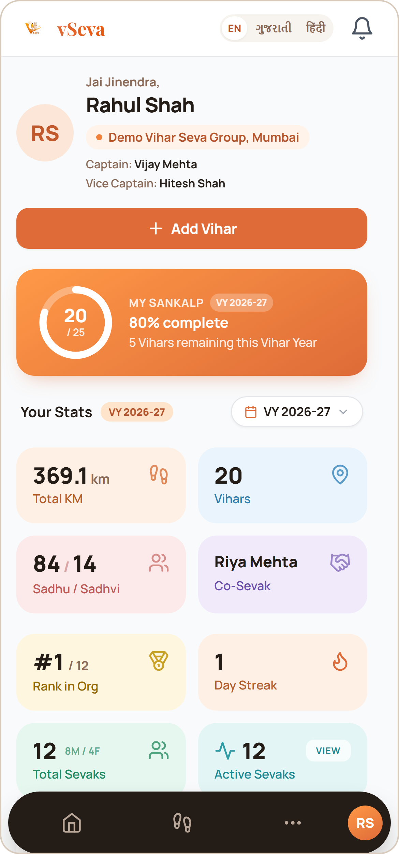
UI Design with a Real-Life App Example
Case Study: vSeva
What is UI Design?
UI defines how a product looks, feels and communicates with users.
Good UI makes actions clear, predictable and easy to perform.
Good UX ensures the interface supports the user’s goals efficiently.
vSeva is a digital platform for managing Vihar Seva, Sevaks, Vihars, statistics, approvals, notifications and organizational activities.
Real-life case study: designing for Sevaks, Captains and Vihar organizations.
Real vSeva Sevak dashboard · sample data
Notes:
Open by defining UI vs UX in one sentence each, then introduce vSeva as the real project used as the case study. Mention the screenshot is the real app running with sample (demo) data, not real members’ data.

Slide 2
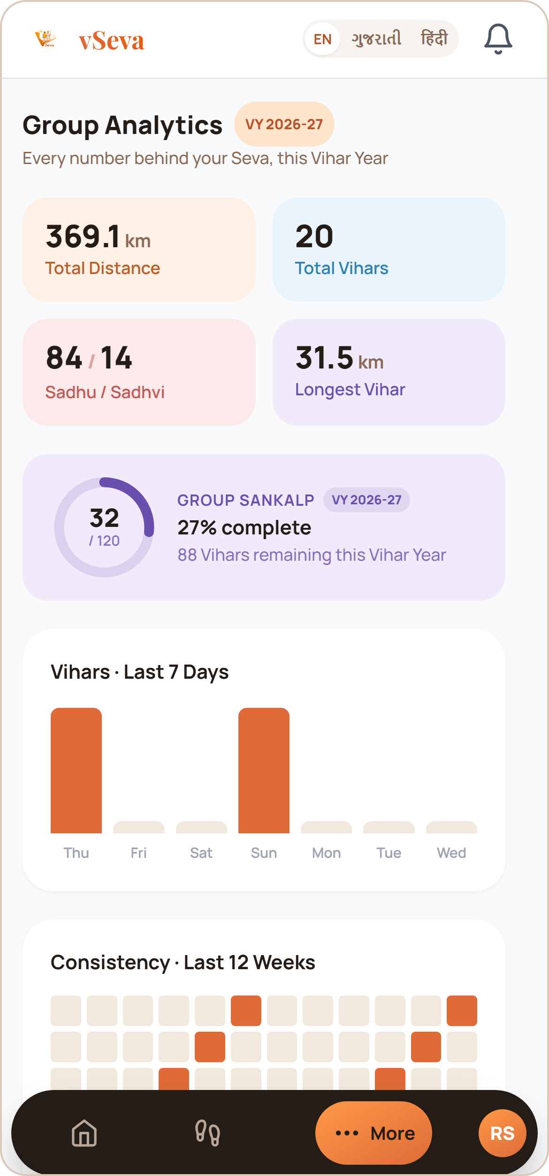
Good Design — What Works?
VISIBILITY OF SYSTEM STATUS
vSeva: Sankalp ring + Vihar statistics
Why: Users see their progress at a glance.
4
1
3
CONSISTENCY & STANDARDS
vSeva: Same cards, type, spacing and nav on every screen
Why: Learn once, reuse everywhere.
2
2
1
RECOGNITION OVER RECALL
vSeva: Add Vihar button, KPI cards, labelled nav
Why: Actions are visible — nothing to memorise.
3
2
VISUAL HIERARCHY
vSeva: Big KPIs → supporting info → detailed records
Why: Key info first (as in Google Maps).
4
FAMILIAR PATTERNS
vSeva: Bottom nav, cards, badges, bell — like WhatsApp
Why: Users already know these patterns.
5
5
Dashboard
Group Analytics
Design principles used
Usability
Consistency
Visibility
Recognition
Hierarchy
Notes:
Walk through the numbers on the screenshots: 1 Sankalp ring shows progress (visibility). 2 The same card style appears on Dashboard and Group Analytics (consistency). 3 Add Vihar is always visible (recognition over recall). 4 Greeting, then action, then big numbers, then details (hierarchy). 5 Bottom navigation and cards are patterns people know from WhatsApp and Google Maps. Screens show sample data.

Slide 3
Bad Design — When UI Gets in the User’s Way
Common UI mistakes and how they would hurt a Vihar management app — not a verdict on vSeva.
PROBLEM
→ PRINCIPLE VIOLATED
→ USER IMPACT
TOO MUCH INFORMATION
Every stat and setting on the first screen
Users take longer to decide
1
Visual hierarchy · Hick’s Law
INCONSISTENT UI
Different buttons for similar actions
Users unsure what will happen
2
Consistency & standards
HIDDEN SYSTEM STATUS
Vihar submitted, no clear confirmation
User can’t tell if it worked
3
Visibility of system status
POOR MOBILE LAYOUT
Tiny, crowded buttons; content overflow
Accidental taps, hard to use
4
Fitts’s Law · Responsive design
UNNECESSARY COMPLEXITY
Too many steps for a simple task
Users avoid the feature
5
Efficiency of use
GOOD
Add Vihar
→
Submit
→
Confirmation
3 steps, clear result
BAD
Open menu
→
Find section
→
Open submenu
→
Fill extra fields
→
Submit
→
Unclear result
Notes:
Be clear these are typical mistakes, not a claim that vSeva is badly designed. For each row say the problem, name the principle it breaks, and the effect on a Sevak or Captain. Finish with the two flows: the same task done in 3 clear steps versus 6 confusing ones.

Slide 4
How Can We Improve the Design?
1
SIMPLIFY
2
PRIORITIZE
3
GUIDE
4
OPTIMIZE
Remove extras; reduce cognitive load.
Most important actions and info first.
Clear feedback, status, confirmations, labels.
Devices, accessibility, performance, real behaviour.
vSeva Design Evolution
Key principles
→
Nielsen’s heuristics: visibility of status · real-world match · consistency · error prevention · recognition over recall
Gestalt → grouping and proximity
Fitts’s Law → easier-to-hit controls
Hick’s Law → fewer choices, faster decisions
Accessibility → readable text, contrast, touch-friendly controls
BEFORE
Information-heavy
Unclear hierarchy
Possible overflow
AFTER
Clear hierarchy
Responsive cards
Simple navigation
Visible status
Fast interactions
Thank You
Design is not just how an interface looks —
it is how easily people accomplish their goals.
Notes:
Four steps: simplify, prioritize, guide, optimize. Then the before/after of vSeva’s own redesign work, and the principles behind each decision. Close with the one-line takeaway: good UI is useful, understandable, consistent, efficient, accessible, responsive and predictable.

