Slide 1
Analysis of Health Factors Associated
with Heart Disease
Capstone Project: Exploratory Data Analysis (EDA)
Submitted by: Jyoti Prakash Das

Slide 2
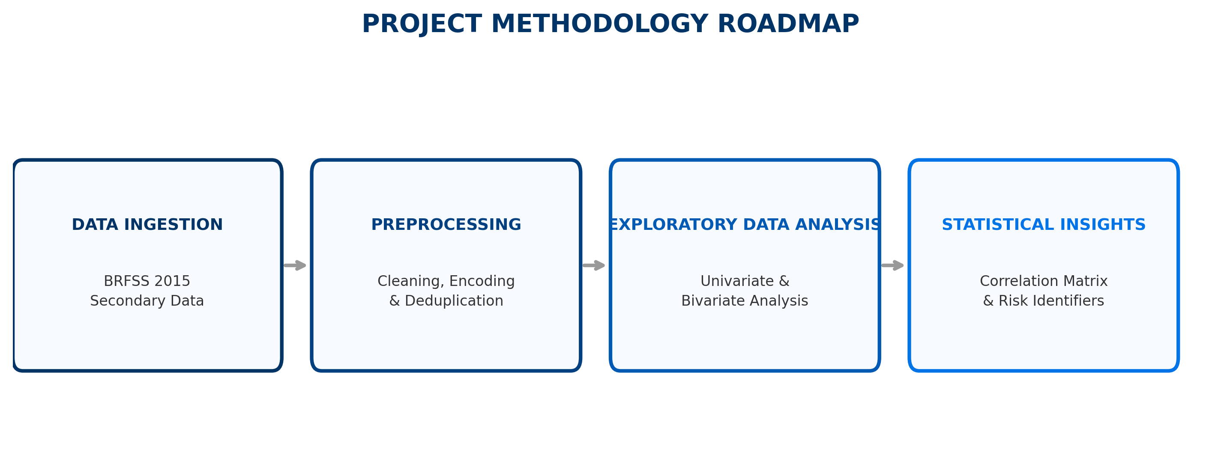
1. Project Overview & Objectives
• Dataset: BRFSS 2015 Health Indicators (Behavioral Risk Factor Surveillance System).
• Scale: 253,680 survey responses with 22 health features.
• Objective: To conduct Exploratory Data Analysis (EDA) to identify significant demographic, clinical, and lifestyle indicators of heart disease.
• Approach: Data Cleaning → Univariate Analysis → Bivariate Analysis → Correlation Study.

Slide 3
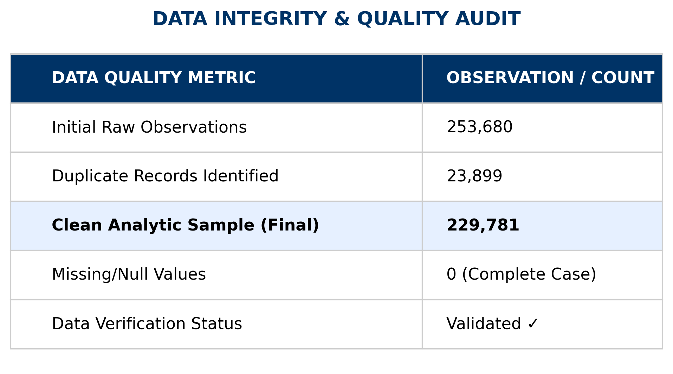
2. Data Cleaning & Integrity
• Duplicate Handling: Identified and removed 23,899 duplicate records to ensure statistical validity.
• Final Sample Size: 229,781 unique observations.
• Missing Values: Verified dataset contains zero null values.
• Encoding: Coded variables (e.g., Sex: 0/1, Diabetes: 0/1/2) were mapped to human-readable labels for analysis.

Slide 4
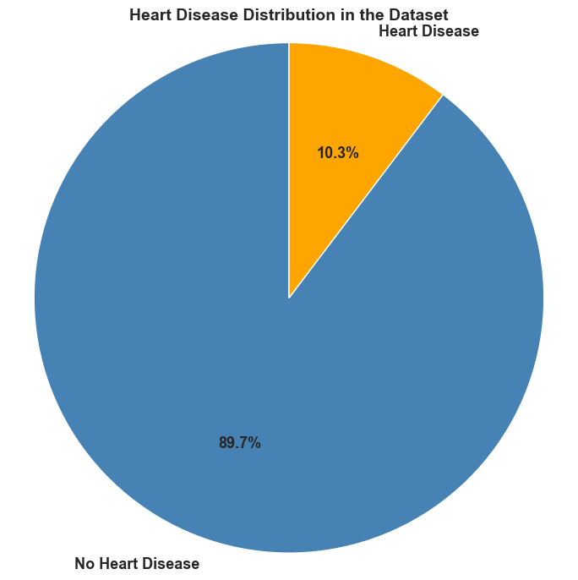
3. Target Variable Analysis
• Variable: 'HeartDiseaseorAttack' (Binary).
• Distribution: The dataset is significantly imbalanced.
• No Heart Disease: ~90% (Majority Class).
• Heart Disease: ~10% (Minority Class).
• Analytical Note: This imbalance establishes the baseline probability and highlights the rarity of the condition in the general population.
[PASTE SCREENSHOT:
Bar Chart: Target Variable Count]

Slide 5
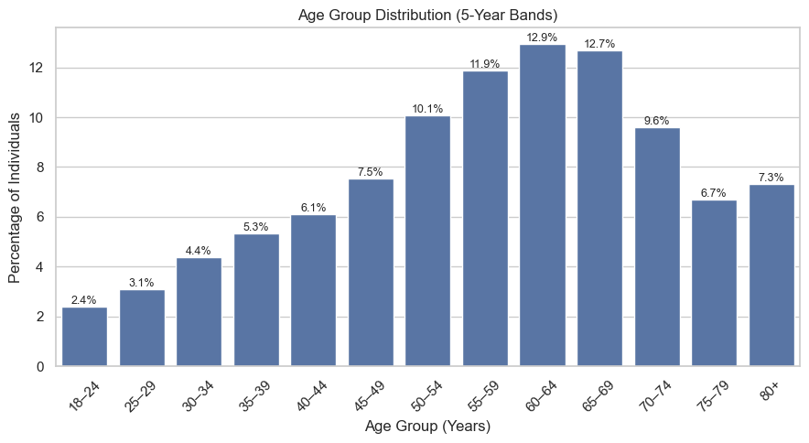
4. Univariate Analysis: Demographics
• Age Structure: The survey population skews towards older adults, with the highest density in the 60-69 age bracket.
• Gender Balance: Females slightly outnumber males in the dataset (56.1% vs 43.9%).
• Education/Income: The dataset represents a relatively educated population, which may introduce socioeconomic bias.

Slide 6
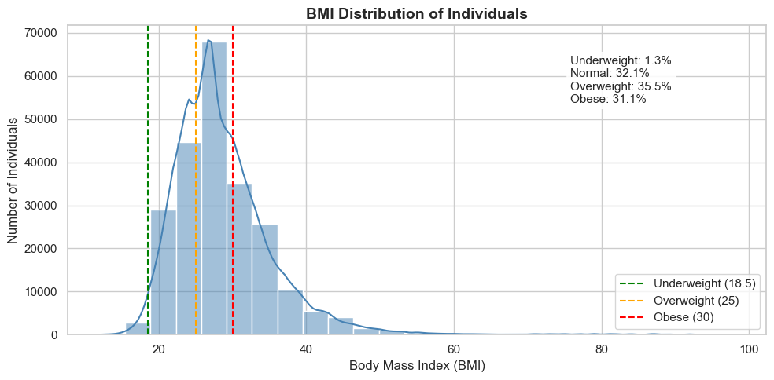
5. Univariate Analysis: Health Metrics
• BMI Distribution: The BMI distribution is right-skewed, with most individuals in the Overweight (35.5%) and Obese (31.1%) categories.
• General Health: Majority of respondents self-report 'Good' to 'Excellent' health.
• Outliers: Significant outliers observed in BMI, representing extreme obesity cases.

Slide 7
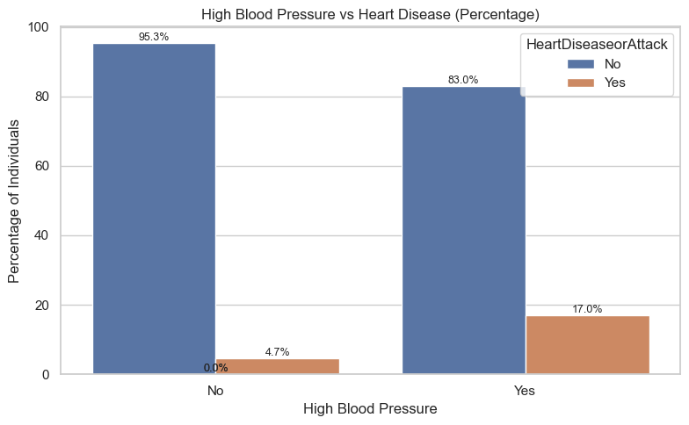
6. Bivariate Analysis: Clinical Factors
• Hypertension (High BP): The strongest differentiator. Prevalence of heart disease is drastically higher in individuals with High BP (17 % compared to 4.7%).
• High Cholesterol: Similarly strong positive association (16.4 % as compared to 5.6 %).
• Conclusion: These two clinical markers are the most reliable indicators of cardiac risk in this dataset.

Slide 8
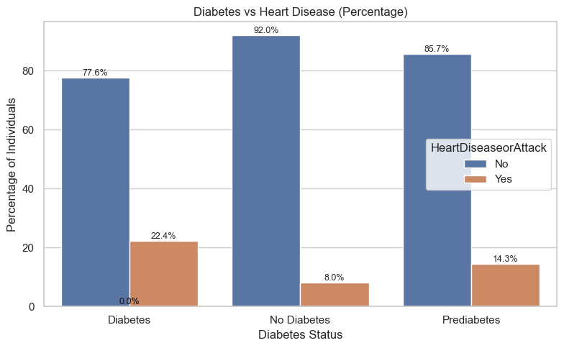
7. Lifestyle & Comorbidities
• Diabetes: Individuals with diabetes show 2x-3x higher rates of heart disease.
• Smoking: Lifetime smokers show elevated risk compared to non-smokers.
• Stroke: Strong comorbidity; history of stroke is highly predictive of heart disease.
• Difficulty Walking: Strong proxy for overall physical decline and cardiac risk.

Slide 9
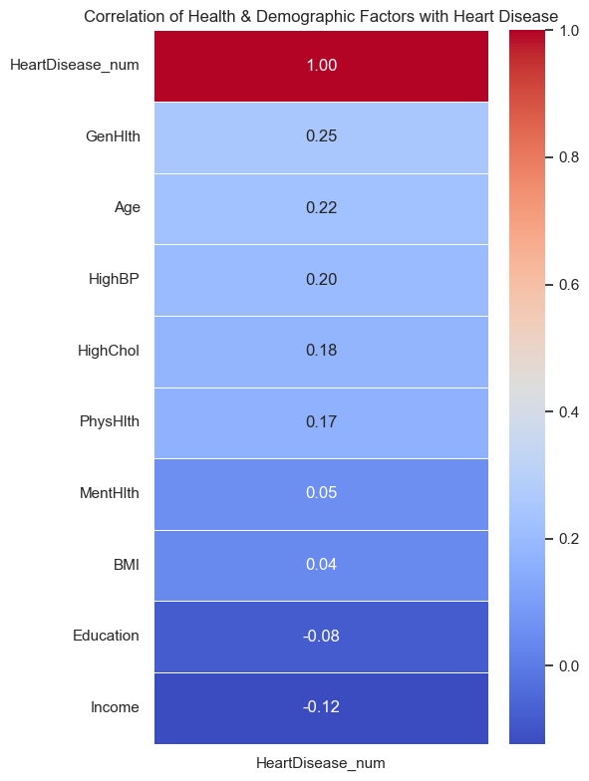
8. Correlation Analysis
Methodology: Pearson Correlation Coefficient
• Strongest Positive Associations:
Age, Poor General Health, High Blood Pressure, and High Cholesterol show the highest correlations with heart disease.
• Protective Factors:
Higher Income and Education levels are negatively correlated with heart disease, indicating lower cardiovascular risk.
• Multicollinearity:
Physical Health and General Health are strongly related, reflecting overlapping health conditions.

Slide 10
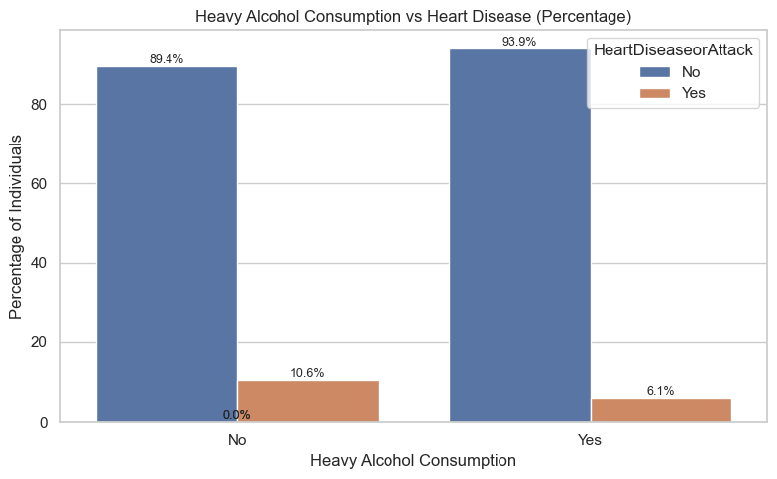
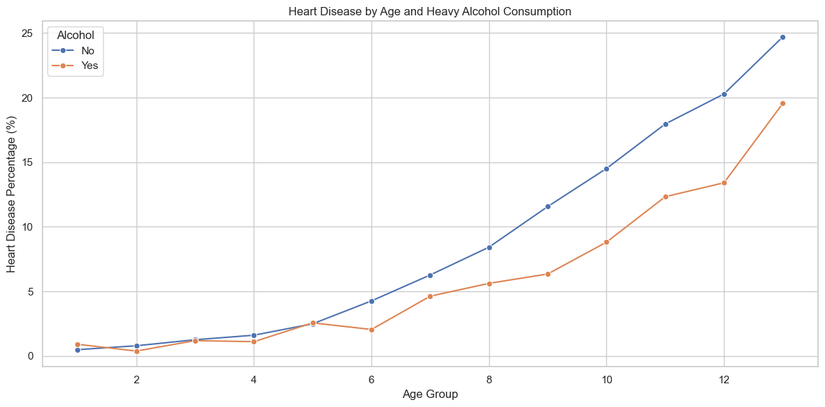
9. Advanced Insight: The Alcohol Paradox
• Observation: Heavy drinkers appear to have lower heart disease rates.
• Confounder: Age strongly influences this pattern.
• Finding: Heavy drinkers are mostly younger; non-drinkers are older.
• Conclusion: The apparent benefit is misleading (Simpson’s Paradox).

Slide 11
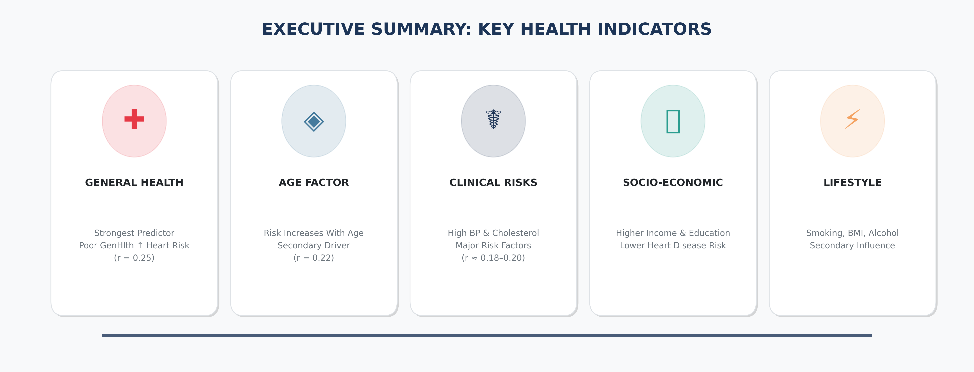
10. Summary of Key Findings
• General Health is the strongest predictor (r = 0.25)
• Age increases risk but is secondary (r = 0.22)
• High BP & High Cholesterol are major clinical risks (r = 0.20, 0.18)
• Physical Health matters more than BMI or Mental Health
• Higher Income & Education reduce disease risk
• Lifestyle factors play a secondary role

Slide 12
11. Conclusion & Limitations
Conclusion
• This Exploratory Data Analysis confirms well-established cardiovascular risk patterns.
• Poor general health, high blood pressure, high cholesterol, and increasing age show the strongest associations with heart disease.
• Socioeconomic factors (income and education) appear protective, while lifestyle factors such as BMI, smoking, and alcohol play a secondary role.
• Overall, the dataset demonstrates strong internal consistency and meaningful health insights.
Limitations
• Self-Reported Data
All health and lifestyle variables are self-reported, which may introduce recall and reporting bias.
• Class Imbalance
Only ~10% of individuals report heart disease, which limits direct prevalence comparisons and requires caution in interpretation.
• Correlation ≠ Causation
This is an observational dataset — relationships show association, not medical causality.
• Coded Variables
Age, income, and education are grouped into categories, reducing numerical precision.

