Slide 1

Programing for Engineer II
Week14
Final
presentation
(S/W development)
Group : B1
2018047101 김태인
2018047183 신용진
2020030655 최수빈
9017620224 Maël Jaouen

Slide 2
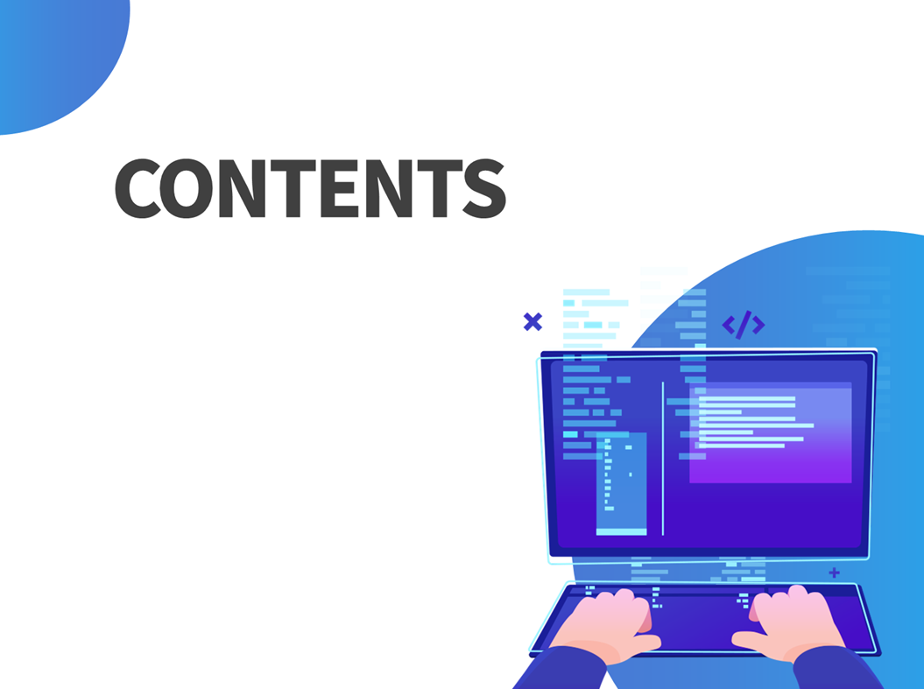
Programing for Engineer II
What is the mission ?
How do we have solved it
The result and conclusion
01
02
03

Slide 3

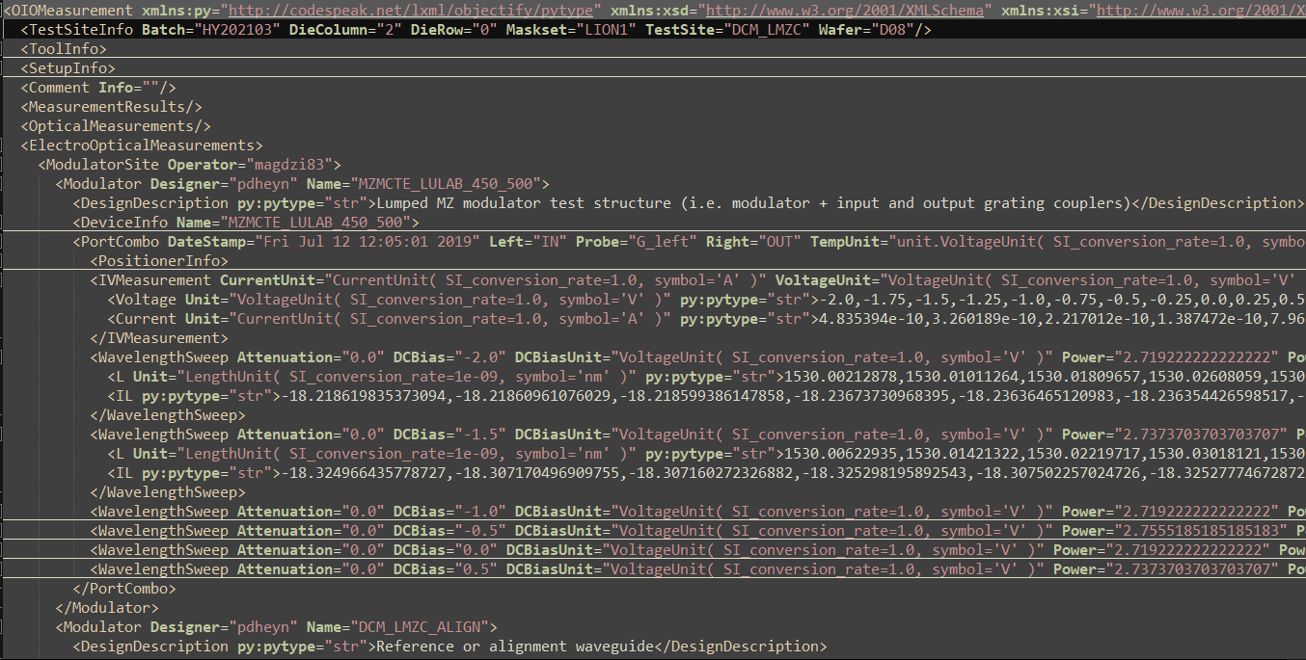


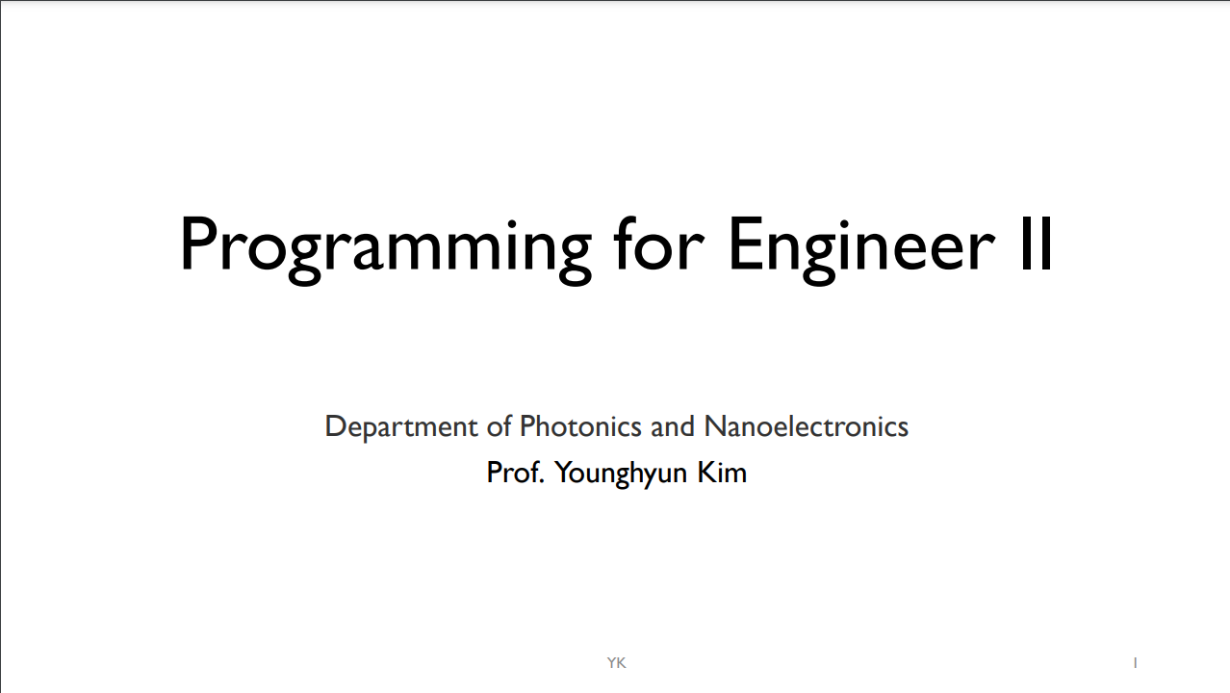
What is the mission ?
CHPATER 01
S/W developer (Wafer scale data analysis)
Make Module : Decomposed into functional units
Modularization
3

Slide 4
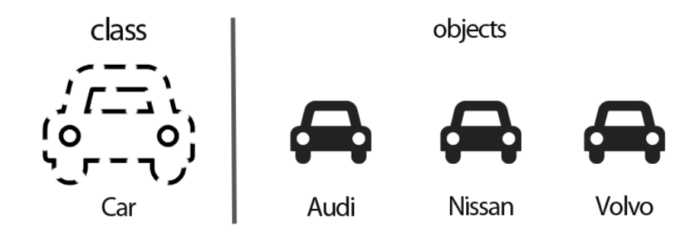
What is the mission ?
CHPATER 01
OOP ( Object-oriented programing)
4

Slide 5
What is the mission ?
CHPATER 01
S/W developer (Wafer scale data analysis)
setup.py
filter.py
fitting.py
extracting.py
graphplot.py
to_csv.py
handler.py
core.py
run.py
5

Slide 6
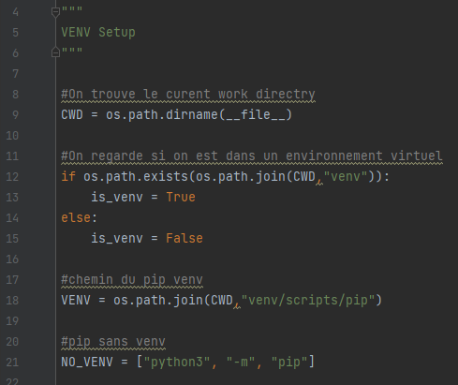
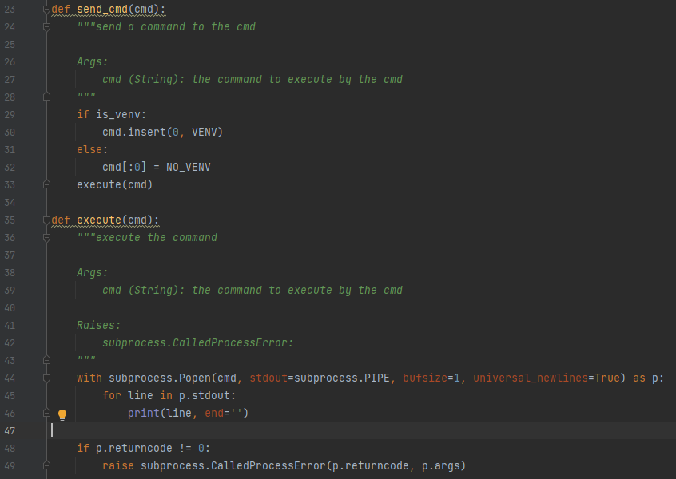
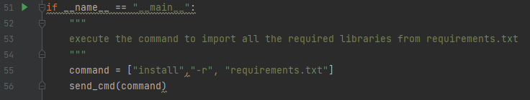
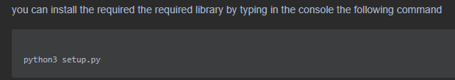
How do we have solved it (setup.py)
CHPATER 02
6

Slide 7
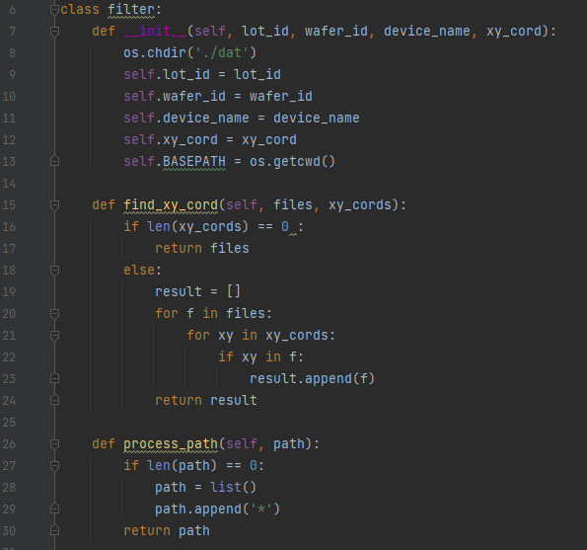
How do we have solved it (filter.py)
CHPATER 02
: module for filtering the files given in the input it return a list of path for files that make it through the filters
7

Slide 8
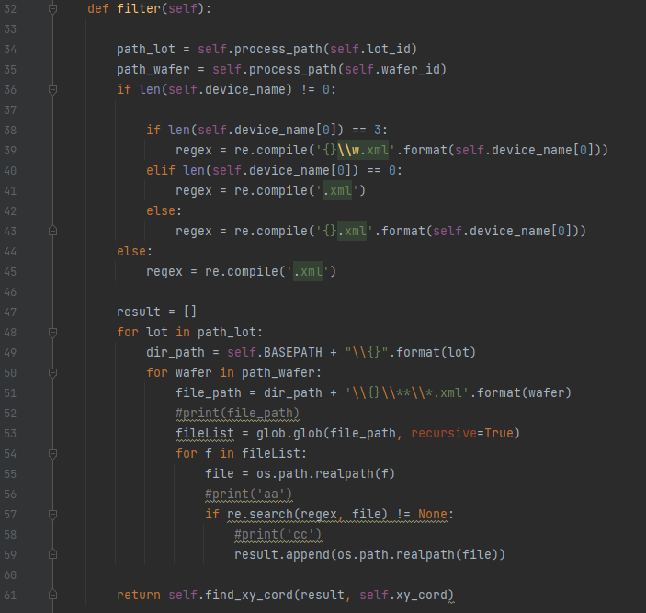
How do we have solved it (filter.py)
CHPATER 02
8

Slide 9
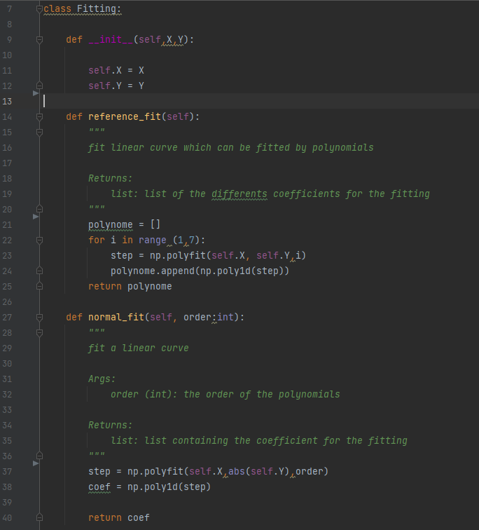
How do we have solved it (fitting.py)
CHPATER 02
: module for fitting data like the IV or the reference curve. It return coefficients for the fitting.
9

Slide 10
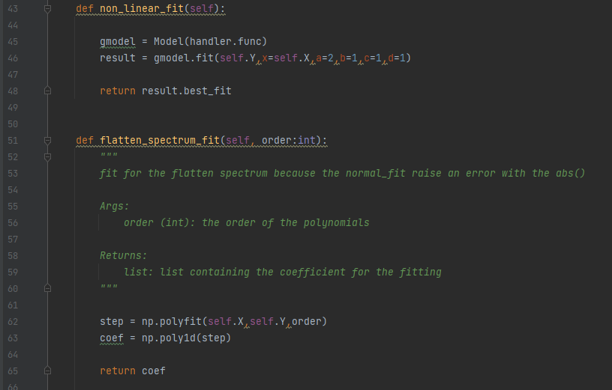
How do we have solved it (fitting.py)
CHPATER 02
10

Slide 11
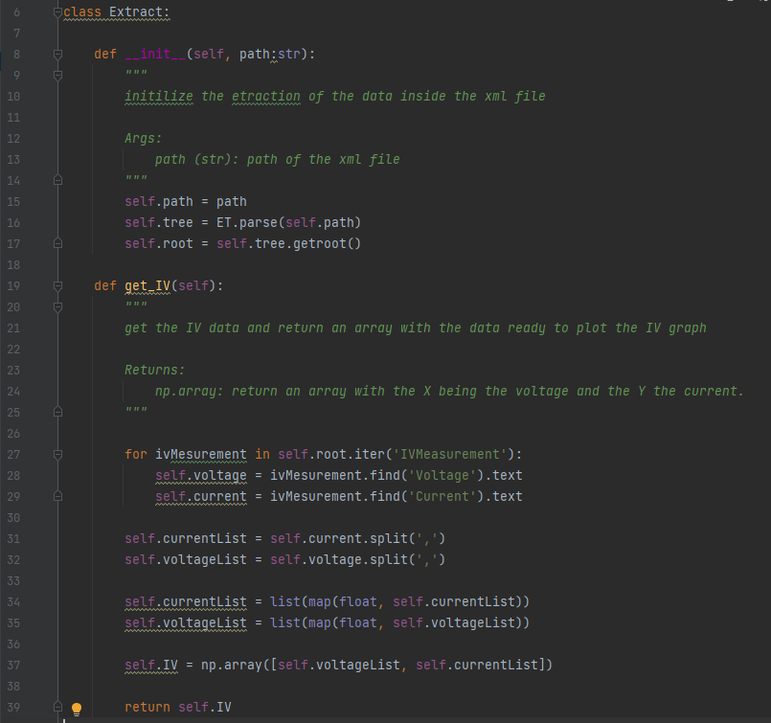
How do we have solved it (extracting.py)
CHPATER 02
: module for extracting various data from a XML file like the current, the voltage, the wavelength the dB or the information about the operator etc...
11

Slide 12
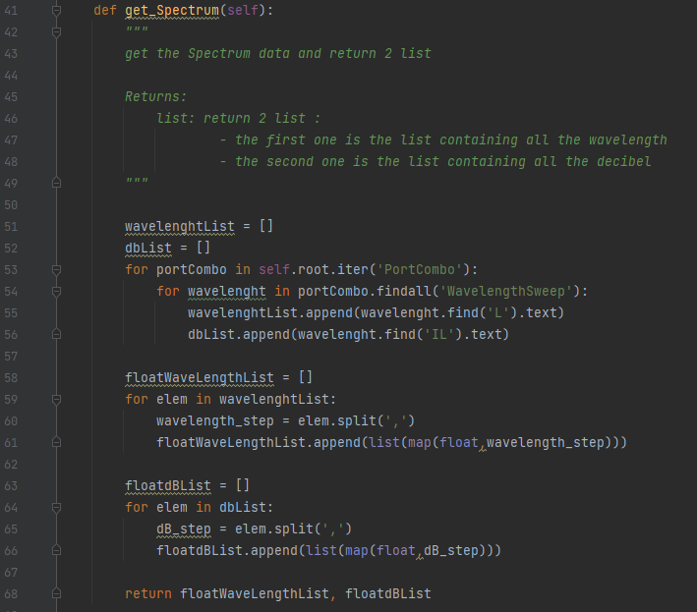
How do we have solved it (extracting.py)
CHPATER 02
12

Slide 13
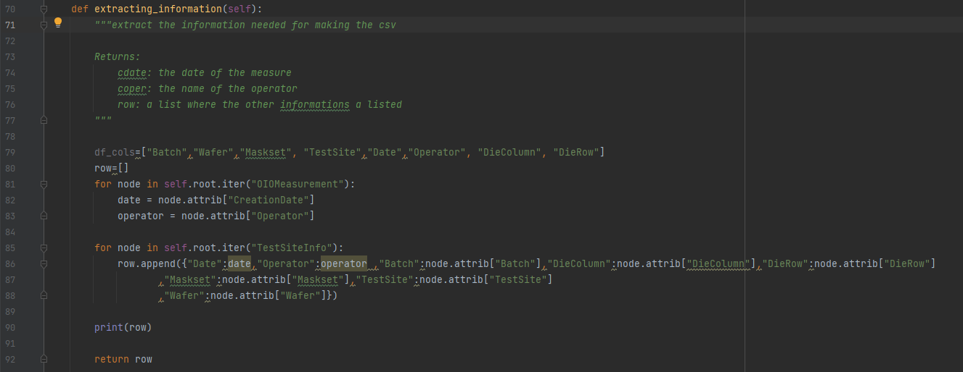
How do we have solved it (extracting.py)
CHPATER 02
13

Slide 14
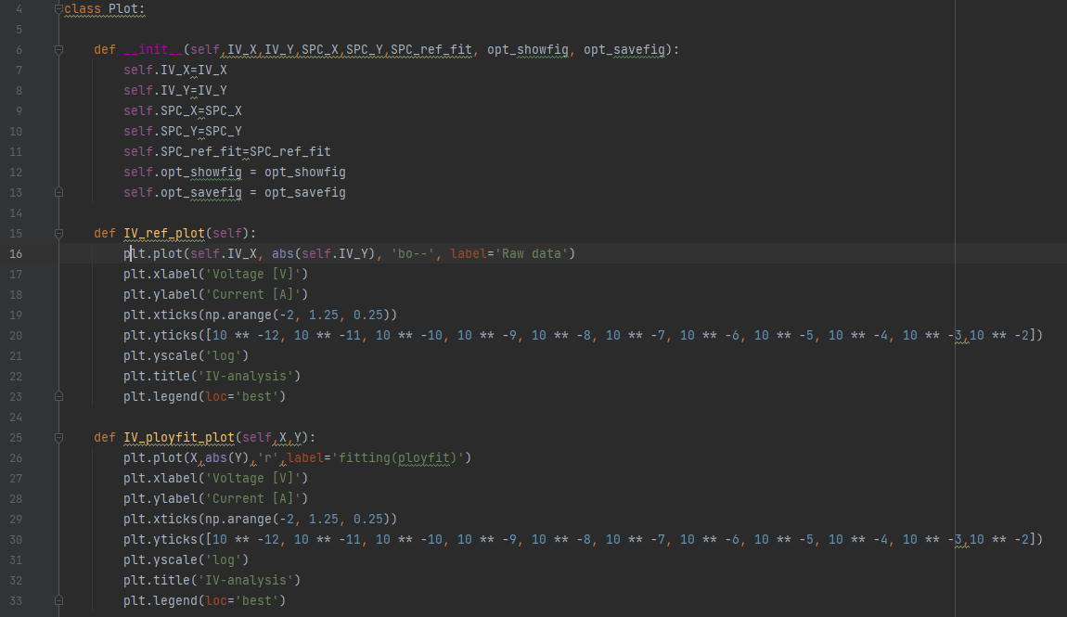
How do we have solved it (graphplot.py)
CHPATER 02
: module for making plots, like the data analysis graph and save it inside a given folder
14

Slide 15
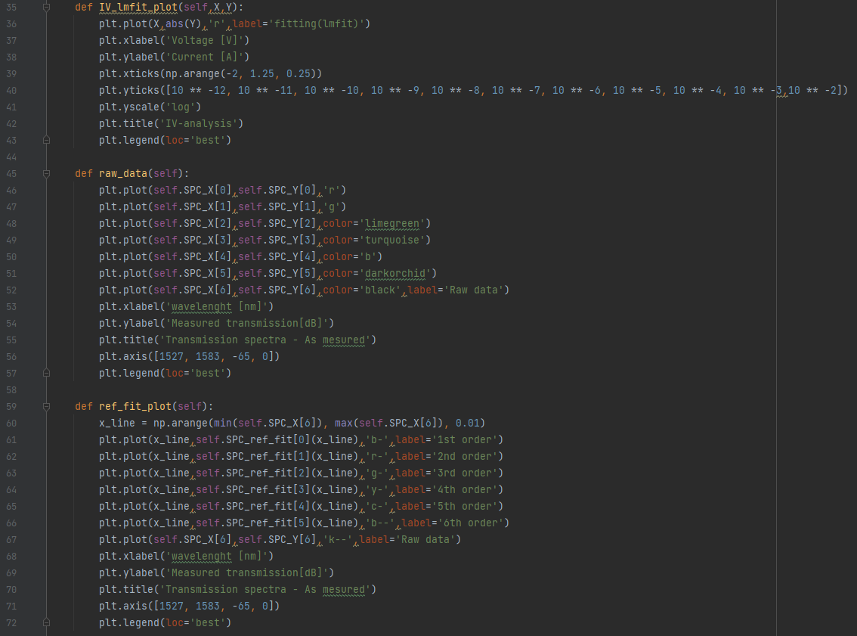
How do we have solved it (graphplot.py)
CHPATER 02
15

Slide 16
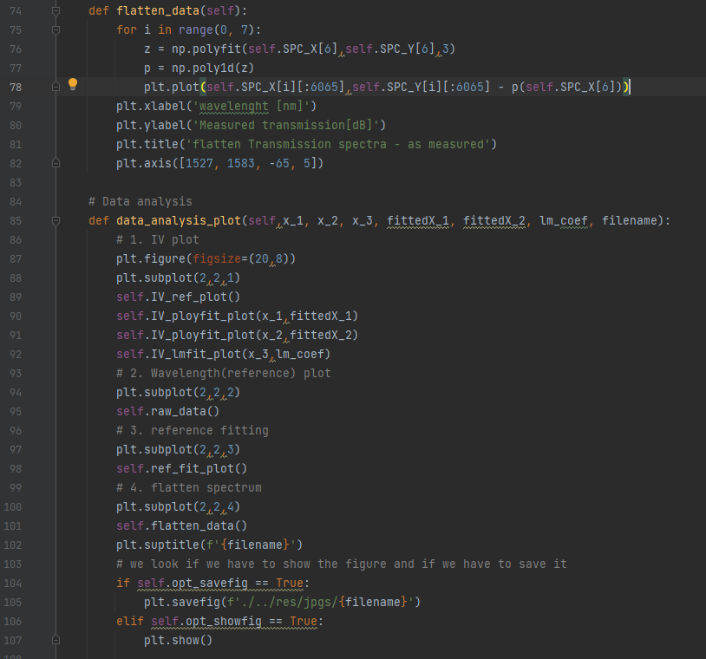
How do we have solved it (graphplot.py)
CHPATER 02
16

Slide 17
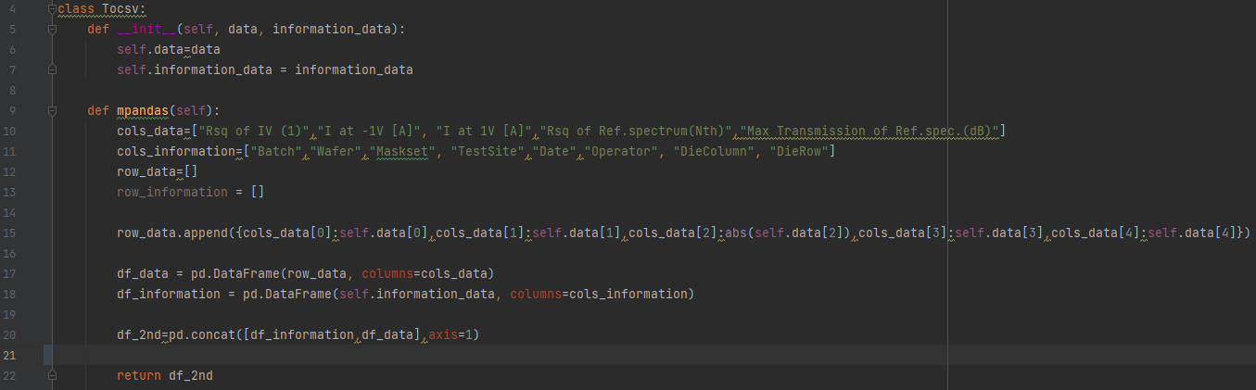
How do we have solved it (to_csv.py)
CHPATER 02
: module for dataframe for a given file,
it return a datagrams that we can use after
17

Slide 18
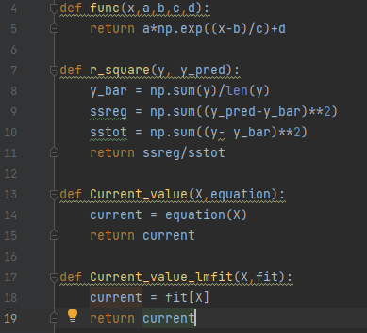
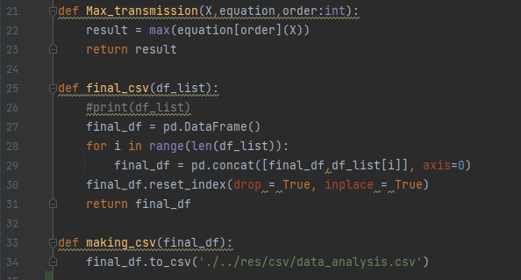
How do we have solved it (handler.py)
CHPATER 02
: This file has no class its just functional programming. It’s helpful for making various function like the function for the lmfit or the assembly of several dataframes into one or creating the final csv file.
18

Slide 19
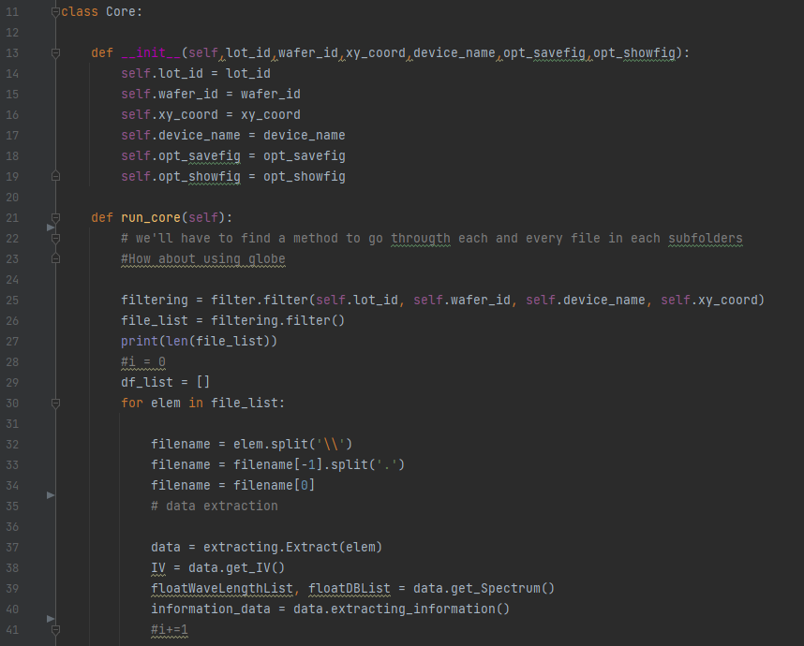
How do we have solved it (core.py)
CHPATER 02
: The core of our program, it here that we call all the other module
19

Slide 20
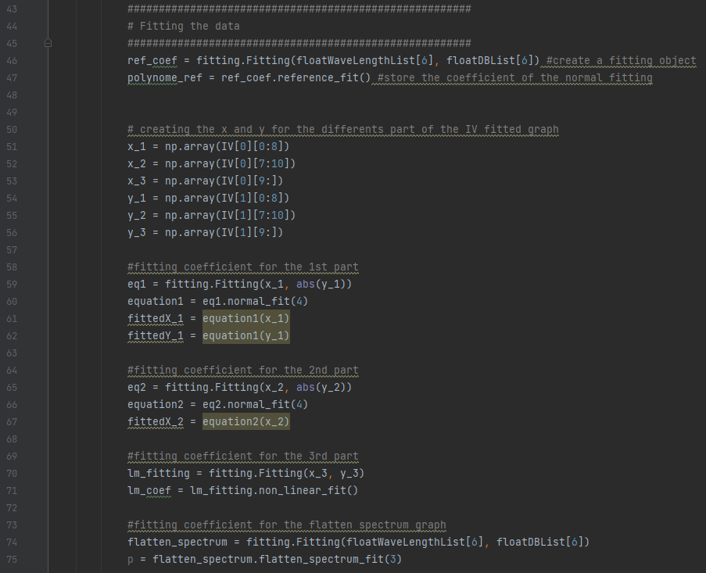
How do we have solved it (core.py)
CHPATER 02
20

Slide 21
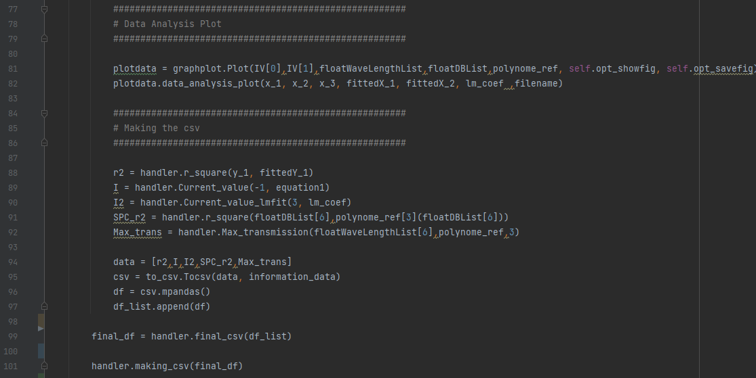
How do we have solved it (core.py)
CHPATER 02
21

Slide 22
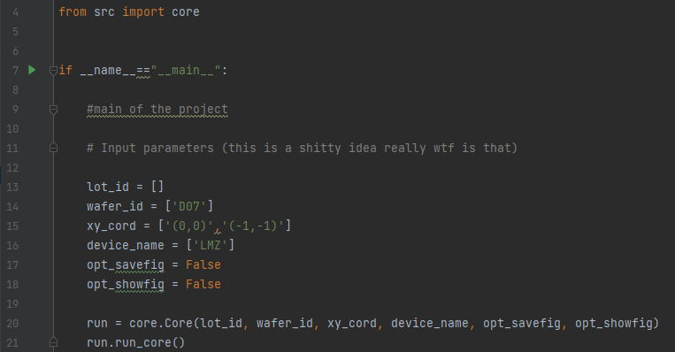
How do we have solved it (run.py)
CHPATER 02
: the entrance of our program we can change the parameters here.
22

Slide 23
The result and conclusion
CHPATER 01
Things to improve
It is to write a summary of the commentary and what each function performs.
There is a problem with some lmfit in the fitting part.
Lastly maybe some part of our code can be optimized to be more efficient and take less time to compute.
23

Slide 24

Programing for Engineer II
https://github.com/PEgroupB1/data-analysis-software

