Slide 1

Water Cycle VR GUIDE
Done By
Adnan Ali 201520023
Zainab Shahid

Slide 2
Content
Introduction
Literature Review
Requirement analysis
Conclusion

Slide 3
Introduction
Virtual Reality (VR) allows the user to have a visual view of scenario that might not be easily accessible
Being one of the top trending technology it will help evolve the education sector as well
Developed application will allows kids to visualize Earths water cycle and easier for them to understand
As kids love to play games, we will include a mini game as it will make it easier to pass information to them.

Slide 4
Problem Statement
Few VR applications
Lack of Guidance within the application
Lack of visualization

Slide 5
Objective
to develop a virtual reality application for water cycle education.
to provide users with a game to understand water cycle.
to provide user with different mode of interaction.
to provide user with real model view of water cycle.

Slide 6
Expected outcome
The developed application will allow kids to have tour of different phases of water cycle
The developed application will guide kids through different phases with help of a robot companion
The developed application will have a mini game for kids as part of interaction.

Slide 7
Gantt Chart

Slide 8
Literature Review

Slide 9
Similar App

Slide 10
Comparison Table

Slide 11
Requirement Analysis
Our application includes Three main modules:
Main Menu
Tour Guide
Game Mode

Slide 12
Main Menu Module
R1: The application shall allow user to select Tour Guide/Game or Exit the application
Tour Guide
R2: The application shall guide the user with robot companion.
R3: The application shall pass the user through all the water cycle phases.
R4: The application shall allow user to look around.
Mini Game:
R5: The application shall allow user to move player as needed.
R6: The application shall limit user gameplay time.
R7: The application must record user gameplay time for high score.

Slide 13
Non-functional Requirements
The application must not lag for more than 0.002 seconds

Slide 14
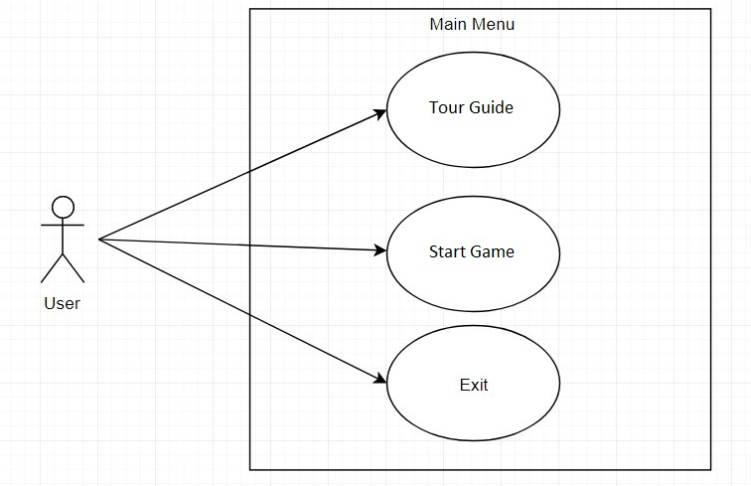
Use case Diagram
Main Menu

Slide 15
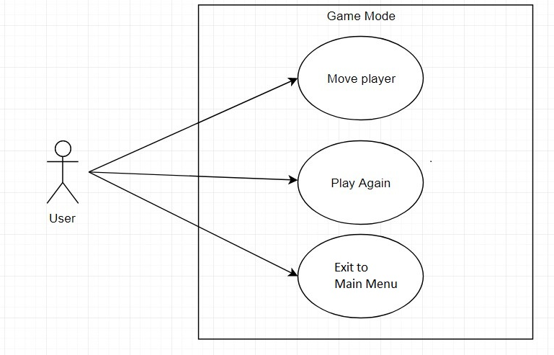
Use Case Diagram
Game Mode

Slide 16

Use Case Diagram
Tour Guide

Slide 17
System Sequence Diagram

Slide 18
Conclusion

Slide 19
Thank you
Questions?

