Slide 1

Water Cycle VR GUIDE
Water Cycle
VR Guide
Presented By
Adnan Ali 201520023
Zainab Shahid 201520629
Supervised by
Dr. Saqib Iqbal

Slide 2
Content
Introduction
Requirements
Conclusion
Reference

Slide 3
Introduction
Virtual Reality (VR) allows the user to have a visual view of scenario that might not be easily accessible
Being one of the top trending technology it will help evolve the education sector as well
Developed application will allows kids to visualize Earths water cycle and easier for them to understand
As kids love to play games, we will include a mini game as it will make it easier to pass information to them.

Slide 4
Requirement Analysis
Our application includes three main modules:
Main Menu
Tour Guide
Game Mode

Slide 5
Main Menu Module
R1: The application shall allow user to select Tour Guide/Game or Exit the application
Tour Guide
R2: The application shall guide the user with robot companion.
R3: The application shall pass the user through all the water cycle phases.
R4: The application shall allow user to look around.
Mini Game:
R5: The application shall allow user to move player as needed.
R6: The application shall limit user gameplay time.
R7: The application must record user gameplay time for high score.

Slide 6
Design
System architecture establishment, component and deployment diagrams
Component diagram: whole system is decomposed into subsystems

Slide 7
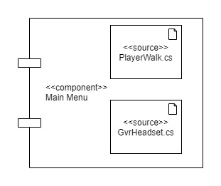
Main Menu Module

Slide 8
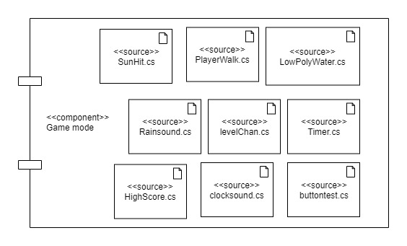
Game Mode Module

Slide 9
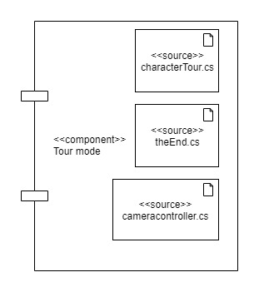
Tour Mode Module

Slide 10
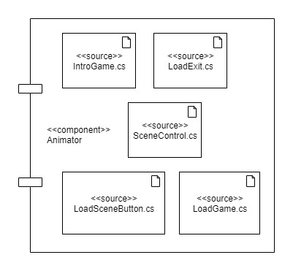
Animator Module

Slide 11
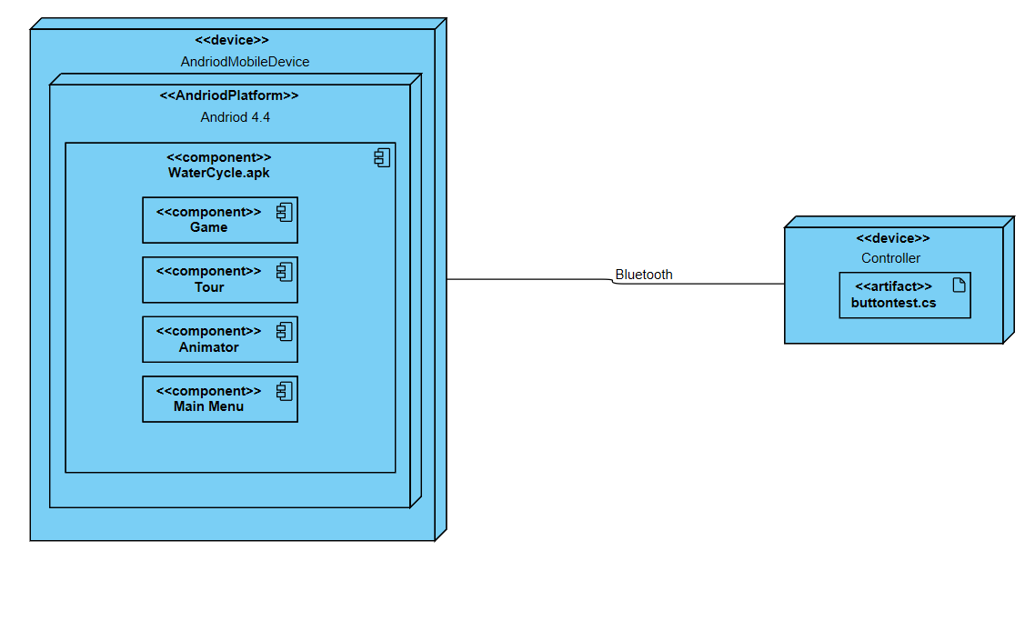
Deployment Diagram

Slide 12
Implementation
Application implementation
Hardware and Software requirements
User Interface

Slide 13
Software options
Two Main Options : Unity/Un-real
Narrowed down to Unity
Why unity ?
particle system management
Animator control
Platform support
Microsoft Visual Studio
Better integration with unity

Slide 14
Hardware Description
VR headset
Android Device
Bluetooth Controller

Slide 15
User Interface
Different interface for levels
Easy to interact
Least number of buttons
Simplicity

Slide 16
Testing

Slide 17
Conclusion
Virtual Reality application to educate students
Visual view of the water cycle
Mini game to polish up user’s knowledge.

Slide 18
Future Work
Improve Graphics
Text-to-Speech
Animations
Different Languages
Game Modes

Slide 19
References
[1] S. Sukhin, "Splash Sim: A VR Experience in the Water Cycle - Apps on Google Play," Google, 10 2017. [Online]. Available: https://play.google.com/store/apps/details?id=com.splashsim.splashsim&hl=en_US. [Accessed 28 7 2019].
[2] A. V. Education, "Cicle de l'Aigua VR - Apps on Google Play," Google, 1 2016. [Online]. Available: https://play.google.com/store/apps/details?id=com.allvreducation.cicledelaigua&hl=en. [Accessed 28 7 2019].
[3] EUROCASE, "TABI The Water Cycle - Apps on Google Play," Google, 1 2016. [Online]. Available: https://play.google.com/store/apps/details?id=com.eurocase.hydrologic_cycle&hl=en. [Accessed 28 7 2019].
[4] S. Xpert, "วัฏจักรน้ำ (Water Cycle) - Apps on Google Play," Google, 10 2018. [Online]. Available: https://play.google.com/store/apps/details?id=com.studioxpert.watercycle. [Accessed 28 7 2019].

Slide 20
Thank you
Questions?

