Slide 1

Water Cycle VR GUIDE
Water Cycle
VR Guide
Presented By
Adnan Ali 201520023
Zainab Shahid 201520629
Supervised by
Dr. Saqib Iqbal

Slide 2
Content
Introduction
Requirements
Conclusion
Reference

Slide 3
Introduction
Virtual Reality (VR) allows the user to have a visual view of scenario that might not be easily accessible
Being one of the top trending technology it will help evolve the education sector as well
Developed application will allows kids to visualize Earths water cycle and easier for them to understand
As kids love to play games, we will include a mini game as it will make it easier to pass information to them.

Slide 4
Requirement Analysis
Our application includes three main modules:
Main Menu
Tour Guide
Game Mode

Slide 5
Main Menu Module
R1: The application shall allow user to select Tour Guide/Game or Exit the application
Tour Guide
R2: The application shall guide the user with robot companion.
R3: The application shall pass the user through all the water cycle phases.
R4: The application shall allow user to look around.
Mini Game:
R5: The application shall allow user to move player as needed.
R6: The application shall limit user gameplay time.
R7: The application must record user gameplay time for high score.

Slide 6
Design
System architecture establishment, component and deployment diagrams
Component diagram: whole system is decomposed into subsystems
Main Menu
Tour Guide
Game Mode

Slide 7
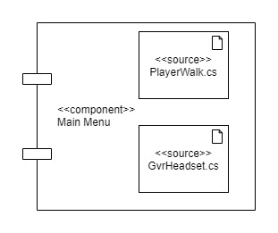
Main Menu Module

Slide 8
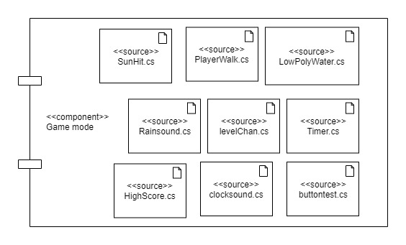
Game Mode Module

Slide 9
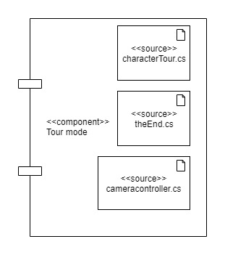
Tour Mode Module

Slide 10
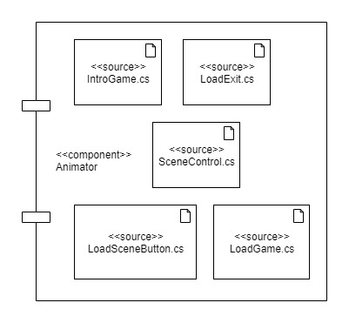
Animator Module

Slide 11
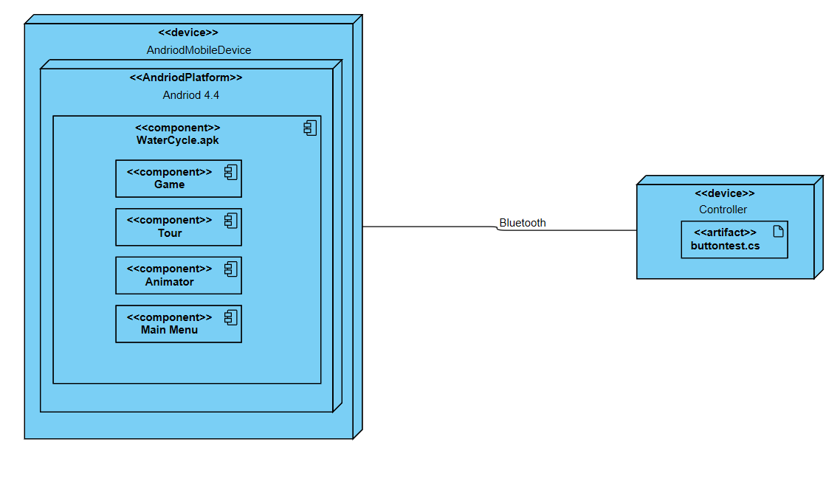
Deployment Diagram

Slide 12
Implementation
Application implementation
Hardware and Software requirements
User Interface

Slide 13
Software options
Two Main Options : Unity/Un-real
Narrowed down to Unity
Why unity ?
particle system management
Animator control
Platform support
Microsoft Visual Studio
Better integration with unity

Slide 14
Hardware Description
VR headset
Android Device
Bluetooth Controller

Slide 15
User Interface
Different interface for levels
Easy to interact
Least number of buttons
Simplicity

Slide 16
Testing
The software meets its non-functional requirements.
To identify and reveal as many errors as possible in the tested software.
To perform the required tests efficiently and effectively, within budgetary and scheduling limitations.
Types of System Tests
Functional testing
Non- functional testing
Testing techniques
Functional testing: Equivalence class partitioning (ECP) & State transition testing.
Non-functional: Survey

Slide 17
Unit Testing
Test Case ID | Test Scenario | Test Case Description | Precondition | Test Steps | Test Data | Expected Results | Actual Result | Test Result
TC_001 | Starting the tour guide for the water cycle | Testing the start tour guide functionality by looking at the button for 2 seconds | Launch the app. | Look at the Tour Guide button for 2 seconds. | Gaze at the start tour button for 2 sec. | Tour guide Started | Tour Guide started | Pass
TC_002 | Starting the tour guide for the water cycle | Testing the start tour guide functionality by not looking at the tour guide button | Launch the app | Look anywhere but not on the Tour Guide button | Gaze anywhere expect the start tour button. | Tour Guide does not start. i.e. no action taken | Tour guide does not start | Pass
TC_003 | Starting the tour guide for the water cycle | Testing the Start tour guide functionality by looking at start Game button | Launch the app. | Looks at the start game button for 2 seconds. | Gaze at the start game button for 2 seconds. | Game starts | Game starts and tour guide does not start | Pass

Slide 18
System Testing
Test Case ID | Test Scenario | Test Case Description | Precondition | Test Steps | Test Data | Expected Results | Actual Result | Test Result
STC_001 | Testing the flow of the user entering the tour and exiting it | The user will enter the tour by gazing at the start tour button for 2 seconds, then the user will the tour with button A. | App is launched. | User gazes at the start tour button for 2 seconds. | Gaze at the start tour button for 2 seconds. | User enters the tour. | User enters tour. | Pass
 |  |  |  | User presses Button A to exit the tour | Button A | User exits the tour. | User exits the tour.
STC_002 | Testing the flow of the user entering the game, playing the game and exiting it. | The user will enter the game by gazing at the Start Game for 2 seconds, plays the game and then the user exits the Game with button A. | App is launched. | User gazes at the Start Game button for 2 seconds. | Gaze at the start game button for 2 seconds. | User enters the game. | User enters the game. | Pass
 |  |  |  | User moves the player right. | Move the 360 ˚ Rocker to right. | Player moves right. | Player moves right.
 |  |  |  | User moves the player left. | Move the 360 ˚ Rocker to left. | Player moves left. | Player moves left.
 |  |  |  | User exits the Game. | Button A | Player exits the game. | Player exits the game.

Slide 19
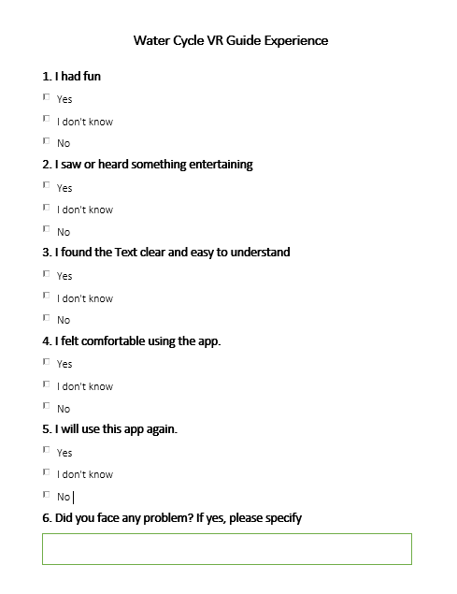
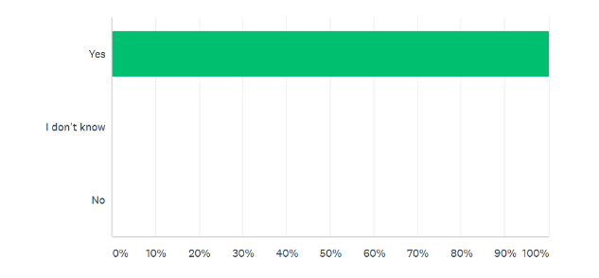
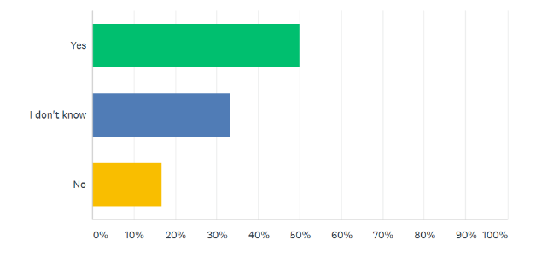
Usability Testing
SURVEY
TEST RESULTS
I saw or heard something entertaining
I found the text clear and easy to understand

Slide 20
Conclusion
The project is a Virtual Reality application to educate students
Visual view of the water cycle
Mini game to polish up user’s knowledge.
The project included Literature review and the study of similar apps in the domain.
The project went through Software development life cycle.
Establishment of project report.

Slide 21
Future Work
Improve Graphics
Text-to-Speech
Animations
Different Languages
Game Modes

Slide 22
References
[1] S. Sukhin, "Splash Sim: A VR Experience in the Water Cycle - Apps on Google Play," Google, 10 2017. [Online]. Available: https://play.google.com/store/apps/details?id=com.splashsim.splashsim&hl=en_US. [Accessed 28 7 2019].
[2] A. V. Education, "Cicle de l'Aigua VR - Apps on Google Play," Google, 1 2016. [Online]. Available: https://play.google.com/store/apps/details?id=com.allvreducation.cicledelaigua&hl=en. [Accessed 28 7 2019].
[3] EUROCASE, "TABI The Water Cycle - Apps on Google Play," Google, 1 2016. [Online]. Available: https://play.google.com/store/apps/details?id=com.eurocase.hydrologic_cycle&hl=en. [Accessed 28 7 2019].
[4] S. Xpert, "วัฏจักรน้ำ (Water Cycle) - Apps on Google Play," Google, 10 2018. [Online]. Available: https://play.google.com/store/apps/details?id=com.studioxpert.watercycle. [Accessed 28 7 2019].

Slide 23
Thank you
Questions?

