Slide 1

Water Cycle VR GUIDE
Water Cycle
VR Guide
Presented By
Adnan Ali 201520023
Zainab Shahid 201520629
Supervised by
Dr. Saqib Iqbal

Slide 2
Content
Introduction
Literature Review
Requirement analysis
Conclusion
Reference

Slide 3
Introduction
Virtual Reality (VR) allows the user to have a visual view of scenario that might not be easily accessible
Being one of the top trending technology it will help evolve the education sector as well
Developed application will allows kids to visualize Earths water cycle and easier for them to understand
As kids love to play games, we will include a mini game as it will make it easier to pass information to them.

Slide 4
Problem Statement
Few VR applications
Lack of Guidance within the application
Lack of visualization

Slide 5
Objective
to develop a virtual reality application for water cycle education.
to provide users with a game to understand water cycle.
to provide user with different mode of interaction.
to provide user with real model view of water cycle.

Slide 6
Expected outcome
The developed application will allow kids to have tour of different phases of water cycle
The developed application will guide kids through different phases with help of a robot companion
The developed application will have a mini game for kids as part of interaction.

Slide 7
Gantt Chart

Slide 8

Literature Review
Very few apps have been created in this domain.
Much apps were focused on water cycle lessons rather than visualization of the water cycle.
Teachers are looking forward to such applications
to ease the teaching.

Slide 9
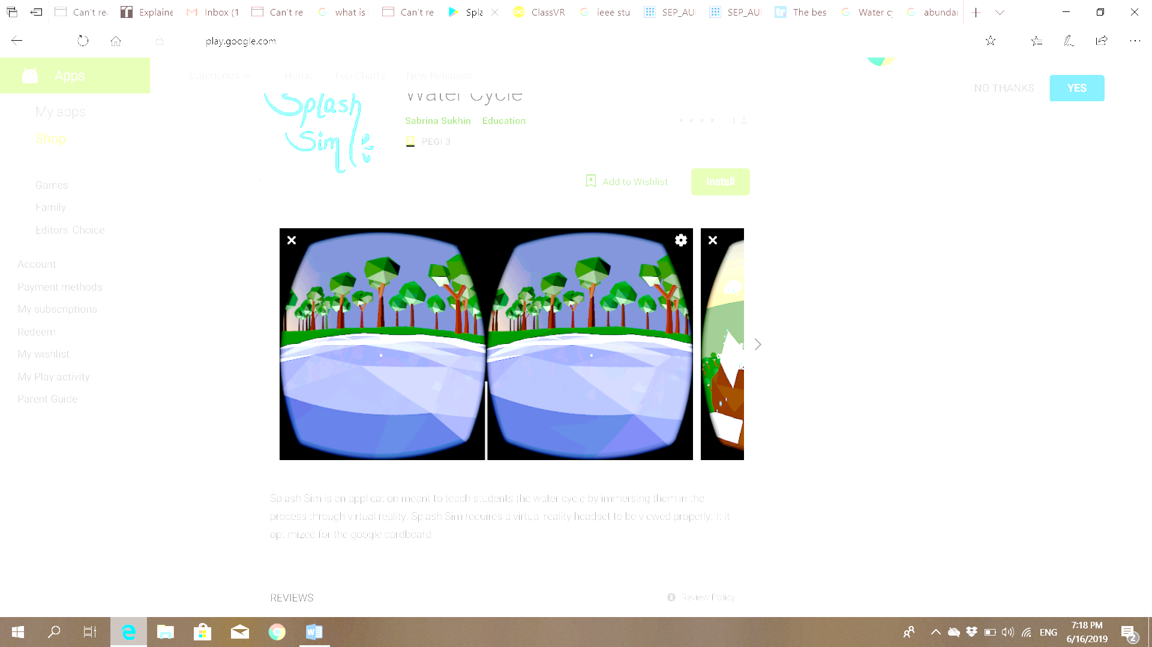
Similar Apps
Splash Sim: A VR Experience in the Water Cycle
Features:
VR app.
User is taken to a tour to see different phases of water cycle.
Text is appeared to explain user about the phases.
Audio effect of rain, wind and birds.
Weaknesses:
Lack of animation in evaporation stage.
No text to speech implementation.
The tour gets on repeated by itself.

Slide 10
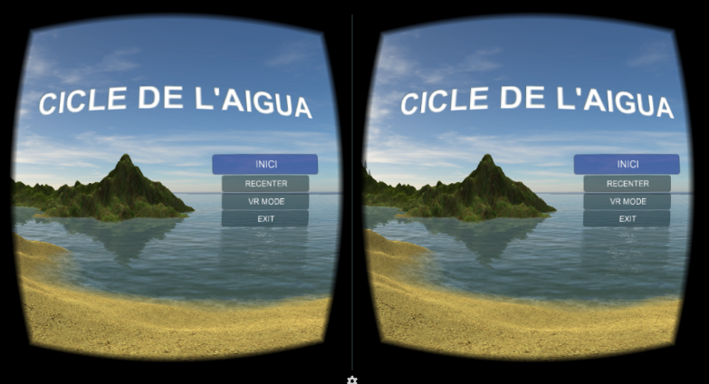
Similar Apps
Cicle de l’Aigue VR (Water cycle VR)
Features:
VR app.
An audio voice to explain user the water cycle.
Audio effect for rain and wind.
Main menu to allow user to choose the option they would like to go for.
Bluetooth control.
Weaknesses:
Hanging occurs while the scene is viewed from different angles.
The app has no other language support other than Catalan language.

Slide 11
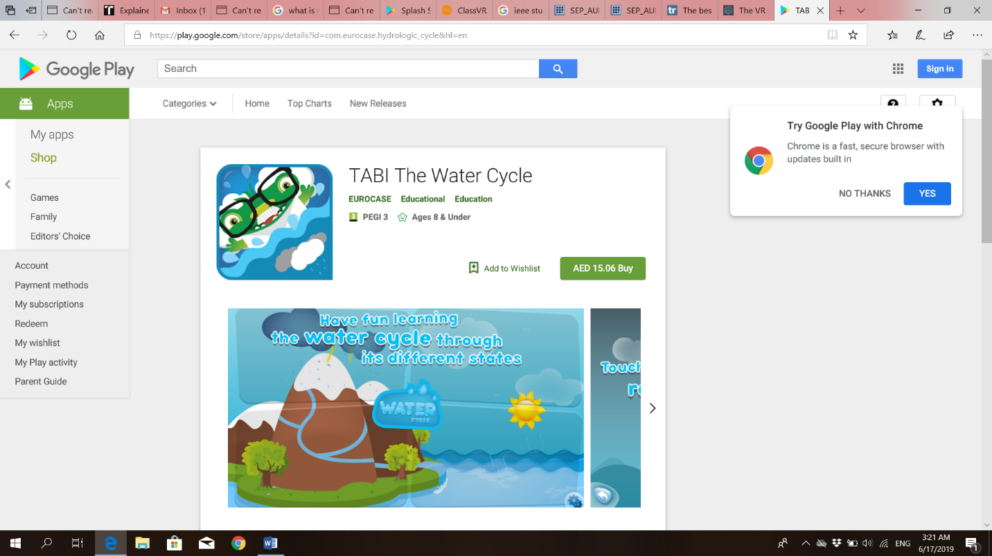
Similar Apps
TABI the water cycle
Features:
User plays a game to create evaporation, condensation and precipitation.
Text shown at the beginning to guide the user to play the game.
Weaknesses:
Not a VR app.
Not complete water cycle.
Lack of phase transformations.

Slide 12
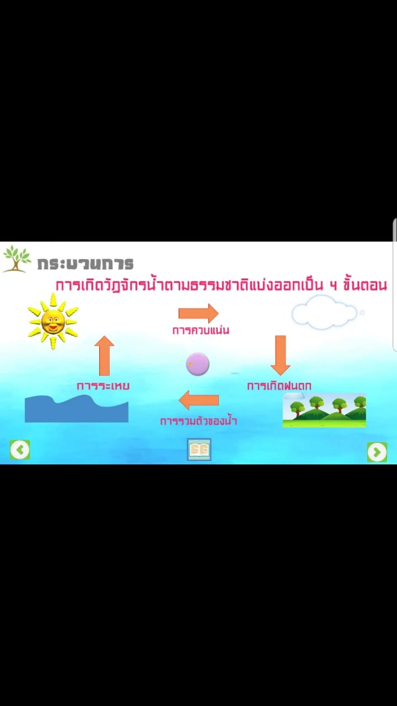
Similar Apps
วัฏจักรน้ำ (Water Cycle)
Features:
Main menu to allow user to choose where they want to go.
Lessons about water cycle explaining the phases.
Game to educate user more about water and to allow them to understand it more.
Audio speech to engage then user more in the app and explain each step clearly.
Weaknesses:
No language support other than Thai language.
Not a VR app.
All phases are not shown continually to explain the transformation between them.

Slide 13
Comparison Table
Features\ Apps | Splash Sim | Cicle de l’Aigue VR | TABI the water cycle | วัฏจักรน้ำ (Water Cycle ) | VR Water Cycle tour and game (Our app)
VR app | ✓ | ✓ |  |  | ✓
Interactivity implementation | ✓ | ✓ |  |  | ✓
Main menu |  | ✓ | ✓ | ✓ | ✓
Phase Explanatory text | ✓ |  | ✓ | ✓ | ✓
Guided tour | ✓ | ✓ |  |  | ✓
Educative Game |  |  | ✓ | ✓ | ✓
Animation | ✓ | ✓ | ✓ | ✓ | ✓
Robot companion |  |  |  |  | ✓
Text to speech implementation |  | ✓ |  | ✓

Slide 14
Requirement Analysis
Our application includes three main modules:
Main Menu
Tour Guide
Game Mode

Slide 15
Main Menu Module
R1: The application shall allow user to select Tour Guide/Game or Exit the application
Tour Guide
R2: The application shall guide the user with robot companion.
R3: The application shall pass the user through all the water cycle phases.
R4: The application shall allow user to look around.
Mini Game:
R5: The application shall allow user to move player as needed.
R6: The application shall limit user gameplay time.
R7: The application must record user gameplay time for high score.

Slide 16
Non-functional Requirements
The application must not lag for more than 0.002 seconds

Slide 17
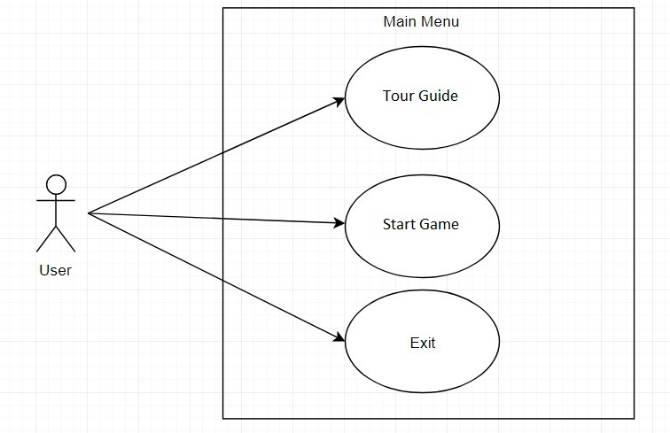
Use case Diagram
Main Menu

Slide 18
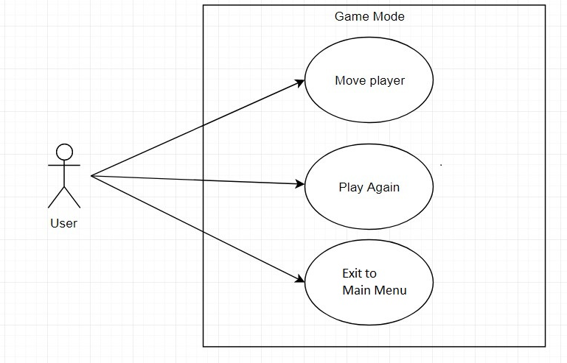
Use Case Diagram
Game Mode

Slide 19

Use Case Diagram
Tour Guide

Slide 20
System Sequence Diagram

Slide 21
Future Work
Designing of the system.
Implementation of the system.
Testing of the system.
Final report.

Slide 22

Conclusion
This app is being made to benefit students and enhance their knowledge.
Not many VR apps in this domain are launched yet.
Most suitable programming language and technology will be used to implement this VR app.

Slide 23
References
[1] S. Sukhin, "Splash Sim: A VR Experience in the Water Cycle - Apps on Google Play," Google, 10 2017. [Online]. Available: https://play.google.com/store/apps/details?id=com.splashsim.splashsim&hl=en_US. [Accessed 28 7 2019].
[2] A. V. Education, "Cicle de l'Aigua VR - Apps on Google Play," Google, 1 2016. [Online]. Available: https://play.google.com/store/apps/details?id=com.allvreducation.cicledelaigua&hl=en. [Accessed 28 7 2019].
[3] EUROCASE, "TABI The Water Cycle - Apps on Google Play," Google, 1 2016. [Online]. Available: https://play.google.com/store/apps/details?id=com.eurocase.hydrologic_cycle&hl=en. [Accessed 28 7 2019].
[4] S. Xpert, "วัฏจักรน้ำ (Water Cycle) - Apps on Google Play," Google, 10 2018. [Online]. Available: https://play.google.com/store/apps/details?id=com.studioxpert.watercycle. [Accessed 28 7 2019].

Slide 24
Thank you
Questions?

