Slide 1

AN EXTENSION TO TRACE EXPRESSIONS TO IMPROVE ERROR REPORTING
Candidate: Andrea Canepa
Supervisor: Prof. Davide Ancona
Bachelor degree in Computer Science – A.Y. 2018/2019

Slide 2
What are Trace Expressions ?

Slide 3
Trace Expressions
Trace expressions (TE) are a specification formalism designed for Runtime Verification.
TE can denote finite and infinite traces of events
TE can monitor events that happen in a system, such as method invocations or sequence of operations
Event type: given a universe of events ε, an event type is a subset 𝜗 of ε
TE has being implemented in Prolog language which is based on the logical paradigm

Slide 4







Trace Expressions
Operational semantics of Trace Expressions

Slide 5





Trace Expressions
Empty trace containment

Slide 6


Trace Expressions
Starting from basic operators we can derive new ones

Slide 7
The problem

Slide 8
Problem
What happens if, at some time, an invalid event, with regard to the state in which the system is, occurs ?
Runtime error !
At the moment we can only know the current trace expression and the event that caused the crash.

Slide 9
Let’s consider a simple example

Slide 10


Print Writer
Events, event types and trace expressions denoting a specification for a Print Writer object:

Slide 11
Error
Imagine that an open_file event occurs right after another open_file event: opening a file twice is not correct !
But the information we have is not very human-readable nor meaningful:

Slide 12
How to improve this ?

Slide 13

Solution
We extend our language adding annotations to trace expressions without changing their semantics
Error reporting is clearer if we show annotations and events instead of the trace expression itself
It is possible to exploit the freedom of the Prolog terms to define expressive annotations (e.g. simple labels rather than a list of values)

Slide 14


Print Writer Revisited

Slide 15


Next with annotations
Extension of our language and its Prolog implementation

Slide 16


Next without annotations
Extension of our language and its Prolog implementation

Slide 17
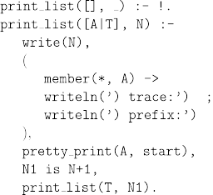
PrintList
To track each transition we track the status:
  event
  annotation
  new Trace Expression

Slide 18
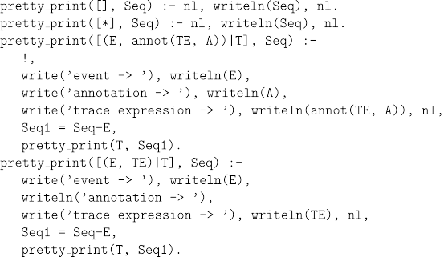
PrettyPrint

Slide 19
Tested examples

Slide 20


Ex.1 - Iterators

Slide 21
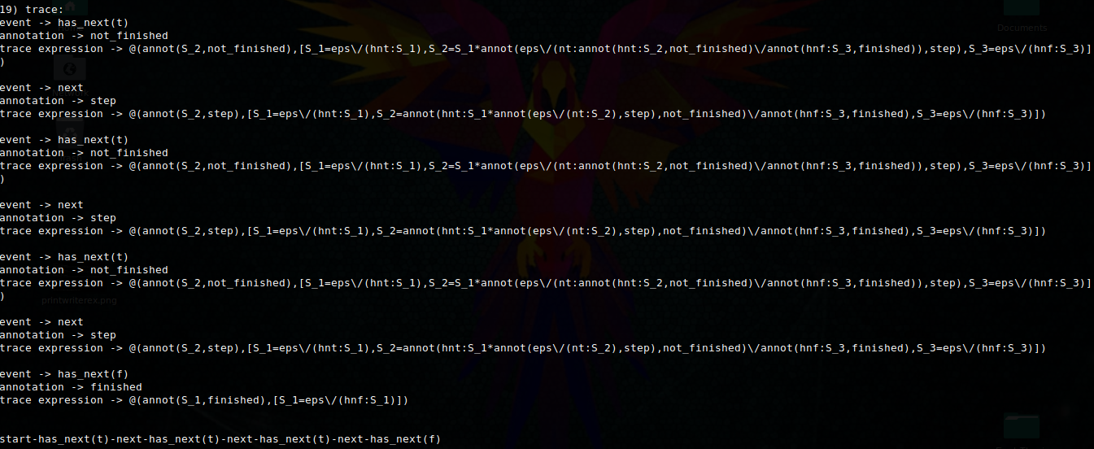
Ex.1 - Iterators

Slide 22


Ex.2 – Print Writer

Slide 23
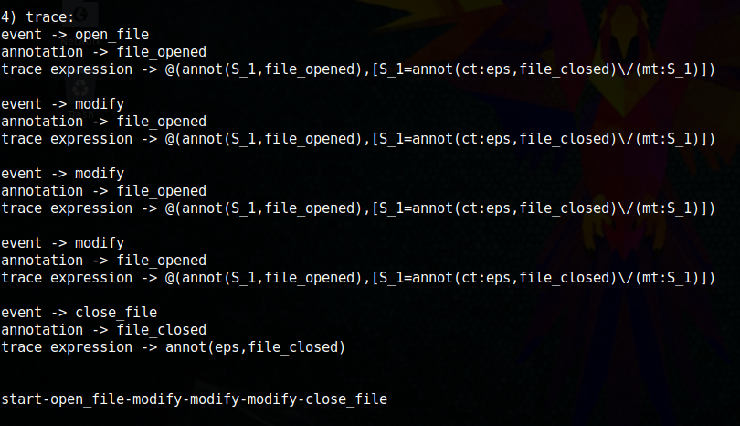
Ex.2 – Print Writer

Slide 24


Ex.3 - Turnstile

Slide 25
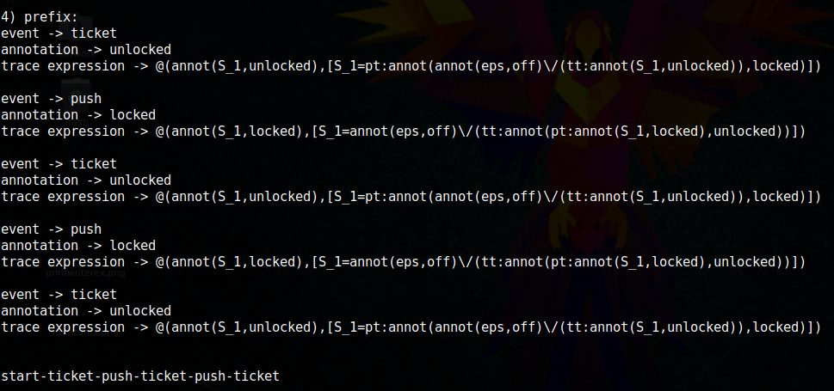
Ex.3 - Turnstile

Slide 26
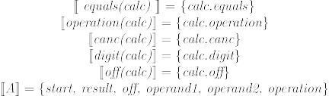
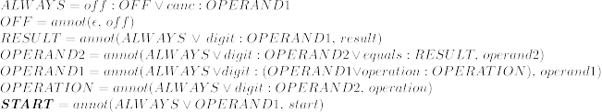
Ex.4 – Simple Calculator

Slide 27
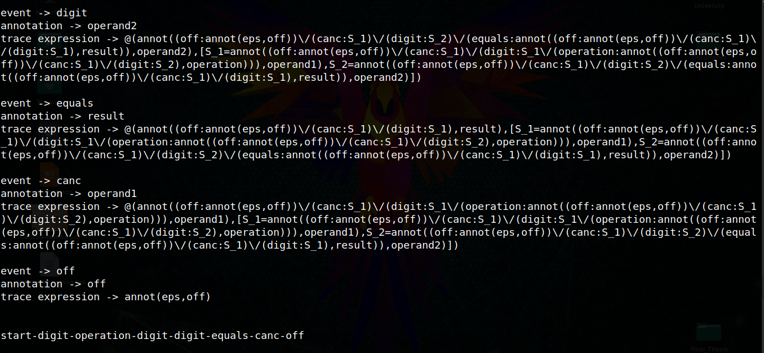
Ex.4 – Simple Calculator

Slide 28
Conclusions
The user now is able to stick annotations to trace expressions at language level
Labels customizable by need
Debug is easier since we track down events, annotations and trace expressions after each event occurence

Slide 29
Future Developments
This implementation is working only for flat annotations, it could be interesting to consider also nested annotations
New error reporting at a higher level based on annotations

Slide 30
References and sources
D. Ancona, A. Ferrando, and V. Mascardi. Comparing trace expressions and linear temporal logic for runtime verification. In Theory and Practice of Formal Methods - Essays Dedicated to Frank de Boer on the Occasion of His 60th Birthday, pages 47--64, 2016.
Prolog manual and documentation - http://www.swi-prolog.org/
Prolog: Linguaggio e Metodologia di Programmazione Logica – Furlan F. e Lanzarone G.A.
https://github.com/LucaFranceschini/trace-expressions - Advanced implementation of Trace Expressions

Slide 31
This theme is licensed under a Creative Commons Attribution-ShareAlike 3.0 Unported License.
It makes use of the works of
Kelly Loves Whales and Nick Merritt.
Thank you for your attention !

