Slide 1
Introduction to HTAP

Slide 2
Agenda
Substitute-h2k.rb: Running HOT2000 from the command line
GenoOpt: Running a batch of simulations
GenOpt: Running an optimization
Customizing HTAP (Archetypes, constuctions, systems)

Slide 3

Schematic
Archetype
House
Archetype
House
.h2k file
Upgrade specification (& costs)
Upgrade specification (& costs)
Locale & weather
Optimization parameters
Visualization
GenOpt
Pre- processor
HOT2000 or ESP-r
Post processer
Optimization framework

Slide 4
Working in HTAP | Broken in HTAP | Unsupported
Location Fuel costs Operating conditions Archetype (.h2k file) Air tightness Window spec (U-value & SHGC) Ceiling construction Wall construction Basement assembly Exposed floors PV Heating (furnace/boiler/HP/P9) DHW DWHR HRV | AC (Opt-Cooling-Spec) User-defined loads (Opt-ElecLoadScale, Opt-DHWLoadScale) SDHW (Opt-DWHRandSDHW) | Geometry changes Site exposure, soil characteristics Secondary DHW HOT2000 occupant definitions Driers & fanhoods

Slide 5
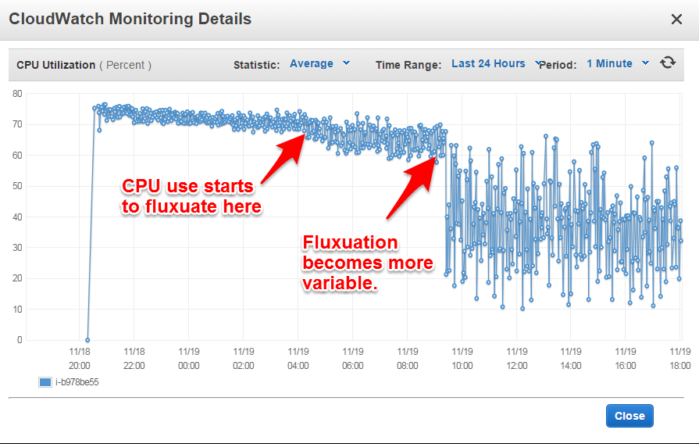
Genopt code efficiency

Slide 6
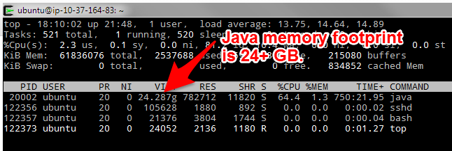
Genopt Memory use

Slide 7
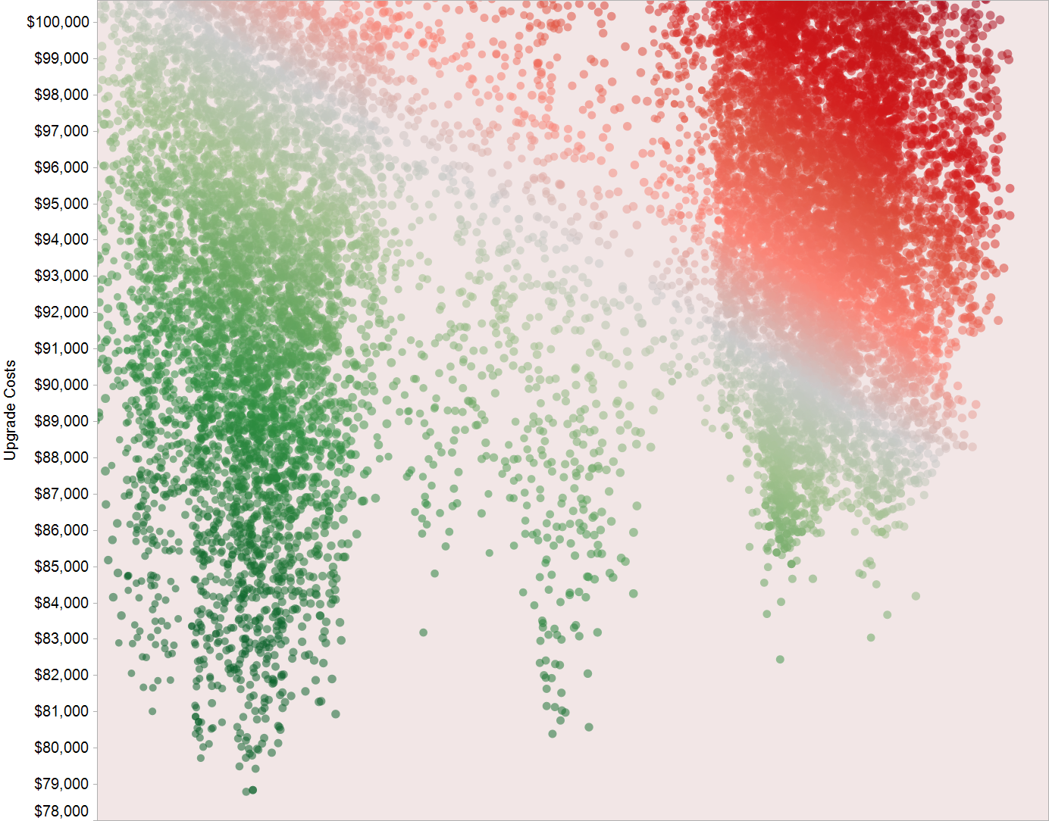

Guiding principles
Questions?
Julia.Purdy@Canada.ca
Jeff.Blake@Canada.ca
Alex.Ferguson@Canada.ca

