Slide 1
FIR Filter Design
Finite Impulse Response (FIR) FILTER

Slide 2
Digital Filtering
In signal processing, the function of a filter is to remove unwanted parts of the signal, such as random noise, or to extract useful parts of the signal, such as the components lying within a certain frequency range

Slide 3
Analog Filter:
Input: electrical voltage or current which is the direct analogue of a physical quantity (sensor output)
Components: resistors, capacitors and op amps
Output: Filtered electrical voltage or current
Applications: noise reduction, video signal enhancement, graphic equalisers

Slide 4
Digital Filter:
Input: Digitized samples of analog input (requires ADC)
Components: Digital processor (PC/DSP/ASIC/FPGA)
Output: Filtered samples (requires DAC)
Applications: noise reduction, video signal enhancement, graphic equalisers

Slide 5
Ideal Filters
One of the reasons why we design a filter is to remove disturbances
SIGNAL
Filter
NOISE
We discriminate between signal and noise in terms of the frequency spectrum

Slide 6
Ideal Filter Frequency Response

Slide 7
Conditions for Non-Distortion
Problem: ideally we do not want the filter to distort the signal we want to recover.
Same shape as s(t), just scaled and delayed.
IDEAL
FILTER

Slide 8
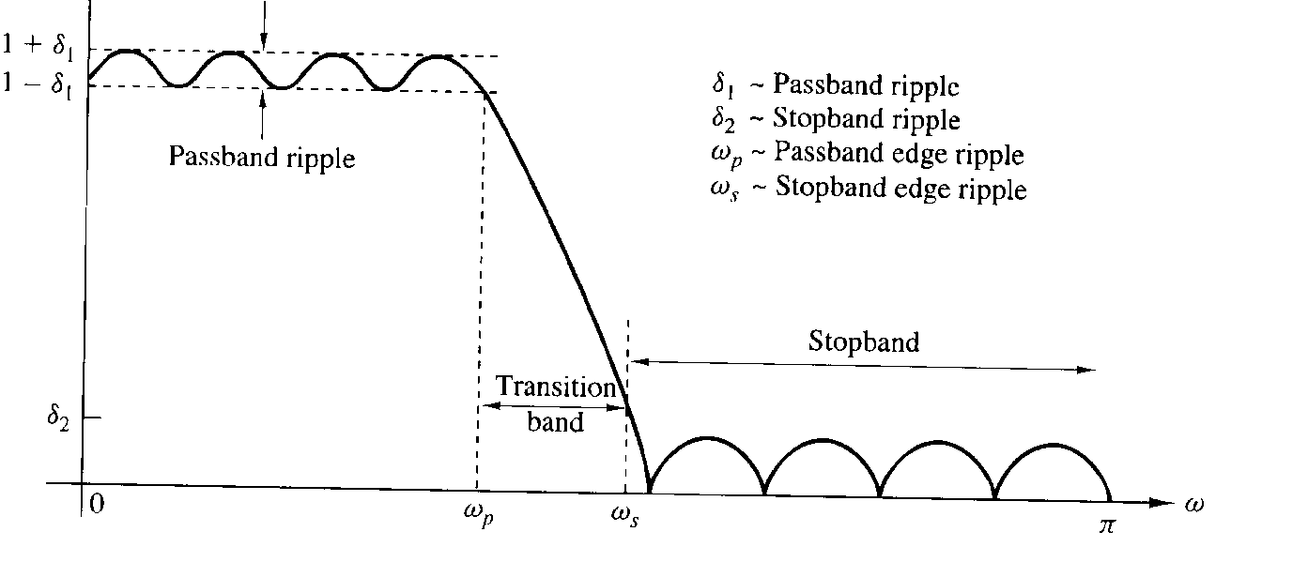
Characteristics of Non Ideal Digital Filters
IDEAL
Positive freq. only
NON IDEAL

Slide 9
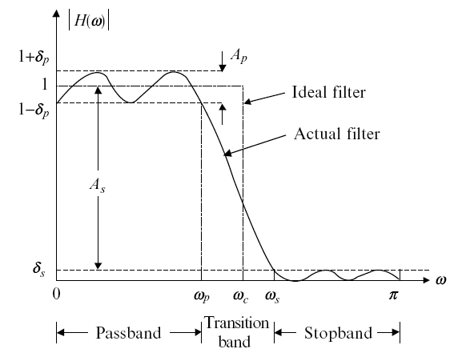
Realistic vs. Ideal Filter Response

Slide 10
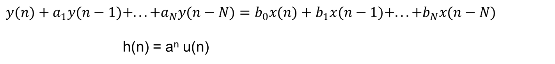
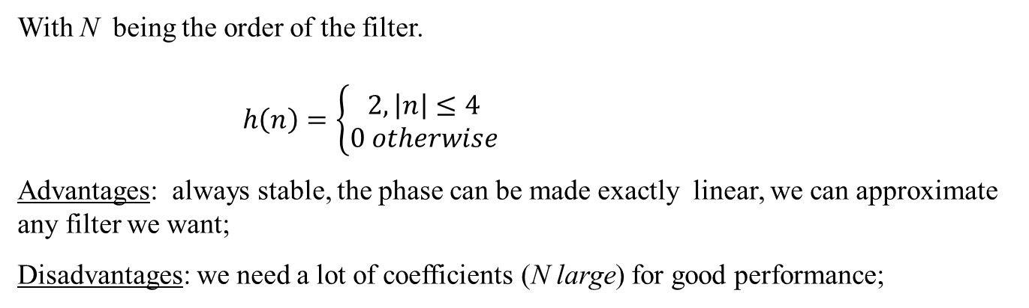
Types Of Digital Filters
a) Finite Impulse Response (FIR), non recursive, of the form
With N being the order of the filter.
$h\left(n\right)=\left\{\begin{matrix}2, \left|n\right|≤4 \\ 0 otherwise\end{matrix}\right.$
Advantages: always stable, the phase can be made exactly linear, we can approximate any filter we want;
Disadvantages: we need a lot of coefficients (N large) for good performance;
b) Infinite Impulse Response (IIR), recursive, of the form
$$y(n)+a_{1}y(n−1)+...+a_{N}y(n−N)=b_{0}x(n)+b_{1}x(n−1)+...+b_{N}x(n−N)$$
h(n) = a^{n} u(n)
Advantages: very selective with a few coefficients;
Disadvantages: non necessarily stable, non linear phase.

Slide 11
Advantage of FIR over IIR
They have an exact linear phase
They are always stable.
The design methods are generally linear.
They can be realized efficiently in hardware.
The filter start-up transients have finite duration.

Slide 12
Design Techniques For FIR Filters
Fourier Series Method
Frequency Sampling Method
Window Techniques

Slide 13
Design of FIR filters: Windows
(i) Start with ideal infinite duration
(ii) Truncate to finite length. (This produces unwanted ripples increasing in height near discontinuity.)
(iii) Modify to
Weight w(n) is the window

Slide 14
FIR Filter Design based on Windows Function Method
A direct and straightforward method is based on truncating the Fourier series representation of the prescribed frequency response is discussed in this section.

Slide 15
Finite Impulse Response (FIR) Filters
Definition: a filter whose impulse response has finite duration.

