Slide 1
Handout # 22 Network Security & Final Review
CSC 458/2209 – Computer Networks
Instructed by:
AbdulAziz AlHelali – L0101
a.alhelali@mail.utoronto.ca
Joe Lim – L5101
joe.lim@utoronto.ca
Sajad Shirali-Shahreza – L0201
shirali@cs.toronto.edu
Slides adapted from
Professor Yashar Ganjali

Slide 2
Announcements
Final exam time:
Thursday Dec. 14th, 2 PM – 5 PM
A → MA: UC 266
ME → Z: UC273

Slide 3
Network Security
understand principles of network security:
cryptography and its many uses beyond “confidentiality”
authentication
message integrity
network attacks
security in practice:
firewalls and intrusion detection systems
security in application, transport, network, link layers

Slide 4
What is Network Security
confidentiality: only sender, intended receiver should “understand” message contents (other person cant understand)
sender encrypts message
receiver decrypts message
authentication: sender, receiver want to confirm identity of each other
message integrity: sender, receiver want to ensure message not altered (in transit, or afterwards) without detection(check others have not modify it)
access and availability: services must be accessible and available to users

Slide 5
What can a “bad guy/gal” do?
eavesdrop: intercept messages
actively insert messages into connection
impersonation: can fake (spoof) source address in packet (or any field in packet)
hijacking: “take over” ongoing connection by removing sender or receiver, inserting himself in place
denial of service: prevent service from being used by others (e.g., by overloading resources)

Slide 6



The Language of Cryptography
Alice’s
encryption
key
Bob’s
decryption
key
K
K
A
B
plaintext
encryption
algorithm
ciphertext
decryption
algorithm
plaintext
m plaintext message
K_{A}(m) ciphertext, encrypted with key K_{A}
m = K_{B}(K_{A}(m))

Slide 7
Breaking an Encryption Scheme
cipher-text only attack: Trudy has ciphertext she can analyze
two approaches:
brute force: search through all keys
statistical analysis
known-plaintext attack: Trudy has plaintext corresponding to ciphertext
e.g., in monoalphabetic cipher, Trudy determines pairings for a,l,i,c,e,b,o,
chosen-plaintext attack: Trudy can get ciphertext for chosen plaintext

Slide 8
Symmetric Key Cryptography
K
K
S
S
plaintext
message, m
encryption
algorithm
ciphertext
decryption
algorithm
plaintext
K (m)
m = K_{S}(K_{S}(m))
S
symmetric key crypto: Bob and Alice share same (symmetric) key: K
e.g., key is knowing substitution pattern in mono alphabetic substitution cipher
Q: how do Bob and Alice agree on key value?
S

Slide 9
Simple Encryption Scheme
substitution cipher: substituting one thing for another
monoalphabetic cipher: substitute one letter for another
plaintext: abcdefghijklmnopqrstuvwxyz
ciphertext: mnbvcxzasdfghjklpoiuytrewq
e.g.:
Plaintext: bob. i love you. alice
ciphertext: nkn. s gktc wky. mgsbc
Encryption key: mapping from set of 26 letters
to set of 26 letters

Slide 10
A more sophisticated encryption approach
n substitution ciphers, M₁,M₂,…,M_{n}
cycling pattern:
e.g., n=4: M₁,M₃,M₄,M₃,M₂; M₁,M₃,M₄,M₃,M₂; ..
for each new plaintext symbol, use subsequent substitution pattern in cyclic pattern
dog: d from M₁, o from M₃, g from M₄
Encryption key: n substitution ciphers, and cyclic pattern
key need not be just n-bit pattern
Cipher is a mapping

Slide 11
Symmetric Key Crypto: DES
DES: Data Encryption Standard
US encryption standard [NIST 1993]
56-bit symmetric key, 64-bit plaintext input
block cipher with cipher block chaining
how secure is DES?
DES Challenge: 56-bit-key-encrypted phrase decrypted (brute force) in less than a day
no known good analytic attack
making DES more secure:
3DES: encrypt 3 times with 3 different keys

Slide 12
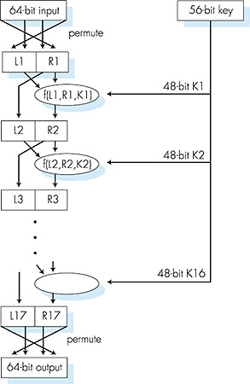
More on DES
DES operation
initial permutation
16 identical “rounds” of function application, each using different 48 bits of key
final permutation

Slide 13
AES: Advanced Encrytion Standard
symmetric-key NIST standard, replaced DES (Nov 2001)
processes data in 128 bit blocks
128, 192, or 256 bit keys
brute force decryption (try each key) taking 1 sec on DES, takes 149 trillion years for AES

Slide 14
Public Key Crytography
symmetric key crypto
requires sender, receiver know shared secret key
Q: how to agree on key in first place (particularly if never “met”)?
public key crypto
radically different approach [Diffie-Hellman76, RSA78]
sender, receiver do not share secret key
public encryption key known to all
private decryption key known only to receiver
Each one has a pair of keys

Slide 15
Public Key Cryptography
+
Bob’s public
key
K
B
-
Bob’s private
key
K
B
plaintext
message, m
encryption
algorithm
ciphertext
decryption
algorithm
plaintext
message
+
K (m)
-
+
B
m = K (K (m))
B
B
Private key not shared so anyone can encrypt but only Bob can decrypt it

Slide 16
Public Key Encryption Algorithms
requirements:
.
.
+
-
1
need K ( ) and K ( ) such that
B
B
-
+
K (K (m)) = m
B
B
2
+
given public key K , it should be impossible to compute private key K
B
-
B
RSA: Rivest, Shamir, Adelson algorithm

Slide 17
RSA: Creating public/private Key Pair
1. choose two large prime numbers p, q.
(e.g., 1024 bits each)
2. compute n = pq, z = (p-1)(q-1)
3. choose e (with e<n) that has no common factors
with z (e, z are “relatively prime”).
4. choose d such that ed-1 is exactly divisible by z.
(in other words: ed mod z = 1 ).
5. public key is (n,e). private key is (n,d).
+
-
K
K
B
B

Slide 18
RSA: Encryption, Decryption
0. given (n,e) and (n,d) as computed above
1. to encrypt message m (<n), compute
e
c = m mod n
2. to decrypt received bit pattern, c, compute
d
m = c mod n
magic
happens!
e
d
m = (m mod n)
mod n
c

Slide 19
RSA Example:
Bob chooses p=5, q=7. Then n=35, z=24.
e=5 (so e, z relatively prime).
d=29 (so ed-1 exactly divisible by z).
encrypting 8-bit messages.
e
Encrypted message
bit pattern
m
m
e
c = m mod n
encrypt:
0000l000
12
24832
17
d
d
c
c
m = c mod n
decrypt:
17
481968572106750915091411825223071697
12

Slide 20
RSA: Another Important Property
The following property will be very useful later:
-
+
+
-
K (K (m)) = m
=
K (K (m))
B
B
B
B
use public key first, followed by private key
use private key first, followed by public key
result is the same!

Slide 21
RSA in practice: Session Keys
exponentiation in RSA is computationally intensive
DES is at least 100 times faster than RSA
use public key crypto to establish secure connection, then establish second key – symmetric session key – for encrypting data
session key, K_{S}
Bob and Alice use RSA to exchange a symmetric key K_{S}
once both have KS, they use symmetric key cryptography

Slide 22
Authentication
Goal: Bob wants Alice to “prove” her identity to him
Protocol ap1.0: Alice says “I am Alice”
“I am Alice”
Failure scenario??

Slide 23
Authentication
Goal: Bob wants Alice to “prove” her identity to him
Protocol ap1.0: Alice says “I am Alice”
in a network,
Bob can not “see” Alice, so Trudy simply declares
herself to be Alice
“I am Alice”

Slide 24
Authentication: Another Try
Protocol ap2.0: Alice says “I am Alice” in an IP packet
containing her source IP address
Alice’s
IP address
“I am Alice”
Failure scenario??

Slide 25
Authentication: Another Try
Protocol ap2.0: Alice says “I am Alice” in an IP packet
containing her source IP address
Trudy can create
a packet “spoofing”
Alice’s address
Alice’s
IP address
“I am Alice”

Slide 26
Authentication: Another Try
Protocol ap3.0: Alice says “I am Alice” and sends her
secret password to “prove” it.
Alice’s
IP addr
Alice’s
password
“I’m Alice”
Failure scenario??
Alice’s
IP addr
OK

Slide 27
Authentication: Another Try
Protocol ap3.0: Alice says “I am Alice” and sends her
secret password to “prove” it.
Alice’s
IP addr
Alice’s
password
“I’m Alice”
playback attack: Trudy records Alice’s packet
and later
plays it back to Bob
Alice’s
IP addr
OK
Alice’s
IP addr
Alice’s
password
“I’m Alice”

Slide 28
Authentication: Yet Another Try
Protocol ap3.1: Alice says “I am Alice” and sends her
encrypted secret password to “prove” it.
Alice’s
IP addr
encrypted
password
“I’m Alice”
Failure scenario??
Alice’s
IP addr
OK

Slide 29
Authentication: Yet Another Try
Protocol ap3.1: Alice says “I am Alice” and sends her
encrypted secret password to “prove” it.
Alice’s
IP addr
encrypted
password
“I’m Alice”
record
and
playback
still works!
Alice’s
IP addr
OK
Alice’s
IP addr
encrypted
password
“I’m Alice”

Slide 30
Authentication: Yet Another Try
Goal: avoid playback attack
nonce: number (R) used only once-in-a-lifetime
ap4.0: to prove Alice “live”, Bob sends Alice nonce, R. Alice
must return R, encrypted with shared secret key
“I am Alice”
R
K (R)
Alice is live, and only Alice knows key to encrypt nonce, so it must be Alice!
A-B
Failures, drawbacks?

Slide 31
Authentication: ap5.0
ap4.0 requires shared symmetric key
can we authenticate using public key techniques?
ap5.0: use nonce, public key cryptography
“I am Alice”
Bob computes
R
+
-
-
K
(K (R)) = R
K (R)
A
A
A
and knows only Alice could have the private key, that encrypted R such that
“send me your public key”
+
K
A
+
-
K
(K (R)) = R
A
A

Slide 32
ap5.0: Security Hole
man (or woman) in the middle attack: Trudy poses as Alice (to Bob) and as Bob (to Alice)
I am Alice
I am Alice
R
-
K (R)
T
R
-
Send me your public key
K (R)
+
A
K
T
Send me your public key
+
K
A
+
K (m)
Trudy gets
T
-
+
+
m = K (K (m))
K (m)
T
T
-
A
sends m to Alice encrypted with Alice’s public key
+
m = K (K (m))
A
A

Slide 33
ap5.0: Security Hole
man (or woman) in the middle attack: Trudy poses as Alice (to Bob) and as Bob (to Alice)
difficult to detect:
Bob receives everything that Alice sends, and vice versa. (e.g., so Bob, Alice can meet one week later and recall conversation!)
problem is that Trudy receives all messages as well!

Slide 34
Digital Signatures
cryptographic technique is analogous to hand-written signatures:
sender (Bob) digitally signs document, establishing he is the document owner/creator.
verifiable, nonforgeable: recipient (Alice) can prove to someone that Bob, and no one else (including Alice), must have signed document

Slide 35
Digital Signatures
simple digital signature for message m:
Bob signs m by encrypting with his private key K_{B}, creating “signed” message, K_{B}(m)
-
-
Bob’s message, m
-
Bob’s private
key
-
K
m,K
(m)
B
B
Dear Alice
Oh, how I have missed you. I think of you all the time! …(blah blah blah)
Bob
Bob’s message, m, signed (encrypted) with his private key
Public key
encryption
algorithm

Slide 36
Digital Signatures
suppose Alice receives msg m, with signature: m, K_{B}(m)
Alice verifies m signed by Bob by applying Bob’s public key K_{B} to K_{B}(m) then checks K_{B}(K_{B}(m) ) = m.
If K_{B}(K_{B}(m) ) = m, whoever signed m must have used Bob’s private key.
Alice thus verifies that:
Bob signed m
no one else signed m
Bob signed m and not m‘
non-repudiation:
Alice can take m, and signature K_{B}(m) to court and prove that Bob signed m

Slide 37
Message Digests
large
message
m
H: Hash
Function
computationally expensive to public-key-encrypt long messages
goal: fixed-length, easy- to-compute digital “fingerprint”
apply hash function H to m, get fixed size message digest, H(m).
H(m)
Hash function properties:
many-to-1
produces fixed-size msg digest (fingerprint)
given message digest x, computationally infeasible to find m such that x = H(m)

Slide 38
Internet checksum: poor crypto hash function
Internet checksum has some properties of hash function:
produces fixed length digest (16-bit sum) of message
is many-to-one
But given message with given hash value, it is easy to find another message with same hash value:
message
ASCII format
message
ASCII format
I O U 1
0 0 . 9
9 B O B
49 4F 55 31
30 30 2E 39
39 42 D2 42
I O U 9
0 0 . 1
9 B O B
49 4F 55 39
30 30 2E 31
39 42 D2 42
B2 C1 D2 AC
different messages
but identical checksums!
B2 C1 D2 AC

Slide 39
Digital signature = signed message digest
Bob sends digitally signed message:
Alice verifies signature, integrity of digitally signed message:
large
message
m
H: Hash
function
H(m)
encrypted
msg digest
-
K_{B}(H(m))
Bob’s
private
key
digital
signature
(encrypt)
large
message
m
-
Bob’s
public
key
digital
signature
(decrypt)
K
B
+
H: Hash
function
K
encrypted
msg digest
B
+
-
K_{B}(H(m))
H(m)
H(m)
equal
?

Slide 40
Hash function algorithms
MD5 hash function widely used (RFC 1321)
computes 128-bit message digest in 4-step process.
arbitrary 128-bit string x, appears difficult to construct msg m whose MD5 hash is equal to x
SHA-1 is also used
US standard [NIST, FIPS PUB 180-1]
160-bit message digest

Slide 41
SSL: Secure Sockets Layer
original goals:
Web e-commerce transactions
encryption (especially credit-card numbers)
Web-server authentication
optional client authentication
minimum hassle in doing business with new merchant
available to all TCP applications
secure socket interface
widely deployed security protocol
supported by almost all browsers, web servers
https
billions $/year over SSL
mechanisms: [Woo 1994], implementation: Netscape
variation -TLS: transport layer security, RFC 2246
provides
confidentiality
integrity
authentication

Slide 42
SSL and TCP/IP
Application
Application
SSL
TCP
TCP
IP
IP
normal application
application with SSL
SSL provides application programming interface (API) to applications
C and Java SSL libraries/classes readily available

Slide 43
SSL Cipher Suite
cipher suite
public-key algorithm
symmetric encryption algorithm
MAC algorithm
SSL supports several cipher suites
negotiation: client, server agree on cipher suite
client offers choice
server picks one
common SSL symmetric ciphers
DES – Data Encryption Standard: block
3DES – Triple strength: block
RC2 – Rivest Cipher 2: block
RC4 – Rivest Cipher 4: stream
SSL Public key encryption
RSA

Slide 44
SSL Record Protocol
data
data
fragment
MAC
data
fragment
MAC
record
header
encrypted
data and MAC
record
header
encrypted
data and MAC
record header: content type; version; length
MAC: includes sequence number, MAC key M_{x}
fragment: each SSL fragment 2¹⁴ bytes (~16 Kbytes)

Slide 45
SSL Record Format
1 byte
2 bytes
3 bytes
content
type
length
SSL version
data
MAC
data and MAC encrypted (symmetric algorithm)

Slide 46
What is network-layer confidentiality?
between two network entities:
sending entity encrypts datagram payload, payload could be:
TCP or UDP segment, ICMP message, OSPF message ….
all data sent from one entity to other would be hidden:
web pages, e-mail, P2P file transfers, TCP SYN packets …
“blanket coverage”

Slide 47
Virtual Private Networks (VPNs)
motivation:
institutions often want private networks for security.
costly: separate routers, links, DNS infrastructure.
VPN: institution’s inter-office traffic is sent over public Internet instead
encrypted before entering public Internet
logically separate from other traffic

Slide 48
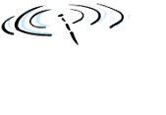


Virtual Private Networks (VPNs)
public Internet
laptop
w/ IPsec
IP
header
IPsec
header
Secure
payload
IP
header
IPsec
header
Secure
payload
IP
header
IPsec
header
Secure
payload
router w/
IPv4 and IPsec
router w/
IPv4 and IPsec
IP
header
payload
IP
header
payload
branch office
headquarters

Slide 49
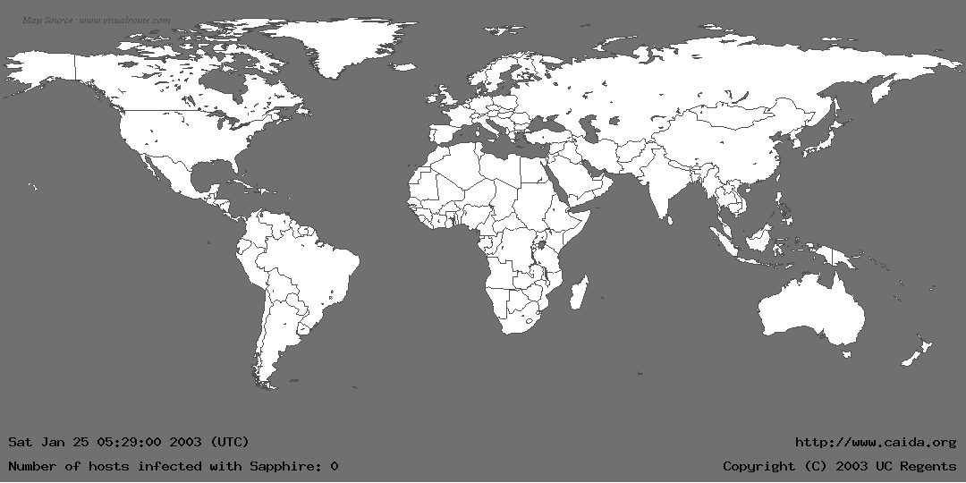
Life Just Before Slammer
Notes:
Does anyone not know what a worm is?

Slide 50
Connectivity: Good vs. Evil
Network have improved significantly: in terms of bandwidth and latency
Good
We can communicate
Exchange information
Transfer data
…
Evil
It’s easier to do harm
Harmful code can propagate faster
Information collection, violating privacy
…

Slide 51
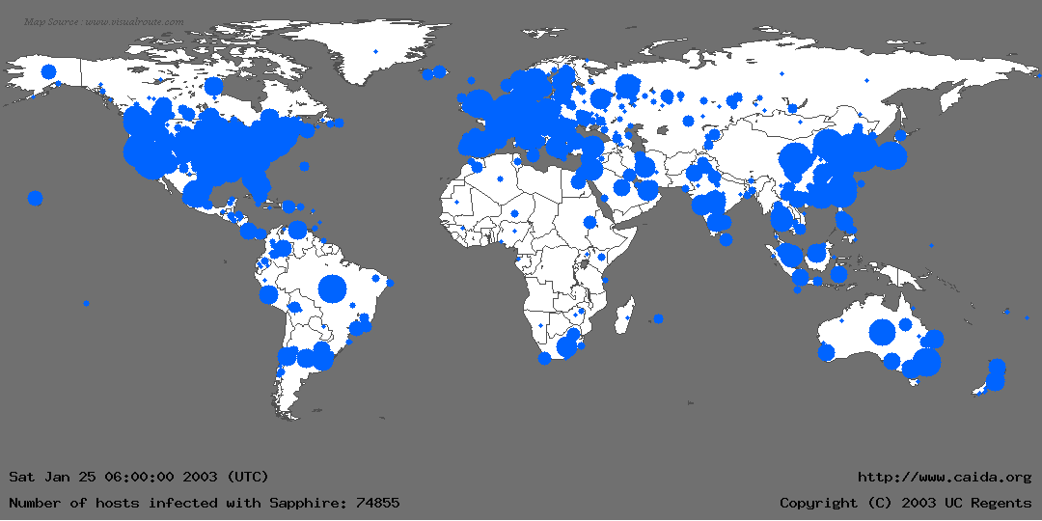
Life Just After Slammer

Slide 52
A Lesson in Economy
Slammer exploited connectionless UDP service, rather than connection-oriented TCP.
Entire worm fit in a single packet! (376 bytes)
When scanning, worm could “fire and forget”.
Stateless!
Worm infected 75,000+ hosts in 10 minutes (despite broken random number generator).
At its peak, doubled every 8.5 seconds.
Progress limited by the Internet’s carrying capacity (= 55 million scans/sec)

Slide 53
Why Security?
First victim at 12:45 am
By 1:15 am, transcontinental links starting to fail
300,000 access points downed in Portugal
All cell and Internet in Korea failed (27 million people)
5 root name servers were knocked offline
911 didn’t respond (Seattle)
Flights canceled
Notes:
Entire worm was 376 bytes (single packet)

Slide 54
Witty Worm
Notes:
Start with a bit of motivation
Describe what a worm is… search online for animation

Slide 55
Witty Worm – Cont’d
Attacks firewalls and security products (ISS)
First to use vulnerabilities in security software
ISS announced a vulnerability
buffer overflow problem
Attack in just one day!
Attack started from a small number of compromised machines
In 30 minutes 12,000 infected machines
90 Gb/s of UDP traffic

Slide 56
Internet Design
Destination routing
Packet based (statistical multiplexing)
Global addressing (IP addresses)
Simple to join (as infrastructure)
Power in end hosts (end-to-end argument)
“Ad hoc” naming system

Slide 57
Internet Design vs. Security
Destination routing
Keeps forwarding tables small
Simple to maintain forwarding tables
How do we know where packets are coming from?
Probably simple fix to spoofing, why isn’t it in place?
Packet based (statistical multiplexing)
Global addressing (IP addresses)
Simple to join (as infrastructure)
Power in end hosts (end-to-end argument)
“Ad hoc” naming system

Slide 58
Internet Design vs. Security
Destination Routing
Packet Based (statistical multiplexing)
Simple + Efficient
Difficult resource bound per-communication
How to keep someone from hogging? (remember, we can’t rely on source addresses)
Global Addressing (IP addresses)
Simple to join (as infrastructure)
Power in End Hosts (end-to-end argument)
“Ad hoc” naming system

Slide 59
Internet Design vs. Security
Destination routing
Packet based (statistical multiplexing)
Global Addressing (IP addresses)
Very democratic
Even people who don’t necessarily want to be talked to
“every psychopath is your next door neighbor” – Dan Geer
Simple to join (as infrastructure)
Power in end hosts (end-to-end argument)
“Ad hoc” naming system

Slide 60
Internet Design vs. Security
Destination routing
Packet based (statistical multiplexing)
Global addressing (IP addresses)
Simple to join (as infrastructure)
Very democratic
Misbehaving routers can do very bad things
No model of trust between routers
Power in End Hosts (end-to-end argument)
“Ad hoc” naming system

Slide 61
Internet Design vs. Security
Destination routing
Packet based (statistical multiplexing)
Global addressing (IP addresses)
Simple to join (as infrastructure)
Power in end-hosts (end-to-end argument)
Decouple hosts and infrastructure = innovation at the edge!
Giving power to least trusted actors
How to guarantee good behavior?
“Ad hoc” naming system

Slide 62
Internet Design vs. Security
Packet Based (statistical multiplexing)
Destination Routing
Global Addressing (IP addresses)
Simple to join (as infrastructure)
Power in End Hosts (end-to-end argument)
“Ad hoc” naming system
Seems to work OK
Fate sharing with hierarchical system
Off route = more trusted elements

Slide 63
DoS: Via Resource Exhaustion
CPU
User-time
Uplink bandwidth
Downlink bandwidth
Memory (e.g. TCP TCB exhaustion)
Notes:
Note to Martin. For DDoS have a computer and enumerate all the resources that can be exhausted for a DDoS

Slide 64
DoS: Via Resource Exhaustion
Uplink bandwidth
Saturate uplink bandwidth using legitimate requests (e.g. download large image)
Solution: use a CDN (Akamai)
Solution: admission control at the server (not a network problem??)
CPU time similar to above
Victim Memory
TCP connections require state, can try to exhaust
E.g. SYN Flood (next few slides)
Notes:
Main argument is that the end-host has all the information it needs to
Distinguish between fair and unfair use. It should implement its own admission control policy. This stops being a network problem at this point and more of an OS issue.
E-protests
(Question, what is cheaper? Cpu or bandwidth?)

Slide 65
Who Is Responsible?
Can we rely on the attack victim to stop DoS attacks?
If not, who can do this?
How?
Which resource is cheaper?
Bandwidth, or
CPU

Slide 66
TCP Handshake
C
S
SYN_{C}
Listening
Store data
SYN_{S}, ACK_{C}
Wait
ACK_{S}
Connected
Notes:
End-host stores all flow state.
For TCP this is done per connection using a TCB (transmission control block)

Slide 67
Example: SYN Flooding
C
S
SYN_{C1}
Listening
SYN_{C2}
Store data
SYN_{C3}
SYN_{C4}
SYN_{C5}

Slide 68
Protection against SYN Attacks
[Bernstein, Schenk]
SYN Cookies
Client sends SYN
Server responds to Client with SYN-ACK cookie
sqn = f(src addr, src port, dest addr, dest port, rand)
Server does not save state
Honest client responds with ACK(sqn)
Server checks response
If matches SYN-ACK, establishes connection
Drop Random TCB in SYN_RCVD state (likely to be attackers)

Slide 69
Distributed DoS (DDoS)
Attacker compromises multiple hosts
Installs malicious program to do her biding (bots)
Bots flood (or otherwise attack) victims on command; Attack is coordinated
Bot-networks of 80k to 100k have been seen in the wild
Aggregate bandwidth > 20Gbps (probably more)
E.g. Blue Frog (by Blue Security)
Notes:
Important to note what aspects of the Internet design make this problem
So difficult to solve
* Mention blue security!

Slide 70
Blue Frog
Anti-spam tool:
Persuade spammers to remove community members’ addresses from their mailing list
Users register: Do Not Intrude Registry, Firefox, and IE plugins
Automatic reports: ISPs, law-enforcement, …
Spammers attacked
Intimidating e-mails
DDoS attack to “Blue Security” web page
Redirected to blogs.com → Collapse
Attackers identified
Blue Security ceased its anti-spam operation.

Slide 71
What About Downlink? (Flooding)
Assume attacker generates enough traffic to saturate downlink bandwidth.
What can the server do?
What can the network do?
Ideally want network to drop bad packets
How to tell if a packet is part of a legitimate flow? (requires per flow state?)
Even harder, how to tell if a SYN packet is part of a legitimate request?
Is the phone network immune to such attacks?
Notes:
Important to note what aspects of the Internet design make this problem
So difficult to solve

Slide 72
DoS Aplenty
Attacker guesses TCP seq. number for an existing connection:
Attacker can send Reset packet to close connection. Results in DoS.
Most systems allow for a large window of acceptable seq. #’s
Only have to a land a packet in
Attack is most effective against long lived connections, e.g. BGP.
Congestion control DoS attack
Generate TCP flow to force target to repeatedly enter retransmission timeout state
Difficult to detect because packet rate is low
Congestion
Congestion
Congestion
RTO
2*RTO
Notes:
DDoD is a catch phrase for …. Limiting access.

Slide 73
Indirection Attacks
Rely on connecting to “end-points” to get content/access services
Unfortunately network end-points (e.g. IPs, DNS names) are loosely bound
Long history of problems

Slide 74
Example: Fetching a Web Page
Client
DHCP Request
ARP request (name server/gateway)
DNS request
HTTP Request

Slide 75
DNS Vulnerability
Users/hosts typically trust the host-address mapping provided by DNS

Slide 76
Bellovin/Mockapetris Attack
Trust relationships use symbolic addresses
/etc/hosts.equiv contains friend.stanford.edu
Requests come with numeric source address
Use reverse DNS to find symbolic name
Decide access based on /etc/hosts.equiv, …
Attack
Spoof reverse DNS to make host trust attacker

Slide 77
Reverse DNS
Given numeric IP address, find symbolic addr
To find 222.33.44.3,
Query 44.33.222.in-addr.arpa
Get list of symbolic addresses, e.g.,
1 IN PTR server.small.com
2 IN PTR boss.small.com
3 IN PTR ws1.small.com
4 IN PTR ws2.small.com

Slide 78
Attack
Gain control of DNS service for evil.org
Select target machine in good.net
Find trust relationships
SNMP, finger can help find active sessions, etc.
Example: target trusts host1.good.net
Connect
Attempt rlogin from coyote.evil.org
Target contacts reverse DNS server with IP addr
Use modified reverse DNS to say “addr belongs to host1.good.net”
Target allows rlogin

Slide 79
DNS Rebinding Attacks
Modern browsers implement the same-origin policy.
Isolate distinct origins.
To attack:
Subvert the same-origin policy
Confuse browser to aggregate network resources.
DNS Rebinding Attacks:
register a domain, e.g. attacker.com
Answer DNS queries for attacker.com with your IP, short TTL, serve malicious JavaScript
Script requests IP address of attacker.com, feed the IP of private server
Read private information
Protecting Browsers from DNS Rebinding Attacks, In Proceedings of ACM CCS 07

Slide 80
Solution – DNS Pinning
Once a hostname is resolved to an IP address, cache the result for a while
Regardless of TTL
Plug-ins can cause problems

Slide 81
TCP Connection Spoofing
Each TCP connection has an associated state
Client IP and port number; same for server
Sequence numbers for client, server flows
Problem
Easy to guess state
Port numbers are standard
Sequence numbers (used to be) chosen in predictable way

Slide 82
IP Spoofing Attack
A, B trusted connection
Send packets with predictable seq numbers
E impersonates B to A
Opens connection to A to get initial seq number
SYN-floods B’s queue
Sends packets to A that resemble B’s transmission
E cannot receive, but may execute commands on A
Other ways to spoof source IP?
Server A
E
B
Notes:
A lot of Internet security is based on the assumption of unpredictable sequence numbers.
Not always a great assumption (see BGP denial of service nonsence)
Go home and break linux’s sequence generator

Slide 83
Reconnaissance/Misc
To attack a victim, first discover available resources
Many commonly used reconnaissance techniques
Port scanning
Host/application fingerprinting
Traceroute
DNS (reverse DNS scanning, Zone transfer)
SNMP
These are meant for use by admins to diagnose network problems!
Trade-off between the ability to diagnose a network and reveal security sensitive information
Notes:
For host/application fingerprinting, mention SYN fingerprinting

Slide 84
Anecdotes …
Large bot networks exist that scan the Internet daily looking for vulnerable hosts
Old worms still endemic on Internet (e.g. Code Red)
Seem to come and go in mass
Surreptitious scanning effort?
Notes:
Ssh trolling

Slide 85
Today
Network Security Goals
Security vs. Internet Design
Attacks
Defenses

Slide 86
Firewalls
Keep out unwanted traffic
Can be done in the network (e.g. network perimeter) or at the host
Many mechanisms
Packet filters
Stateful packet filters
Proxies, gateways

Slide 87
Packet Filters
Make a decision to drop a packet based on packet header
Protocol type
Transport ports
Source/Dest IP address
Etc.
Usually done on router at perimeter of network
And on virtually all end-hosts today

Slide 88
Packet Filters: Problem
Assume firewall rule (allow from port 53 and port 80)
Easy for an attacker to send packets from port 53 or 80
Further attacker can forge source
Not very effective for stopping packets from unwanted senders

Slide 89
Stateful Packet Filter
Idea: Only allow traffic initiated by client
For each flow request (e.g. SYN or DNS req) keep a little state
Ensure packets received from Internet belong to an existing flow
To be effective must keep around sequence numbers per flow
Very common, used in all NAT boxes today
Stateful NATs downside: failure → all connection state is lost!

Slide 90
Proxies
Want to look “deeper” into packets
Application type
Content
Can do by reconstructing TCP flows and “peering” in, however this is really hard
(Digression next slide)

Slide 91
Passive Reconstruction of TCP Stream
Use passive network element to reconstruct TCP streams
“Peer” into stream to find harmful payload (e.g. virus signatures)
Why is this really hard?
Notes:
Open up question to the class, can anyone tell me why this is really hard?

Slide 92
Reconstructing Streams
Must know the client’s view of data
Have to know if packet reaches destination (may not if TTL is too short)
Have to know how end-host manages overlapping TCP sequence numbers
Have to know how end-host manages overlapping fragments
TTL = 0
X
End host
router

Slide 93
Proxies
Full TCP termination in the network
Often done transparently (e.g. HTTP proxies)
Allows access to objects passed over network
E.g. files, streams etc.
Does not have same problems as stream reconstruction
Plus can do lots of other fun things
E.g. content caching

Slide 94
Proxy Discussion
Proxies duplicate per-flow state held by clients
How does this break end-to-end semantics of TCP?
E.g. what if proxy crashes right after reading from client? (lost data!)
How to fix?
Lots of work in this area

Slide 95
Final Comments
Internet not designed for security
Many, many attacks
Defense is very difficult
Attackers are smart; Broken network aids them!
Retrofitting solutions often break original design principles
Some of these solutions work, some of the time
Some make the network inflexible, brittle
Time for new designs/principles?

