Slide 1
CSC148 Ramp-up Fall 2015
Larry Zhang
(Based on slides from Michael Kimmins)
(Based on slides from Orion Buske)
(based on notes by Velian Pandeliev, Jonathan Taylor, Noah Lockwood, and software-carpentry.org)

Slide 2
Overview
In the next 6 hours, we’ll cover the background required for CSC148.
This session is for students with programming experience who haven't necessarily taken the prerequisite, CSC108.
Please ask questions anytime!

Slide 3
Outline
Talking
Talking
Talking
Talking
Lunch break
Talking
Talking
Talking
Talking

Slide 4
More explicit outline
Overview of Python
Variables and types
Strings, lists, tuples
For loops and conditionals
Lunch break
Functions and Dictionaries
Files and While loops
Function design recipes
Testing

Slide 5

Meet Python...

Slide 6
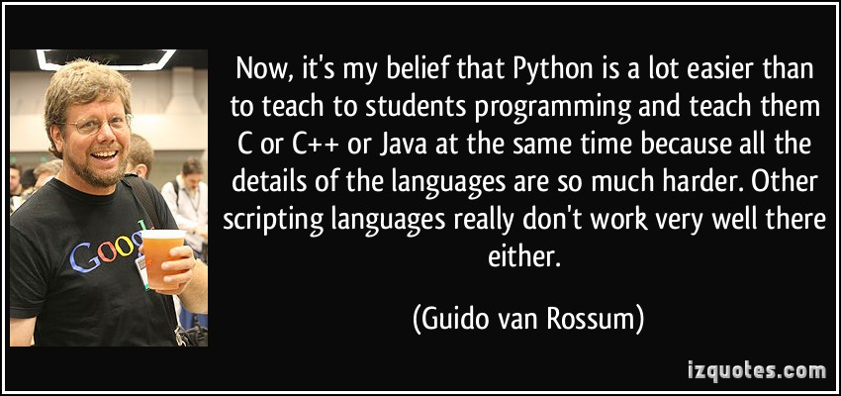

Slide 7
My favorite language for maintainability is Python. It has simple, clean syntax, object encapsulation, good library support, and optional named parameters.
- Bram Cohen
In many ways, it's a dull language, borrowing solid old concepts from many other languages & styles: boring syntax, unsurprising semantics, few automatic coercions, etc etc. But that's one of the things I like about Python.
- Tim Peters
Life is short, use Python.
- Anonymous

Slide 8
Let's speak some Python
Python is interpreted (no compilation necessary)
No end-of-line character (no semicolons!)
Whitespace matters (4 spaces for indentation)
No extra code needed to start (no "public static ...")
Python is dynamically typed

Slide 9
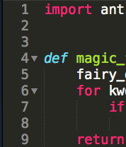
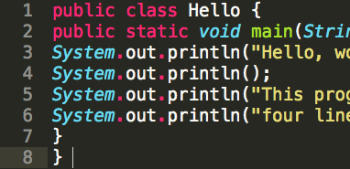
Whitespace matters
vs

Slide 10
Whitespace matters
def foo(x):
if x > 10:
print('Hi')
print('Bye')
def foo(x):
if x > 10:
print('Hi')
print('Bye')

Slide 11
Python is dynamically typed
The type of a variable is interpreted at runtime (instead of specified at compile time)
One variable can change type during runtime.
# Comments start with a '#' character.
# Python has dynamic typing, so:
x = 5 # assignment statement (no type specified)
x = 'jabberwocky' # re-assign x to a string
print(x) # prints 'jabberwocky'

Slide 12
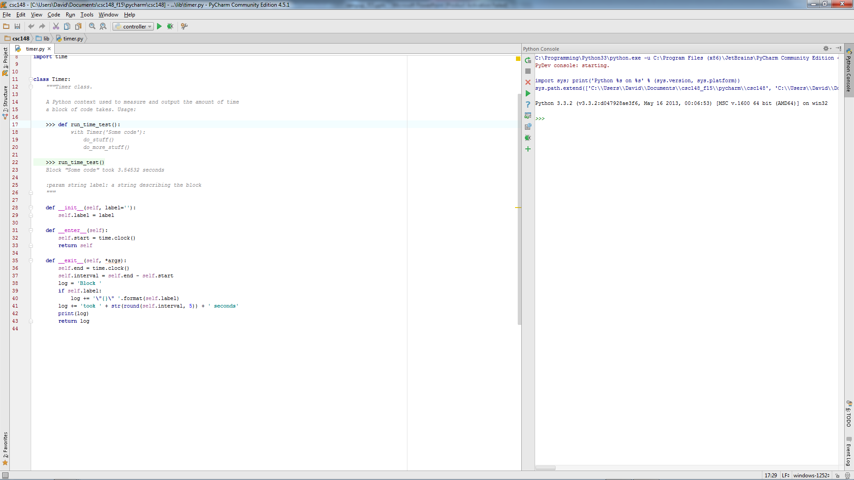
Python programs
Programs are stored in .py files
Using the PyCharm IDE (Integrated Development Environment)
Run the current file
File output and interactive Python “shell”
Edit Python files here

Slide 13
The blueprint of a Python file:
from random import randint
from math import cos
import names from other modules

Slide 14
The blueprint of a Python file:
from random import randint
from math import cos
def my_function(arg):
...
return answer
class MyClass:
...
import names from other modules
define functions and classes

Slide 15
The blueprint of a Python file:
from random import randint
from math import cos
def my_function(arg):
...
return answer
class MyClass:
...
if __name__ == '__main__':
my_variable = 21 * 2
...
import names from other modules
define functions and classes
your main block goes down here!

Slide 16
The blueprint of a Python file:
from random import randint
from math import cos
def my_function(arg):
...
return answer
class MyClass:
...
if __name__ == '__main__':
my_variable = 21 * 2
...
the main block mantra

Slide 17
Interactive Python
Python can also be run interactively.
The result is automatically shown (unlike in a program, where you must call print).
Python 3.2.3 (v3.2.3:3d0686d90f55, Apr 10 2012, 11:25:50)
Type "help", "copyright", "credits" or "license" for more information.
>>> 42
42
>>> (2 ** 3 - 4) / 8
0.5

Slide 18
Getting help
Official Python documentation:
http://docs.python.org/py3k/library/
The help function provides usage information:
>>> help(print)
The dir function shows names within a given type, module, object:
>>> dir(str)

Slide 19
Moar resources!
Last term's 108 and 148 course websites:
http://www.cdf.toronto.edu/~csc108h/summer/
http://www.cs.toronto.edu/~david/courses/csc148_f14/
Software Carpentry (online lectures):
http://software-carpentry.org/
Google!
http://lmgtfy.com/?q=python+add+to+list

Slide 20
Learn you to good speak Python
Python's style guide:
http://www.python.org/dev/peps/pep-0008/
Google's Python style guide:
http://google-styleguide.googlecode.com/svn/trunk/pyguide.html
Expert mode:
pychecker: http://pychecker.sourceforge.net/
pyflakes: https://launchpad.net/pyflakes/

Slide 21
A programmer who doesn't care about style is like a painter who doesn't care about colour.

Slide 22
Variables (storing data)
Variables refer to an object of some type
Several basic data types:
Integers (whole numbers): int
>>> the_answer = 42
Floating-point (decimal) numbers: float
>>> pi = 3.14159
>>> radius = 2.0
>>> pi * (radius ** 2)
12.56636
operators: * / % + - ** //
"shortcut" operators: x = x + 1 → x += 1
>>> 2**3
8
>>> 5 // 2
2

Slide 23
More types (kinds of things)
Boolean (True/False) values: bool
>>> passed = False
>>> not passed
True
>>> 5 < 4 # comparisons return bool
False
>>> 5 and 4 # this can bite you
4
Operators: and or not

Slide 24
More types (kinds of things)
None (it's Python's NULL)
>>> x = None
>>> print(x)
None
>>> x

Slide 25
Strings

Slide 26
Strings
Strings (basically lists of characters): str
>>> welcome = 'Hello, world!'
>>> welcome[1] # index, starting with 0
'e'
Slices return substrings:
>>> welcome[1:5] # slice from 1 (included) to 5 (not included)
'ello'
>>> welcome[:3] # from the start of 3 (not included)
‘Hel'
>>> welcome[9:] # from 9 (included) to the end
'rld!'
>>> welcome[:-2] # from the start to the second-last (not included)
'Hello, worl'

Slide 27
Working with strings
Stick strings together (concatenation):
>>> salutation = 'Hello, '
>>> name = 'Orion'
>>> salutation + name # evaluates to a new string
'Hello, Orion'
The len function is useful:
>>> len(name) # number of characters
5

Slide 28
Tons of useful methods
Here are some, look at help(str) for more:
>>> name = 'Orion'
>>> name.endswith('ion')
True
>>> 'rio' in name # substring testing
True
>>> name.startswith('orio')
???? Thoughts?
>>> name.lower()
'orion' # new string!
>>> name.index('i')
2 # What did this do? Try help(str.index)

Slide 29
POP QUIZ!
Write a boolean expression that evaluates to:
True if the variable response starts with the letter "q", case-insensitive,
False if it does not.
(in CS lingo, we'd say: True iff (if and only if) the variable response starts with the letter "q", case-insensitive)

Slide 30
POP QUIZ!
response.lower().startswith('q')

Slide 31
Making strings pretty
String formatting (str.format):
http://docs.python.org/release/3.1.5/library/string.html#formatstrings
{} are replaced by the arguments to format
Formatting parameters can be specified using :format
Similar to printf
>>> n = 99
>>> where = 'on the wall'
>>> '{} bottles of beer {}'.format(n, where)
'99 bottles of beer on the wall'

Slide 32
Standard input/output
Generating output (stdout): print()
Can take multiple arguments (will be joined with spaces)
Reading keyboard input: input()
>>> name = input(‘Type your name: ')
Type you name: Orion >>> name 'Orion'
>>> print('Hello ' + name)
Hello Orion
>>> 'Hello {} '.format(name)
'Hello Orion' # Why quotes here?

Slide 33
Converting between types
AKA: how to sanitize user input
Functions: int(), float(), str(), bool()
>>> float('3.14')
3.14
>>> int(9 / 5) # truncates
1
>>> float(3)
3.0
>>> str(3.14)
'3.14'
>>> '{:.4f}'.format(3.14159265358)
'3.1416'

Slide 34
Converting between types
Don't do anything silly:
>>> int('fish')
Traceback (most recent call last):
File "<stdin>", line 1, in <module>
ValueError: invalid literal for int() with base 10: 'fish'
And beware:
>>> int('3.0')
Traceback (most recent call last):
File "<stdin>", line 1, in <module>
ValueError: invalid literal for int() with base 10: '3.0'

Slide 35
Exercise 1: Temperature
C = (5 / 9) * (F - 32)
Write a program that:
prompts the user for degrees in Fahrenheit
converts the number into Celsius
prints out the number in Celsius
to just 2 decimal places, if you dare
(You can assume the user enters a number)

Slide 36
Exercise 1: Solution
Self-check: does your code work for 98.6?
# Read in the input
fahrenheit = float(input('Input temperature (F): '))
# Convert to Celsius
celsius = (5 / 9) * (fahrenheit - 32)
# Display the answer
print('Temperature is {:.2f} degrees C'.format(celsius))

Slide 37
Sequences

Slide 38
Sequences, of, things!
There are two main kinds of sequences (things in an order) in Python:
- The [mighty] list
- The (humble,) tuple

Slide 39
[Lists, of, things]
Lists are a very important data structure in Python
They are a mutable sequence of any objects
>>> colours = ['red', 'blue', 'yellow']
>>> friends = [] # forever alone
>>> random_stuff = [42, 3.14, 'eat pie']
>>> wtf = [[], [2, 3], friends] # this is crazy
>>> my_friends = list(friends) # copy a list
Index and slice like strings:
>>> colours[0] # indexing returns the element
'red'
>>> random_stuff[2:] # slicing returns a sub-list
['eat pie']

Slide 40
[Lists, of, things].stuff()
We can change, add, and remove elements from lists
>>> marks = [98, None, 62, 54]
>>> marks[1] = 75 # change that None
>>> marks.append(90) # add 90 to the end
>>> marks.remove(62) # remove the 62
>>> marks.sort() # sort in place
>>> print(marks)
??? Thoughts?
[54, 75, 90, 98]

Slide 41
[Lists, of, things].stuff()
Lots of other awesome features, too
>>> marks = [74, 62, 54]
>>> len(marks) # size
3
>>> 54 in marks # membership testing
True
>>> marks.pop(1) # remove/return value at index 1
62
>>> marks + [1, 2] # concatenation
[74, 54, 1, 2] # new list

Slide 42
Variable aliasing
Careful! Multiple variables might be referring to the same mutable data structure:
>>> sorted_list = [1, 2, 3]
>>> not_a_copy = sorted_list # not a copy
>>> not_a_copy.append(0)
>>> sorted_list
[1, 2, 3, 0] # crap
>>> actually_a_copy = list(sorted_list)
>>> another_copy = sorted_list[:]

Slide 43
(Tuples, of, things)
Tuples are like fast, simple lists, that are immutable
>>> stuff = (42, 3.14, 'eat pie')
>>> stuff[0] = 'a'
Traceback (most recent call last):
File "<stdin>", line 1, in <module>
TypeError: 'tuple' object does not support item assignment
Can always create a list from them:
>>> L = list(stuff)

Slide 44
For Loops

Slide 45
For loops!
For loops repeat some code for each element in a sequence
This is a foreach loop in most languages
>>> colours = ['red', 'green', 'blue']
>>> for colour in colours:
... print(colour)
...
red
green
blue

Slide 46
For loops!
But wait, I actually wanted the index!
Use range(n) in a for loop to loop over a range.
>>> for i in range(2):
... print(i)
0
1
To start at a value other than 0:
>>> for i in range(4, 6):
... print(i)
4
5

Slide 47
For loops!
But wait, I actually wanted the index!
How should we loop over the indices of a list?
>>> colours = ['red', 'green', 'blue']
>>> for i in range(len(colours)):
... print('{}. {}'.format(i, colours[i]))
...
0. red
1. green
2. blue

Slide 48
For loops!
But wait, I actually wanted the index!
Now, over the indices and items!
>>> colours = ['red', 'green', 'blue']
>>> n = len(colours)
>>> for (i, colour) in zip(range(n), colours):
... print('{}. {}'.format(i, colour))
...
0. red
1. green
2. blue
zip returns a list of pairs

Slide 49
For loops!
But wait, I actually wanted the index!
Now, over the indices and items!
>>> for (i, colour) in enumerate(colours):
... print('{}. {}'.format(i, colour))
...
0. red
1. green
2. blue

Slide 50
Exercise 2: Times table
Compute (and store in a variable) a times table for the numbers 0 through 9 as a list of lists.
For example, if it were just from 0 through 3, you should create:
[[0, 0, 0, 0],
[0, 1, 2, 3],
[0, 2, 4, 6],
[0, 3, 6, 9]]

Slide 51
Exercise 2: Solution
table = []
n = 10 # from 0 to (n - 1)
for i in range(n):
# Compute the n'th row
row = []
for j in range(n):
row.append(i * j)
# Add row to full table
table.append(row)

Slide 52
Exercise 2: Solution
table = []
n = 10 # from 0 to (n - 1)
for i in range(n):
# Compute the n'th row
row = []
# Add row to full table
table.append(row)
for j in range(n):
row.append(i * j)
Does this still work?

Slide 53
Conditionals

Slide 54
Conditionals (if, elif, else)
If statements allow you to execute code sometimes (based upon some condition)
elif (meaning 'else if') and else are optional
if amount > balance:
print('You have been charged a $20'
' overdraft fee. Enjoy. ')
balance -= 20
elif amount == balance:
print('You are now broke')
else:
print('Your account has been charged')
balance -= amount # deduct amount from account

Slide 55
Functions

Slide 56
Functions (basically the best things ever)
They allow you to group together a bunch of statements into a block that you can call.
"If you have the same code in two places, it will be wrong in one before long."
"Never copy-paste code if at all possible."
They can take in information (arguments) and give back information (return value).
Important: If you don't specify a return value, it will be None
def celsius_to_fahrenheit(degrees):
return (9 / 5) * degrees + 32
f = celsius_to_fahrenheit(100)

Slide 57
Docstrings
Each function should have a docstring (a multi-line, triple-quoted string right after the function declaration)
Describes what the function does, not how it does it.
Describe the argument and return types.
It is shown when help is called on your function, so it should be sufficient for other people to know how to use your function.
def celsius_to_fahrenheit(degrees):
"""Convert degrees from C to F.
@type degrees: int | float
@rtype: float
"""

Slide 58
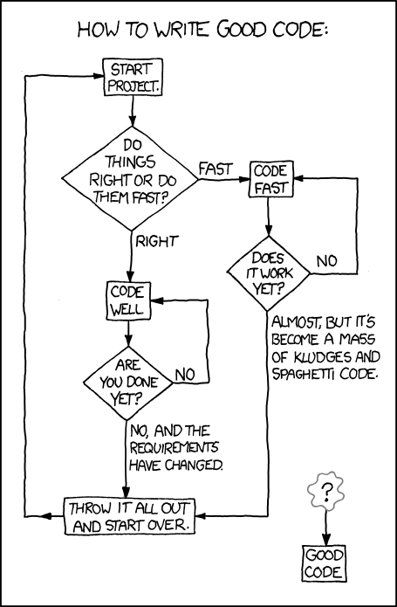

Slide 59
Changing things
Functions can modify mutable arguments
def double(L):
"""Modify L so it is equivalent to L + L
@type L: list
@rtype: None
"""
for i in range(len(L)):
L.append(L[i])
L = [1, 2, 3]
L = double(L) # Don't do this! Why?
# double(L) changes the list and then returns None
print(L) # None

Slide 60
Changing things
Functions can modify mutable arguments
def double(L):
"""Modify L so it is equivalent to L + L
@type L: list
@rtype: None
"""
for i in range(len(L)):
L.append(L[i])
L = [1, 2, 3]
double(L)
# double(L) changes the list and then returns None
print(L) # [1, 2, 3, 1, 2, 3]

Slide 61
Changing things
Immutable:
>>> stuff = (42, 3.14, 'carpe diem')
>>> stuff[0] = 'a'
Traceback (most recent call last):
File "<stdin>", line 1, in <module>
TypeError: 'tuple' object does not support item assignment

Slide 62
Changing things
Immutable:
>>> hi = 'hello'
>>> hi[0]
'h'
>>> hi[0] = 'j'
Traceback (most recent call last):
File "<stdin>", line 1, in <module>
TypeError: 'str' object does not support item assignment

Slide 63
Changing things
mutable:
>>> list = [1,2,3,4]
>>> list[0]
1
>>> list[0] = 10
>>> list
[10, 2, 3, 4]

Slide 64
More control tools
Pass: A null operation. Nothing happens
>>> def do_something(number):
... for index in range(number):
... if number == 3:
... pass
... else:
... print(number)
... return None

Slide 65
Exercise 3: Functions
Two words are a reverse pair if each word is the reverse of the other.
1) Write a function is_reverse_pair(s1, s2) that returns True iff s1 and s2 are a reverse pair.

Slide 66
Exercise 3: Solution
def is_reverse_pair(s1, s2):
pass

Slide 67
Exercise 3: Solution
def is_reverse_pair(s1, s2):
if len(s1) != len(s2):
return False
for i in range(len(s1)):
if s1[i] != s2[len(s2) - 1 – i]:
return False
return True
Or, using slicing:
def is_reverse_pair(s1, s2):
return s1[::-1] == s2

Slide 68
Exercise 3: Functions
Two words are a reverse pair if each word is the reverse of the other.
1) Write a function is_reverse_pair(s1, s2) that returns True iff s1 and s2 are a reverse pair.
2) Write a function print_reverse_pairs(wordlist) that accepts a list of strings and prints out all of the reverse pairs in the given list, each pair on a line.

Slide 69
Exercise 3: Solution
def print_reverse_pairs(wordlist):
pass

Slide 70
Exercise 3: Solution
def print_reverse_pairs(wordlist):
for s1 in wordlist:
for s2 in wordlist:
if is_reverse_pair(s1, s2):
print('{}, {}'.format(s1, s2))

Slide 71
Dictionaries

Slide 72
{'dictionaries': 'awesome'}
Dictionaries (type dict) are an unordered association of keys with values
We usually use them to store associations:
like name -> phone number
phone number -> name
student id -> grade

Slide 73
{'dictionaries': 'awesome'}
Dictionaries (type dict) are an unordered association of keys with values
We usually use them to store associations:
like name -> phone number
phone number -> name
student id -> grade
grade -> student id #BAD, why?

Slide 74
{'dictionaries': 'awesome'}
Dictionaries (type dict) are an unordered association of keys with values
We usually use them to store associations:
like name -> phone number
phone number -> name
student id -> grade
grade -> list of student ids
Keys must be unique and immutable

Slide 75
{'dictionaries': 'awesome'}
>>> scores = {'Alice': 90, 'Bob': 76, 'Eve': 82}
>>> scores['Alice'] # get
90
>>> scores['Charlie'] = 64 # set
>>> scores.pop('Bob') # delete
76
>>> 'Eve' in scores # membership testing
True
>>> for name in scores: # loops over keys
... print('{}: {}'.format(name, scores[name]))
...
Charlie: 64
Alice: 88
Eve: 82

Slide 76
A brief detour to open some files

Slide 77
A brief detour to open some files
The naïve way:
f = open('myfile.txt')
for line in f:
... # do something with each line
f.close()
# What happens if an error occurs?

Slide 78
A brief detour to open some files
Use with/as to open something for a while, but always close it, even if something goes wrong.
Easiest way to read files:
with open('myfile.txt') as open_file:
for line in open_file:
... # do something with each line
Easiest way to write to files:
with open('myfile.txt', 'w') as open_file:
open_file.write(data) # write to the file

Slide 79
A brief detour to open some files
Writing
balance = 40
with open('output.txt', 'w') as file:
file.write('I can write\n')
file.write('Account balance{}\n'.format(balance))

Slide 80
A brief detour to open some files
Write a file tolkien.txt that takes a list, and writes down the given list entries to the file.
The function should take in this list:
>>> characters = ['Frodo Baggins', 'Samwise Gamgee', 'Gandalf', 'Aragorn II', 'Legolas Greenleaf', 'Meriadoc Brandybuck', 'Peregrin Took']

Slide 81
A brief detour to open some files
Write a file tolkien.txt that takes a list, and writes down the given list entries to the file.
The function should take in this list:
>>> characters = ['Frodo Baggins', 'Samwise Gamgee', 'Gandalf', 'Aragorn II', 'Legolas Greenleaf', 'Meriadoc Brandybuck', 'Peregrin Took']
>>> with open('tolkien.txt', 'w') as file:
... for name in characters:
... file.write('{}\n'.format(name))

Slide 82
tolkien.txt
Frodo Baggins
Samwise Gamgee
Gandalf
Aragorn II
Legolas Greenleaf
Meriadoc Brandybuck
Peregrin Took

Slide 83
A brief detour to open some files
Use the text file we made right now, read from the file tolkien.txt and store each line in a list characters within Python.

Slide 84
A brief detour to open some files
Use the text file we made right now, read from a a file tolkien.txt and store each line in a list characters.
>>> with open('tolkien.txt') as file:
... characters = file.readlines()
...
>>> characters
['Frodo Baggins\n', 'Samwise Gamgee\n', 'Gandalf\n', 'Aragorn II\n', 'Legolas Greenleaf\n', 'Meriadoc Brandybuck\n', 'Peregrin Took\n']
What happened?

Slide 85
A brief detour to open some files
Use the text file we made right now, read from a a file tolkien.txt and store each line in a list characters.
>>> characters = []
>>> with open(‘tolkien.txt’) as file:
... for line in file:
... characters.append(line.strip())
...
>>> characters
['Frodo Baggins', 'Samwise Gamgee', 'Gandalf', 'Aragorn II', 'Legolas Greenleaf', 'Meriadoc Brandybuck', 'Peregrin Took']
Better.

Slide 86
Exercise 4: Dictionaries
Write a function print_record that takes a dictionary as input. Keys are student numbers (int), values are names (str). The function should print out all records, nicely formatted.
>>> record = {1234: 'Tony Stark', 1138: 'Steve Rogers'}
>>> print_record(record)
Tony Stark (#1234)
Steve Rogers (#1138)

Slide 87
Exercise 4: Solution
def print_record(record):
for pin in record:
print('{} (#{})'.format(record[pin], pin))

Slide 88
Exercise 4: Dictionaries
Write a function print_record that takes a dictionary as input. Keys are student numbers (int), values are names (str). The function should print out all records, nicely formatted.
>>> record = {1234: 'Tony Stark', 1138: 'Steve Rogers'}
>>> print_record(record)
Tony Stark (#1234)
Steve Rogers (#1138)
Write a function count_occurrences that takes an open file as input, and returns a dictionary with key/value pairs of each word and the number of occurrences of that word. (a word is a white-space delimited token, and can have punctuation)
>>> open_file = io.StringIO('a b a a c c a.')
>>> count_occurences(open_file)
{'a': 3, 'b': 1, 'a.': 1, 'c': 2}
hints: in and str.split

Slide 89
Exercise 4: Solution
def count_occurrences(file):
counts = {}
for line in file:
for word in line.split():
if word in counts:
counts[word] += 1
else:
counts[word] = 1
return counts

Slide 90
While Loops

Slide 91
While loops
While loops keep repeating a block of code while a condition is True
# What does this code do?
val = 10
while val > 0:
print('hello')
val -= 1
# prints 'hello' 10 times

Slide 92
While loops
While loops keep repeating a block of code while a condition is True
# What does this code do?
val = 167
while val > 0:
if val % 2 == 0:
print('0')
else:
print('1')
val = int(val / 2)
# prints (reverse) binary representation of val

Slide 93
While loops
break can be used to exit a loop early
# What does this code do?
while True: # This is an infinite loop
# Stop when the user types 'quit', 'Q', etc.
response = input('Enter number or ”quit”:')
if response.lower().startswith('q'):
break # This breaks out of the loop
...

Slide 94
Modules (why reinvent the wheel?)
Python has a spectacular assortment of modules that you can use (you have to import their names first, though)
>>> from random import randint # now we can use it!
>>> randint(1, 6) # roll a die
4 # http://xkcd.com/221/
>>> import math
>>> math.sqrt(2)
1.4142135623730951
>>> math.cos(0)
1.0
>>> import datetime
>>> dir(datetime)

Slide 95
Exercise 5: Guessing game
Implement a guessing game:
Guess a number between 0 and 100: 50
Too high.
Guess a number between 0 and 100: 25
Too low.
Guess a number between 0 and 100: 40
Too low.
Guess a number between 0 and 100: -2
Guess a number between 0 and 100: 47
Correct. Thanks for playing!
hint: "random" module

Slide 96
Exercise 5: Solution
from random import randint
# Choose a random number
low = 0
high = 100
answer = randint(low, high)
found = False
while not found:
print('Guess a number between {} and {}: '.format(low, high), end='')
guess = int(input())
# Print response if guess is in range
if guess >= low and guess <= high:
if guess > answer:
print('Too high.')
elif guess < answer:
print('Too low.')
else:
print('Correct. Thanks for playing!')
found = True # Or you could use break here

Slide 97
The “Design Recipe” of Functions
The step-by-step instructions of how make a dish function

Slide 98
The function design recipe
Example
Type contract
Header
Body
Test
Say we want to implement a function to determine whether a number is even.
Let’s try to follow the recipe …

Slide 99
The function design recipe
Example
Write one or two examples of calls of your function and the expected return values.
Write it as a docstring.
”””
>>> is_even(2)
True
>>> is_even(7)
False
”””

Slide 100
The function design recipe
2. Type contract
Describe the types of the parameters and any return values
such as
”””
@type value: int
@rtype: bool
>>> is_even(2)
True
>>> is_even(7)
False
”””
@type param_name: type_name
@rtype: return_type_name

Slide 101
The function design recipe
3. Header
Write the function header above the docstring
Give each parameter a meaning name
def is_even(value):
”””
@type value: int
@rtype: bool
>>> is_even(2)
True
>>> is_even(7)
False
”””
Note the indentation!

Slide 102
The function design recipe
4. Description
Describe what the function does and mention each parameter by name
def is_even(value):
”””
return True iff value is
divisible by 2.
@type value: int
@rtype: bool
>>> is_even(2)
True
>>> is_even(7)
False
”””

Slide 103
The function design recipe
5. Body
Write the implementation of the function.
def is_even(value):
”””
return True iff value is
divisible by 2.
@type value: int
@rtype: bool
>>> is_even(2)
True
>>> is_even(7)
False
”””
return value % 2 == 0

Slide 104
The function design recipe
6. Test
Test your function on all example cases, and any additional cases.
Try it on tricky and corner cases.
def is_even(value):
”””
return True iff value is
divisible by 2.
@type value: int
@rtype: bool
>>> is_even(2)
True
>>> is_even(7)
False
”””
return value % 2 == 0

Slide 105
Testing
Unit test
Doctest

Slide 106
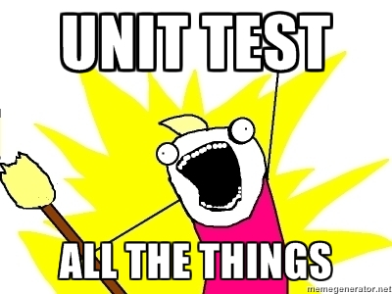

Slide 107
Testing the code
Why test?
Assures correctness of the program under specific conditions
Thinking of testing while coding makes the coder design a code that is better designed
Helps you think about edge cases (e.g. What if user tries to delete a file that isn’t there? What if a function that takes mutable data is given an immutable type?)

Slide 108
Testing the code
def is_even(value):
”””
return True iff value is
divisible by 2.
@type value: int
@rtype: bool
>>> is_even(2)
True
>>> is_even(7)
False
”””
return value % 2 == 0
even.py

Slide 109
Testing the code
Docstrings omitted for space!
create a new file called test_even.py
import unittest
from even import is_even
class EvenTestCase(unittest.TestCase):
def test_is_two_even(self):
self.assertTrue(is_even(2))
if __name__ == '__main__':
unittest.main()

Slide 110
Testing the code
In unit testing, test_* methods are recognized by the module.
import unittest
from even import is_even
class EvenTestCase(unittest.TestCase):
def test_is_two_even(self):
self.assertTrue(is_even(2))
if __name__ == '__main__':
unittest.main()

Slide 111
Doctest
def is_even(value):
”””
return True iff value is
divisible by 2.
@type value: int
@rtype: bool
>>> is_even(2)
True
>>> is_even(7)
False
”””
return value % 2 == 0
Test cases that are written in the docstring.
We already wrote some!

Slide 112
Doctest
def is_even(value):
”””
return True iff value is
divisible by 2.
@type value: int
@rtype: bool
>>> is_even(2)
True
>>> is_even(7)
False
”””
return value % 2 == 0
The doctest module scans all the docstrings and search for pieces of text that look like interactive Python sessions, then execute these sessions to verify that it works exactly as shown.

Slide 113
To run doctest
def is_even(value):
”””
return True iff value is
divisible by 2.
@type value: int
@rtype: bool
>>> is_even(2)
True
>>> is_even(7)
False
”””
return value % 2 == 0
if __name__ == '__main__':
import doctest
doctest.testmod()

Slide 114
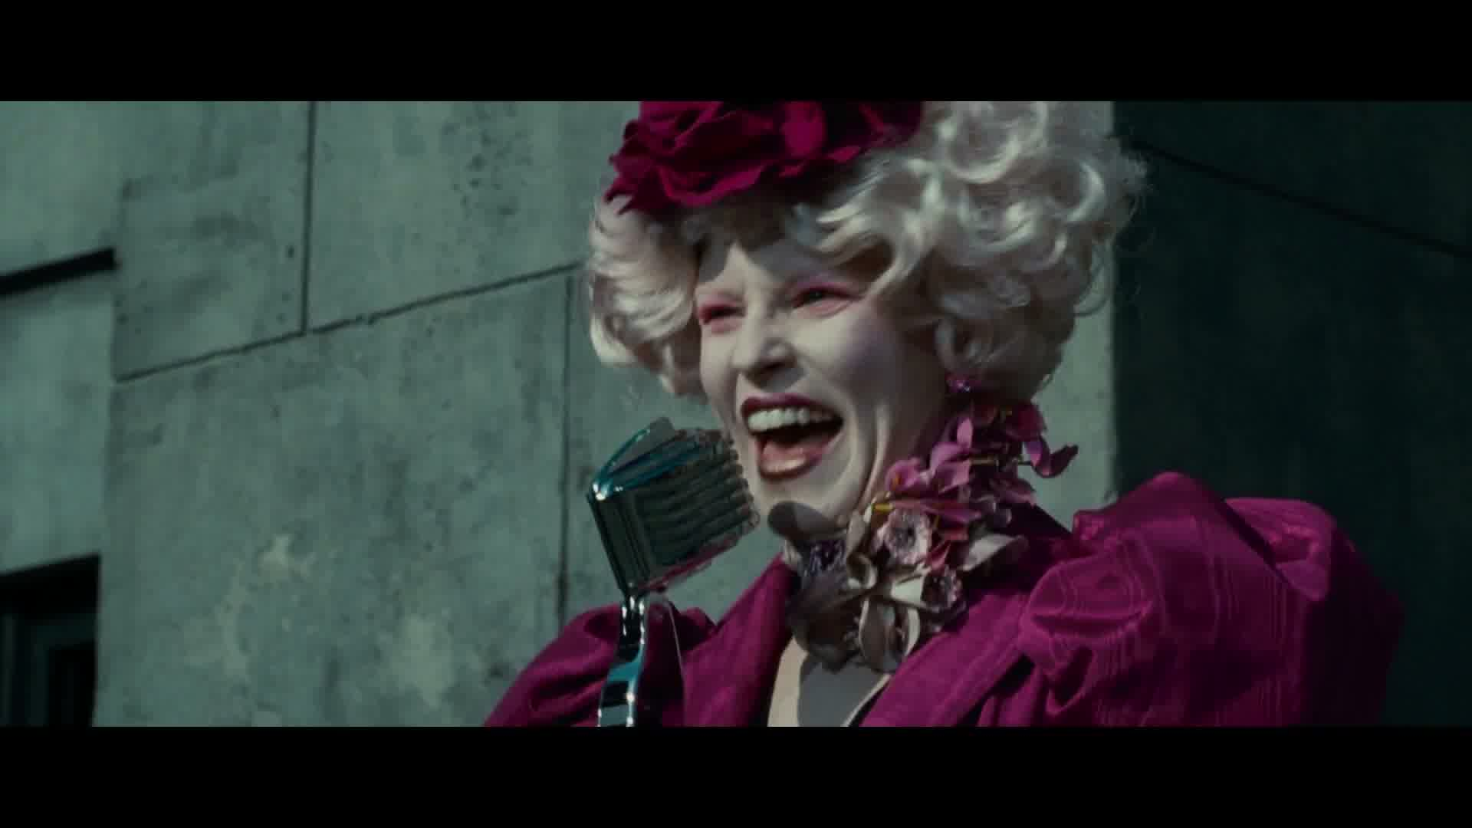
Congratulations! You survived this!

Slide 115
fin

